Slide 1


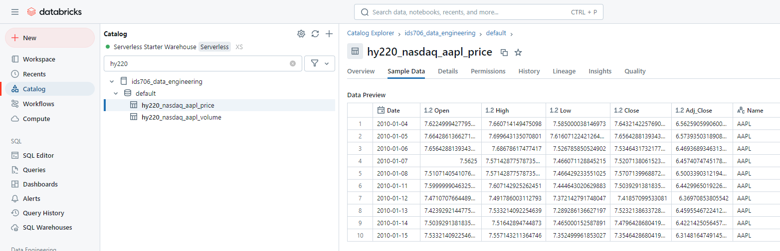


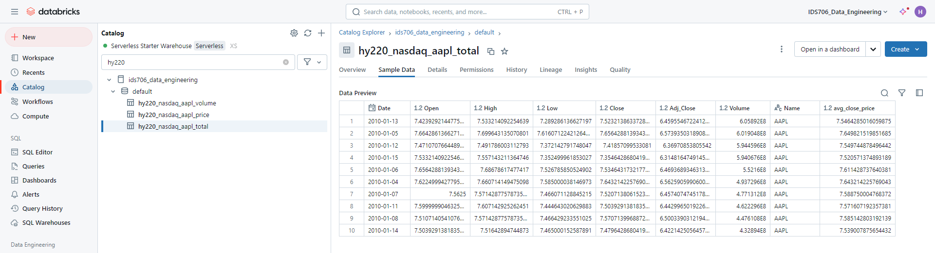
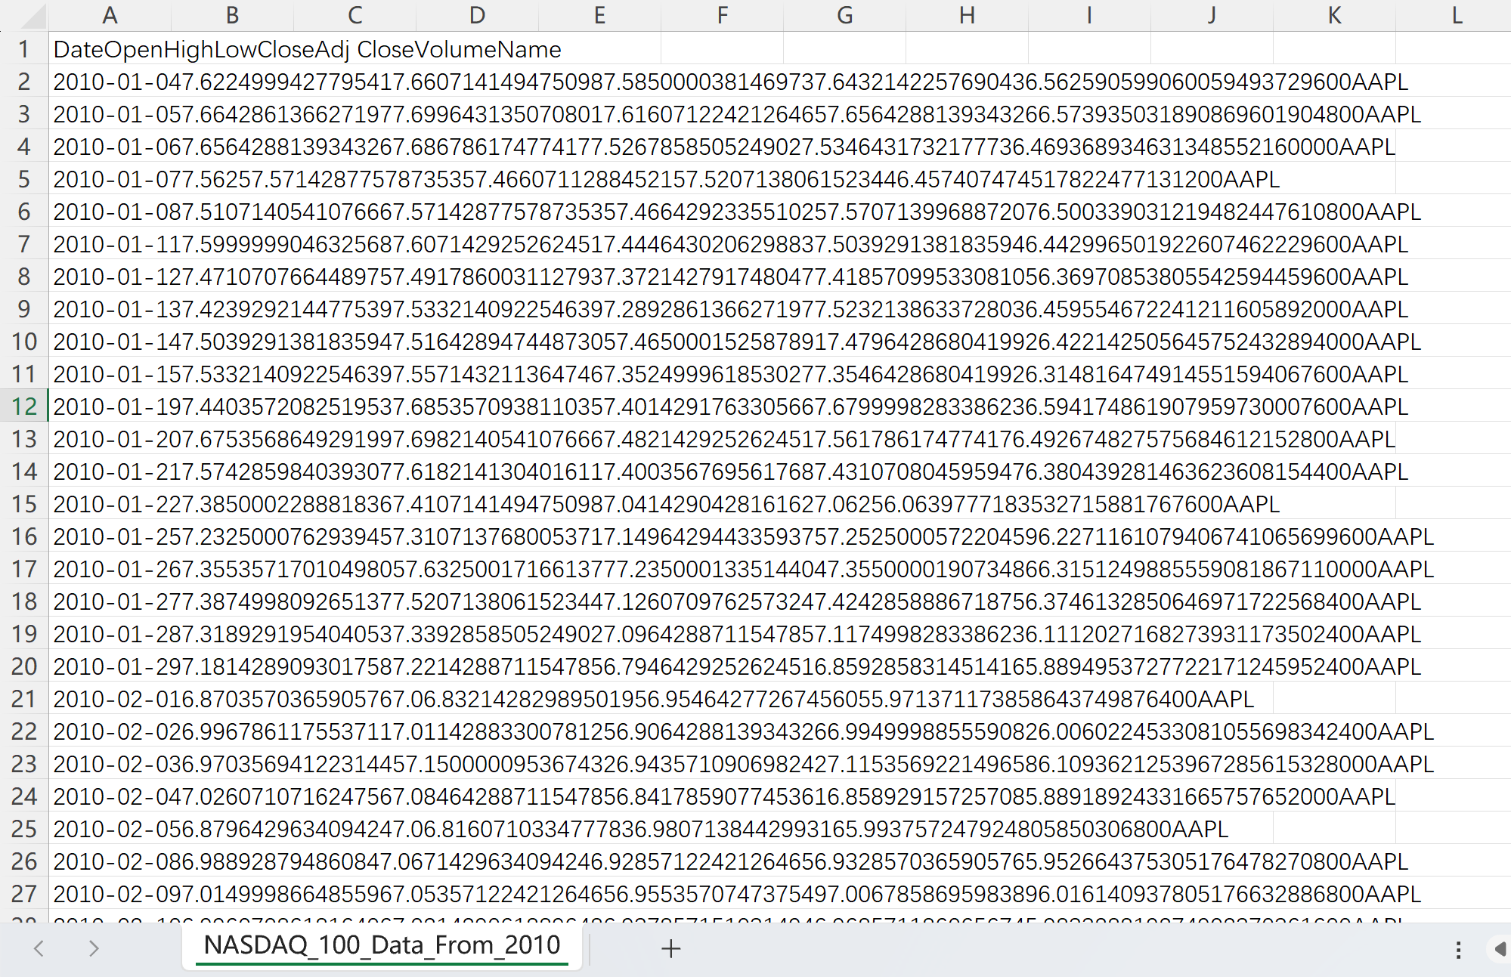
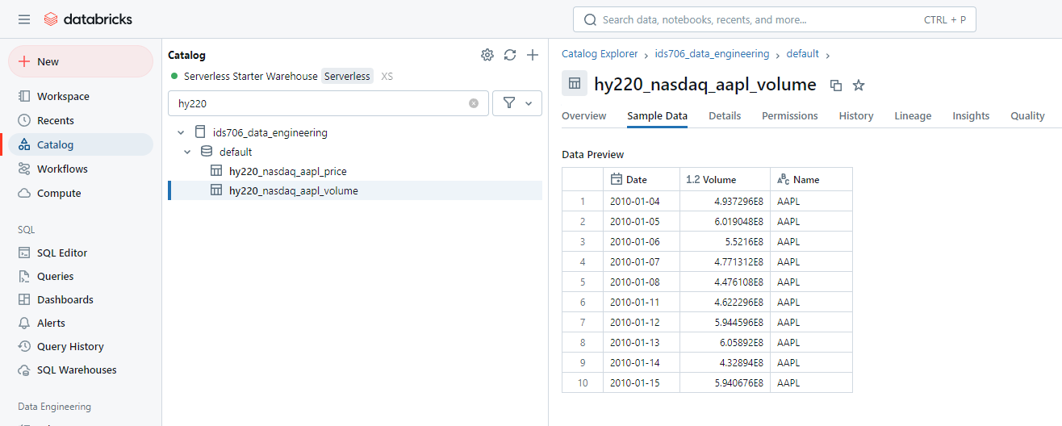
mylib/transform_load.py
mylib/query.py
Databricks “Price” Table
Columns include: Date, Open, High, Low, Close, Adj Close, Name
csv “NASDAQ_100_Data” file
databricks-sql-conntector
databricks-sql-conntector
Load csv and spilt into 2 DataFrames
Create tables and insert data respectively
Join tables by key: Date & Name
Aggregation by AVG() on Close
SORTING by ascending in volume and date
Databricks “Total” Table
Columns include:
Date, Open, High, Low, Close, Adj Close, Volume, Name
Databricks “Volume” Table
Columns include: Date, Volume, Name

