Slide 1
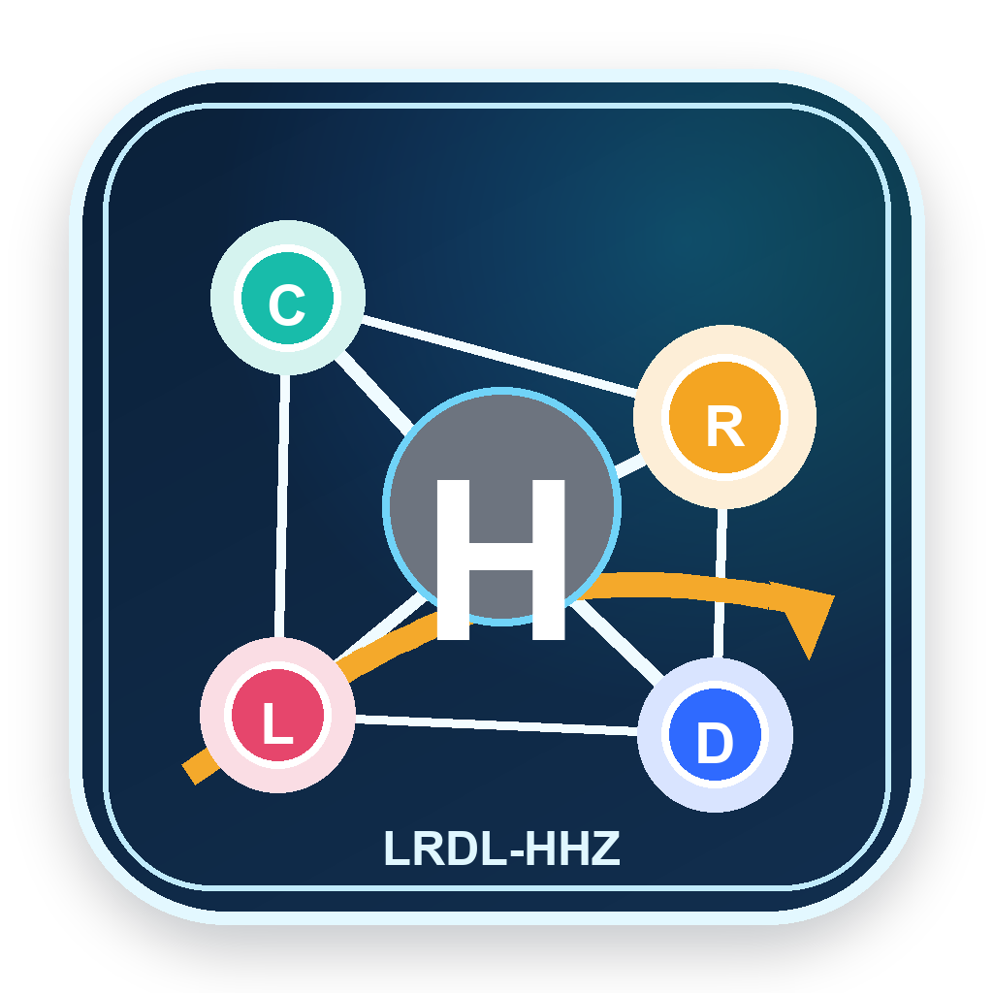
LONELINESS, SOCIAL CONNECTION, AND RISK DECISIONS
BROAD FIELD
Does loneliness change how people choose risk?
Social psychology and behavioral decision science
POPULATION
Ages 16-24
PREDICTOR
Loneliness and social connectedness
A quantitative psychology and statistics project for late adolescents and emerging adults, linking social disconnection to reward timing, impulsive spending, risky choice, and conflict response.
OUTCOME
Risk Decision Index
CONTEXT
Digital peer networks
Developed by He Haoze (何昊泽)
01

Slide 2
Loneliness is modeled as a social signal that can shift decision weighting.
Perceived isolation
Affective pressure
Decision weighting
Observable choices
Lower belonging and weaker access to support cues
>
Stress, urgency, and affiliation motives become more salient
>
Immediate reward and defensive conflict responses gain weight
>
Higher composite risk index across tasks
The model is not diagnostic. It is a measurable behavioral-decision framework informed by loneliness, social connectedness, social exclusion, delay discounting, and risk-taking literature.
Developed by He Haoze (何昊泽)
02

Slide 3
The study converts subjective experience into auditable 0-100 indices.
Loneliness Index
Social Connection Index
Immediate Reward Bias
7 custom Likert items
6 support and contact items
6 delay-choice tasks
Impulsive Spending
High-Risk Choice
Conflict Defense
5 consumption impulse items
5 binary risk tasks
5 conflict-response scenarios
RDI = .35 Reward + .25 Spending + .25 Risk + .15 Conflict
Developed by He Haoze (何昊泽)
03

Slide 4
The website is a data-collection system, not a static project page.
01
02
03
04
Survey UI
Scoring API
SQLite database
Research outputs
Numeric social signals and choice tasks
Immediate profile plus 0-100 indices
Synthetic rows and live submissions stay separated
Dashboard, CSV, workbook, PDF, slides, video script
Seeded database: 420 synthetic pilot rows. Live submissions are written as live_submission records.
Developed by He Haoze (何昊泽)
04

Slide 5
The synthetic pilot produces a clear loneliness-risk gradient.
Key statistics
Cronbach alpha for loneliness: 0.911
ANOVA F(2, 417) = 258.59
Eta squared = 0.554
Interpretation: the demonstration data support the model logic and validate the technical pipeline; live data are still needed for a real empirical claim.
Developed by He Haoze (何昊泽)
05

Slide 6
Regression separates loneliness from social connection and stress.
OLS model
Loneliness z: b = 9.81, p < .001
Connection z: b = -5.13, p < .001
Stress z: b = 4.94, p < .001
Controls: age, sleep, platform intensity, and loneliness-by-connection interaction.
Developed by He Haoze (何昊泽)
06

Slide 7
Participants get a profile while the study gains structured data.
Website interaction
Personal report
1. User enters social-platform, messaging, in-person, support, stress, and sleep indicators.
Risk Decision Index
2. Choice tasks estimate immediate reward bias, risky choice, spending impulse, and conflict defense.
64.2
3. The API returns a Risk Decision Index and decision type.
Reward-sensitive accelerator
4. Saved responses are stored locally in SQLite and can be exported as CSV.
Public survey: https://taste-empire-come-advancement.trycloudflare.com/survey
Developed by He Haoze (何昊泽)
07

Slide 8
A rigorous project distinguishes evidence, pilot simulation, and real data.
Evidence
Peer-reviewed sources support constructs and mechanisms.
Synthetic pilot
Generated rows test the pipeline and are clearly labeled.
Live submissions
Website entries are stored separately in SQLite.
Ethics
A supervised study should add consent language and avoid identifiers.
Core sources include UCLA loneliness measurement, short loneliness surveys, social connectedness, DOSPERT risk-taking, delay discounting, impulsive buying, social exclusion, and public-health social connection reports.
Developed by He Haoze (何昊泽)
08

Slide 9
The research package can now move from local demo to public collection.
Public access layer
Route map
Current survey
https://taste-empire-come-advancement.trycloudflare.com/survey
/survey
Questionnaire and personal report
GitHub repo
https://github.com/haobosun940-crypto/loneliness-risk-decision-lab
/dashboard
Live submissions and CSV export
Render setup
https://dashboard.render.com/blueprint/new?repo=https://github.com/haobosun940-crypto/loneliness-risk-decision-lab
/research
Model outputs and workflow
Downloads
https://taste-empire-come-advancement.trycloudflare.com/downloads
/downloads
PDF, Word, PPT, workbook, video, package
The temporary tunnel is ready for classmate collection now. Render should be used for a stable long-running study link.
Developed by He Haoze (何昊泽)
09

Slide 10
The strongest next step is real sampling, not more decoration.
1
Pilot review
2
Collect 80-150 live responses
Have a mentor review item wording, consent, and risk language.
Use the QR/link and keep synthetic data separate.
3
Run Stata/R replication
4
Revise claims
Use the included .do file and workbook model sheets.
Replace demonstration language with empirical findings only after real data.
Final output: public research website, Word report, PDF paper, workbook, deck, video, and full package.
Developed by He Haoze (何昊泽)
10

