Slide 1
AUVs enabled reliable seabed mapping to enhance ocean operations

Slide 2
Objectives
Automatic alignment for adjacent survey line of MBES data from AUV.

Slide 3
Literature Review
AUVs
MBES
Calibration

Slide 4
AUV (Autonomous Underwater Vehicle)
What is AUV?
-Underwater robot that does not rely on external control or communication.
- It can navigate autonomously, collect data and return to the surface.

Slide 5
AUV (Autonomous Underwater Vehicle)
Application in Seabed Mapping
- Bathymetry: Equipped with sonar systems to create bathymetric map.
- Topography: Capturing the features of seabed.

Slide 6
AUV (Autonomous Underwater Vehicle)
Navigation and location
- Inertial Navigation System (INS): Accelerators; Gyroscopes.
-Acoustic Transponders: Based on Time of Flight (TOF) of signals from acoustic beacons.
-Geophysical: Use external Environmental information as reference.

Slide 7
AUV (Autonomous Underwater Vehicle)
Navigation and location
MBES(Multibeam Echosounder): Both Acoustic and Geophysical categories.
- Sonar sensor based on acoustic signals.
- Bathymetric sonar based on Detection; Identification; Classification in the environment.

Slide 8
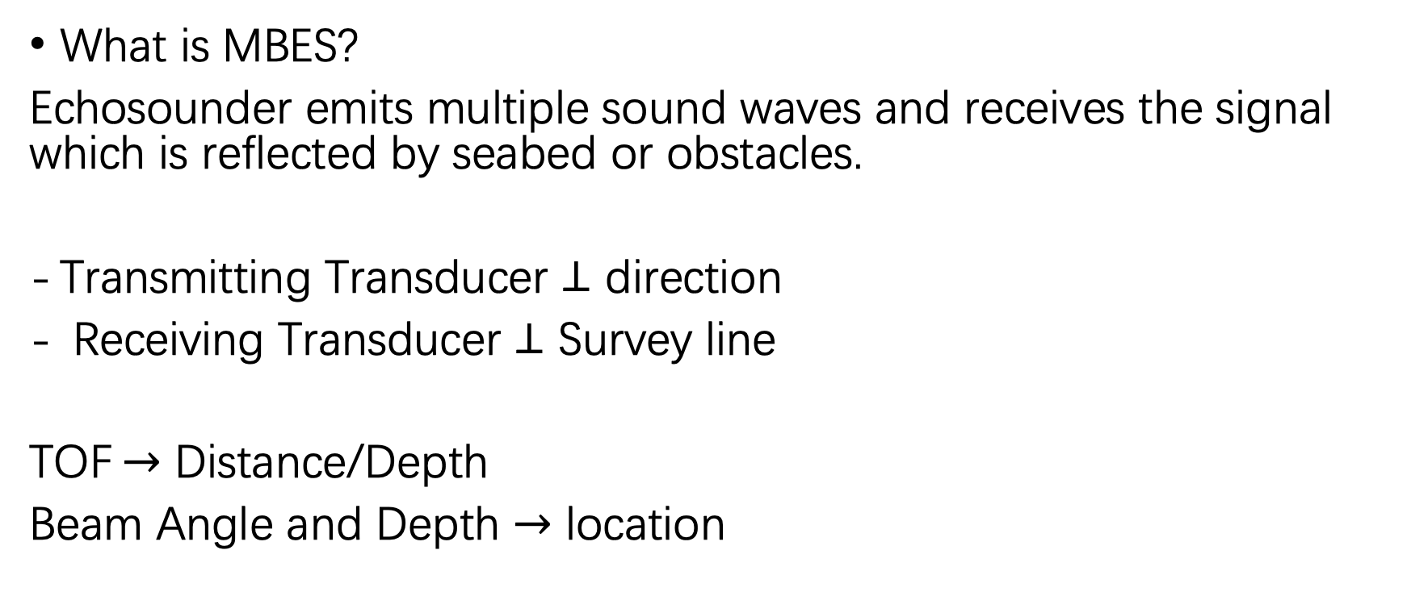
MBES (Multibeam Echosounder System)
What is MBES?
Echosounder emits multiple sound waves and receives the signal which is reflected by seabed or obstacles.
Transmitting Transducer $⊥$ direction
Receiving Transducer $⊥$ Survey line
TOF$→$ Distance/Depth
Beam Angle and Depth $→$ location

Slide 9
MBES (Multibeam Echosounder System)
Misalignment issues in MBES data
Vehicle Motion: Roll, Pitch and Yaw.
- Heave: vertical movement of the vehicle.
INS Drift: Causing vehicle deviate from the survey line.
Currents and Tides

Slide 10
MBES (Multibeam Echosounder System)
Misalignment issues in MBES data
Current solution:
-manual adjustment
- automatic calibration
? Motion
? Heave
? Survey line
Progress report

