Slide 1
Coverage Path Planning

Slide 2
Coverage Path Planning (CPP)
A path that passes over all points of an area of interest where there are obstacles the must be avoided.
Constant altitude
Constant depth

Slide 3
Coverage Path Planning (CPP)
Constant altitude
- Surface gradient: steep enough.
Constant depth
- Any single region of seafloor intersecting with the plane.
- The deepest the surface is, the wider the FOV becomes.

Slide 4
Possible CPP method
Constant depth - Most of the applications for AUVs are benefited from constant depth coverage method.
- Cell Decomposition
- SLAM (Simultaneous Localization and Mapping)
- Possibility estimation
- CPPNet

Slide 5
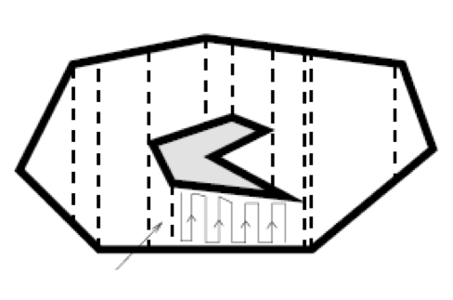
Cell decomposition
Target region divided into several cells without obstacles by sweep line.
Use TSP (Traveling Salesman Problem) to generate a sequence that accesses each cell only once.
Trapezoidal decomposition
Morse Cell decomposition
Boustrophedon
Spiral

Slide 6
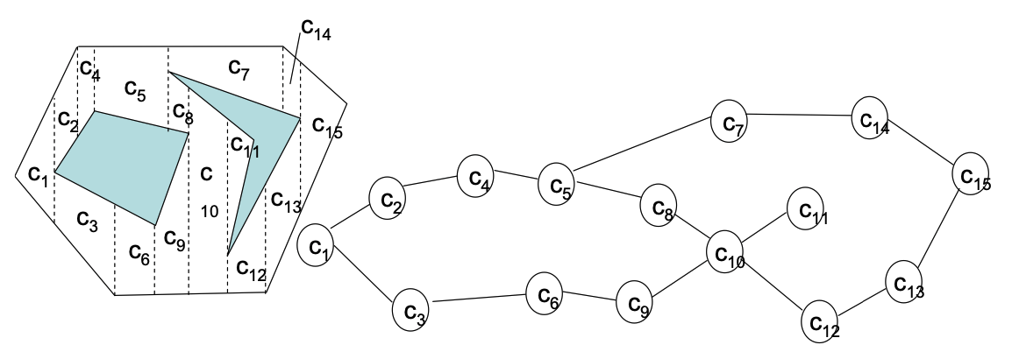
TSP (Traveling Salesman Problem)
It is used to find a path that can only visit each cell once then return to starting point with the shortest total path.

Slide 7
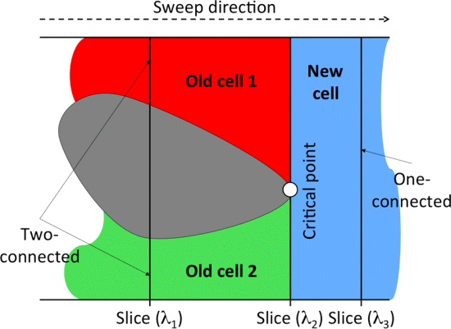
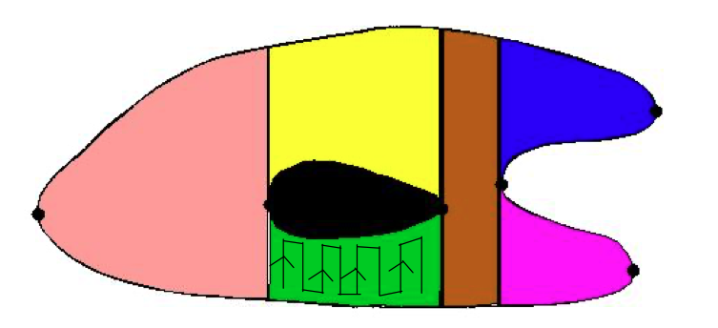
Cell decomposition
Sweep line---ex. BCD (Boustrophedon) h(x,y)=x
Sweep line through the space stopping at vertices.
Find the critical points.
Determine the lower line and upper line status
If the sweep line connected with two points, then divided into two new cells.
Coverage
After cells divided, Every intersects extend to edge.
The length can be calculated.
Each length can be connected by short path.

Slide 8
CPPNet
It is built using CNN
Input: Graph-based representation of the grid map.
Output: Edge probability heat graph- Value of each edge is the Probability of belonging to the optimal TSP tour.

Slide 9
Question
Algorithm
Platform/ROS/Simulink/…
Device

