Slide 1
Genome Rearrangement Combinatorial Algorithms
Phillip Compeau and Pavel Pevzner
Bioinformatics Algorithms: an Active Learning Approach
©2013 by Compeau and Pevzner. All rights reserved

Slide 2
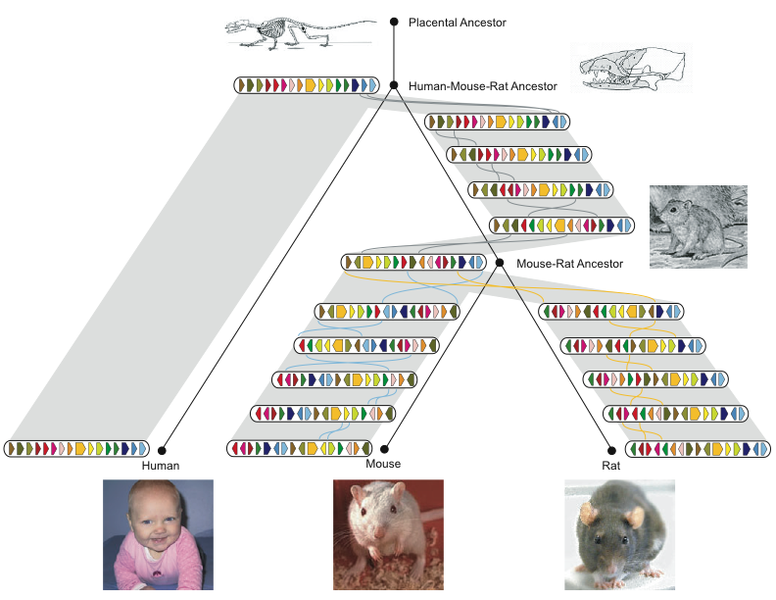
History of Chromosome X
Rat Consortium, Nature, 2004

Slide 3
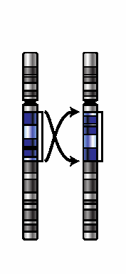
“Transforming Mice into Men”
Notes:
Whitehead Inst. got 16 blocks on X; distance=13.

Slide 4
Series of Reversals
Notes:
Whitehead Inst. got 16 blocks on X; distance=13.

Slide 5
Series of Reversals
Notes:
Whitehead Inst. got 16 blocks on X; distance=13.

Slide 6
Series of Reversals
Notes:
Whitehead Inst. got 16 blocks on X; distance=13.

Slide 7
Series of Reversals
Notes:
Whitehead Inst. got 16 blocks on X; distance=13.

Slide 8
Series of Reversals
Notes:
Whitehead Inst. got 16 blocks on X; distance=13.

Slide 9
Series of Reversals
Notes:
Whitehead Inst. got 16 blocks on X; distance=13.

Slide 10
Human-Mouse Transformation Accomplished!
Notes:
Whitehead Inst. got 16 blocks on X; distance=13.

Slide 11
Types of Rearrangements
Reversal
1 2 3 4 5 6
1 2 -5 -4 -3 6
Translocation
1 2 3 4 5 6
1 6 4 5 2 3
Fusion
1 2 3 4
5 6
1 2 3 4 5 6
Fission

Slide 12
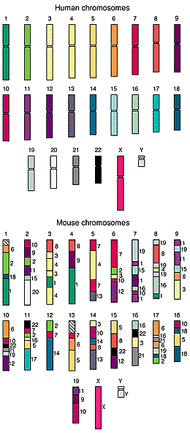
Comparative Genomic Architectures: Mouse vs Human Genomes
Humans and mice have similar genomes, but their genes are ordered differently
~245 rearrangements
Reversals
Fusions
Fissions
Translocations

Slide 13
Are There Fragile Regions in the Human Genome?
Transforming Men into Mice
Sorting by Reversals
Breakpoint Theorem
Rearrangements in Tumor Genomes
2-Breaks
Breakpoint Graphs
2-Break Distance Theorem
Rearrangement Hotspots in the Human Genome
Synteny Block Construction
Notes:
Whitehead Inst. got 16 blocks on X; distance=13.

Slide 14
Reversals
1
2
3
9
10
8
4
7
5
6
+1 +2 +3 +4 +5 +6 +7 +8 +9 +10

Slide 15
Reversals
1
2
3
9
10
8
4
7
5
6
+1 +2 +3 +4 +5 +6 +7 +8 +9 +10

Slide 16
Reversals
1
2
3
9
10
8
4
7
5
6
+1 +2 +3 -8 -7 -6 -5 -4 +9 +10

Slide 17
Reversals
1
2
3
9
10
8
4
7
5
6
+1 +2 +3 -8 -7 -6 -5 -4 +9 +10
The reversal introduced two breakpoints (disruptions in gene order).

Slide 18
Rearrangement Scenario with 5 Reversals
Notes:
hour

Slide 19
Rearrangement Scenario with 4 Reversals
Reversal distance: the minimum number of reversals to transform one permutation into another.

Slide 20
Sorting by 4 Reversals
Sorting by Reversals Problem: Calculate the reversal distance between a permutation and the identity permutation (+1 +2 … +n).
Input: A permutation P.
Output: The reversal distance between P and the identity permutation.

Slide 21
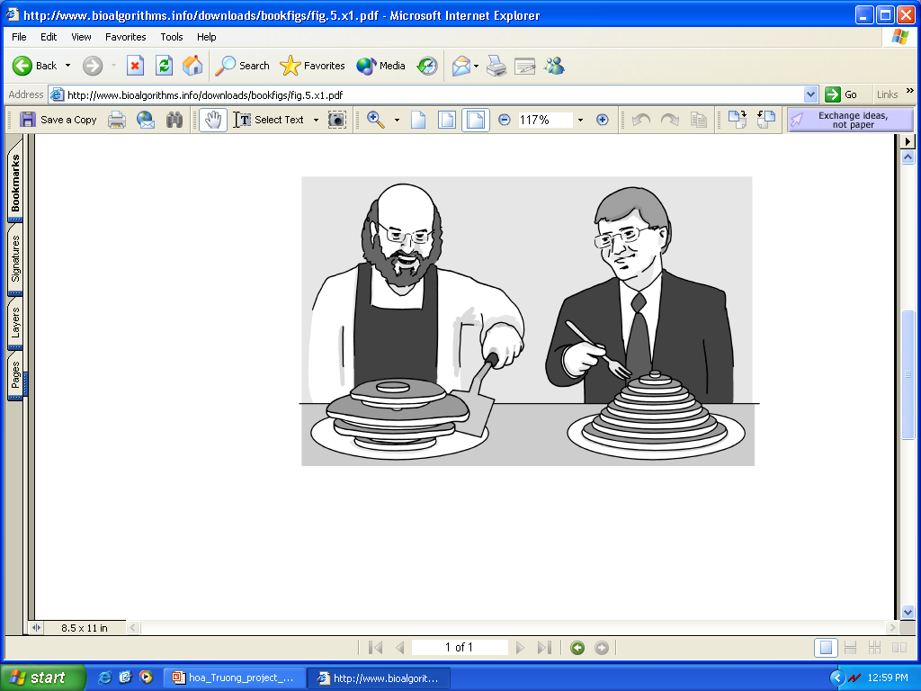
Pancake Flipping Problem
The chef is sloppy: he prepares an unordered stack of pancakes of different sizes
The waiter wants to rearrange them (so that the smallest winds up on top, and so on, down to the largest at the bottom)
He does it by flipping over several from the top, repeating this as many times as necessary
Christos Papadimitrou and Bill Gates flip pancakes

Slide 22
Pancake Flipping Problem: Greedy Algorithm
Question: How many flips are necessary for any permutation of size n?
Greedy approach: 2 prefix reversals at most to place a pancake at correct position. Thus, 2n–2 steps suffice.
Bill Gates and Christos Papadimitriou showed in the mid1970s that this problem can be solved by at most 5/3 (n+1) prefix reversals.
W.H. Gates and C.H. Papadimitriou. Bounds for sorting by prefix reversal. Discrete Math. 27 (1979), 47--57. (received Jan. 1978)

Slide 23
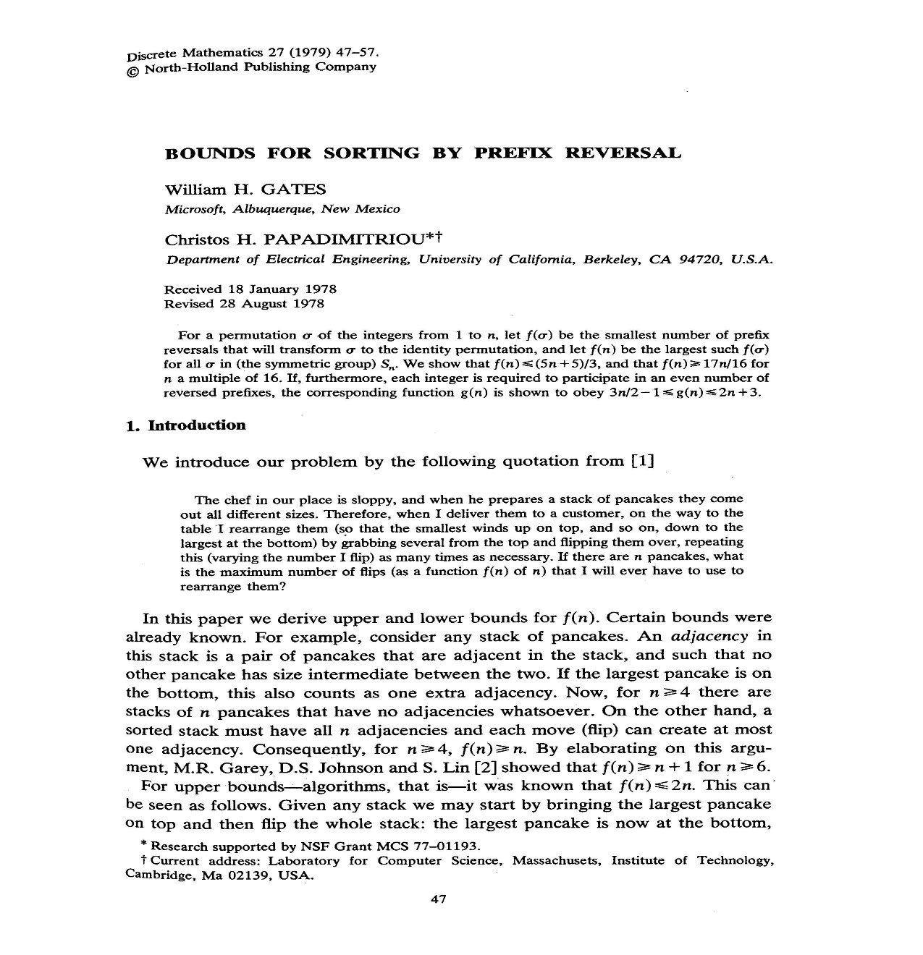

Slide 24
Sorting By Reversals: A Greedy Algorithm
In sorting permutation π = 1 2 3 6 4 5, the first three elements are already in order so it does not make any sense to break them
The length of the already sorted prefix of π is denoted prefix(π)
prefix(π) = 3
This results in an idea for a greedy algorithm: increase prefix(π) at every step

Slide 25
Greedy Algorithm: An Example
Doing so, π can be sorted
1 2 3 6 4 5
1 2 3 4 6 5
1 2 3 4 5 6
Number of steps to sort permutation of length n is at most (n – 1)

Slide 26
Greedy Algorithm: Pseudocode
SimpleReversalSort(π)
1 for i ← 1 to n – 1
2 j ← position of element i in π (i.e., π_{j} = i )
3 if j ≠i
4 π ← π * ρ(i, j)
5 output π
6 if π is the identity permutation
7 return

Slide 27
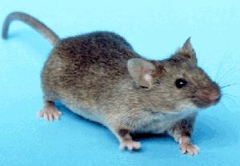
Greedy Sorting by Reversals
(+1 -7 +6 -10 +9 -8 +2 -11 -3 +5 +4)

Slide 28

Greedy Sorting by Reversals
(+1 -7 +6 -10 +9 -8 +2 -11 -3 +5 +4)
(+1 -2 +8 -9 +10 -6 +7 -11 -3 +5 +4)
(+1 +2 +8 -9 +10 -6 +7 -11 -3 +5 +4)
(+1 +2 +3 +11 -7 +6 -10 +9 -8 +5 +4)
(+1 +2 +3 -4 -5 +8 -9 +10 -6 +7 -11)
(+1 +2 +3 +4 -5 +8 -9 +10 -6 +7 -11)
(+1 +2 +3 +4 +5 +8 -9 +10 -6 +7 -11)
(+1 +2 +3 +4 +5 +6 -10 +9 -8 +7 -11)
(+1 +2 +3 +4 +5 +6 -7 +8 -9 +10 -11)
(+1 +2 +3 +4 +5 +6 +7 +8 -9 +10 -11)
(+1 +2 +3 +4 +5 +6 +7 +8 +9 +10 -11)
(+1 +2 +3 +4 +5 +6 +7 +8 +9 +10 +11)

Slide 29
Analyzing SimpleReversalSort
SimpleReversalSort does not guarantee the smallest number of reversals and takes five steps on π = 6 1 2 3 4 5 :
Step 1: 1 6 2 3 4 5
Step 2: 1 2 6 3 4 5
Step 3: 1 2 3 6 4 5
Step 4: 1 2 3 4 6 5
Step 5: 1 2 3 4 5 6

Slide 30
Analyzing SimpleReversalSort (cont’d)
But it can be sorted in two steps:
π = 6 1 2 3 4 5
Step 1: 5 4 3 2 1 6
Step 2: 1 2 3 4 5 6
So, SimpleReversalSort(π) is not optimal
The problem is NP-hard; approximation algorithms are desirable

