Slide 1
Are there Fragile Regions in the Human Genome? Combinatorial Algorithms
Phillip Compeau and Pavel Pevzner
Bioinformatics Algorithms: an Active Learning Approach
©2013 by Compeau and Pevzner. All rights reserved

Slide 2
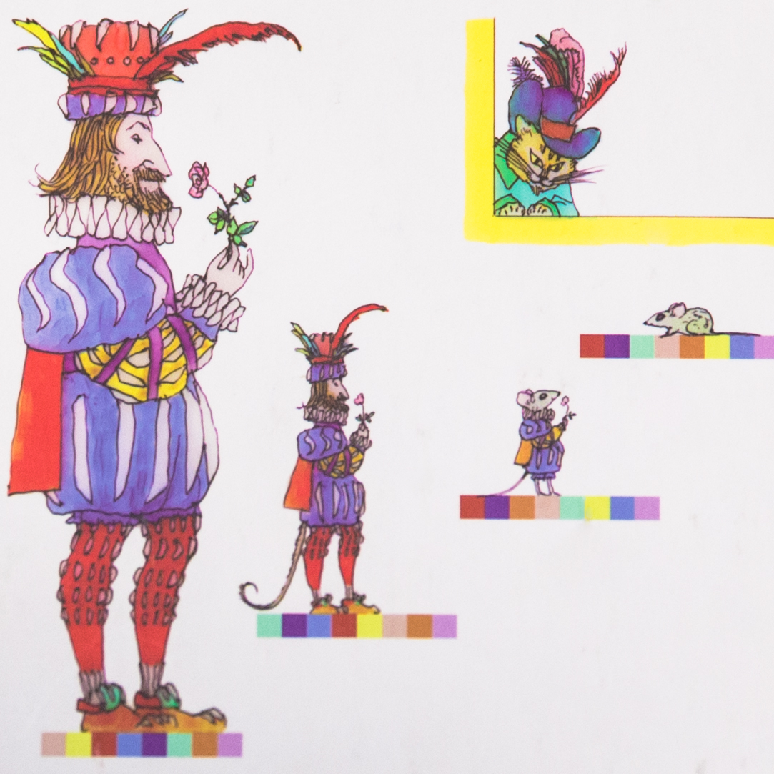
Notes:
Whitehead Inst. got 16 blocks on X; distance=13.

Slide 3
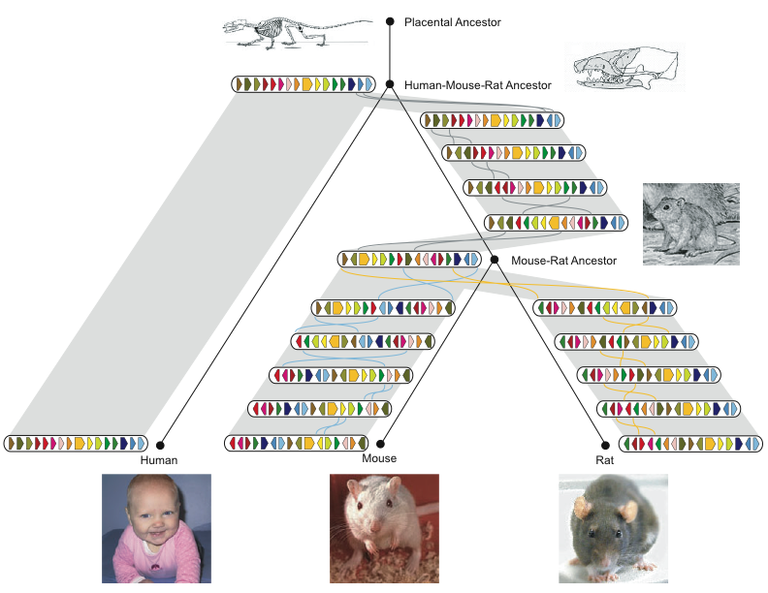
History of Chromosome X
Rat Consortium, Nature, 2004

Slide 4

Genome Rearrangements
Mouse (X chromosome)
Unknown ancestor ~ 75 million years ago
Human (X chromosome)
What are the similarity blocks and how to find them?
What is the evolutionary scenario for transforming one genome into the other?
Notes:
hour

Slide 5
Genome rearrangements
Mouse (X chromosome)
Unknown ancestor ~ 75 million years ago
Human (X chromosome)
What are the similarity blocks and how to find them?
What is the evolutionary scenario for transforming one genome into the other?
Notes:
hour

Slide 6
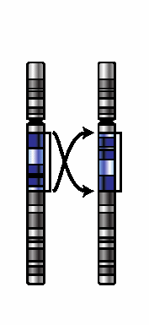
Transforming Mice into Men
Notes:
Whitehead Inst. got 16 blocks on X; distance=13.

Slide 7
Series of Reversals
Notes:
Whitehead Inst. got 16 blocks on X; distance=13.

Slide 8
Series of Reversals
Notes:
Whitehead Inst. got 16 blocks on X; distance=13.

Slide 9
Series of Reversals
Notes:
Whitehead Inst. got 16 blocks on X; distance=13.

Slide 10
Series of Reversals
Notes:
Whitehead Inst. got 16 blocks on X; distance=13.

Slide 11
Series of Reversals
Notes:
Whitehead Inst. got 16 blocks on X; distance=13.

Slide 12
Series of Reversals
Notes:
Whitehead Inst. got 16 blocks on X; distance=13.

Slide 13
Human-Mouse Transformation Accomplished!
Notes:
Whitehead Inst. got 16 blocks on X; distance=13.

Slide 14
Types of Rearrangements
Reversal
1 2 3 4 5 6
1 2 -5 -4 -3 6
Translocation
1 2 3 4 5 6
1 6 4 5 2 3
Fusion
1 2 3 4
5 6
1 2 3 4 5 6
Fission

Slide 15
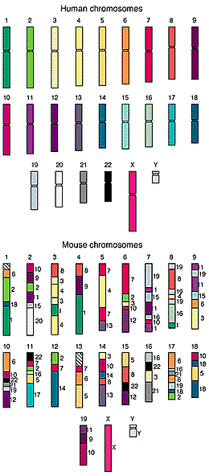
Comparative Genomic Architectures: Mouse vs Human Genomes
Humans and mice have similar genomes, but their genes are ordered differently
~245 rearrangements
Reversals
Fusions
Fissions
Translocations

Slide 16
Transforming mice into men (X chromosome)
+1 -2 +3 -4 +5 -6 +7 -8 -9 +10 +11
+1 +7 +9 +11 +10 +3 +2 +6 +5 -4 +8
Notes:
Whitehead Inst. got 16 blocks on X; distance=13.

Slide 17
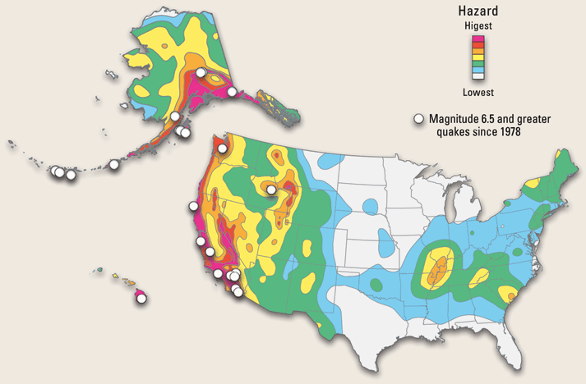
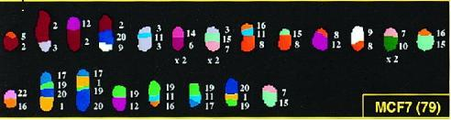
Evolutionary Earthquakes
Are there any rearrangement hotspots in mammalian genomes?
Notes:
hour

Slide 18
Are There Any Rearrangement Hotspots in This Scenario?
Notes:
Whitehead Inst. got 16 blocks on X; distance=13.

Slide 19
Are There Any Rearrangement Hotspots in This Scenario?
Earthquake!
Earthquake!
Notes:
Whitehead Inst. got 16 blocks on X; distance=13.

Slide 20
Are There Any Rearrangement Hotspots in This Scenario?
Earthquake!
Earthquake!
Notes:
Whitehead Inst. got 16 blocks on X; distance=13.

Slide 21
Are There Any Rearrangement Hotspots in This Scenario?
Earthquake!
Earthquake!
Notes:
Whitehead Inst. got 16 blocks on X; distance=13.

Slide 22
Are There Any Rearrangement Hotspots in This Scenario?
Earthquake!
Earthquake!
Notes:
Whitehead Inst. got 16 blocks on X; distance=13.

Slide 23
A Rearrangement Hotspots Found!
Rearrangement hotspot
Earthquake!
Earthquake!
Notes:
Whitehead Inst. got 16 blocks on X; distance=13.

Slide 24
More Rearrangement Hotspots
Rearrangement hotspots
Notes:
Whitehead Inst. got 16 blocks on X; distance=13.

Slide 25

Random Breakage Model of Chromosome Evolution
Susumu Ohno, 1973: Rearrangements occur at random positions (no fragile regions).
Nadeau & Taylor, 1984: the first statistical arguments in favor of the Random Breakage Model (RBM).

Slide 26
Does RBM Have Predictive Power?
Apply N random reversals to a chromosome consisting of M “genes.” Can we predict how many blocks of length k will be generated?
If we can predict it, will these predictions fit what we observe in real genomes?

Slide 27
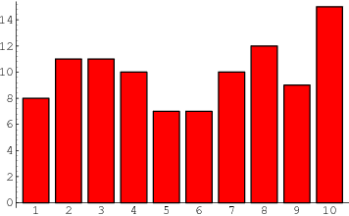
Does RBM Have Predictive Power?
Apply N random reversals to a chromosome consisting of M “genes.” Can we predict how many blocks of length k will be generated?
number of blocks
block size

Slide 28
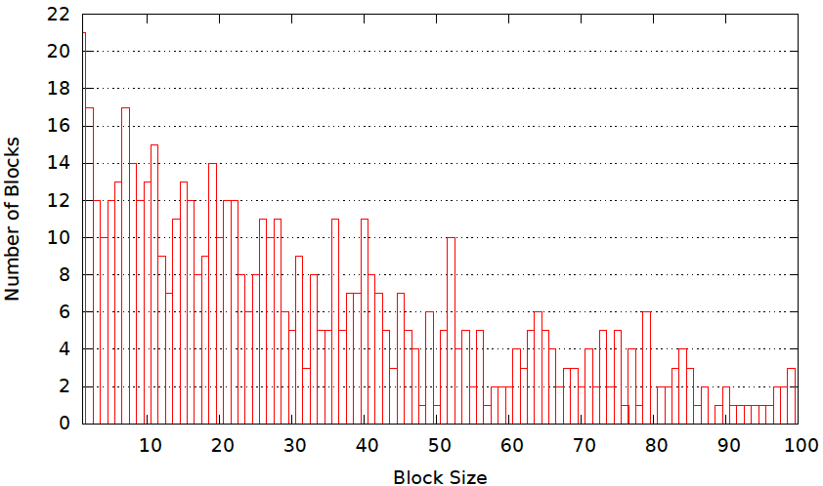
Does RBM Have Predictive Power?
Apply N random reversals to a chromosome consisting of M “genes.” Can we predict how many blocks of length k will be generated?
320 reversals 25,000 genes
If we can predict it, will these predictions fit what we observe in real genomes?
Despite the fact that reversals occur at random positions, we can predict (roughly) how many blocks of each length will be generated!

Slide 29
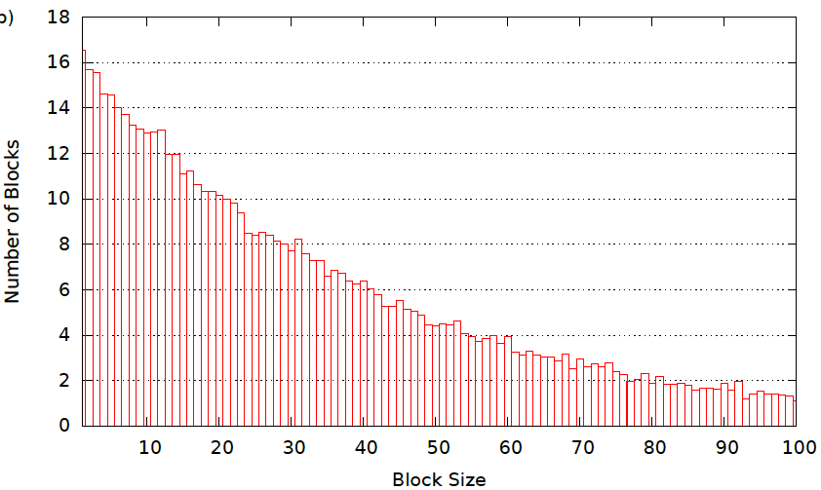
Histogram of Synteny Block Lengths (averaged over 100 simulations)

Slide 30
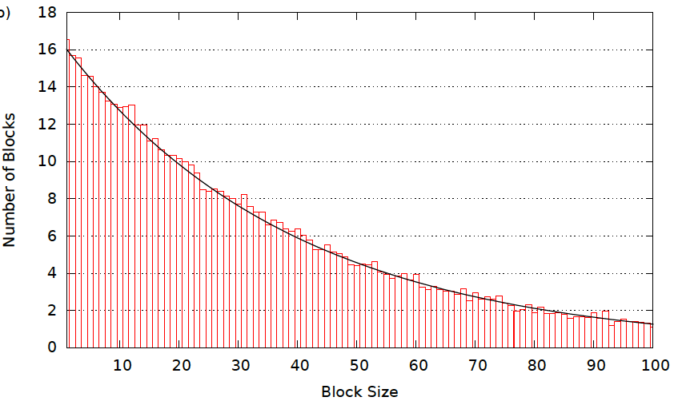
Exponential Distribution (simulated data)
y=λe^{-λ∙x}

Slide 31
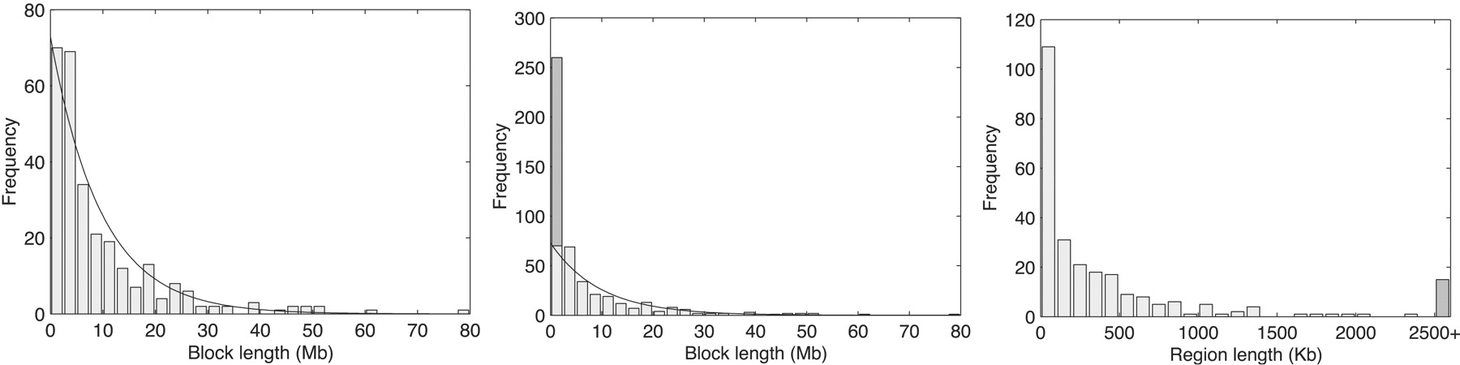
Lengths of Real Human-Mouse Synteny Blocks
y=λe^{-λ∙x}
1990s: RBM was embraced by biologists and has become de facto theory of chromosome evolution.

Slide 32
Are There Fragile Regions in the Human Genome?
Transforming Men into Mice
Sorting by Reversals
Breakpoint Theorem
2-Breaks
Breakpoint Graphs
2-Break Distance Theorem
Notes:
Whitehead Inst. got 16 blocks on X; distance=13.

Slide 33
Reversals
1
2
3
9
10
8
4
7
5
6
+1 +2 +3 +4 +5 +6 +7 +8 +9 +10

Slide 34
Reversals
1
2
3
9
10
8
4
7
5
6
+1 +2 +3 +4 +5 +6 +7 +8 +9 +10

Slide 35
Reversals
1
2
3
9
10
8
4
7
5
6
+1 +2 +3 -8 -7 -6 -5 -4 +9 +10

Slide 36
Reversals
1
2
3
9
10
8
4
7
5
6
+1 +2 +3 -8 -7 -6 -5 -4 +9 +10
The reversal introduced two breakpoints (disruptions in gene order).

Slide 37
Rearrangement Scenario with 5 Reversals
Notes:
hour

Slide 38
Rearrangement Scenario with 4 Reversals
Reversal distance: the minimum number of reversals to transform one permutation into another.

Slide 39
Sorting by 4 Reversals
Sorting by Reversals Problem: Calculate the reversal distance between a permutation and the identity permutation (+1 +2 … +n).
Input: A permutation P.
Output: The reversal distance between P and the identity permutation.

Slide 40
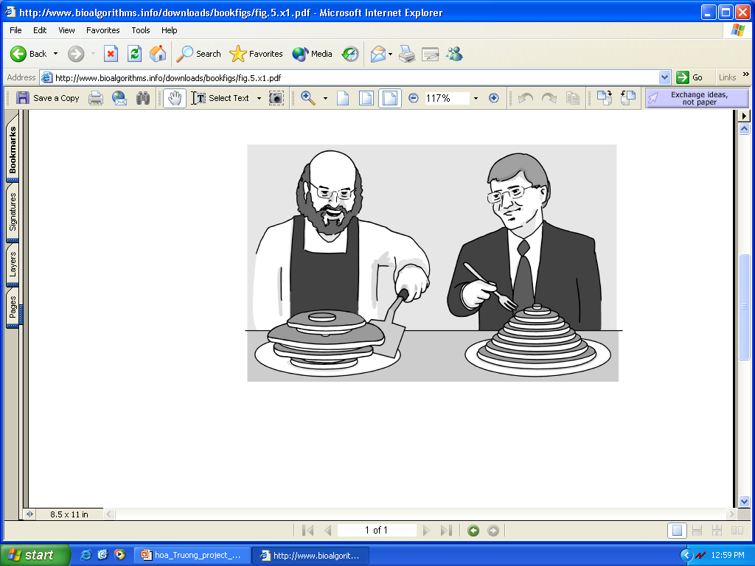
Pancake Flipping Problem
The chef is sloppy: he prepares an unordered stack of pancakes of different sizes
The waiter wants to rearrange them (so that the smallest winds up on top, and so on, down to the largest at the bottom)
He does it by flipping over several from the top, repeating this as many times as necessary
Christos Papadimitrou and Bill Gates flip pancakes

Slide 41
Pancake Flipping Problem: Greedy Algorithm
Question: How many flips are necessary for any permutation of size n?
Greedy approach: 2 prefix reversals at most to place a pancake at correct position. Thus, 2n–2 steps suffice.
Bill Gates and Christos Papadimitriou showed in the mid1970s that this problem can be solved by at most 5/3 (n+1) prefix reversals.
W.H. Gates and C.H. Papadimitriou. Bounds for sorting by prefix reversal. Discrete Math. 27 (1979), 47--57. (received Jan. 1978)

Slide 42
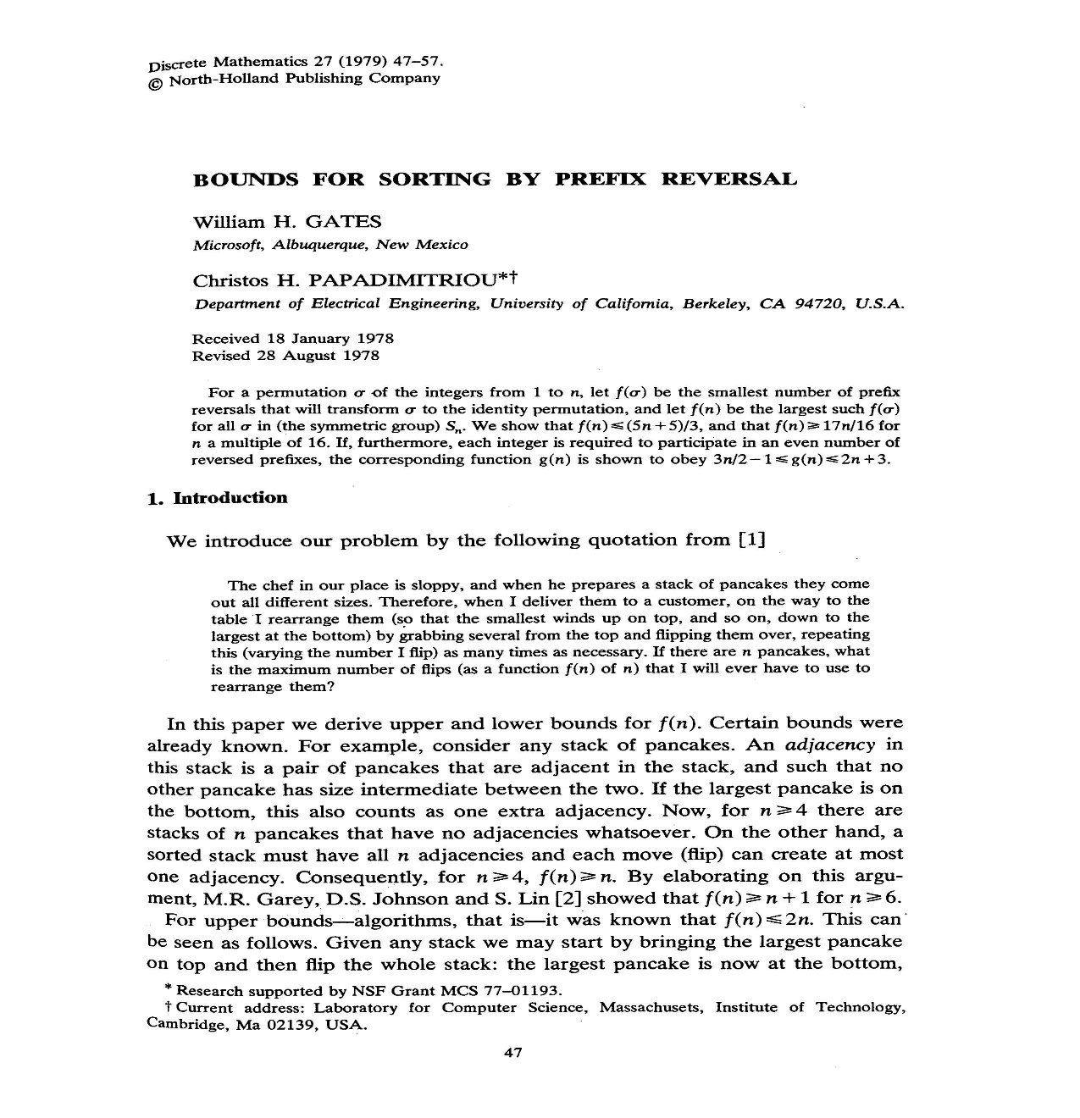

Slide 43
Sorting By Reversals: A Greedy Algorithm
In sorting permutation π = 1 2 3 6 4 5, the first three elements are already in order so it does not make any sense to break them
The length of the already sorted prefix of π is denoted prefix(π)
prefix(π) = 3
This results in an idea for a greedy algorithm: increase prefix(π) at every step

Slide 44
Greedy Algorithm: An Example
Doing so, π can be sorted
1 2 3 6 4 5
1 2 3 4 6 5
1 2 3 4 5 6
Number of steps to sort permutation of length n is at most (n – 1)

Slide 45
Greedy Algorithm: Pseudocode
SimpleReversalSort(π)
1 for i ← 1 to n – 1
2 j ← position of element i in π (i.e., π_{j} = i )
3 if j ≠i
4 π ← π * ρ(i, j)
5 output π
6 if π is the identity permutation
7 return

Slide 46
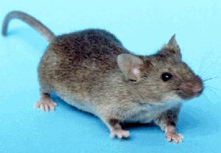
Greedy Sorting by Reversals
(+1 -7 +6 -10 +9 -8 +2 -11 -3 +5 +4)

Slide 47

Greedy Sorting by Reversals
(+1 -7 +6 -10 +9 -8 +2 -11 -3 +5 +4)
(+1 -2 +8 -9 +10 -6 +7 -11 -3 +5 +4)
(+1 +2 +8 -9 +10 -6 +7 -11 -3 +5 +4)
(+1 +2 +3 +11 -7 +6 -10 +9 -8 +5 +4)
(+1 +2 +3 -4 -5 +8 -9 +10 -6 +7 -11)
(+1 +2 +3 +4 -5 +8 -9 +10 -6 +7 -11)
(+1 +2 +3 +4 +5 +8 -9 +10 -6 +7 -11)
(+1 +2 +3 +4 +5 +6 -10 +9 -8 +7 -11)
(+1 +2 +3 +4 +5 +6 -7 +8 -9 +10 -11)
(+1 +2 +3 +4 +5 +6 +7 +8 -9 +10 -11)
(+1 +2 +3 +4 +5 +6 +7 +8 +9 +10 -11)
(+1 +2 +3 +4 +5 +6 +7 +8 +9 +10 +11)

Slide 48
Analyzing SimpleReversalSort
SimpleReversalSort does not guarantee the smallest number of reversals and takes five steps on π = 6 1 2 3 4 5 :
Step 1: 1 6 2 3 4 5
Step 2: 1 2 6 3 4 5
Step 3: 1 2 3 6 4 5
Step 4: 1 2 3 4 6 5
Step 5: 1 2 3 4 5 6

Slide 49
Analyzing SimpleReversalSort (cont’d)
But it can be sorted in two steps:
π = 6 1 2 3 4 5
Step 1: 5 4 3 2 1 6
Step 2: 1 2 3 4 5 6
So, SimpleReversalSort(π) is not optimal

Slide 50
Are there Fragile Regions in the Human Genome?
Transforming Men into Mice
Sorting by Reversals
Breakpoint Theorem
2-Breaks
Breakpoint Graphs
2-Break Distance Theorem
Notes:
Whitehead Inst. got 16 blocks on X; distance=13.

Slide 51
Adjacencies and Breakpoints
Given π = π₁π₂π₃…π_{n-1}π_{n}, a pair of elements π _{i} and π _{i + 1} are adjacent if
π_{i+1} = π_{i} + 1
For example:
π = 1 9 3 4 7 8 2 6 5
(3, 4) or (7, 8) and (6,5) are adjacent pairs

Slide 52
Breakpoints: An Example
There is a breakpoint between any neighboring elements that are not adjacent:
π = 1 9 3 4 7 8 2 6 5
Pairs (1,9), (9,3), (4,7), (8,2) and (2,6) form breakpoints of permutation π
b(π) - # breakpoints in permutation π

Slide 53
Extending Permutations
We put two elements π ₀ =0 and π _{n + 1}=n+1 at the ends of π
Example:
π = 1 9 3 4 7 8 2 6 5
Extending with 0 and 10
π = 0 1 9 3 4 7 8 2 6 5 10
Note: A new breakpoint was created after extension

Slide 54
Reversal Distance and Breakpoints
Each reversal eliminates at most 2 breakpoints.
π = 2 3 1 4 6 5
0 2 3 1 4 6 5 7 b(π) = 5
0 1 3 2 4 6 5 7 b(π) = 4
0 1 2 3 4 6 5 7 b(π) = 2
0 1 2 3 4 5 6 7 b(π) = 0

Slide 55
Reversal Distance and Breakpoints
Each reversal eliminates at most 2 breakpoints.
π = 2 3 1 4 6 5
0 2 3 1 4 6 5 7 b(π) = 5
0 1 3 2 4 6 5 7 b(π) = 4
0 1 2 3 4 6 5 7 b(π) = 2
0 1 2 3 4 5 6 7 b(π) = 0
This implies:
reversal distance ≥ #breakpoints / 2

Slide 56
Sorting By Reversals: A Better Greedy Algorithm
BreakPointReversalSort(π)
1 while b(π) > 0
2 Among all possible reversals, choose reversal ρ minimizing b(π • ρ)
3 π ← π • ρ(i, j)
4 output π
5 return

Slide 57
Sorting By Reversals: A Better Greedy Algorithm
BreakPointReversalSort(π)
1 while b(π) > 0
2 Among all possible reversals, choose reversal ρ minimizing b(π • ρ)
3 π ← π • ρ(i, j)
4 output π
5 return
Problem: This algorithm may run forever!

Slide 58
Strips
Strip: an interval between two consecutive breakpoints in a permutation
Decreasing strip: strip of elements in decreasing order (e.g., 4 3 ).
Increasing strip: strip of elements in increasing order (e.g., 7 8 and 5 6)
0 1 9 4 3 7 8 2 5 6 10
A single-element strip can be declared either increasing or decreasing. We will choose to declare them as decreasing with the exception of the strips consisting of only 0 or n+1

Slide 59
Reducing the Number of Breakpoints
Theorem 1:
If permutation π contains at least one decreasing strip, then there exists a reversal ρ that decreases the number of breakpoints (i.e., b(π • ρ) < b(π) )

Slide 60
Things to Consider
For π = 1 4 6 5 7 8 3 2
0 1 4 6 5 7 8 3 2 9 b(π) = 5
Choose decreasing strip with the smallest element k in π (k = 2 in this case)

Slide 61
Things to Consider (cont’d)
For π = 1 4 6 5 7 8 3 2
0 1 4 6 5 7 8 3 2 9 b(π) = 5
Choose decreasing strip with the smallest element k in π (k = 2 in this case)

Slide 62
Things to Consider (cont’d)
For π = 1 4 6 5 7 8 3 2
0 1 4 6 5 7 8 3 2 9 b(π) = 5
Choose decreasing strip with the smallest element k in π (k = 2 in this case)
Find k – 1 in the permutation

Slide 63
Things to Consider (cont’d)
For π = 1 4 6 5 7 8 3 2
0 1 4 6 5 7 8 3 2 9 b(π) = 5
Choose decreasing strip with the smallest element k in π (k = 2 in this case)
Find k–1 in the permutation
Reverse the segment between k and k-1:
0 1 4 6 5 7 8 3 2 9 b(π) = 5
0 1 2 3 8 7 5 6 4 9 b(π) = 4
What if k-1 occurs to the right of k?

Slide 64
Reducing the Number of Breakpoints again
If there is no decreasing strip, there may be no reversal ρ that reduces the number of breakpoints (i.e., b(π • ρ) ≥ b(π) for any reversal ρ). E.g. 04561237
By reversing an increasing strip ( # of breakpoints stay unchanged ), we will create a decreasing strip at the next step. Then the number of breakpoints will be reduced in the next step (Theorem 1).

Slide 65
Things to Consider (cont’d)
There are no decreasing strips in π below:
π = 0 1 2 5 6 7 3 4 8 b(π) = 3
π • ρ(6,7) = 0 1 2 5 6 7 4 3 8 b(π) = 3
ρ(6,7) does not change the # of breakpoints
ρ(6,7) creates a decreasing strip thus guaranteeing that the next step will decrease the # of breakpoints.

Slide 66
ImprovedBreakpointReversalSort
ImprovedBreakpointReversalSort(π)
1 while b(π) > 0
2 if π has a decreasing strip
Among all possible reversals, choose reversal ρ
that minimizes b(π • ρ)
4 else
5 Choose a reversal ρ that flips an increasing strip in π
6 π ← π • ρ
7 output π
8 return
Upper bound: 2* b(π)

Slide 67
Signed Permutations
Up to this point, all permutations to sort were unsigned
But genes have directions… so we should consider signed permutations
5’
3’
π = 1 -2 - 3 4 -5
This can be converted to: 1 2 4 3 6 5 7 8 10 9.
So, the previous approximation algorithm works.

Slide 68
Are There Fragile Regions in the Human Genome?
Transforming Men into Mice
Sorting by Reversals
Breakpoint Theorem
2-Breaks
Breakpoint Graphs
2-Break Distance Theorem
Notes:
Whitehead Inst. got 16 blocks on X; distance=13.

Slide 69
From Linear to Circular Chromosomes
(+a –b –d +c) (+e +f +g +h +i +j)

Slide 70
From Linear to Circular Chromosomes
f
e
b
g
a
d
j
h
c
i
(+a –b –d +c) (+e +f +g +h +i +j)
Black directed edges represent synteny blocks.

Slide 71
From Linear to Circular Chromosomes
f
e
b
g
a
d
j
h
c
i
(+a –b –d +c) (+e +f +g +h +i +j)
Black directed edges represent synteny blocks.
Red undirected edges connect adjacent synteny blocks.

Slide 72
Equivalent Representations of a Circular Genome
b
b
=
a
d
a
c
c
d
Q=(+a-b-d+c) Q=(+a-b-d+c)

Slide 73
Reversals on Circular Chromosomes
b
b
reversal
a
c
a
c
d
d
P=(+a-b-c+d) Q=(+a-b-d+c)
A reversal deletes two red edges and replaces them by two other red edges (on the same 4 nodes)

Slide 74
Fusion/Fission as Replacement of Two Red Edges
b
b
fission
a
c
a
c
fusion
d
d
P=(+a-b-c+d) Q= (+a-b) (-c+d)
2-break: a rearrangement that replaces two red edges with two new red edges on the same 4 nodes.

Slide 75
Translocation on linear chromosomes
-a +b +c -d
-a +f -g +h
+e +f -g +h
+e +b +c -d
Translocation on circularized chromosomes
d
●
●
d
d
c
a
c
a
c
a
b
2-break
b
b
Circularization
Linearization
●
e
●
e
e
h
f
h
f
h
f
g
g
g

Slide 76
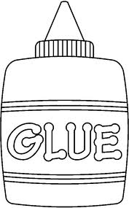
-a +b +c -d
-a +f -g +h
+e +f -g +h
+e +b +c -d
Translocation on linear chromosomes
d
●
●
d
c
a
c
a
Circularization
of linear
chromosomes
b
2-break
b
●
e
●
e
h
f
h
f
g
g

Slide 77
-a +b +c -d
-a +f -g +h
+e +f -g +h
+e +b +c -d
d
●
d
c
a
c
a
Circularization
of linear
chromosomes
b
2-break
b
Linearization
of circular
chromosomes
●
e
e
h
f
h
f
g
g

Slide 78
2-Break Distance
2-Break distance d(P,Q):
minimum number of 2-breaks transforming genome P into genome Q
2-Break Distance Problem. Find the 2-break distance between two genomes.
Input. Two genomes on the same set of synteny blocks.
Output. The 2-break distance between these genomes.

Slide 79
Are There Fragile Regions in the Human Genome?
Transforming Men into Mice
Sorting by Reversals
Breakpoint Theorem
2-Break Distance Problem
Breakpoint Graphs
2-Break Distance Theorem
Notes:
Whitehead Inst. got 16 blocks on X; distance=13.

Slide 80
Comparing Genomes P and Q
b
a
P
c
d
c
a
Q
b
d

Slide 81
Different Drawing of Q
b
a
P
c
b
d
a
c
c
Q
d
a
Q
b
d

Slide 82
Superimposing P and Q
b
BreakpointGraph(P,Q)
a
P
c
b
d
a
c
c
d
a
Q
b
d

Slide 83
Red and Black Edges in Breakpoint Graph Form..
b
BreakpointGraph(P,Q)
a
P
c
b
d
a
c
c
d
a
Q
b
d

Slide 84
Blue and Black Edges in Breakpoint Graph Form…
b
BreakpointGraph(P,Q)
a
P
c
b
d
a
c
c
d
a
Q
b
d

Slide 85
What About Red and Blue Edges???
b
BreakpointGraph(P,Q)
a
P
c
b
d
a
c
c
d
a
Q
b
d

Slide 86
Alternating Red-Blue Cycles
BreakpointGraph(P,Q)
b
Red and blue edges form
alternating red-blue cycles.
a
c
d
cycle(P,Q): number of red-blue alternating cycles

Slide 87
Breakpoint Graph
b
b
BreakpointGraph(P,Q)
a
P
c
a
P
c
b
d
d
a
c
c
b
Q
d
a
Q
b
a
c
d
d

Slide 88
a
f
b
P
e
c
d
What is cycle(P,Q)?
Q
a
b
e
c
d
f

Slide 89
a
f
b
P
e
c
d
Arranging blacks edges of Q
in the same order as black edges in P
Q
a
a
f
b
Q
b
e
c
d
e
c
f
d

Slide 90
a
f
b
P
BreakpointGraph(P,Q)
e
a
c
f
d
b
e
c
d
Q
a
a
f
b
b
e
c
d
e
c
f
d

Slide 91
a
f
b
P
BreakpointGraph(P,Q) cycle(P,Q)=3
e
a
c
f
d
b
e
c
d
Q
a
a
f
b
b
e
c
d
e
c
f
d

Slide 92
Given P, What Genome Q Maximizes cycle(P,Q)?
b
a
c
d
P=(+a-b-c+d)

Slide 93
Given P, What Genome Q Maximizes cycle(P,Q)?
BreakpointGraph(P,P)
b
Identity
Breakpoint
Graph
a
c
cycle(P,P)=#blocks=4
d
P=(+a-b-c+d)

Slide 94
Genome Rearrangements Affect Red-Blue Cycles
Each transformation P Q corresponds to a transformation:
BreakpointGraph(P,Q) BreakpointGraph(Q,Q)
b
b
Series of 2-breaks transforming P into Q
a
c
a
c
d
d
cycle(P,Q)=2 cycle(Q,Q)= 4

Slide 95
Genome Rearrangements Affect Red-Blue Cycles
Each transformation P ➔ Q
corresponds to a transformation
BreakpointGraph(P,Q) ➔ BreakpointGraph(Q,Q)
b
b
series of 2-breaks transforming P into Q
a
c
a
c
d
d
cycle(P,Q)=2 cycle(Q,Q)= 4

Slide 96
Rearrangements Change cycle(P,Q)
P=(+a –b –c +d) → P’=(+a –b –c -d) → P’’=Q=(+a +c +b -d)
BreakpointGraph(P,Q) → BreakpointGraph(P’,Q) → BreakpointGraph(Q,Q)
cycle(P,Q)=2 → cycle(P’,Q)=3 → cycle(Q,Q)=4
‏
‏
c
c
c
a
b
a
b
a
b
d
d
d

Slide 97
Rearrangements Change cycle(P,Q)
P=(+a –b –c +d) → P’=(+a –b –c -d) → P’’=Q=(+a +c +b -d)
BreakpointGraph(P,Q) → BreakpointGraph(P’,Q) → BreakpointGraph(Q,Q)
cycle(P,Q)=2 → cycle(P’,Q)=3 → cycle(Q,Q)=4
‏
‏
c
c
c
a
b
a
b
a
b
d
d
d

Slide 98
Are There Fragile Regions in the Human Genome?
Transforming Men into Mice
Sorting by Reversals
Breakpoint Theorem
2-Breaks
Breakpoint Graphs
2-Break Distance Theorem
Notes:
Whitehead Inst. got 16 blocks on X; distance=13.

Slide 99
Sorting by 2-Breaks
2-breaks
P → ... → Q
BreakpointGraph(P,Q) → ... → BreakpointGraph(Q,Q)
cycle(P,Q) → ... → cycle(Q,Q)=blocks(Q,Q)
# of red-blue cycles increases by blocks(P,Q) - cycle(P,Q)
How much each 2-break can contribute to this increase?

Slide 100
A 2-Break May Change cycle(P,Q) by …
cycle(P,Q)
does not change
cycle(P,Q)
increases by 1
cycle(P,Q)
decreases by 1

Slide 101
Each 2-Break Increases #Cycles by at Most 1
A 2-break:
adds 2 new red edges and thus creates at most 2 new cycles (containing two new red edges)
removes 2 red edges and thus destroys at least 1 old cycle (containing two old edges)
change in the number of cycles ≤ 2-1=1.

Slide 102
There Exists a 2-Break Increasing cycle(P,Q) by 1
cycle(P,Q)
does not change
cycle(P,Q)
increases by 1
cycle(P,Q)
decreases by 1

Slide 103
2-Break Distance Theorem
A 2-break increases #cycles by at most 1.
There exists a 2-break increasing #cycles by 1.
Every sorting by 2-breaks must increase #cycles by
blocks(P,Q) - cycle(P,Q)
2-break distance between genomes P and Q:
d(P,Q) = blocks(P,Q) - cycle(P,Q)

Slide 104
2-Break Distance between Human and Mouse Genomes
Human and Mouse genomes can be decomposed into 280 synteny blocks (at least 0.5 million nucleotides in length)
The breakpoint graph on these blocks has 35 cycles
The 2-break distance between Human and Mouse:
d(H,M) = blocks(H,M)-cycle(H,M) = 280-35=245
There are numerous 245-step scenarios.
The true scenario may have more than 245 steps.

