Slide 1
DNA Mapping and Brute Force Algorithms

Slide 2
Outline
Restriction Enzymes and Physical Map
Gel Electrophoresis
Partial Digest Problem
Brute Force Algorithm for Partial Digest Problem
Branch-and-Bound Algorithm for Partial Digest Problem
Double Digest Problem

Slide 3
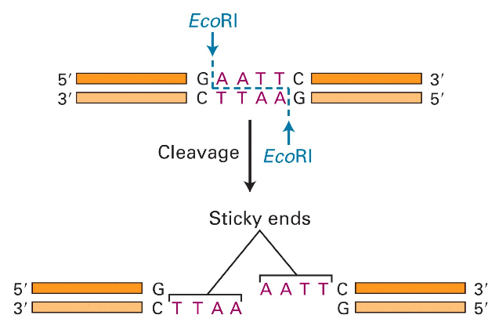
Molecular Scissors
Molecular Cell Biology, 4th edition

Slide 4
Discovering Restriction Enzymes
HindII - first restriction enzyme – was discovered accidentally in 1970 while studying how the bacterium Haemophilus influenzae takes up DNA from the virus
Recognizes and cuts DNA at sequences:
  GTGCAC
  GTTAAC

Slide 5
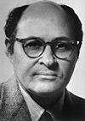
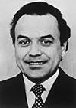

Discovering Restriction Enzymes
My father has discovered a servant who serves as a pair of scissors. If a foreign king invades a bacterium, this servant can cut him in small fragments, but he does not do any harm to his own king. Clever people use the servant with the scissors to find out the secrets of the kings. For this reason my father received the Nobel Prize for the discovery of the servant with the scissors".
Daniel Nathans’ daughter
(from Nobel lecture)
Werner Arber Daniel Nathans Hamilton Smith
Werner Arber – discovered restriction
enzymes
Daniel Nathans - pioneered the application
of restriction for the
construction of genetic
maps
Hamilton Smith - showed that restriction
enzyme cuts DNA in the
middle of a specific sequence

Slide 6
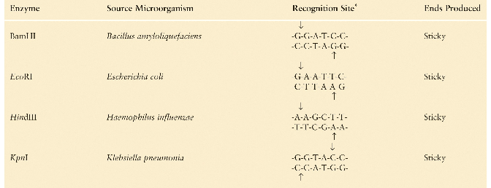
Recognition Sites of Restriction Enzymes
Molecular Cell Biology, 4th edition

Slide 7
Uses of Restriction Enzymes
Recombinant DNA technology
Cloning
Detecting mutations
DNA mapping

Slide 8
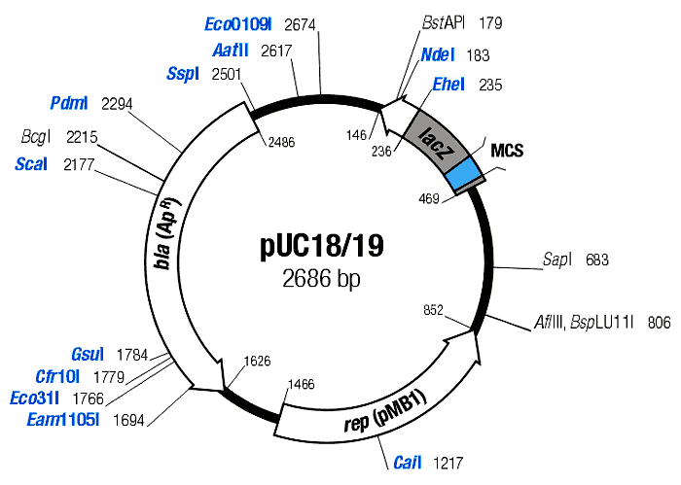
Restriction Maps
• A map showing positions of restriction sites in a DNA sequence.
• If DNA sequence is known then construction of restriction map is a trivial exercise.
• In early days of molecular biology, DNA sequences were often unknown.
• Biologists had to solve the problem of reconstructing restriction maps without knowing DNA sequences.

Slide 9
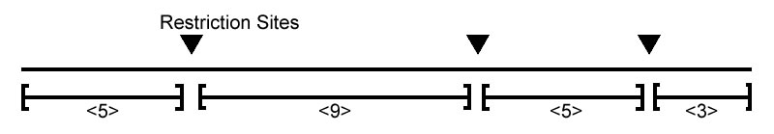
Full/Complete Restriction Digest
• Cutting DNA at each restriction site creates
multiple restriction fragments:
• Is it possible to reconstruct the order of
the fragments from the sizes of the fragments
{3,5,5,9} ?

Slide 10
Measuring Lengths of Restriction Fragments
Restriction enzymes break DNA into restriction fragments.
Gel electrophoresis is a process for separating DNA by size and measuring sizes of restriction fragments.
Can separate DNA fragments that differ in length by only 1 nucleotide for fragments up to 500 nucleotides long.

Slide 11
Gel Electrophoresis
DNA fragments are injected into a gel positioned in an electric field
DNA are negatively charged near neutral pH
  The ribose phosphate backbone of each nucleotide is acidic; DNA has an overall negative charge
DNA molecules move towards the positive electrode

Slide 12
Gel Electrophoresis (cont’d)
DNA fragments of different lengths are separated according to size
  Smaller molecules move through the gel matrix more readily than larger molecules
The gel matrix restricts random diffusion so molecules of different lengths separate into different bands

Slide 13
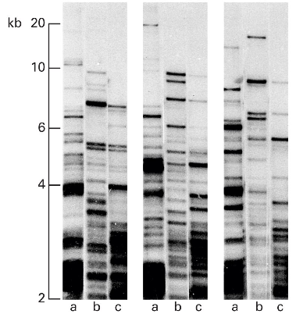
Gel Electrophoresis: Example
Direction of DNA movement
Smaller fragments travel farther
Molecular Cell Biology, 4th edition

Slide 14
Complete Restriction Digest: Multiple Solutions
• Alternative ordering of restriction fragments:
vs

Slide 15
Partial Restriction Digest
The sample of DNA is exposed to the restriction enzyme for only a limited amount of time to prevent it from being cut at all restriction sites
Each DNA molecule is cut at most twice. Keep in mind many molecules are present
The experiment generates the set of all possible restriction fragments between every two (not necessarily consecutive) sites, equally likely
The set of fragment sizes is used to determine the positions of the restriction sites in the DNA sequence

Slide 16
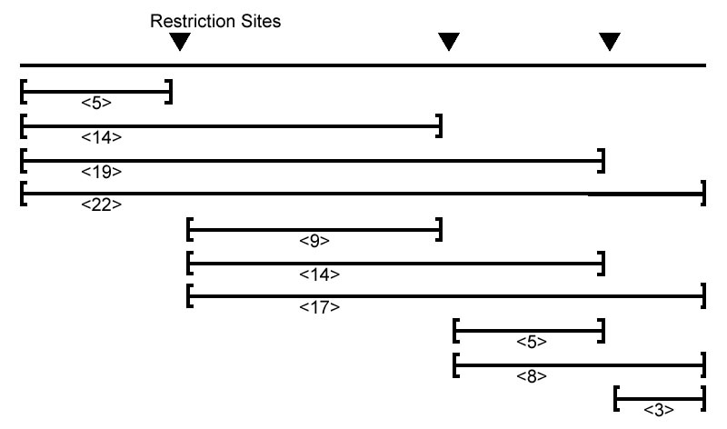
Partial Digest Example
Partial Digest results in the following 10 restriction fragments:

Slide 17
Multiset of Restriction Fragments
We assume that multiplicity of a fragment can be detected, i.e., the number of restriction fragments of the same length can be determined (e.g., by observing twice as much fluorescence intensity for double fragments than for a single fragment)
Multiset: {3, 5, 5, 8, 9, 14, 14, 17, 19, 22}

Slide 18
Partial Digest Fundamentals
X:
the set of n integers representing the location of all sites in the restriction map, including the start and end
n:
the total number of sites
DX:
the multiset of integers representing lengths of each of the C(n,2) fragments produced from a partial digest

Slide 19
One More Partial Digest Example
X | 0 | 2 | 4 | 7 | 10
0 |  | 2 | 4 | 7 | 10
2 |  |  | 2 | 5 | 8
4 |  |  |  | 3 | 6
7 |  |  |  |  | 3
10
Representation of DX = {2, 2, 3, 3, 4, 5, 6, 7, 8, 10} as a two dimensional table, with the elements of
X = {0, 2, 4, 7, 10}
along both the top and left row/column. The element at (i, j) in the table denotes x_{j} – x_{i} for 1 ≤ i < j ≤ n.

Slide 20
Partial Digest Problem: Formulation
Goal: Given all pairwise distance between points on a line, reconstruct the positions of those points
Input: The multiset of pairwise distance L, containing n(n-1)/2 integers
Output: A set X, of n integers, such that
DX = L

Slide 21
Partial Digest: Multiple Solutions
It is not always possible to uniquely reconstruct a set X based only on DX.
For example, the set
X = {0, 2, 5}
and
(X + 10) = {10, 12, 15}
both produce DX={2, 3, 5} as their partial digest set.
The sets {0,1,2,5,7,9,12} and {0,1,5,7,8,10,12} present a less trivial example of non-uniqueness. They both digest into:
{1, 1, 2, 2, 2, 3, 3, 4, 4, 5, 5, 5, 6, 7, 7, 7, 8, 9, 10, 11, 12}

Slide 22
Homometric Sets
 | 0 | 1 | 2 | 5 | 7 | 9 | 12
0 |  | 1 | 2 | 5 | 7 | 9 | 12
1 |  |  | 1 | 4 | 6 | 8 | 11
2 |  |  |  | 3 | 5 | 7 | 10
5 |  |  |  |  | 2 | 4 | 7
7 |  |  |  |  |  | 2 | 5
9 |  |  |  |  |  |  | 3
12
 | 0 | 1 | 5 | 7 | 8 | 10 | 12
0 |  | 1 | 5 | 7 | 8 | 10 | 12
1 |  |  | 4 | 6 | 7 | 9 | 11
5 |  |  |  | 2 | 3 | 5 | 7
7 |  |  |  |  | 1 | 3 | 5
8 |  |  |  |  |  | 2 | 4
10 |  |  |  |  |  |  | 2
12

Slide 23
Brute Force Algorithms
Also known as exhaustive search algorithms; examine every possible variant to find a solution
Efficient in rare cases; usually impractical
Can be the basis for the design of other algorithms (e.g., branch-and-bound)

Slide 24
Partial Digest: Brute Force
Find the restriction fragment of maximum length M. M is the length of the DNA sequence.
For every possible set
X={0, x₂, … ,x_{n-1}, M}
compute the corresponding DX.
If DX is equal to the experimental partial digest L, then X is output as the correct restriction map.

Slide 25
BruteForcePDP
BruteForcePDP(L, n):
M <- maximum element in L
for every set of n – 2 integers 0 < x₂ < … x_{n-1} < M
X <- {0,x₂,…,x_{n-1},M}
Form DX from X
if DX = L
return X
output “no solution”

Slide 26
Efficiency of BruteForcePDP
BruteForcePDP takes O(M ^{n-2}) time since it must examine all possible sets of positions.

Slide 27


O-notation: an asymptotic upper bound
f(n) = O(g(n)) iff there exist two positive constant c and n₀ such that 0 f(n) cg(n) for all n n₀
cg(n)
f(n)
n₀
For example, 5n + 108 = O(n) and 2n = O(nlog n).

Slide 28
How fast functions grow?
 | 30n | 92n log n | 26n² | 0.68n³ | 2^{n}
100 | 0.003 sec. | 0.003 sec. | 0.26 sec. | 0.68 sec. | 4 x 10¹⁶ yr.
100,000 | 3.0 sec. | 2.6 min. | 3.0 days | 22 yr.
function
n
(Assume one million operations per second.)
For very large data sets, algorithms with a complexity greater than O(n log n) are often impractical!

Slide 29
Efficiency of BruteForcePDP
BruteForcePDP takes O(M ^{n-2}) time since it must examine all possible sets of positions.
One way to improve the algorithm is to limit the values of x_{i} to only those values that occur in L.

Slide 30
AnotherBruteForcePDP
AnotherBruteForcePDP(L, n)
M <- maximum element in L
for every set of n – 2 integers 0 < x₂ < … x_{n-1} < M from L
X <- { 0,x₂,…,x_{n-1},M }
Form DX from X
if DX = L
return X
output “no solution”

Slide 31
Efficiency of AnotherBruteForcePDP
It is more efficient, but still slow
If L = {2, 998, 1000} (n = 3, M = 1000), BruteForcePDP will be extremely slow, but AnotherBruteForcePDP will be quite fast
Fewer sets are examined, but runtime is still exponential: O(n^{2n-4})

Slide 32
Branch-and-Bound Algorithm for PDP
search tree from bruteforce
partial solution
complete solution
Define D(y, X) as the multiset of all distances between new site y and all previously determined restriction sites X = {x₁, x₂, …, x_{m}}:
D(y, X) = {|y – x₁|, |y – x₂|, …, |y – x_{m}|}
Then D(y, X) should be contained in L!

Slide 33
PartialDigest Algorithm
PartialDigest(L):
width <- Maximum element in L
DELETE(width, L)
X <- {0, width}
PLACE(L, X)
X: a partial solution.

Slide 34
PartialDigest Algorithm (cont’d)
PLACE(L, X) // Resolve L with respect to X
if L is empty
output X
return
y <- maximum element in L
// Decide if the fragment involves the left or right end
if D(y, X ) is contained in L
Add y to X and remove lengths D(y, X) from L
PLACE(L,X )
Remove y from X and add lengths D(y, X) to L
if D(width-y, X ) is contained in L
Add width-y to X and remove lengths D(width-y, X) from L
PLACE(L,X )
Remove width-y from X and add lengths D(width-y, X ) to L
return

Slide 35
An Example
L = { 2, 2, 3, 3, 4, 5, 6, 7, 8, 10 }
X = { 0 }

Slide 36
An Example
L = { 2, 2, 3, 3, 4, 5, 6, 7, 8, 10 }
X = { 0 }
Remove 10 from L and insert it into X. We know this must be
the length of the DNA sequence because it is the largest
fragment.

Slide 37
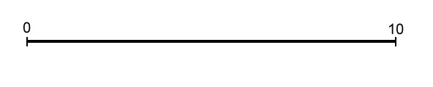
An Example
L = { 2, 2, 3, 3, 4, 5, 6, 7, 8, 10 }
X = { 0, 10 }

Slide 38
An Example
L = { 2, 2, 3, 3, 4, 5, 6, 7, 8, 10 }
X = { 0, 10 }
Take 8 from L and make y = 2 or 8. But since the two cases are symmetric, we can assume y = 2.

Slide 39
An Example
L = { 2, 2, 3, 3, 4, 5, 6, 7, 8, 10 }
X = { 0, 10 }
We find that the distances from y=2 to other elements in X are D(y, X) = {8, 2}, so we remove {8, 2} from L and add 2 to X.

Slide 40
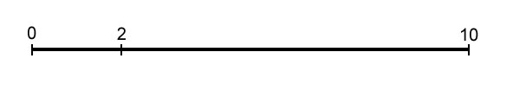
An Example
L = { 2, 2, 3, 3, 4, 5, 6, 7, 8, 10 }
X = { 0, 2, 10 }

Slide 41
An Example
L = { 2, 2, 3, 3, 4, 5, 6, 7, 8, 10 }
X = { 0, 2, 10 }
Take 7 from L and make y = 7 or y = 10 – 7 = 3. We will
explore y = 7 first, so D(y, X ) = {7, 5, 3}.

Slide 42
An Example
L = { 2, 2, 3, 3, 4, 5, 6, 7, 8, 10 }
X = { 0, 2, 10 }
For y = 7, D(y, X ) = {7, 5, 3}. Therefore we
remove {7, 5 ,3} from L and add 7 to X.
D(y, X) = {7, 5, 3} = {|7 – 0|, |7 – 2|, |7 – 10|}.

Slide 43
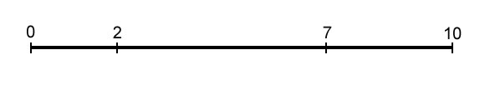
An Example
L = { 2, 2, 3, 3, 4, 5, 6, 7, 8, 10 }
X = { 0, 2, 7, 10 }

Slide 44
An Example
L = { 2, 2, 3, 3, 4, 5, 6, 7, 8, 10 }
X = { 0, 2, 7, 10 }
Take 6 from L and make y = 6. Unfortunately
D(y, X) = {6, 4, 1 ,4}, which is not a subset of L. Therefore we won’t explore this branch.
6

Slide 45
An Example
L = { 2, 2, 3, 3, 4, 5, 6, 7, 8, 10 }
X = { 0, 2, 7, 10 }
This time make y = 4. D(y, X) = {4, 2, 3 ,6}, which is a
subset of L so we will explore this branch. We remove
{4, 2, 3 ,6} from L and add 4 to X.

Slide 46
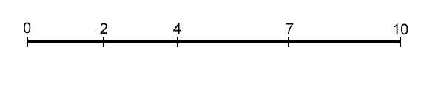
An Example
L = { 2, 2, 3, 3, 4, 5, 6, 7, 8, 10 }
X = { 0, 2, 4, 7, 10 }

Slide 47
An Example
L = { 2, 2, 3, 3, 4, 5, 6, 7, 8, 10 }
X = { 0, 2, 4, 7, 10 }
L is now empty, so we have a solution, which is X.

Slide 48
An Example
L = { 2, 2, 3, 3, 4, 5, 6, 7, 8, 10 }
X = { 0, 2, 7, 10 }
To find other solutions, we backtrack.

Slide 49
An Example
L = { 2, 2, 3, 3, 4, 5, 6, 7, 8, 10 }
X = { 0, 2, 10 }
More backtrack.

Slide 50
An Example
L = { 2, 2, 3, 3, 4, 5, 6, 7, 8, 10 }
X = { 0, 2, 10 }
This time we will explore y = 3. D(y, X) = {3, 1, 7}, which is
not a subset of L, so we won’t explore this branch.

Slide 51
An Example
L = { 2, 2, 3, 3, 4, 5, 6, 7, 8, 10 }
X = { 0, 10 }
We backtracked to the root (actually, a symmetric solution y = 8). Therefore, we have found all the solutions.

Slide 52
Analyzing PartialDigest Algorithm
Still exponential in the worst case, but is very fast on average.
Informally, let T(n) be the time PartialDigest takes to place n cuts.
  No branching case: T(n) < T(n-1) + O(n)
    Quadratic
  Branching case: T(n) < 2T(n-1) + O(n)
    Exponential (i.e., O(n2^{n})), but much better than pure BruteForce.

Slide 53
Double Digest Mapping
Double Digest is yet another experimental method to construct restriction maps.
  Use two restriction enzymes; three full digests:
    One with only first enzyme
    One with only second enzyme
    One with both enzymes
Computationally, the Double Digest problem is more complex than the Partial Digest problem.

Slide 54
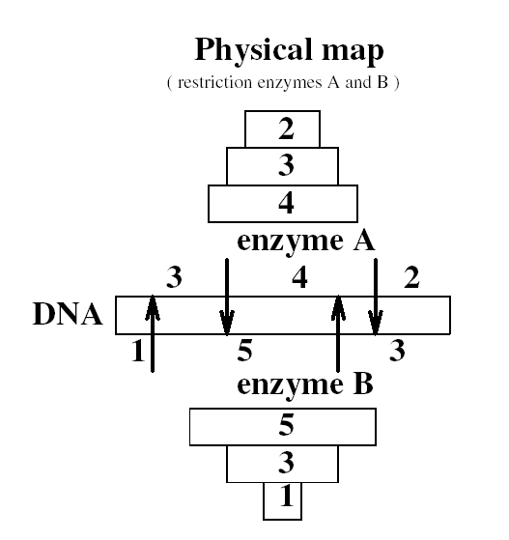
Double Digest: Example

Slide 55
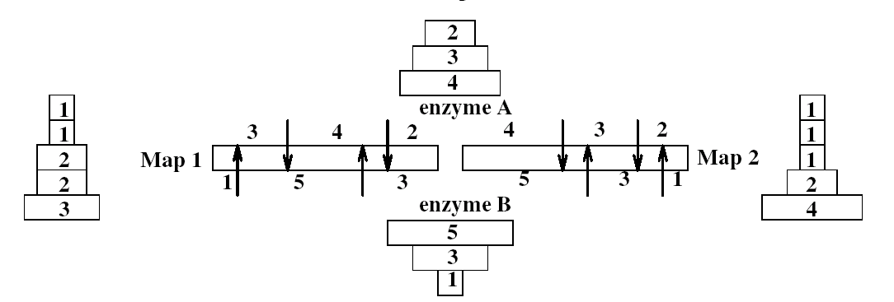
Double Digest: Example
Without the information of dX (i.e., A+B), it is impossible to (uniquely) solve the double digest problem as this diagram illustrates.

Slide 56
Double Digest Problem
Input: dA – fragment lengths from the (complete)
digest with enzyme A.
dB – fragment lengths from the digest with
enzyme B.
dX – fragment lengths from the digest with
both A and B.
Output: A – location of the cuts in the
restriction map for the enzyme A.
B – location of the cuts in the
restriction map for the enzyme B.

