Slide 1
Loan Default Prediction
Credit Risk Intelligent Assessment System
Machine Learning | Random Forest | CIBIL Credit Scoring

Slide 2
Background & Problem Statement
⚠️
📋
🎯
Business Pain Point
Current Approach
Our Goal
Loan defaults cause massive financial losses for banks and lenders each year, making accurate risk prediction critical.
Traditional banks rely on simple threshold rules (e.g. CIBIL Score ≥ 550), which miss complex multi-factor risk patterns.
Build a machine learning model that predicts loan defaults more accurately using all available applicant features.

Slide 3
Dataset Overview
Target:
Loan Approved / Rejected
Class Split:
62% Approved | 38% Rejected
Key Feature:
CIBIL Score (near-perfect predictor)
Domain:
Consumer Credit / Credit Information Bureau Limited (CIBIL)
Class Distribution

Slide 4
Baseline Models
Baseline 1 — DummyClassifier
Baseline 2 — CIBIL Rule (≥ 550)
Strategy: Always predicts "Approved" (majority class) Precision: 0.62 | Recall: 1.00 F1 Score: 0.7671 Insight: Zero intelligence — but already 77% F1. This is the floor any useful model must beat.
Strategy: Single threshold business rule Accuracy: 0.9536 | F1: 0.9615 Insight: One rule reaches 96% F1 — because CIBIL score is a near-perfect predictor in this dataset. ML must beat this to add value.
→

Slide 5
Why Machine Learning Over Rules?
Comparison | CIBIL Rule | ML Model
Decision Basis | Single score threshold | All features combined
Flexibility | Fixed — manual changes needed | Learns from data automatically
Complex Patterns | Cannot capture | Captures non-linear interactions
Scalability | Hard to extend | Retrain with new data easily
F1 Score | 0.9615 | 0.9970 ✅
Rules reach 96% — ML squeezes out the remaining 3.5%, preventing real financial losses at scale.

Slide 6
Feature Engineering — What Changed from Raw Data?
Original data — 13 columns
New features created — 4
loan_id
REMOVED
➕ total_assets
no_of_dependents
KEPT
residential + commercial + luxury + bank_asset_value
education
ENCODED → education_Graduate
Combines 4 asset columns into one cleaner signal
self_employed
ENCODED → self_employed_Yes
income_annum
KEPT
➕ loan_to_income_ratio
loan_amount
KEPT
loan_amount ÷ income_annum
How large is the loan relative to earnings?
loan_term
KEPT
cibil_score
KEPT (raw value)
➕ payment_to_income
residential_assets_value
MERGED ↓
(loan_amount ÷ loan_term) ÷ income_annum
commercial_assets_value
MERGED ↓
Monthly repayment burden vs income — #2 most important feature
luxury_assets_value
MERGED ↓
➕ income_per_dependent
bank_asset_value
MERGED ↓
loan_status
TARGET variable
income_annum ÷ (no_of_dependents + 1)
Effective disposable income per person in household
13 raw columns → Delete 1 · Encode 2 · Merge 4 into 1 · Add 4 new = 11 final features into the model

Slide 7
Model Comparison (Cross-Validation F1)
CIBIL Baseline = 0.9615 | ✅ Random Forest & Gradient Boosting beat the baseline

Slide 8
Why Not Use Accuracy as the Main Metric?
The Accuracy Trap
Better Metrics for Imbalanced Data
Imagine a dataset where:
• 95% of loans are Approved
• 5% of loans are Rejected (defaulters)
Recall (Sensitivity) | TP / (TP + FN)
Catches all real defaulters — critical in finance. Missing one is costly.
Precision | TP / (TP + FP)
A model that ALWAYS says "Approved":
Of those flagged as default, how many truly are? Avoids over-rejection.
Accuracy = 95% ✅ (looks great!)
But it misses 100% of defaulters.
Recall = 0% → Every bad loan gets approved.
F1 Score | 2 × (Precision × Recall) / (Precision + Recall)
Balances both. Best single metric for imbalanced classification.
High accuracy ≠ Good model when data is imbalanced
ROC-AUC | Area under the ROC curve
Measures overall discrimination power regardless of threshold.
This project uses F1 + ROC-AUC as primary metrics — not accuracy — because 62/38 class split demands it.

Slide 9
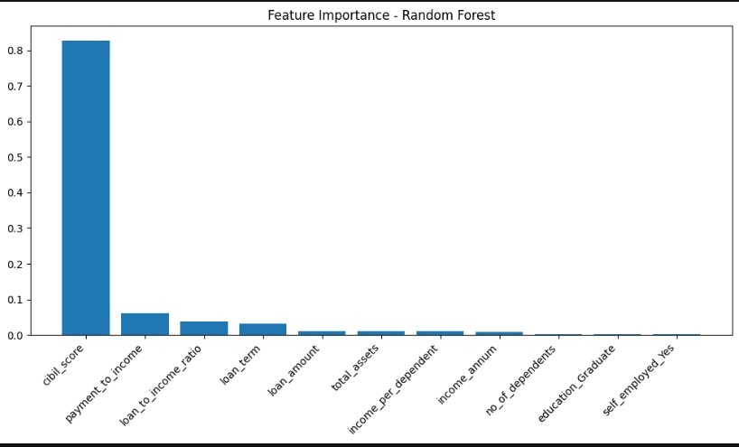
Feature Importance — What Drives the Model?
Key Takeaways
#1 cibil_score
83% importance
Near-single-handed predictor
#2 payment_to_income
6% importance
Repayment capacity signal
#3 loan_to_income_ratio
4% importance
Debt burden relative to income
CIBIL dominates — confirming why a single rule baseline was already 96% accurate.

Slide 10
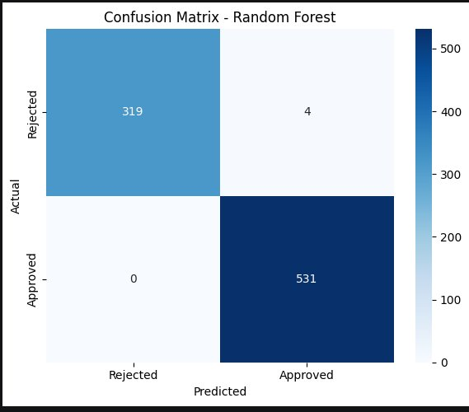
Confusion Matrix — Which Error Matters More?
Two Types of Error
❌ False Positive (FP) = 4
Actual: Rejected → Predicted: Approved
Bank approves a loan that WILL default → Direct financial loss (bad debt)
⚠️ False Negative (FN) = 0
Actual: Approved → Predicted: Rejected
Bank rejects a creditworthy customer → Lost revenue, customer dissatisfied
Verdict: FP is more severe — approving a defaulter costs real money. Our model achieves FP=4, FN=0. ✅

Slide 11
Final Model: Random Forest — Test Set Results
99.53%
99.25%
100%
Accuracy
Precision
Recall
Overall correct predictions
Low false approval rate
Zero missed defaults
99.62%
99.96%
F1 Score
ROC-AUC
Balanced precision & recall
Near-perfect class discrimination

Slide 12
Conclusion & Recommendations
✅
Random Forest achieves F1=0.9962 on the test set, surpassing both baselines with zero missed defaults (Recall=100%).
Key metrics:
Best CV F1 (tuned): 0.9970
Test F1: 0.9962
Test ROC-AUC: 0.9996
Optimal threshold: 0.60 | Improvement over CIBIL rule: +3.47%
Model Performance:
Replacing the CIBIL threshold rule with this model captures an additional ~3.5% of edge cases, directly reducing loan loss exposure.
🏦
Business Value:
Deploy as a scoring API, monitor for distribution drift, and schedule periodic retraining as new loan data accumulates.
🔄
Next Steps:

