Slide 1
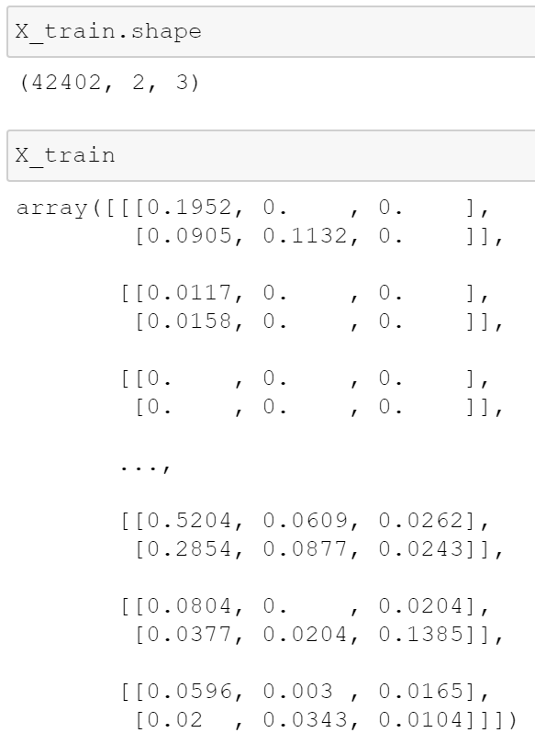
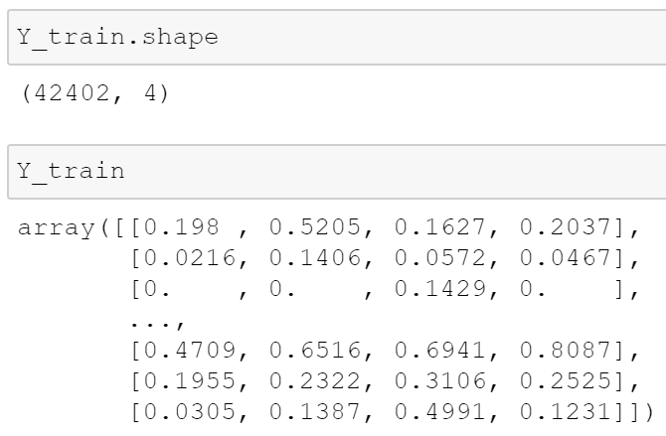
1213 | item1213 | 0.2447 | 0.1952 | 0 | 0
1214 | item1213 | 0.198 | 0.0905 | 0.1132 | 0
…… | …… | …… | …… | …… | ……
1258 | item1213 | 0.174 | 0.1386 | 0.0156 | 0
1259 | item1213 | 0.1174 | 0.1174 | 0 | 0
47
item
item
item
item
1218 | item1217 | 0 | 0 | 0 | 0
1219 | item1217 | 0 | 0 | 0 | 0
…… | …… | …… | …… | …… | ……
1258 | item1217 | 0.4534 | 0.3382 | 0.4608 | 0
1259 | item1217 | 0.7157 | 0.7157 | 0 | 0
42
item
item
item
item
item
item
………… 1146..
Item1213 p1213 p1214
3
1256 | item1232 | 0 | 0 | 0 | 0
1257 | item1232 | 0 | 0 | 0 | 0
1258 | item1232 | 1 | 1 | 0 | 0
Item1214 p1213 p1214
Item1215 p1213 p1214
Item2356 p1249 p1250
Item2357 p1249 p1250
Item2358 p1249 p1250

Slide 2
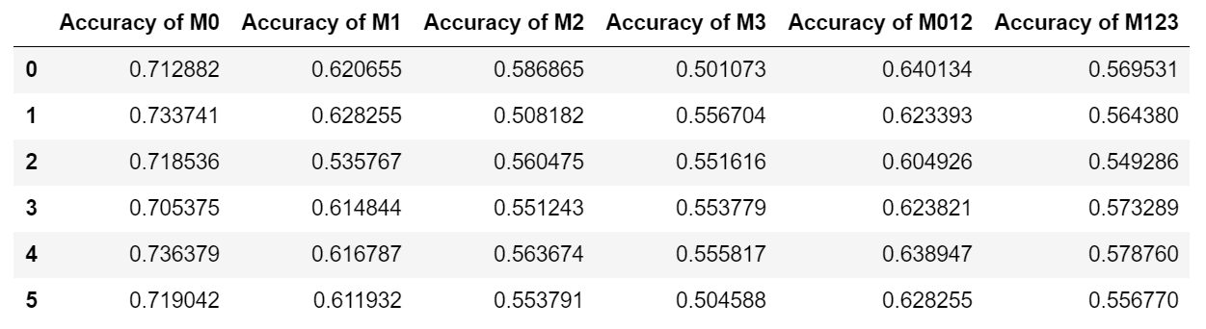
Results
keras.layers.LSTM(75, return_sequences=True, input_shape=(X_train.shape[1], X_train.shape[2])),
keras.layers.LSTM(units=30, return_sequences=True),
keras.layers.LSTM(units=30),
keras.layers.Dense(units=4)

