Slide 1
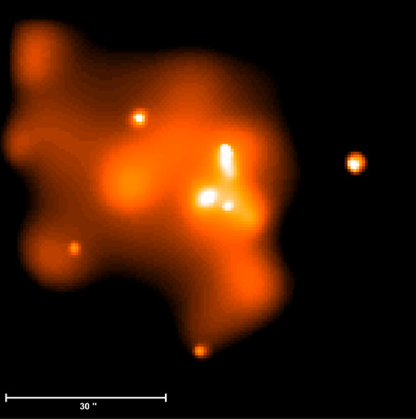
Global Compton heating/cooling in hot accretion flows
Feng Yuan
with:
F. G. Xie (谢富国；Shanghai Astronomical Observatory)
J. P. Ostriker (Princeton University)

Slide 2
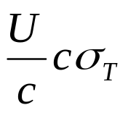
Two effects of Compton scattering in accretion flows
Consider collision between photons and electrons in hot accretion flow, two effects:
Momentum
  Radiation force:
  Balance with grav. force → Eddington luminosity
Energy
  For photons: Compton up-scattering or Comptonization, which is the mechanism of producing X-ray emission in BH systems
  For electrons: they can obtain or loss energy due to the scattering with photons (e.g., Compton radiative cooling)

Slide 3

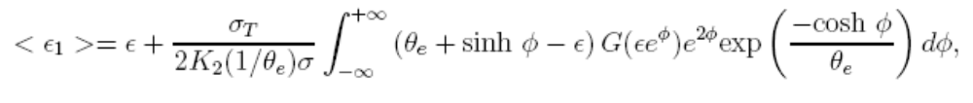

We will focus on electrons and “non-local” scattering
(because hot accretion flow is optically thin in radial direction)
ADAF
Assume the electrons have T_{e} and the photon energy is Є, after each
scattering on average the electron will obtain energy:
Thompson limit:

Slide 4
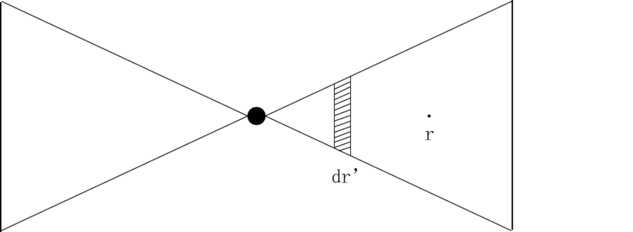
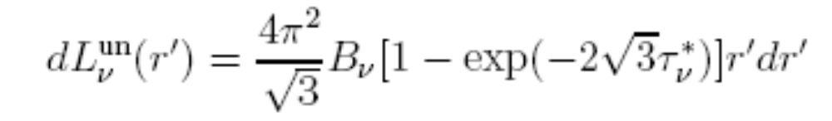
The spectrum received at radius r
It is difficult to directly calculate
the radiative transfer when scattering is important.
So we use two-stream approximation,
calculate the vertical radiative
transfer in a zone around r’.
The spectrum before Comptonization is:
The spectrum after Comptonization is calculated based on
Coppi & Blandford (1990)

Slide 5

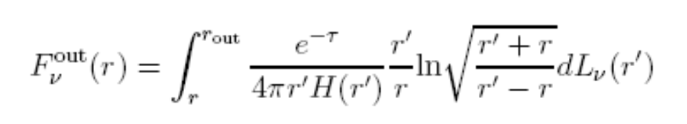
The spectrum received at radius r
When calculating the radiative
transfer from dr’ to r, we neglect
for simplicity the scattering.
Then from the region inside of r:
From the region outside of r:

Slide 6

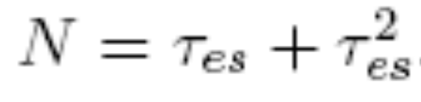
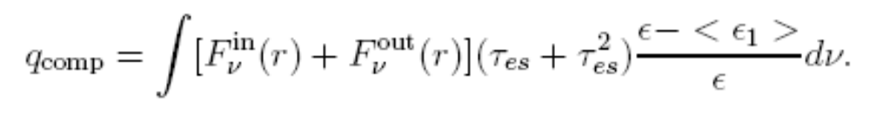
The Compton heating/cooling rate
The number of scattering at
radius r with unit length and
optical depth is :
So the heating/cooling rate (per unit volume of the accretion flow) at radius r is:
unit length in r

Slide 7
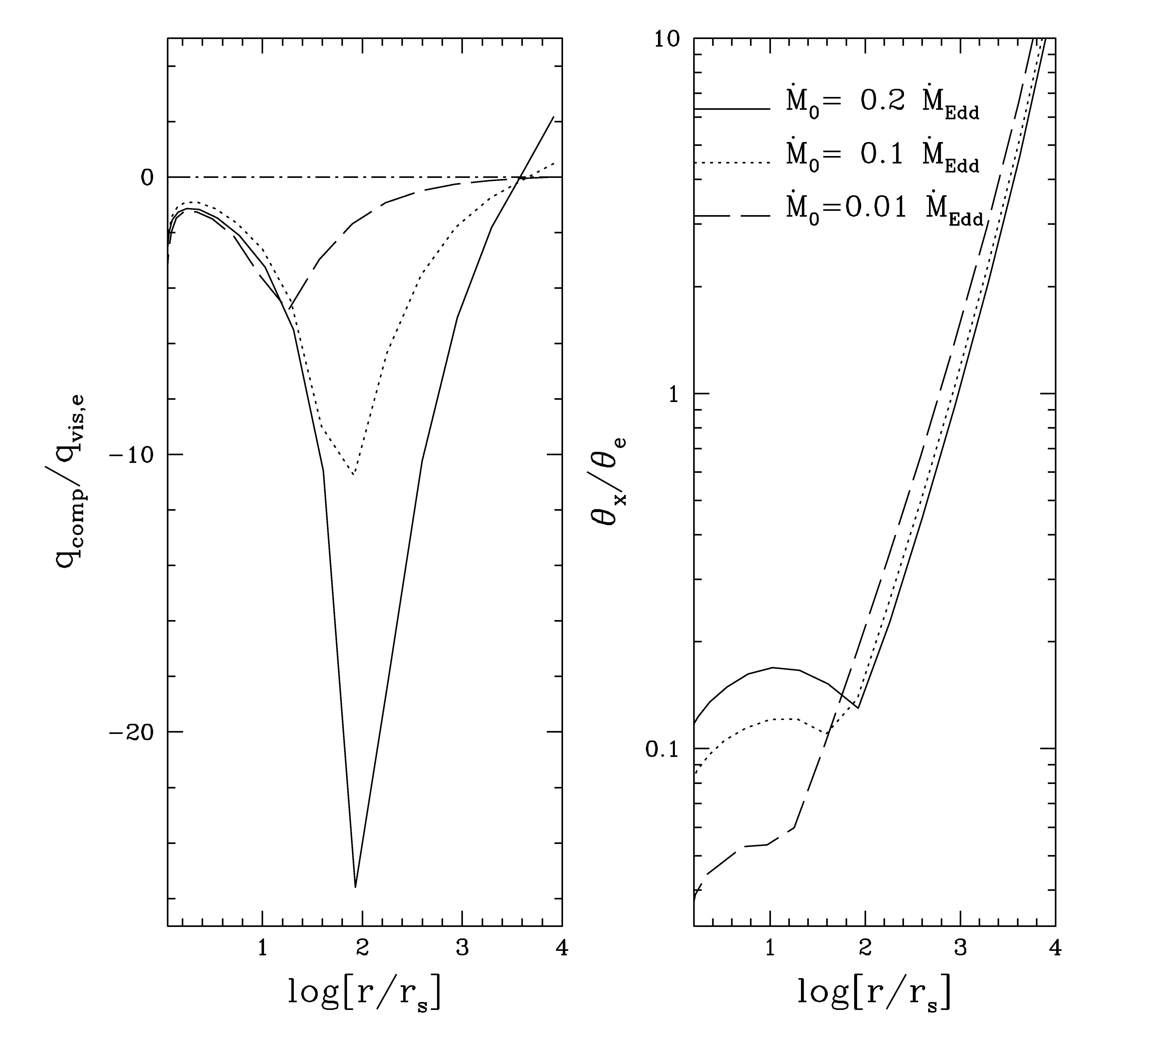
When Compton heating/cooling is important?
We compare Compton heating/cooling
with viscous heating (why?)
Result: Cooling is important when dotM>0.01
Heating is important when dotM>0.2 (function of r!)

Slide 8
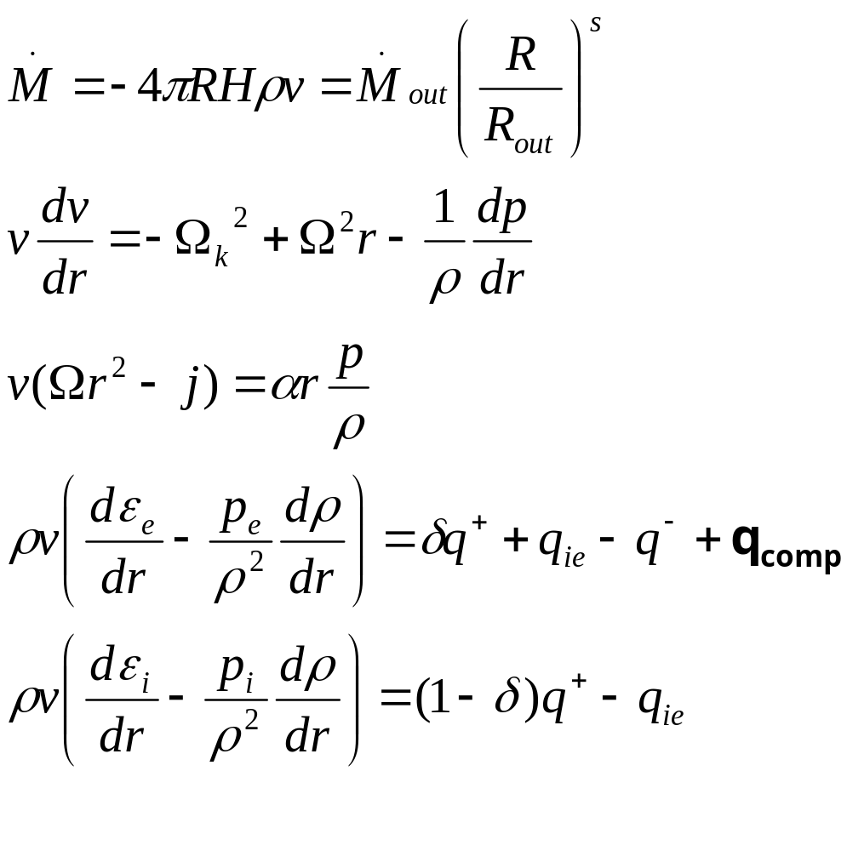
Getting the self-consistent solutions
δ~0.5 (from the modeling to Sgr A*)
The new Compton heating/cooling term

Slide 9

Get the self-consistent solutions using the iteration method
procedure:
  guess the value of Compton heating/cooling at each radius,
  solve the global solution,
  compare the obtained Compton heating/cooling with the guessed value to see whether they are identical.
  If not, use the new value of Compton heating and get the new solution until they are identical.

Slide 10
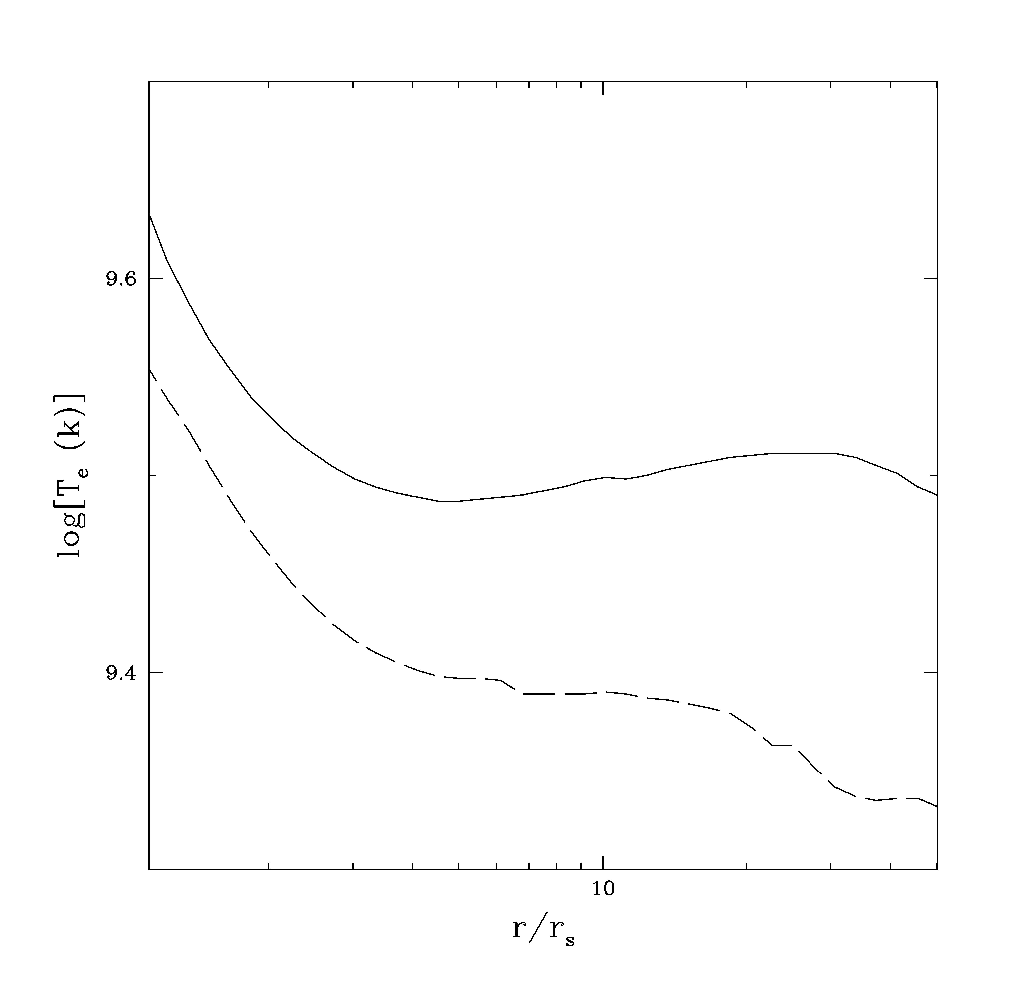
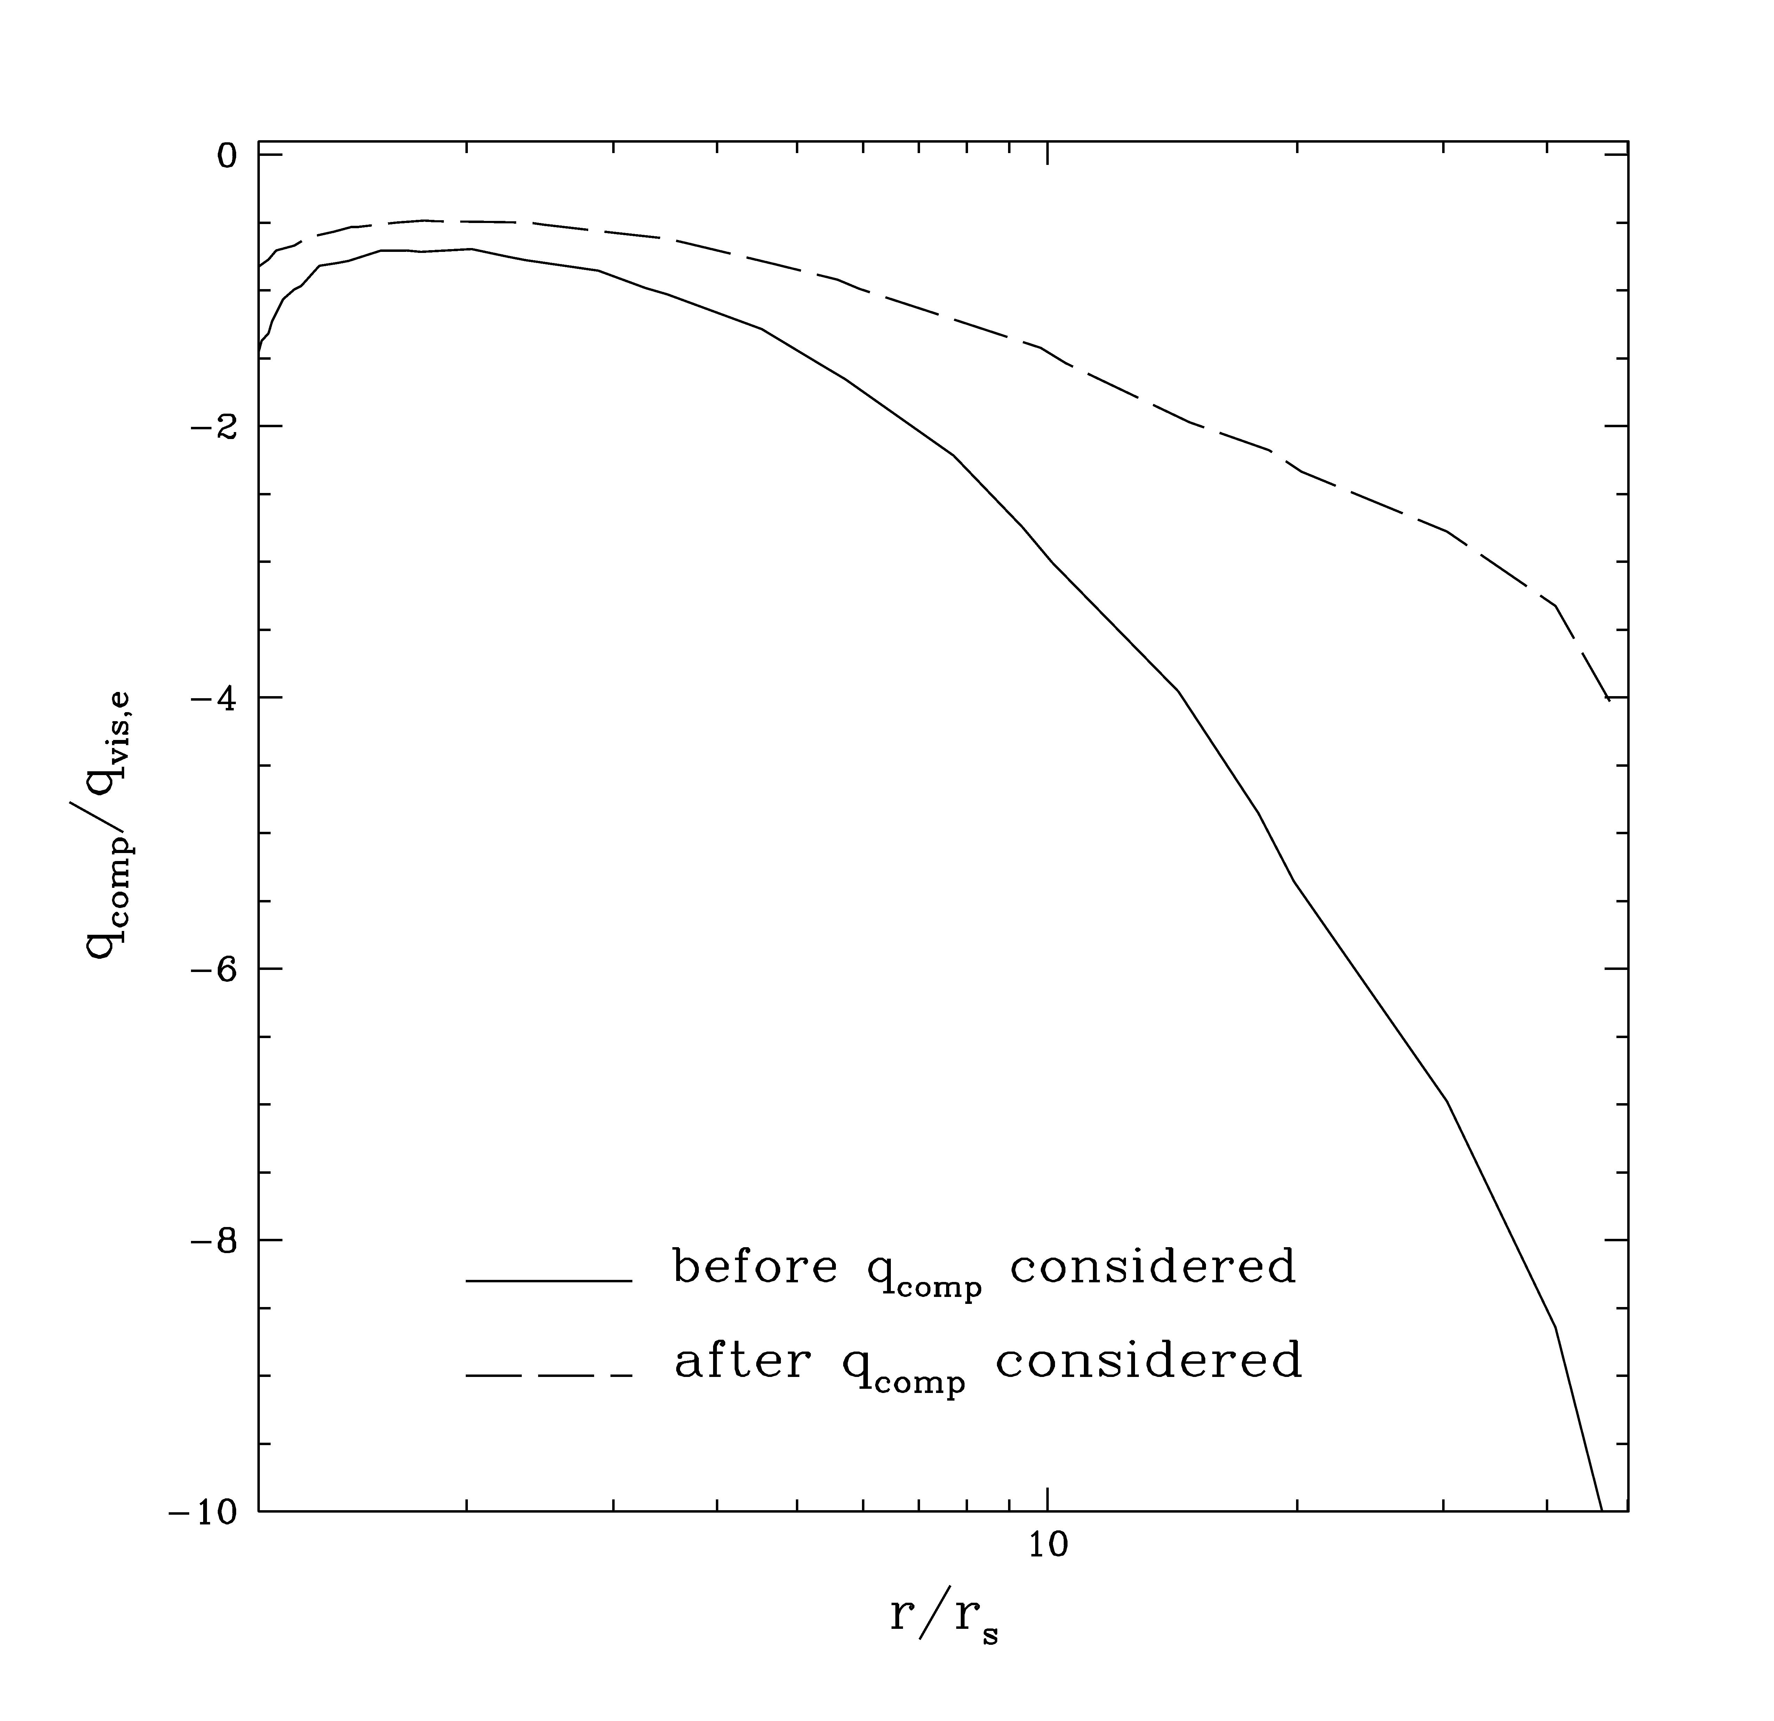
The self-consistent solutions (I): dynamics
Self-consistent solution
Electron temperature
Compton heating/cooling rate

Slide 11
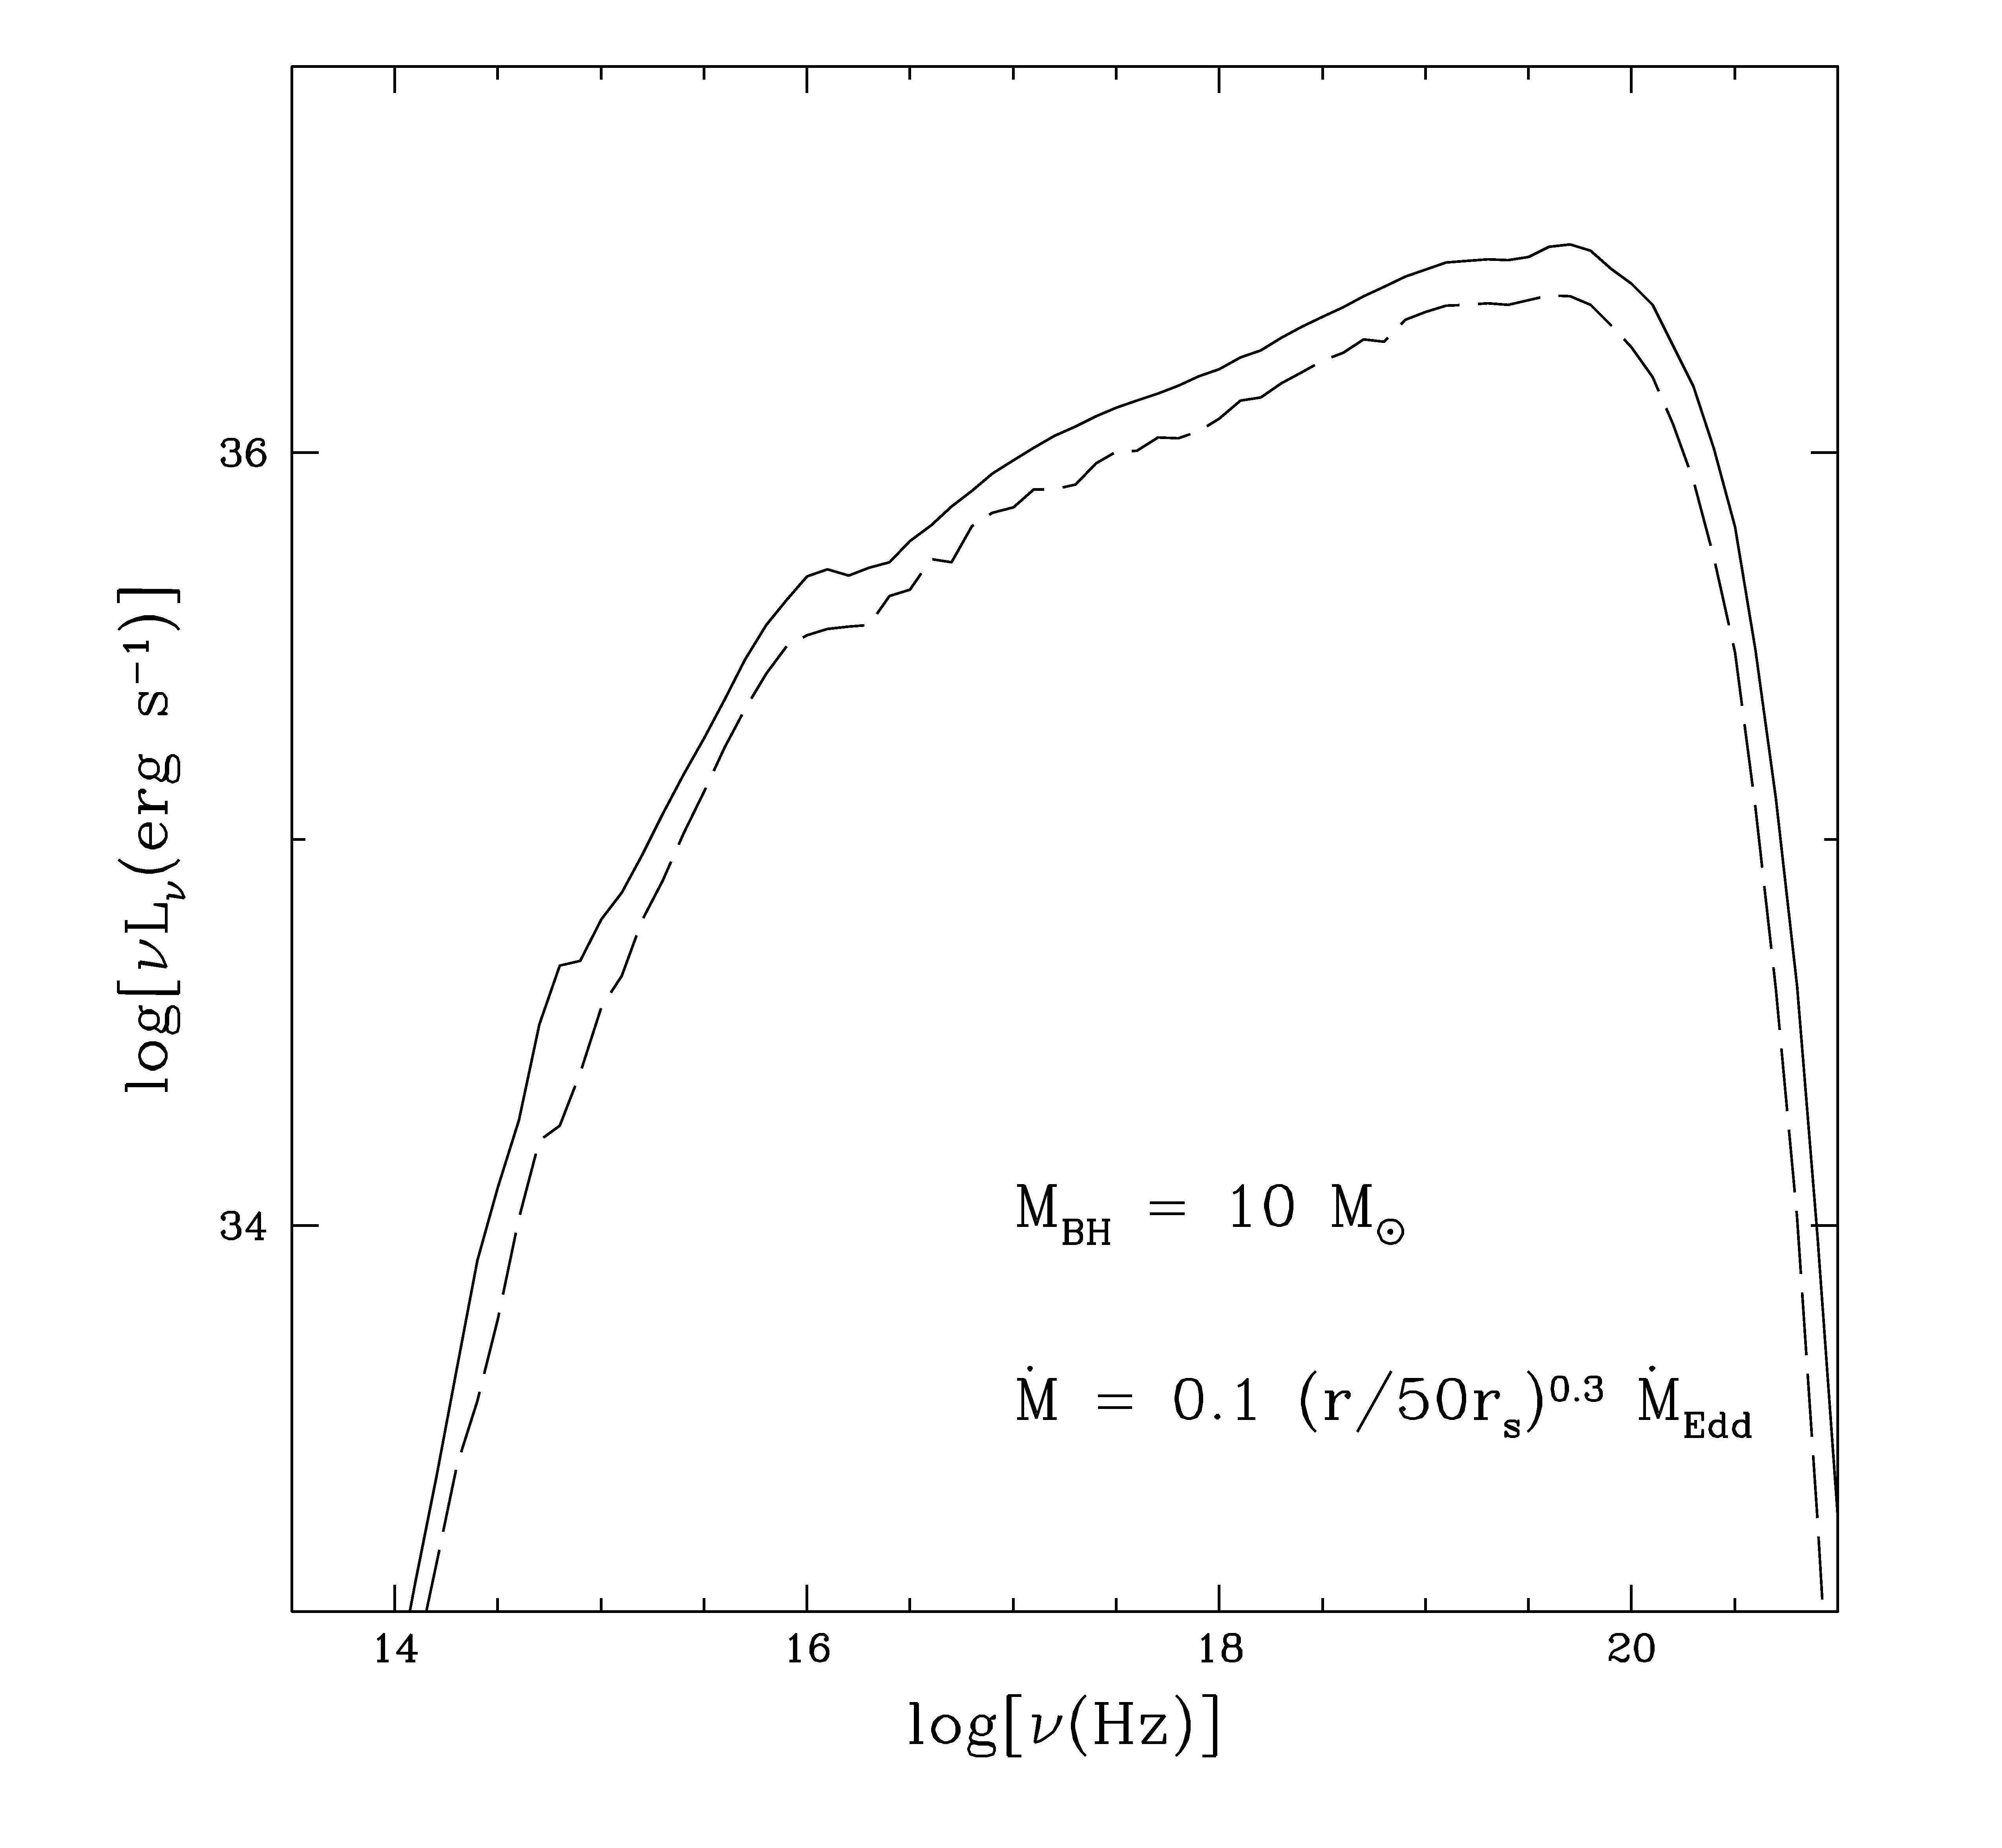
The self-consistent solutions (II): spectrum
For a given dotM, L should be larger, but E_{cutoff} smaller

Slide 12
Consequence of strong Compton heating at large radii
Compton heating is important at large radii when accretion rate is large
As a result, no steady hot solution exists when Mdot is large
This will result in “oscillation” of the activity of BH:
  strong Compton heating → drive the gas outside of a certain
  radius out and only matter within this radius accreted → all matter
  is used up → the central luminosity stops → inflow resumes on
  a cooling timescale → the cycle repeats.

Slide 13
Two-dimensional case
The above conclusion holds for 1-D
For a 2-D accretion flow, when Mdot is high, scattering is important. Then, much of the luminosity will "leak out" perpendicular to the disc
In this case
  we may obtain steady solution up to a higher luminosity
  Strong outflow will be driven (force & energy) in the vertical direction
  These outflow may be fragmented due to thermal instability → explain the origin of BLR in AGNs?
  radiation-hydrodynamic simulation is required to check

