Slide 1
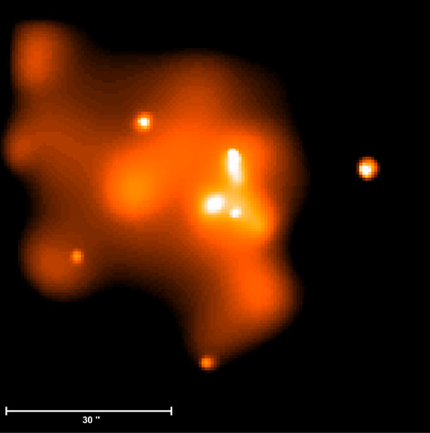
Accretion onto the Supermassive Black Hole in our Galactic Center
Feng Yuan
Shanghai Astronomical Observatory

Slide 2
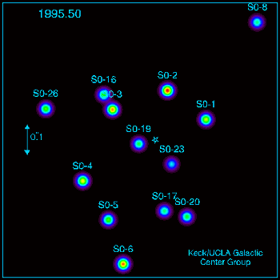
Why focus on the Galactic Center?
Best evidence for a BH (stellar orbits)
  M ≈ 4x10⁶ M
Largest BH on the sky (horizon ≈ 8 μ")
  VLBI imaging of horizon
X-ray & IR variability probes gas at ~ R_{s}
Accretion physics at extreme low
luminosity (L ~ 10⁻⁹ L_{EDD})
Most detailed constraints on ambient conditions around BH
  Feeding the “monster”
  Stellar dynamics & star formation in Galactic Nuclei
Useful laboratory for other BH systems

Slide 3
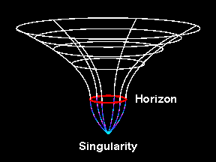
Outline
??
??
How does the gas get from the
surrounding medium to the BH?
What determines the accretion
rate, radiative efficiency, and
observed emission from the BH?

Slide 4
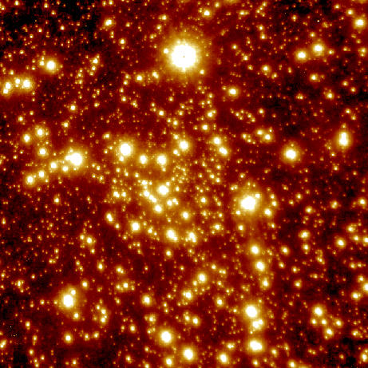
Fuel Supply
IR (VLT) image of central ~ pc
Chandra image of central ~ 3 pc
Genzel et al.
Baganoff et al.
Young cluster of massive stars in the central ~ pc loses ~ 10⁻³ M yr⁻¹ ( ≈ 2-10" from BH)
Hot x-ray emitting gas
(T = 1-2 keV; n = 100 cm⁻³)
produced via shocked
stellar winds

Slide 5




Mass Accretion Rate onto the BH
BHs ‘sphere of influence’
Bondi
Accretion
Radius
Black hole
observed
ρ & T ⇒

Slide 6
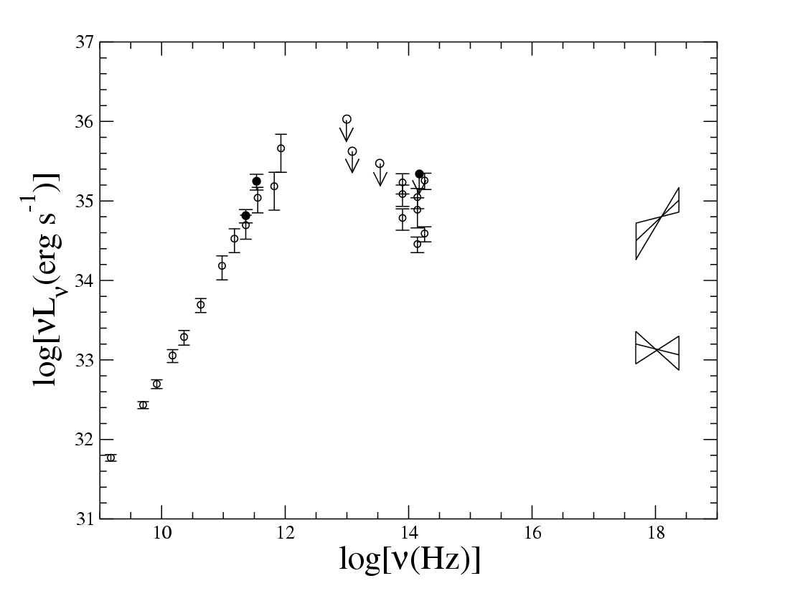
Observational Results for Sgr A* (I): Spectrum
flat radio spectrum
submm-bump
two X-ray states
  quiescent: photon indx=2.2
  the source is resolved
  flare: phton index=1.3
Total Luminosity ~ 10³⁶ ergs s-1
~ 100 L ~ 10⁻⁹ L_{EDD} ~ 10⁻⁶ M c²
Flare
VLA
BIMA
SMA
Keck
VLT
Quiescence

Slide 7
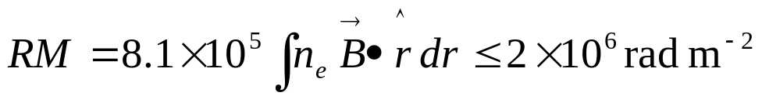
Observational Results for Sgr A* (II): Variability & Polarization
1.X-ray flare: timescale: ~hour timescale (duration) ~10 min (shortest)
→10Rs;
amplitude: can be ~45
2.IR flare: timescale: ~30-85 min (duration); ~5 min (shortest)
→similar to X-ray flares;
amplitude: 1-5, much smaller than X-ray
3. Polarization:
at cm wavelength: no LP but strong CP;
at submm-bump: high LP(7.2% at 230 GHz; <2% at 112
GHz) → a strict constraint to density & B field:
RM (Faraday rotation measure) can not be too large:

Slide 8

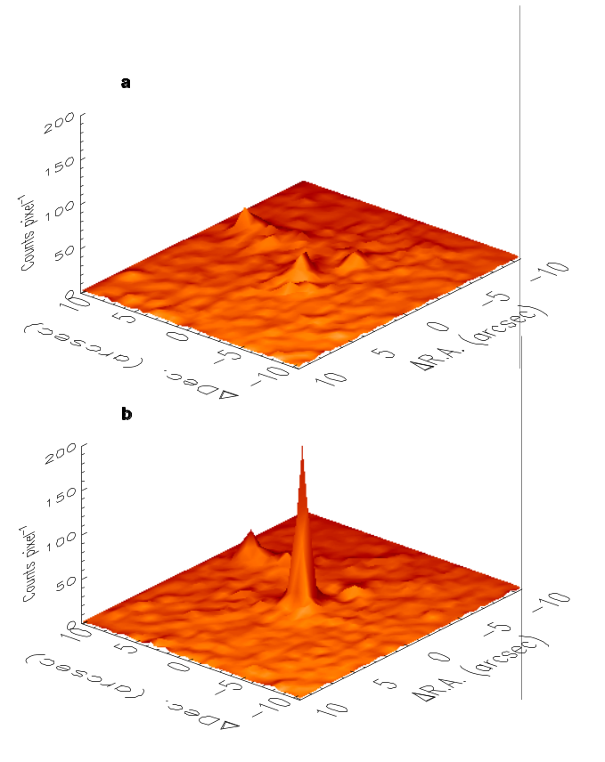
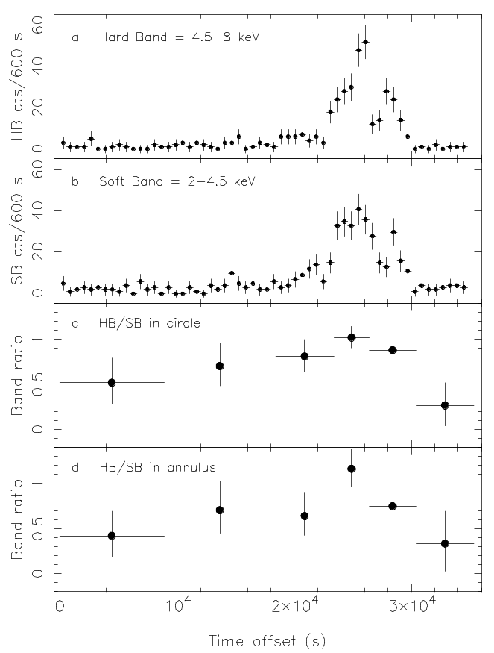
X-ray Flares

Slide 9
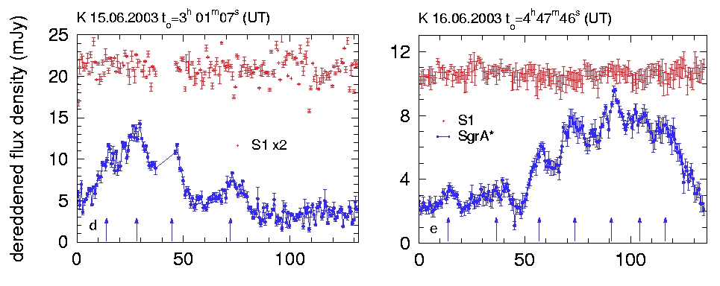
Variable IR Emission
Time (min)
Genzel et al. 2003
Light crossing time of Horizon: 0.5 min
Orbital period at 3R_{S} (last stable orbit for a = 0): 28 min

Slide 10
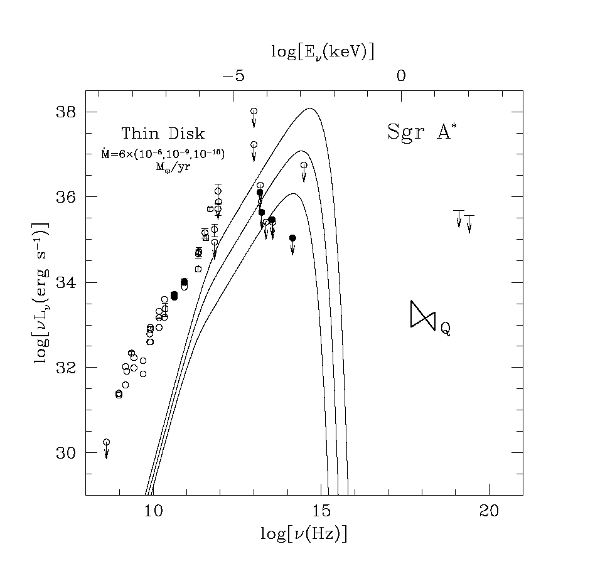

The Standard Thin Disk Ruled Out
inferred low efficiency
where is the expected
blackbody emission?
observed gas on ~ 1” scales
is primarily hot & spherical,
not disk-like
absence of stellar eclipses
argues against τ >> 1 disk
(Cuadra et al. 2003)

Slide 11
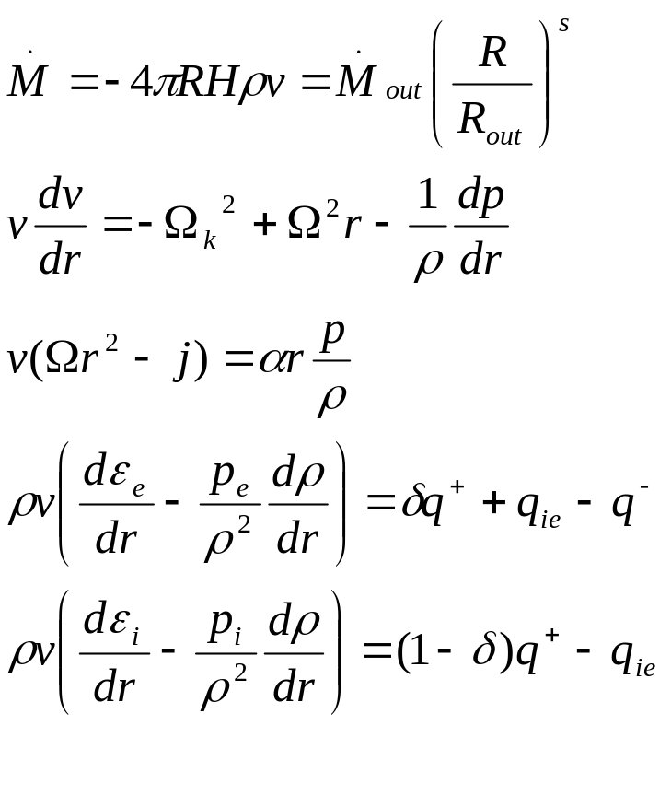
Radiation-hydrodynamics Equations for ADAF(&RIAF)
Mass accretion rate:
The radial and azimuthal
Components of the momentum
Equations:
The electron energy equation:
The ions energy equation:
“old” ADAF: s=0; δ<<1
“new” ADAF (RIAF): s>0; δ≤1

Slide 12
“Old” ADAF Model for Sgr A*
Narayan et al., 1995;1998
The “old” ADAF (e.g., Ichimaru 1977; Rees et al. 1982; Narayan & Yi 1994;1995; Abramowicz et al. 1995…)
  ADAF: most of the viscously dissipated energy is stored in the thermal energy and advected into the hole rather than radiated away.
  T_{p}=10¹²K;T_{e}=10⁹—10¹⁰K; →geometrically thick
  Accretion rate = const.
  Efficiency<<0.1, because electron heating is inefficient
Success of this ADAF model:
  low luminosity of Sgr A*;
  rough fitting of SED;
Problems of this ADAF model:
  predicted LP is too low because RM is too large;
  predicted radio flux is too low.

Slide 13
“Old” ADAF Model for Sgr A*
Narayan et al., 1995, Nature;1998, ApJ
What is ADAF? (e.g., Ichimaru 1977; Rees et al. 1982; Narayan & Yi 1994;1995)
  a hot, optically thin, geometrically thick, advection-dominated accretion flow: assuming the only heating mechanism to electrons is Coulomb collision, viscous energy heats ions only, when the accretion rate is low, most of the viscously dissipated energy is stored in the thermal energy and advected into the hole rather than radiated away.
  T_{p}=10¹²K;T_{e}=10⁹—10¹⁰K; collisionless plasma-→nonthermal?
  Accretion rate = const.
  Efficiency<<0.1, because electron heating is inefficient
Success of this ADAF model:
low luminosity of Sgr A*; rough fitting of SED;
Problems of this ADAF model:
predicted radio flux is too low; predicted LP is too low.

Slide 14
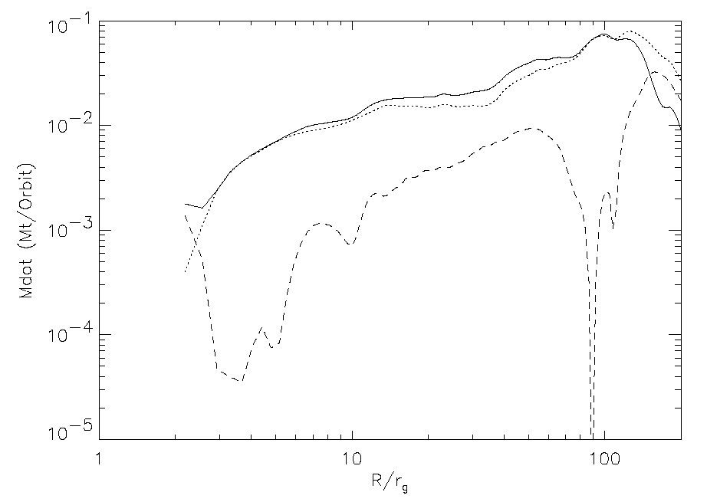

Theoretical Developments of ADAF
Outflow/convection
Very little mass supplied at large radii accretes into the black hole (outflows/convection suppress accretion)
Electron heating mechanism: direct viscous heating?
turbulent dissipation & magnetic reconnection→
Particle distribution: nonthermal?
(1) e..g., weak shocks & magnetic reconnection (2) collisionless plasma
→nonthermal?
MHD numerical simulation result:
(however, collisionless-→kinetic theory?)
(Stone & Pringle 2001; Hawley & Balbus 2002; Igumenshchev et al. 2003)

Slide 15
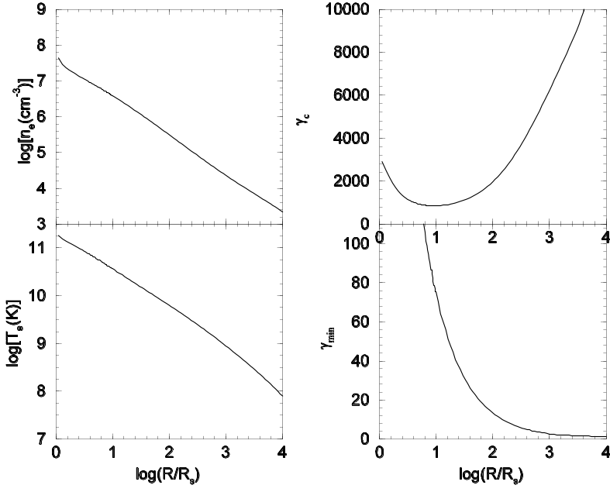
Updated ADAF Model---RIAF
Yuan, Quataert & Narayan 2003, ApJ; 2004, ApJ
Aims of the modified model:
1.does the lower density accretion
flow work?
2. is there any way to improve the
radio fitting? Or, does the inclusion
of nonthermal electrons help?
Method
1. outflow and electron heating:
2. inclusion of power-law electrons
(with p=3, parameter η)
3. calculate the dynamics and radiative
transfer (from both thermal and
power-law electrons) in RIAF

Slide 16
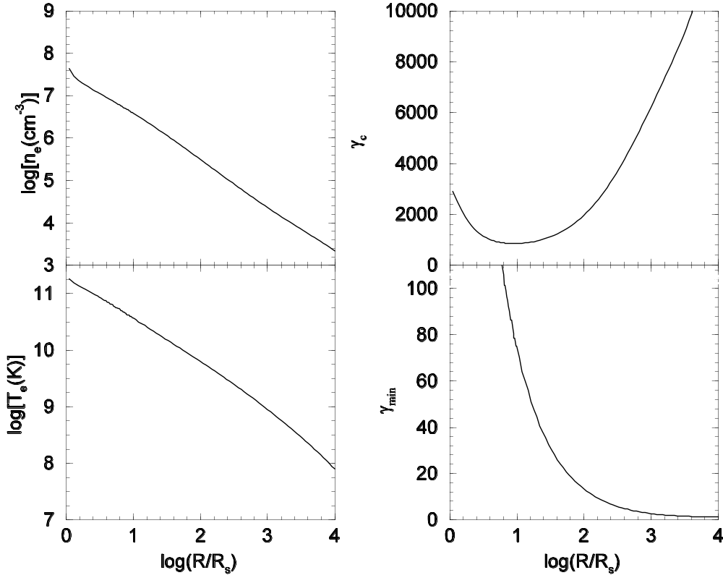
The Global Solution of Accretion Flows
Yuan, Quataert & Narayan 2003, ApJ

Slide 17
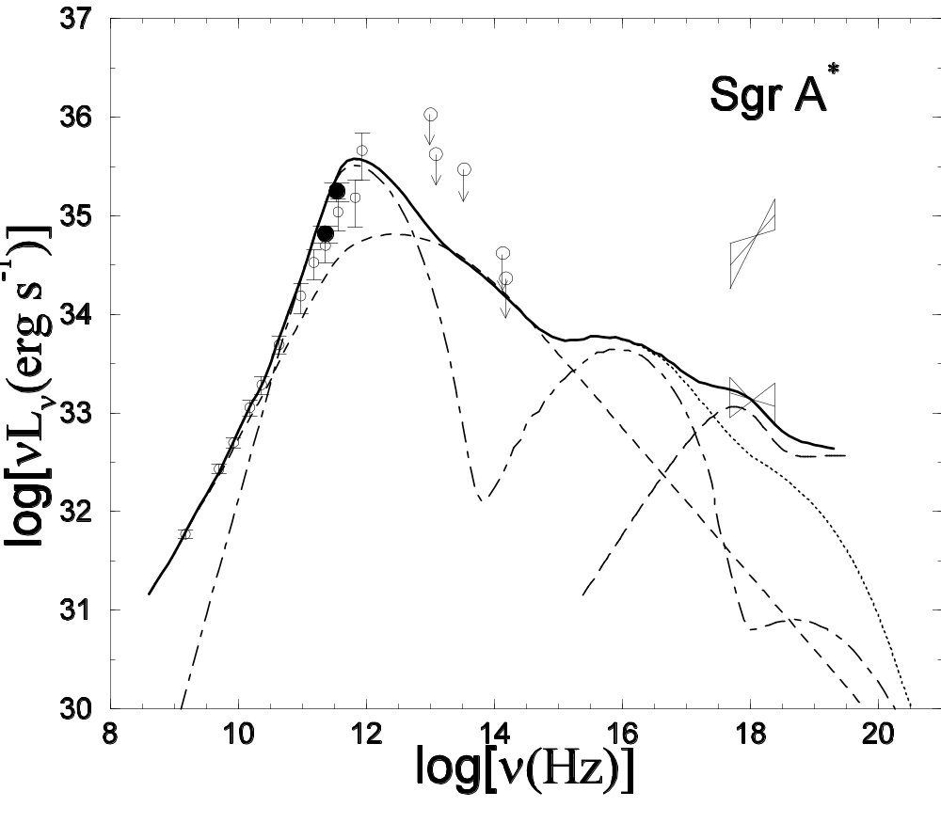
RIAF Model for the Quiescent State
total emission from both
thermal and power-law electrons
synchrotron emission from
power-law electrons
synchrotron, bremsstrahlung
and their Comptonization from
thermal electrons
bremsstrahlung from the
transition region around the
Bondi radius

Slide 18
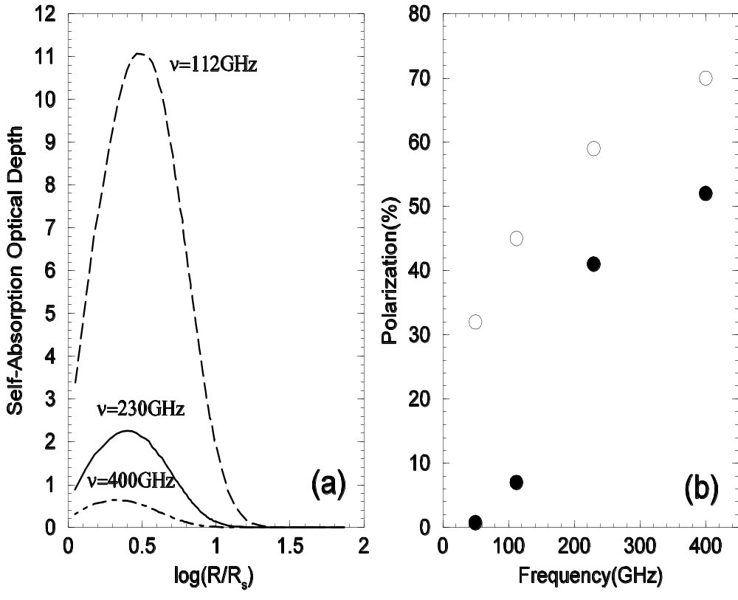
Updated ADAF Model for Sgr A*: Polarization Result for the Quiescent State

Slide 19

Summary: the efficiency of RIAF in Sgr A*
Mdot ~ 10⁻⁶ M_{sun}/yr, L ~ 10³⁶erg/s, so efficiency ~10⁻⁶
In the “old” ADAF(no outflow), this low efficiency is due to the inefficient electron heating (or ion energy advection)
In the “new” ADAF (with outflow and ),
Mdot_{BH} ~ 10⁻⁸M_{sun}/yr, so outflow contributes a factor of 0.01
The other factor of ~10⁻⁴ is due to electron energy advection: the energy heating electrons is stored as their thermal energy rather than radiated away (electron energy advection)

Slide 20
Understanding the IR & X-ray flares of Sgr A*: Basic Scenario
At the time of flares, at the innermost region of accretion flow, ≤10R_{s}, some transient events, such as magnetic reconnection (solar flares!), occur.
These processes will heat/accelerate some fraction of thermal electrons in accretion flow to very high energies.
The synchrotron & its inverse Compton emissions from these high-energy electrons can explain the IR & X-ray flares detected in Sgr A*

Slide 21
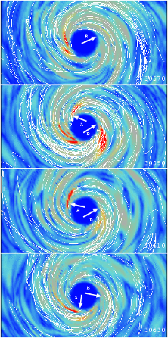
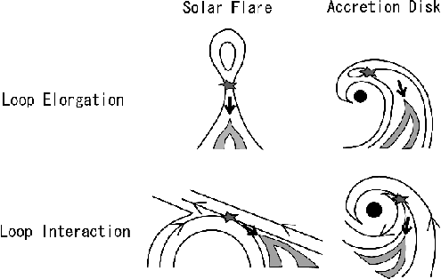
Understanding the IR & X-ray flares of Sgr A*: Basic Scenario
Machida & Matsumoto, 2003, ApJ

Slide 22
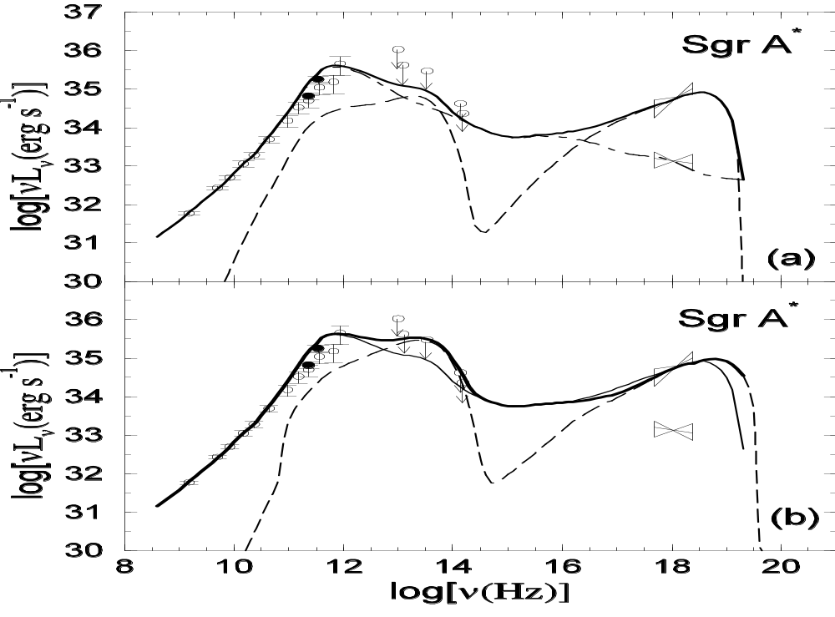

Synchrotron & SSC models for
IR & X-ray flares
Power-law electrons
With p=1.1, R=2.5Rs
=630.
Yuan, Quataert, Narayan 2003, ApJ

Slide 23
Synchrotron model for the flare state of Sgr A*
The synchrotron emission from accelerated/heated electrons in the magnetic reconnection will be responsible for the X-ray/IR flares
Broken power-law:
N_{pl}(γ)=N₀ γ^{-p}1 (γ_{min}≤γ≤γ_{mid} ; to describe the heated electrons)
N_{pl}(γ)=N₀ γ^{-p}2 (γ_{mid}≤γ≤γ_{max}; to describe the accelerated electrons)
p₁=3; p₂=1

Slide 24
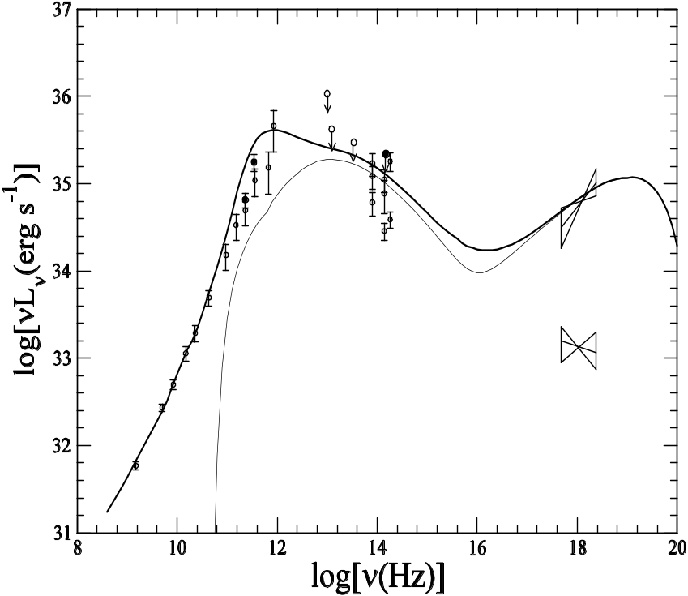
Synchrotron Model for the Flare State of Sgr A*: Results
η= 7%
η_{IX} = 1
γ_{max} ~ 10⁶
(γ_{min} ~100-500; γ_{mid} ~10⁵ ; ~0.5% electrons are accelerated; N_{IR}/N_{xray}~ 50

Slide 25
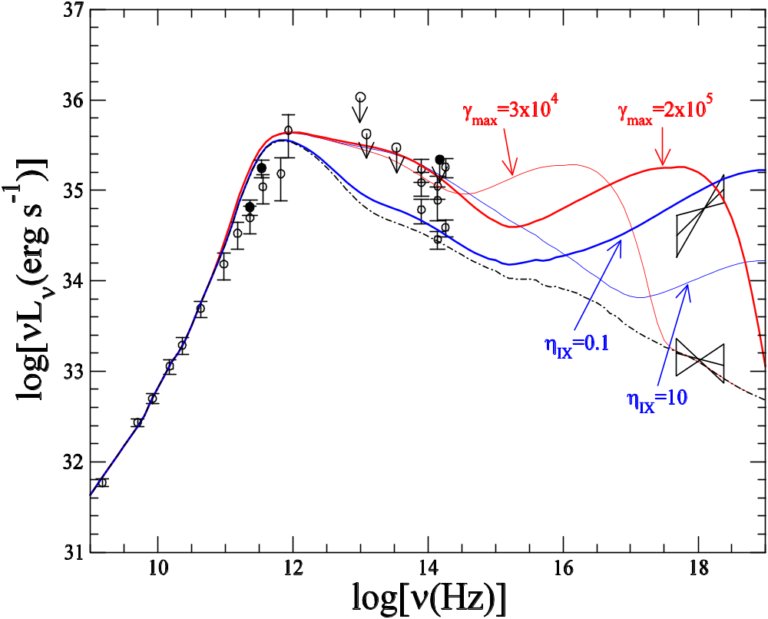
Synchrotron Model for the Flare of Sgr A*: Effects of Changing Parameters
Yuan,Quataert, & Narayan 2004,ApJ

Slide 26
Synchrotron Model for the Flare of Sgr A*: Predictions & Interpretations
X-ray & IR flares should often correlated, but not always.
X-ray flares have larger amplitudes than IR flares
IR & X-ray flares should be accompanied by only small amplitude variability in radio & sub-mm due to the absorption of thermal electrons.
IR & X-ray emission should be linearly polarized.

Slide 27

The Size Measurements of Sgr A*
Bower et al. 2004, Science; Shen et al. 2005, Nature;
An independent test to accretion models
Observed size of Sgr A*(FWHM):
  7mm: 0.712 mas (Bower et al.) or 0.724 mas (Shen et al. )
  3.5mm: 0.21 mas (Shen et al.)
Intrinsic size of Sgr A*(by subtracting the scattering size)
  7mm: 0.237 mas (Bower et al. ) or 0.268 mas (Shen et al.)
  3.5mm: 0.126 mas (Shen et al.)
  Note: the results require the intrinsic intensity profile must be well characterized by a Gaussian profile. However, this may not be true…

Slide 28
Testing the RIAF Model with the Size Measurements
Yuan, Shen & Huang 2006, ApJ
Calculating the intrinsic intensity profile from RIAFs---not Gaussian
  Assumptions: Schwarzschild BH; face-on RIAF
Taking into account the relativistic effects (gravitational redshift; light bending; Doppler boosting: ray-tracing calculation): again not Gaussian
We therefore simulate the observed size by taking into account the scattering broadening and compare it with observations
Results:
  7mm: 0.729 mas (observation: 0.712 & 0.724 mas)
  3.5 mm: 0.248 mas (observation: 0.21 mas)
  Slightly larger: a rapidly rotating BH in Sgr A*??

Slide 29
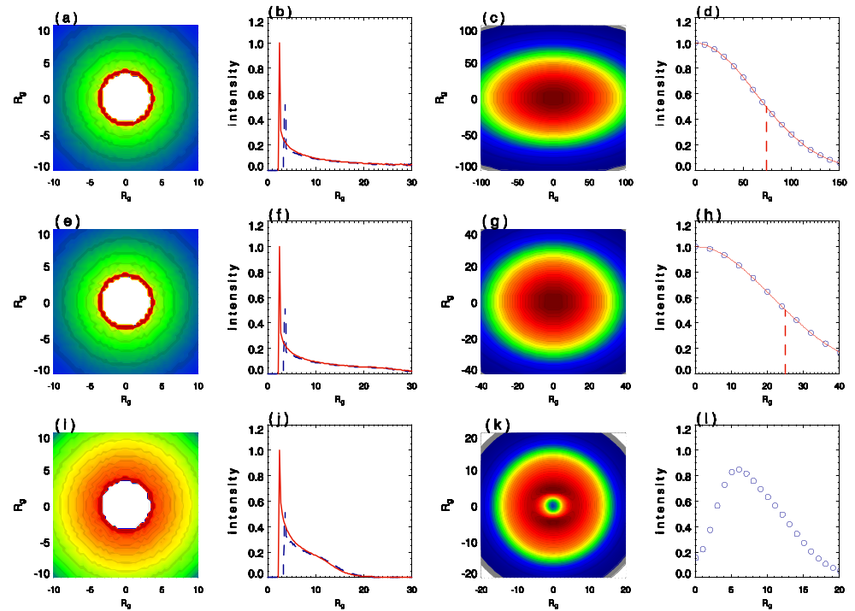
Input intensity profile
Simulation result
Gaussian fit
7mm(up) & 3.5mm(lower) simulation results
Yuan, Shen, & Huang 2006, ApJ

Slide 30
Predicted image of Sgr A* at 1.3 mm
Yuan, Shen & Huang 2006, ApJ

Slide 31
The constraint of the measured size on other models
Pure Jet model (Falcke & Markoff 2000)
  Jet component: low-frequency radio emission
  Nozzle component: submm bump
Jet-ADAF model (Yuan, Markoff & Falcke 2002)
  Jet component: low-frequency radio emission
  ADAF component: submm bump

Slide 32
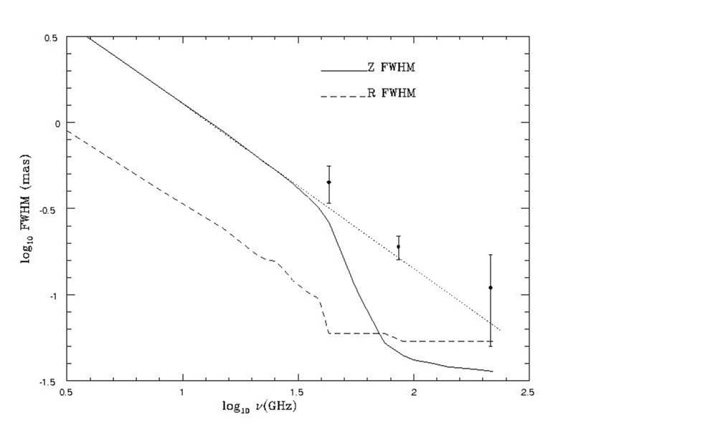
Predicted size of the
major axis by the jet
component
Predicted size of the
major axis by the
Nozzle component:
0.04mas at 3.5mm
The jet model of Falcke & Markoff 2000
Predicted size of the
Minor axis

Slide 33
Thank you!

