Slide 1
On the convective instability of hot radiative accretion flow
Feng Yuan
Shanghai Astronomical Observatory, CAS
Collaborator: Defu Bu (SHAO)

Slide 2
OUTLINE
Background:
  previous simulation results on non-radiative accretion flow: convectively unstable
Motivation of our work (radiative flow)
why convection interesting & why radiative flow
Two-D simulation of radiative accretion flow:
  Unstable!

Slide 3
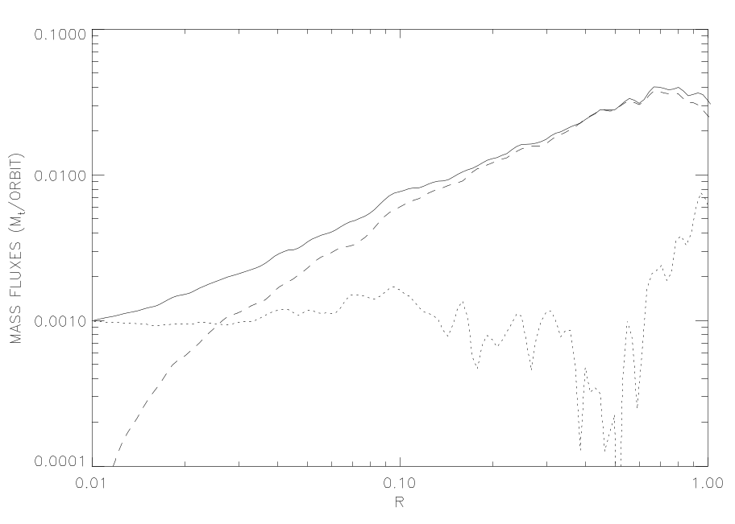
Previous Work:
ADAFs are convectively unstable
Igumenshchev & Abramowicz 1999; Stone, Pringle & Begelman 1999; Stone & Pringle 2000
This is the most important simulation result of accretion flow in the past decade
Reason: entropy increases inward (consistent with Narayan & Yi prediction)
Consequence: Mdot decreases inward because:
  Convective outflow
  Circulation in convective eddies
Stone, Pringle & Begelman 1999
Note: Mdot decreases inward NOT because of
outflow with positive Be!

Slide 4
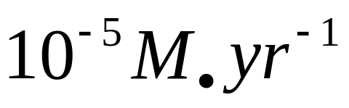
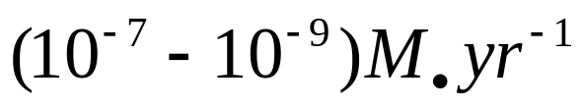
Confirmed by Observations in Sgr A*
Chandra observation combined with Bondi theory give the accretion rate at Bondi radius
High linear polarization at radio waveband requires innermost region accretion rate:
Therefore Mdot must decrease inward

Slide 5
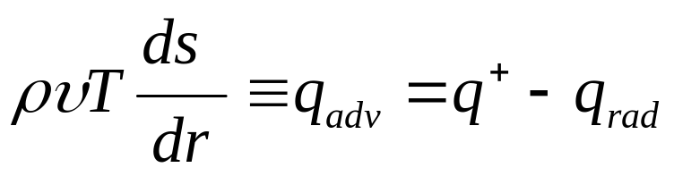
Motivation of our work
Mdot vs. R is important because:
  how to understand observation (e.g., Sgr A*)
  Black hole growth
  Black hole spin evolution
Previous works neglect radiative cooling
Radiation is often very important, can’t be neglected (e.g., LHAF)
  Qualitatively: Radiative cooling can loss energy, like convection
  Quantitatively: radiative cooling makes the entropy gradient smaller or even change sign

Slide 6
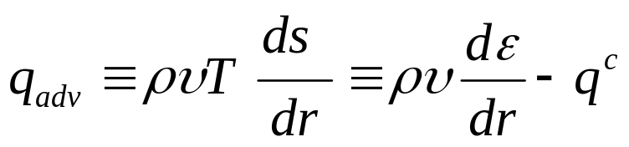
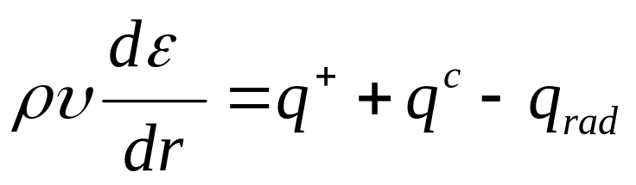
LHAF (Luminous hot accretion flow)
(Yuan 2001)
Energy eq.
So the critical rate of ADAF
is determined by q^+=q_rad
Since we have:
So:
This determines another critical rate by q^c + q^+ = q_rad, below which
but above the critical rate of ADAF, the flow is still hot. This is LHAF.

Slide 7
Analytical prediction: convectively stable
(Yuan 2001)
LHAF (Luminous hot accretion flow) is radiative:
  Radiative cooling > viscous heating (so advection is negative)
One-D analytical analysis: entropy decreases inward:
Thus LHAF is predicted to be convectively stable
But is this true in 2D case??

Slide 8
2D simulation of radiative accretion flow
Equations
Models
  Models A, B & C; accretion rates differing by 100 respectively

Slide 9
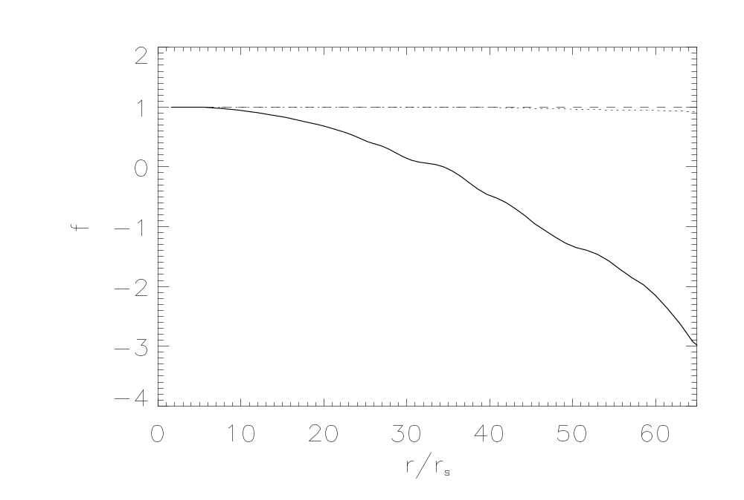
Result one: confirm LHAF solution of Yuan (2001)
Advection factor f=q_{adv}/q_{vis}
LHAF: f <0
ADAF: f ~ 1 >0
Yuan & Bu 2010

Slide 10
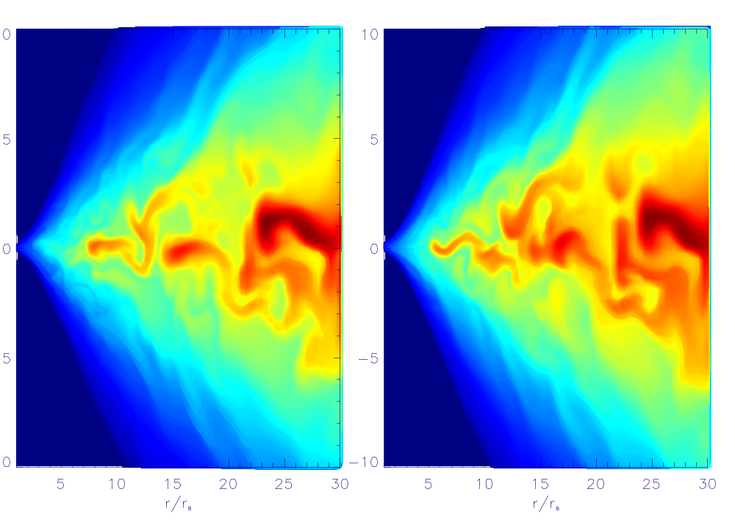
Result two: LHAF is also convectively unstable
LHAF
ADAF
Density snapshot: Qualitative evidence

Slide 11
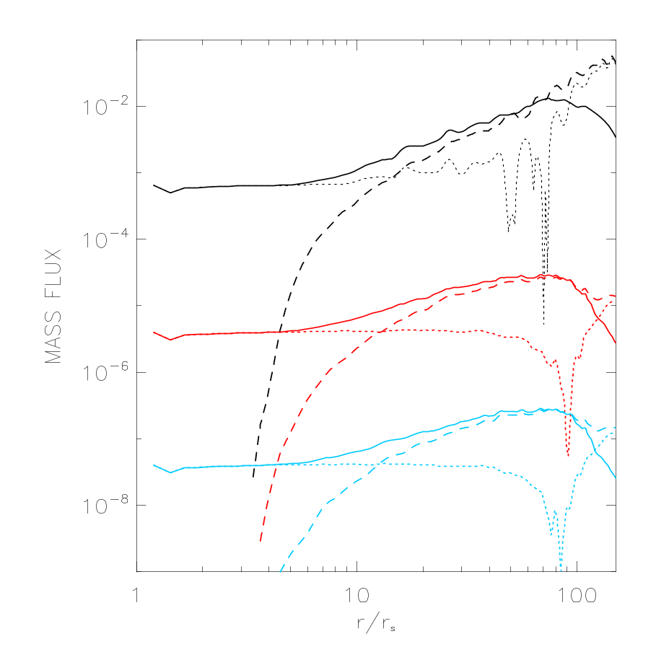
Result two: LHAF is also convectively unstable (cont.)
Mdot decrease inward: quantitative evidence for convective instability
Mdot profiles of ADAFs and LHAF are almost parallel
LHAF
ADAF

Slide 12
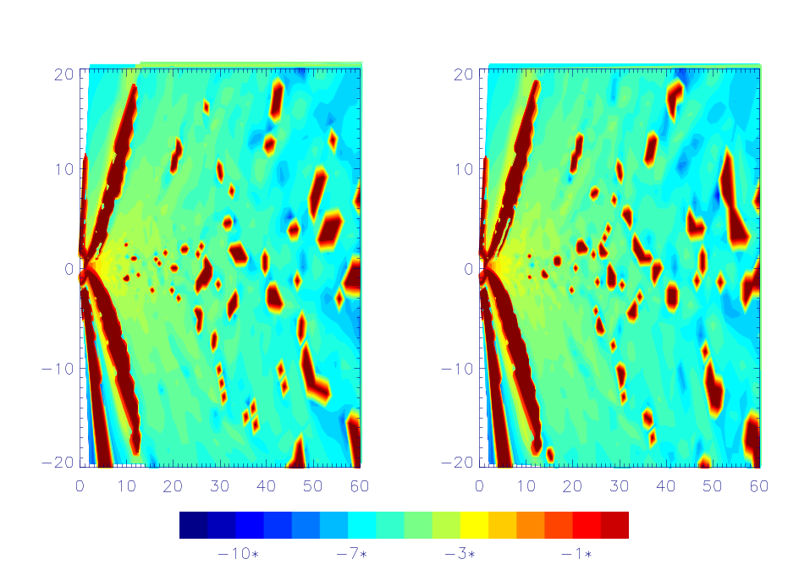
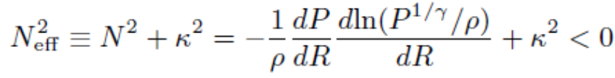
Physical reason of convective instability (I): instability condition
Condition of convective instability of rotating flow
So most region N_{eff}^2<0
The necessary (also dominant) condition of instability is entropy increases inward
Radial gradient of entropy
Epicyclic frequency
N_{eff} ; red region denotes N^2>0

Slide 13
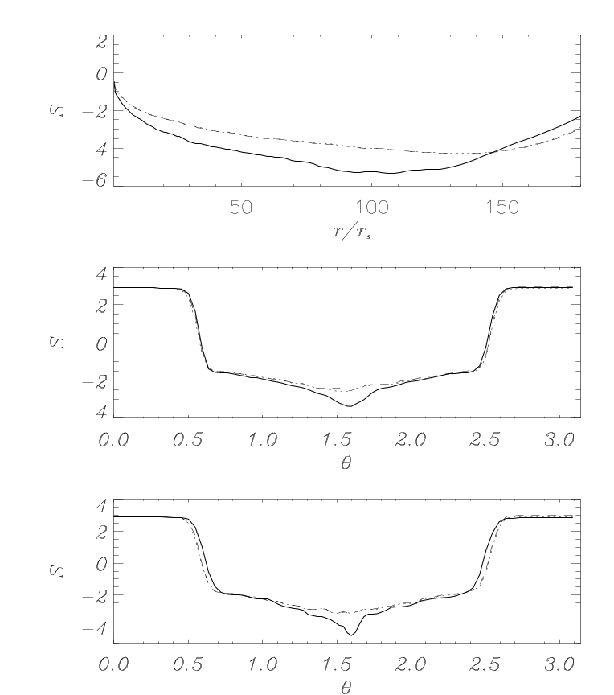
Physical reason of convective instability (II): entropy gradient
entropy of LHAF does increase radially. why?
energy equation:
For steady state, we have
One-D case:
Two-D case:
So we can have:
i.e., entropy increases inward

Slide 14
Thank you!

