Slide 1

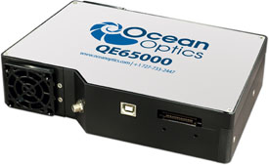
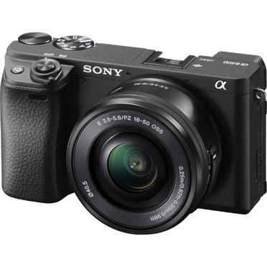
The spectral
Reflectance function
PCA
Analysis
Eigenvectors
24 Color Checker
Eigenspace
Analysis
Linear
Regression
Eigenvaluse
New RGB values
Transformation
Matrix
Chromatic
Adaptation
Color
Correction
Inverse
Chromatic
Adaptation
RGB values

Slide 2
The spectral
Reflectance function
PCA
Analysis
Eigenvectors
24 Color Checker
Eigenspace
Analysis
Linear
Regression
Eigenvaluse
New RGB values
Transformation
Matrix
Chromatic
Adaptation
Color
Correction
Inverse
Chromatic
Adaptation
RGB values

Slide 3
Spectral
Reflectance
PCA
Analysis
Eigenvalue
24 Color Checker
Spectrophotometer
RGB value
RGB to XYZ
Color
Correction
Chromatic
Adaptation
Transformation
Matrix
Camera

Slide 4
Hyperspectral image
Spectral
Reflectance
PCA
Analysis
Eigenvalue
24 Color Checker
Spectrophotometer
RGB value
RGB to XYZ
Chromatic
Adaptation
Color
Correction
Transformation
Matrix
Camera
Notes:
高光譜影像分為兩部分 分光光度計對於24 color Checker的光譜測量以及分析
從相機中拍攝的影像，
其中影像必須經過XYZ空間轉換、色彩校正、色適應最終得到XYZ色彩空間轉換光譜反射率的轉換矩陣。

Slide 11
Expression from ReduceSet
Expression from Reduce2nd Set
Traverse exp
Traverse exp
N
If other sub_exp be its childexp&
#sub_exp > #exp
N
If other sub_exp be its childexp&
#sub_exp > #exp
Y
Y
Remove sub_exp
to Reduce2nd
Remove sub_exp
to ReduceSet
Insert and replace
Insert and replace
Clear ReduceSet
Clear Reduce2nd
#sub_exp : count of sub expression #exp : count of expression
N
N
If ReduceSet is empty
If Reduce2nd is empty
Y
Y

