Slide 1
Design and Implementation of Smart Roll-Call System based on Face Recognition
软英1501 郝国尧 20154840
指导教师： 宋杰 齐乃龙

Slide 2
Outline
Subject introduce
Requirement Analyze
System implement and design
Conclusion and future work
Notes:
My presentation will be divided into five parts. They are subject introduce requirement analyze, system implement, system design and conclusion

Slide 3
Subject source
Traditional roll call disadvantage
Improve the roll call process
1. Roll call spends a long time
2. The result of roll call is not directly perceived
Notes:
Roll call is an important process in education. It is widely used in universities and education organization. But the roll call process spends a long time, the time spent will growth linearly as the student number growth. The traditional roll call result is not directly perceived. People need to integrate all roll call record to get what they want. This system is designed to solve this problem.

Slide 4
Requirement Analyze
Business requirement
Fast up the roll call process
Provide concrete roll call result
Three groups of users:
Teachers
Students
Administrators

Slide 5
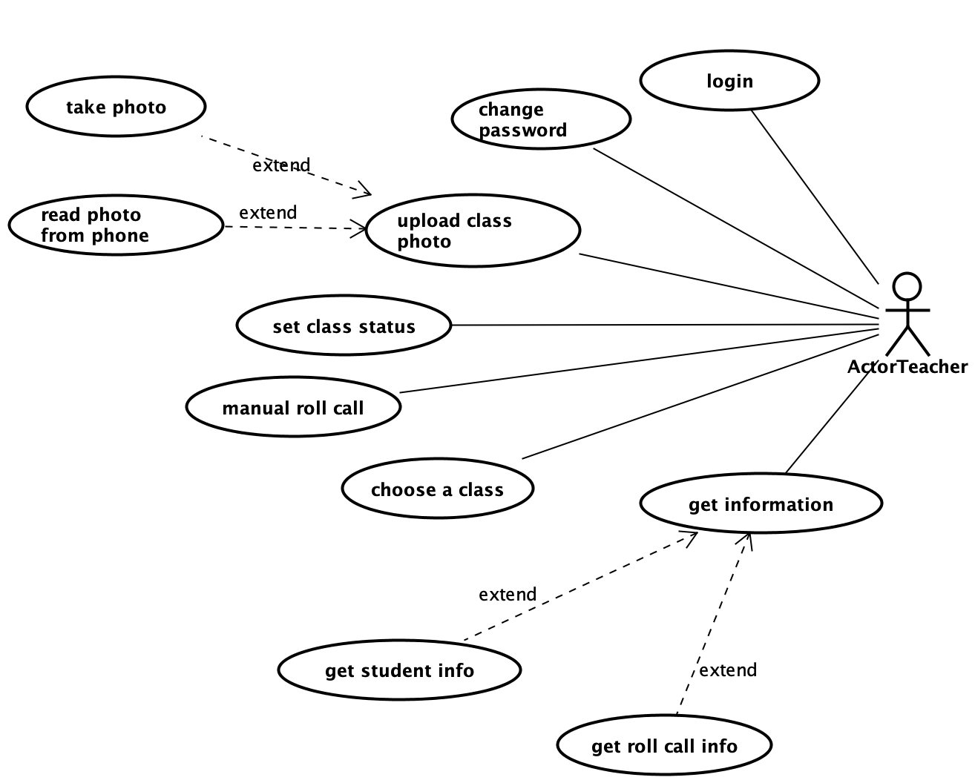
Teachers requirement
Functional requirement
1. Roll call in light workload
2. Retrieve information
Non-functional requirement
Notes:
Developers need to consider the non-functional requirement of the system

Slide 6
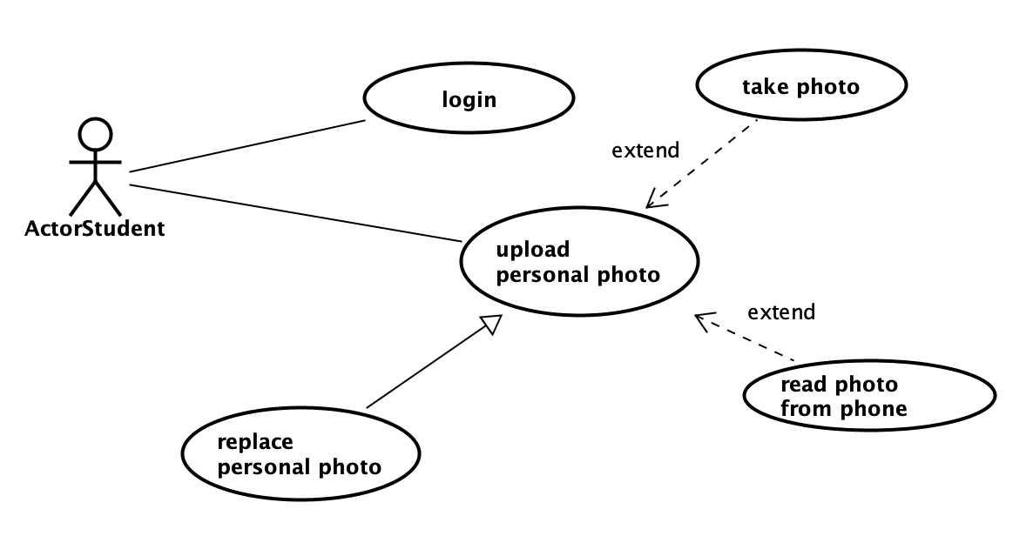
Users requirement
Features:
Only use the system for once or several times at most
Doesn’t provide students convinence directly
Notes:
Developers need to consider the non-functional requirement of the system

Slide 7
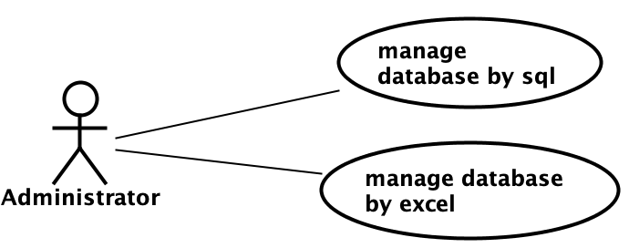
Administrators requirement
Importance of administrators:
Manage all information of teachers, students, classes

Slide 8
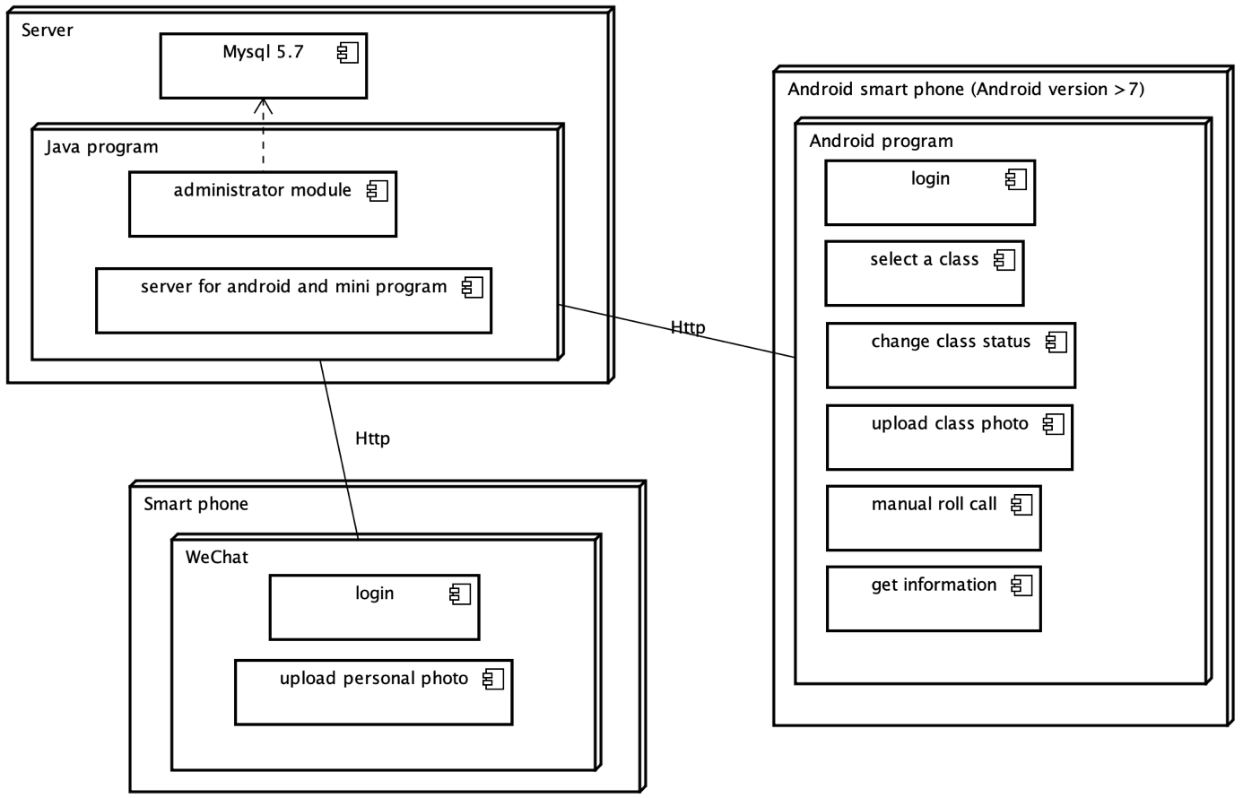
System Analyze and Implement
1. WeChat mini program
2. Android application
3. Server and administrator program

Slide 9
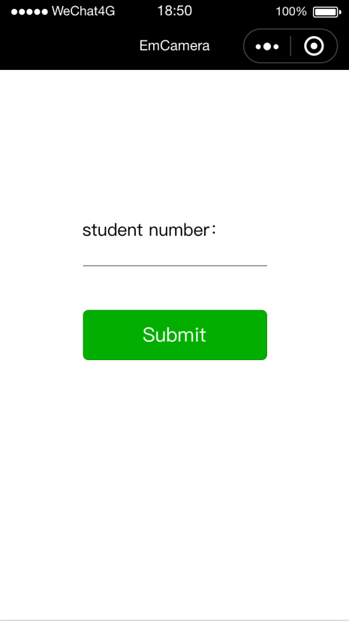
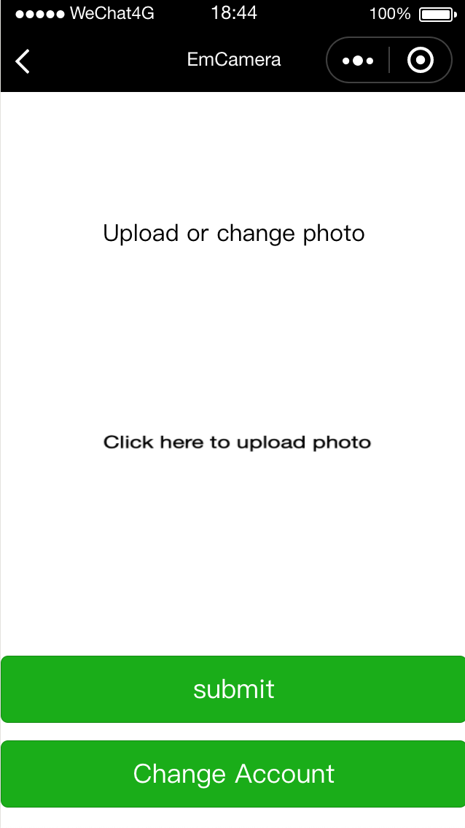
WeChat Mini Program
Notes:
The WeChat mini program is concise in interface. It has only two interfaces. The first is used to login student number, the second is used to upload personal photo.

Slide 10
Student login
Automate login is provided.
Page.onLoad(){ }
Notes:
The system provides convenience for teachers instead of students.

Slide 11
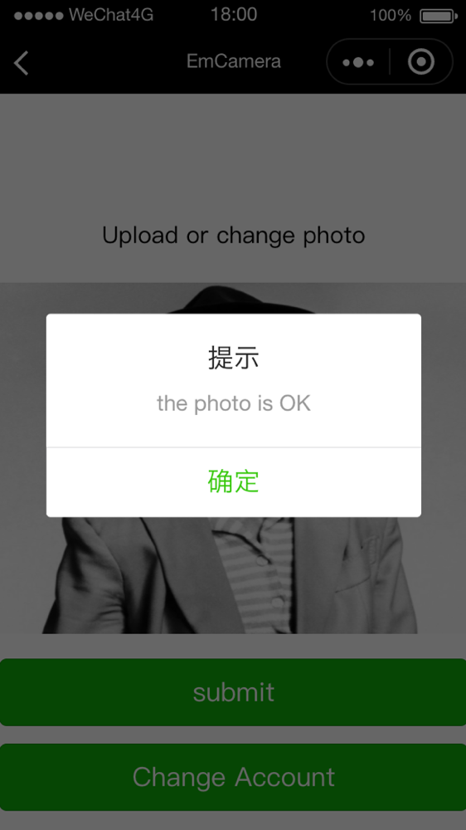
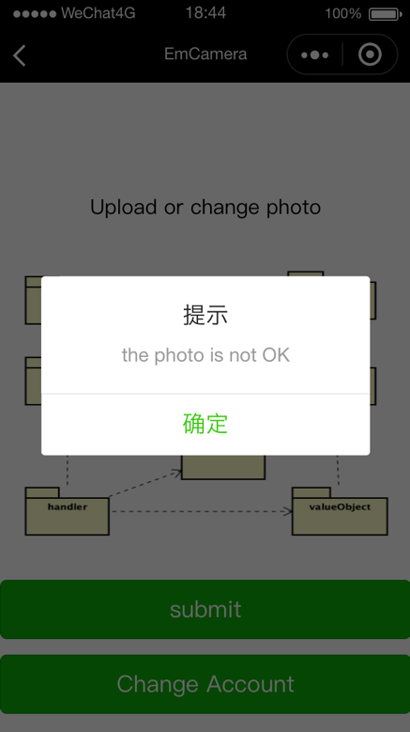
Student Upload Personal Picture
Notes:
After the student upload the image, the system will verify whether the photo is qualified. Exactly one face means

Slide 12
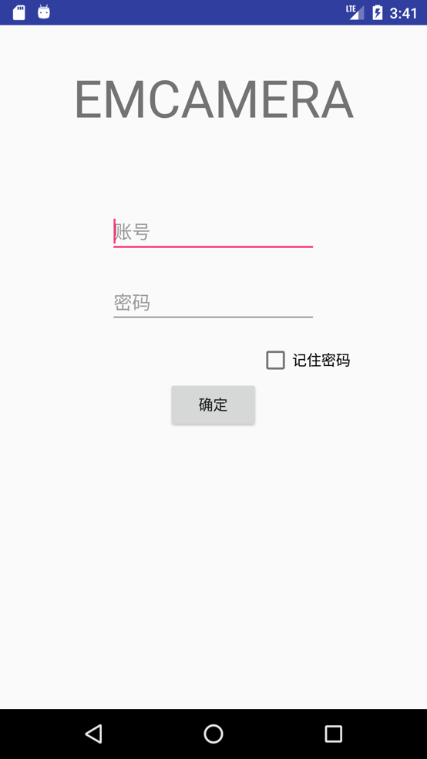
Android Application

Slide 13
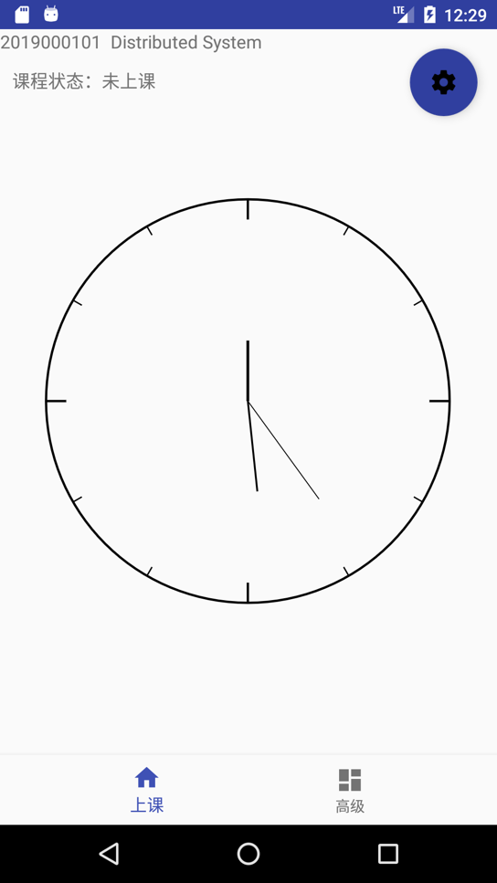
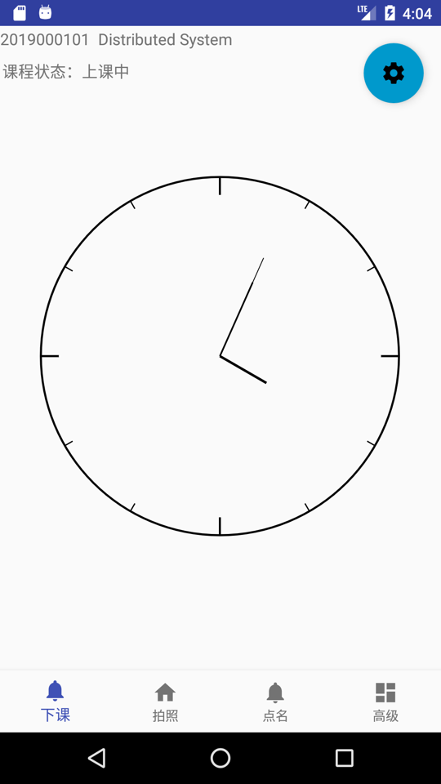
Change class status(begin and finish roll call)
Notes:
During a class, the roll call button and the take photo button will be created.

Slide 14
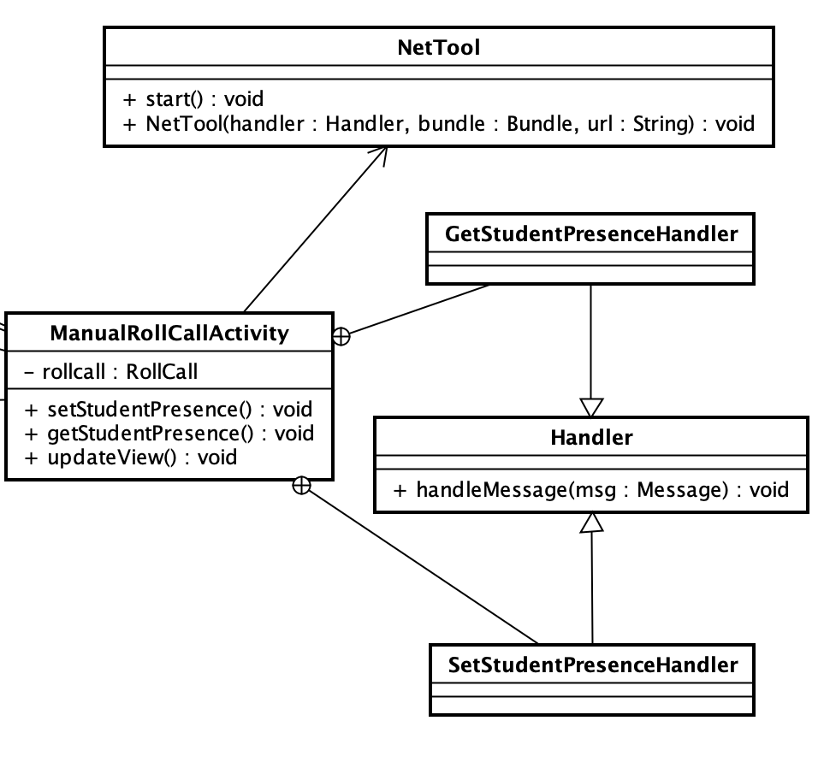
Asynchronous data request
Asynchronous means more user-friendly
User Class handler to implement
Notes:
There are two types of data request, synchronous data request and asynchronous data request.
Means the thread will stuck and wait the server to reply. During this process, the application will be stuck. So users may think the application is malfunctional.
When

Slide 15
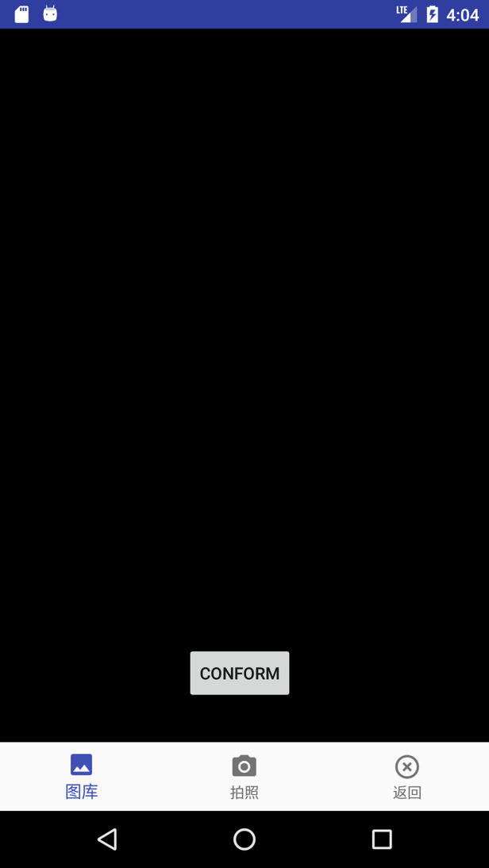
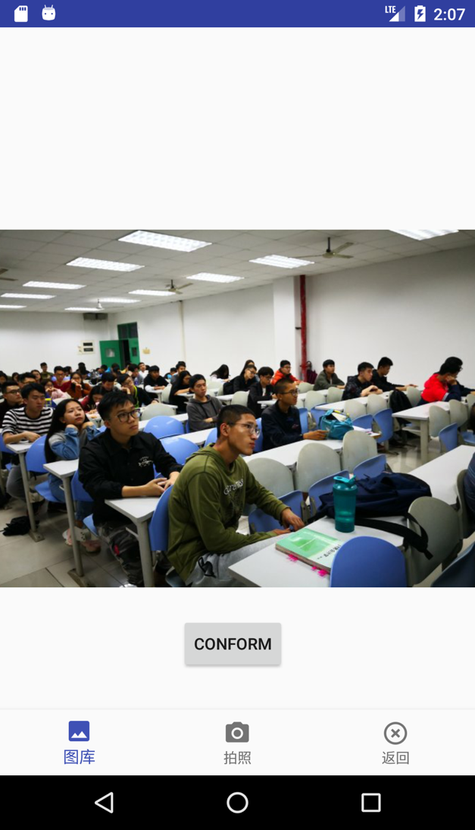
Auto Roll Call
Notes:
User can choose a photo from album or take a photo using camera. The chosen photo will be shown.

Slide 16
Auto Roll Call
Two steps:
Face detection and segmentation
Face recognition

Slide 17
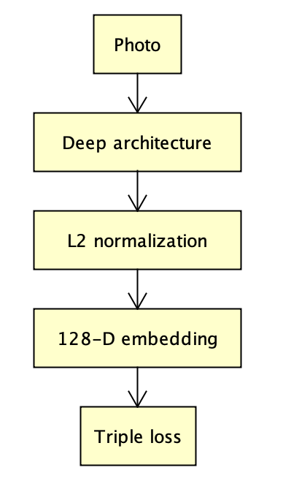
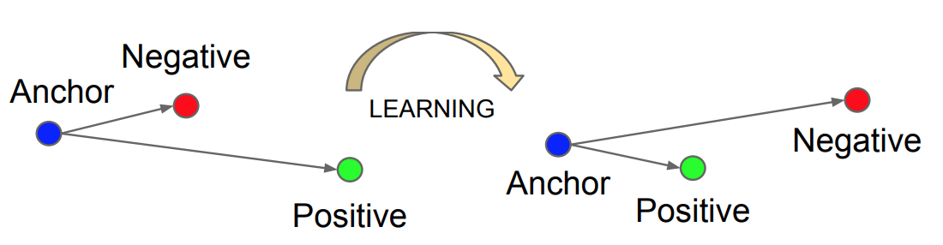
Face recognition
Using FaceNet
Triple loss
Notes:
Previous method of getting the embedding is usuallly get one middle layer from a classification deep architecture. With triple loss, the embedding can be trained directly.

Slide 18
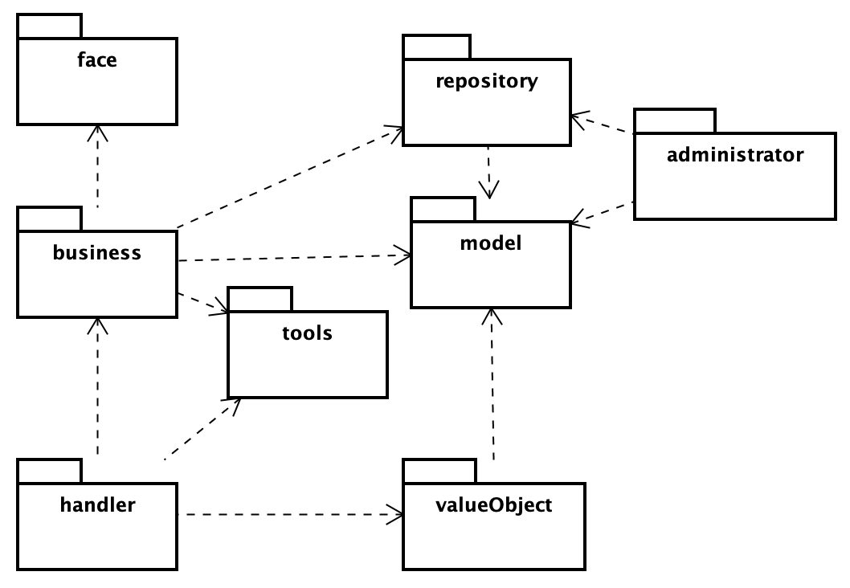
Server Implement
PCMBER architecture
(presentation - controller - mediator - bean - mediator - resource )

