Slide 1
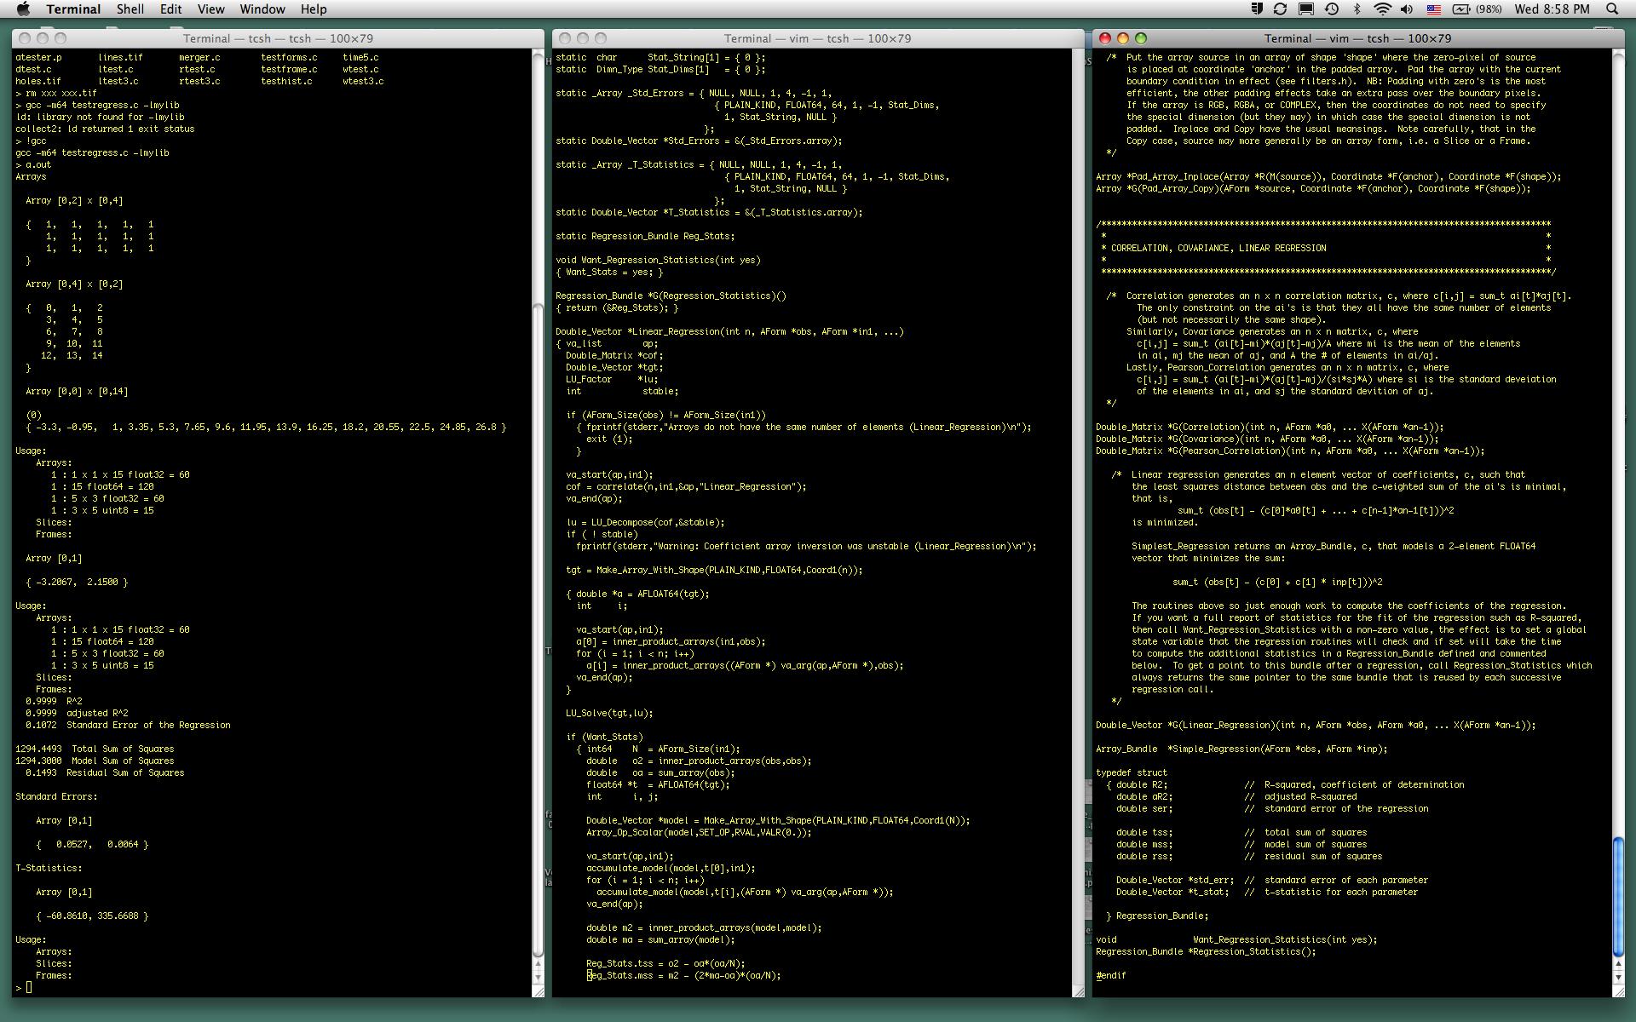
Mylib: an open C image analysis library
Gene Myers
HHMI Janelia Farm Research Campus

Slide 2
WHY?
Support for 2Gb+ N-dimensional arrays ... ( X OpenCV)
... in a space and time efficient manner ... ( X Matlab)
... with many superior implementations of image analysis methods ... (e.g. Watershed, Level Sets, FFT)
... that is relatively easy to use. ( X ITK)
Allows rapid transition from Matlab prototype to efficient C-based implementation (entire group uses it)
Enables rapid development in C, albeit object-oriented
Fully re-entrant
Clean compiles on Mac, UNIX, and Windows
Sample Applications:
Whisker Tracker
Neuron Tracer
Watershed inside Mitya’s EM segmentation
Tiff reader/writer in V3D

Slide 3
N-dimensional arrays of any base type and support for RGB, RGBA, and COMPLEX
Histograms: Entropy, Thresholding (Otsu,...), Moments
Correlations, Covariance, Pearson Correlation, Linear Regression
Simple Tiff I/O
Convolutions: Common filters, Derivatives/Gradients, Curvature, GVF
Distance transforms, Geodesics, Voronoi & Delauney Decompositions
Level-set Component trees
Watersheds
Drawing primitives
General flood-fill operations including flooding hyper-surfaces
SWC neuron model support
Linear algebra including tri- and penta-diagonal systems (splines & snakes)
Function minimization and root finding
FFT including real optimization and normalized correlation
Random variables of many common distributions
Hash table
Shortest paths
General region object concept
Array slices and movable frames that are in effect arrays (A-Forms)

Slide 4
MYLIB OBJECTS
Every object of type X:
Copy_X can be copied
Pack_X can be packed
Read_X can be read/written to a file
Write_X
X_Refcount has a reference count that can be ...
Inc_X inc’d and ...
Free_X dec’d: either freed or killed
Kill_X
Routines that create objects are called “generators”, e.g.:
Copy_Array, Read_Array
Make_Array_With_Shape, Down_Sample, …
One can get a listing of all generated objects not yet freed or killed and/or their number:
X_Usage
X_List
The entire object abstraction can be reset: Reset_X

Slide 5
Free vs. Kill Example
FILE *f = fopen(“myfile”,“r”);
while ( ! eof(f))
{ Array *a = Read_Array(f);
// compute and report
// something about a
Kill_Array(a);
}
Suppose: 15M, 10M, 20M, 15M, 17M, 25M, 20M, 10M, 18M, 15M
UNIX system malloc and free will each be called ten times.

Slide 6
Free vs. Kill Example
FILE *f = fopen(“myfile”,“r”);
while ( ! eof(f))
{ Array *a = Read_Array(f);
// compute and report
// something about a
Free_Array(a);
}
Suppose: 15M, 10M, 20M, 15M, 17M, 25M, 20M, 10M, 18M, 15M
System malloc called once, realloc twice
If all the arrays were the same size, then one call to malloc and the same object instance gets recycled ten times.
At the end, the 15M array is in a “container” of size 25M, hence the reason for Pack_Array

Slide 7
Reference Count Example
FILE *f = fopen(“myfile”,“r”);
while ( ! eof(f))
{ Array *a = Read_Array^{G}(f); // a.RC = 1
...
Watershed *w = Build_Watershed^{G}(a^{I},0); // a.RC = 2
Free_Watershed(w^{F}); // a.RC = 1
...
Free_Array(a^{F}); // a.RC = 0
... // ==> freed
}

Slide 8
Reference Count Example
FILE *f = fopen(“myfile”,“r”);
while ( ! eof(f))
{ Array *a = Read_Array^{G}(f); // a.RC = 1
...
Watershed *w = Build_Watershed^{G}(a^{I},0); // a.RC = 2
Free_Array(a^{F}); // a.RC = 1
...
Free_Watershed(w^{F}); // a.RC = 0
... // ==> freed
}

Slide 9
ARRAYS: ATTRIBUTES
Every array routine works in n-dimensions
(unless it doesn’t make sense, e.g. matrix inversion)
kind: PLAIN_, RGB_, RGBA_, COMPLEX_KIND
type: [U]INT(8|16|32|64)_ | FLOAT(32|64)_TYPE
scale: # of bits in values (only useful for tiff I/O)
ndims: # of dimensions
dims[i]: size of dimension i (Dimn_Type = int32)
text: any C-string (used a label for printouts or meta-data for tiff)
data: pointer to a linear array of the data
size: total # of elements, (Size_Type = int64)
Make_Array_With_Shape(PLAIN_KIND,INT32_TYPE,Coord2(5,4)) a 5x4 int array
Make_Array_With_Shape(RGB_KIND,UINT8_TYPE,Coord2(5,4)) a 3x5x4 8-bit unsigned int array
5x4 RED, GREEN, & BLUE planes
Make_Array_With_Shape(COMPLEX_KIND,FLOAT64_TYPE,Coord2(5,4)) a 5x4x2 double array
a[x,0] + i a[x,1] ≡ complex #

Slide 10
VALUES
typedef union { uint64 uval; int64 ival; float64 rval } Value;
a type that encodes any kind of base value (e.g uint8, int16, float32)
a scalar in terms of passing parameters,
e.g. no different than passing a routine an int or a double.
Constants:
UVAL: unsigned integer values
IVAL: integer values
RVAL: floating point values
Constructors:
VALU(u) a Value whose value is the unsigned integer value of expression u
VALI(i) a Value whose value is the integer value of expression i
VALR(r) a Value whose value is the real value of expression r
VALU(32) VALI(i+3) VALR(sqrt(22.2))
Complex_Op_Scalar(A,MUL_OP,RVAL,VALR(3.2),VALR(2.1));
multiply every element of A, which must be COMPLEX, by 3.2+2.1i

Slide 11
ARRAYS: OPERATORS
A op B where op is = + - * / ^ << >> min max (COMPLEX math if wanted)
Array_Op_Array(A,SET_OP,B)
A and B do not need to be the same type or kind or size.
B is reused until A is filled up
A op <constant>
Array_Op_Scalar(A,MUL_OP,RVAL,VALR(3.2));
Conversion between kinds, types, and scales
Convert_Array_Inplace(A^{RM},PLAIN,FLOAT32,1.);
Convert_Array^{G}(A,PLAIN,FLOAT32,1.);
Binarize an array
Threshold_Array(A^{RM},VALU(15)) A is of unsigned type
Scale an array
Scale_Array_To_Range(A^{RM},VALU(0),VALU(255))
Computing range of values in an array
Range_Bundle rng
Array_Range(&rng^{RO},A)
A “bundle” is a temporary structure used as a way of returning
multiple values, in this case, rng.minval and rng.maxval.

Slide 12
ARRAYS: OPERATORS
Clipping an array to a subregion
Clip_Array_[Inplace](A,Coord2(1,2),Coord2(5,6))
Down-sampling an array (either generate or in-place)
Down_Sample[_Inplace](A,Coord2(2,3))
Padding an array (by any amount with boundary)
Use_[Zero|Reflective|Wrap|Extent|Inversion]_Boundary()
Pad_Array[_Inplace](A,Coord2(2,2),Coord2(3,3))
2 x 2
3 x 2
(1,2)
(5,6)
3 x 3

Slide 13
BOUNDARIES
-15-14-13-12-11-10 -9 -8 -7 -6 -5 -4
-9 -7 -8 -6 -5 -4 -3 -2 -1 0 1 2
-3 -2 -1 6 7 8
3 4 5 12 13 14
9 10 11 18 19 20
15 16 17 24 25 26
21 22 23 24 25 26 27 28 29 30 31 32
27 28 29 30 31 32 33 34 35 36 37 38
Inversion Boundary
15 16 17 12 13 14 15 16 17 12 13 14
21 22 23 18 19 20 21 22 23 18 19 20
3 4 5 0 1 2
9 10 11 6 7 8
15 16 17 12 13 14
21 22 23 18 19 20
3 4 5 0 1 2 3 4 5 0 1 2
9 10 11 6 7 8 9 10 11 6 7 9
Wrap Boundary
0 0 0 0 0 0 0 0 0 0 0 0
0 0 0 0 0 0 0 0 0 0 0 0
0 0 0 0 0 0
0 0 0 0 0 0
0 0 0 0 0 0
0 0 0 0 0 0
0 0 0 0 0 0 0 0 0 0 0 0
0 0 0 0 0 0 0 0 0 0 0 0
Zero Boundary
15 14 13 12 13 14 15 16 17 16 15 14
9 8 7 6 7 8 9 10 11 10 9 8
3 2 1 4 3 2
9 8 7 10 9 8
15 14 13 16 15 14
21 20 19 22 21 20
15 14 13 12 13 14 15 16 17 16 15 14
9 8 7 6 7 8 9 10 11 10 9 8
Reflective Boundary
0 0 0 0 1 2 3 4 5 5 5 5
0 0 0 0 1 2 3 4 5 5 5 5
0 0 0 5 5 5
6 6 6 11 11 11
12 12 12 17 17 17
18 18 18 23 23 23
18 18 18 18 19 20 21 22 23 23 23 23
18 18 18 18 19 20 21 22 23 23 23 23
Extend Boundary
0 1 2 3 4 5
6 7 8 9 10 11
12 13 14 15 16 17
18 19 20 21 22 23

Slide 14
Boundaries & Value Iterators
Use_<X>_Boundary() -- use this kind of boundary from here on.
All mylib routines that require boundaries, e.g. filters, gradients, curvature, use an implicit boundary, explicit padding is never required.
Value_Iterator -- an object that delivers a value on each element of an array
Vector_Iterator -- ......................double vector ......................
double NEXT_VALUE/VECTOR(vi) -- give me the next value/vector
void KILL_VALUE/VECTOR(vi) -- get rid of the object
vm = Derivative(Matlab,a);
vs = Partial(Sobel,a,2,0,1);
vc = Gradient(Iso5,a); // In general you can define your own
vi = Levelset_Curvature(a,vc); // derivative scheme
for (p = 0; p < a->size; p++)
{ double x = NEXT_VALUE(vi); // In matlab this would require multiple
... // copies of a, you would run out of
} // space on a big image

Slide 15
Slices
A rectangular subspace of an array:
slice = G(Make_Slice)(I(a),Coord2(1,5),Coord2(2,8));
A slice has a current position which you can set and you can also move it forward and backward one element in a.
A slice very efficiently (constant time) tells you if its current position is in the array or not, and you can very efficiently move through the successive positions in the slice.
p = Set_Slice_To_First(slice);
for (i = 0; i < Slice_Size(slice); i++)
{ // ... process a[p] ...
p = Next_Slice_Index(slice);
}
This is a big deal because a->data is a linear vector!!!

Slide 16
Frames
A rectangular shape with a reference point, that can be moved around
an underlying array:
frame = Make_Frame^{G}(a^{I},Coord2(10,10),Coord2(-2,-2));
A frame also has a current position which you can set and you can also move it forward and backward one element in a.
ref. pnt.
ref. pnt.
10 x 10
cur. pos.
10 x 10
-2 x -2
-2 x -2
a

Slide 17
Frames (continued)
They can be moved very efficiently, observe boundary setting when outside the array, and very efficiently deliver the values in their
sub-window in one of two ways:
if ( ! Frame_Within_Array(frame))
{ int16 *values = Frame_Values(frame); // Assuming a is int16
for (p = 0; p < Frame_Size(frame); p++)
{ // ... access values[p] ...
}
}
else
{ int64 *offsets = Frame_Offsets(frame);
int16 *d = ((int16 *) a->data) + Frame_Index(frame);
for (p = 0; p < Frame_Size(frame); p++)
{ // ... process d[offsets[p]] ...
}
}

Slide 18
Slices & Frames are Array-Forms
Both a slice and a frame are effectively arrays.
An “array form” or AForm is any one of the 3.
Almost all mylib routines work on AForms!!!
Frame *frame = Make_Frame(a,Coord(20,20,20),Coord(10,10,10));
Place_Frame(frame,0);
for (p = 0; p < a->size; p++)
{ Histogram *his = Histogram_Array(frame,256,VALU(0),VALU(255));
double mean = Histogram_Mean(his);
double sigma = Histogram_Sigma(his);
double entropy = Histogram_Entropy(his);
...
Move_Frame_Forward(frame);
}

Slide 19




Regions
A region is a 2n- or (3^{n}-1)-connected region of pixels all satisfying some common property P.
A region can have outer and inner contours (holes), and borders and exteriors on either side of each countour.
A 4-connected region
An 8-connected region
Outer exterior
Outer exterior
Outer border
Outer contour
Outer border
Outer contour
A hole
A hole
Not a hole
A hole!

Slide 20
Regions
A region is a 2n- or (3^{n}-1)-connected region of pixels all satisfying some common property P.
It can be an argument to many other mylib routines
It can be thought of as a mask over any array of a given shape
Region *Record_Region^{G}(A,con,leftseed,holes?,P)
Region *Record_Level_Set^{G}(Tree,set,holes?)
Region *Record_Watershed^{G}(Shed,basin,holes?)
Region *Fill_Region_Holes(R^{RM})
Range_Bundle *Region_Range(&range^{RO},R)
Double_Vector *Region_COM(&vector^{RO},R)
Extent_Bundle *Region_Extent(&extent^{RO},R)
Histogram *Histogram_Region^{G}(A,R,nbins,binsize,offset)
Histogram *Histagain_Region(H^{RM},A,R,clip)

Slide 21
Documentation
Get lastest version from https://subversion/myerslab/genelib
Say “make” on a UNIX/MAC OS X system and it builds.
Each module has a .p-file and a .h-file. The .h-file carefully documents the effective of each routine declared within it.
There is a DOCUMENTS subfolder that will ultimately contain a complete web-based documentation with examples.
All parameters and return values are documented with 1-letter superscript codes.

Slide 22
FINAL WORDS
Continued development (not everything is ship-shape)
Continued additions as per my whim or request
Your additions are welcome and I am happy to help show you how.
I support this library, one-two day turn around on most bug reports.

