Slide 1
Multi-Pulse Wavefront Sensing for High-Repetition-Rate X-ray FEL
Algorithm, Optical Design, Experimental Workflow, and Performance Evaluation
Generated from current project results

Slide 2
Motivation
  High-repetition-rate FEL can produce multiple X-ray pulses within one detector integration window.
  A conventional Hartmann workflow expects one wavefront per frame, but here one frame may contain many pulses.
  The core problem is to recover pulse-wise wavefronts from one accumulated detector image.

Slide 3
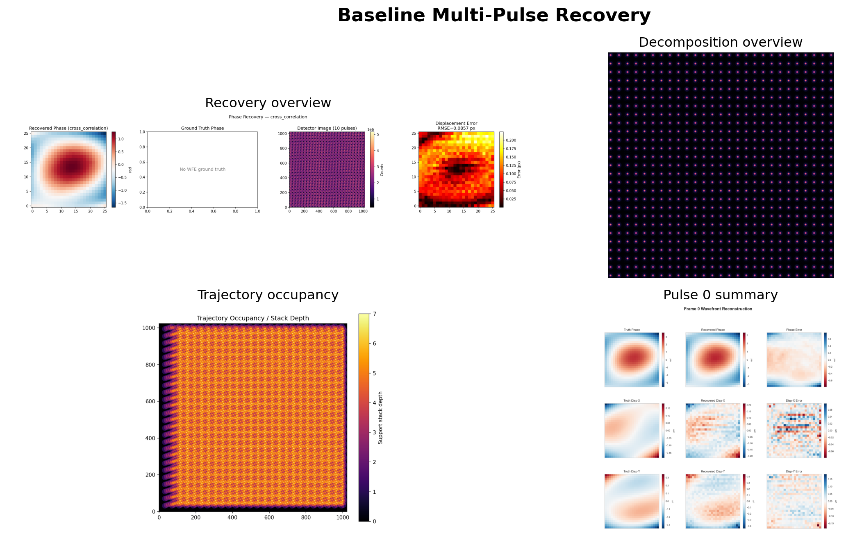

Slide 4
Research Objective
  Simulate accumulated multi-pulse X-ray Hartmann measurements.
  Decompose one accumulated frame into pulse-wise spot fields.
  Recover local spot displacements and reconstruct pulse-wise wavefront phase.
  Evaluate accuracy, robustness, and operating limits.

Slide 5
Optical Design
  Incoming distorted X-ray wavefront is sampled by a Hartmann mask and then propagated to the detector.
  Baseline geometry: 10 keV, z = 450 mm, pitch = 25 um, hole = 13 um.
  The detector integrates 10 translated pulses into a single accumulated image.

Slide 6
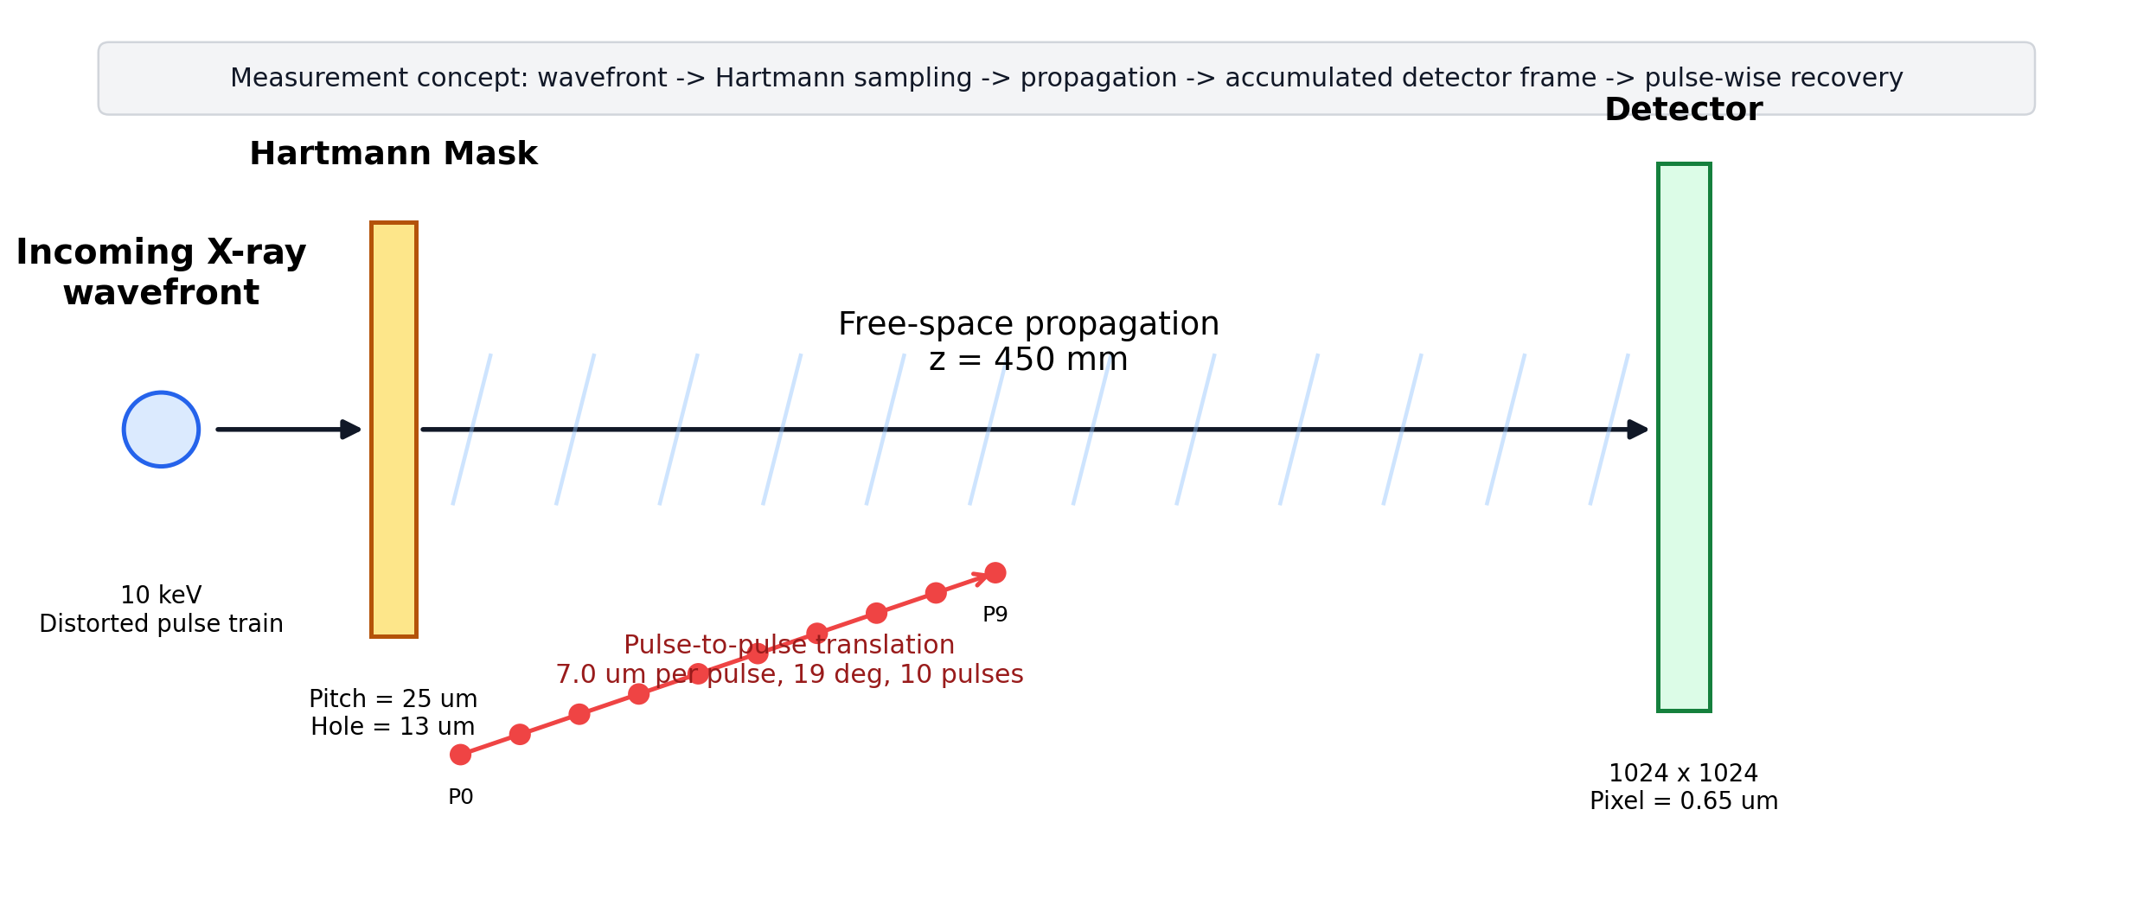

Slide 7
Experimental Workflow
  Forward model: wavefront setup -> Hartmann propagation -> detector accumulation.
  Inverse model: decomposition -> cross-correlation shift estimation -> slope integration -> phase reconstruction.
  Code path: simulate.py -> recover.py -> sweep scripts -> plotting.

Slide 8
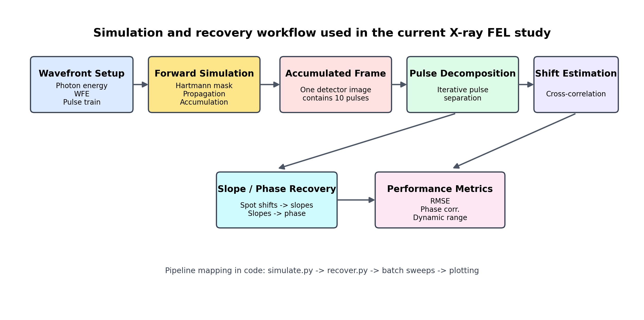

Slide 9
Recovery Algorithm
  Generate or load an accumulated detector frame.
  Decompose the frame into pulse-wise spot components.
  Estimate local shifts with cross-correlation.
  Convert shifts to slopes and integrate to phase.
  Compare against oracle and pulse-wise reference metrics.
  Main recovery method: cross_correlation
  Decomposition: iterative
  Patch half-size: 13
  Reference mode: per_pulse

Slide 10
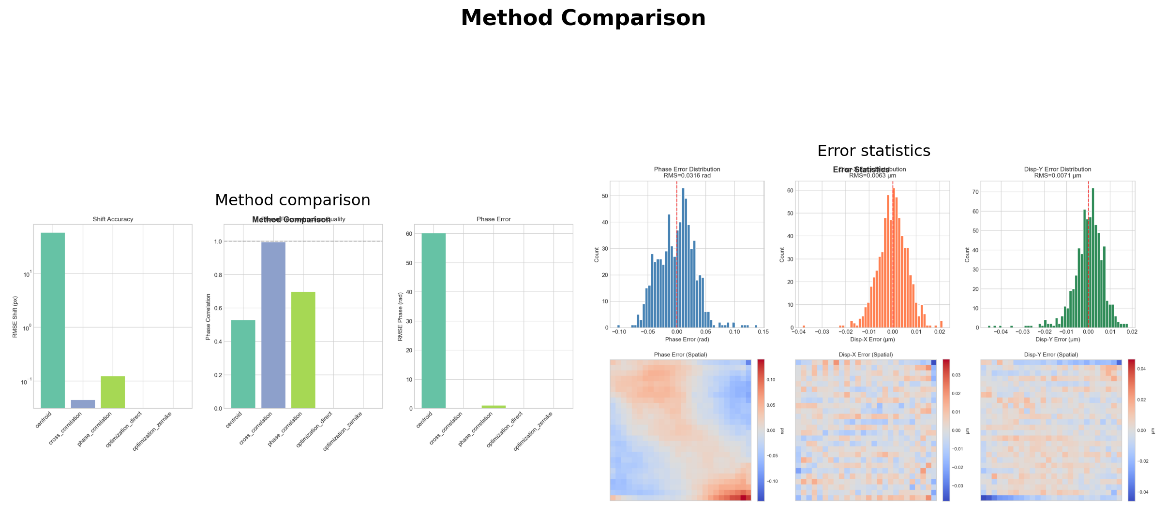

Slide 11
Baseline Experimental Configuration
  Propagation distance: 450 mm
  Pulse-to-pulse step: 7 um
  Translation angle: 19 deg
  Number of pulses: 10
  Sub-aperture grid: 26 x 26
  Fresnel number: 0.757
  Detector pixel size: 0.65 um

Slide 12
Baseline Result: Decomposition and Recovery
  The baseline case successfully decomposes one accumulated frame into pulse-wise spot maps.
  Mean decomposition confidence: 0.9978
  Oracle per-frame shift RMSE: 0.0468 px
  Cross-correlation remains stable over all 10 pulses.

Slide 14
Baseline Result: Pulse-Wise Phase and Displacement
  The recovery is consistent across all pulses rather than relying on one best frame.
  Average cross-correlation shift RMSE: 0.0441 px
  Average cross-correlation phase RMSE: 0.1111 rad
  Average phase correlation: 0.9937

Slide 15
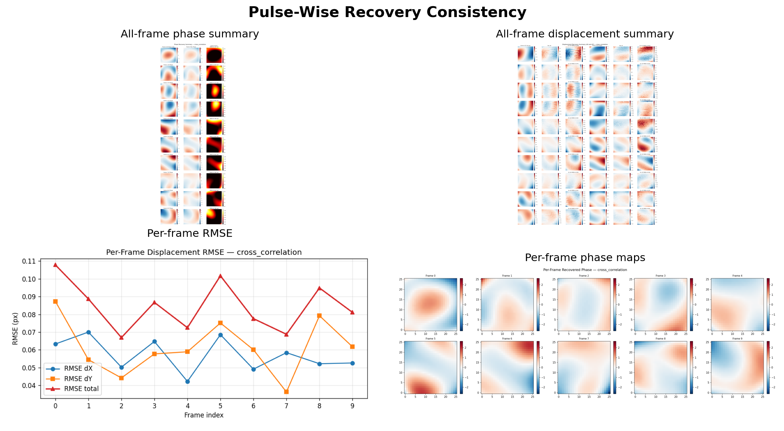

Slide 16
Method Comparison
  cross_correlation is the only reliable primary method in the current pipeline.
  centroid fails badly under the multi-pulse accumulated condition.
  phase_correlation remains usable as a comparison baseline, but is clearly weaker.

Slide 17
Method | Avg. shift RMSE (px) | Avg. phase RMSE (rad) | Avg. phase corr.
Centroid | 56.9241 | 60.1476 | 0.5275
Cross-correlation | 0.0441 | 0.1111 | 0.9937
Phase correlation | 0.1214 | 0.9730 | 0.6965

Slide 19
Physical Performance and Limits
  Displacement resolution: 28.66 nm
  Angular resolution: 0.06368 urad
  Conservative 3sigma displacement resolution: 85.97 nm
  Minimum measurable phase-gradient scale: 3227.03 rad/m
  Dynamic range: 436:1
  Highest measurable spatial frequency: 20000.0 m^-1
  Minimum resolvable period: 50 um

Slide 20
Parameter Sweep Design
  Three parameter sweeps were used to map the operating envelope.
  STEP_M: 7.0 -> 10.0 um, interval 0.5 um
  Z_PROP_M: 450 -> 1000 mm, interval 50 mm
  WFE: 1 -> 5 rad
  N_PULSES = 10 was fixed in all sweep runs.

Slide 21
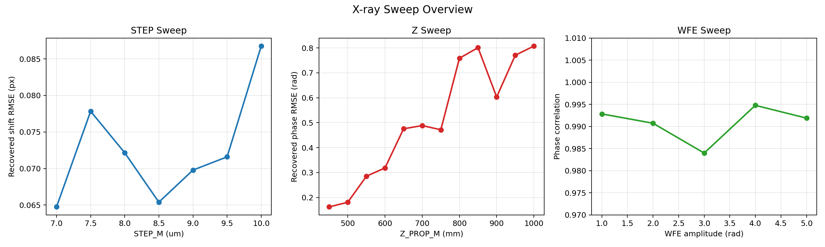

Slide 22
Sweep Result I: STEP Dependence
  Stable operating region is around 7.0 - 8.0 um.
  Best shift RMSE appears at STEP_M = 7.0 um.
  Best phase RMSE appears at STEP_M = 8.0 um.
  Performance degrades noticeably for STEP_M >= 9.5 um.

Slide 23
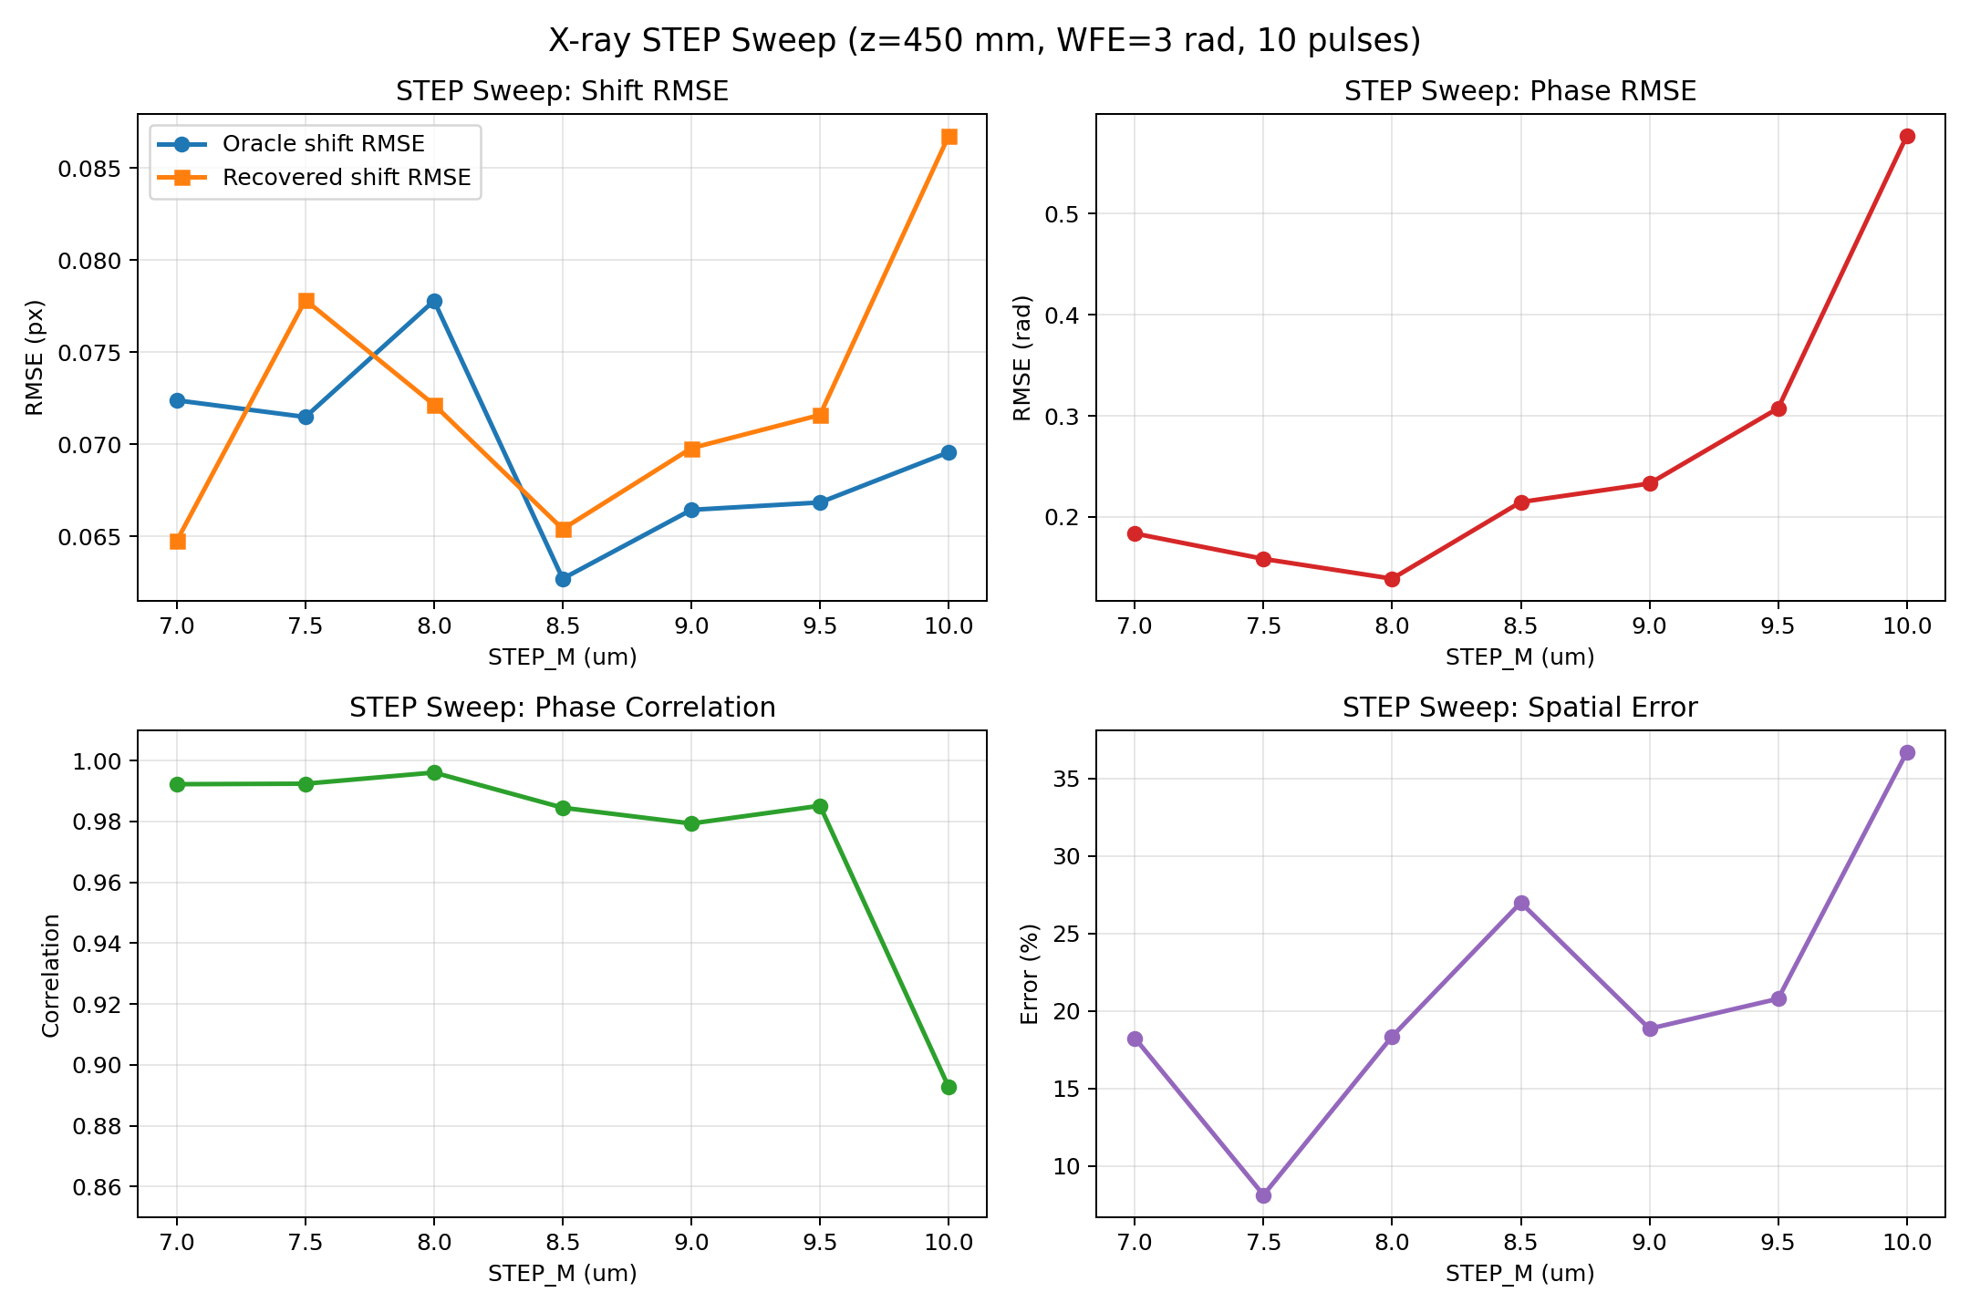

Slide 24
Sweep Result II: Propagation Distance Dependence
  Best shift RMSE appears near Z = 500 mm.
  Best phase RMSE appears near Z = 450 mm.
  Performance degrades strongly beyond 700 mm.
  This is the expected sensitivity vs. dynamic-range trade-off.

Slide 25
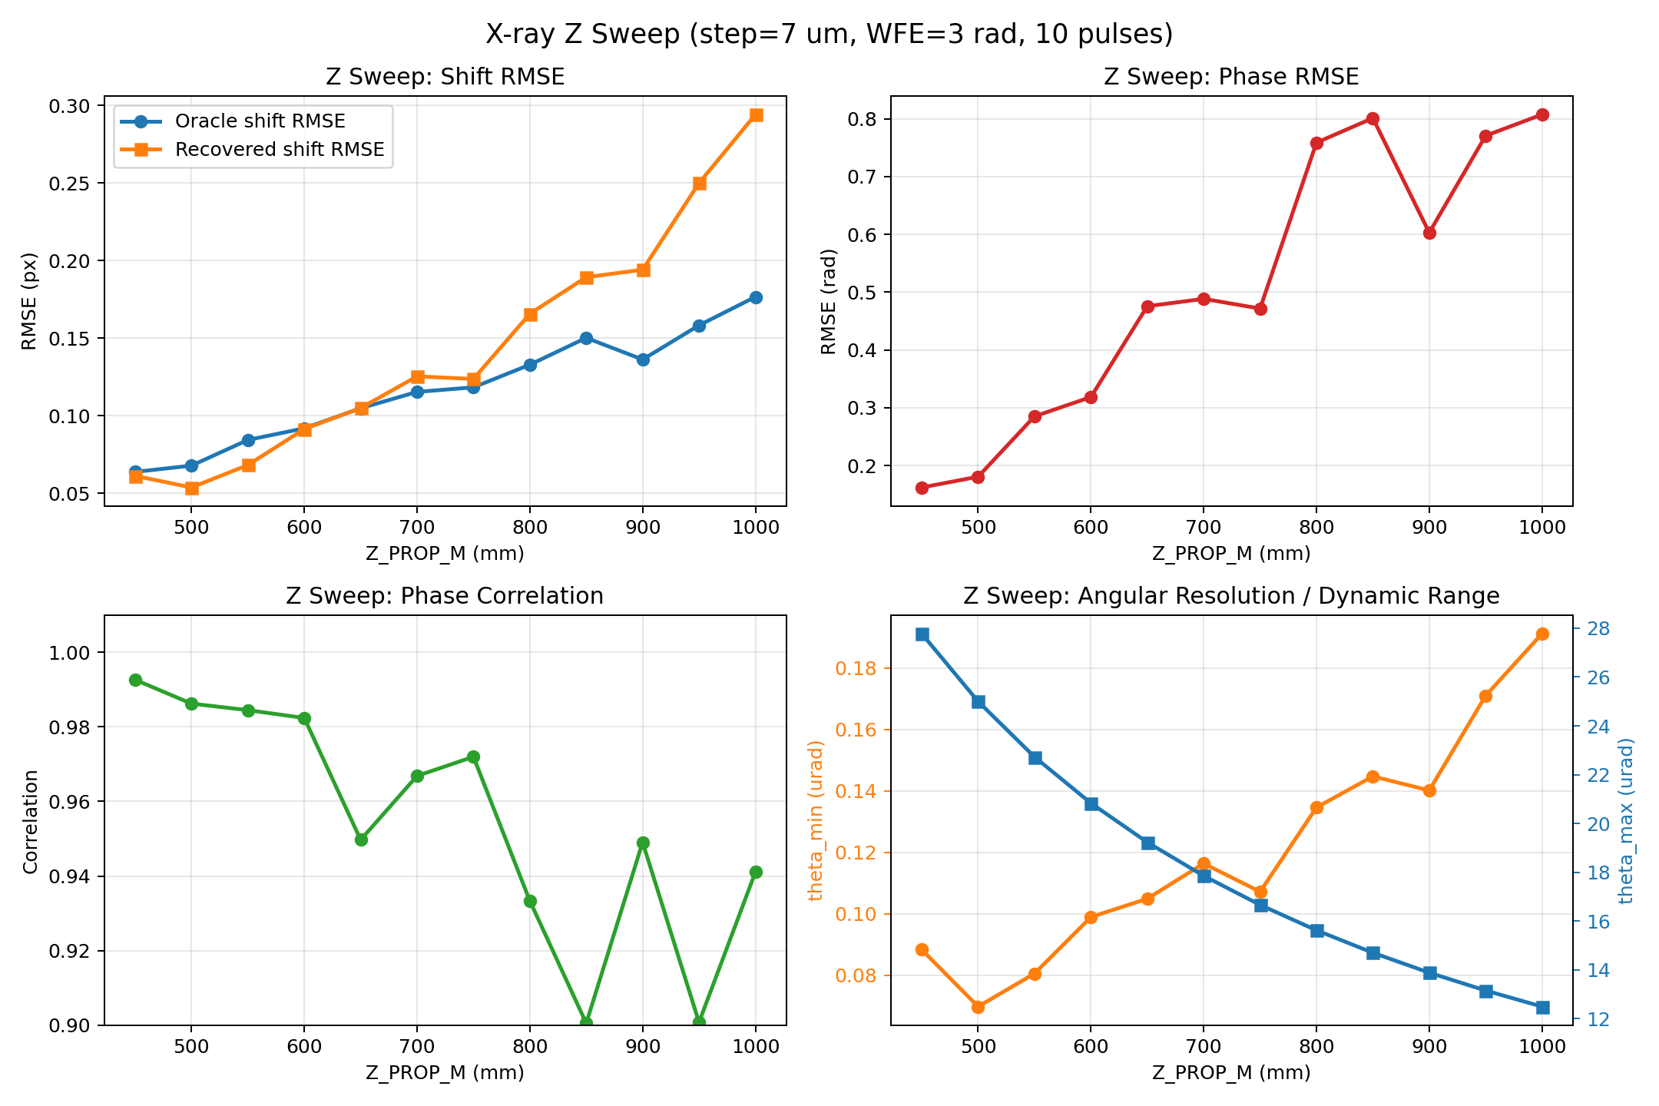

Slide 26
Sweep Result III: Wavefront Error Dependence
  Best overall accuracy appears at WFE = 1.0 rad.
  Shift and phase RMSE increase as aberration strength grows.
  The algorithm remains usable across the tested 1 - 5 rad range.

Slide 27
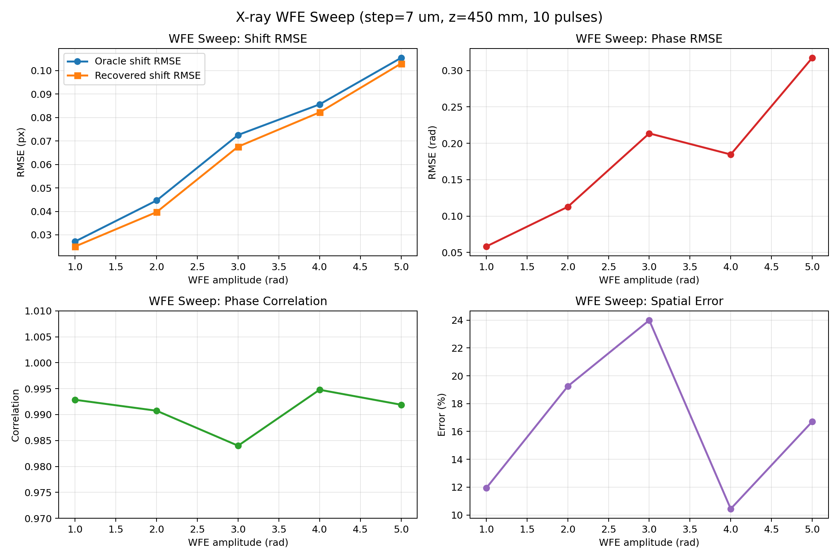

Slide 28
Recommended Operating Point
  N_PULSES = 10
  STEP_M = 7.0 um
  Z_PROP_M = 450 mm
  WFE = 3.0 rad as a representative medium-aberration benchmark
  Recovery method: cross_correlation
  Decomposition method: iterative
  The current pipeline already achieves nanometer-scale displacement sensitivity on accumulated multi-pulse X-ray Hartmann data.

Slide 30
Conclusion
  The current X-ray Hartmann workflow successfully recovers pulse-wise wavefront information from a single accumulated detector frame.
  Cross-correlation is the strongest recovery method in the present implementation.
  The present geometry works best near 450 - 500 mm.
  The system already reaches high displacement sensitivity while preserving practical dynamic range.

