Slide 1
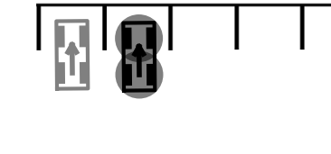
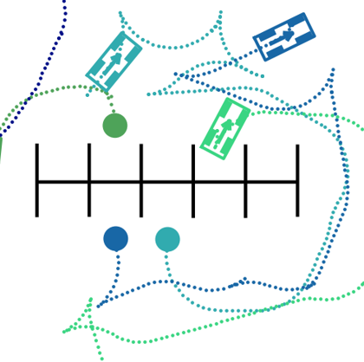

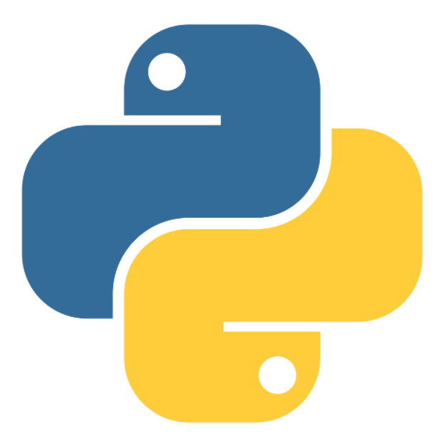

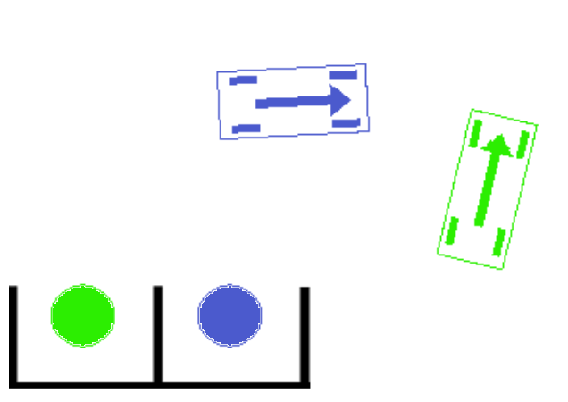
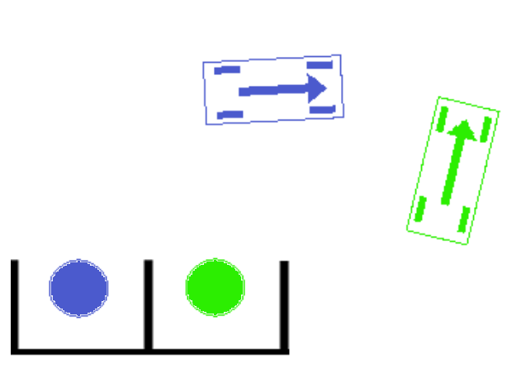
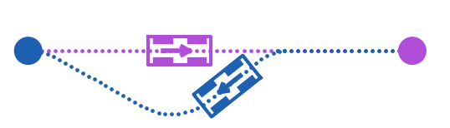

Smart Parking Space Assignment using Motion Planning
Motivation
Project Aim
On average Australians will spend 3120 hours on searching for parking spaces in their lifetime according to a study from Parkhound [1]. Locating parking spaces for incoming vehicles with sensors installed in the parking lots can save drivers’ time and money/fuel.
Design algorithms that assign empty parking spaces for vehicles coming into the parking lots.
Use motion planning to provide a reference path for incoming vehicles.
Problem/Modelling
Approaches
Assign available parking spaces if vehicles start at random positions in the parking lot.
Motion planning in multi-vehicle scenarios while the parking lot can not have access to future movements of incoming vehicles.
Parking Space Assignment
Greedy Distance-Based
Assign the closest parking space to a vehicle.
If multiple vehicles have the same goal, assign it to the closest vehicle.
Prioritized Distance-Based
Specify random priorities to vehicles.
If multiple vehicles have the same goal, assign it to the vehicle has the highest priority.
Implementation
Distance Metric
The weighted distance for special Euclidean group state space consisting of Cartesian and angular component was used.
Motion Planning
RRT* is the low-level planning algorithm [2]
Reed Shepp steering function to satisfy non-holonomic constraints [3].
Generate an initial trajectory from the start to goal position for each vehicle without considering other vehicles.
In the refining phase, check whether conflicts occur over all time steps.
If there are conflicts, randomly choose one among affected vehicles to replan while keeping other affected vehicles stopping.
Python
Parking Environment Creator
Visualization + Animation
C++
Motion Planning using OMPL
Simulation Results
Example
We evaluated the performance of our goal assignment algorithms in the simulation environment. For each number of agents (1 to 5 agents), there are 20 scenarios where vehicles start at random positions.
 | Methods | Average | Improvement Compared to Random (%)
Success Rate (%) | Random | 81.0 | -
 | Greedy | 93.0 | 14.8
 | Prioritized | 91.0 | 12.4
Average path length * | Random | 74.5 | -
 | Greedy | 25.8 | 65.4
 | Prioritized | 24.7 | 66.8
Max path length ** | Random | 105.9 | -
 | Greedy | 39.4 | 62.8
 | Prioritized | 35.4 | 66.6
Notes:
In total, there are 20 x 5 x 3 = 300 scenarios
The simple replanning strategy is incomplete. It tends to fail when a large number of agents involves.
The prioritized goal assignment only tested up to 120 random sequences of priorities. The number of permutations is factorial 𝑁! It is not practical to test all permutations for a large 𝑁.
Greedy Method
Prioritized Method
* Average path length is the average of average path lengths of all agents among all successful scenarios
** Max path length is the average of longest path lengths of all agents among all successful scenarios.
Future Work
Simple Replanning
“Closed-Loop” goal assignment for dynamic scenarios where vehicles can come in from the entrance and go out of the scene via the exit.
Heuristic costs for the distance metric such as obstacle density
Improve the motion planning by PRM and space-time A*
Improve the motion planning to adapt driver-mixed (human driver and autonomous cars) scenarios.
Compare the performance of greedy and prioritized methods when a large number of agents involves.
[1] Parkhound, “Australian drivers spend over 3,000 hours looking for parking in their lifetime,” Parkhound, 13-May-2019. [Online]. Available: https://www.parkhound.com.au/blog/australian-drivers-spend-over-3000-hours-looking-for-parking-in-their-lifetime/. [Accessed: 22-May-2021].
[2] S. Karaman and E. Frazzoli, “Sampling-based algorithms for optimal motion planning,” The International Journal of Robotics Research, vol. 30, no. 7, pp. 846–894, Jun. 2011, doi: 10.1177/0278364911406761.
[3] Steven M. LaValle. Planning Algorithms. Cambridge University Press, New York, NY, USA, 2006.

