Slide 1
Introduction to Cyber Security
COMP3134 Week 11

Slide 2
Overview
Objective
Web Application Hacking
Cross-site Scripting (XSS)
Main Teaching Points
When there is an opening, you must validate
Inputs/imported items must be verified
Learning Outcome(s)
Implement various tactics to attack a network or application
Critique and execute mitigation techniques

Slide 3
Web Application Hacking

Slide 4
Web Application Hacking
Problem
Focus is on construction, protection from attackers secondary
Development sometimes outsourced
Developers move on to other projects
Comparison
Hiring painter
Significance / Risks
Company and attacker may have same starting point
Attacker has specialized skill
Company may not have specialized knowledge in IT field

Slide 5
Web Application Hacking
Implication
With same starting point but contrast of skill
Who has advantage?
Attack techniques always ahead of mitigation techniques
Application
Areas of concern
Information passed to application
Forms
Errors messages returned

Slide 6
Web Application Hacking
General Techniques
Unvalidated Input
Parameter/Form Tampering
Injection Flaws
Cross-site Scripting (XSS)

Slide 7
Unvalidated Input
Definition
Input from client not validated before being processed
“All user controller input is evil and therefore must be tested”
Comparison
Ask for currency, receive game coin
Significance / Risks
Sometimes user input in directly processed in application

Slide 8
Parameter/Form Tampering
Definition
Manipulation of parameters passed between client and web application
Significance / Risks
Integrity between parameter passed and web application compromised
Implication
CIA violated if verifications not done

Slide 9
Injection Flaws
Definition
Untrusted data is interpreted and executed as valid data or command
Accomplished by
Constructing malicious command or queries
Passing them as valid commands
Difference
Invalid data vs Injected data
Incorrect vs malicious

Slide 10
Injection Flaws
Targets
SQL Server
System Command
File Upload

Slide 11
Injection Flaw Target: SQL Server
Definition
Injection via database management system of SQL
Structured Query Language
Significance / Risks
Most application have a database connection
Sometimes connection is not a secure as can be

Slide 12
Injection Flaw Target: System Command
Definition
Injection of a command line statement via application vulnerability
Occurs because of lack on input data validation
Significance / Risks
Command statements affect network layer

Slide 13
Injection Flaw Target: File
Definition
Attacker uploads file or installs & runs program onto victim’s server
Occurs when command is exec()-uted directly from user input
Significance / Risks
Ability to alter file system structure gets attacker ultimate control
If and only if has permissions

Slide 14
Cross-site Scripting (XSS)

Slide 15
Cross-site Scripting (XSS)
Definition
Attack that injects malicious code into a vulnerable web application
Difference
XSS vs Injection
target the application VS target users of application
Significance / Risks
User machine is affected by visiting web application

Slide 16
Cross-site Scripting (XSS)
Categories
Reflected
Stored
DOM-based
Susceptibilities
HTTP headers
Form fields that directly output content to user

Slide 17
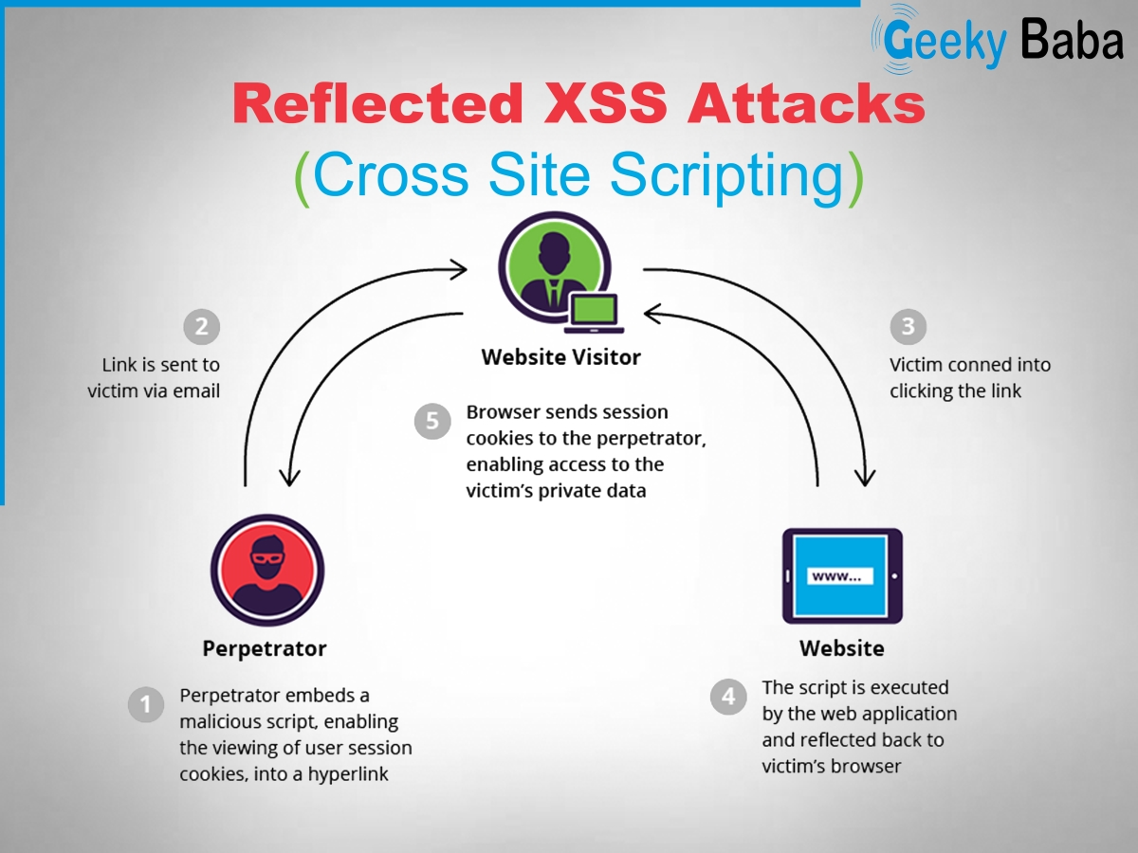
Reflected XSS

Slide 18
Reflected XSS
Definition
Also know as non-persistent XSS
Attacker sends link to server that yields http request => malicious code to execute on victim’s machine
Steps
1) Attacker finds vulnerability in application
2) Attacker send link to victim
3) Victim clicks on links
4) Victim is sent to vulnerability of application
5) Data is taken (user info, session cookies, etc) or malware installed
6) Info in sent to attacker

Slide 19
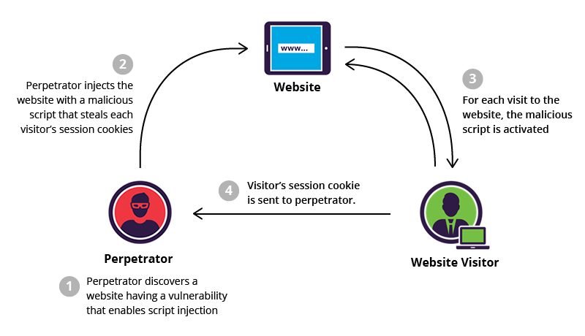
Stored XSS

Slide 20
Stored XSS
Definition
Also know as persistent XSS
Malicious code or script is permanently stored on a vulnerable application via a persistence storage medium
Database
Steps
1) Attacker finds vulnerability in application
2) Attacker embeds malicious code in application
3) Victim accesses application
4) Malicious code is executed
5) Data is taken (user info, session cookies, etc) or malware installed
6) Info in sent to attacker

Slide 21
DOM-based XSS
Definition
Document Object Model-based Cross-site Scripting
When application contains JavaScript that processes data from an untrusted source in an unsafe way
Components
Source
Sink

Slide 22
DOM-based XSS
Source
A source is a JavaScript property that contains data that an attacker could potentially control.
document.URL
document.referrer
location
location.href
location.search
location.hash
location.pathname

Slide 23
DOM-based XSS
Sink
A sink is a DOM object or function that allows JavaScript code execution or HTML rendering.
eval
setTimeout
setInterval
document.write
element.innerHTML

Slide 24
DOM-based XSS
Goal
Place data into a source, such that it is propagated to a sink => causes JavaScript execution
Create new process or DOM elements exploiting vulnerabilities

Slide 25
XSS Evasion Techniques
Definition
Methods attackers use to bypass XSS filters.
Evade
Built-in XSS filters by modern browsers
Input validation performed by the application and server

Slide 26
XSS Evasion Techniques
Browser filters
Ineffective against Stored and DOM XSS
Looks for suspicious <script> tags => blocks either code block or entire code
What are some disadvantages of either behavior?
Search often done by regex
Server-side application
Effective against Stored and Reflected XSS
Developer must manually update code to protect against newer threats

Slide 27
XSS Evasion Techniques
Encode Characters
Avoid regex detection
Enter html entity codes or hexadecimal encoding
Whitespace Embedding
Consecutive whitespace ignored by html
Breaks regex rules
Tag manipulation
Nest tag within tag
<scr<script>ipt>document.write("Successful XSS")</scr<script>ipt>
More
https://www.owasp.org/index.php/XSS_Filter_Evasion_Cheat_Sheet

Slide 28
XSS Mitigations
Definition
Strategy to prepare for and lessen the effects of potential threats faced by a data center.
Prevention Source
OWASP site
https://cheatsheetseries.owasp.org/cheatsheets/Cross_Site_Scripting_Prevention_Cheat_Sheet.html

Slide 29
XSS Mitigations
Rules
Deny all content unless the rules below are followed
HTML Escape Before Inserting Untrusted Data into HTML Element Content
Attribute Escape Before Inserting Untrusted Data into HTML Common Attributes
JavaScript Escape Before Inserting Untrusted Data into JavaScript Data Values
Please note there are some JavaScript functions that can never safely use untrusted data as input - EVEN IF JAVASCRIPT ESCAPED!
CSS Escape And Strictly Validate Before Inserting Untrusted Data into HTML Style Property Values
URL Escape Before Inserting Untrusted Data into HTML URL Parameter Values

Slide 30
Terms to Know
Unvalidated Input
Parameter/Form Tampering
Injection Flaws
SQL Injection
Command Injection
File Injection
SQL
XSS
Reflected XSS
Stored XSS
DOM-based XSS

Slide 31
Terms to Know
Persistent
Non-persistent
Source
Sink
Evasion technique
XSS Mitigation

Slide 32
Resources
Websites
https://owasp.org/www-community/attacks/xss/
Videos
https://www.youtube.com/watch?v=GoqGlxJxItg

