Slide 1
Introduction to Cyber Security
COMP3134 Week 12

Slide 2
Overview
Objective
Fraudulent Activities & Authentication
Securing Application
Main Teaching Points
Goal should be to minimize vulnerabilities to reduce application risks
Learning Outcome(s)
Implement various tactics to attack a network or application
Critique and execute mitigation techniques

Slide 3
Fraudulent Activities

Slide 4
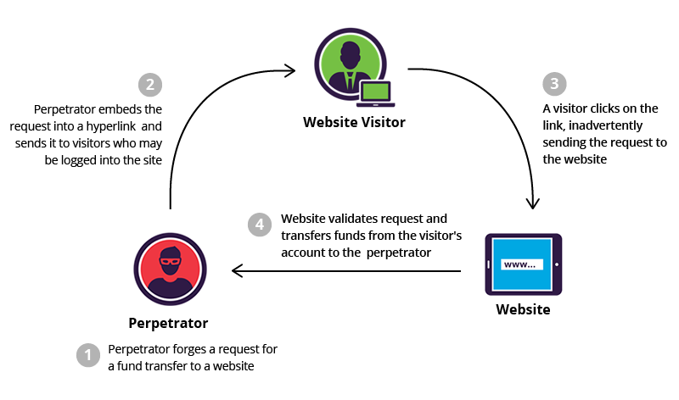
Cross-site Request Forgery

Slide 5
Cross-site Request Forgery
Definition
CSRF, XSRF
Unauthorized commands transmitted from a user that is trusted by application
Also known as one-click attacks, session riding
Difference
XSS vs CSRF
Exploits trust that application has in a user’s browser

Slide 6
Cross-site Request Forgery
Accomplished by
Tricking a web browser into executing an unwanted action in an application to which a user is logged in
Significance / Risks
User believes request is processed by company
Once spoofed, user distrusts company
Damaged client relationships

Slide 7
Cross-site Request Forgery
Application
Sending email or link that tricks the victim into sending a forged request to a server.
User is usually authenticated
Makes it impossible to distinguish a legitimate request from a forged one.

Slide 8
Cross-site Request Forgery
Mitigation
User
Logging off web applications when not in use
Securing usernames and passwords
Not allowing browsers to remember passwords
Avoiding simultaneously browsing while logged into an application
Application
Generate unique random tokens for every session request or ID.
Checked & verified by the server.
Session requests having either duplicate tokens or missing values are blocked
Attacks are customized to application

Slide 9
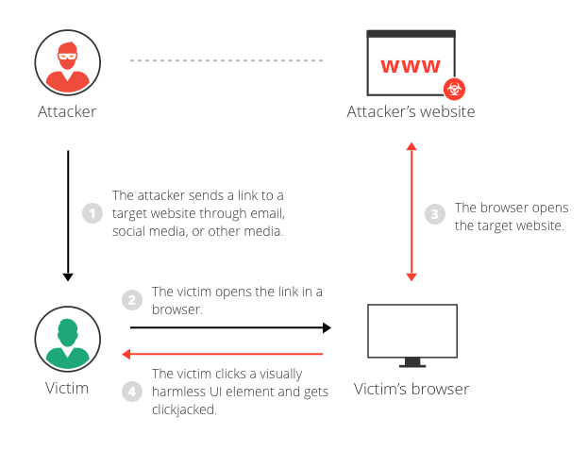
Clickjacking

Slide 10
Clickjacking
Definition
Attack that tricks a user into clicking a webpage element which is invisible or disguised as another element.
Comparison
Touch doorknob and receive a shock
Significance / Risks
Can cause users to unwittingly engage in attackers malicious plan

Slide 11
Clickjacking
Accomplished by
Displaying invisible HTML element inside or on top of another HTML element
User believes they are clicking the visible element but in fact they are clicking an invisible element
Variations
Likejacking
Facebook Like button is manipulated, causing users to like a page they did not intend to like.
Cursorjacking
Changes the cursor for the position the user perceives to another position.
Worked for flash applications and the Firefox browser
Has been sinced been fixed

Slide 12
Clickjacking
Mitigation
Client-Side
Frame Breaking
Do not allow your webpage to be displayed within a frame (<frame>, <iframe>, <object>
Add JavaScript code to site
Not best solution
Can easily be by-passed
Server-Side
HTTP security headers
X-Frame-Options
Disallows rendering of a page in a frame

Slide 13
Authentication

Slide 14
Password Cracking
Definition
Process of guessing password
Significance / Risks
If no mitigation defense put in place => only matter of time before password guessed
Mitigation
Lockout policy
You must wait N minutes before attempting to log in again
Captcha
Ban IP

Slide 15
Password Cracking
Attack Types
Dictionary
Create text file of words => load into program => attempt each word as password
Hybrid
File of words, file of symbols => follow same process of Dictionary
Brute-force
Trial and error approach and hoping, eventually, to guess correctly

Slide 16
Understanding What Cookies Are & Their Use
Definition
Cookies are used to store information about user to be accessed later
Facilitate user-experience on site
Stored as small files on file system => easily accessed
Unencrypted, plain text
Comparison
When humans remember personal things about other humans
Significance / Risks
Holds personal information about user, does not adhere to CIA

Slide 17
Understanding What Cookies Are & Their Use
Implication
Attacker gains physical access to user machine => cookie info exposed
Mitigation
User
Do not select “Remember Me” option
Clear cookies periodically
Application
Do not store authentication of users
Secure cookie by setting the secure and HttpOnly cookie attributes

Slide 18
URL Obfuscation
Definition
Attack where the real URL that a user is directed to is obfuscated in hopes to trick user
Comparison
Which of these words/terms spelled correctly
Mispelled
Principal
Sucessfull
Independant

Slide 19
URL Obfuscation
Significance / Risks
Very hard to distinguish obfuscated URL from real one
Site landing page will look same too
Mitigation
Double check spelling of URL on which you are clicking
Understand which communications application would send you

Slide 20
Terms to Know
CSRF, XSRF
Clickjacking
Likejacking
Cursorjacking
Cookie
URL Obfuscation

Slide 21
Resources
Websites
https://owasp.org/www-community/attacks/csrf
Videos
https://www.youtube.com/watch?v=13QPmRuhbhU

