Slide 1
DSC 204A: Systems for Scalable Analytics
5/15/23 Programming Assignment 2
Feature Engineering & Model Selection with Apache Spark
Presenter: Megha Agarwal
Slide Contributors: Pradyumna Sridhara

Slide 2
Today we’ll go through
Goals
Hardware Platform
Spark overview
Spark API Examples
Assignment Tasks and Grading
Demo
Few Tips

Slide 3
Learning Outcomes
Get hands-on experience with Apache Spark
Get familiar with feature engineering. Learn how to transform raw data into machine-learning usable data
Get experience on model selection

Slide 4
Hardware Platform: DSMLP
UCSD’s Data Science & Machine Learning Platform (DSMLP)
Uses Kubernetes to manage clusters
Spark is automatically set up as soon as server is started More information here.

Slide 5




Hardware Platform: DSMLP
DSMLP
Login node
Spark cluster namespace
SSH Tunnel & Port Forwarding
Kubernetes
Spark-Workers
running
Spark jobs
Your machine
NFS mounted
Spark-Master
Running: Jupyter Notebook, Spark driver, master, UIs
Public dataset

Slide 6
1.Spark
2.Tasks

Slide 7
Spark: Overview
Spark is a general-purpose cluster computing system
Data processing: Spark data APIs
Machine learning: ML (for DataFrame) and MLlib (for RDD)
Graph processing: GraphX
Streaming data: Spark Streaming
Notes:
Mainly used for large-scale data analytics. Provides APIs to perform distributed computations across the cluster.

Slide 8
Spark Interfaces: Overview
Languages: Scala (native), Java, Python (PySpark), R, SQL
APIs: (multiple choices) RDD, DataFrame, DataSet (only in Scala and Java), Koalas
Notes:
Spark here refers to the design/framework of how to efficiently do data analytics in a distributed fashion.
Framework has been implemented in multiple languages. Different styles/flavors of APIs.

Slide 9
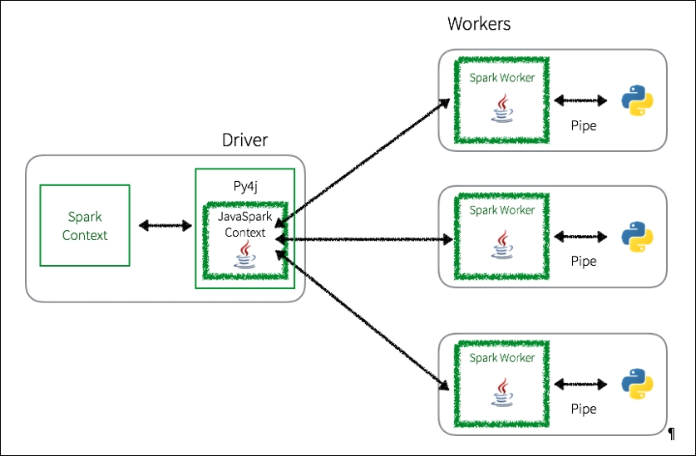
Python + Spark = PySpark: Architecture
Your Python code
Things you don’t have direct control
Notes:
Data processing is handled by Python processes
Data persistence and transfer is handled by Spark JVM processes. Errors you get will mention Java and Scala.
Spark Context = programmatically represents the connection to a Spark cluster. APIs are executed through the SparkContext.
Worker comms is through TCP over the network.
Spark or PySpark executor is a worker node that runs tasks on a cluster. Each executor has its own memory that is allocated by the Spark driver. This memory is used to store cached data, intermediate results, and task output. https://spark.apache.org/docs/latest/configuration.html#memory-management
A SparkContext represents the connection to a Spark cluster, and can be used to create RDDs, accumulators and broadcast variables on that cluster. Only one SparkContext should be active per JVM. You must stop() the active SparkContext before creating a new one.

Slide 10
Spark APIs: Overview
Resilient Distributed Dataset (RDD):
A distributed collection of data.
Oldest. The most basic abstraction of Spark.
ML support: MLlib. Maintenance only, i.e., no new features.
DataFrame (Recommended):
Named columns, like a table
More user-friendly API than RDDs.
Built on top of RDD but uses several optimizations.
ML support: Spark ML, actively being developed.
Koalas (Not part of Spark but from DataBricks):
Pandas API on Spark. DataFrame under the hood.
Even newer.
ML support: Integrates with MLFlow, a product from DataBricks.
Notes:
RDD – if you want finer control. Say, if you have unstructured data like media streams or streams of text. Difficult to imagine data in that style (MapReduce)
DataFrame – more familiar way of looking at data.
Koalas – closer to Pandas.

Slide 11
Spark APIs: Things in Common
Immutable. No in-place operations. Koalas mimics mutability but is still immutable in its core
Distributed
Lazy. No computation happens until an action is called. Examples:
collect()
count()
take(), show(), head(), first()
Notes:
https://sparkbyexamples.com/pyspark/pyspark-rdd-actions/
immutable objects are easy to parallelize.

Slide 12
Spark APIs: Differences
 | RDD | DataFrame | Koalas
Abstraction level | Low | High | High
Named columns | No | Yes | Yes
Query optimizations | No | Yes | Yes
Programming style | map-reduce | Dataflow, SQL | Pandas-like
Best suited for | Unstructured data Low-level ops Func. Programming / Map-reduce lovers | Structured data High-level ops with optimizations Python, R, SQL users | Pandas/Dask users who just switched to Spark
No need to stick to one specific API. Spark offers methods to convert from one to another.

Slide 13
Spark APIs: Example
Two-column table: (key, value)
Task:
group by key and calculate mean values.
value contains NULLs. Ignore the NULLs.

Slide 14
Spark APIs: Example - RDD
# RDD
agg = rdd.\
filter(lambda x: x[1] is not None).\
aggregateByKey((0, 0))( # initial value
lambda acc, x: (acc[0] + x, acc[1] + 1), # combine step
lambda acc1, acc2: ( # reduce step
acc1[0] + acc2[0],
acc1[1] + acc2[1]
)
)
mean = agg.mapValues(lambda x: x[0] / x[1])
rdd = rdd.map(lambda x: x[0]).\
distinct().leftOuterJoin(mean)
resource

Slide 15
Spark APIs: Example - DataFrame
# Spark DataFrame
sdf = sdf.groupBy('key').agg(F.avg('value'))

Slide 16
Spark APIs: Example - Koalas
# Koalas
kdf = kdf.groupby('key').agg({'value':'mean'})
Externally, Koalas DataFrames follow the structure of pandas DataFrames
Internally, Koalas translate pandas APIs into the logical plan of Spark SQL.
Helps Pandas users who want to scale out using PySpark as well as Spark users who want to leverage Koalas to become more productive.
Check out these resources:
10 Minutes to Koalas, Koalas Documentation
Interoperability between Koalas and Apache Spark, Blog Post, Aug 2020
10 Minutes from pandas to Koalas on Apache Spark, Blog Post, March 2020
Notes:
Can do things like plotting data in a Spark dataframe.
Caveat – very recent. Might be prone to bugs, some features might not be available – nested types for Tasks 2 and 3.

Slide 17
How does Dask compare with Spark?
Spark is older (since 2010) and well-trusted!
Integrates well with other Apache projects, all-inclusive
Provides good high-level optimizations on uniformly applied computations
Provides excellent support for streaming data
Dask is smaller and lighter weight than Spark, meaning fewer features.
Able to implement more complex algorithms and ad-hoc systems
Interoperate with other technologies like Numpy (!)
To re-emphasize from PA1 discussion, DS tools are evolving very fast, so understanding the internals is important.
reference
Notes:
From the Apache Family. It’s grown out of Hadoop, which is much older (2006).
Spark is a framework by itself, with its own ecosystem mostly running on JVM infrastructure. An all-in-one package.
More trusted.
Dask is often used in conjunction with other libraries, as a small part of a large system.
Almost everything you can do in Spark, you can do with Dask. It’s a question of how easy and how efficient, scalability.

Slide 18
1.Spark
2.Tasks

Slide 19
Tasks: overview
You will be given 8 tasks.
Part 1 (feature engineering): 1 to 6
Part 2 (model selection): 7 to 8
For each task, you need to implement a function named task_i(), the signature and return values of which is fixed. Do not modify the input/output blocks.
For each task, you will need to populate a python dict inside the function body. Use only native python data types and structures for this dict.
Notes:
Regression model using Decision Tree to predict the user rating for a product.
Helper functions – Initialize spark context, to read and write data,
you can focus only on the task at hand.

Slide 20
Tasks: datasets
You will be given 5 tables from the Amazon review dataset.
product - The metadata about each product
review - The review scores for product
product_processed - Same as above, but with some preprocessing
ml_features_train - Table with all features after Part 1
ml_features_test - Same as above, test split
Notes:
You are given ML-ready features in a different table for Part 2, by feature engineering + join (product and users) tables since this takes time to do it by yourself.

Slide 21
Tasks: Example
Description: Calculate the mean of a column x.
Output schema:
Code example:
res
| -- mean_x: float -- mean of x
def task_0(df):
res = {'mean_x': None}
# ----Your implementation------
mean_x = df[‘x'].mean()
…
# ----Put result------
res['mean_x'] = mean_x
# --------------------------
return res
You can only code in this section!
Notes:
If you’re using numpy, please convert.

Slide 22
Grading
Correctness: 100 for correctness, however, we have a timeout.
Runtime:
Extra points for fast runtime
Points deducted for slow runtime

Slide 23
Grading - Correctness
Several sub-tests for each task with hidden datasets.
Your code must pass all sub-tests to be counted pass for that task.

Slide 24
Grading - Timing
Hard timeout: 2 hours. Will kill after it.
You get points for each task you passed in 2 hours.
We will deduct points if runs for more than 1 hour.
Extra points if your code is correct and runs fast. Details in the PDF document provided to you.

Slide 25
Quick Note on DSMLP
Fixed number of resources. Shared by other courses as well
Cannot extend it like we did in AWS.
DSMLP might not be able to schedule resources for you if there is a surge in demand
Can happen if lot of students request for resources at the same time.
Highly recommended to start early and complete early.
Shut down your cluster if you know you’ll be AFK for a while. Currently there is a 3hr automatic timeout. No daily limit.

Slide 26
Demo
Notes:
ConEmu for windows
https://spark.apache.org/docs/latest/web-ui.html

Slide 27
Best Practices
Spark’s best practices are aligned with SQL best practices.
Use the native DataFrame APIs or Spark SQL as much as possible ¹
User-defined Functions (UDFs) are tricky to optimize.
Native APIs handle NULLs gracefully.
Spark is lazily evaluated. Try to avoid redundant computations for better runtime.
Check for cross joins if join queries seem slow.
Start early!

Slide 28
Questions?

