Slide 2
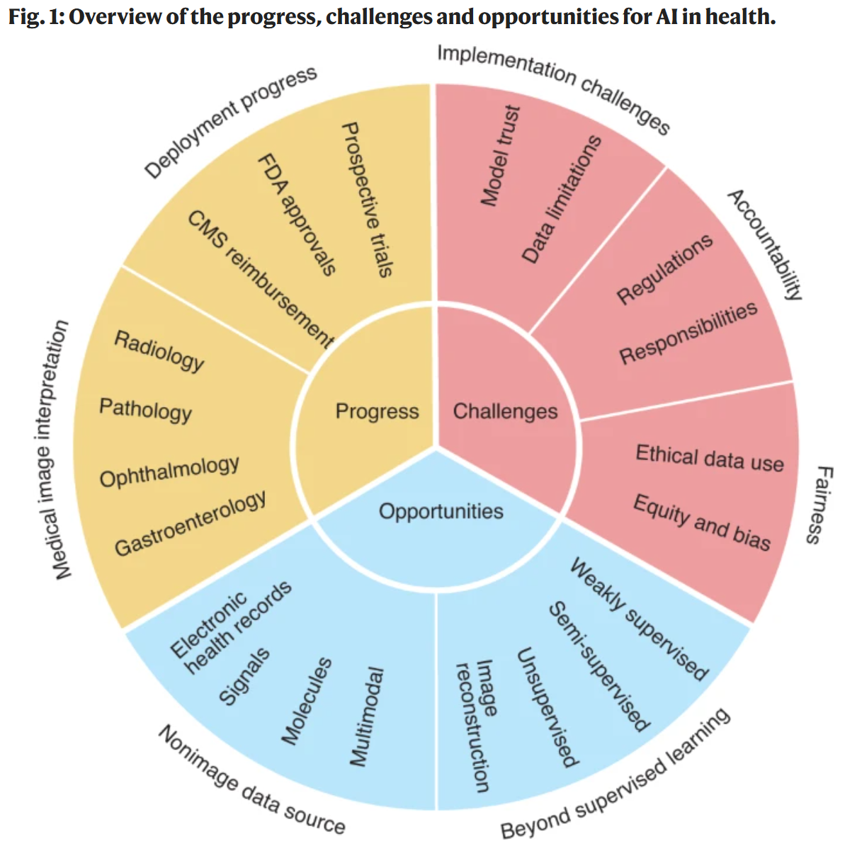
AI in health and medicine | Nature Medicine

