Slide 1

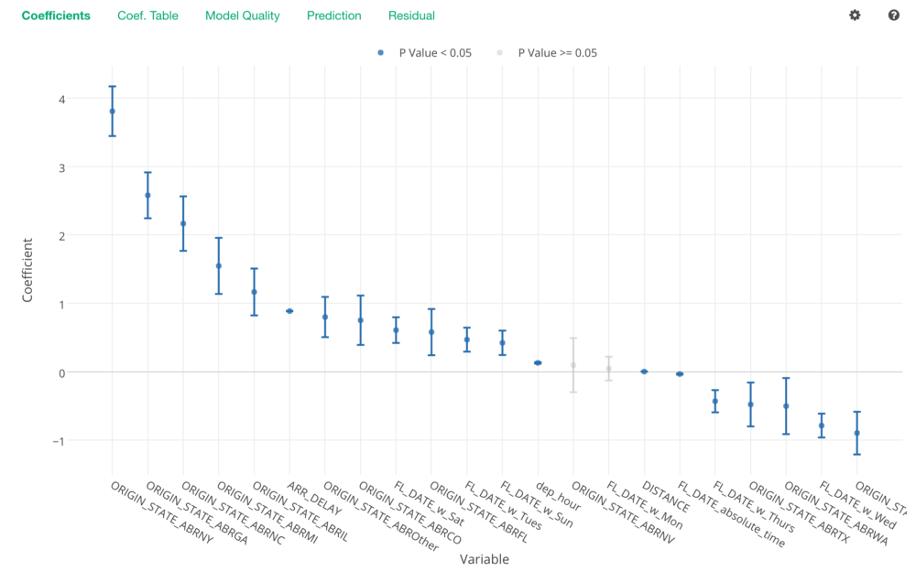
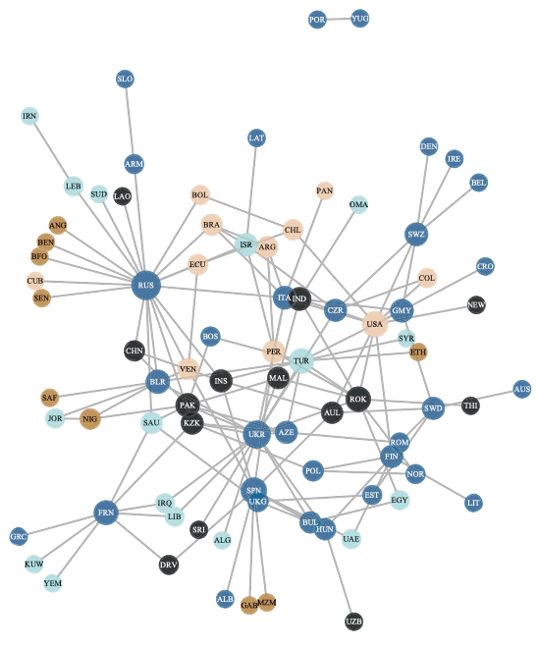

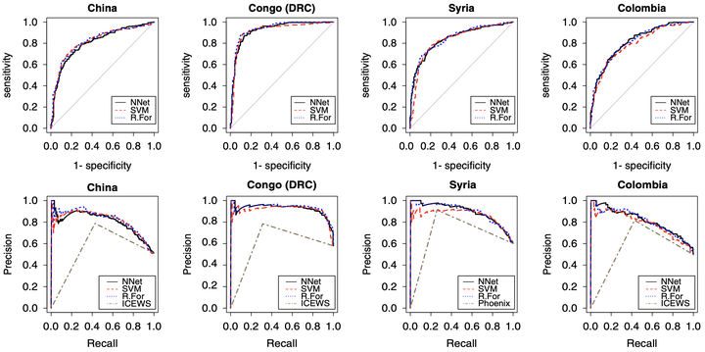
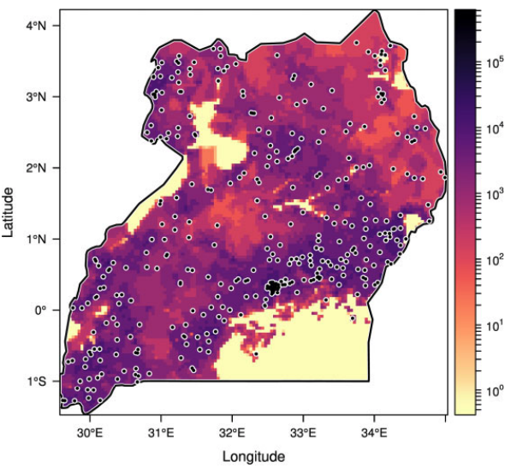
GV 900 Political Explanation
2021-2022
Dr. Howard Liu
University of Essex
Email: howard.liu@essex.ac.uk

Slide 2

Welcome!
Module Objectives:
1. Become a good political science knowledge “consumer”
Read, understand, and evaluate statistical analyses published in PS journals
Acquire the basics statistical knowledge to become a future data scientist
Be able to take more advanced modules
2. Become a good political science knowledge “producer”
Be able to conduct rigorous quantitative analyses/research
Be familiar with basic statistical models
Feel comfortable analyzing data in R

Slide 3
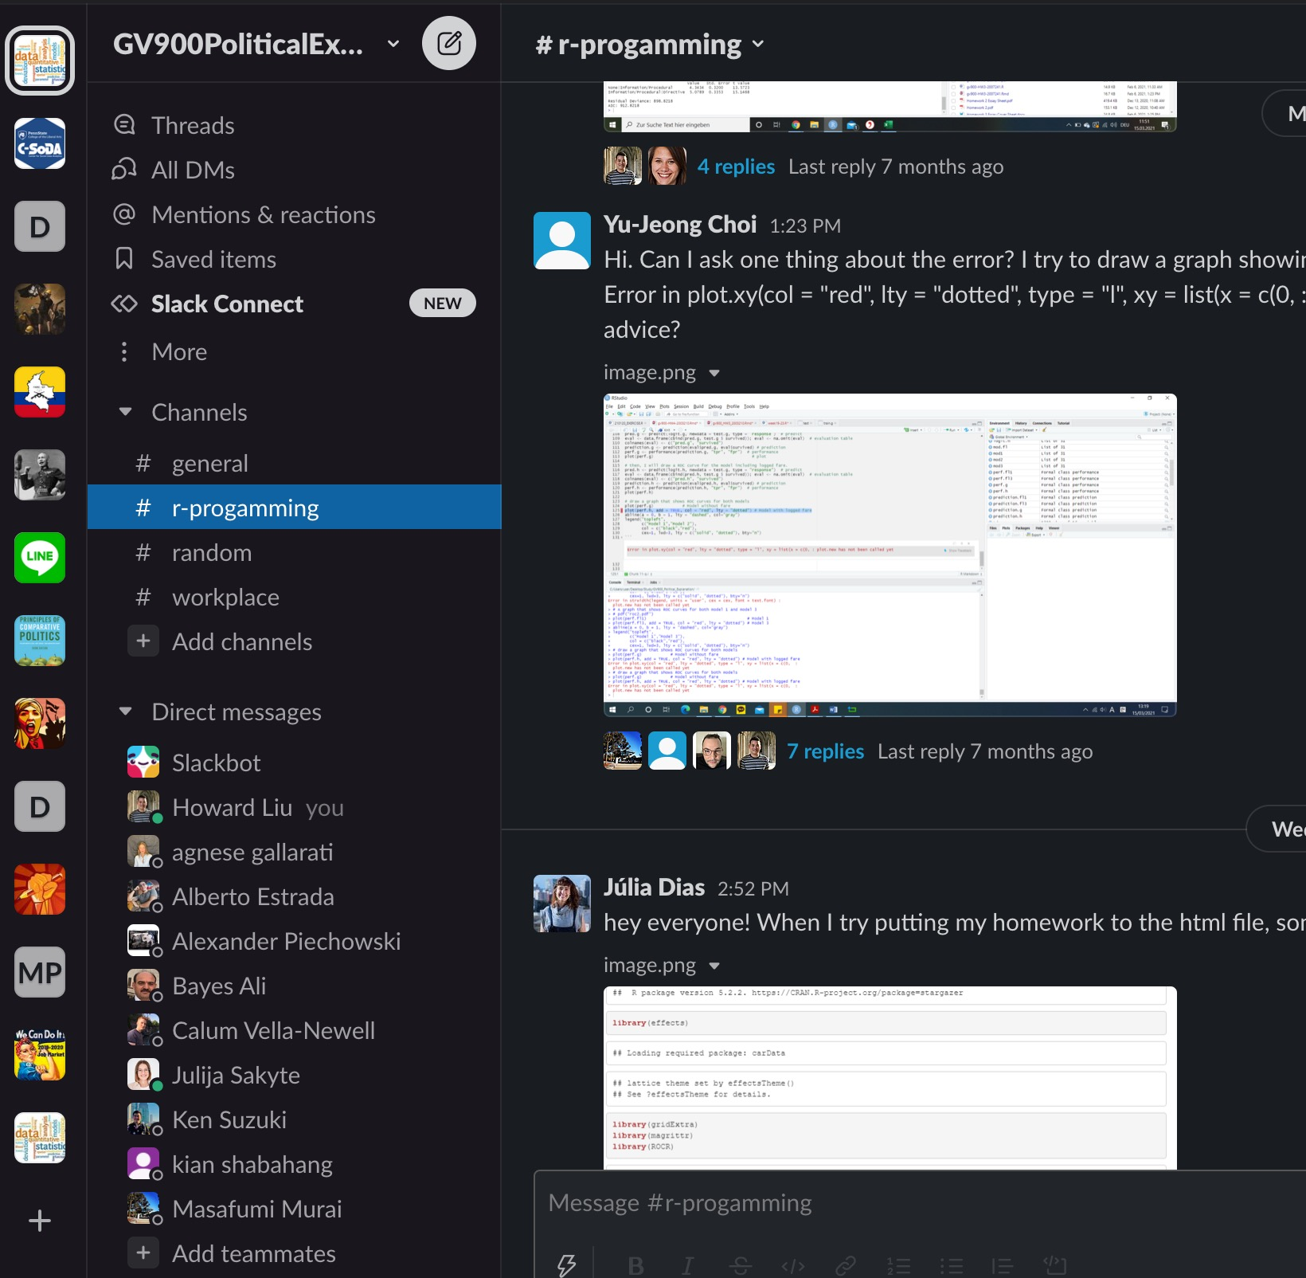
Module Structure
1. Lecture: 50 min or less in-person lecture
I will teach basic knowledge on research design and statistical concepts
2. R session: 50 min or less pre-recorded video
I will teach R programming step by step
Video available on Moodle by Monday
3. Q&A on Slack:
Post questions on Slack, either me or other students will jump in answering
Students who answer questions more than 15 times, will receive 10 extra points in their final exam, which is a lot.
Online office hour: Appointment-based
Individual meetings (Calendly): https://calendly.com/howard-hl-liu/15min

Slide 4
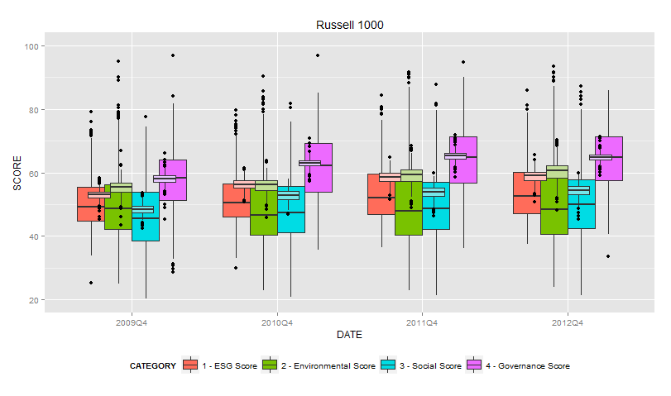
Schedule: Spring 2021
Week 16 Multiple regression: interactive models
Week 17 Multiple regression: models for nonlinear relationships (HW 3)
Week 18 Multiple regression: fixed-effects and random-effects
Week 19 Logistic regression (HW 3 Due)
Week 20 Evaluating predictive abilities of models
Week 21 Binary time-series cross-sectional models
Week 22 Ordered logistic regression
Week 23 Multinomial logistic regression (HW 4)
Week 24 Event count models
Week 25 Review and Final Take-home Exam (HW 4 Due)

Slide 5
Logistics
1. Install R and RStudio on your computer (by next week)
Mac: https://www.youtube.com/watch?v=1PsPfMaLWSk
Windows: https://www.youtube.com/watch?v=9-RrkJQQYqY
3. Advice: Google is your best friend
StackOverflow (Q&A platform for R): https://stackoverflow.com/
I would advise you to Google before you ask questions on Slack
4. Slack as our main mode of communication: gv900-2021.slack.com (join by next week)
Install tutorial: https://slack.com/help/articles/207677868-Download-Slack-for-Mac.
Everyone can ask; everyone can answer
A GTA and I will monitor Slack regularly, and you should do the same
You can email me if you have time-sensitive matters. Everything else please goes into the Slack.

Slide 6
Homework for the First Week
Enjoy the fun in this class!

