Slide 1

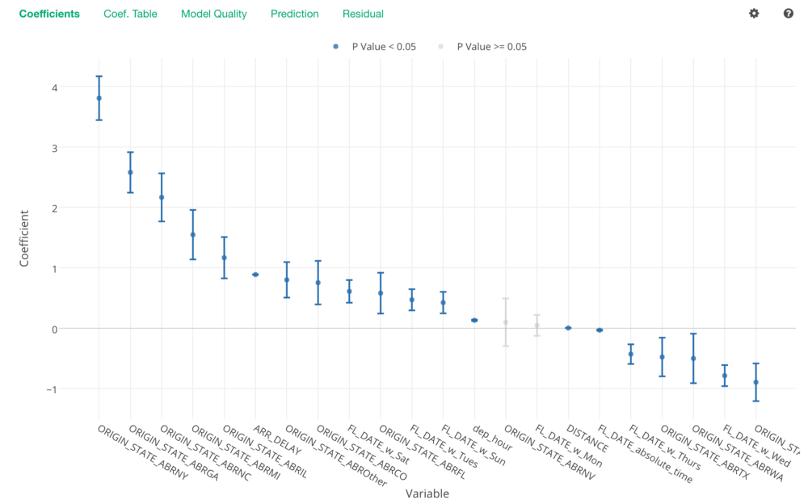
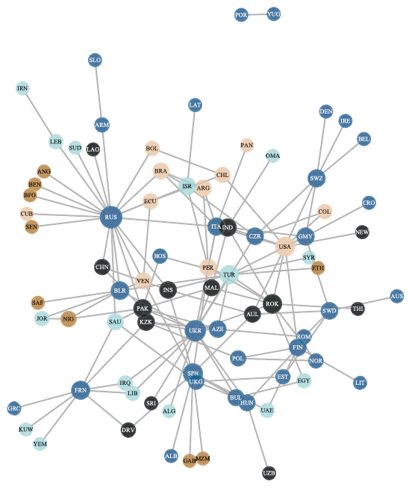
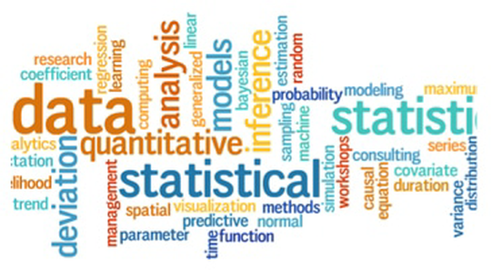
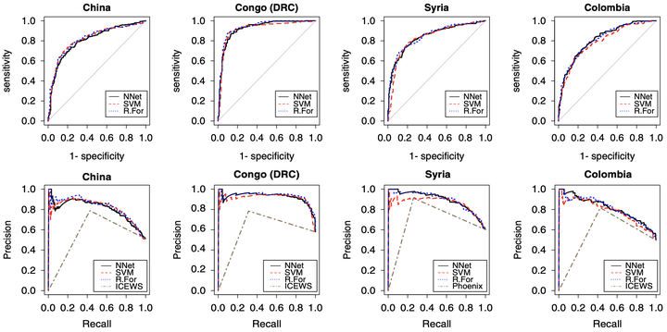
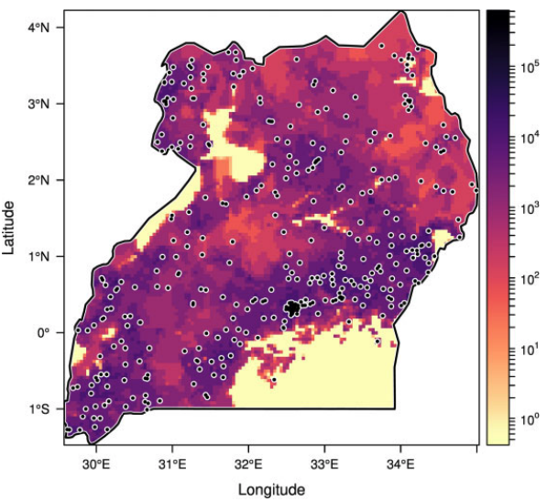
Data Science Bootcamp for Beginners using R
Dr. Howard Liu
University of South Carolina
Email: howard.hl.liu@gmail.com

Slide 2

Welcome!
Bootcamp Objectives:
1. Become a good political science knowledge “consumer”
Read, understand, and evaluate statistical analyses published in PS journals
Acquire the basics statistical knowledge to become a future data scientist
Be able to take more advanced modules
2. Become a good political science knowledge “producer”
Be able to conduct rigorous quantitative analyses/research
Be familiar with basic statistical models
Feel comfortable analyzing data in R

Slide 3
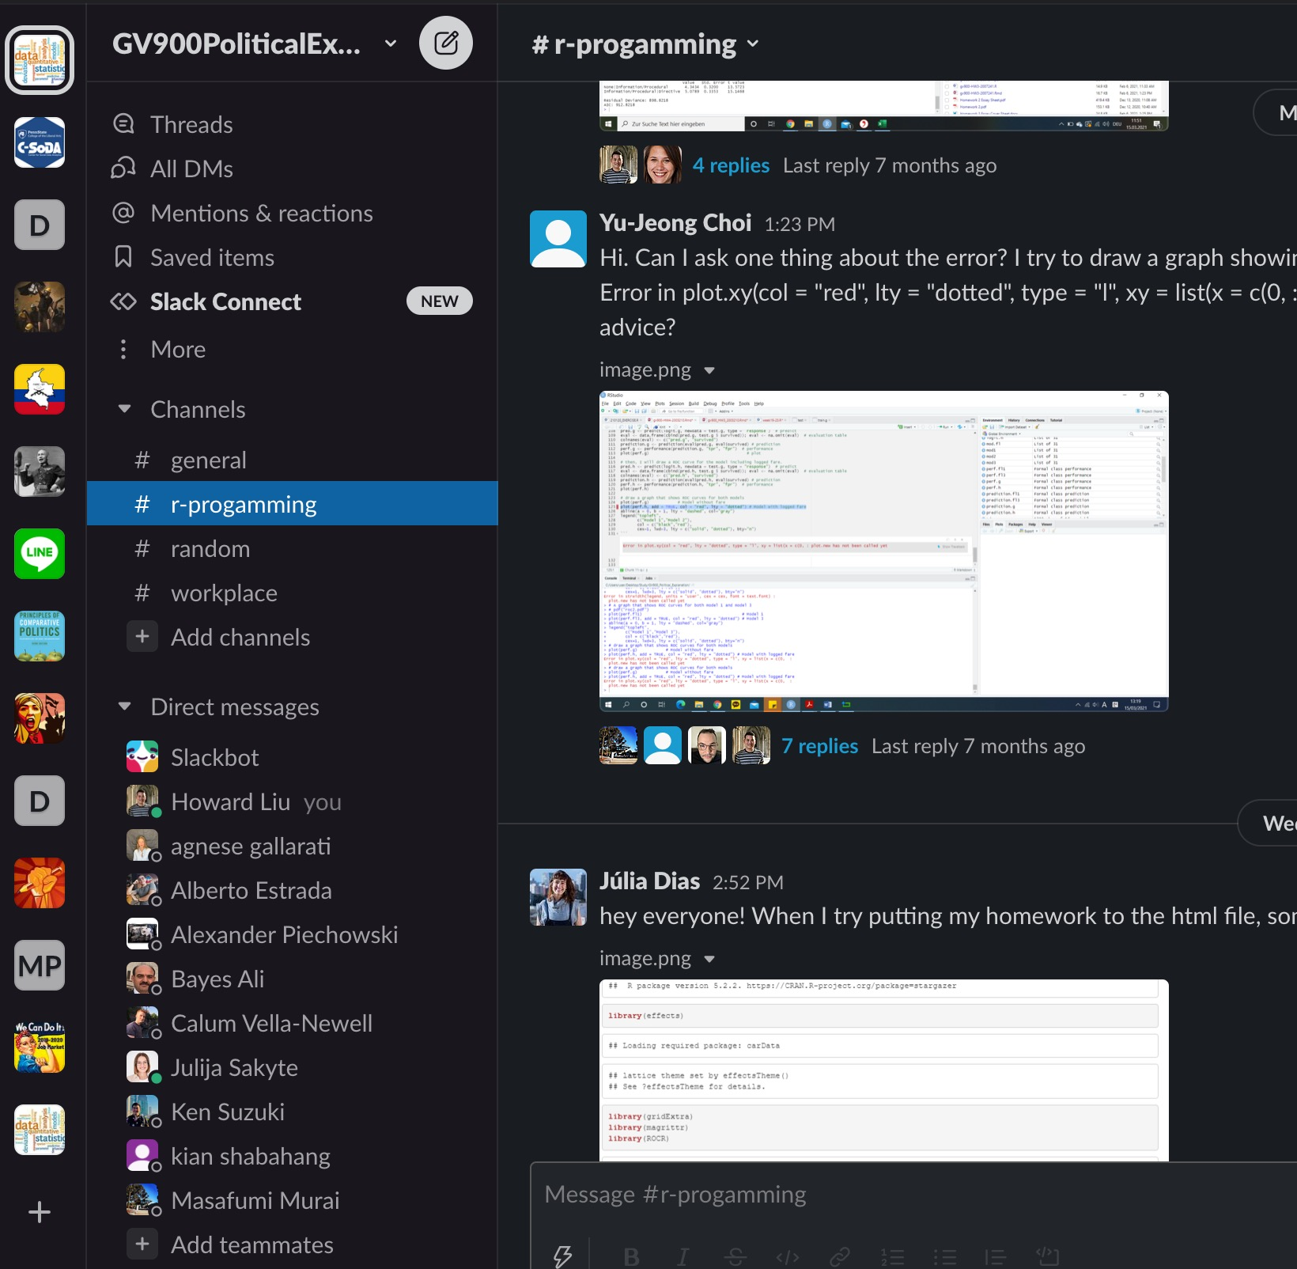
Module Structure
1. Lecture: 50 min or less lecture
I will teach basic knowledge on research design and statistical concepts
2. R session: 50 min or less programming lab
I will teach R programming step by step
3. Q&A on Slack:
Post questions on Slack, either me or other students will jump in answering
Students who answer questions more than 15 times, will receive 10 extra points in their final exam, which is a lot.
Online office hour: Appointment-based
Individual meetings (Calendly): https://calendly.com/howard-hl-liu/15min

Slide 4
Logistics
1. Install R and RStudio on your computer
Mac: https://www.youtube.com/watch?v=1PsPfMaLWSk
Windows: https://www.youtube.com/watch?v=9-RrkJQQYqY
2. Install Latex on your computer
Mac: https://www.youtube.com/watch?v=nUuW_8Hy1qA
Windows: https://www.youtube.com/watch?v=kSN-gS4SIqc
3. Advice: Google is your best friend
StackOverflow (Q&A platform for R): https://stackoverflow.com/
I would advise you to Google (or ask ChatGPT) before you ask questions on Slack

Slide 5
Homework for the First Day
Enjoy the fun in this class!

