Slide 1
Matching Data
Some quick statistics

Slide 2
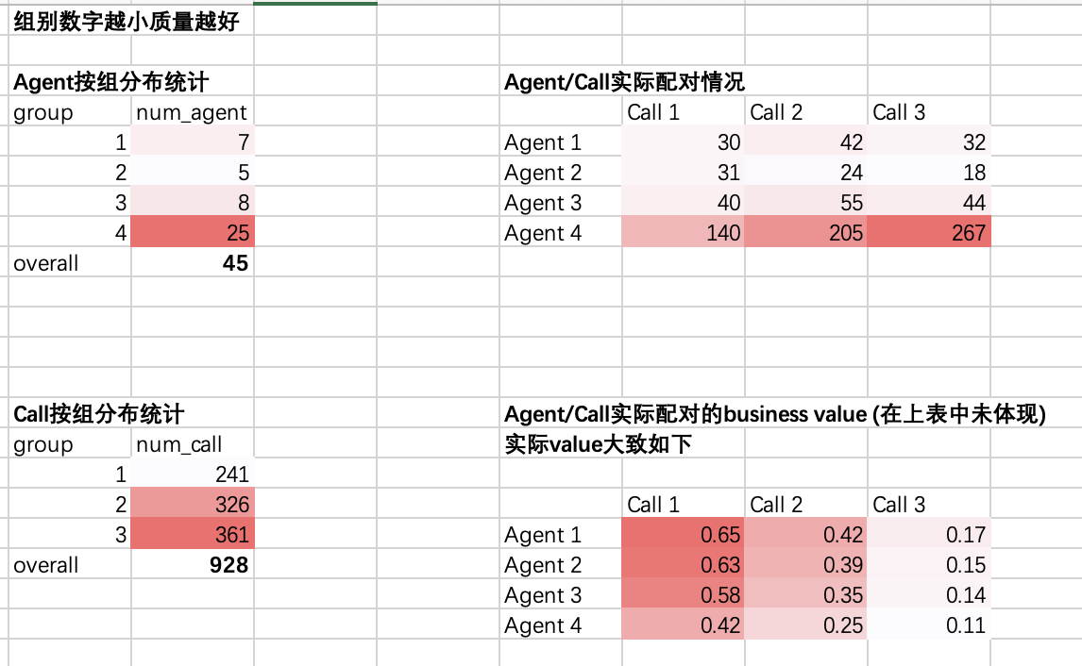
Date 10.01

Slide 3
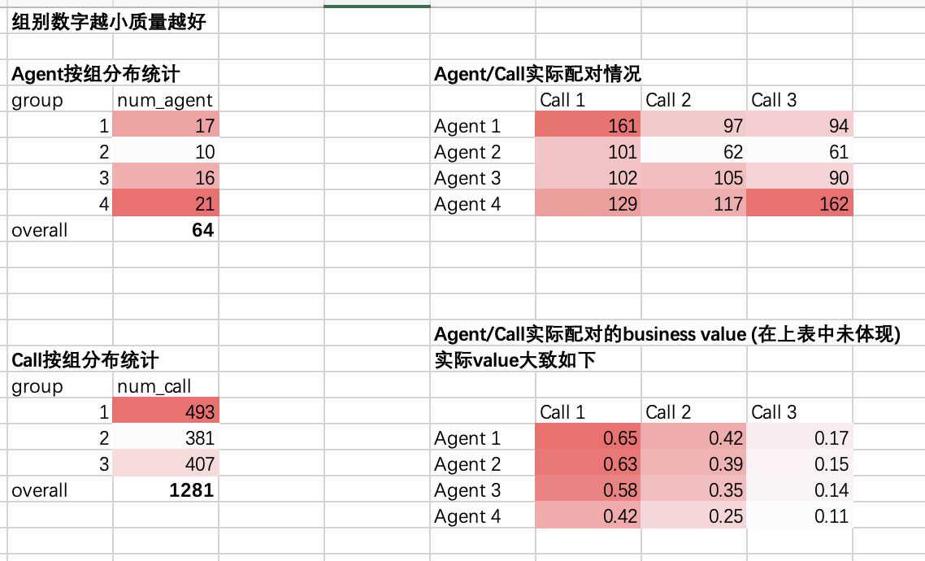
Date 11.01

