Slide 1
QFGB 8948 — Team Portfolio Project
Client-ready portfolio recommendation using factor analysis, MVO, Risk Parity, and historical simulation
Time-Varying Factor Model
& Portfolio Analysis
CLIENT
Georgina
TEAM MEMBERS & ROLES
PROJECT DATE
Member
Role
Today: December 31, 2013
End of the provided data set; no later returns are used.
Jeff and Aryan
Quantitative Modelling & Factor Analysis
Cameron, Hao and James
Portfolio Construction & Optimisation
Aryan
Client Analysis & Presentation
Ezra
Risk Decomposition & Simulation
Assignment structure followed: client situation, investment analysis, risk decomposition and HS, MVO proposal, RP proposal, HS comparison, and final investment proposal.
Fordham University | MSQF Spring 2026

Slide 2
Page 1 — Client Situation
Current wealth · current portfolio · historical risk-return · client goals · required return
CLIENT MANDATE
REQUIRED RETURN ANALYSIS
CURRENT PORTFOLIO
Input
Value
W(t+1) = W(t) x (1 + r - 2%) + $200K
Solve for r so W(5) = $23.00mm
Ann. Return
Ann. Vol.
Age
57 years old
6.40%
8.40%
Current Wealth
$18.00mm
Required Ret.
Current Ret.
Return Gap
Annual Income
$200K / yr for next 5 years
6.02%
6.40%
+0.38 pts
Sharpe
Worst DD
Annual Spending
2% of wealth / yr
0.458
-37.0%
Retirement
Age 62; five-year horizon
Year
Start
Ret.
Inc.
Spend
End
Yr 1
$18.00mm
6.0%
$200K
$360K
$18.92mm
Wealth Target
$23.00mm at retirement
Yr 2
$18.92mm
6.0%
$200K
$378K
$19.88mm
Drawdown Limit
No worse than 15% of $18mm
Yr 3
$19.88mm
6.0%
$200K
$398K
$20.88mm
Goal
Result
Current Portfolio
Equal weight: 20% each x 5 assets
Yr 4
$20.88mm
6.0%
$200K
$418K
$21.92mm
Return / Wealth Target
YES
Yr 5
$21.92mm
6.0%
$200K
$438K
$23.00mm
Drawdown <= 15%
NO
The current allocation reaches the wealth target on average, but its historical drawdown is more than double the client's stated limit.
QFGB 8948 – Team Portfolio Project
Page 1

Slide 3
Page 2 — Investment Analysis
Risk-return profile · distribution characteristics · factor profiles · asset interpretation
ASSET RISK-RETURN STATISTICS (ANNUALISED, JAN 2004-DEC 2013)
FACTOR PROFILES & ASSET IDENTIFICATION
Asset
Ann. Ret
Ann. Vol
Sharpe
Skew
Kurt.
Max DD
Asset
Home Factor
Likely Class
Read-through
Asset 1
4.55%
2.65%
0.754
0.46
3.36
-2.8%
Asset 1
US AGG (+0.89)
Core bonds
Low vol anchor
Asset 2
8.40%
18.63%
0.314
-0.54
0.69
-50.8%
Asset3
9.33%
24.96%
0.271
-0.34
1.50
-62.3%
Asset 2
US Growth (+0.94)
US equity
Return engine
Asset 4
4.27%
4.86%
0.353
0.24
-0.21
-8.0%
Asset3
Commod. (+0.71)
Alt / real asset
Largest drawdown
Asset 5
5.44%
7.13%
0.405
-0.92
5.37
-13.5%
Asset 4
HF FOF Div (+0.58)
Multi-asset HF
Diversifier
Eq-Wt Portfolio
6.40%
8.40%
0.458
--
--
-23.7%
Asset 5
TIPs (+0.97)
Inflation bonds
Duration / TIPS
CORRELATION & DISTRIBUTION TAKEAWAYS
IMPLICATION FOR PORTFOLIO CONSTRUCTION
Asset 2 and Asset3 dominate return-seeking risk: together they explain about 87% of the equal-weight portfolio's asset TRC.
Asset 5 has a strong TIPS identity and a fat left tail, so it is useful but not a pure cash substitute.
Asset 1 is the cleanest defensive sleeve, while Asset 4 behaves like a multi-asset diversifier.
Issue
Implication
Return need
Requires some equity/alt exposure; pure defensive portfolios fall short.
Drawdown need
Requires reducing Asset3 concentration and controlling equity-factor TRC.
Next step
Estimate time-varying factor loadings before applying MVO constraints.
QFGB 8948 – Team Portfolio Project
Page 2

Slide 4
Page 3 — Risk Decomposition & Historical Simulation
TRC · factor TRC using average filtered betas · HS 2004-2013 · current allocation goal assessment
ASSET TRC — EQUAL-WEIGHT PORTFOLIO
FACTOR TRC — AVG FILTERED KALMAN BETAS
CURRENT HS RESULTS
Asset
Weight
Ann. Vol
TRC %
Factor
Bucket
Beta
TRC %
End Wealth
Ann. Ret.
Asset3
20.0%
24.96%
52.8%
US Growth
Equity
0.268
42.7%
1.83x
6.40%
Asset 2
20.0%
18.63%
34.2%
Long Short HF
Alternatives
0.259
24.6%
Asset 5
20.0%
7.13%
7.1%
Commodities
Macro
0.117
19.5%
Ann. Vol.
Worst DD
Asset 4
20.0%
4.86%
5.4%
Global AGG
Rates
0.167
6.5%
8.40%
-37.0%
Asset 1
20.0%
2.65%
0.5%
TIPs
Other
0.182
6.3%
HF FOF Div
Alternatives
0.113
5.8%
Current portfolio passes the return goal but fails the client's drawdown limit.
US AGG
Rates
0.146
1.5%
LONG-ONLY ENUMERATION DIAGNOSTIC
Interpretation: long-only capped searches can reduce drawdown, but none reached both the 6.02% wealth-return requirement and the 99% drawdown-safety mandate. This motivates comparing factor-constrained MVO with a client-feasible relaxed MVO.
Cap
Tested
DD-Safe
Ret >= Req.
Both
Best Safe Ret.
30%
826
10
569
0
5.48%
35%
2,226
78
1,445
0
5.56%
50%
7,051
627
4,241
0
5.65%
Factor TRC sums to 100.0%; asset TRC sums to 100.0%.
QFGB 8948 – Team Portfolio Project
Page 3

Slide 5
Page 3B — How We Estimated Factor Loadings
Time-varying factor model · filtered betas · no smoothed look-ahead · inputs to Page 3 and Page 4
1. SELECT FACTORS
2. FIT KALMAN MODEL
3. USE AVG FILTERED BETAS
For each asset, choose exactly five factors:
Home factor = highest absolute correlation.
Cross-risk factors = strongest factor from each remaining risk bucket.
Observation:
r_t = F_t' beta_t + eps_t
State update:
beta_t = beta_{t-1} + eta_t
Filtered betas use information available up to each month. Smoothed betas use future observations and are cleaner for diagnostics, but they introduce look-ahead bias for portfolio construction.
Asset
Home Factor
Bucket
Asset 1
US AGG
Rates
Each asset gets its own five-factor state-space model, so exposures are allowed to evolve through 2004-2013 instead of being one static regression beta.
Final convention: average filtered Kalman beta over the 2004-2013 sample, which smooths single-month noise while staying time-safe.
Asset 2
US Growth
Equity
Asset3
Commodities
Macro
Asset 4
HF FOF Div
Alternatives
Asset 5
TIPs
Other
4. WHERE THE LOADINGS ENTER THE ANALYSIS
Slide
Use of Loadings
Page 2
Identify likely asset classes and key risk drivers.
Page 3
Decompose current portfolio risk by factor TRC.
Page 4
Apply factor TRC caps and compare constrained vs relaxed MVO.
Data convention: Average filtered Kalman beta, 2004-01-31 to 2013-12-31; asset and factor returns are the shared 2004-2013 monthly project data.
QFGB 8948 – Team Portfolio Project
Page 3B

Slide 6
Page 4B - Factor-Constrained MVO Considered
Page 4A — Factor-Constrained MVO Considered
Assignment-style factor TRC guardrails considered before relaxing them for client feasibility.
Assignment-style factor TRC guardrails considered before relaxing them for client feasibility.
Objective: maximize Sharpe | return >= 0.50% monthly | long-only | asset TRC <= 40% | factor TRC capped, including US Growth <= 40%
Objective: maximize Sharpe | return >= 6.02% yearly | long-only | asset TRC <= 40% | factor TRC capped, including US Growth <= 40%
PROPOSED ALLOCATION
KEY RISK RATIOS
TOP FACTOR TRC (CAPS)
Asset
Current
MVO
Change
Metric
Value
Factor
TRC
Cap
Asset 1
20.0%
42.1%
+22.1 pts
Ann. Return
6.00%
US Growth
40.0%
40.0%
Asset 2
20.0%
15.0%
-5.0 pts
Ann. Vol
6.21%
TIPs
19.9%
30.0%
Asset3
20.0%
12.6%
-7.4 pts
Sharpe
0.555
Long Short HF
18.6%
20.0%
Asset 4
20.0%
0.0%
-20.0 pts
TE vs Current
3.06%
Commodities
12.4%
30.0%
Asset 5
20.0%
30.3%
+10.3 pts
Worst DD
-22.8%
US AGG
8.3%
25.0%
Global AGG
4.7%
15.0%
Gross Exposure
1.00x
ASSET TOTAL RISK CONTRIBUTION
Asset 1
5.6%
Factor model input: Average filtered Kalman beta, 2004-01-31 to 2013-12-31. Averaging filtered betas smooths single-date Kalman noise and uses only information available by 12/31/2013.
Asset 2
32.2%
Asset3
40.0%
Why this cannot satisfy the client:
It meets the rounded 6.00% yearly hurdle, but five-year wealth is $22.98mm, slightly below $23.00mm. More importantly, worst historical wealth drawdown is -22.8% of initial wealth, versus the client's -15.0% limit. Long-only factor caps leave no short hedge to reduce the 2008 drawdown enough.
Asset 4
0.0%
Asset 5
22.2%
Asset TRC shows each asset's share of total portfolio variance.
QFGB 8948 – Team Portfolio Project
QFGB 8948 - Team Portfolio Project
Page 4B
4B

Slide 7
Page 4A - Client-Constrained MVO
Page 4B — Client-Constrained MVO
Relaxed assignment risk caps so the final recommendation satisfies the client's return and drawdown goals.
Relaxed assignment risk caps so the final recommendation satisfies the client's return and drawdown goals.
Objective: maximize Sharpe | exact Page 1 wealth-target return | historical drawdown >= -15% of initial wealth | factor/asset TRC caps relaxed | gross <= 2.10x
Objective: maximize Sharpe | exact wealth-target return | historical drawdown >= -15% of initial wealth | factor/asset TRC caps relaxed | gross <= 2.10x
PROPOSED ALLOCATION
KEY RISK RATIOS
TOP FACTOR TRC (INFO)
Asset
Current
MVO
Change
Metric
Value
Factor
TRC
Bucket
Asset 1
20.0%
120.0%
+100.0 pts
Ann. Return
6.02%
US Growth
71.0%
Equity
Asset 2
20.0%
22.7%
+2.7 pts
Ann. Vol
5.88%
US AGG
32.2%
Rates
Asset3
20.0%
9.2%
-10.8 pts
Sharpe
0.589
HF FOF Div
-14.9%
Alternatives
Asset 4
20.0%
-52.2%
-72.2 pts
TE vs Current
5.65%
Long Short HF
14.1%
Alternatives
Asset 5
20.0%
0.2%
-19.8 pts
Worst DD
-15.0%
High Yield
6.0%
Credit
Global AGG
-4.8%
Rates
Gross Exposure
2.04x
ASSET TOTAL RISK CONTRIBUTION
Asset 1
21.7%
Factor model input: Average filtered Kalman beta, 2004-01-31 to 2013-12-31. Averaging filtered betas smooths single-date Kalman noise and uses only information available by 12/31/2013.
Asset 2
52.7%
Asset3
21.1%
Client goal check: projected wealth is $23.00mm versus $23.00mm target; historical worst wealth drawdown is -15.0% of initial wealth versus the -15.0% limit. This requires relaxing assignment factor/asset TRC caps and using 2.04x gross long/short exposure.
Asset 4
4.3%
Asset 5
0.1%
Asset TRC shows each asset's share of total portfolio variance.
QFGB 8948 – Team Portfolio Project
QFGB 8948 - Team Portfolio Project
Page 4A
4A

Slide 8
Page 5 — Risk Parity Proposal
Long-only risk-control alternatives from teammate rolling 36-month Risk Parity analysis.
Purpose: test whether long-only risk budgeting can reduce drawdown without the leverage/shorting required by the client-constrained MVO.
ROLLING BACKTEST SUMMARY (JAN 2007-DEC 2013)
HRP END-OF-SAMPLE WEIGHTS
Method
Ret
Vol
Sharpe
Max DD
TE
Largest TRC
Asset
Weight
Equal Weight
4.25%
9.14%
0.357
-23.66%
0.00%
54.6%
Asset 1
64.8%
Vol RP
4.59%
3.97%
0.909
-7.38%
6.13%
22.6%
Asset 2
1.6%
Covar RP
4.32%
3.86%
0.864
-8.06%
6.31%
20.0%
Asset3
0.7%
MDP
3.56%
4.46%
0.576
-12.39%
6.61%
39.6%
Asset 4
25.5%
HRP
4.55%
2.87%
1.239
-3.79%
8.21%
48.4%
Asset 5
7.4%
Defensible takeaway: HRP has the best Sharpe and smallest historical drawdown among RP methods, but its return is below the 6.02% client hurdle. Risk Parity is therefore a strong long-only risk-control benchmark, not a complete solution to the client's wealth target.
Why this matters for Page 4: the best long-only risk budgeting result supports the same conclusion as MVO. Drawdown can be controlled, but meeting both drawdown and return requires relaxing something beyond a simple long-only allocation.
QFGB 8948 – Team Portfolio Project
Page 5

Slide 9
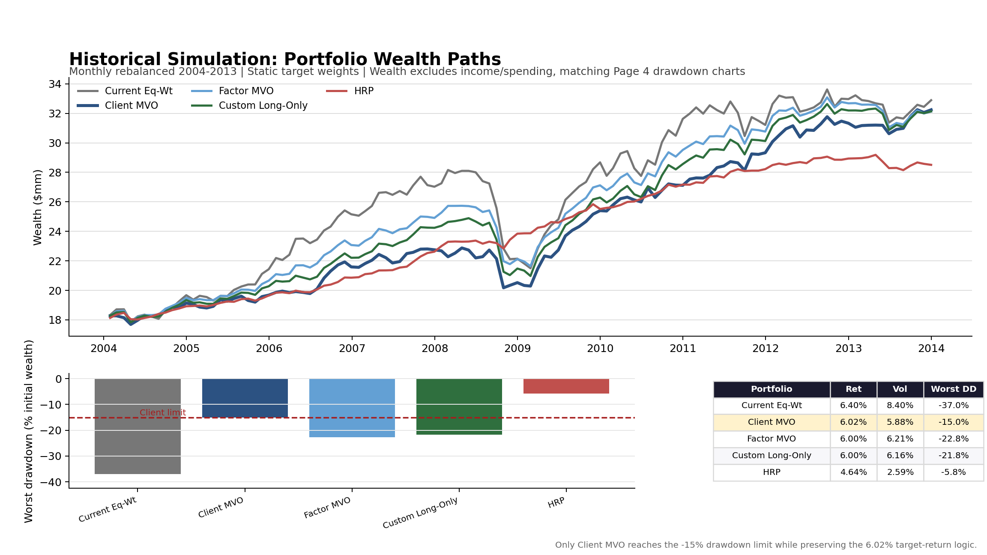
Page 6 — Historical Simulation Comparison
Historical wealth paths and drawdown outcomes for the main portfolios considered.
Method: apply each portfolio's target weights to the same 2004-2013 monthly asset returns with monthly rebalancing.
QFGB 8948 – Team Portfolio Project
Page 6

Slide 10
Page 7 — Final Recommendation
Use the client-constrained MVO as the recommendation if implementation allows; keep the long-only alternatives as fallbacks.
DECISION TABLE
Portfolio
Weights
Ret
Vol
Worst DD
Conclusion
Current Eq-Wt
20/20/20/20/20
6.40%
8.40%
-37.0%
Fails drawdown
Client MVO
120/22.7/9.2/-52.2/0.2
6.02%
5.88%
-15.0%
Meets client goals
Factor MVO
42.1/15.0/12.6/0/30.3
6.00%
6.21%
-22.8%
Shows factor caps
Custom Long-Only
40/19.5/8.7/0/31.8
6.00%
6.16%
-21.8%
Return ok, DD fail
HRP
64.8/1.6/0.7/25.5/7.4
4.64%
2.59%
-5.8%
Risk-control fallback
Recommendation: present Client MVO as the only tested allocation that meets both the exact five-year wealth target and the 15% historical drawdown limit. The tradeoff is implementation complexity: it requires shorting Asset 4 and about 2.04x gross exposure.
If the client rejects long/short exposure: use the long-only MVO, but explicitly disclose that the full mandate is not satisfied. The factor-constrained and custom long-only portfolios satisfy the return target but miss drawdown; HRP satisfies drawdown but misses return.
Bottom line: the analysis does not pretend every constraint can be met by a simple long-only portfolio. It separates the client-feasible recommendation from the factor-constrained and risk-parity diagnostics that explain why the relaxation is necessary.
QFGB 8948 – Team Portfolio Project
Page 7

