Slide 1
Predicting Game Result
Presented by:
Santosh Suwal
HaoNan Ou
Zhiqiang Wang

Slide 2

What is League of Legends (LOL)?
Multiplayer online battle arena
2 teams: Blue and Red
Goal: To take down the enemy Nexus to win the game

Slide 3
Data Overview
First 10 minutes of LOL diamond ranked games
40 columns & 9879 rows
Goal: Use a classification model to predict the outcome of a game based on the first 10 minutes statistics

Slide 4
Data Exploration
&
Data Cleaning

Slide 5
Data Exploration
Game ID: To indicate each game is unique
19 features from each team (total 38) are collected after 10 minutes in game

Slide 6
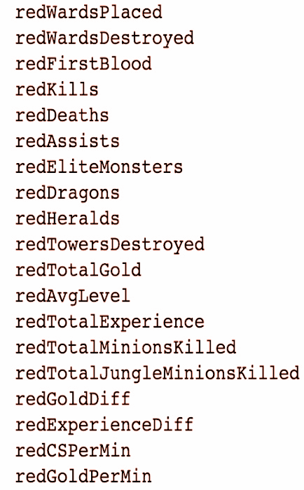
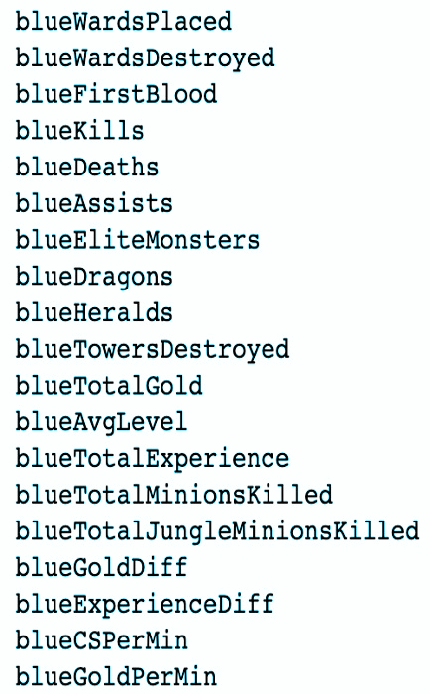

Slide 7
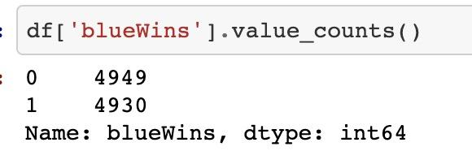
Target Variable
Target Value: blueWins
1 = Blue team wins
0 = Red team wins

Slide 8
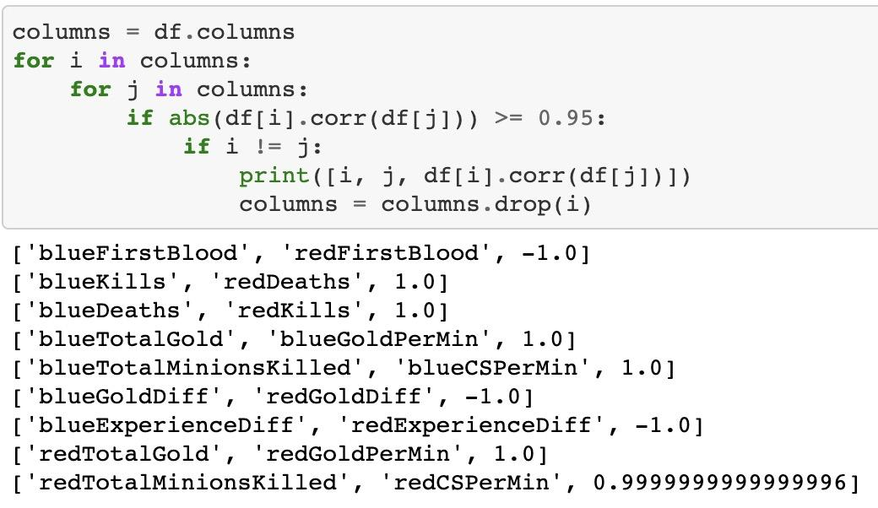
Correlation between Features

Slide 9
Data Cleaning
We dropped the following columns:
Inversely correlated
Perfectly correlated
All derived values

Slide 10
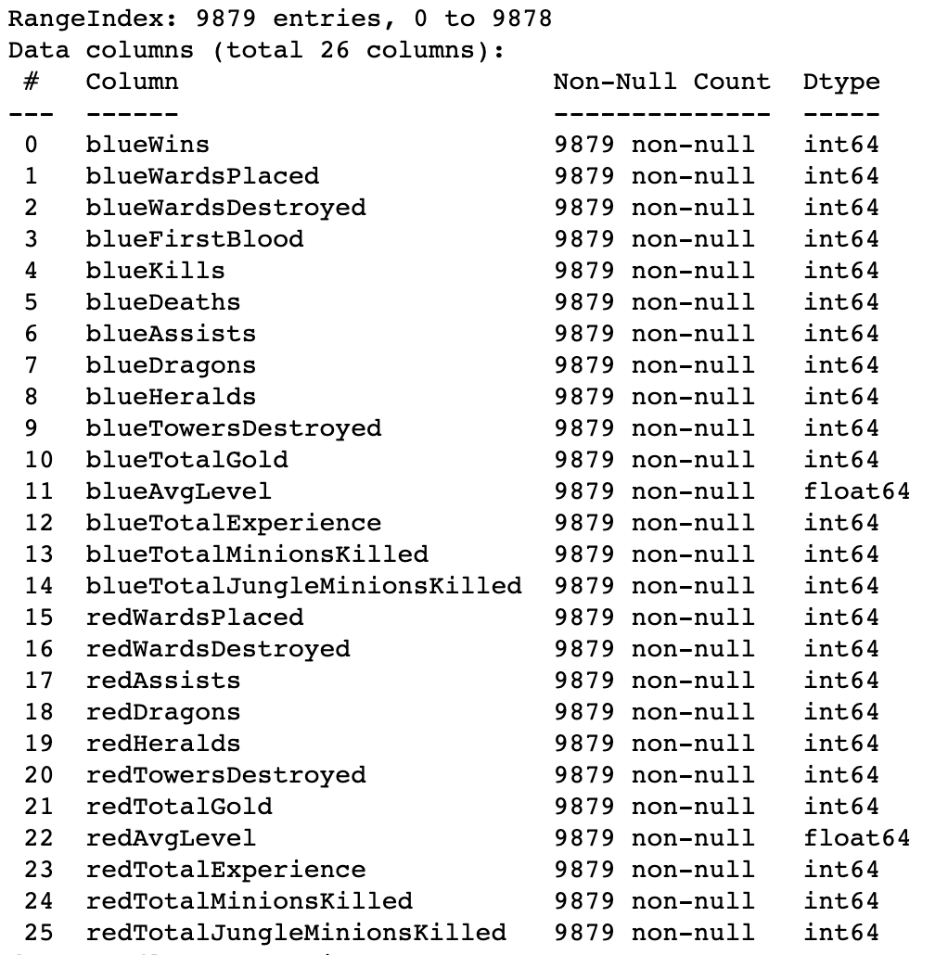
Finalized Data

Slide 11
Transformation, Feature Selection, Modeling

Slide 12
Feature Scaling
Normalization via min-max scaling
Standardization

Slide 13
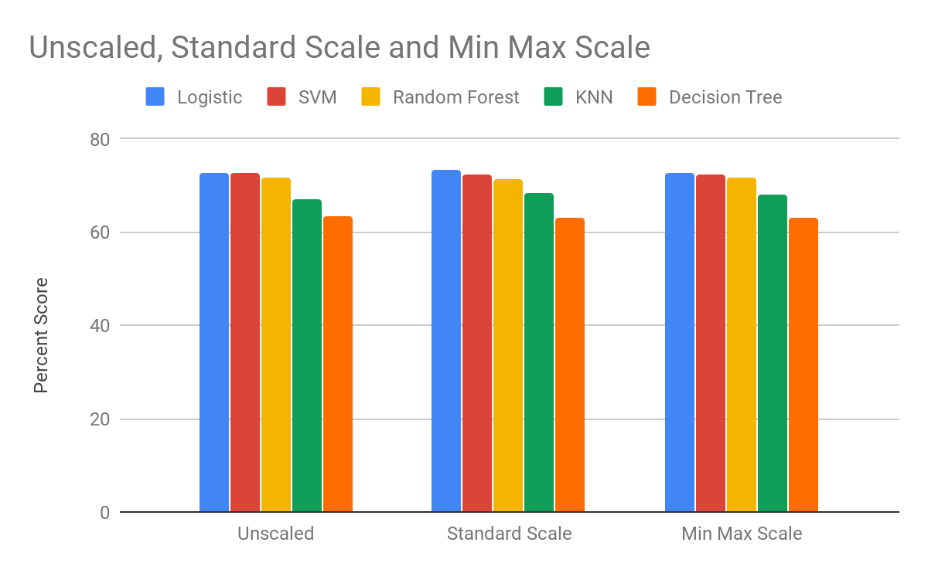
Classification

Slide 14
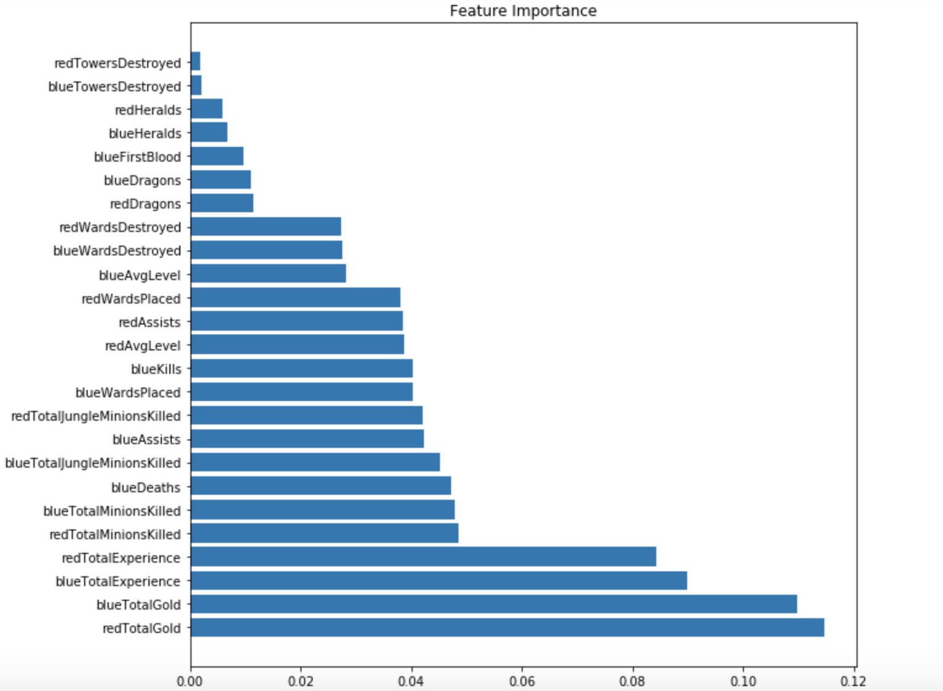
Important Features
Important Feature

Slide 15
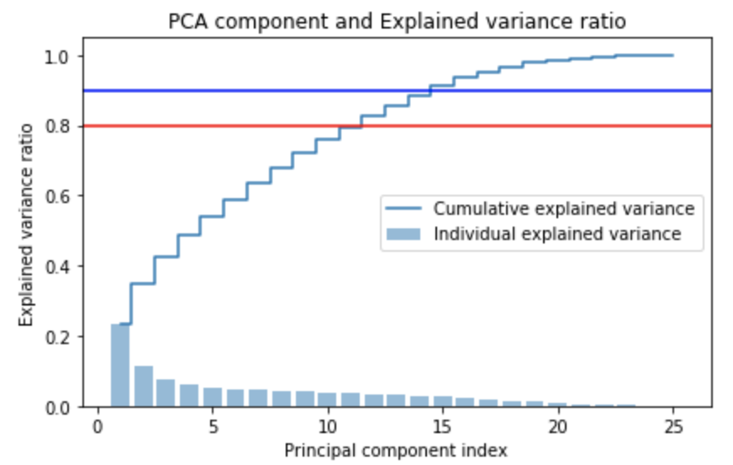
PCA

Slide 16
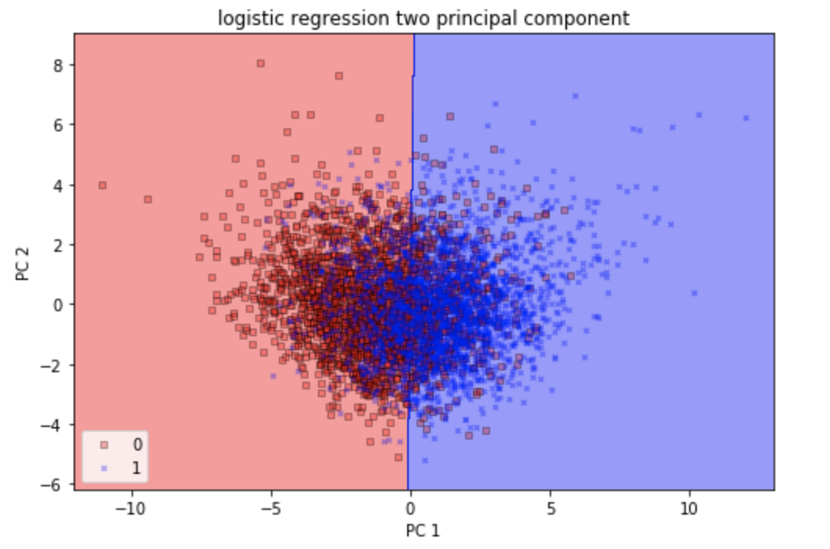
PCA Plot

Slide 17
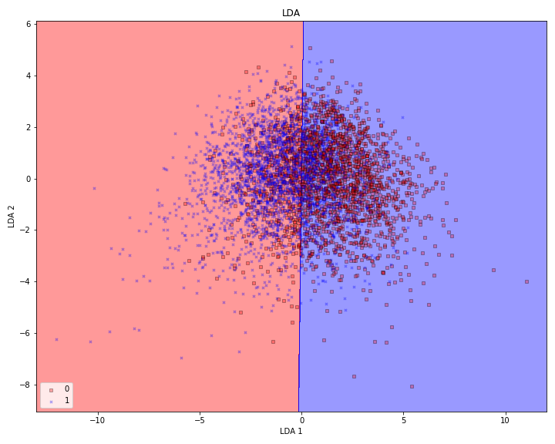
LDA

Slide 18
Grid Search CV
Best Params | Score
LogisticRegression C = 0.001 | 72.7%
KNeighborsClassifier n_neighbors = 21 | 70.1%
SVM C = 0.01, kernel=’rbf’ | 72.5%

Slide 19
Metrics, Validation, Evaluation

Slide 20
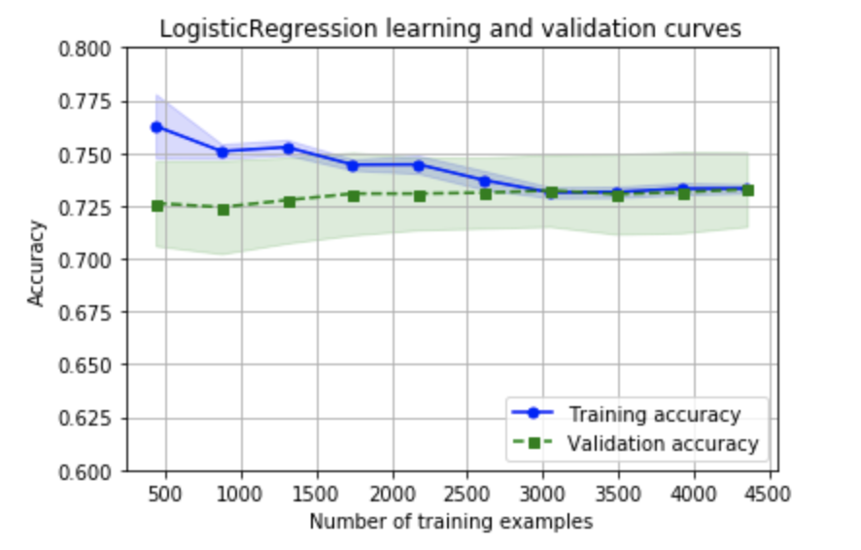
Learning and Validation Curves

Slide 21
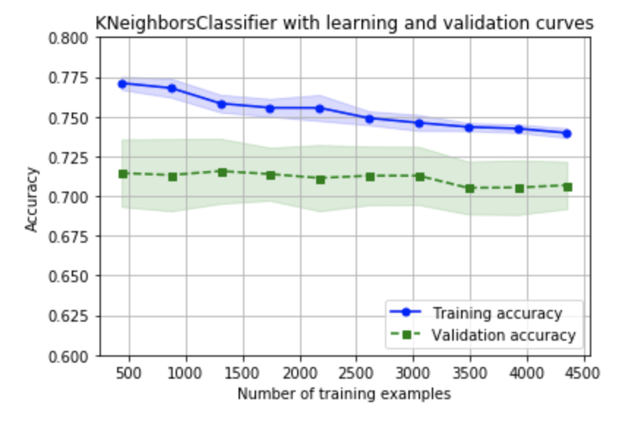
Learning and Validation Curves

Slide 22
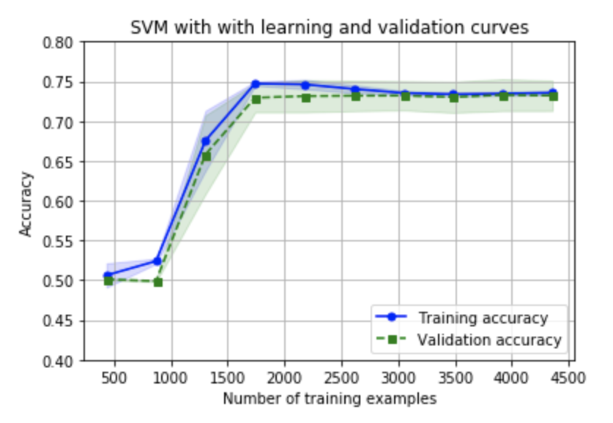
Learning and Validation Curves

Slide 23
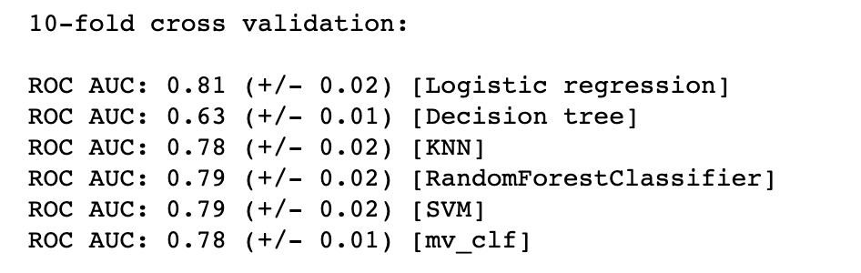
Evaluating the Model Performance of Each Classifier
Notes:
Mv_clf majority vote algorithm allow us to combine different classification algorithms associated with individual weights for confidence. Our goal is to build a stronger meta-classifier that balances out the individual classifiers' weaknesses on a particular dataset.

Slide 24
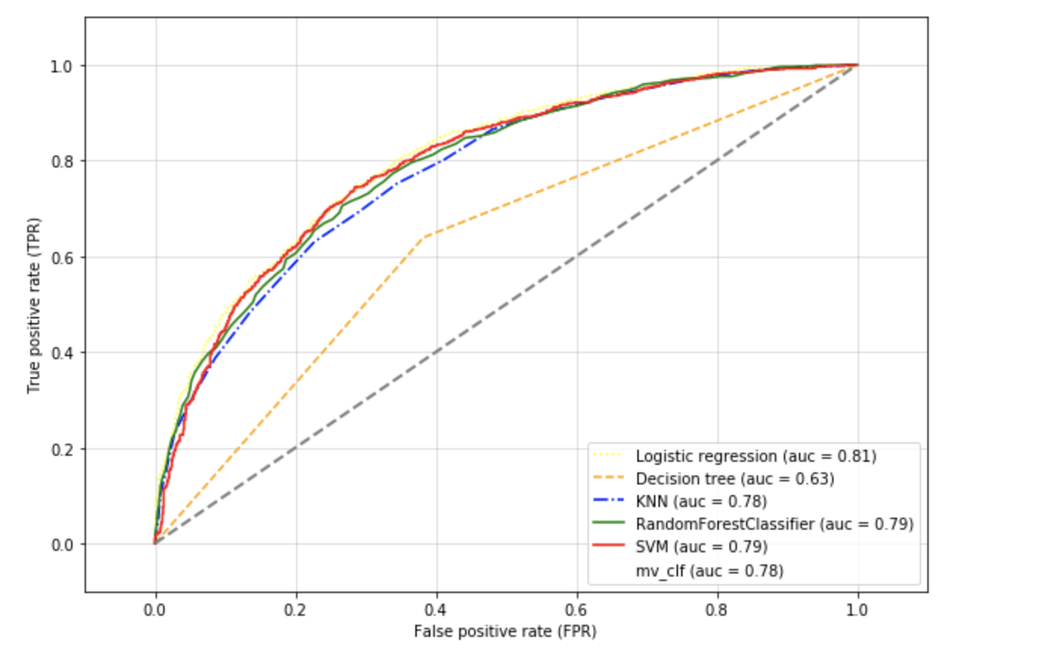
ROC Curve

Slide 25
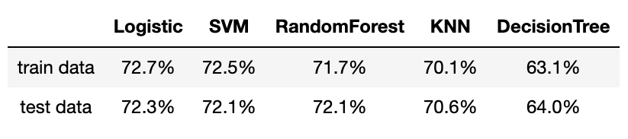
Conclusion
Accuracy Score Table

Slide 26
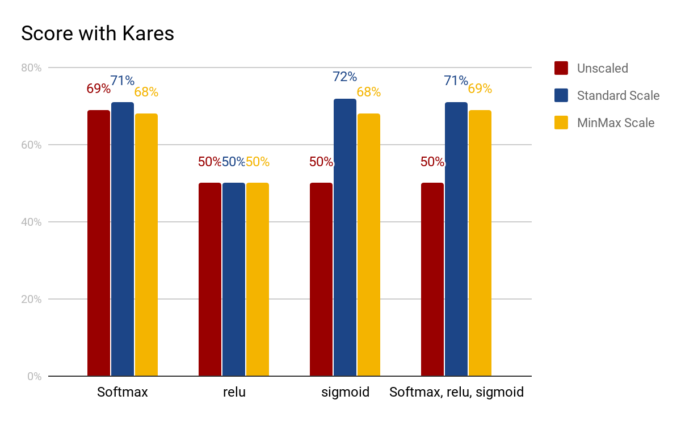
Keras (Dense Layer)

Slide 27
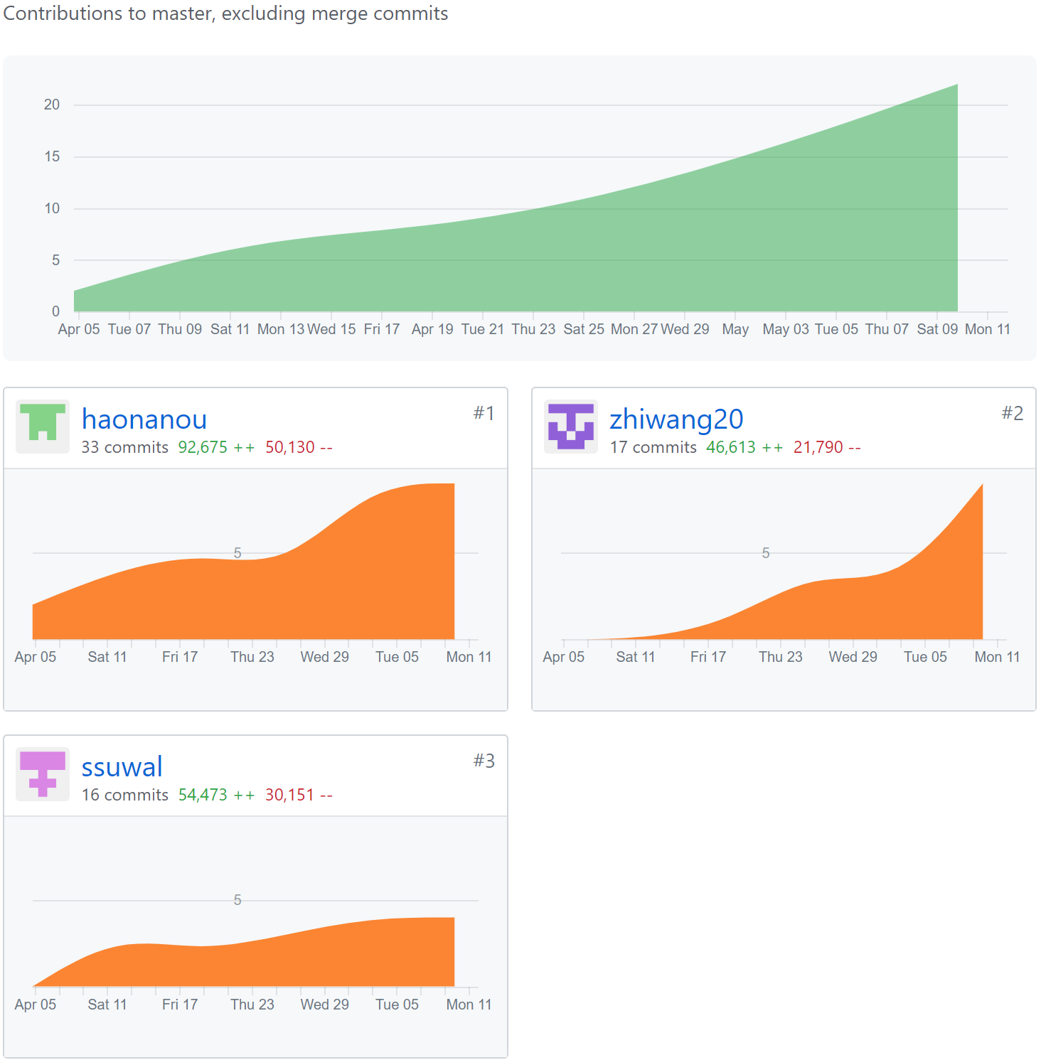
Github
99 commits
30 Pull Requests
10 issues
5 meetings

Slide 28
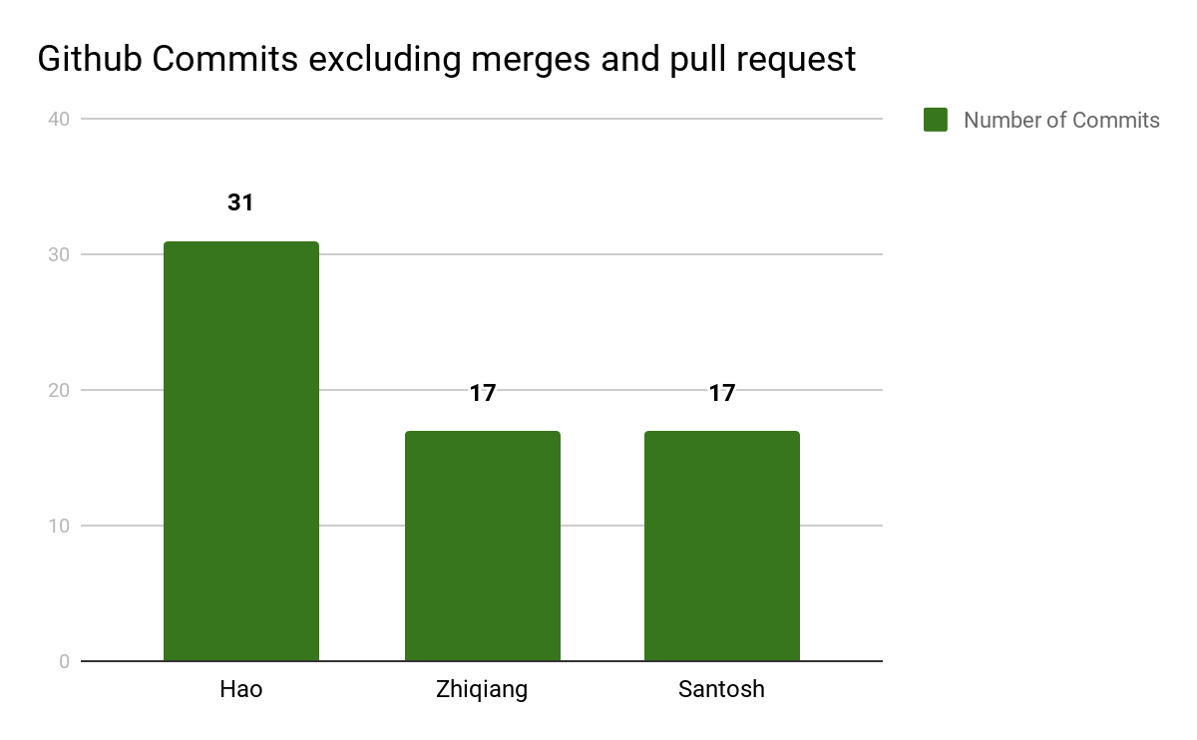

Slide 29
Thank You!
Q&A

