Slide 1
League of Legend

Slide 2
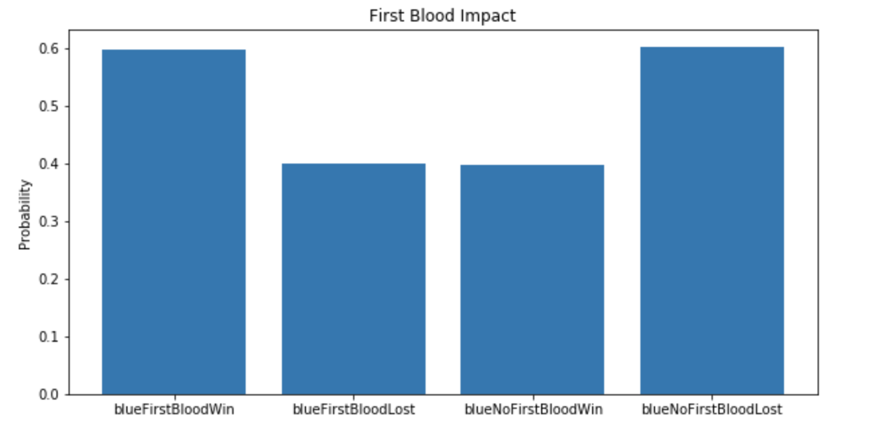
First Blood Impact

Slide 3
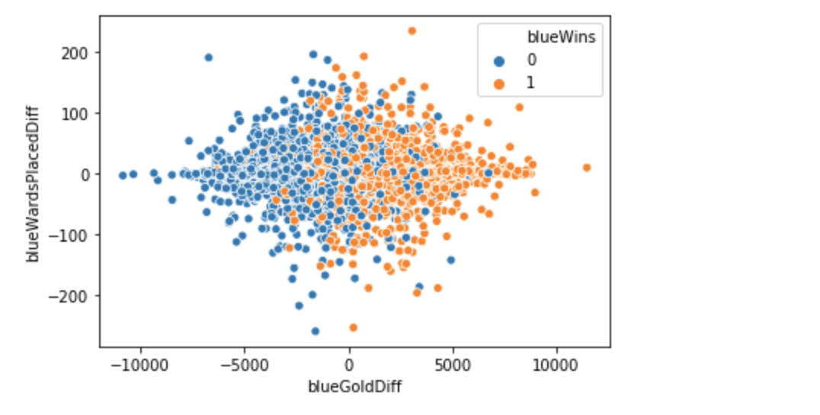
GOLD DIFFERENCE AND WARD PLACEMENT

Slide 4
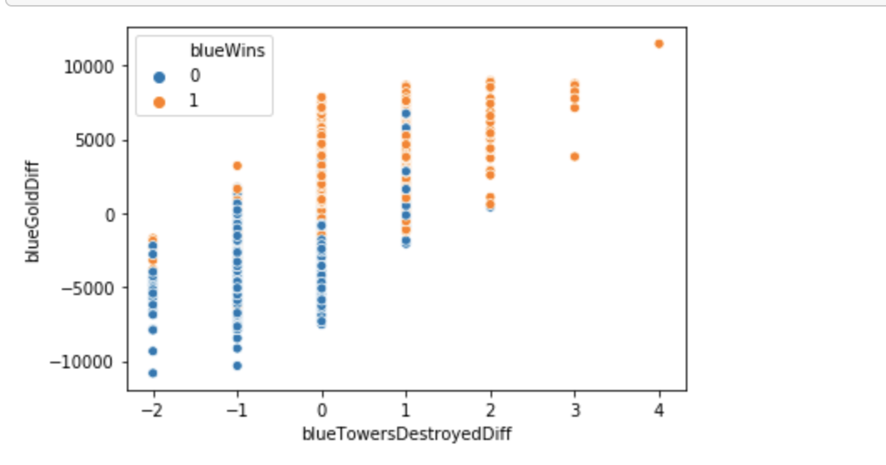
tOWER dESTOYED WITH GOLD DIFFERENCE

Slide 5
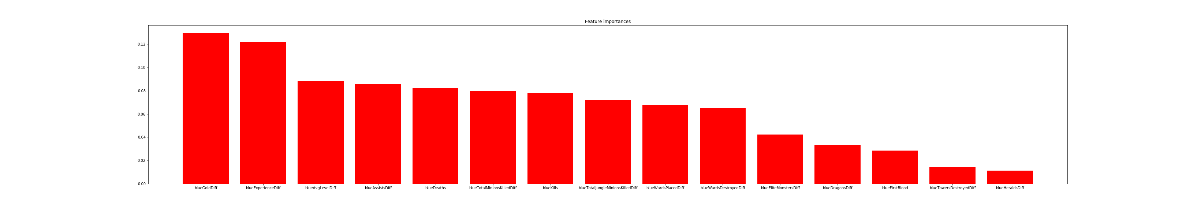
Freture importances
Notes:
feature blueGoldDiff (0.129797)
blueExperienceDiff (0.121670)
blueAvgLevelDiff (0.087944)
blueAssistsDiff (0.085831)
blueDeaths (0.082185)
blueTotalMinionsKilledDiff (0.079467)
blueKills (0.078096)
blueTotalJungleMinionsKilledDiff (0.072183)
blueWardsPlacedDiff (0.067786)
blueWardsDestroyedDiff (0.065257)
blueEliteMonstersDiff (0.042382)
blueDragonsDiff (0.033358)
blueFirstBlood (0.028509)
blueTowersDestroyedDiff (0.014306)
blueHeraldsDiff (0.011229)

Slide 6
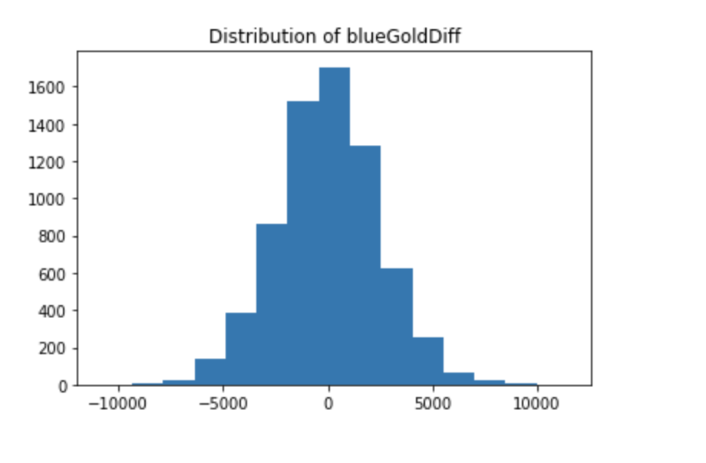
IF Regression y = BlueGoldDIff

Slide 7
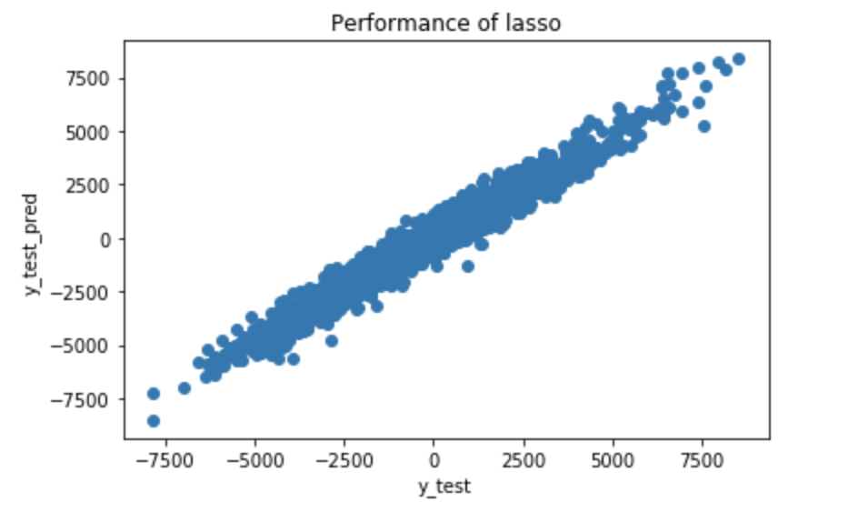
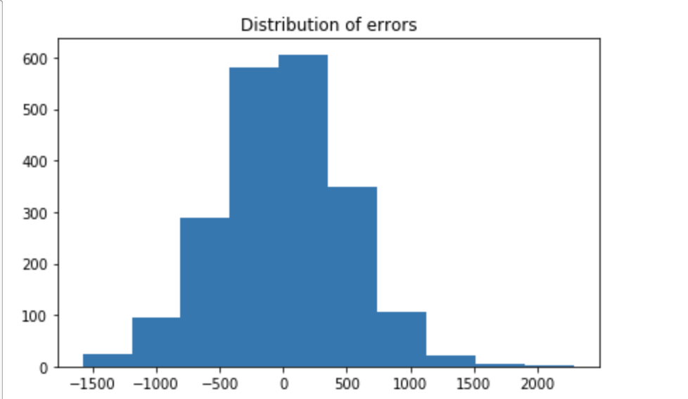
Lasso

Slide 8
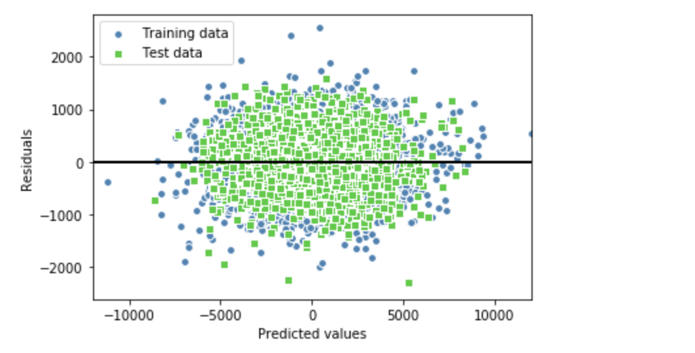
Regression
Notes:
MSE train: 260335.294, test: 250903.936
R^2 train: 0.957, test: 0.957

Slide 9
Score table
Classifier | Accuracy
Dummy | 0.502 (+/- 0.013)
KNN | 0.681 (+/- 0.009)
Decision Tree | 0.635 (+/- 0.020)
SVC | 0.722 (+/- 0.011)
Random Forest | 0.701 (+/- 0.014)
Logistic | 0.729 (+/- 0.007)
Notes:
Svc=support vector classifier
+- std
When using 70% train set of train.csv

Slide 10
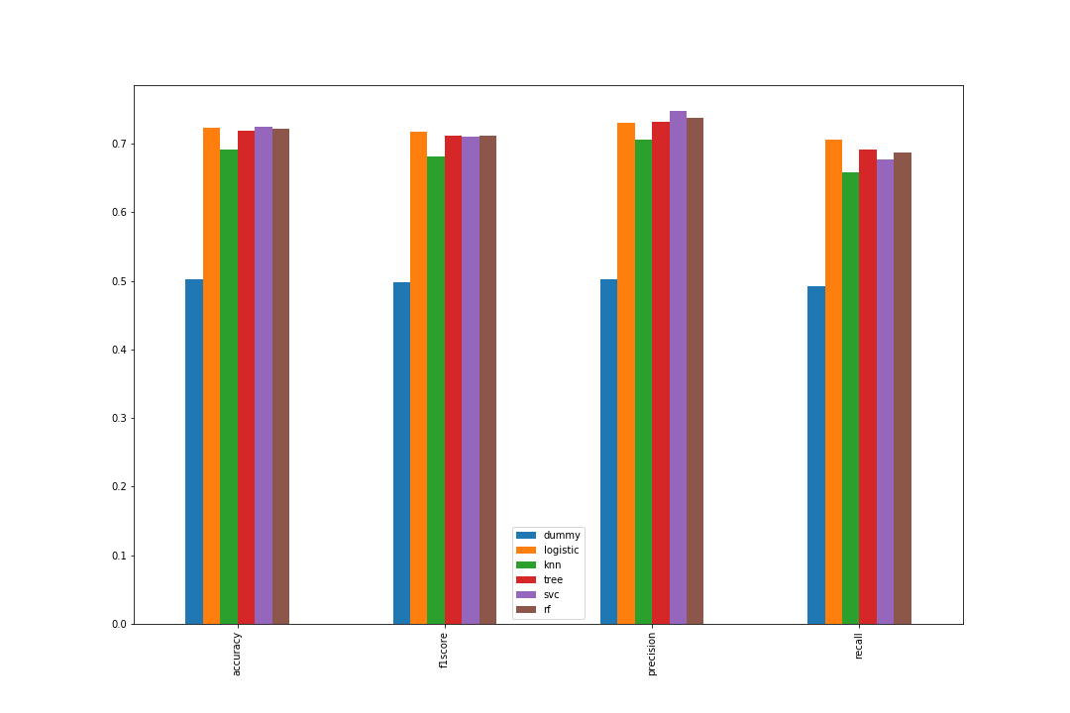
Compare Different Classification

Slide 11
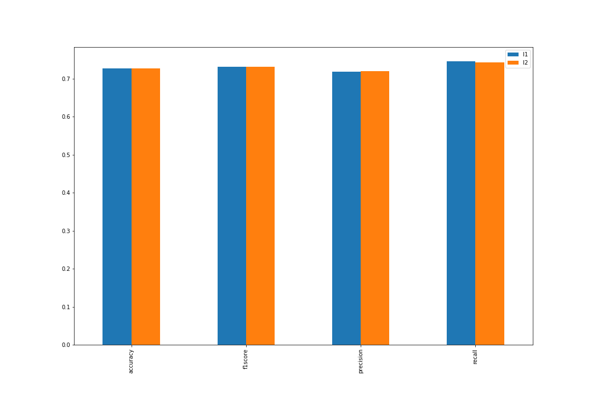
L1 and L2 regularization Logistic

