Slide 1
Intelligent Test Selection
Data Discovery Tool
Haoning Xia
Sept. 10, 2021

Slide 2
Agenda
Introduction
ITS problem and background, assumptions
Data Requirements
Data Discovery Tool
Microservice Architecture
Product Onboarding

Slide 3
Intelligent Regression Test Selection
Value Proposition
New SNPS Foresight Intelligent Regression Test Selection
Given changelist, select minimal test set with highest likelihood of failure
Configurable for variety of use-cases
Value for Design team: Higher Quality Checkins, Faster Development
Gen. smaller high-quality set of tests for pre-checkin testing & validation
Value for DV/R&D: Catch Regression Failures early
Front-load failures during periodic regression
Value for Infrastructure: Optimize on Resources and Quality
Achieve same or higher quality targets with less (machines, licenses)
R&D Implementation Phase
Individual R&D Testing
(Pre-Checkin)
Unit Test
Level-0 Regressions
Checkin
(gated)
Daily Dev-Checkin-Test Cycle
Resource Cost
Individual R&D Testing
(Post-Checkin)
Continuous Integration
Continuous Regressions
(Bundled)
Functionality Validation
Full Testing & Benchmarking
Nightly
Level1/Level2 Regression (nightly)
Benchmark (nightly)
Reduce Cost for Better Quality
And Faster TAT

Slide 4








Test Selection in the Product Development Flow
Different applications for different users/use-cases
Failure Assignment
Developer
Automatic (Beta)
Failure Analysis
Predictions for pre-checkin regression (daily L0)
Test/Fix bugs
L0 regressions
Chime process
Nightly Regressions
Automatic (Phase 3)
Objective: Detect failures early
Benefits: Early detection of failures/Enable faster analysis TAT/Detect chances of bulk failures
Checkin
Nightly Build
CI system
Automatic (phase 2)
Objective: Detect failures early
Benefit: Feed-back to R&D/Failure Analysis

Slide 5
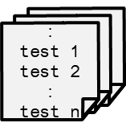
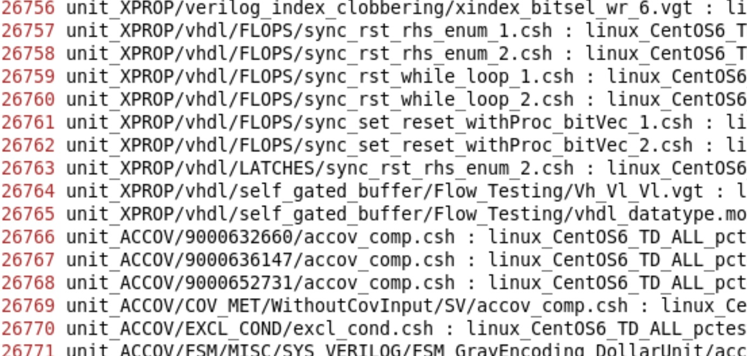


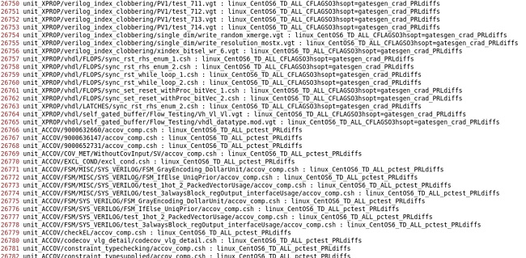




Foresight Intelligent Test Selection: High-level Architecture
Data Sources, Training, and Prediction
Data Sources
Coverage Data
P4 Db
ML Model
Features
Source Code
Source Code
Changelist data
F1
Feature Extraction Flow
Culprit History Db
Regression Data
Predicted Test cases
Single Changelist data

Slide 6
Foresight ITS
Data Requirements

Slide 7
Data Requirements
Minimum data and workflow for predictive model
Periodic coverage runs on entire target test-list (~once every 2-4 weeks depending on customer)
Nightly Pass/fail report and .vdb files for all library of possible tests to select from
Historical Pass/Fail reports for regression runs including failed changelists
Min 30 days of data to get any decent results from ITS.
This is similar to the *.rpt/.vdb files that is generated in regular runs
Perforce/GIT: Changelist information
RTL changes.
Ideally, how to filter out the non-RTL changes (like configuration, docs, etc,.)
Feature extraction from turn-in code:
Add switch to vcs in compilation phase in the data runs for the .vdb files in custom VCS build
User provided criteria for PASS/FAIL classification (regex(es) or full python module. Up to user)
Run SNPS utility to extracts features from the RTL changes in the sandbox for the run
anonymized feature data transfer to SNPS from customer helps TAT for SNPS expts/QOR analysis
Minimal meta information on data-set.
No code related data, no IP.
Will go through review before transfer

Slide 8
Data Requirements
Minimum data and workflow for predictive model
Minimum 30 consecutive days of data (call this a time-window)
One full coverage run at the beginning of the selected time-window
With Line-coverage turned on
Full coverage runs every 3-4 weeks after that.
Coverage data must be saved per test
We need individual test to code line mapping data
SNPS will analyze and extract required data from the coverage data
May require 45+ days
if the distribution of tests varies considerably OR
The number of changelists varies considerably OR
Both

Slide 9
Data Requirements
Minimum data for predictive model
Periodic coverage runs on entire target test-list (~once every 2-4 weeks)
Periodic Pass/fail report and .vdb files for all library of possible tests to select from
Period is equal to period of regular regressions
Historical Pass/Fail reports for regression runs including failed changelists
Min 30 days of data to get any decent results from ITS.
This is similar to the *.rpt/.vdb files that is generated in regular runs
Perforce/GIT: Changelist information
RTL changes.
Ideally, how to filter out the non-RTL changes (like configuration, docs, etc,.)
Feature extraction from turn-in code:
This extracts features from the RTL changes in the sandbox for the run

Slide 10
ITS: Data-flow and Bootstrapping
Important Data points, and process
Need Pass fail/info for all tests run for every regression
This lets us select changelist for day-00 and day-0+N
Day 0: First coverage snapshot
Initialize model
Day 20: First model candidate
Train model
Day 0+N: Second coverage snapshot
Used to Refresh Model
Coverage run for all tests
Individual vdb per test
Use flags from SNPS R&D
Daily Regressions
Get data per changelist
Use data from day 0 to day 20
data from for daily regression CL
Evaluate going forward
Coverage run for all tests
Individual vdb per test
Use flags from SNPS R&D
Get changelist for this daily regression
Run smallest test possible with flags from SNPS R&D
Get VDB and use ITS to extract features
Use historical data from Xilinx DB for pass/fail info
day-00
day-05
day-10
day-15
day-20
day-25
day-30
day-35
day-40
day-45
day-50
day-55
day-60
Collect Training Data
Predict tests for changelists corresponding to each daily regression and compare with DB results

Slide 11
Precision vs. Recall
https://en.wikipedia.org/wiki/Precision_and_recall#
In pattern recognition, information retrieval and classification (machine learning), precision (also called positive predictive value) is the fraction of relevant instances among the retrieved instances, while recall (also known as sensitivity) is the fraction of the total amount of relevant instances that were actually retrieved. Both precision and recall are therefore based on an understanding and measure of relevance.
Suppose a computer program for recognizing dogs in photographs identifies 8 dogs in a picture containing 12 dogs and some cats. Of the 8 identified as dogs, 5 actually are dogs (true positives), while the rest are cats (false positives). The program's precision is 5/8 while its recall is 5/12. When a search engine returns 30 pages only 20 of which were relevant while failing to return 40 additional relevant pages, its precision is 20/30 = 2/3 while its recall is 20/60 = 1/3. So, in this case, precision is "how useful the search results are", and recall is "how complete the results are".

Slide 12
ITS in production
Behavior over time
Data History curve
Recall meets threshold
Ready for user predictions
Recall curve
Data-points (# regressions)
Minimum recall met
Start on-line training
New Coverage DB
Refresh boot-strapping
Minimum history met
Start boot-strap attempts
Boot-strap phase
Ramp-up phase
Online phase
t₂
t_{k}
t₁
Time (days)
t₃

Slide 13
Data Discovery Tool

Slide 14
Data Discovery Tool
Gather facts and perform prechecks for any given environment to detect if it is suitable for ITS
Report will be generated based on analysis and feedback will consist of what is missing from regressions but required for high quality prediction from ITS.
High level features:
Test report – unique tests and re-seeded tests for each regression
Failure distribution summary – if regressions are stable, recall value will be low
Data imbalance – Failing rate meeting a configurable threshold
Coverage data check
Compile time vdb check
Periodic run-time vdb check
Duration of data:
Length of history – 30 days or 60 days
Provide feedback if data is insufficient
Data analysis – Create a data frame for each regression pool:
Passes
Failures
Crashes

Slide 15
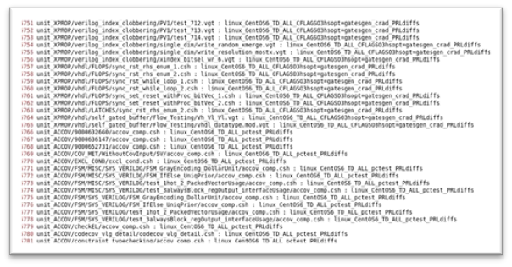
Data Discovery Architecture
Front-end
Mid-end
Back-end
Sqlite
Coverage VDB
Data Discovery
User provided regression library
Changelist
Pass/Fail
CSV
Test count
Optional
Rule File
Regex

Slide 16





Flow chart
Flow 1
Flow 2
.csv
.log
.json
Frontend (Phase 1)
User provide regression folder
User provide database
Regex
Regular expression extract data
SQL command extract data
Data Discovery:
Precheck and Pre-calculation
Midend (Phase 2)
Backend (Phase 3)
Future analyzation
data.db
ITS
DBhelper class manage database
Conncet to our own database
Insert data into table and sort
export to .csv

Slide 17
Front End
All the regression folders
open_files()
save all the files as log_files
find all files useful data find_data()
Travers all the log files and all the lines in the log files. Use Regex to extract useful data
Preprocessing.py
find_files()
Optional
Use os.walk to traverse all places to find the file we want.
Rule File
Go to backend
Connect to database
Regex
Go to midend
do so precheck and precalculation
.log file(regr.log)
User provided regression library

Slide 18
Mid End
Data Discovery
Precheck whether those data is enough or suitable for ITS training
Precalculation for
total test = from test name
Untest = total test - (pass + failure test)
OnlyinPre = len(previous) - len(same_test)
OnlyinCur = len(current) - len(same_test)
Variance = OnlyinPre + OnlyinCur
(first seq is 0,0,0)

Slide 19
Back End
Rule File
Regex
There’s a database_helper class help to manage the database system
Create database (data.db)
Create the dataset table
data.db
Travers all the log files and all the lines in the log files. Use Regex to extract useful data
from database_helper import db to our data_discovery_tool program
Insert into dataset table
Sort the table Order by regression_tag
Seq | product | changelist | Regression Tag | Run Date | Total | Pass | Fail | Untest | OnlyinPre | OnlyinCur | Variance
1,2,3 | ibex | Commit hash | Ibex_time stamp | date | Total test | Pass test | Failed test | Untest number | Only in the previous test | Only in the current test | Variance test
integer | String | hex | String | string | Integer | Integer | Integer | integer | integer | integer | integer
export to the .csv file(output.csv)
There will be sub tables for these three columns which record the passing, failure, and untest’s test name.
Future Analyzation

Slide 20
ITS
Microservice Architecture

Slide 21
ITS – Components
Installer / GUI / CLI
Docker Containers
Service Architecture
Product On-Boarding
ETL
Model Generation
Bootstrap
Feature Generation
Predictions

Slide 22

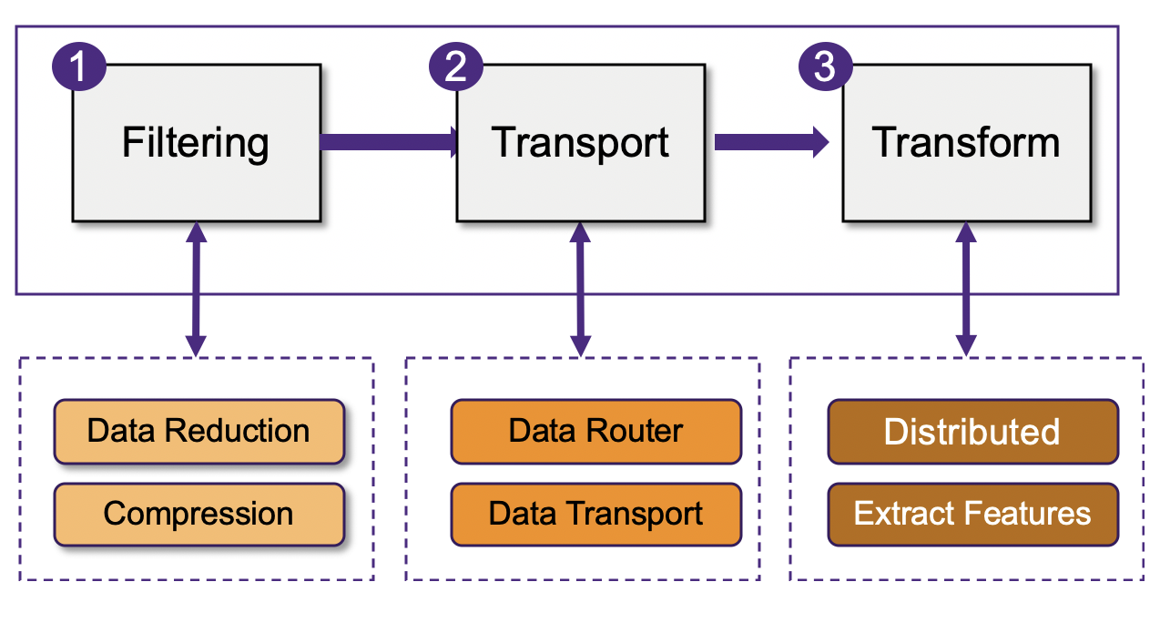


Intelligent Test Selection – Online Mode
High-level Flow of backend and Current Status
ITS On-Boarding
ITS ETL Pipeline
Customer Configuration
Bring-up Services
Data Sources
Coverage Data
SCM Data
Change-list
Culprit History
Regressions
Data Destination
System-level Details
Environment Details
Generate Top-level Config
Installer to check/prepare ENV
Run the docker scripts.
Bring up all the services
Run bootstrap script
Ensemble Learning based Prediction
ITS Feature Generation
Generate Models
Generate Predictions
Consume Data
Generate Features
Consume Features
Dump latest models
Qualify the latest model
Generate the predictions
Features Gen Service
Keeping consuming .parq’s
Dump latest features

Slide 23
Test Selection in the Product Development Flow
Different applications for different users/use-cases
Failure Assignment
Developer
Automatic (Beta)
Failure Analysis
Predictions for pre-checkin regression (daily L0)
Test/Fix bugs
L0 regressions
Chime process
Nightly Regressions
Automatic (Phase 3)
Objective: Detect failures early
Benefits: Early detection of failures/Enable faster analysis TAT/Detect chances of bulk failures
Checkin
Nightly Build
CI system
Automatic (phase 2)
Objective: Detect failures early
Benefit: Feed-back to R&D/Failure Analysis

Slide 24

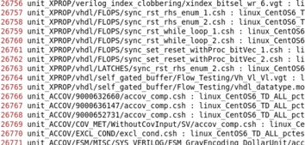
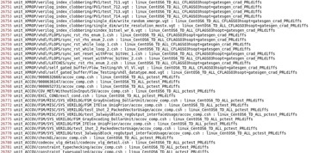



Intelligent Test Selection: High-level Architecture
Data Sources, Training, and Prediction
Data Sources
Coverage Data
P4 Db
ML Model
Features
Source Code
Source Code
Changelist data
F1
Feature Extraction Flow
Culprit History Db
Regression Data
Predicted Test cases
Single Changelist data
We need services to get these
features from Data Sources

Slide 25





ITS Services
List of all the services required for ITS
DC
Data Collection
FGEN
Feature generation
Registry
Global Context Management
Metadata Management
ID Generation
SCM
SCM Management
MODEL
Model Building
PREDICT
Prediction Serving
Breaking the Monolithic Application to Services

Slide 26
ITS – Product Onboarding

Slide 27

Registration flow
Product Key
Register Product
In: product blob
In: regression flavor blob
Post-script
Product Key
Register compile flows
In: list of compile blobs
Identify
Compile flows
Product Key
Register Tests
In: list of test blobs
Identify
tests
On-Boarding
CLI Options
Collect coverage for compile flow
Product Key
Register Run
In: Run Blob
(Time, user)
Collect historical data of test run status
Dynamic Key
Registry
Collect coverage for simulation flow
Dynamic Key
Upload Data

Slide 28
Registration flow for customers
START
1
Register Product Or Design
2
Register Regression Config for product
3
Get or Save Product Key
4
Register compile Information against product key
5
Register Tests Information against product key
6
End

Slide 29
Customer flow
START
1
Search or Get Product Key (Optional)
2
Register Tests (Optional)
3
Register Compile_info (Optional)
predict_S
dc_S
4
Register RUN (MANDATORY)
5
Get/Save Dynamic Key
6
Register scope against dynamic key
Get testlist
7
Test_info
Run Regression with the testlist
8
Upload test_info against Dynamic Key
Vdb List
Cov_info
Upload cov_info against Dynamic Key

Slide 30
Customer flow
START
1
Search or Get Product Key (Optional)
2
Register Tests (Optional)
3
Register Compile_info (Optional)
predict_S
dc_S
4
Register RUN (MANDATORY)
5
Get/Save Dynamic Key
6
Register MCB (scope) against dynamic key
Get testlist
7
Test_info
Run Regression with the testlist
8
Upload test_info against Dynamic Key
Vdb List
Cov_info
Upload cov_info against Dynamic Key
SCM Services – Deep Dive on MCB

Slide 31
Customer Check-in flow
START
1
Search or Get Product Key (Optional)
2
Register Compile_info (Optional)
4
Reference VDB auto-determined
Register RUN (MANDATORY)
5
Get/Save Dynamic Key
6
SCM Service
Register MCB (scope) against dynamic key
Vdb List
MCB

Slide 32
Check-in Flow in CI System
Prediction (triggered by a checkin)
Flow
Checkins
Checkin/Bundle_1
Checkin/Bundle_2
Checkin/Bundle_3
Config1 (compile_flow_1)
Config2 (compile_flow_2)
Config1
Config2
Config1
Config2
comp.vdb.json
comp.vdb.json
comp.vdb.json
comp.vdb.json
comp.vdb.json
comp.vdb.json
merged.comp.vdb.json
merged.comp.vdb.json
Diff of jsons from Checkin/Bundle_1 & 2
Diff of jsons from Checkin/Bundle_2 & 3
ML Engine (prediction)
ML Engine (prediction)
Probable failures for Changelist_2 cf1 (predicted)
Probable failures for Changelist_3 (predicted)

Slide 33
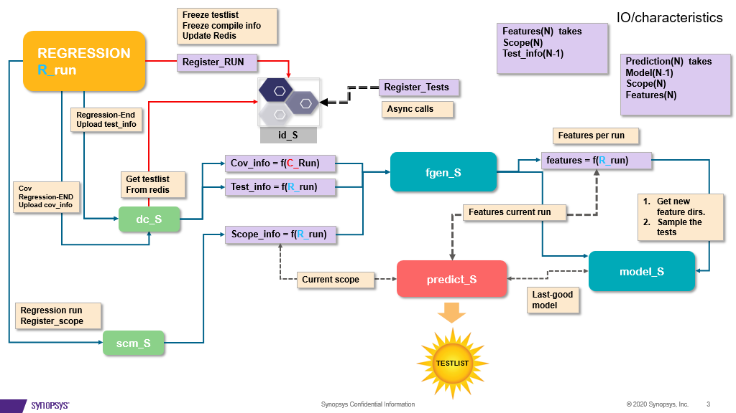

Slide 34


Modified code block (Scope)
Modified code blocks are a set of changes that is made over a period of time to the source code.
MCB:
Changed files
Changed modules(functions)

Slide 35




Step-by-Step Process
Onboarding - Identify all the compile flows for a given regression run
How many compile flows do we have in a given run?
Registration - Each Compile Flow should be registered separately
Register Compile Flow1
Register Compile Flow2
Enable Customer Checkin system to generate compile vdbs
Compile –parse_only and cm options (VCS switches)
Compile –parse_only and CM options (VCS switches)
MCB [Modified Code Block]
Compile vdbs are merged (CURR)
CURR is compared with REF (merged from previous run is default)
DIFF is fed to Predict service
Reference list of VDBs 🡪 cl1.merged_comp.json
Current list of VDBs 🡪 cl5.merged_comp.json
MCB 🡪 diff.json (SCM backend)

Slide 36
FLOW to Determine MCB (scopes) to Design
At the time of onboarding we identify all the COMPILE flows.
This is done pre-registration
Register the compile flows
Enable Customers Checkin flow to be able to generate vdb files for each compile flow
This is supplied to the its utility as LIST of vdb file paths for each compile flow.
The file paths are compared with a REFERENCE LIST
REFERENCE LIST is the PREVIOUS REGRESSION RUN by DEFAULT that is configured into scm service at the time of deployment.
However REFERENCE LIST can be overridden using command line utility at the time of regression.

Slide 37
Registering MCB (scopes)
SCM service is the one that creates MCBs from triggers generated by regression system.
The triggers are generated using the call to ITS.
ITS client expects following as input:
List of compile vdbs generated in CURRENT REGRESION.
Supply path to sandbox.
Supply Dynamic key.
The SCM service will create new MCB for the sandbox specified.
In deployment mode. The sandbox is path to the nightly area which is checked out for creating regression.

Slide 38
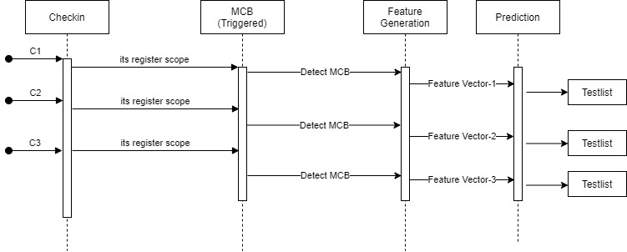
Flow of events for Testlist prediction

Slide 39
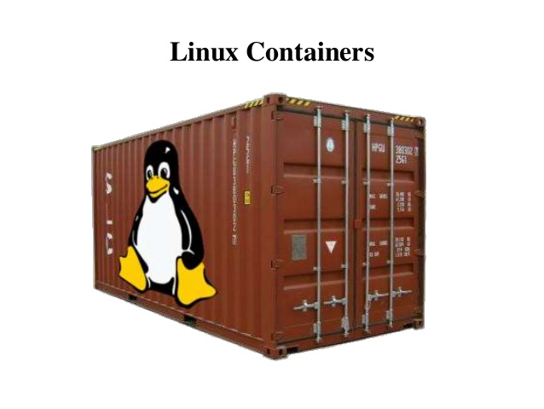
Containers
Trying to solve the
"run anywhere"
problem using Linux containers.
Containers are encapsulations of system environments. But Linux containers have been around for a while!
Docker makes using Linux containers easier.

Slide 40

Introduction to Docker Container
Light weight virtualization
Containers virtualize the OS just like hypervisors virtualizes the hardware
Containers enable any payload to be encapsulated as a lightweight
Wraps up a piece of software in a complete filesystem with environment
Docker, LXCs are most popular implementations of containers today
Can be run on any Linux Server - VMs, physical Hosts, OpenStack
Ability to move around between machines without any modification
Ability of containers to work together
Notes:
Containers enable any payload to be encapsulated as a lightweight, Portable self-sufficient container, that can be manipulated using standard operations and run consistently on any hardware platform.
Wraps up a piece of software in a complete filesystem that contains everything
code, runtime, system tools, libraries etc.
they share the OS kernel and bins/libs where needed
otherwise each of them operate in a self contained environment
s

Slide 41
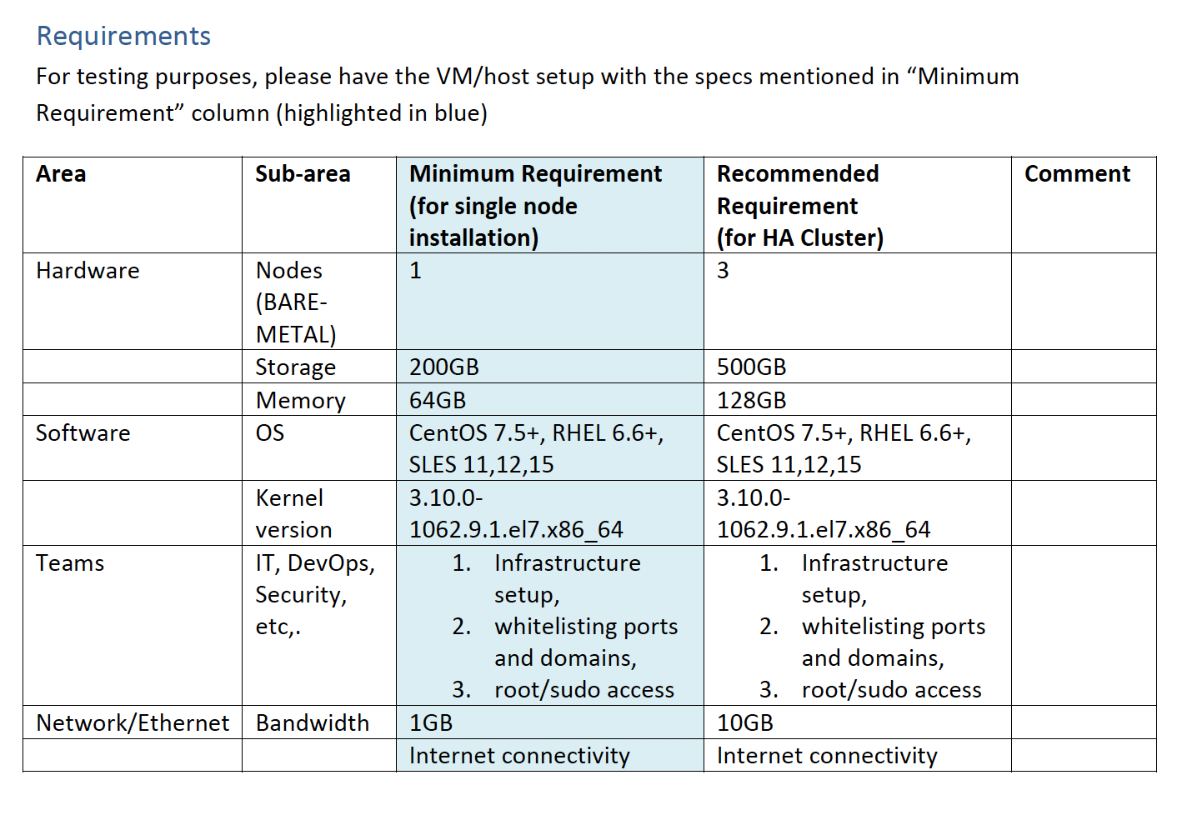
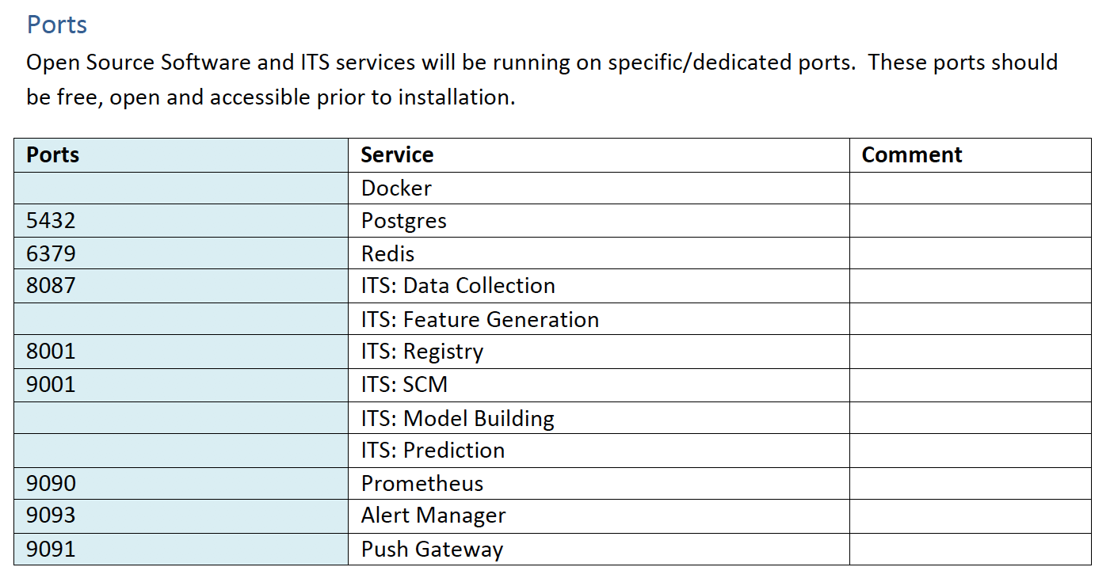
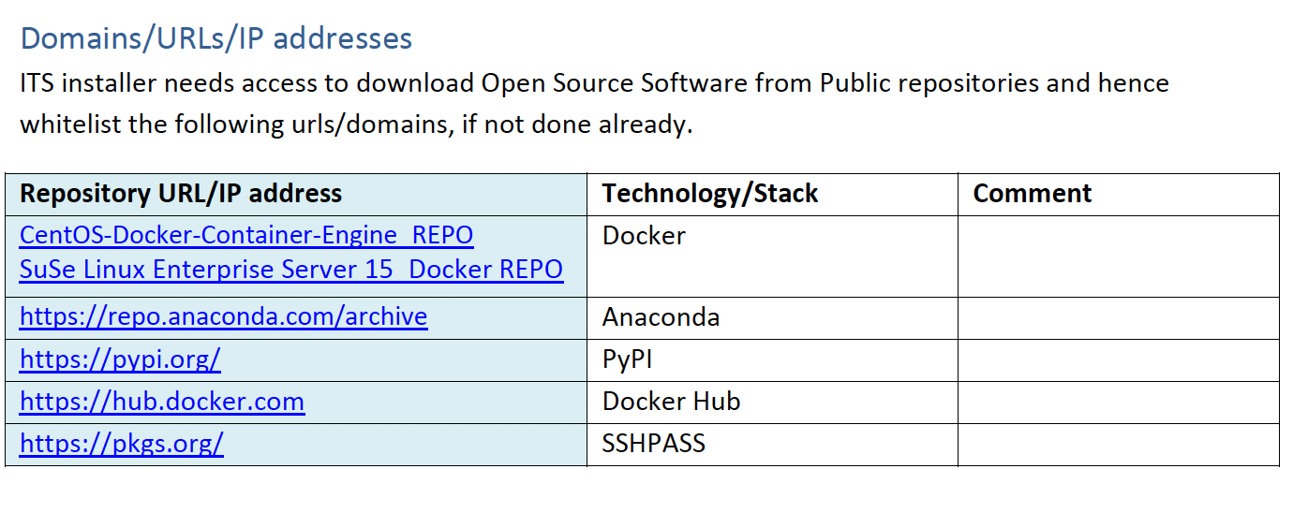
ITS Installation Prerequisites

Slide 42
ITS Installer Flow
SNPS FTP Server
Customer FTP Server
Post SNPS-Install [Ansible]
Setup password-less SSH
On target hosts
Pre-checks
OS, Kernel, System libraries, ports, etc,. [abort if it doesn’t match]
Clean up
Existing Docker instances and ITS services [prompt & cleanup]
Set up ITS
Install docker [yum/zypper]
Start docker
Edit dockerfile (based on user inputs)
Install docker-swarm (if >2 nodes)
Install-ITS
Deploy services
Redis
Postgres
id_S, scm_S, etc
Download
SNPS Installer (if not already available)
ITS tar-ball
SNPS-Installer
Install ITS using SNPS Installer
Handle given to post-install (Ansible)
Installation Report
Post SNPS-Install Downloads
Anaconda [minimal python]
pip install ansible
pip install dnspython
Docker
SSHPASS
Post SNPS-Install [Ansible]
Prompt
Collect Host info from Customer [3 nodes 🡪 cluster install]
Mount points
SSH password
Notes:
Ansible is an open-source software provisioning, configuration management, and application-deployment tool enabling infrastructure as code.

