Slide 1

Nvidia stock prediction
By Haoon Kim

Slide 2
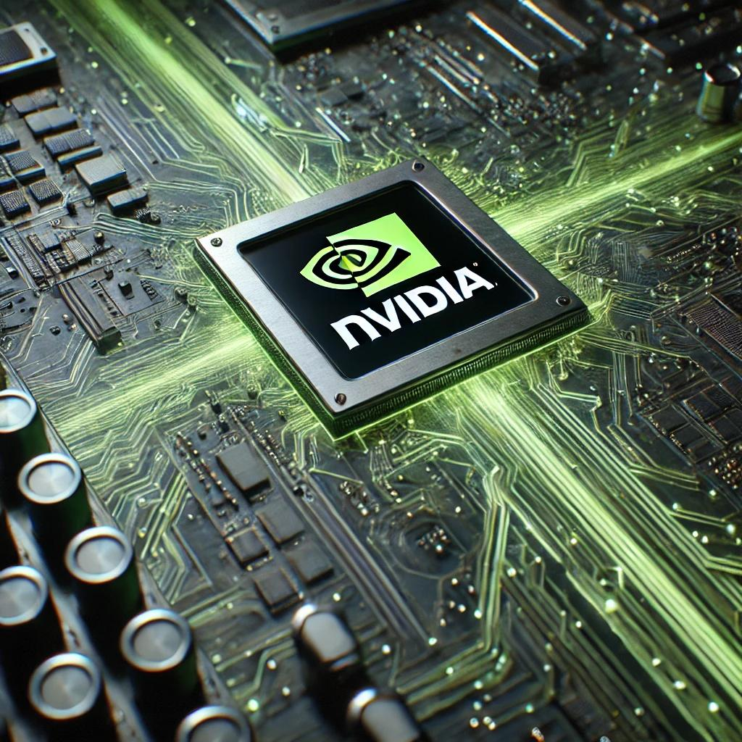
Background NVIDIA is a leading technology company known for its graphics processing units (GPUs). NVIDIA’s stock has surged from last couple years due to AI technologies booming. This project aims to predict NVIDIA's stock prices using historical data and various analysis techniques.

Slide 3
Project Goals
- Analyze stock price trends over time.
- Identify key factors affecting stock prices.
- Provide insights for future stock performance.

Slide 4
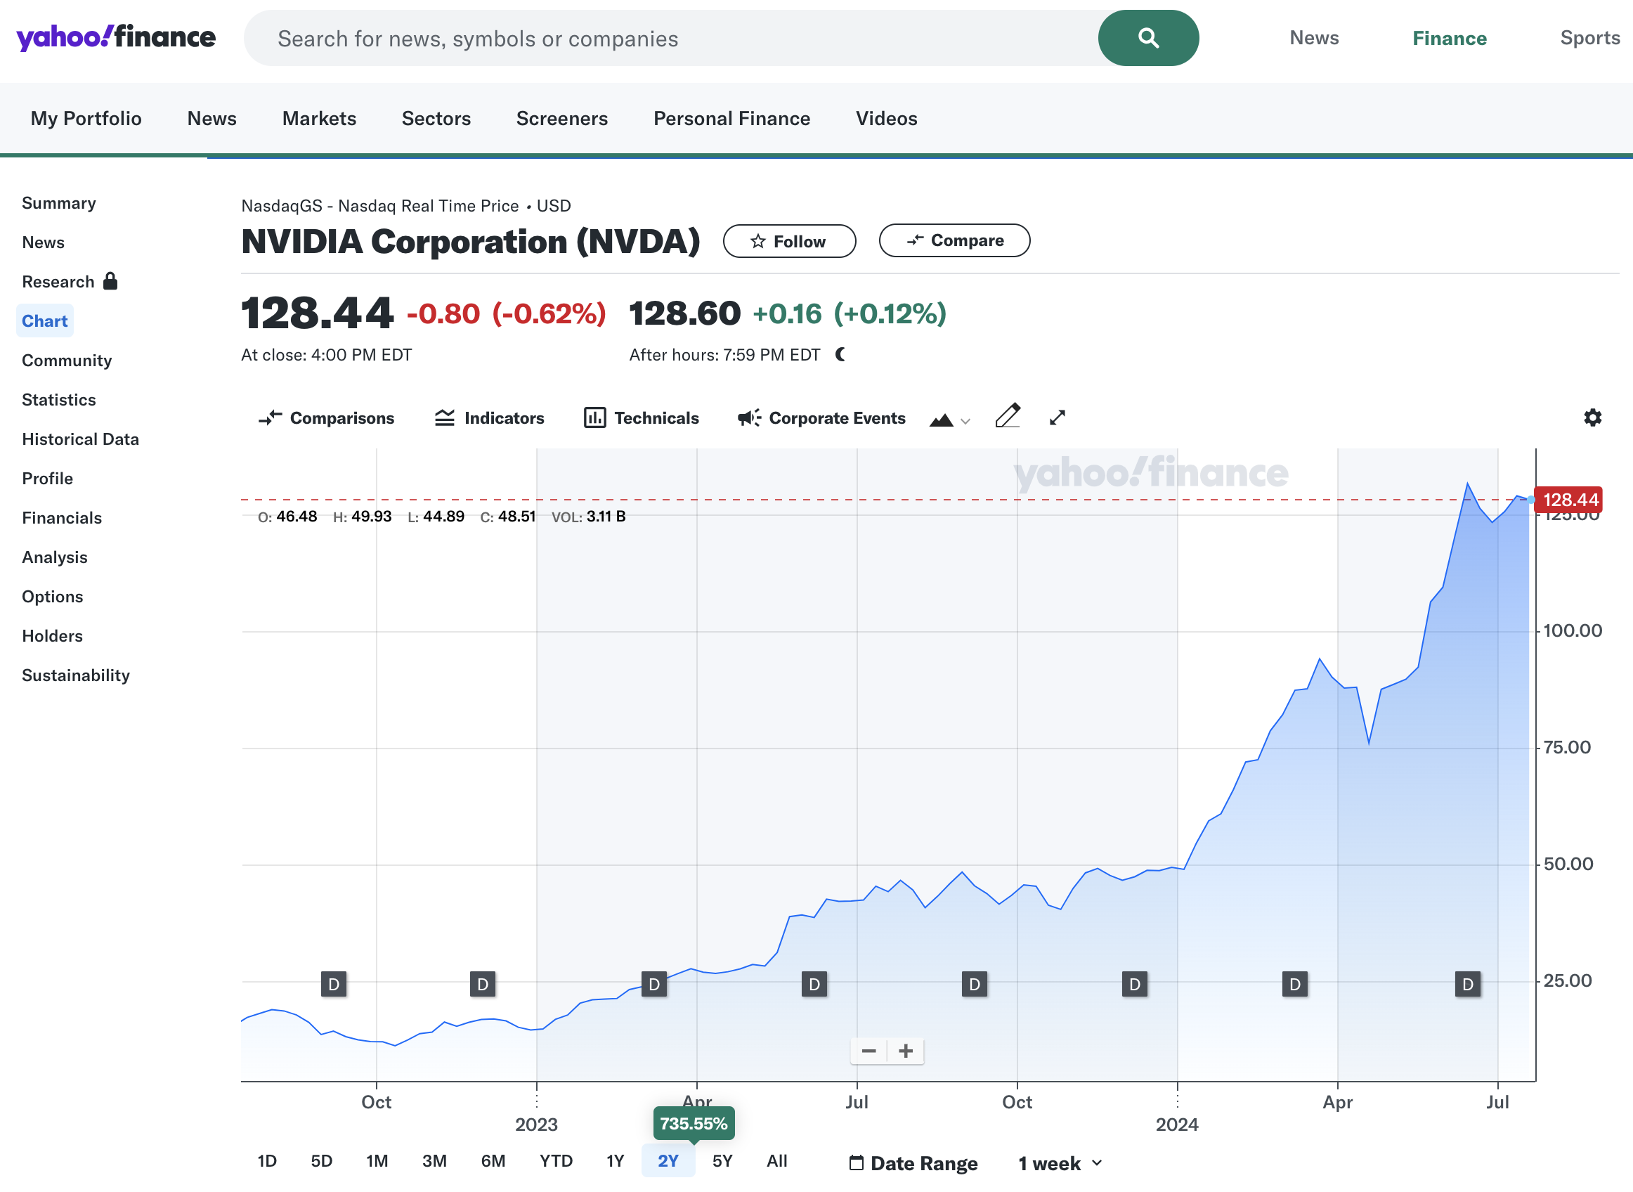
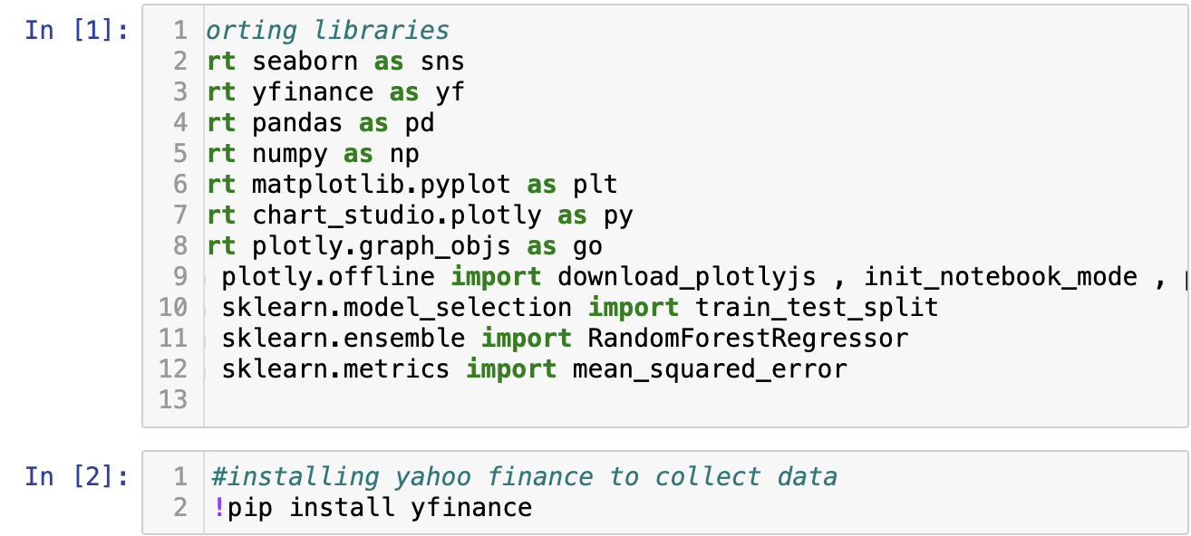
Data Sources
- Historical stock price data from Yahoo Finance
- Financial indicators (e.g., Open, High, Low, Close prices, Volume)

Slide 5
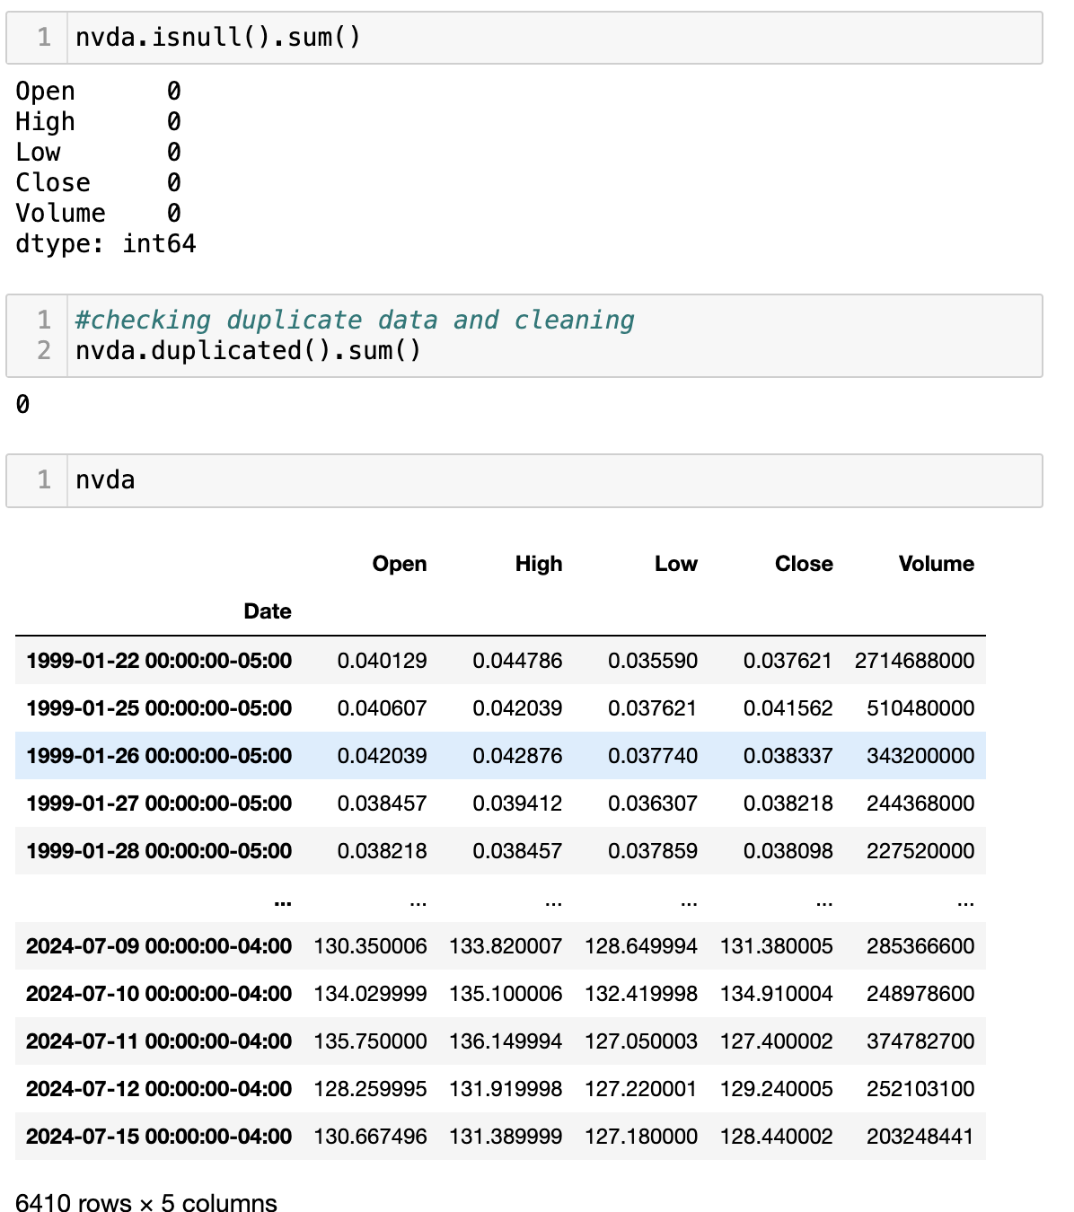
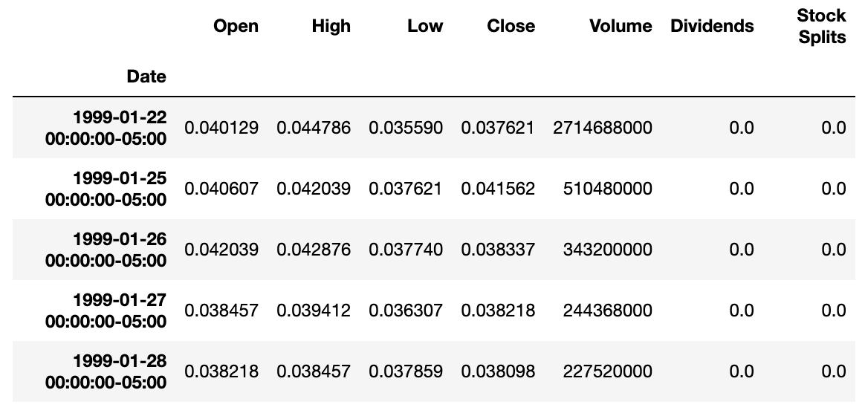
Data Preprocessing
-Data cleaning: Removed unnecessary columns (Dividends, Stock Splits)
- Checked for missing and duplicate data
- Data normalization for consistency

Slide 6

EDA(Exploratory Data Analysis)
Data Visualization and Initial Insights

Slide 7
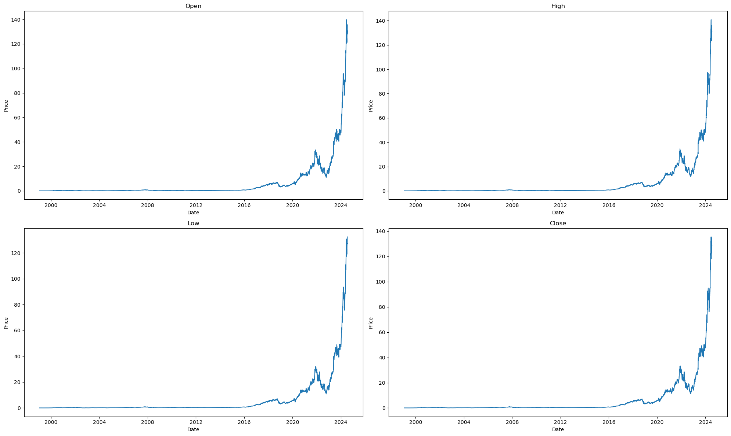
Visualized the price changes over time (Open, High, Low, Close prices)

Slide 8
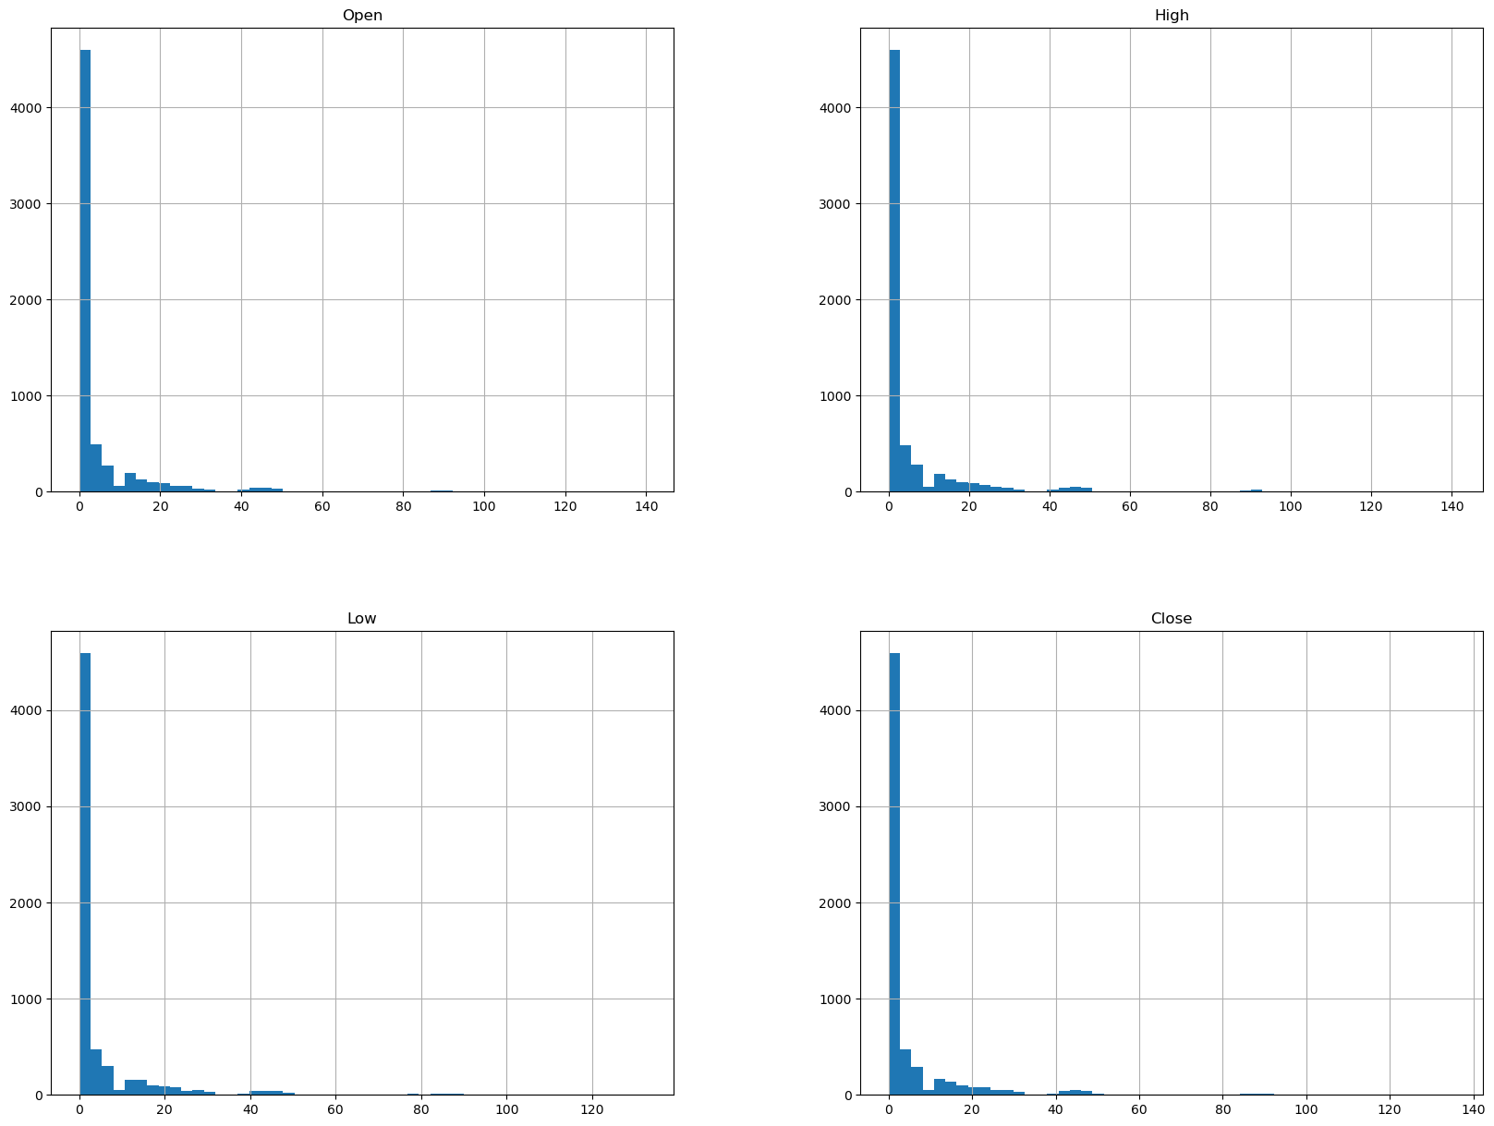
histograms to understand the distribution of price data over time

Slide 9
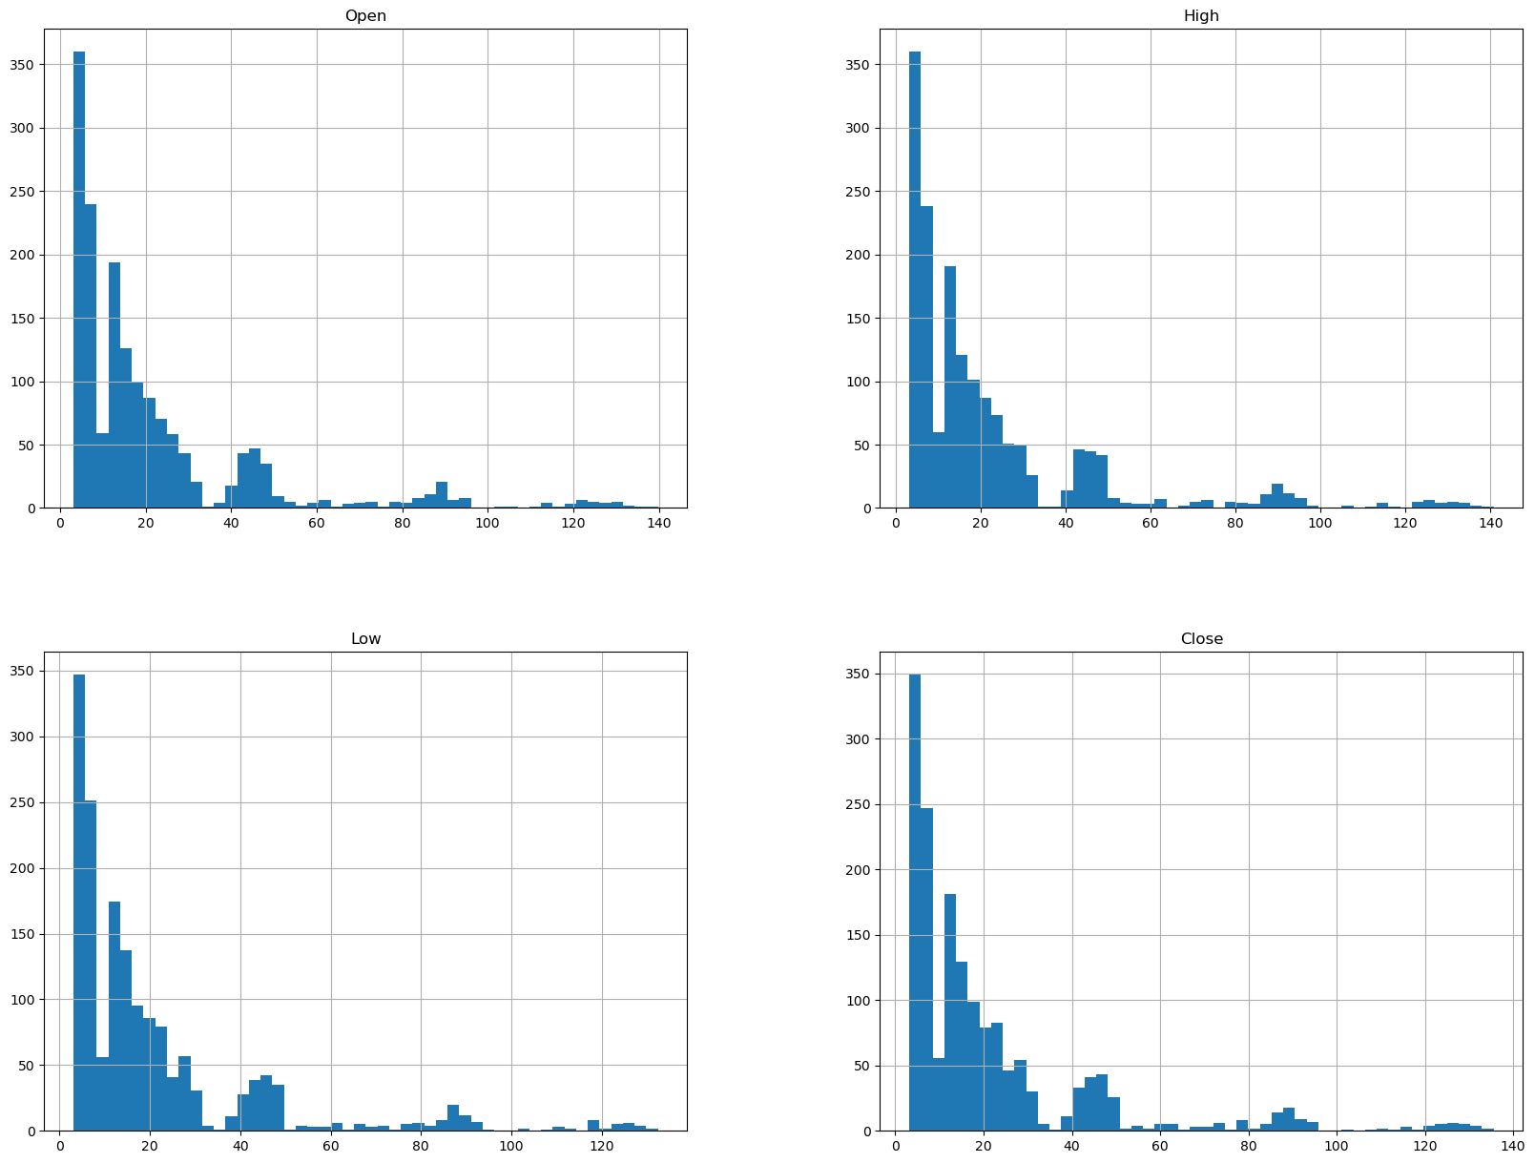
histograms to understand the distribution of price data last 5 years

Slide 10
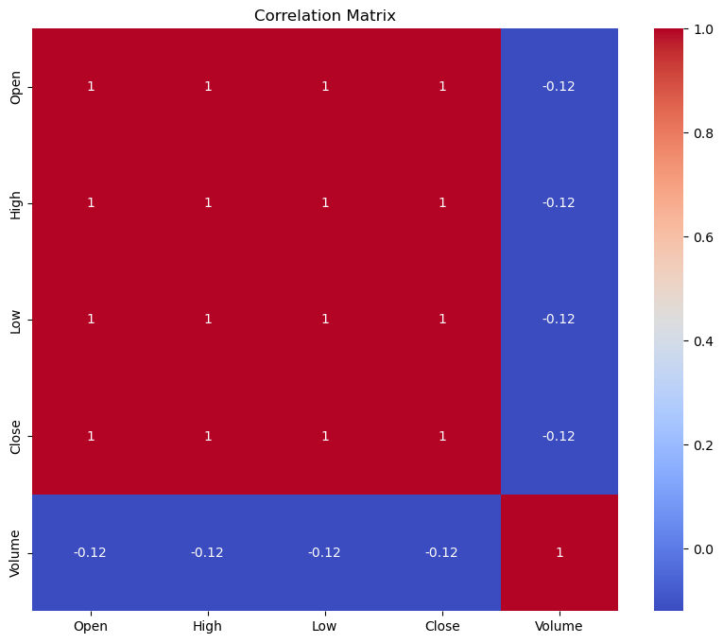
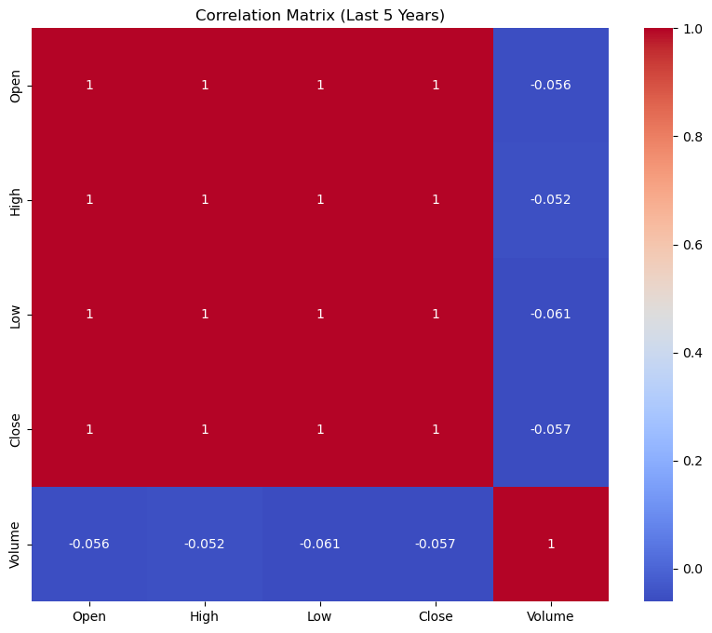
a correlation matrix

Slide 11
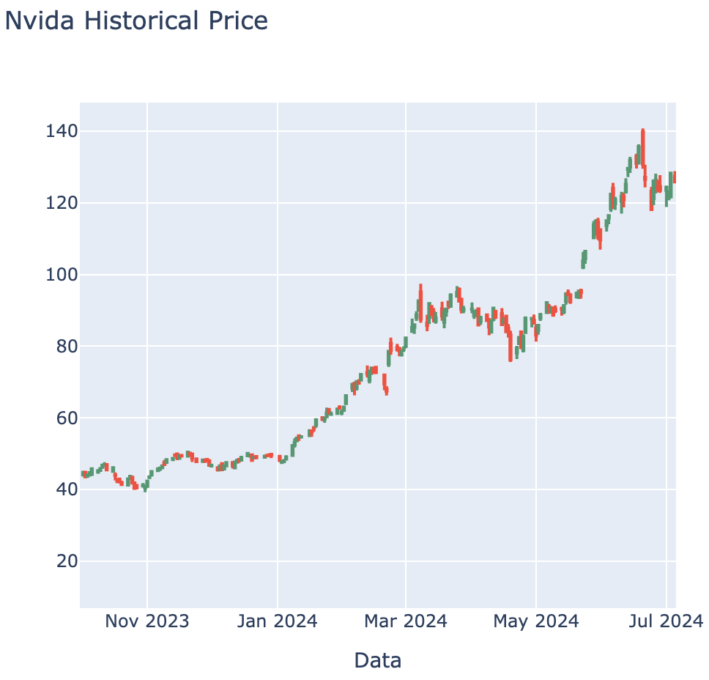
Daily stock change by candlestick

Slide 12
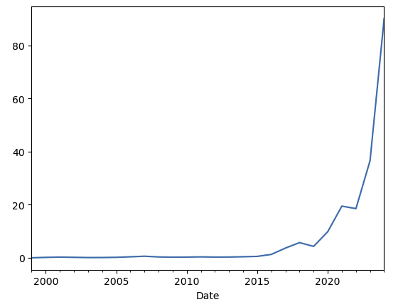
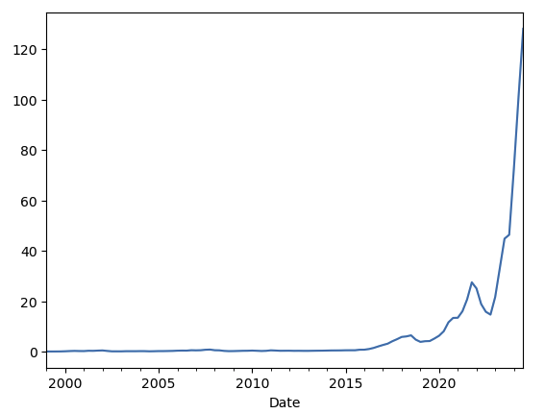
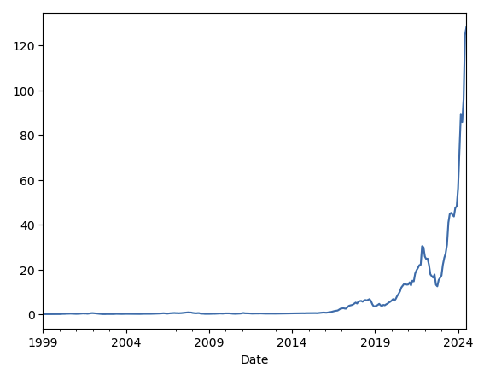
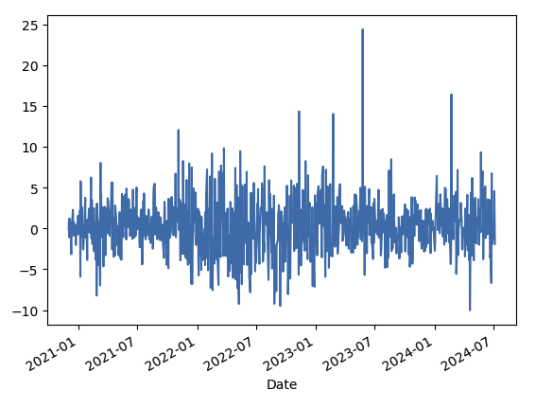
Analyzing Yearly, Quarterly, Monthly and Daily changes
It shows Nvidia stock was low from early 2000, but it has increased a lot after 2016 and 2020 due to new technologies.
Daily percentage change graph analyzes sudden stock price changes due to specific events.

Slide 13
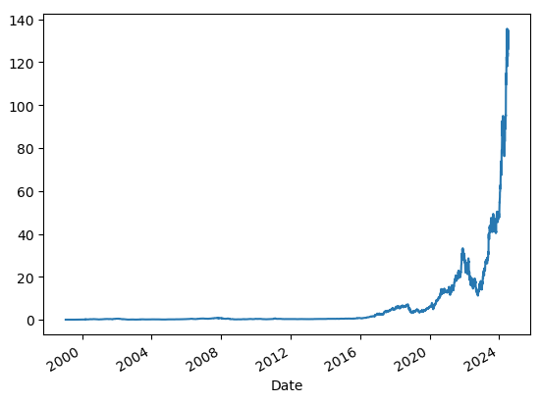
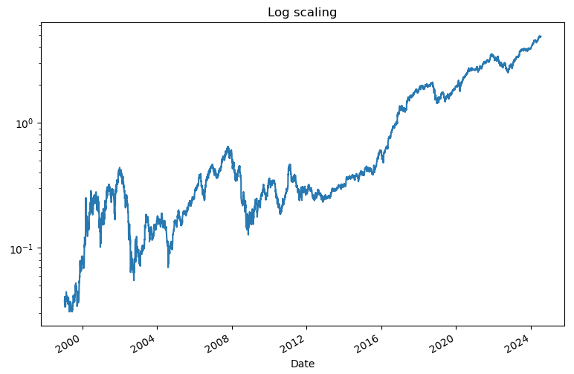
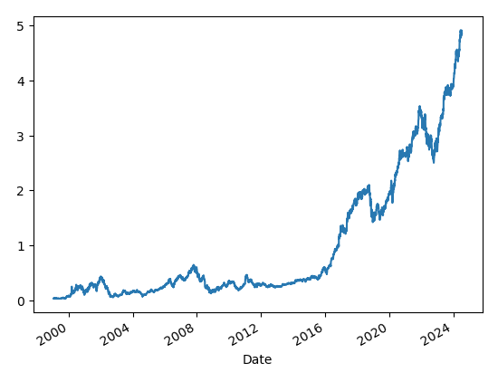
Stock change graph in different scales
- Through Absolute price change, we can see significant jumps and drops.
- Emphasized smaller values, so we can see detailed changes.
- Emphasizes proportional changes, so it shows consistent growth over time.

Slide 14
Prediction Model
Model Description
- Used Random Forest Regressor for predicting stock prices
- Features used: Open, High, Low, Volume
- Target variable: Close price
Model Training and Evaluation
- Split data into training and testing sets (80/20)
- Trained the Random Forest model on the training data

Slide 15
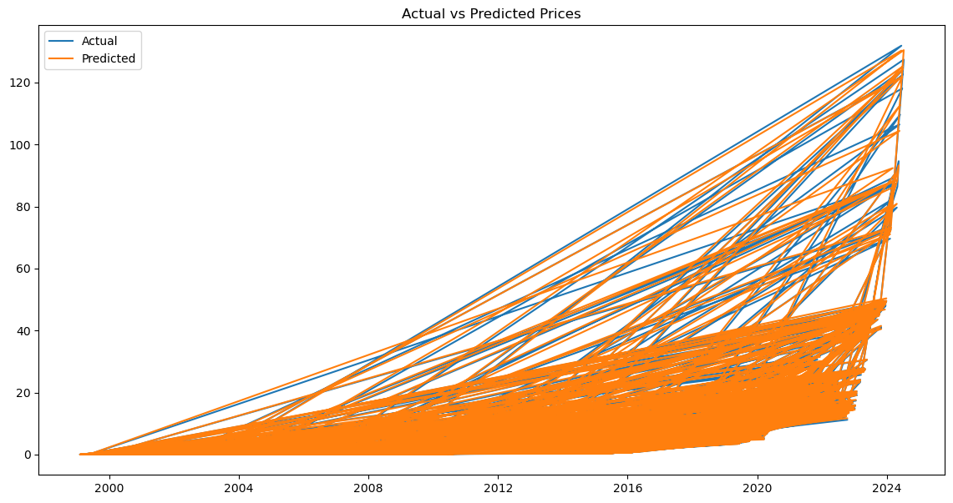

Model Performance
Evaluation Metrics and Results
Mean Squared Error (MSE): 0.07604994886794281 $≈$ 0.076
Visualizations of Actual vs Predicted Prices
Plotted actual vs predicted prices for the test set

Slide 16
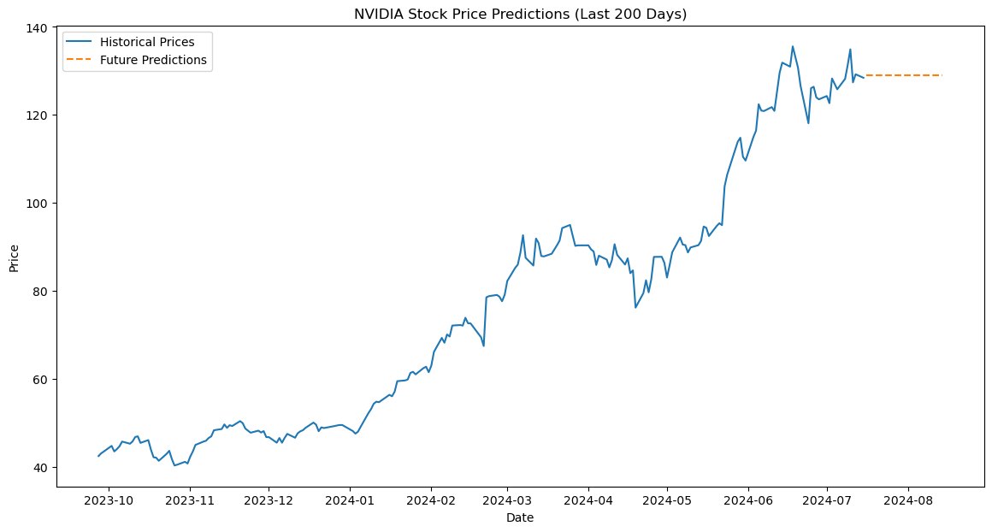
Future Stock Prediction
- Visualized graph showing last 200 days of historical data with future predictions for the next 30days

Slide 17
Conclusion
- The Random Forest model provides a reasonable prediction of NVIDIA's stock prices, indicating potential for practical application in stock market forecasting. I tried different models such as LSTM and its score was bad. Train Score was 2.93 and Test Score was 1387 which is huge, so I decided using Random Forest Model.

