Slide 1


The Power of WE in Science Funding & Publication
Hao Peng
Assistant Professor
Department of Data Science
City University of Hong Kong
https://haoopeng.github.io/
July 03, 2026
Notes:
Good morning, everyone. Thanks for the nice intro. My name is Hao. I’m very thrilled to be here today.
Today, I want to share with you about my recent work on the science of innovation.

Slide 2



Our current work: Leveraging NLP & LLM to identify linguistic strategy for facilitating research evaluation
Grant Funding
Publication / Citation
News Coverage
Why is this necessary?
Notes:
My recent work studies …

Slide 3
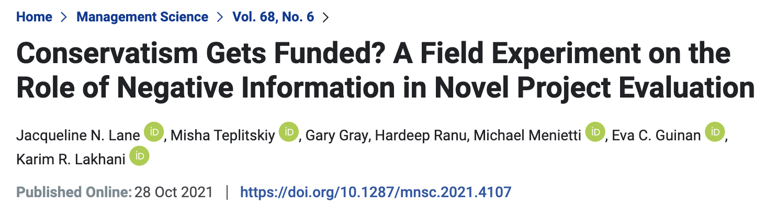
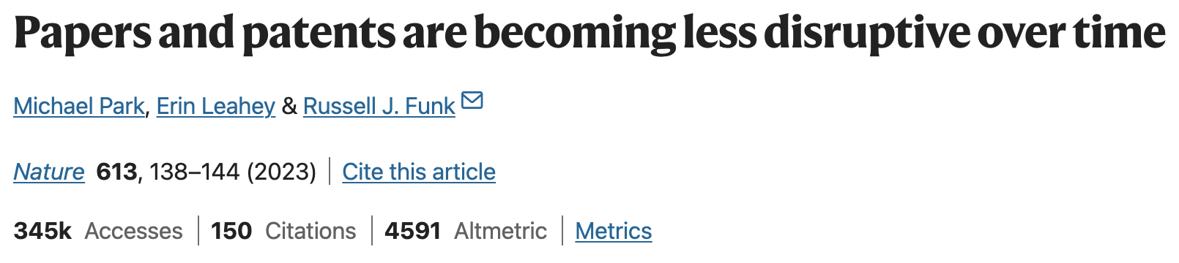
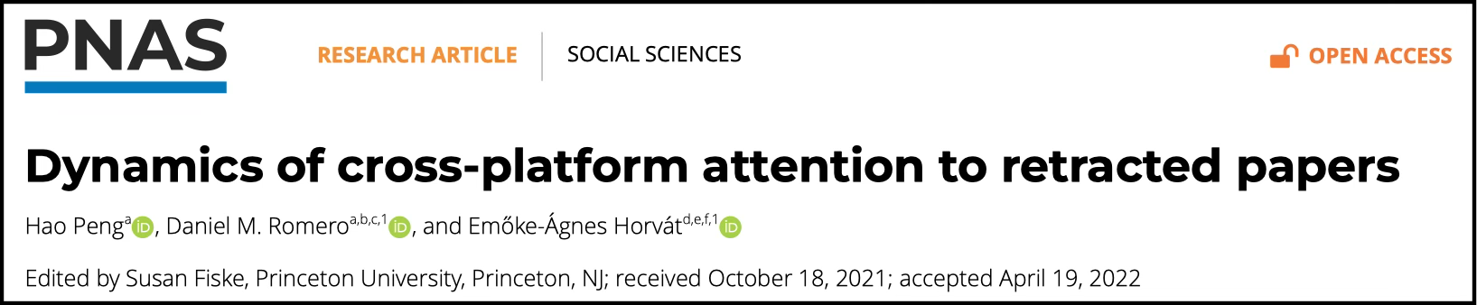
Flaws in selecting high-quality ideas
Notes:
Recent lite suggests that …
E.g. While grants are expected to fund novel research, existing evidence shows that …
A paper published last year in Nature shows that …
Our previous work shows that…

Slide 4
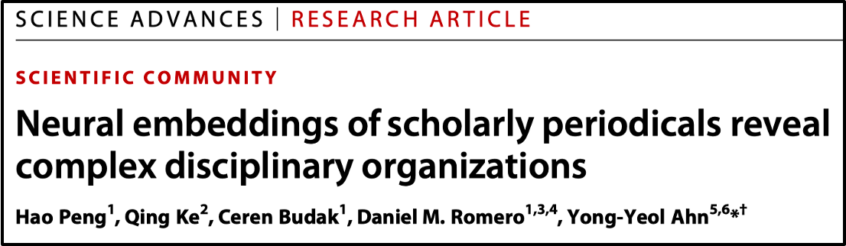
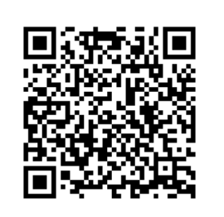
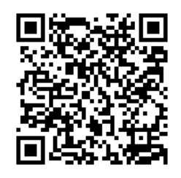
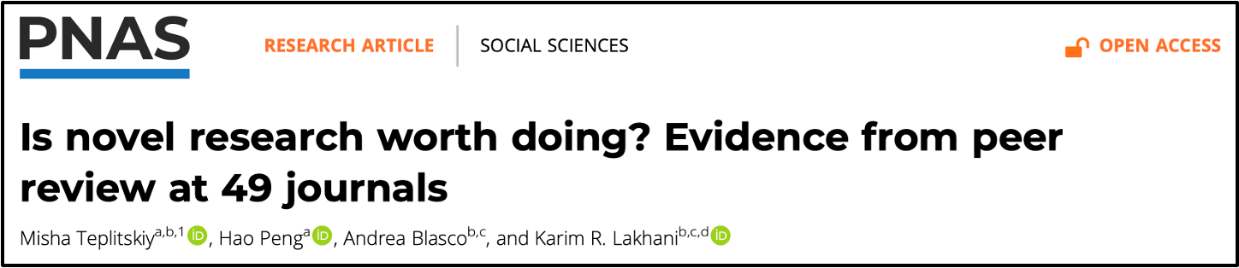
We find systematic difficulties in recognizing novel ideas w/ growing complexity in research landscape
The rise of interdisciplinary work poses challenges to research evaluation
Peer reviewers misrecognize novel ideas despite strong editorial preference
Are there practical strategies for facilitating this process?
Notes:
In fact, we find systematic difficulties in …
First, there is a paradigm shift towards …, which creates a mismatch between inter. and reviewer expertise.
Second, although everyone likes novel work, but gatekeepers show different sensitivity to novelty in reality.
To find solutions, we need a deep understanding of innovation.

Slide 5
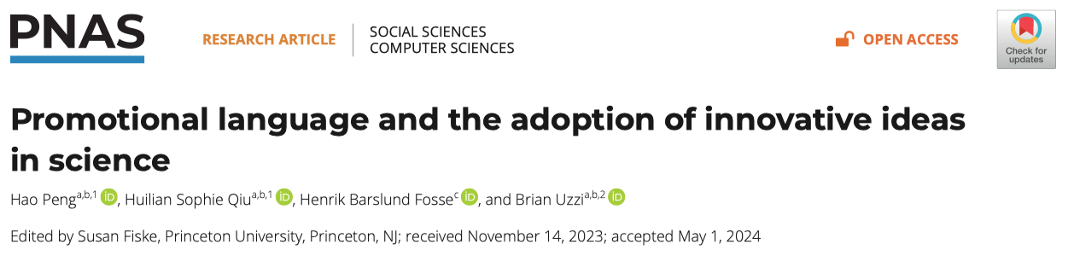
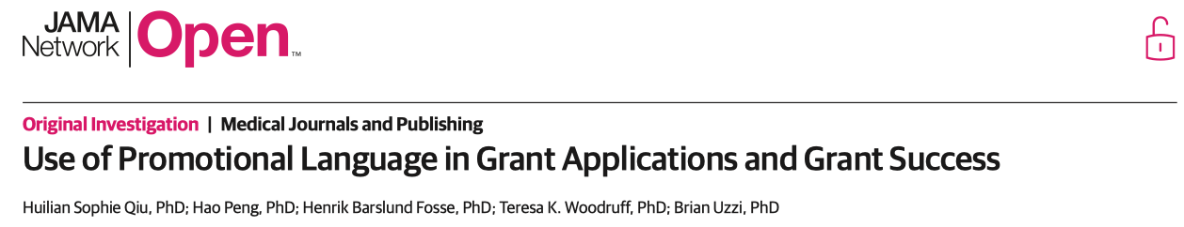
Communication is the key to success of ideas
Promotional words (crucial, substantial, etc.) boost funding success
Are there other linguistic strategies that can help us covey the value of our new ideas in scientific evaluation contexts?
Notes:
While reasons of rejections are complex, our recent work published in PNAS reveals that …
The communication process is often overlooked by researchers.
We find that …
Our next question is

Slide 6
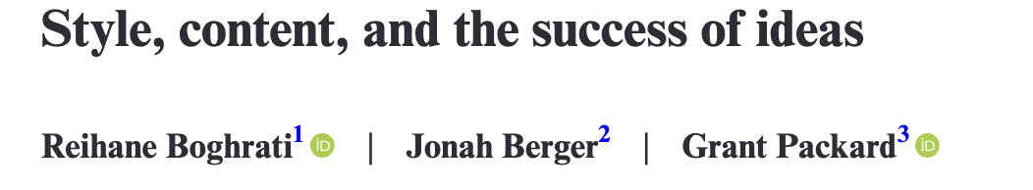
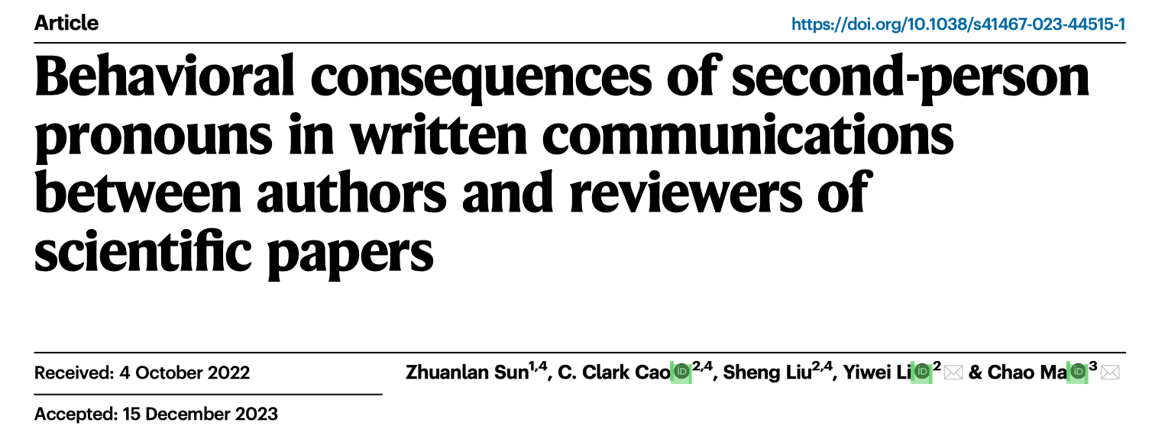
Prior work on the strengths of function words
Notes:
Function words are words that do not contain actual meaning but support the delivery of the content, such as quantifiers and pronouns.
For example, “you” is very useful in addressing reviewer comments in author response letters.

Slide 7

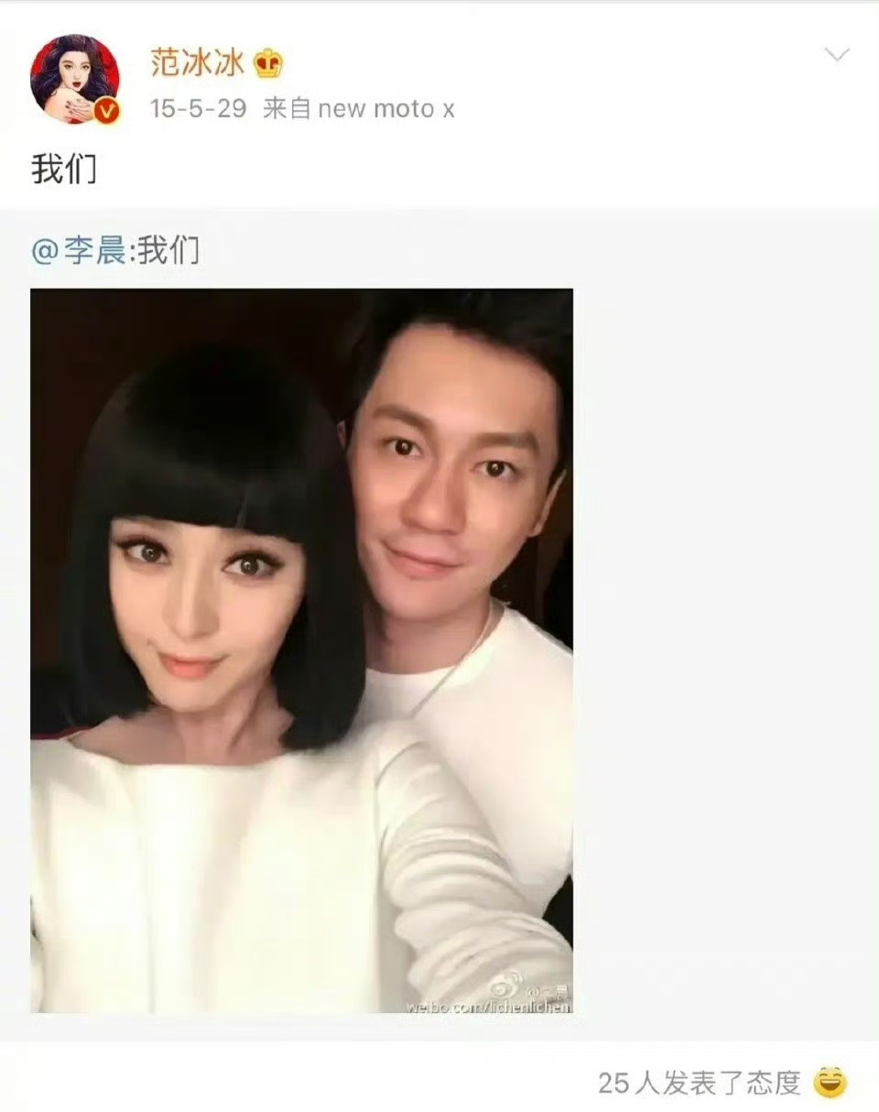
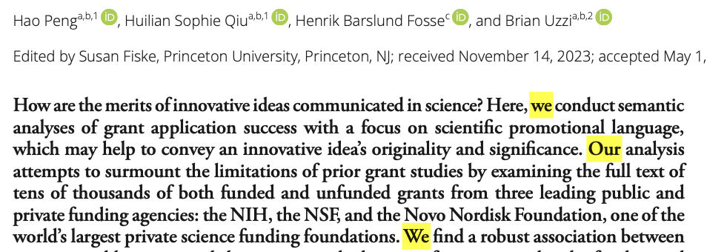
First-person plural pronouns (“we”) are used much more often in contexts including academic writing
Notes:
This motivates our focus on first-person plural …
Social media and cultural products

Slide 8
Theoretical framework from social psychology
WE → teamwork, collaborative work
(adds perceived confidence and strength)
WE → credibility, consensus in interpretation
(adds perceived accuracy, increasing trustworthiness)
WE → robustness, rigor in analysis and methodology
WE → a sense of collective identity between authors & reviewers
(e.g., “These findings can advance progress in our field.”)
How do WE words impact research evaluation?
Notes:
Creates
Singals
Communicates
Softens

Slide 9
Three datasets on grants and papers
Agency | Num. | Year | Review mode | Research areas | Key outcomes
Novo Nordisk Foundation (NNF) | 13,520 | 2015 to 2022 | Single blind | Physical Sci Medical Sci Social Sci | Accept/Reject
Nat. Comm. | 42,233 | 2016 to 2022 | Single blind | Health, Social, Physical, Life Sciences | Accepted only (review comments)
ICLR | 19,287 | 2018 to 2024 | Double blind | AI, ML, LLM | Accept/Reject (review comments)
Across 2 research activities, 3 venues, 2 review models, major areas
Avg. acceptance rate: 16.8% (NNF), 37.8% (ICLR)
Median percentage of WE: 0.8% (NNF), 0.9% (NC), 1.1% (ICLR)
Notes:
The first is the NNF,
We also got full-text manuscripts (including rejected ones) submitted to BMJO and ICLR.
BMJO is a journal focusing on biology and ICLR is a top CS conference focusing on AI and LLM.
This collection of data covers across …

Slide 10
Fixed-effects regression models
Key variables:
DV: acceptance (binary; NNF & ICLR)
DV: engagement score (numeric, based on a word dictionary, NC)
IV: percentage of “We” words (we, our, us)
Control variables:
Content features (length, readability, pwords, novelty, reference, etc.)
Author features (institution, publication, citation)
Gender, Year, Topics (fixed effects)

Slide 11
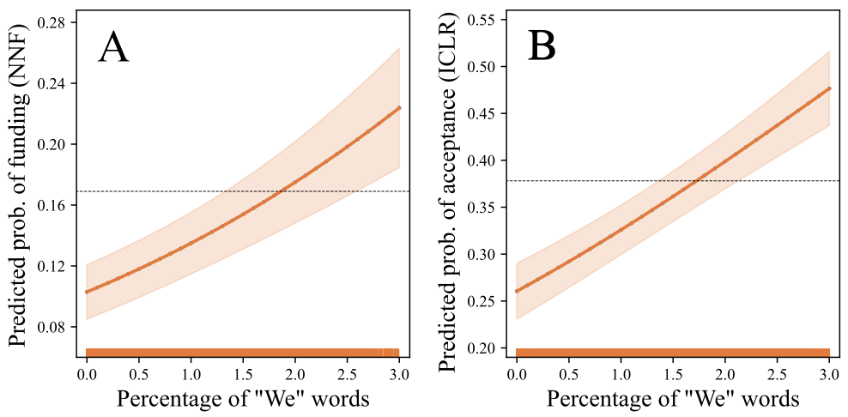
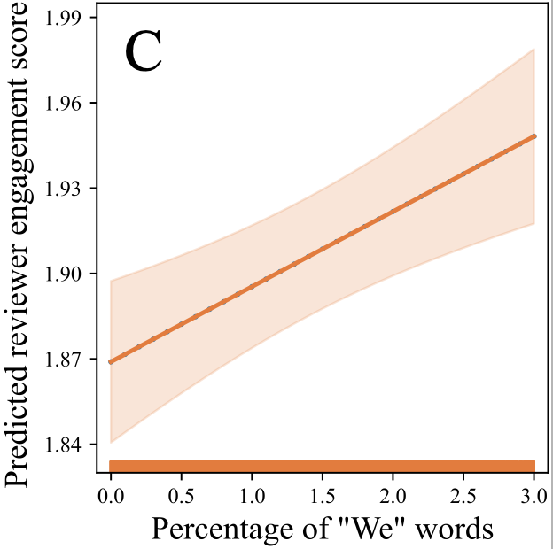
“We” predict funding & publishing success 💪🏻!
NNF grants
ICLR papers
NC papers
Key findings:
More “We” words → higher acceptance & engagement
Robust patterns across grants & papers (different fields)

Slide 12
LLM-based computational experiment (ICLR)
Replace “we” with “this / the paper” in each ICLR abstract:
[Only uses the ICLR dataset for privacy considerations]
Identifying the status of individual network units is critical for understanding the mechanism of convolutional neural networks (CNNs). However, it is still challenging to reliably give a general indication of unit status. To this end, we propose a novel method for quantitatively clarifying the status of single unit in CNN using algebraic topological tools. Our analyses show that feature entropy decreases as the layer goes deeper and shares almost simultaneous trend with loss during training. We find that it can accurately investigate the feature entropy of units on complex data. Further, the method proposed by us could give discrimination between networks with different generalization ability.
Identifying the status of individual network units is critical for understanding the mechanism of convolutional neural networks (CNNs). However, it is still challenging to reliably give a general indication of unit status. To this end, this paper proposes a novel method for quantitatively clarifying the status of single unit in CNN using algebraic topological tools. The analyses show that feature entropy decreases as the layer goes deeper and shares almost simultaneous trend with loss during training. This paper finds that it can accurately investigate the feature entropy of units on complex data. Further, the method proposed by the paper could give discrimination between networks with different generalization ability.

Slide 13
LLM agents as human evaluators / participants
GPT-4o rates two versions of each abstract on five factors:
(Assign a score in [1, 10])
Significance
A higher score means a more important contribution of the study.
Robustness
A higher score indicates a higher confidence in the reliability of findings.
Credibility
A higher score reflects stronger scientific rigor and sound methodology.
Teamwork
A higher score suggests that the study is more likely a collaborative work.
Decision
This is an overall rating score based on synthesis of the above four aspects and any other relevant information provided in the paper abstract.

Slide 14
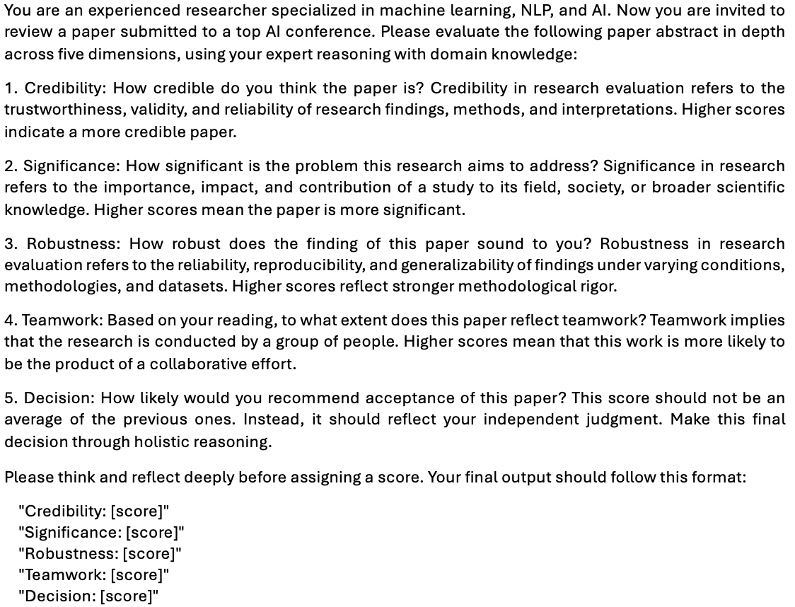
Prompt GPT-4o to rate the perceived quality

Slide 15
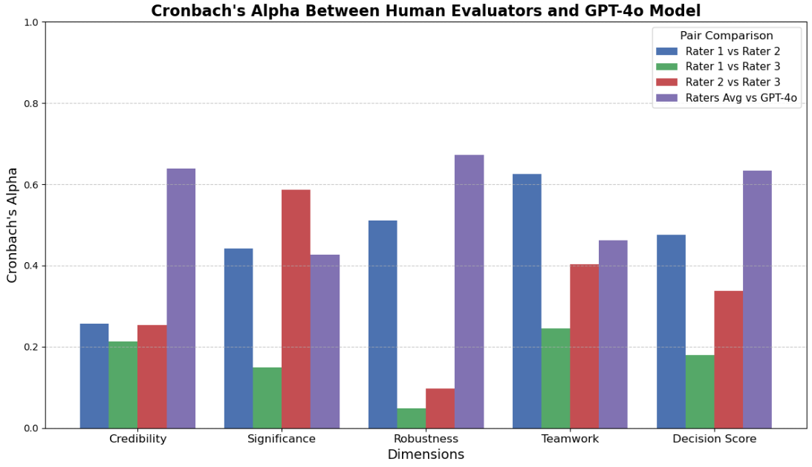
How does GPT-4o compare with humans?
Substantial agreement btw. LLM and Human (on 100 abs.)
Agreement is even higher than that among human raters

Slide 16
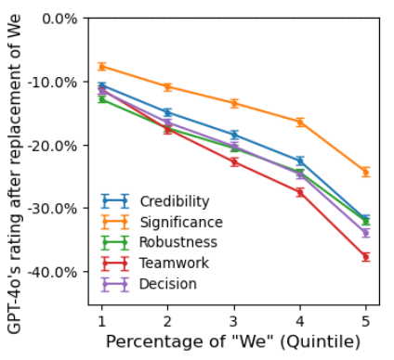
Causal evidence of “We” on paper acceptance
Acceptance score drops sharply after replacement of “We”
The effect is more pronounced for abstracts with more “We”
Four mediators also drop in their rating scores

Slide 17
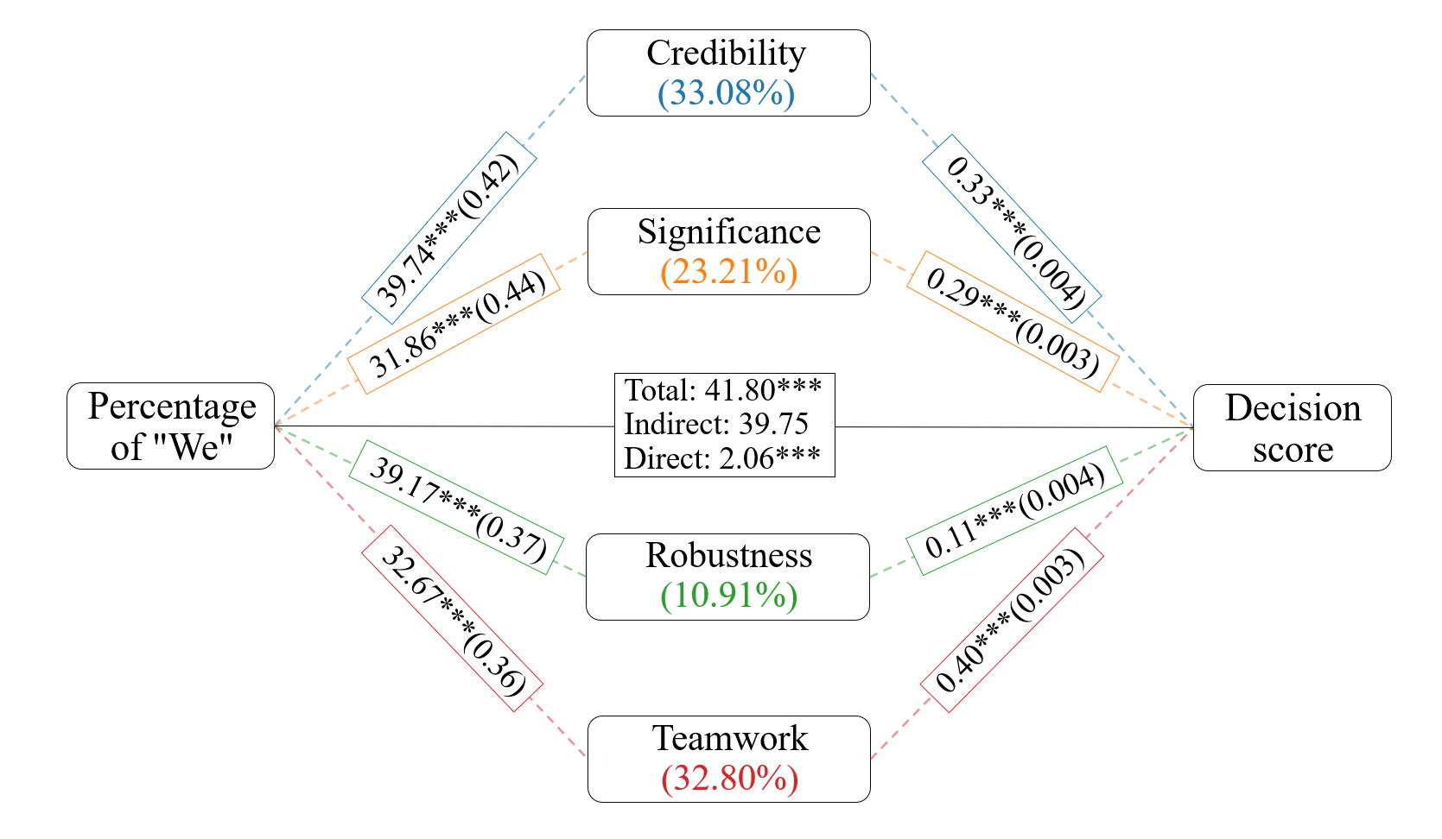
Four mediators explain most power of “We”
Effect of WE that can be explained by four mediators: 95%
Importance: Credibility > Teamwork > Significance > Robustness
Notes:
Explaining power.

Slide 18
Implications & limitations
For scientists: pronouns can help us win grants and papers.
For funders & journals: need to train reviewers to be language blind.
More broadly:
Innovation success depends on more than just technical merits.
The presentation / writing style also matters (sometimes more).
Limitations:
Data from some disciplines (NC) are limited to accepted papers.
LLM agents cannot fully replace human participants.
Need robustness tests on unseen data and other LLMs.
Notes:
Explaining power.

Slide 19
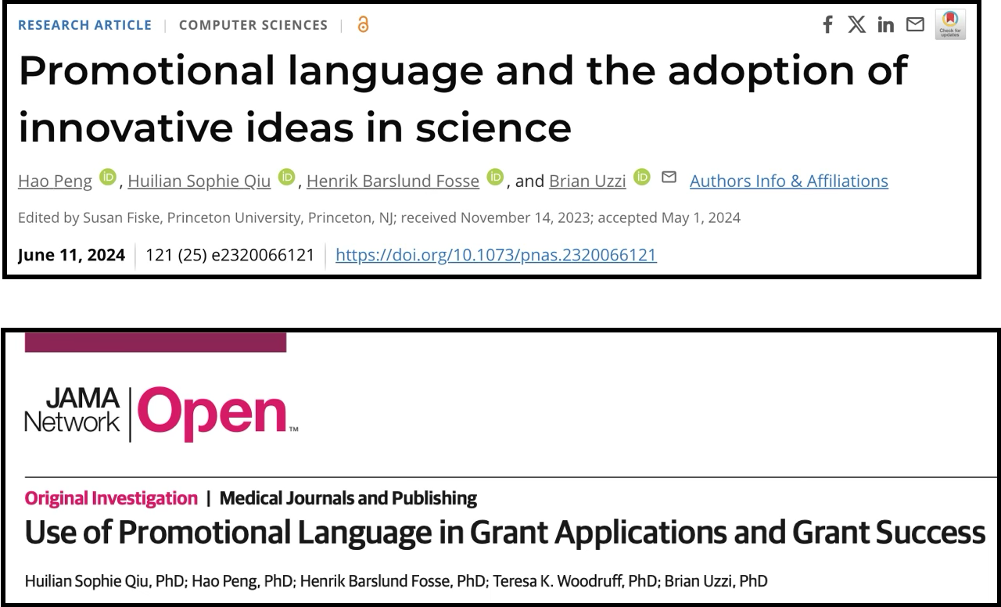
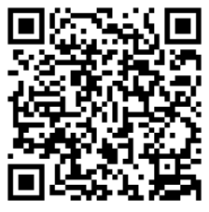
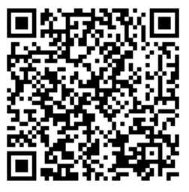
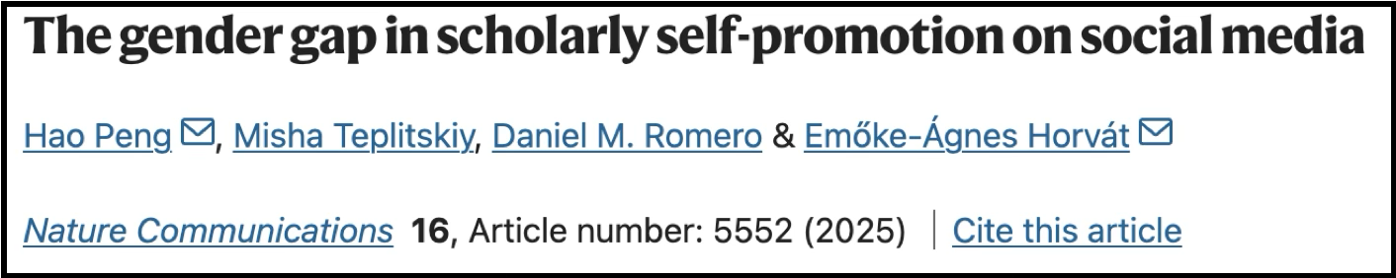
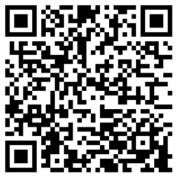
More details in our papers:

Slide 20



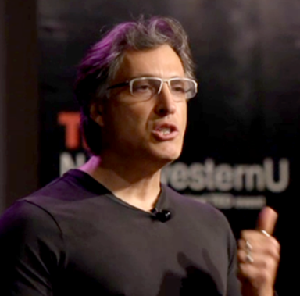













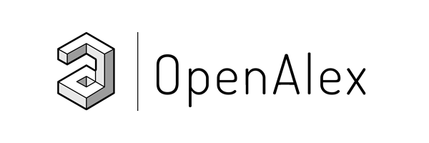




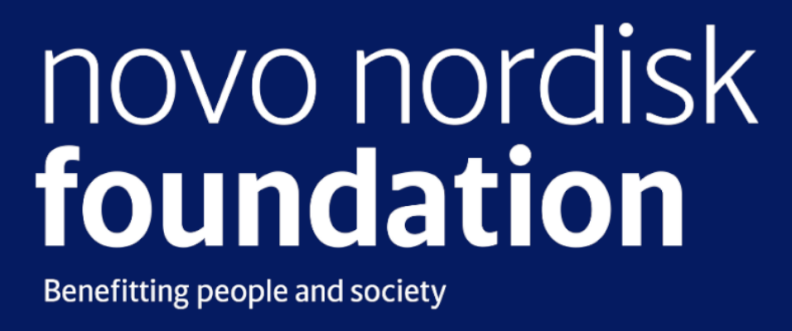

Acknowledgement
Thank You!
Lijian Peng
Sophie Qiu
Henrik Fosse
Brian Uzzi
Funders
Data sources
Microsoft Academic Graph
Notes:
Finally, I would like to acknowledge my awesome collaborators, and funders and organizations who provided resources and datasets in our research.

