Slide 1
Berry Project
Haoqi Wang
10/20/2020

Slide 2
Overview
Acquire and read data
Data clean and data organize
EDA
Conclusion
Reference

Slide 3
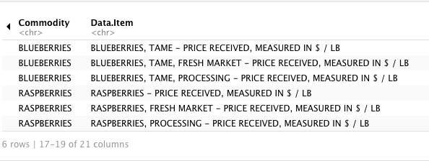
Acquire and read the data
ag_data <- read.csv("berries.csv")

Slide 4
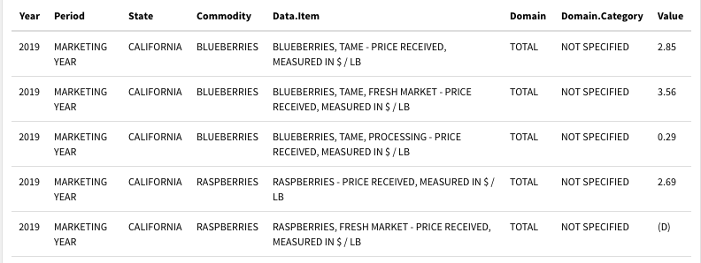
Choose Strawberries Data clean and Data organize

Slide 5
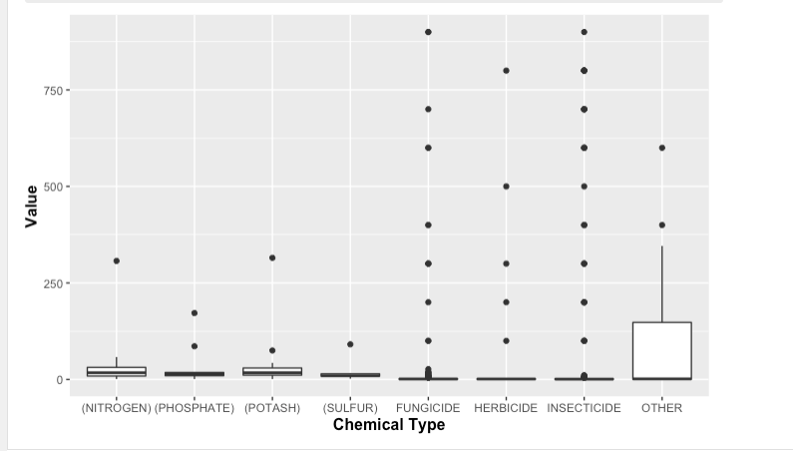
Exploratory data analysis - chemical and value ggplot(sberry1) + geom_boxplot(mapping = aes(x = Chemical, y = Value)) + theme(axis.title = element_text(size = 12, face = "bold")) + labs(x = "Chemical Type")

Slide 6
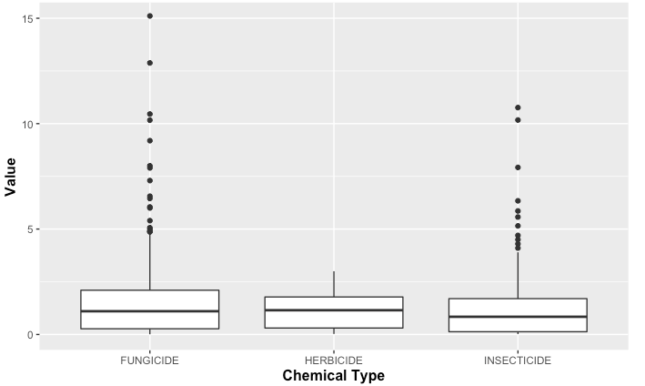
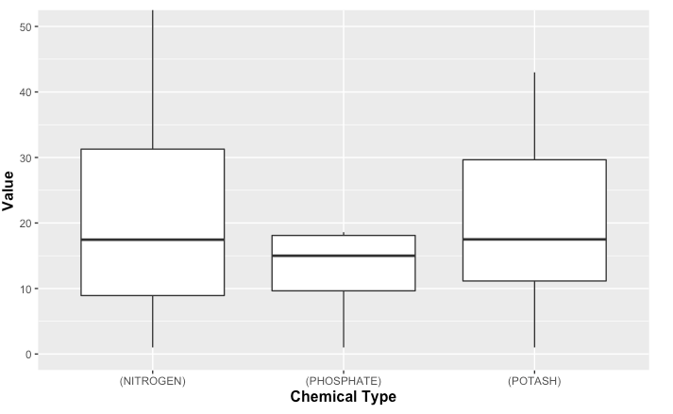
coord_cartesian( ylim=c(0,50))
coord_cartesian( ylim=c(0,15))

Slide 7
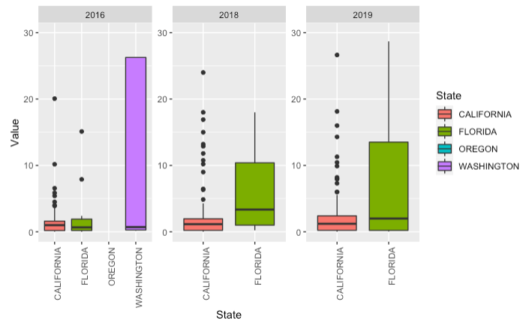
Exploratory data analysis – State and value ggplot(sberry1)+
geom_boxplot(aes(x=State,y=Value,fill=State))+
coord_cartesian( ylim=c(0,30))+
theme(axis.text.x = element_text(angle = 90, hjust = 1))+
facet_wrap(.~Year,scales = "free")

Slide 8
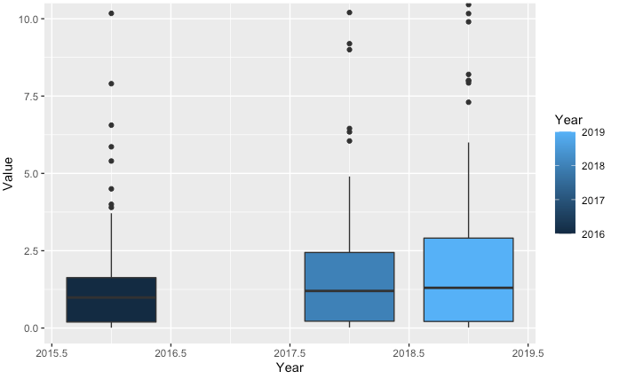
Exploratory data analysis – Year and value
ggplot(sberry1)+
geom_boxplot(aes(x=Year,y=Value,group=Year,fill=Year))+
coord_cartesian( ylim=c(0,10))
theme(axis.text.x = element_text(angle = 90, hjust = 1))

