Slide 1
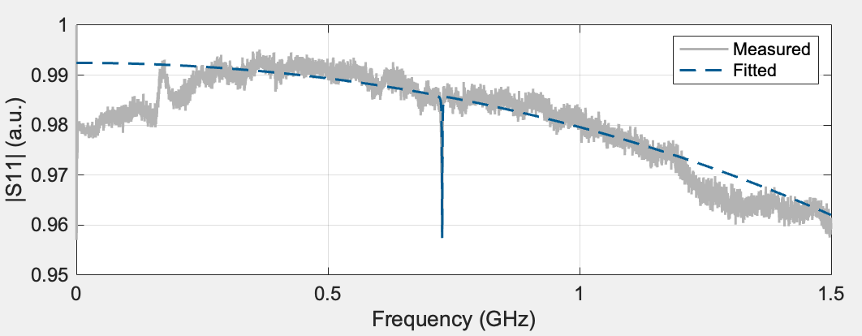
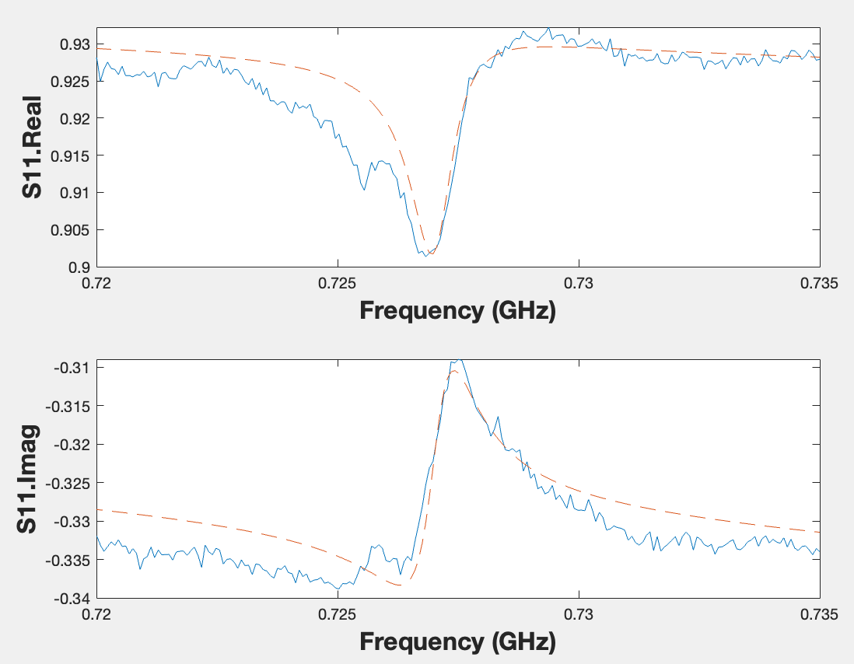
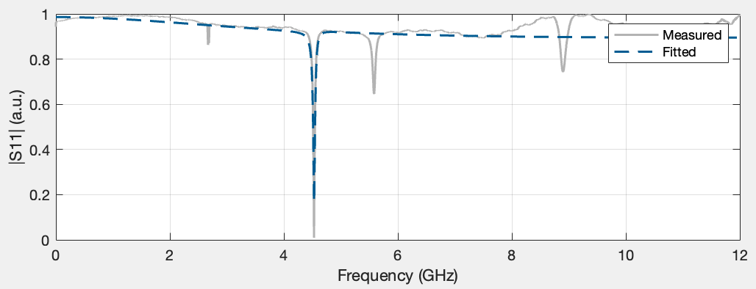
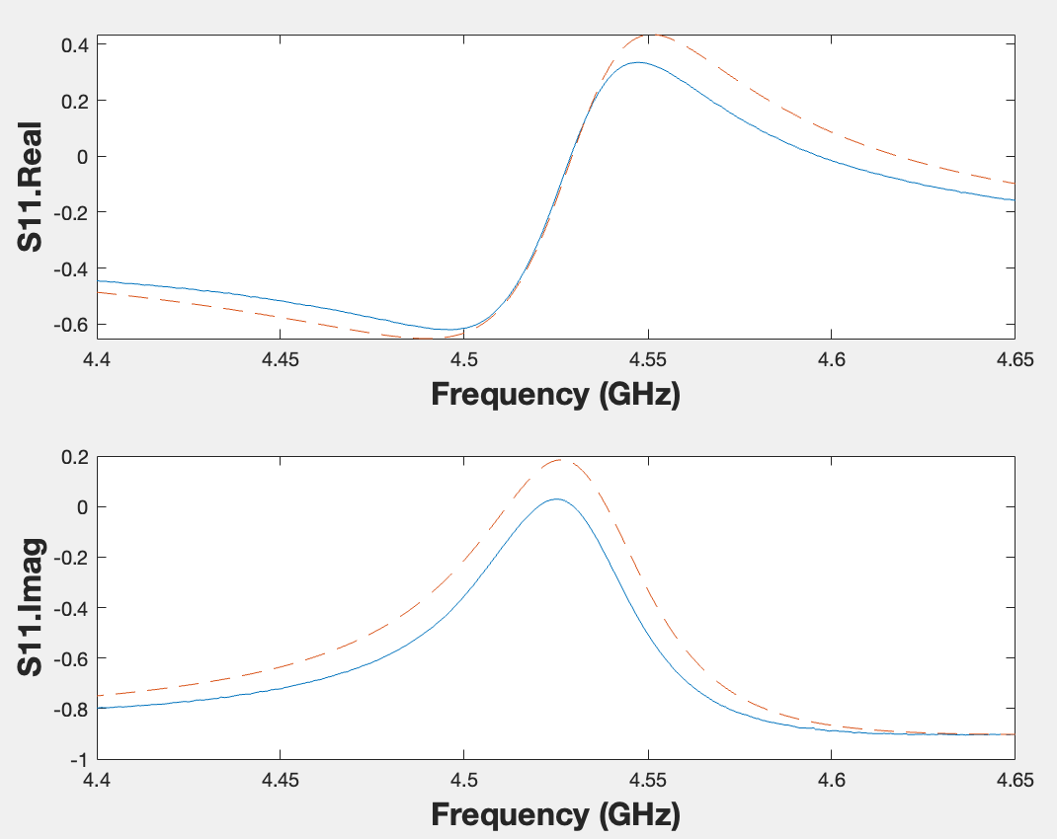
AlScNi S11 at 4K:
Rs = 4.7303 ohm, Ls = 1.7877 nH, Rp = 12239.996 ohm, Cp= 0.00073991 nF
Rm = 3849.8025 ohm, Lm = 54220.2433 nH, Cm = 2.2368e-08 nF
ZnO S11 at 4K:
Rs = 2.7249 ohm, Ls = 0.20786 nH, Rl = 7119.9964 ohm, Cl = 0.00086396 nF
Rm = 15.7971 ohm, Lm = 16.6952 nH, Cm = 1.8875e-06 nF

Slide 2
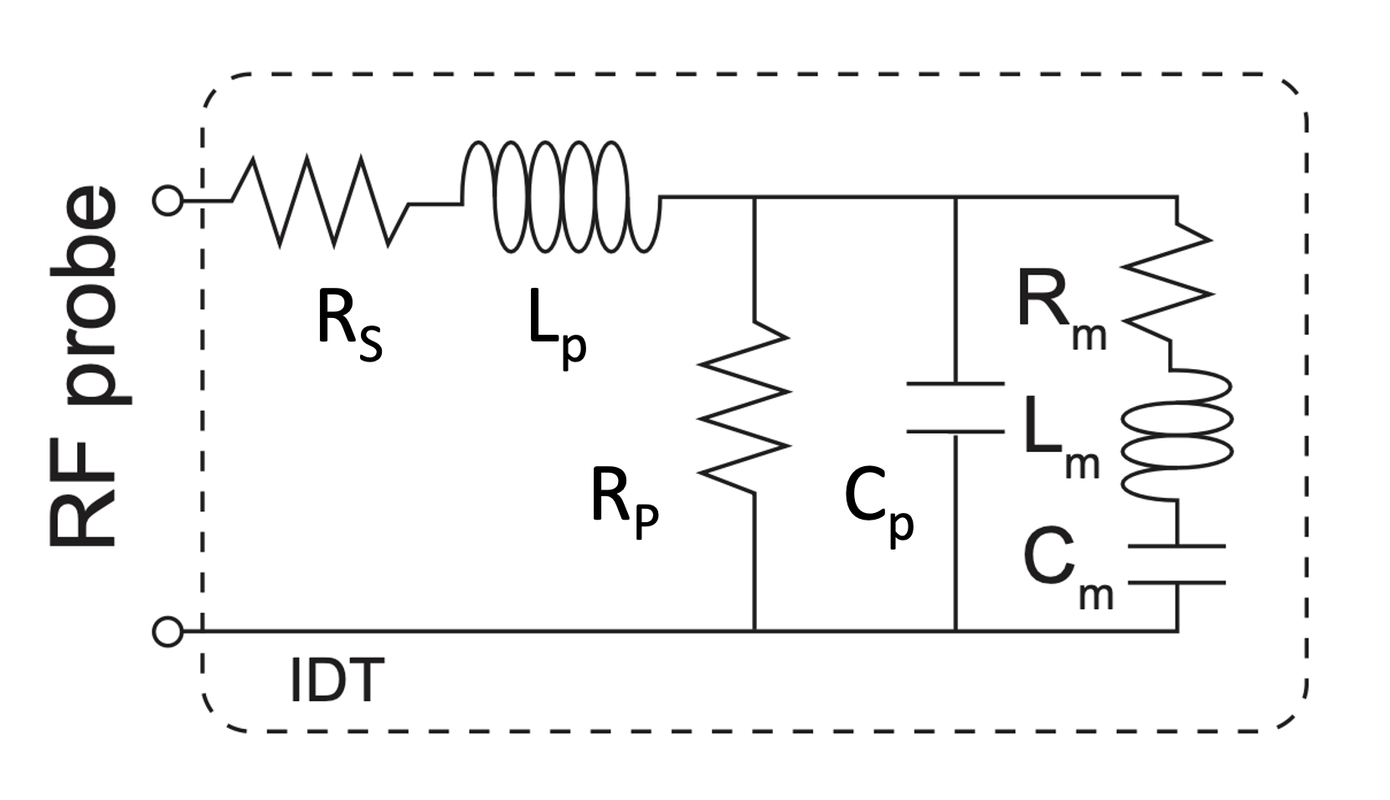
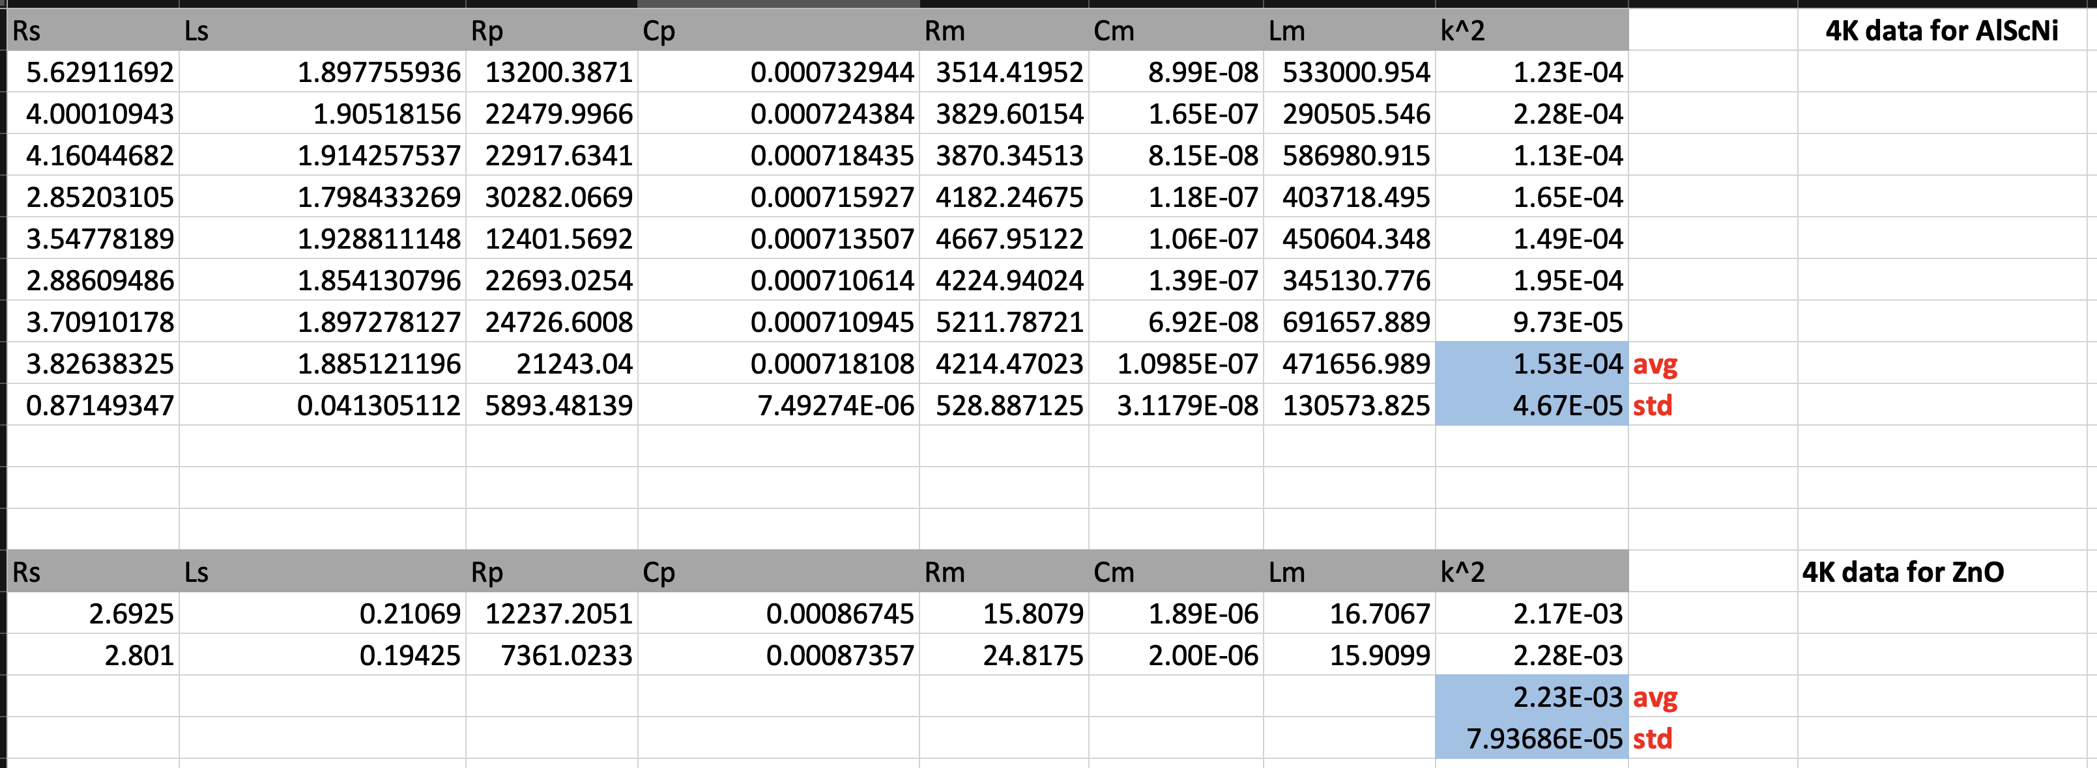
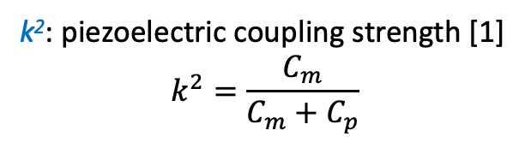
Extracted modified BVD model parameters at 4K
and computed piezoelectric coefficient for ZnO & AlScNi
Modified BVD (Butterworth Van Dyke) Model:
Rs: serial resistance between probe and IDT fingers
Lp: serial inductance between probe and IDT fingers
Rp: effective leakage resistance between IDT finger pairs
Cp: effective capacitance resistance between IDT finger pairs
Rm: directly related to motional energy loss
Cm: electro-mechanical coupling strength
k²: piezoelectric coupling strength [1]
$$k^{2}=\frac{C_{m}}{C_{m}+C_{p}}$$
Extracted k²:
k²: 1.53e-4 (AlScNi)
k²: 2.23e-3 (ZnO)
[1] Wu, Marcelo, et al. "Microwave-to-optical transduction using a mechanical supermode for coupling piezoelectric and optomechanical resonators." Physical review applied 13.1 (2020): 014027.

Slide 3
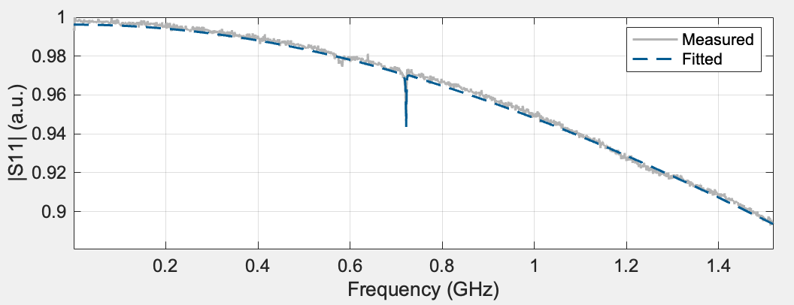
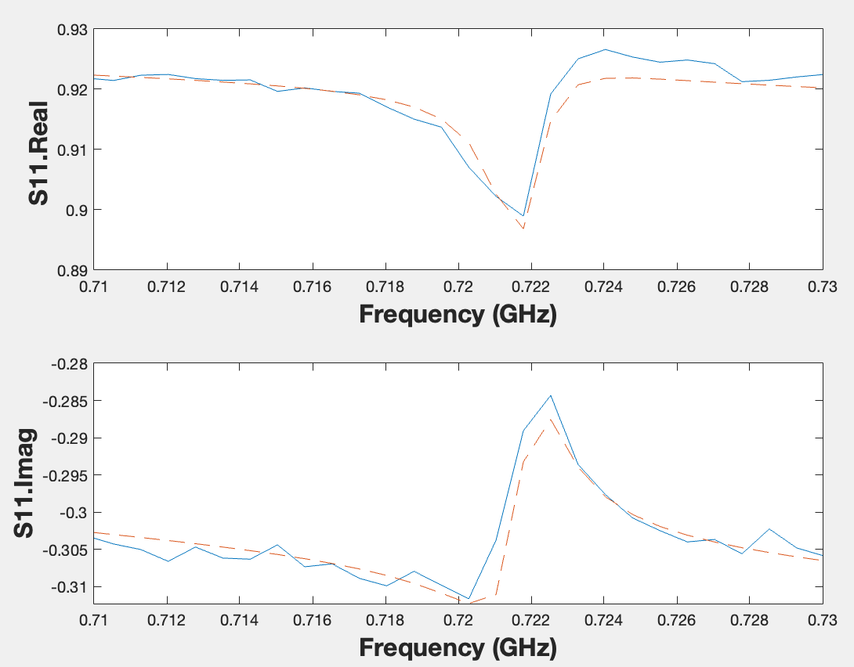
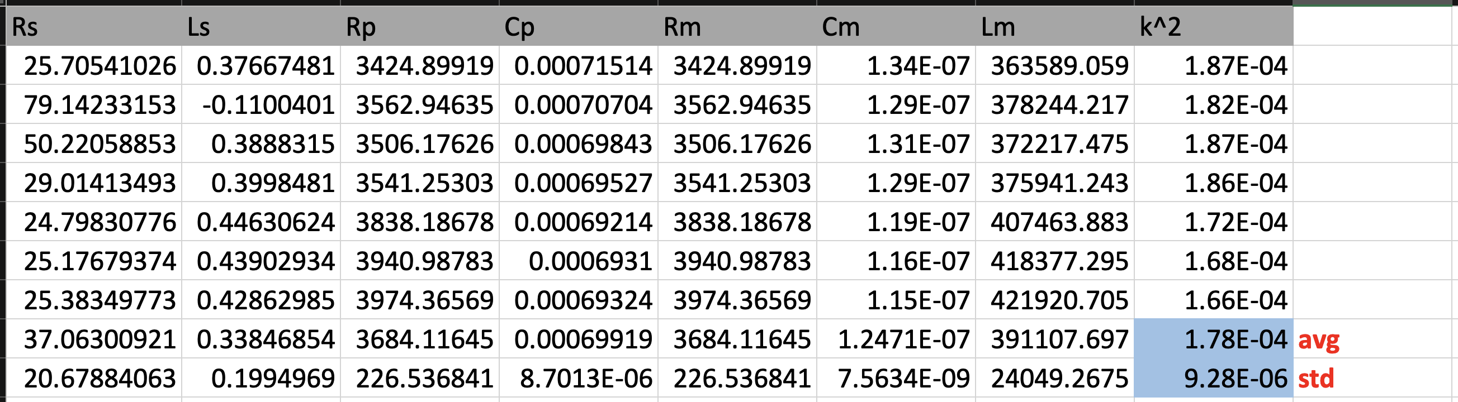
AlScNi S11 at RT:
Rs = 25.4903 ohm, Ls = 0.41437 nH, Rl = 26319.9193 ohm, Cl = 0.0007251 nF
Rm = 3303.3439 ohm, Lm = 55813.2022 nH, Cm = 2.2066e-08 nF
Extracted piezoelectric coupling strength of AlScNi at RT:

