Slide 1
Future Directions: Overview
Five Ways to Intervene in the SAM3 Pipeline
SAM3 Architecture - Where Each Future Direction Intervenes
Reference DB (annotated patches)
D. RAG: retrieve similar annotated patches
Gene Expression (18K genes)
Expression MLP Encoder
C. Expression -> Prompt
B. GigaPath Backbone
A. Supervised Fine-tune
H&E Image (tile 1024px)
Image Encoder (ViT)
Prompt Encoder
Mask Decoder
Mask Output
E. Replace with CellViT / HoVerNet
Points / Boxes
Text (CLIP)
Exemplar Patches
 | Direction
A | Supervised fine-tune image encoder + mask decoder
B | Replace image encoder with pathology foundation model
C | Expression MLP -> Prompt Encoder
D | RAG: retrieval exemplars -> Prompt Encoder
E | Replace whole SAM3 with pathology model

Slide 2
Our training: what the model is actually learning
A two-modal H&E-expression shared-space model before SAM3 integration
Training sample = one spatial tissue location represented as (H&E crop, VisiumHD expression vector, tissue label)
Input | What it is | What it teaches
H&E crop | local morphology around the VisiumHD spot/bin | image tower learns pathology morphology
Expression vector | 18,085-gene log-normalized VisiumHD profile | expression tower learns molecular / semantic tissue signal
Tissue label | 3-class coarse or 8-class fine expert label | semantic anchor used by both towers through CE losses
Goal | Meaning
Main representation goal | H&E and expression embeddings from biologically similar regions should live in a shared space
Classification goal | image branch and expression branch should both predict the tissue label
Alignment goal | paired H&E-expression embeddings should be closer than mismatched pairs when InfoNCE is used
SAM3 goal | use the learned space to rank regions, exemplars, prompts, or masks before/inside SAM3
Important: this is not SAM3 fine-tuning yet. It is the expression-aware representation that will later feed SAM3 ranking/prompting.
Haoran Wu | Group meeting | May 2026

Slide 3
Our architecture: two towers, projection heads, shared classifier
This is the two-modal counterpart to Haiku's three-tower shared-space design
H&E crop 128 px
Image encoder GigaPath / ResNet
Image projection
Shared embedding space
Shared classifier
Expression 18,085 genes
Expression MLP encoder
Expression projection
Part | Implementation | Why it is there
Image encoder | GigaPath tile encoder or ResNet50 | tests pathology foundation model vs generic CNN baseline
Expression encoder | MLP over 18,085 genes | learns compact expression representation from VisiumHD profile
Projection heads | map both modalities to shared embedding | the space used by retrieval and alignment losses
Shared classifier | same classifier applied to image/expression embeddings | forces both modalities to predict the same tissue semantics
Haoran Wu | Group meeting | May 2026

Slide 4
Our input construction: paired H&E morphology and VisiumHD expression
The training unit is a co-localized image-expression pair with tissue-label supervision
Input component | Our setting | Meaning
H&E source | Exp1 tissue_hires_image.png | same histology image underlying VisiumHD spots
Image crop | crop size 128 px for main GigaPath/ResNet ablation | local morphology around each spatial bin
Model input size | GigaPath resized to 224; ResNet kept at 128 | backbone-specific image input requirement
Expression source | expr_log1p.npz with 18,085 genes | molecular profile paired with the image crop
Normalization | scaler.npz applied to expression values | keeps expression features numerically stable
Labels | 3-class or 8-class expert tissue labels | semantic supervision and evaluation target
3-class target
8-class target
tumor / stroma / immune infiltration Coarse biological categories; currently the most stable setting.
all expert labels, including rarer or more ambiguous classes Harder because labels are finer and less morphologically separable.
Haoran Wu | Group meeting | May 2026

Slide 5
Our projection and loss: how the model is optimized
We compare label supervision alone, label supervision plus alignment, and alignment alone
Total loss variants are built from CE_image, CE_expression, and an image-expression alignment term
Loss part | Definition | Role
CE_image | cross entropy from image embedding -> tissue label | teaches H&E morphology to predict tissue semantics
CE_expression | cross entropy from expression embedding -> tissue label | turns expression tower into supervised molecular/semantic anchor
MSE alignment | distance between normalized image/expression embeddings | baseline pairwise closeness objective
InfoNCE alignment | paired image-expression positives vs in-batch negatives | CLIP-style alignment; directly optimizes retrieval structure
Experiment | Loss formula | Question answered
Original baseline | CE_img + CE_expr + 0.5 x MSE | first working shared-space baseline
CE-only | CE_img + CE_expr | tests whether shared labels alone create useful retrieval
CE + InfoNCE | CE_img + CE_expr + lambda x symmetric InfoNCE | tests whether paired alignment adds value beyond labels
InfoNCE-only | symmetric InfoNCE only | tests whether paired data can align without tissue-label anchor
InfoNCE uses tau = 0.07; lambda sweep = 0, 0.05, 0.10, 0.20, 0.50.
Haoran Wu | Group meeting | May 2026

Slide 6
Our training strategy: what is frozen, what is trained, and what changed later
This is the practical methods table for the runs in the result section
Training part | Our setting | Why
Base ablation backbone | frozen GigaPath / frozen ResNet | avoid overfitting while testing projection/expression/loss design
Trainable in base ablation | image projection, expression MLP, shared classifier | these parts learn the cross-modal task
Base optimizer | AdamW, weight decay 1e-4 | standard stable optimizer for neural fine-tuning
Base LR | projection / expression / classifier = 1e-4 | same LR for newly trained parts
Regularization | dropout = 0.3; early stop patience = 2 | reduce overfitting on limited labels
Class imbalance | balanced sampler + sqrt inverse class weights | rare labels contribute more without exploding weights
Training strategy | Image encoder | Schedule/LR | Purpose
Frozen constant | 0 trainable blocks | constant LR | control
Frozen warmup/cosine | 0 trainable blocks | warmup/cosine | tests schedule only
Last-1 warmup/cosine | last 1 image block | backbone LR 1e-5 | controlled pathology feature adaptation
Last-2 warmup/cosine | last 2 image blocks | backbone LR 1e-5 | closest to Haiku-style image fine-tuning
Haoran Wu | Group meeting | May 2026

Slide 7
What we changed across experiments
The goal is to isolate backbone choice, label granularity, alignment loss, and fine-tuning strategy
Backbone
Label target
Loss design
Training strategy
ResNet50
3-class coarse
CE-only
Frozen
GigaPath
8-class fine
CE + InfoNCE
Last-1 block
MUSK pending
InfoNCE-only
Last-2 blocks
Read the experiment grid from left to right: choose a backbone, choose label granularity, choose the loss, then choose whether to fine-tune the image encoder.
This is why the result section separates supervised metrics from retrieval/fusion metrics: classification tells us whether each tower learned tissue semantics; retrieval tells us whether the two towers share a useful space.
Haoran Wu | Group meeting | May 2026

Slide 8
Our experiment grid: same training recipe, different supervision signals
The ablation asks whether retrieval comes from shared labels, cross-modal alignment, or both
Setting | Value | Reason
3-class | tumor / stroma / immune infiltration | coarse labels; expected more stable
8-class | all expert labels | fine-grained labels; tests rare/ambiguous categories
Crop/input | GigaPath: 128 -> 224; ResNet: 128 -> 128 | same H&E crop, backbone-specific input resize
Batch | GigaPath 32; ResNet 128 | GigaPath is heavier, ResNet allows larger batch
Epochs | 8 total, early stop patience 2 | fast controlled ablation, best checkpoint by val macro-F1
Sampling/CE | balanced sampler + sqrt inverse class weights | reduces dominance of common classes
Loss variants
Lambda sweep
Variant | Loss | Question
CE-only | CE_img + CE_expr | Do the two towers only learn label semantics separately?
CE + InfoNCE | CE_img + CE_expr + lambda x symmetric InfoNCE | Does paired H&E-expression alignment improve the shared space?
InfoNCE-only | symmetric InfoNCE | Can paired data align without tissue labels?
0
0.05
0.10
0.20
0.50
only
Presentation interpretation: if CE-only is strong but InfoNCE-only fails, labels are the semantic anchor; if CE+InfoNCE improves retrieval, contrastive alignment adds value beyond classification.
Haoran Wu | Group meeting | May 2026

Slide 9
Completed experiments: ResNet baseline and GigaPath variants
These are the runs already completed before the new loss ablation
Run | Job | Loss | Classes | Crop/Input | Why it was run
ResNet contrastive | 11016975 | InfoNCE only | 8 | 64/64 | simple cross-modal baseline
GigaPath crop64 | 11016957 | CE + CE + MSE | 8 | 64/224 | pathology image features, local crop
GigaPath crop128 | 11016973 | CE + CE + MSE | 8 | 128/224 | larger context for fine labels
GigaPath crop128 | 11016974 | CE + CE + MSE | 3 | 128/224 | coarse tumor/stroma/immune target
Best supervised result
Takeaway: coarse 3-class labels are still more stable than 8-class labels, but Haiku-inspired last-2-block fine-tuning improved both 3-class supervised metrics and 8-class image recognition. Retrieval now shows the fine-tuned models help fused/probe readouts more than raw R@1.
0.765
last-2 expr acc
0.694
last-2 macro-F1
0.745
CE-only R@1
Haoran Wu | Group meeting | May 2026

Slide 10
Key training result tables: what finished and what it means
These are the numbers to cite verbally before showing retrieval
Run | Job | Expr acc | Expr macro-F1 | Image acc | Interpretation
GigaPath 8c crop64 | 11016957 | 0.5948 | 0.4368 | 0.6344 | 8-class baseline, smaller crop
GigaPath 8c crop128 | 11016973 | 0.6100 | 0.4366 | 0.5328 | larger crop did not solve fine labels
GigaPath 3c crop128 | 11016974 | 0.7544 | 0.6724 | 0.6800 | coarse labels much more stable
GigaPath 8c last2 warmcos | 11040134 | 0.6316 | 0.4512 | 0.7084 | fine-tuning improves image branch
Haiku-inspired 3-class training strategy
3-class retrieval/fusion readout
Strategy | Blocks | LR schedule | Expr acc | Macro-F1 | Image acc
Frozen constant | 0 | constant | 0.7568 | 0.6799 | 0.6912
Frozen warm/cos | 0 | warmup/cosine | 0.7532 | 0.6796 | 0.6908
Last-1 warm/cos | 1 | warmup/cosine | 0.7652 | 0.6929 | 0.7920
Last-2 warm/cos | 2 | warmup/cosine | 0.7652 | 0.6945 | 0.8312
Run | R@1 | R@5 | R@10 | Fused R@1
CE-only | 0.745 | 0.811 | 0.848 | 0.856
InfoNCE .10 | 0.722 | 0.858 | 0.900 | 0.858
Last-1 ft | 0.741 | 0.833 | 0.870 | 0.874
Last-2 ft | 0.728 | 0.837 | 0.865 | 0.880
Main interpretation: last-2 fine-tuning wins supervised image accuracy and fused/probe retrieval, while CE-only / last-1 remain strong raw nearest-neighbor baselines.
Haoran Wu | Group meeting | May 2026

Slide 11
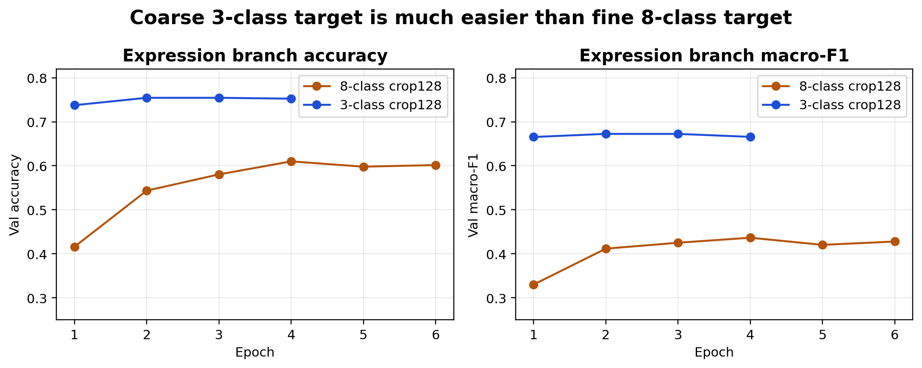
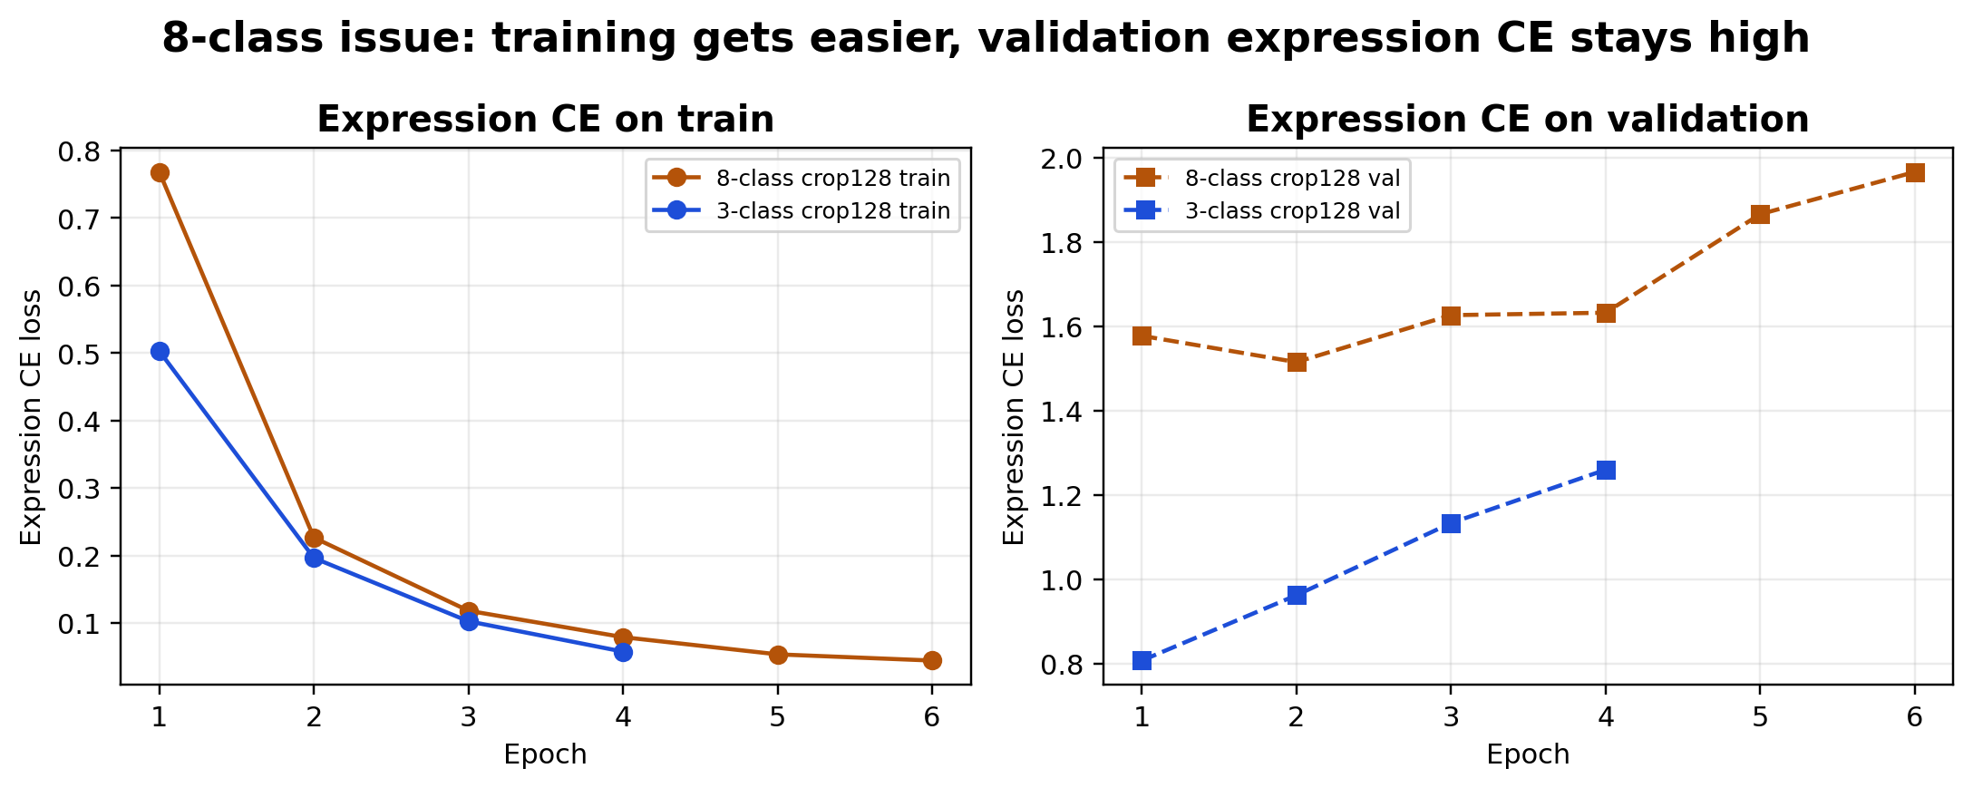
Training behavior: 3-class converges; 8-class generalizes poorly
The 8-class model learns training labels, but validation expression CE stays high
Interpretation: fine 8-class labels likely mix morphology ambiguity, rare classes, and label noise. This is why the next experiment tests whether alignment helps, hurts, or is dominated by classification CE.
Haoran Wu | Group meeting | May 2026

Slide 12
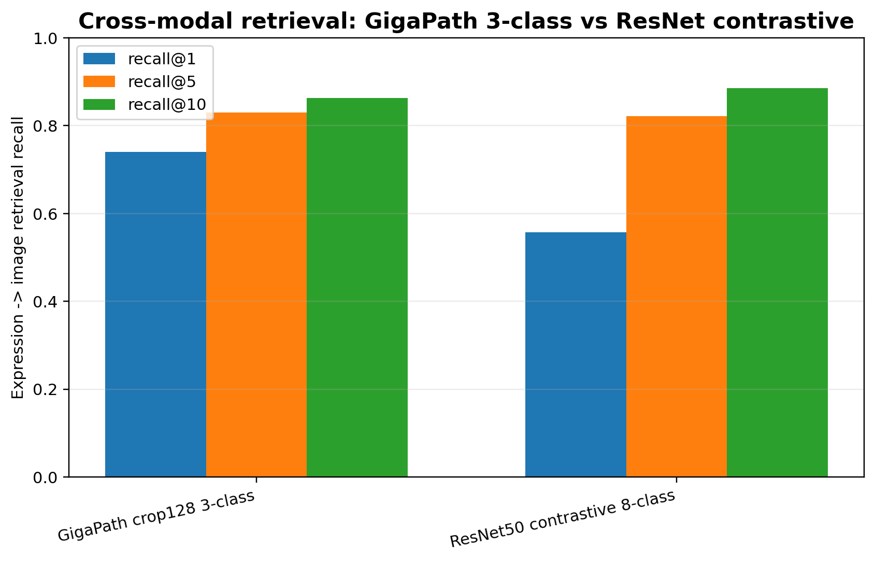
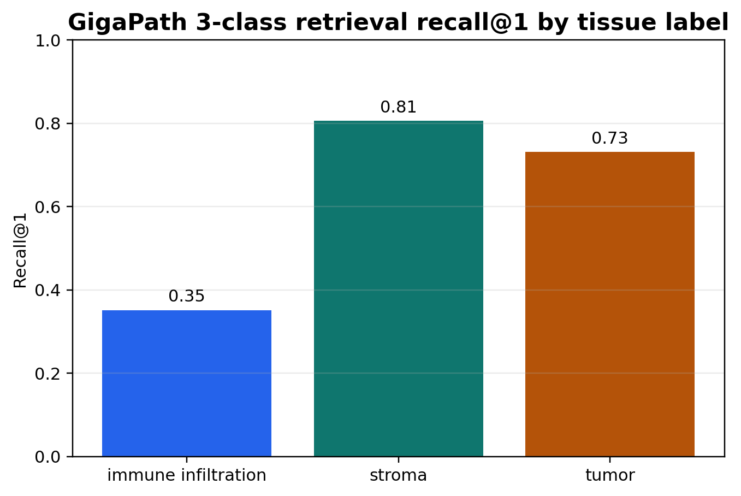
Retrieval results: fine-tuning helps fused/probe readouts
Expression-to-image retrieval checks whether expression embeddings retrieve matching H&E regions
Run | R@1 | R@5 | R@10 | Best fused R@1
GigaPath 3c CE-only | 0.745 | 0.811 | 0.848 | 0.856
GigaPath 3c InfoNCE .10 | 0.722 | 0.858 | 0.900 | 0.858
GigaPath 3c last-1 ft | 0.741 | 0.833 | 0.870 | 0.874
GigaPath 3c last-2 ft | 0.728 | 0.837 | 0.865 | 0.880
GigaPath 3c InfoNCE .50 | 0.721 | 0.852 | 0.888 | 0.861
ResNet 3c CE-only | 0.720 | 0.868 | 0.902 | 0.759
Current retrieval readout: CE-only still has the strongest raw 3-class R@1. Last-1 fine-tuning nearly matches it, while last-2 gives the best fused R@1 and concatenated probe, so the shared representation improved even though raw nearest-neighbor R@1 did not.
Haoran Wu | Group meeting | May 2026

Slide 13
Haiku: what it is actually training
A tri-modal CLIP-style framework over co-registered H&E, mIF, and structured text
Training sample = one spatial tissue region represented three ways: (H&E patch, mIF patch, text description)
Modality | What it carries | Where it comes from
H&E patch | local morphology | strictly registered to the same spatial location as mIF
mIF patch | spatial proteomics / biomarker image | multi-channel molecular image, not ordinary RGB
Text description | biomarker pattern + clinical metadata | generated from patch-level molecular statistics plus patient/slice metadata
Concept | Meaning
Alignment goal | same tissue region across three modalities should be close in embedding space
Separation goal | different regions in the batch should be pushed apart
Not the goal | not just one classifier; classification is only one downstream readout
What it enables | cross-modal retrieval, zero-shot biomarker inference, clinical prediction, counterfactual analysis
This is the central connection to our project: use a shared space first, then use retrieval/fusion to guide biological inference or SAM3 ranking.
Haoran Wu | Group meeting | May 2026

Slide 14
Haiku architecture: three towers project into one 512-dim space
Think of it as CLIP extended from two modalities to three modalities
H&E patch
MUSK ViT H&E encoder
H&E projection
mIF patch
VirTues mIF encoder
mIF projection
Shared 512-dim L2-normalized embedding
Text
BiomedBERT text encoder
Text projection
Part | Exact encoder / mechanism | Why it matters
H&E encoder | pretrained MUSK vision transformer | pathology morphology foundation model
Text encoder | BiomedBERT | clinical / biomarker semantic text
mIF encoder | VirTues pretrained on large mIF data | molecular/protein imaging anchor
mIF channel identity | ESM-3 protein embedding per biomarker channel | lets model know which protein each channel represents
Non-protein channel | DAPI gets a learned embedding | handles channels without protein sequence
Haoran Wu | Group meeting | May 2026

Slide 15
Haiku input construction: how the text and mIF signals are built
The text branch is structured biological language generated from quantitative mIF and clinical metadata
Image part | Haiku setting | Reason
Patch size | H&E and mIF both 256 x 256 | same scale local region
mIF sliding window | stride = floor(0.7P), about 179 | overlapping tissue coverage
Patch filter | tissue coverage > 90% | removes background-heavy samples
mIF normalization | per-channel normalize, clip, rescale to [0,1], 8-bit | standardizes biomarker channels
Text source | How it is computed | What it contributes
Biomarker intensity | patch mean intensity | local protein abundance
Relative level | slice z-score + percentile | whether marker is high/low within the slide
Spatial statistics | coverage, CV, clustering, GLCM texture | how signal is distributed spatially
Discrete pattern | sparse / uniform / clustered / heterogeneous | turns quantitative image statistics into language
Clinical metadata | organ, disease, stage, survival, treatment response | patient/slice context
Key point for our project: we can later generate analogous structured text from gene sets, tissue labels, or clinical metadata instead of using only class labels.
Haoran Wu | Group meeting | May 2026

Slide 16
Haiku projection head and loss: what actually enters contrastive learning
Encoder features are not compared directly; each modality first goes through its own MLP projection head
Projection head for each modality: g_m(h) = BN(W2 ReLU(W1 h))
InfoNCE: positive = same spatial location; negatives = other batch regions
Projection detail | Value | Meaning
Architecture | 2-layer MLP | same structure, separate parameters for each modality
Output dimension | 512 | shared embedding dimension
Normalization | L2 normalize after projection | cosine similarity becomes the comparison metric
Compared features | projected embeddings z, not raw encoder features | prevents encoder-specific feature scales from dominating
Loss detail | Value | Meaning
Similarity | cosine similarity | after L2 normalization
Temperature | tau = 0.07 | controls contrastive sharpness
Batch size | B = 128 | provides in-batch negatives
Formula | exp(sim(pos)/tau) / sum_j exp(sim(neg_j)/tau) | correct pair should rank above wrong pairs
Symmetric loss pair | What it aligns
L_HE <-> mIF | morphology to spatial protein pattern
L_mIF <-> TXT | protein pattern to structured clinical/biomarker semantics
L_HE <-> TXT | morphology to clinical/semantic context
This is why we replaced simple MSE alignment with CLIP-style symmetric InfoNCE in our ablation.
Haoran Wu | Group meeting | May 2026

Slide 17
Haiku training, fusion, and final tasks: the methods details we borrow
The paper's main lesson is controlled fine-tuning plus retrieval-time fusion, not early-fusion classification
Training part | Haiku choice | Interpretation
Frozen | mIF encoder | pretrained molecular anchor
Fine-tuned | last 2 blocks of H&E encoder | small adaptation of MUSK morphology features
Fine-tuned | last 2 blocks of text encoder | small adaptation of BiomedBERT semantics
Fully trained | all projection heads | main learnable bridge into shared 512-dim space
Learning rates | H&E 1e-5; text 2e-5; projection 1e-4 | small LR for foundation encoders, larger LR for new heads
Optimizer/schedule | AdamW; 5000 warmup steps; cosine annealing; 25 epochs | stable contrastive alignment
Fusion setting | Weighting | Meaning
Training-time fusion | none / shared-space alignment | modalities are not concatenated as early input
Biomarker inference | 0.8 x H&E + 0.2 x text | mostly morphology, some clinical/semantic conditioning
Counterfactual retrieval | 0.6 x H&E + 0.4 x text | increase text effect to test conditional shifts
Our equivalent | image-expression alpha sweep | rank H&E regions / candidate SAM3 masks using fused evidence
Final use | What it tests
Cross-modal retrieval | H&E <-> mIF; text -> mIF
Downstream prediction | organ, tissue type, T/N stage, grade, survival, treatment response
Zero-shot biomarker inference | retrieve mIF neighbors and aggregate marker intensity
Counterfactual discovery | fix H&E, edit text metadata, observe retrieved molecular neighbors
Haoran Wu | Group meeting | May 2026

Slide 18
How our current plan maps to Haiku
We borrow the shared-space/retrieval idea, but adapt it to expression + SAM3 rather than mIF + clinical text
Aspect | Haiku | Our current setup | Decision
Molecular anchor | Frozen pretrained mIF encoder | Expression MLP trained with CE_expr | Need stronger molecular pretraining/gene-set text later
Image encoder | MUSK, fine-tune last two blocks | GigaPath/ResNet frozen in ablation; MUSK smoke submitted | MUSK is worth testing because Haiku used it
Text modality | BiomedBERT from structured biomarker + clinical text | not in current training | next: structured gene-set/tissue-region text
Projection | 2-layer MLP to 512-dim | MLP to 128-dim; embed512 GigaPath job running | test whether 512 helps retrieval
Loss | pairwise symmetric InfoNCE across 3 modality pairs | CE_img + CE_expr, with MSE/InfoNCE ablation | CE is needed because expression side lacks pretrained anchor
Fusion | weighted H&E/text query to mIF gallery | retrieval/fusion alpha sweep for image-expression | use for SAM3 proposal/mask ranking
Message for group meeting: I am not claiming we already replicated Haiku. I am using Haiku as the design template, then testing which parts transfer to H&E + VisiumHD expression before connecting the representation to SAM3.
Haoran Wu | Group meeting | May 2026

Slide 19
New ablation: test what each loss term contributes
This turns the loss design from an assumption into an experiment
Experiment | Loss | Status | Question answered
CE-only | CE_img + CE_expr | completed | best raw 3-class R@1 so far
CE + InfoNCE | CE_img + CE_expr + lambda x symmetric InfoNCE | completed | better top-k/fused retrieval in some runs
InfoNCE-only | symmetric InfoNCE only | completed | weak classification, useful diagnostic
Haiku strategy | last-1/2 blocks + warmup/cosine | completed + retrieval done | fine-tuning improves fused/probe readouts
InfoNCE lambda sweep
Overnight readout: training-strategy retrieval completed, the 8-class last-2-block warmup/cosine run completed, and the former OOM retrieval tasks were rerun successfully with chunked retrieval. The validation set is now complete and archived.
0
0.05
0.10
0.20
0.50
Haoran Wu | Group meeting | May 2026

Slide 20
Current HPC status: validation set is complete
Stable CSV/JSON snapshots are written under the project results directory
33
training rows
28
retrieval rows
0
pending evals
11045911
retry done
Final status as of May 7
Snapshot files: /nfs/roberts/project/pi_xy48/hw646/Medical-SAM3/results/visium_hd_exp1/summaries/latest_training_summary.csv /nfs/roberts/project/pi_xy48/hw646/Medical-SAM3/results/visium_hd_exp1/summaries/latest_retrieval_summary.csv
Job | Target | Purpose
11040135 | 3-class | training-strategy retrieval/fusion completed
11040134 | 8-class | GigaPath last-2-block warmup/cosine completed
11045911 | 8-class | GigaPath ablation retrieval tasks 8-11 completed as chunked retry
Current readout: all queued retrieval evals are complete. Last-2 fine-tuning improves classification, fused retrieval, and concat probe; raw R@1 remains strongest for CE-only / last-1.
Haoran Wu | Group meeting | May 2026

Slide 21
Current interpretation and next decision
The model direction is promising, but the loss design needs ablation before integration into SAM3
What is solid now
GigaPath crop128 3-class is the most reliable line; CE-only currently has strongest raw R@1, while InfoNCE helps top-k/fusion.
What improved
Haiku-inspired last-2-block fine-tuning raised 3-class macro-F1 to 0.694, image accuracy to 0.831, fused R@1 to 0.880, and concat probe to 0.866.
What 8-class says
Last-2 warmup/cosine improved 8-class image accuracy to 0.708 and macro-F1 to 0.451, so fine-tuning helps but does not fully solve fine-label noise.
Next decision
Use last-2 for fused/probe-style SAM3 region ranking; keep CE-only/last-1 as raw nearest-neighbor retrieval baselines.
Haoran Wu | Group meeting | May 2026

