Slide 1
CSC4005 – Distributed and Parallel Computing
Prof. Yeh-Ching Chung
School of Data Science
Chinese University of Hong Kong, Shenzhen

Slide 2
Outline
Introduction to Parallel Computers
Message Passing Computing and Programming
Multithreaded Programming
CUDA Programming
OpenMP Programming
Embarrassingly Parallel Computations
Partitioning and Divide-and-Conquer Strategies
Pipelined Computations
Synchronous Computations
Load Balancing and Termination Detection
Sorting Algorithms

Slide 3
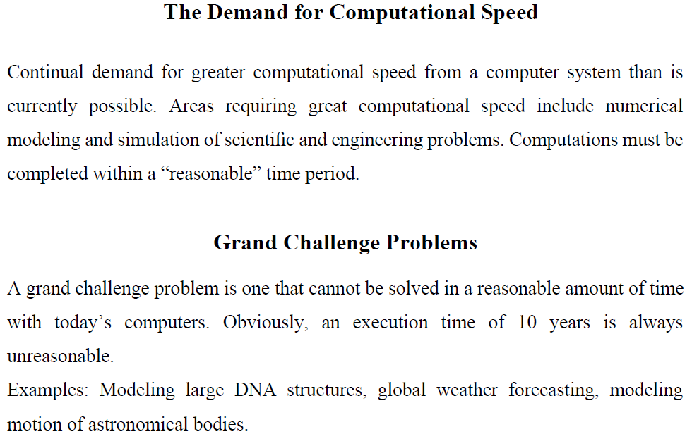
Parallel Computers

Slide 4
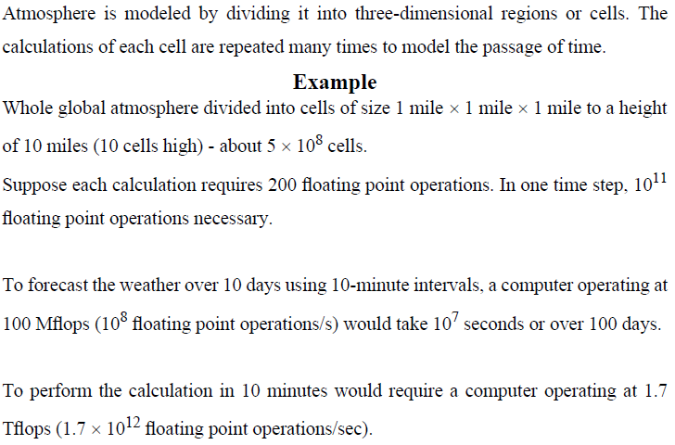
Weather Forecast

Slide 5
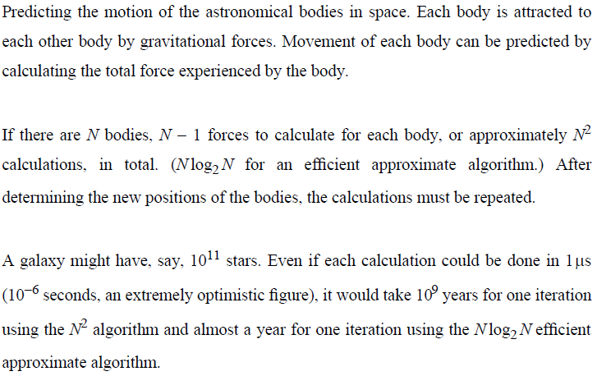
Modeling Motion of Astronomical Bodies (1)

Slide 6
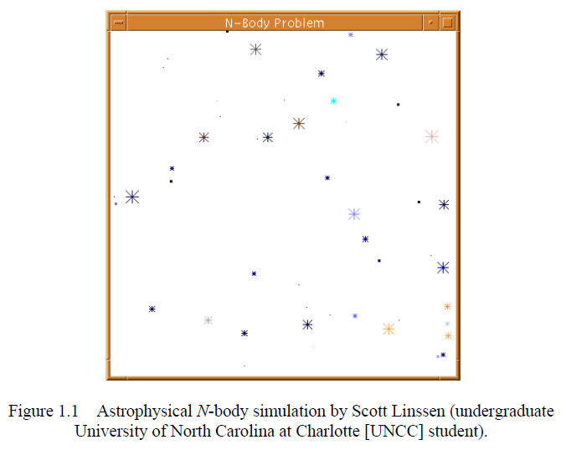
Modeling Motion of Astronomical Bodies (2)

Slide 7
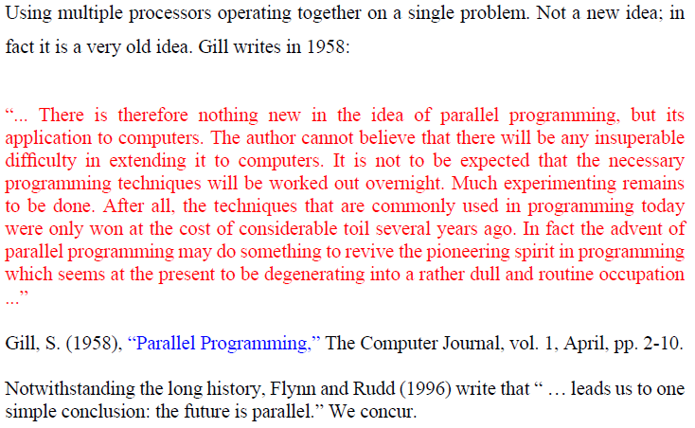
Parallel Computers and Programming

Slide 8
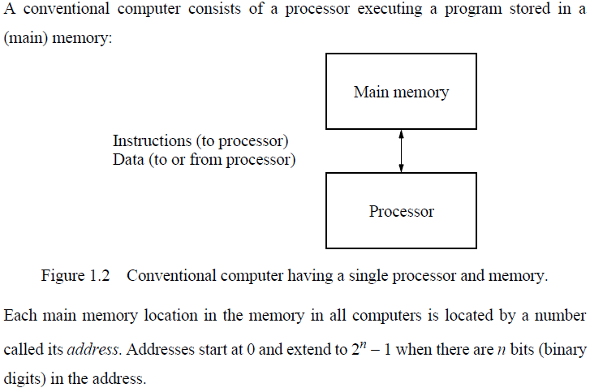
Types of Parallel Computers

Slide 9
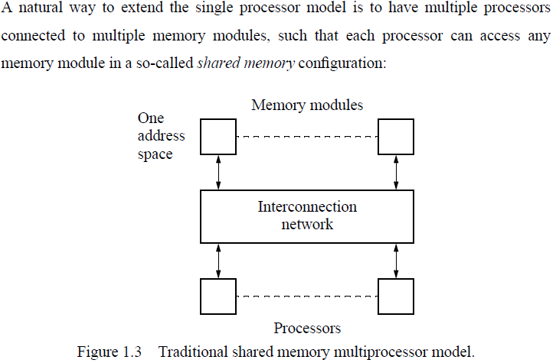
Shared Memory Multiprocessor Systems

Slide 10
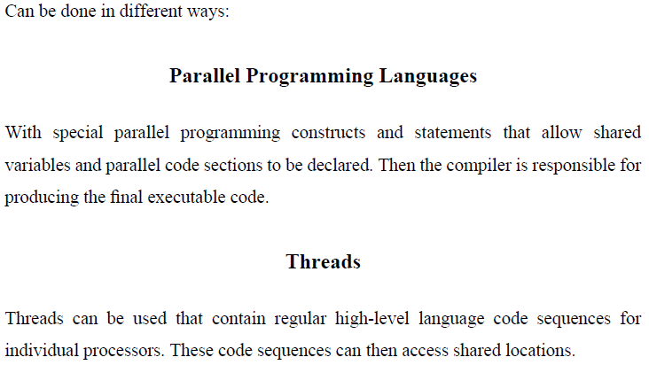
Programming Shared Memory Multiprocessor

Slide 11
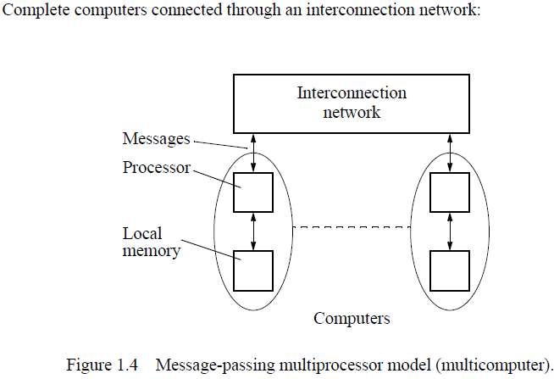
Message Passing Multiprocessor Systems

Slide 12
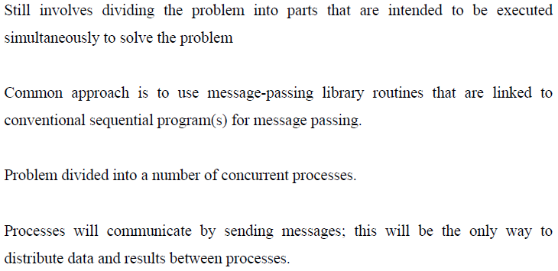
Programming

Slide 13
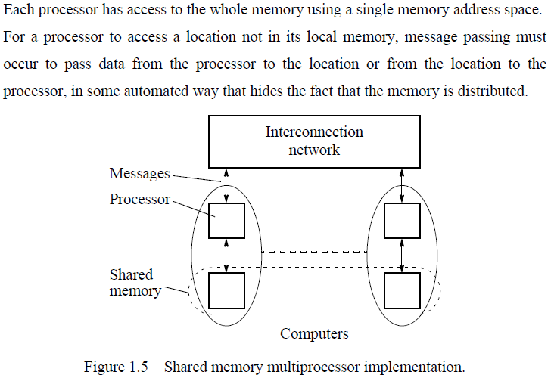
Distributed Shared Memory

Slide 14
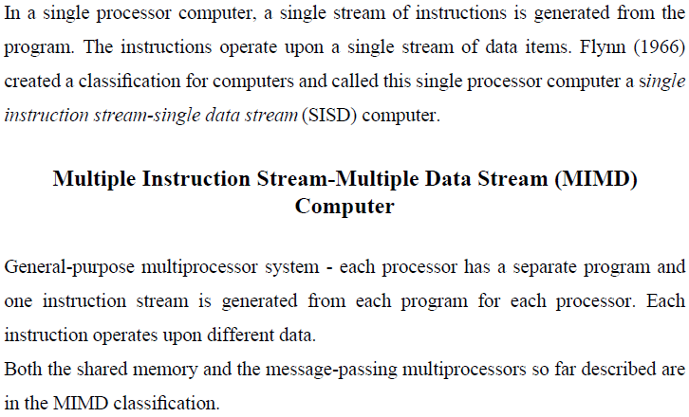
MIMD and SIMD Classifications

Slide 15
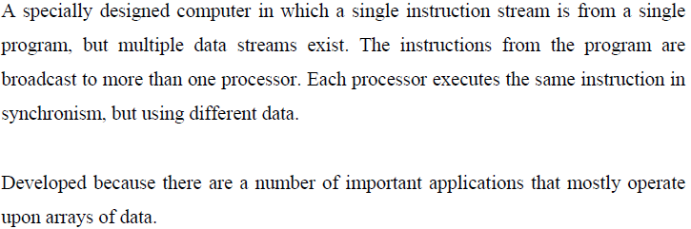
Single Instruction Streaming-Multiple Data Streaming (SIMD) Computers

Slide 16
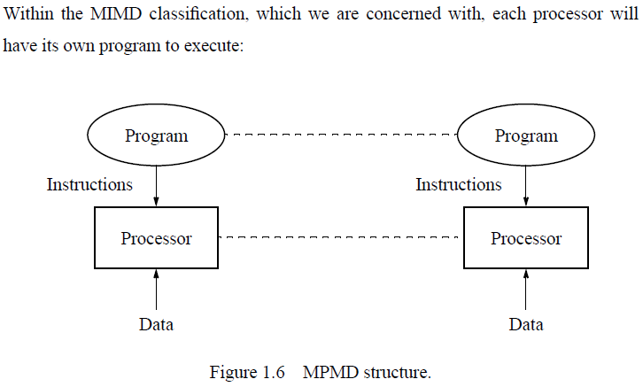
Multiple Program Multiple Data Streaming (MPMD) Structure

Slide 17
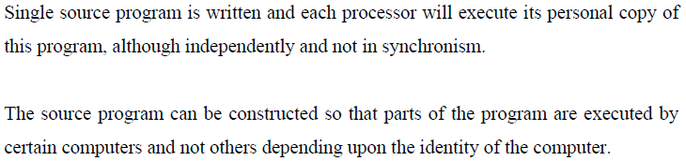
Single Program Multiple Data (SPMD) Structure

Slide 18
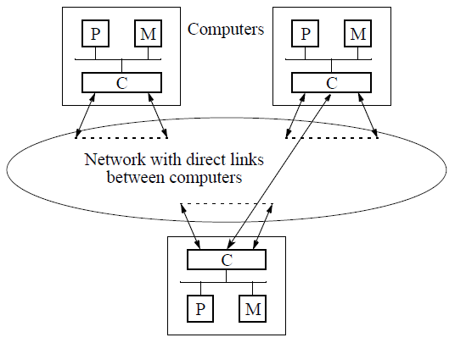
Message-Passing Multicomputers (1)
Static network message-passing multicomputers

Slide 19
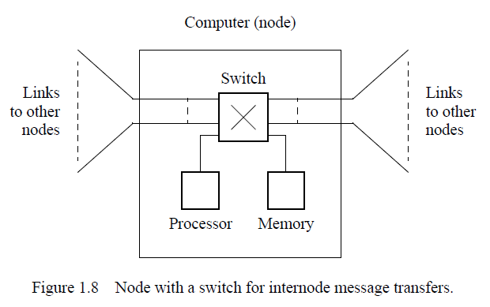
Message-Passing Multicomputers (2)

Slide 20
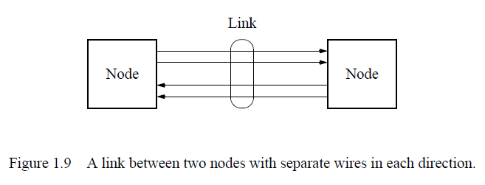
Message-Passing Multicomputers (3)

Slide 21
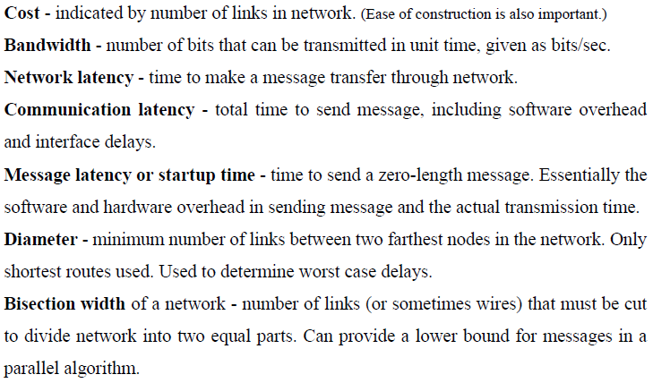
Network Criteria

Slide 22
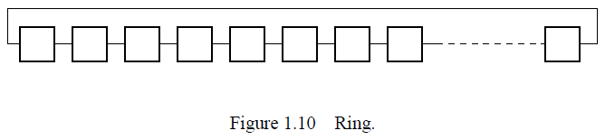
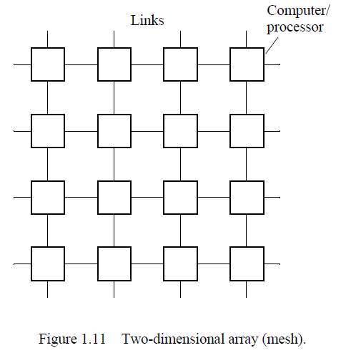
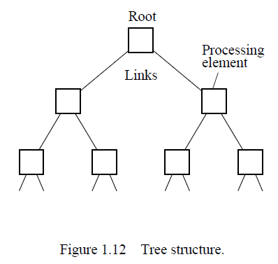
Interconnection Networks (1)

Slide 23
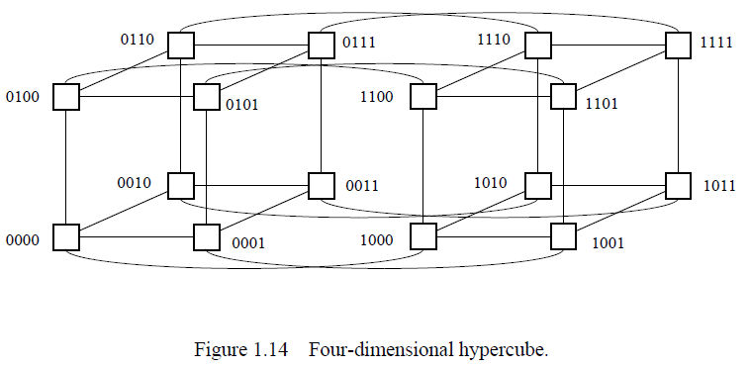
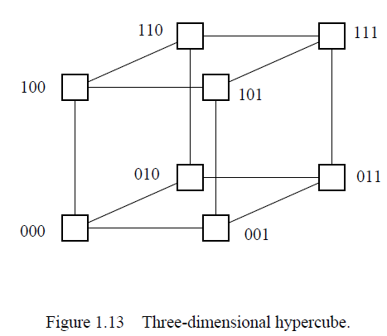
Interconnection Networks (2)

Slide 24
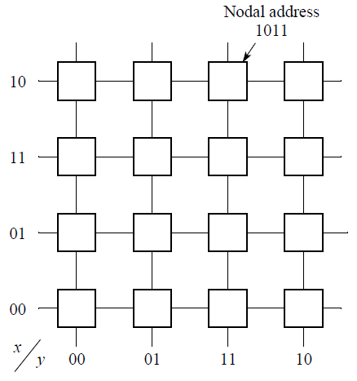
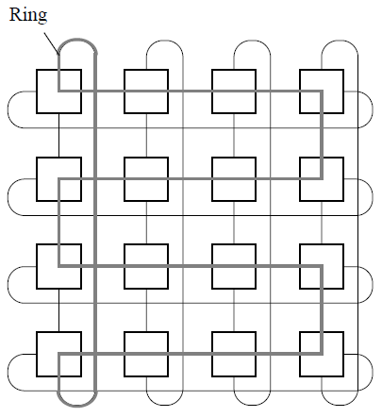
Embedding (1)

Slide 25
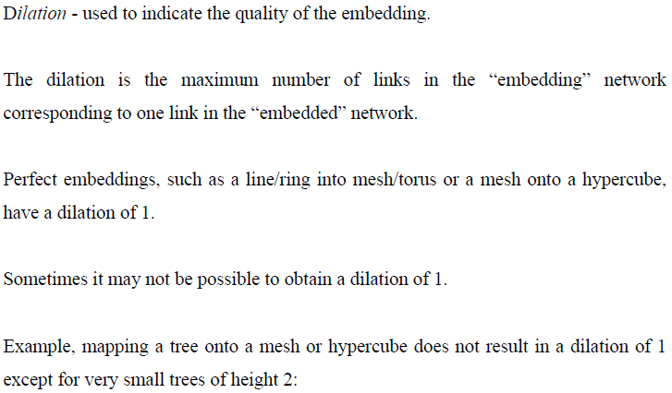
Embedding (2)

Slide 26
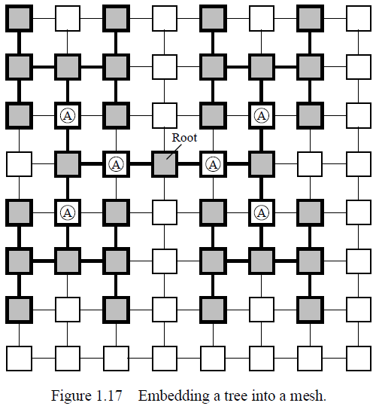
Embedding (3)

Slide 27
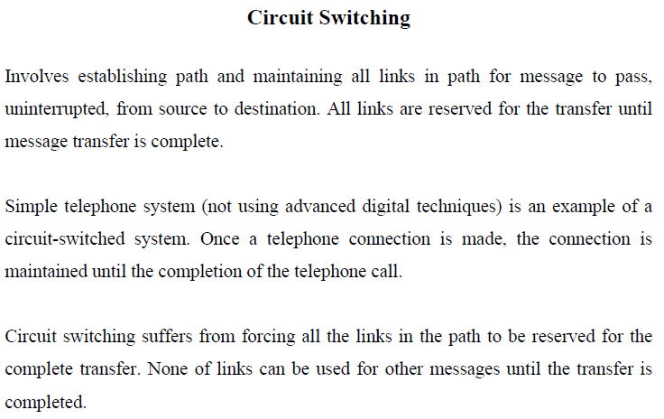
Communication Methods – Circuit Switching

Slide 28
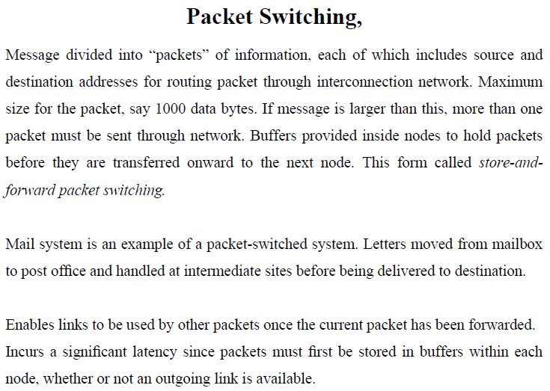
Communication Methods – Packing Switching

Slide 29
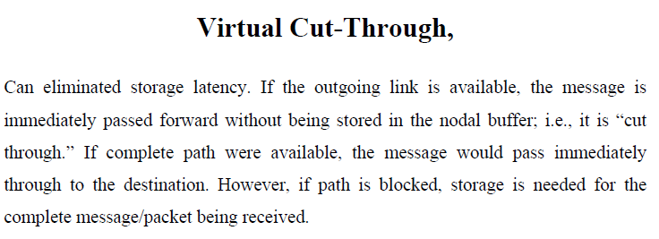
Communication Methods – Virtual Cut-Through

Slide 30
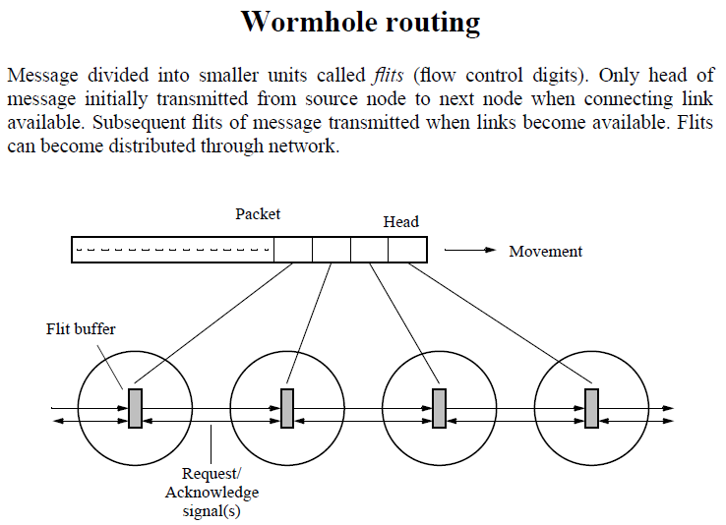
Communication Methods – Wormhole Routing (1)

Slide 31
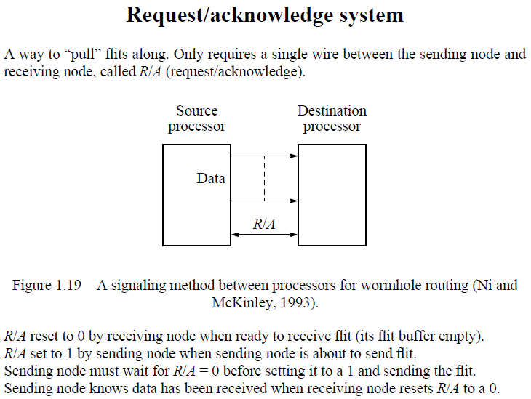
Communication Methods – Wormhole Routing (2)

Slide 32
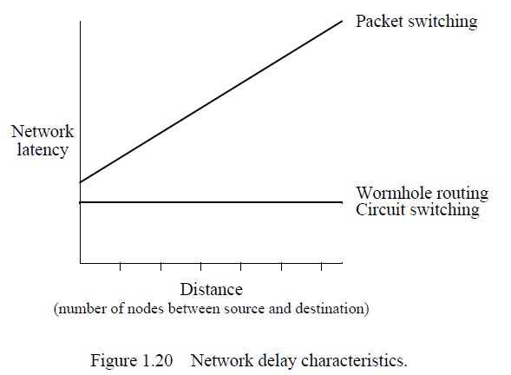
Communication Methods – Wormhole Routing (3)

Slide 33
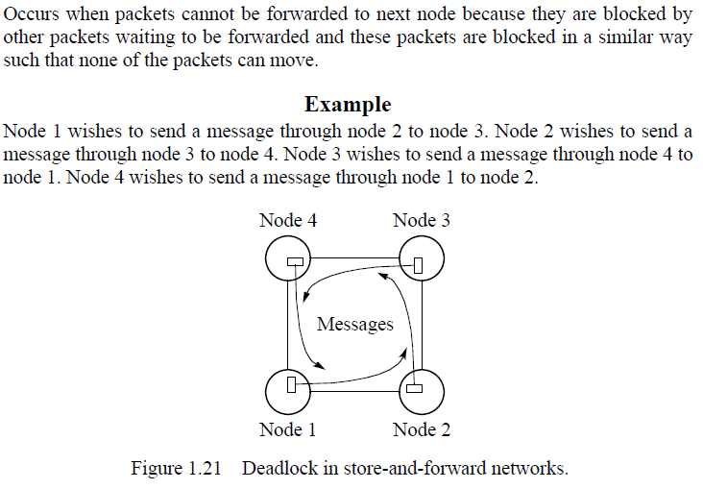
Deadlock

Slide 34
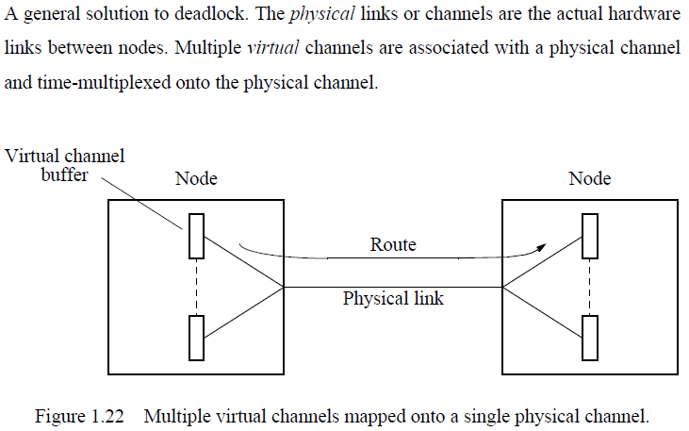
Virtual Channel

Slide 35
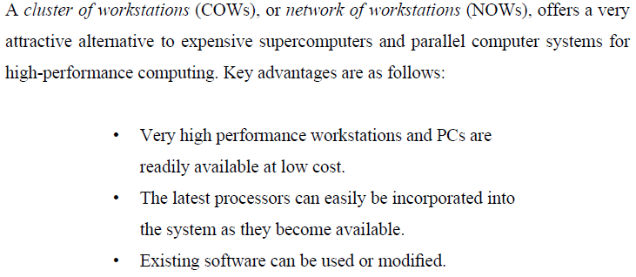
Network Computers as a Multicomputer Platform

Slide 36
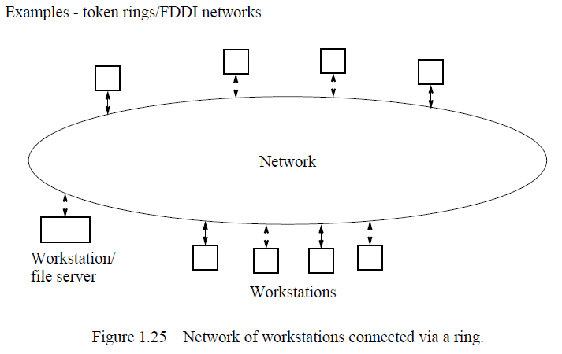
Ring Structures

Slide 37
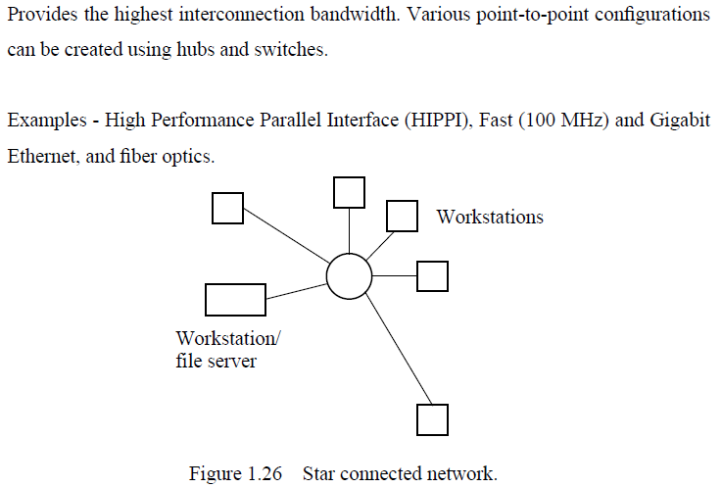
Point-to-Point Communication

Slide 38
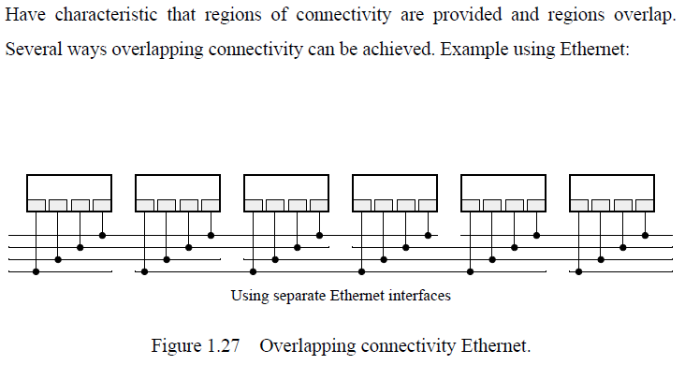
Overlapping Connectivity Networks

Slide 39
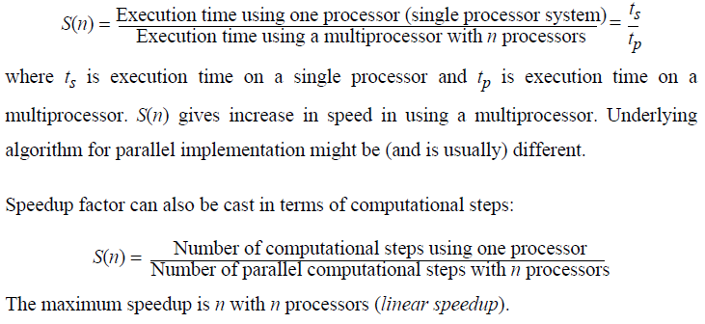
Speedup Factor

Slide 40
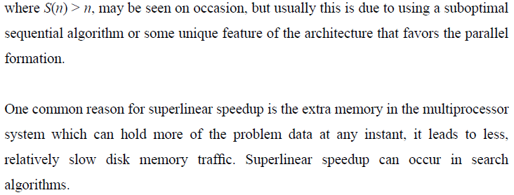
Super-linear Speedup

Slide 41
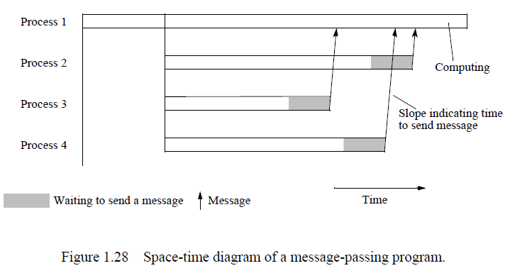
Space-Time Diagram

Slide 42
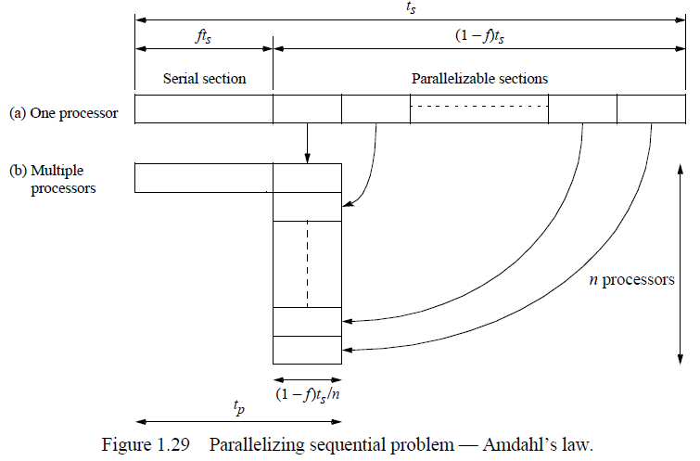
Amdahl’s Law (1)

Slide 43
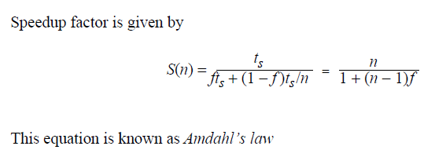
Amdahl’s Law (2)

Slide 44
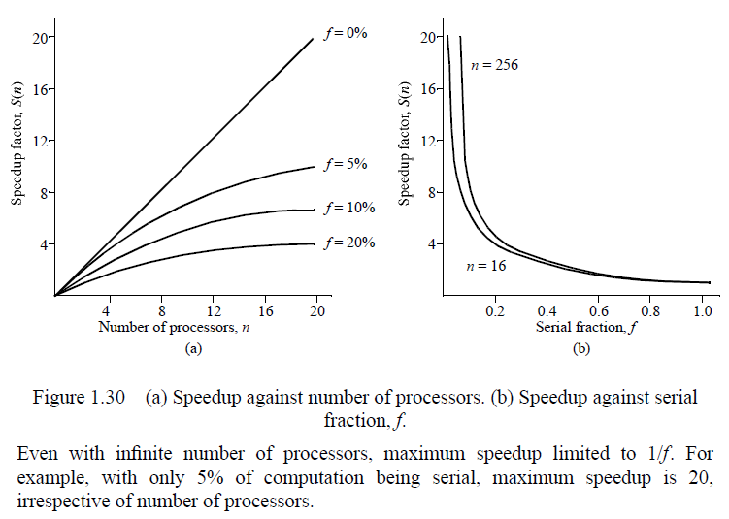
Amdahl’s Law (3)

Slide 45
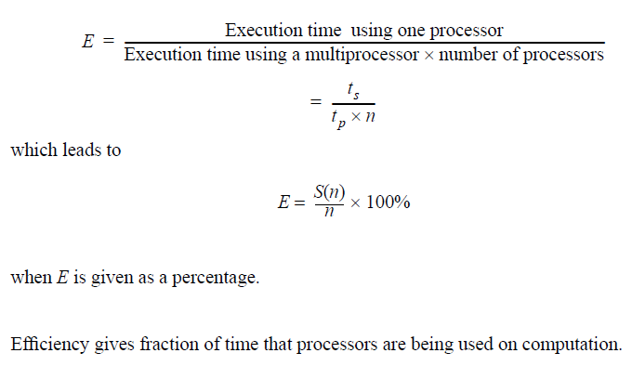
Efficiency

Slide 46
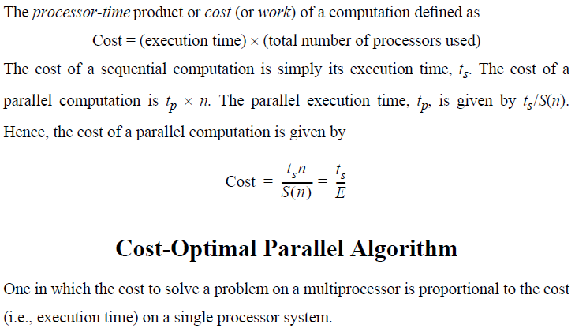
Cost

Slide 47
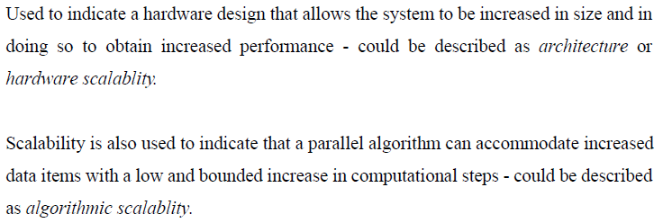
Scalability

Slide 48
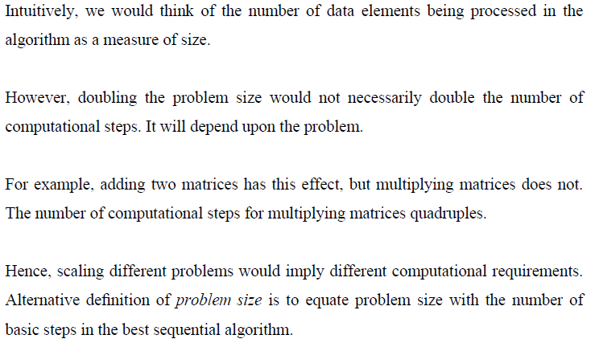
Problem Size

Slide 49

Gustafson’s Law

