Slide 1
CSC4005 – Distributed and Parallel Computing
Prof. Yeh-Ching Chung
School of Data Science
Chinese University of Hong Kong, Shenzhen

Slide 2
Outline
Introduction to Parallel Computers
Message Passing Computing and Programming
Multithreaded Programming
CUDA Programming
OpenMP Programming
Embarrassingly Parallel Computations
Partitioning and Divide-and-Conquer Strategies
Pipelined Computations
Synchronous Computations
Load Balancing and Termination Detection
Sorting Algorithms

Slide 3
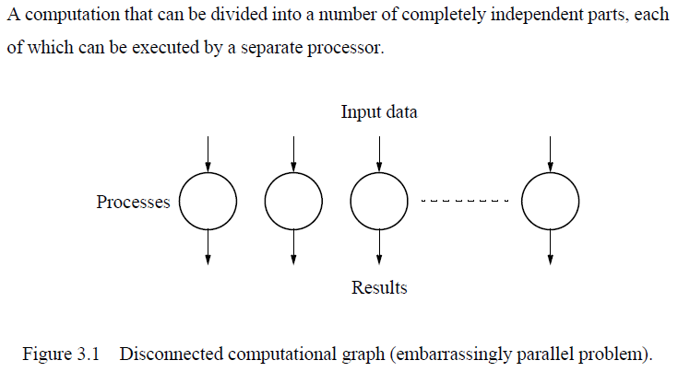
Embarrassingly Parallel Computations (1)

Slide 4
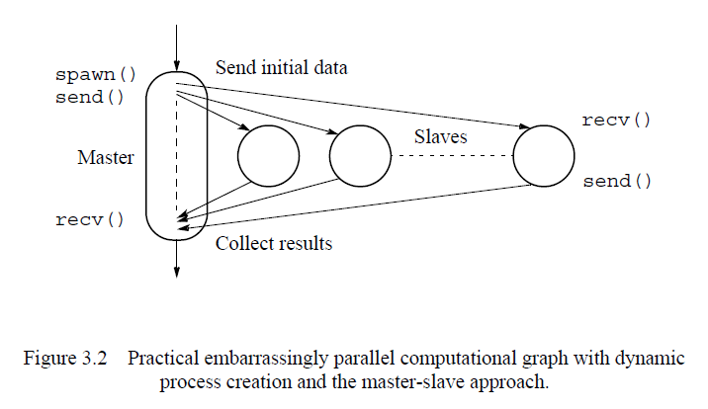
Embarrassingly Parallel Computations (2)

Slide 5
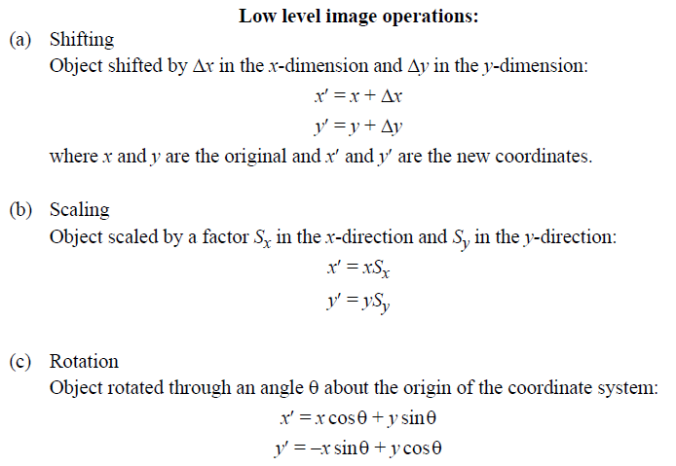
Embarrassingly Parallel Examples (1)

Slide 6
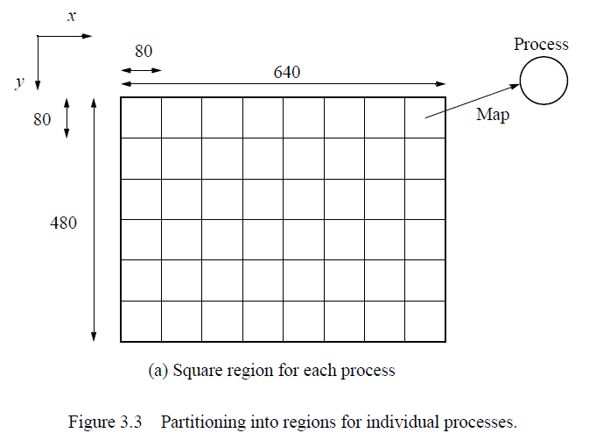
Embarrassingly Parallel Examples (2)

Slide 7
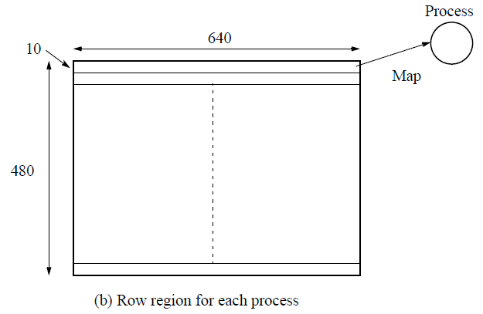
Embarrassingly Parallel Examples (3)

Slide 8
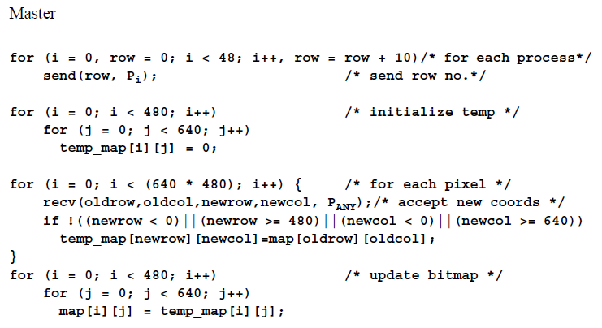
Pseudocode to Perform Image Shift (1)

Slide 9
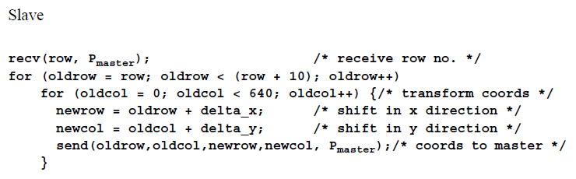
Embarrassingly Parallel Examples (2)

Slide 10
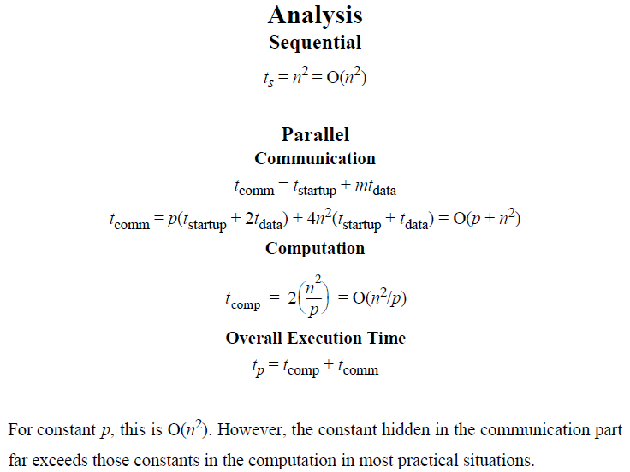
Embarrassingly Parallel Examples (3)

Slide 11
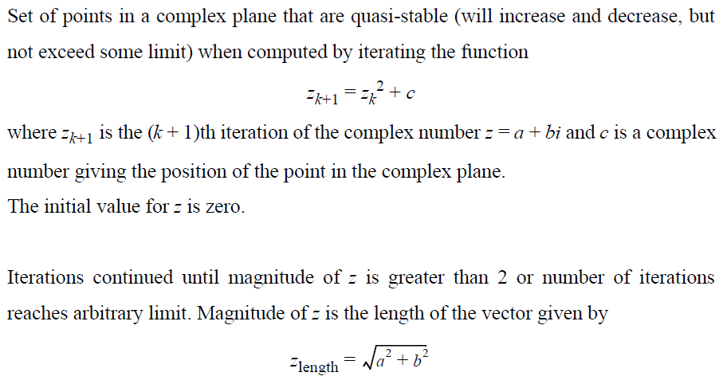
Mandelbrot Set Computation (1)

Slide 12
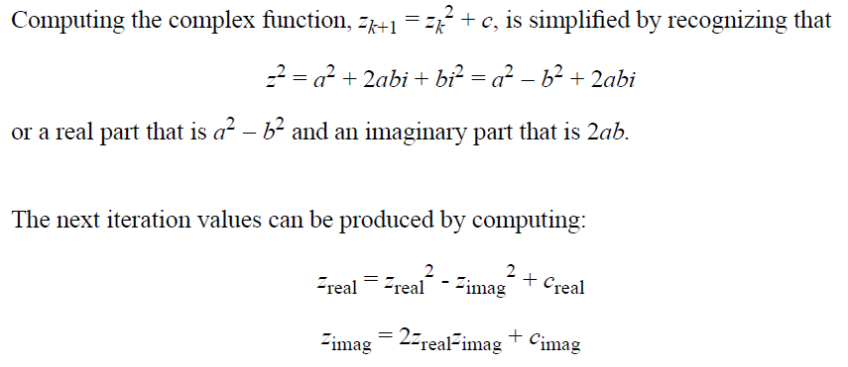
Mandelbrot Set Computation (2)

Slide 13
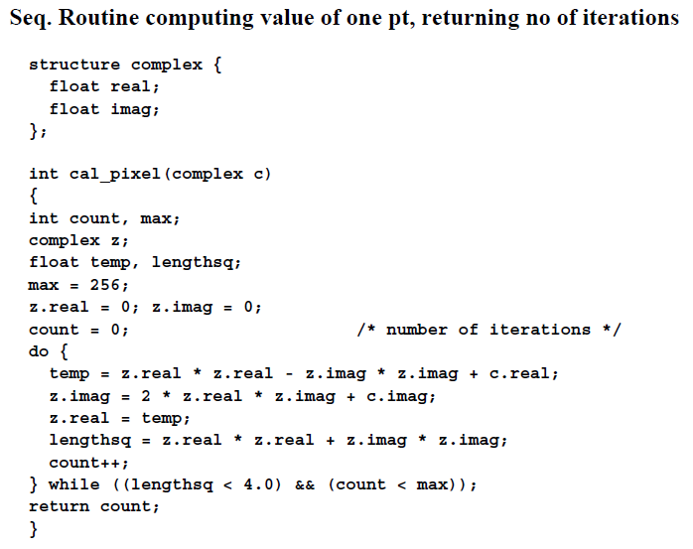
Mandelbrot Set Computation (3)

Slide 14
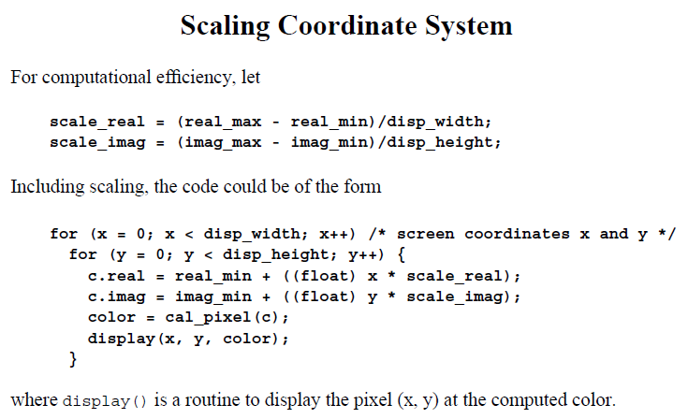
Mandelbrot Set Computation (4)

Slide 15
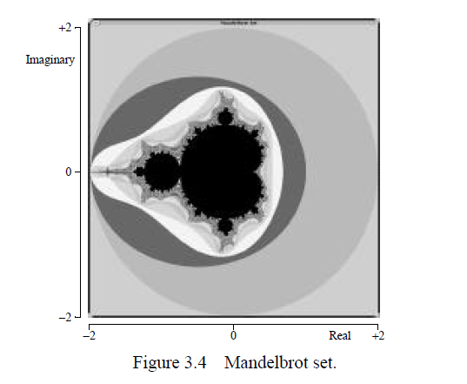
Mandelbrot Set Computation (5)

Slide 16
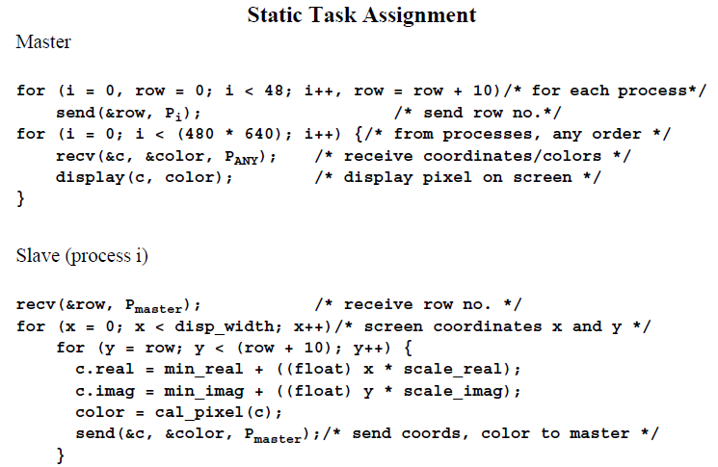
Parallelization of Mandelbrot Computation (1)

Slide 17
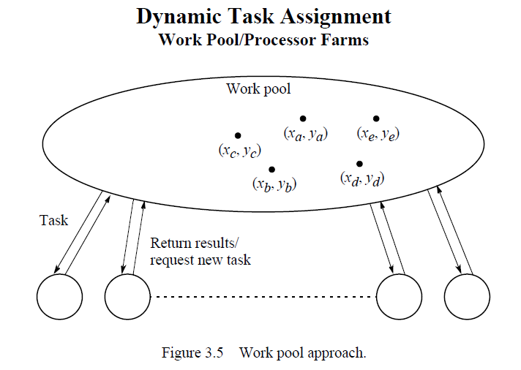
Parallelization of Mandelbrot Computation (2)

Slide 18
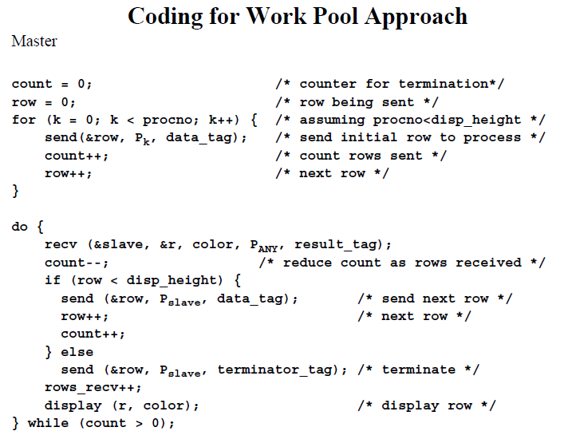
Parallelization of Mandelbrot Computation (3)

Slide 19
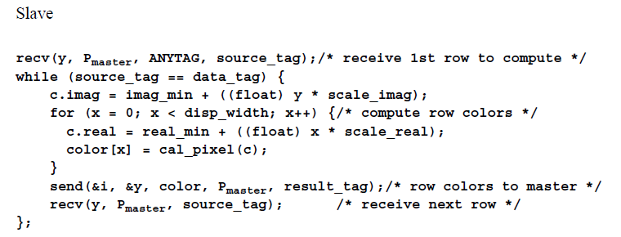
Parallelization of Mandelbrot Computation (4)

Slide 20
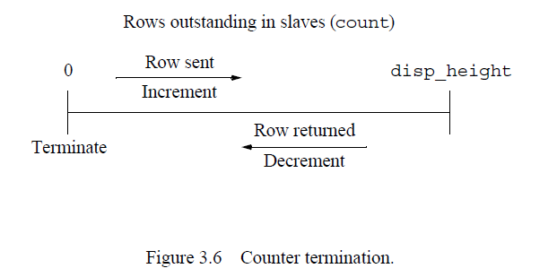
Parallelization of Mandelbrot Computation (5)

Slide 21
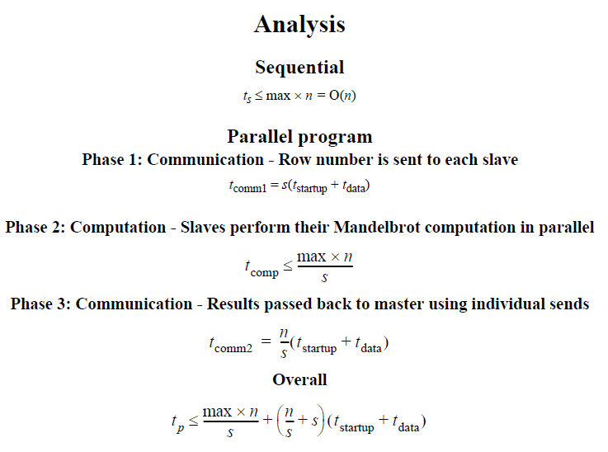
Parallelization of Mandelbrot Computation (6)

Slide 22
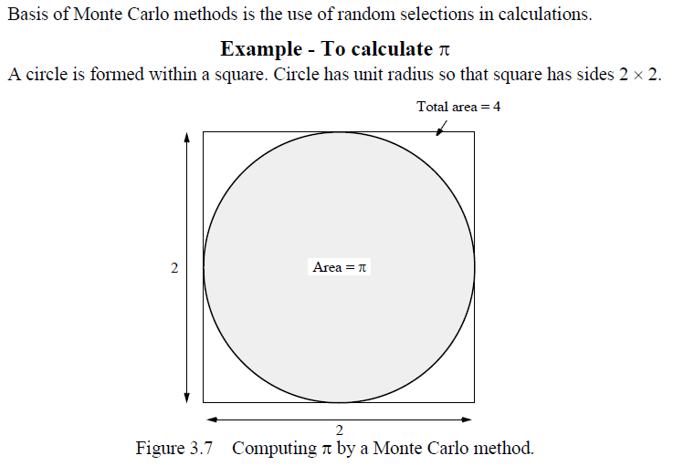
Monte Carlo Methods (1)

Slide 23
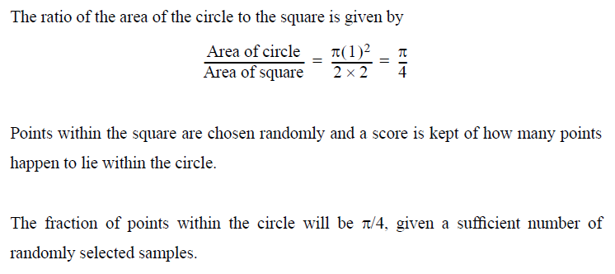
Monte Carlo Methods (2)

Slide 24
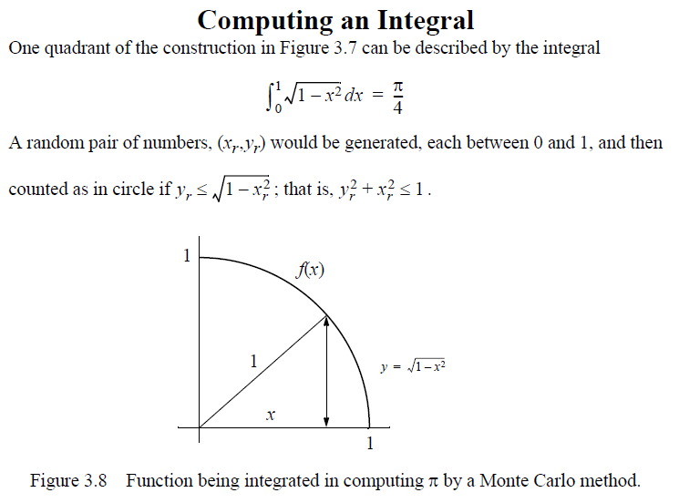
Monte Carlo Methods (3)

Slide 25

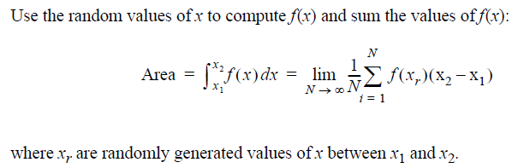
Monte Carlo Methods (4)

Slide 26
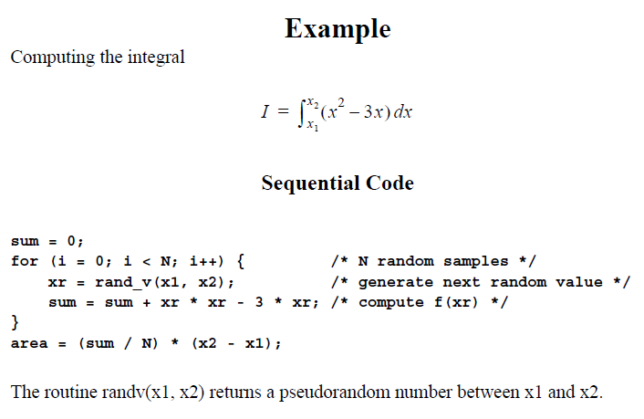
Monte Carlo Methods (5)

Slide 27
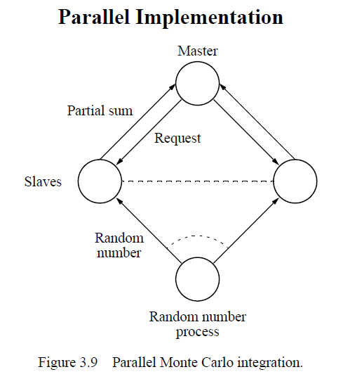
Monte Carlo Methods (6)

Slide 28
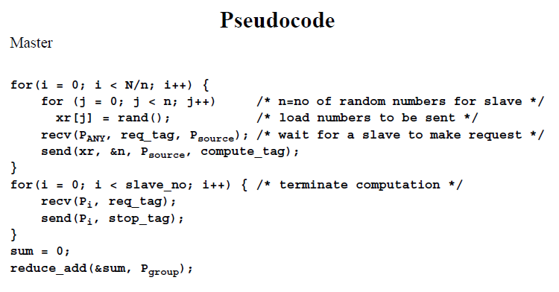
Monte Carlo Methods (7)

Slide 29
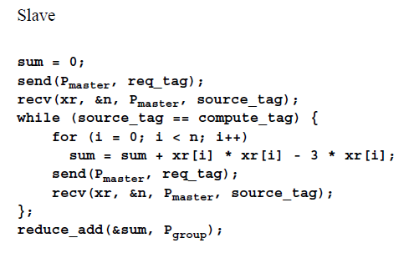
Monte Carlo Methods (8)

Slide 30
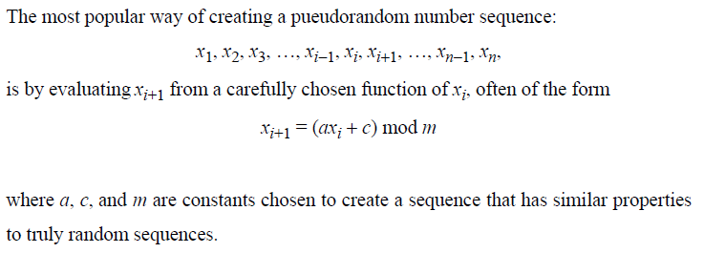
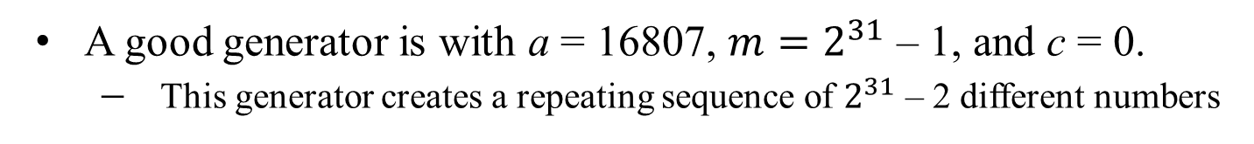
Random Number Generation
A good generator is with a = 16807, $m=2^{31}$ – 1, and c = 0.
This generator creates a repeating sequence of $2^{31}$ – 2 different numbers

Slide 31
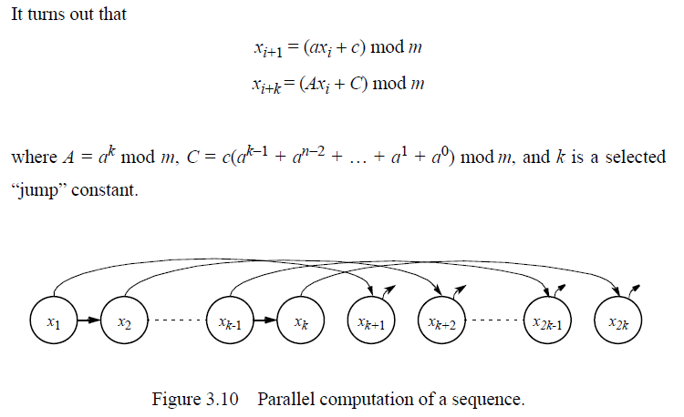
Parallel Random Number Generation

