Slide 1
CSC4005 – Distributed and Parallel Computing
Prof. Yeh-Ching Chung
School of Data Science
Chinese University of Hong Kong, Shenzhen

Slide 2
Outline
Introduction to Parallel Computers
Message Passing Computing and Programming
Multithreaded Programming
CUDA Programming
OpenMP Programming
Embarrassingly Parallel Computations
Partitioning and Divide-and-Conquer Strategies
Pipelined Computations
Synchronous Computations
Load Balancing and Termination Detection
Sorting Algorithms

Slide 3
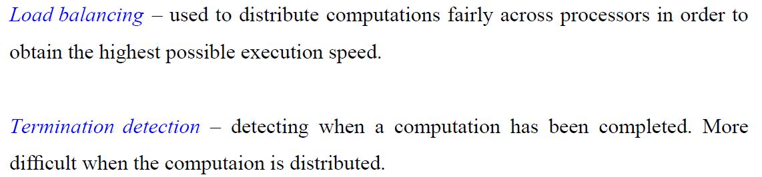
Load Balancing and Termination Detection (1)

Slide 4
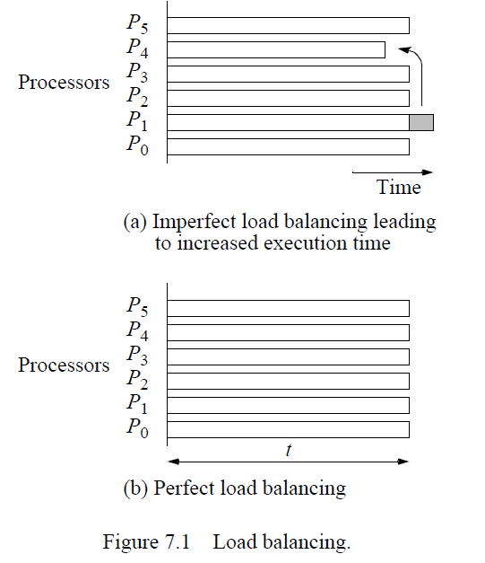
Load Balancing and Termination Detection (2)

Slide 5
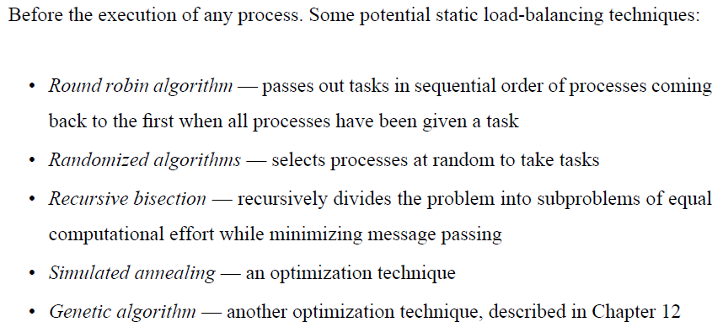
Static Load Balancing (1)

Slide 6
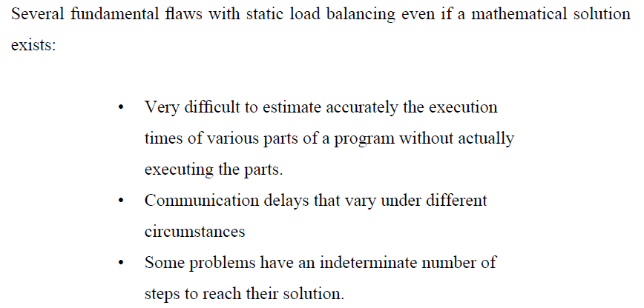
Static Load Balancing (2)

Slide 7
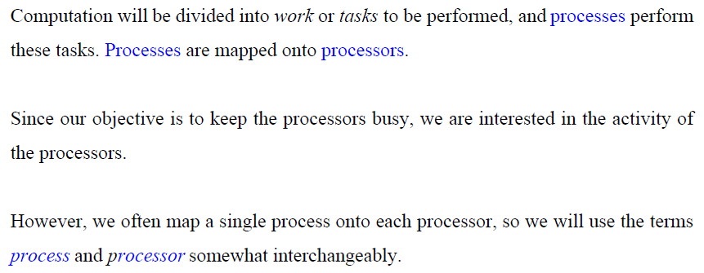
Processes and Processors

Slide 8
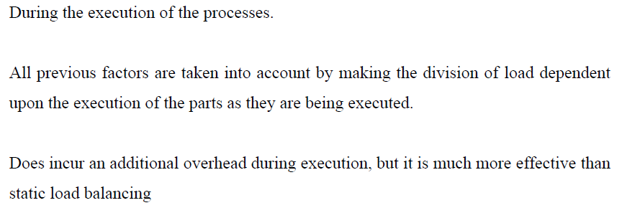
Dynamic Load Balancing (1)

Slide 9
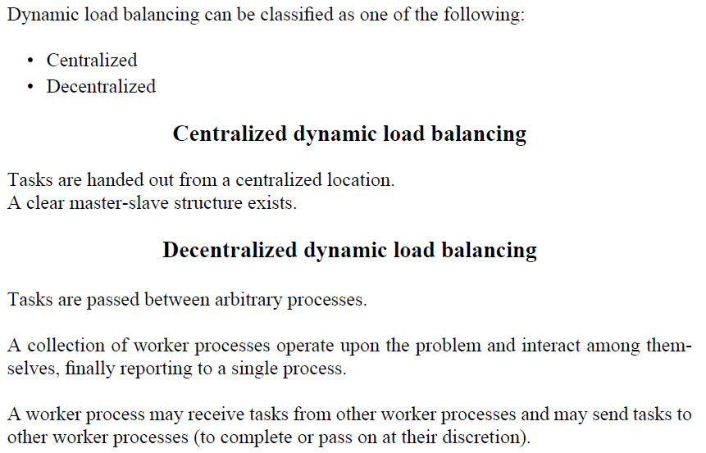
Dynamic Load Balancing (2)

Slide 10
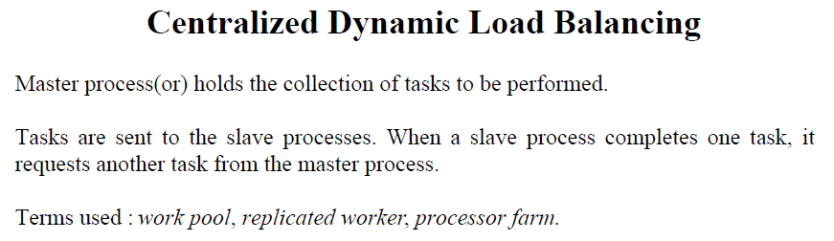
Dynamic Load Balancing (3)

Slide 11
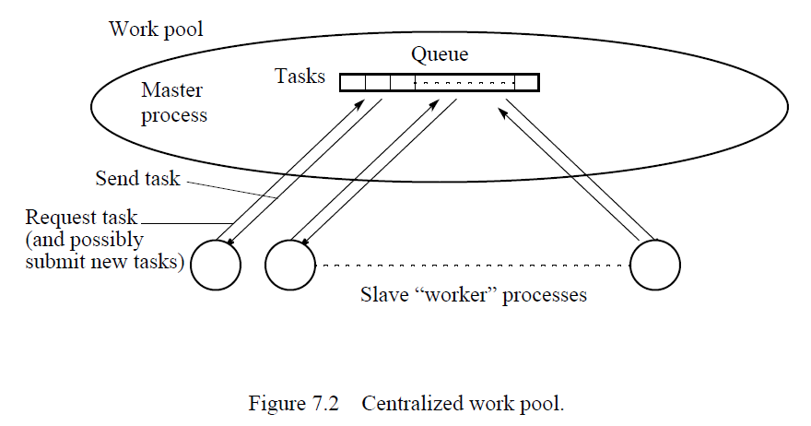
Dynamic Load Balancing (4)

Slide 12
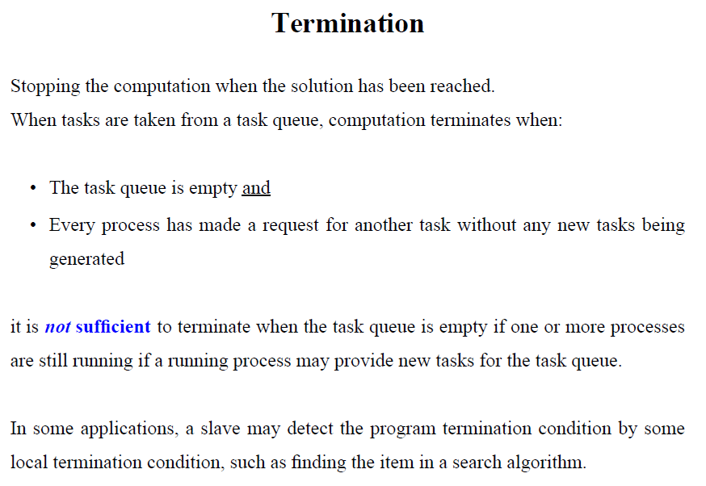
Dynamic Load Balancing (5)

Slide 13
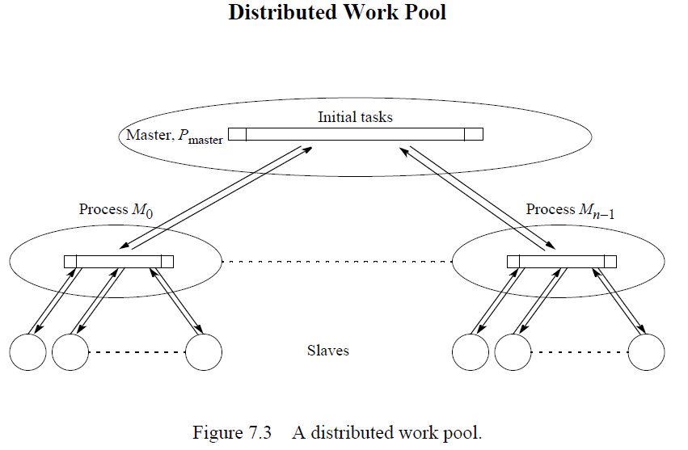
Decentralized Dynamic Load Balancing (1)

Slide 14
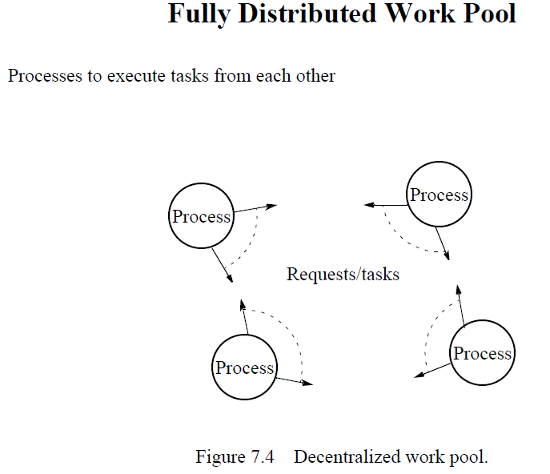
Decentralized Dynamic Load Balancing (2)

Slide 15
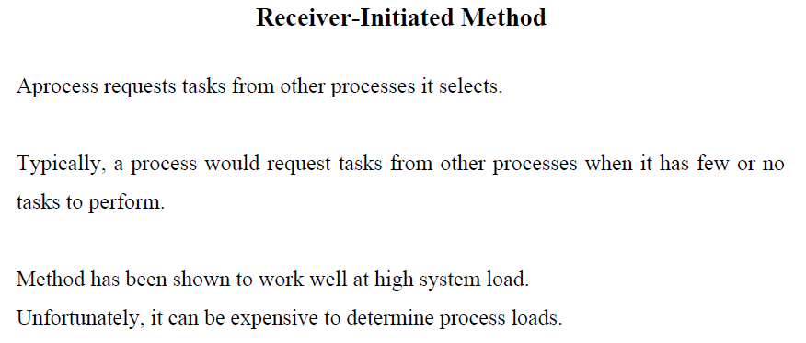
Task Transfer Mechanisms (1)

Slide 16
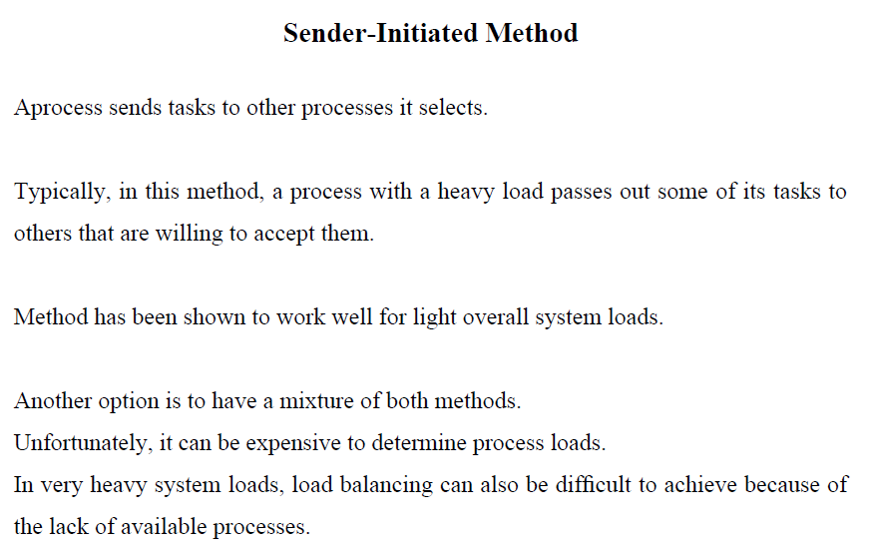
Task Transfer Mechanisms (2)

Slide 17
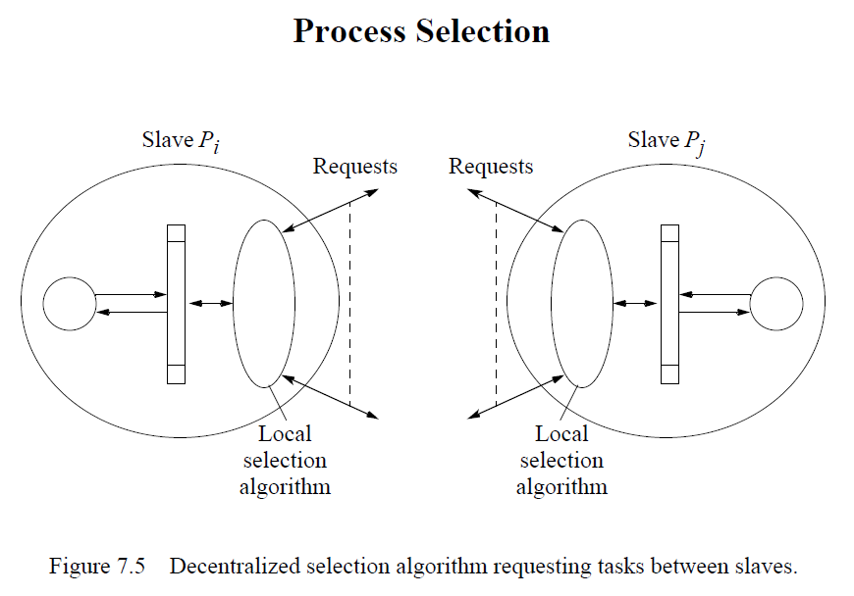
Task Transfer Mechanisms (3)

Slide 18
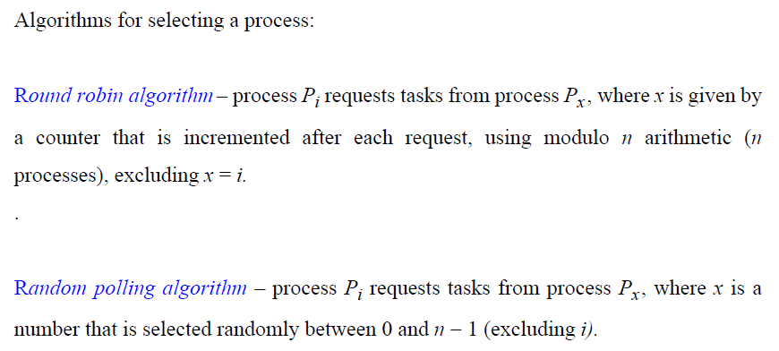
Task Transfer Mechanisms (4)

Slide 19
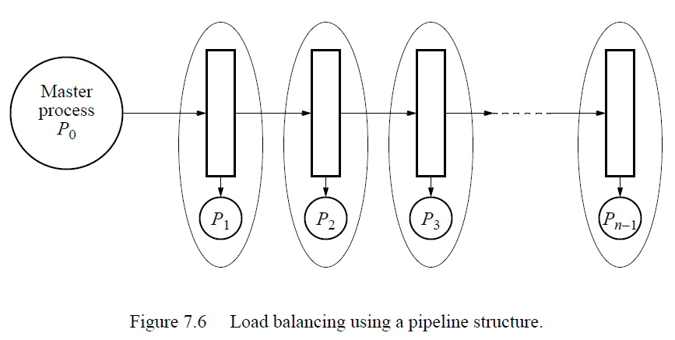
Load Balancing Using a Line Structure (1)

Slide 20
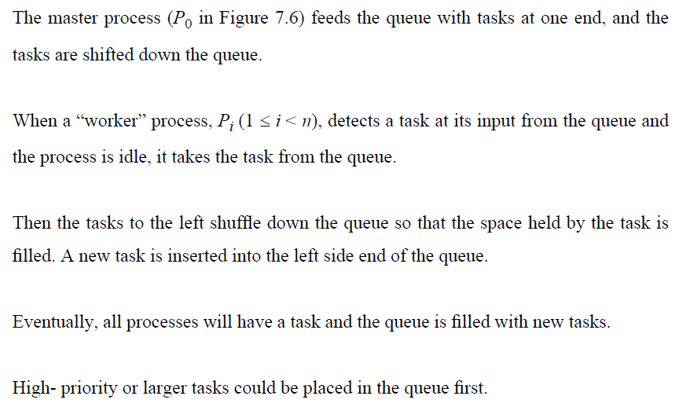
Load Balancing Using a Line Structure (2)

Slide 21
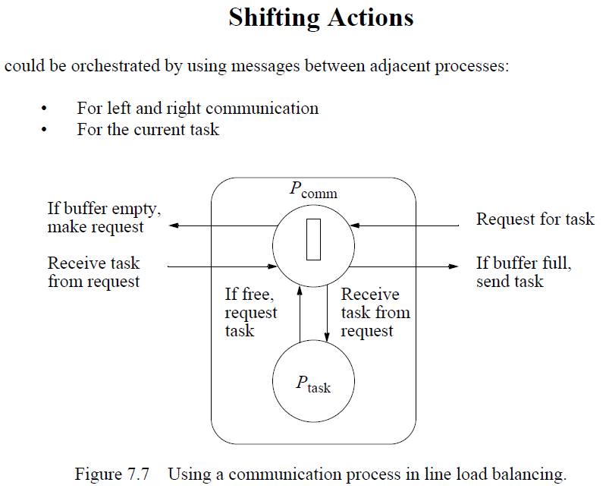
Load Balancing Using a Line Structure (3)

Slide 22
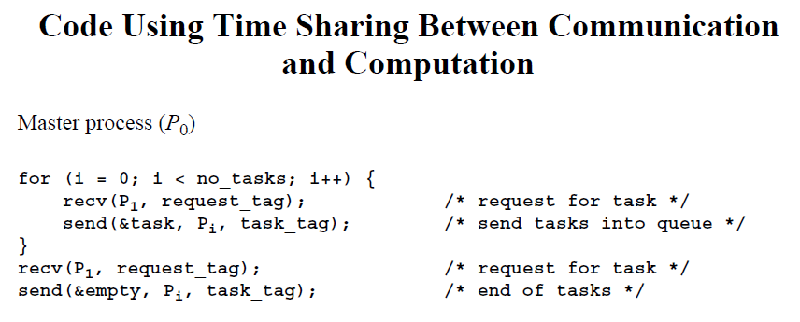
Load Balancing Using a Line Structure (4)

Slide 23
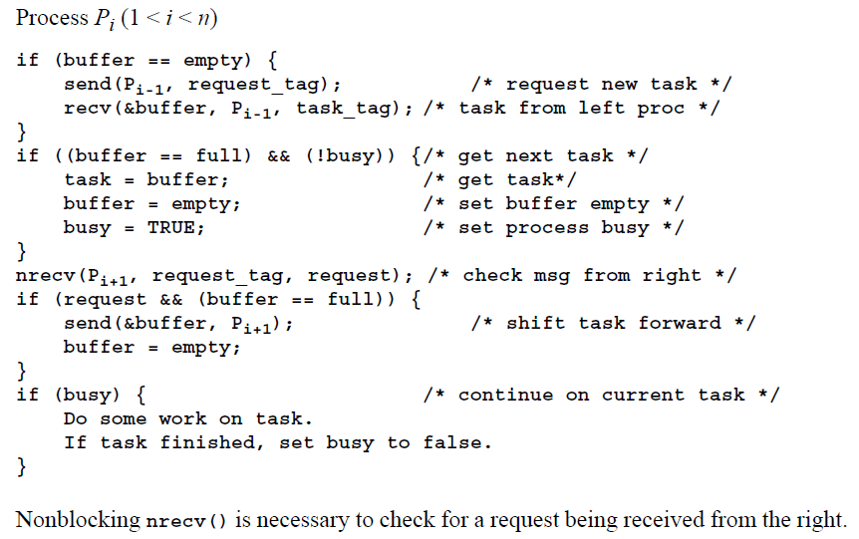
Load Balancing Using a Line Structure (5)

Slide 24
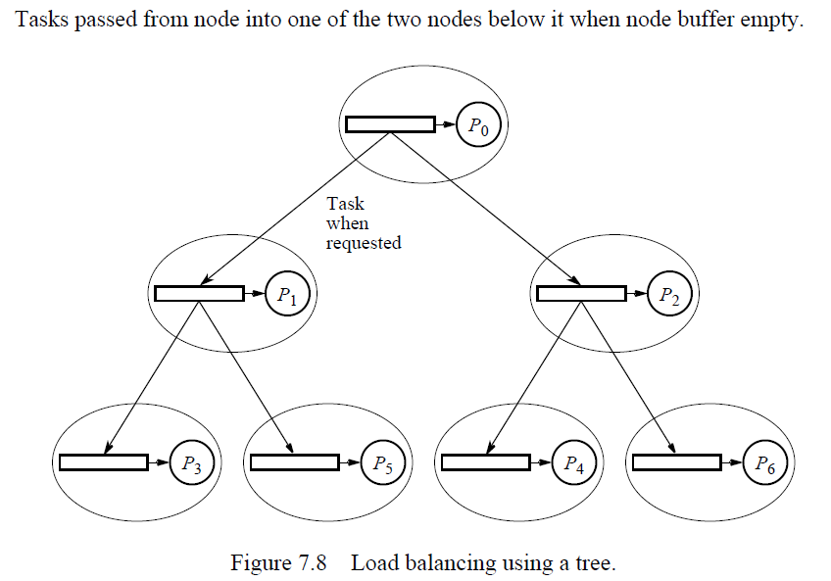
Load Balancing Using A Tree Structure

Slide 25
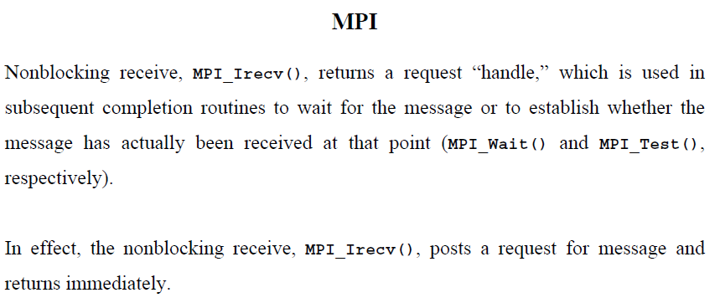
Nonblocking Receive Routines

Slide 26
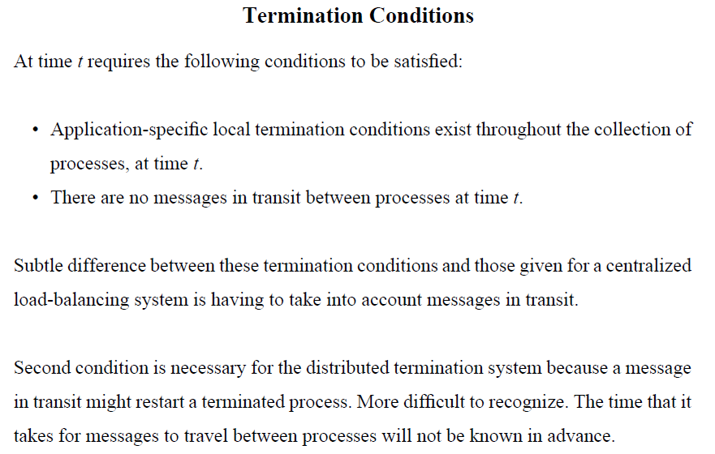
Distributed Termination Detections (1)

Slide 27
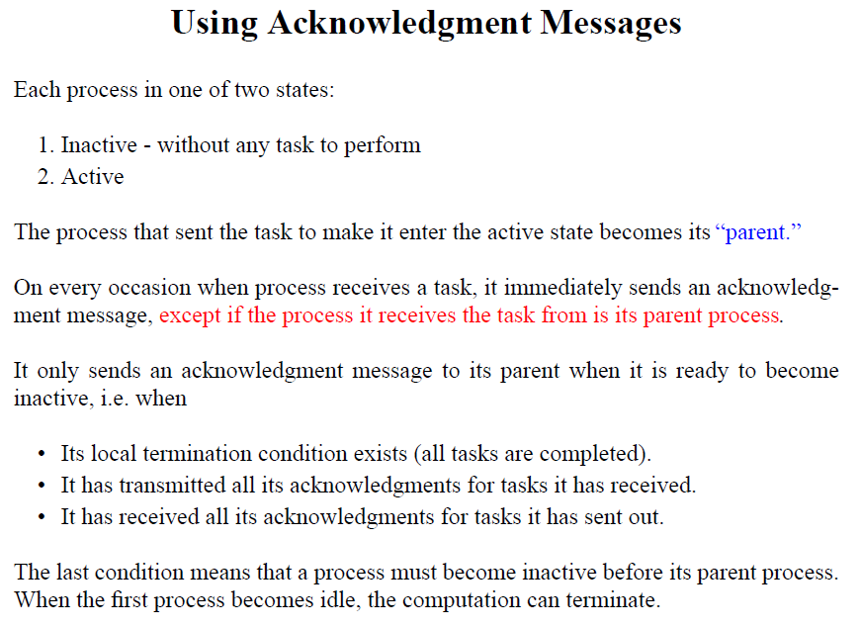
Distributed Termination Detections (2)

Slide 28
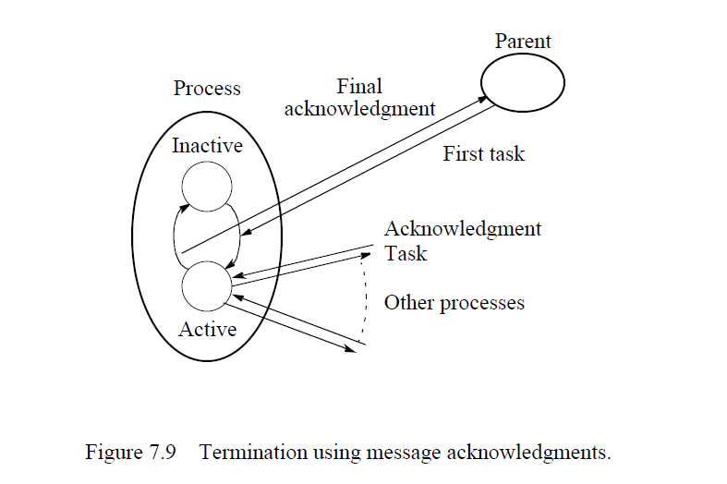
Distributed Termination Detections (3)

Slide 29
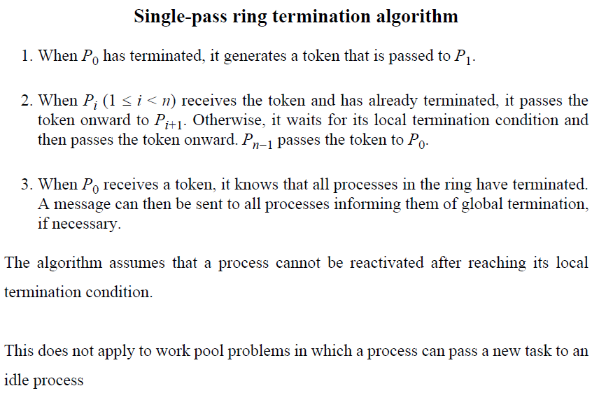
Ring Termination Algorithms (1)

Slide 30
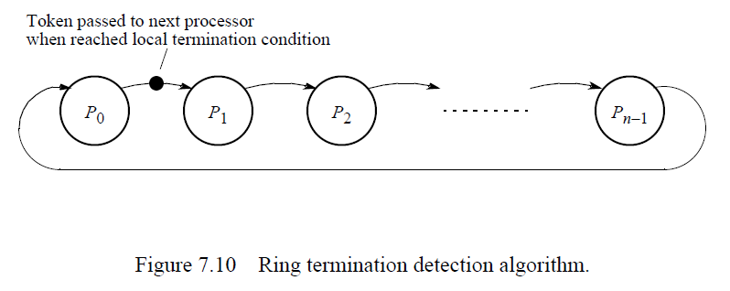
Ring Termination Algorithms (2)

Slide 31
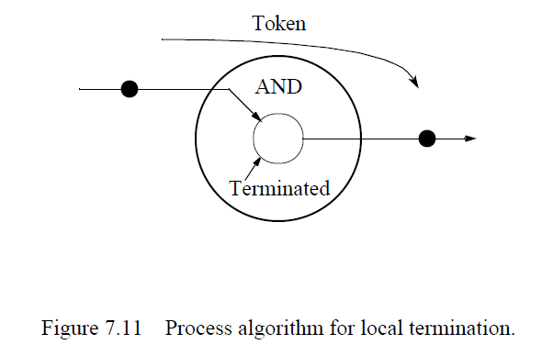
Ring Termination Algorithms (3)

Slide 32
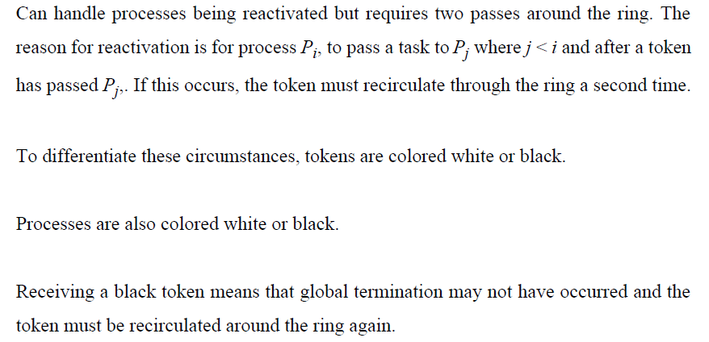
Dual-Pass Ring Termination Algorithm (1)

Slide 33
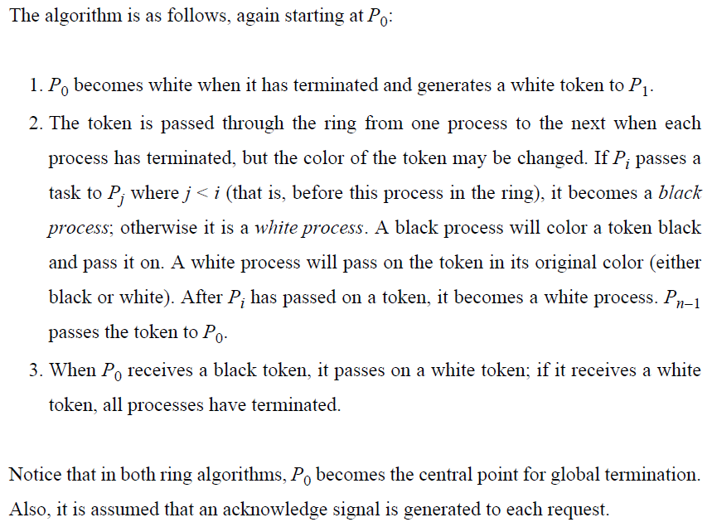
Dual-Pass Ring Termination Algorithm (2)

Slide 34
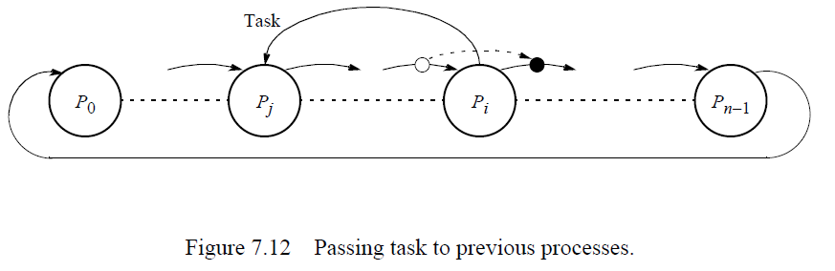
Dual-Pass Ring Termination Algorithm (3)

Slide 35
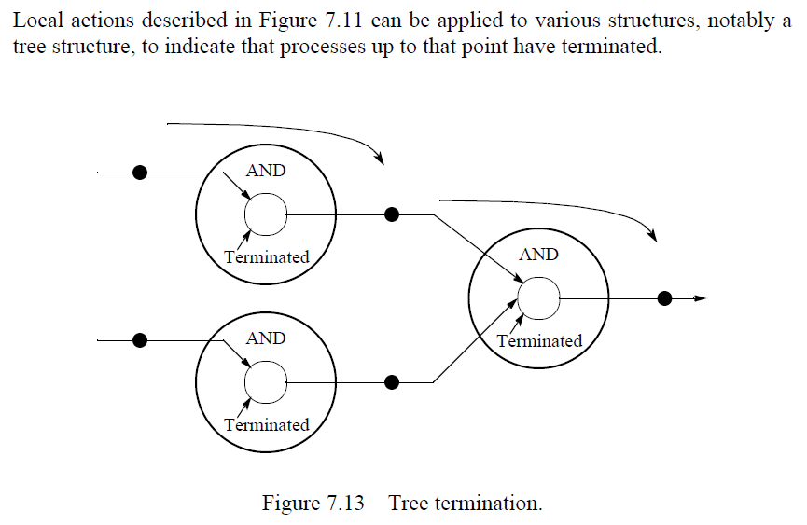
Tree Algorithm (1)

Slide 36
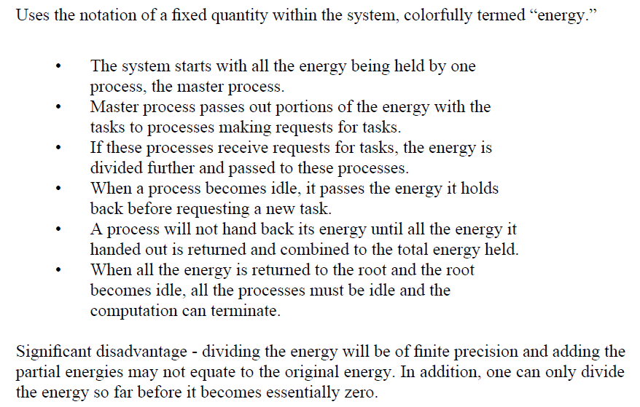
Fixed Energy Distributed Termination Algorithm

Slide 37
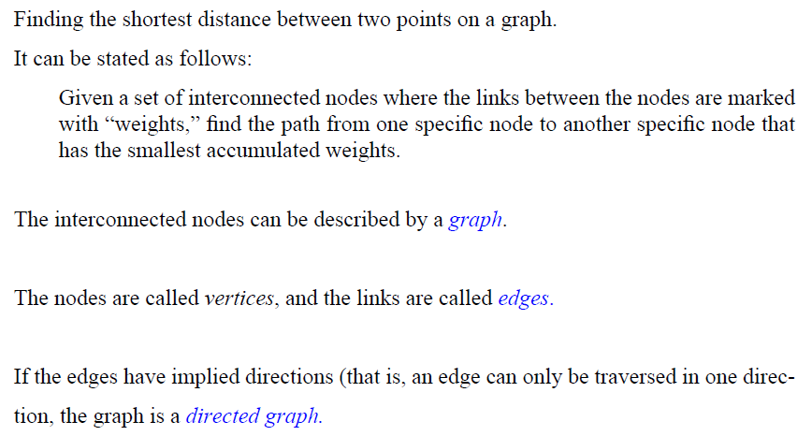
Shortest Path Problem (1)

Slide 38
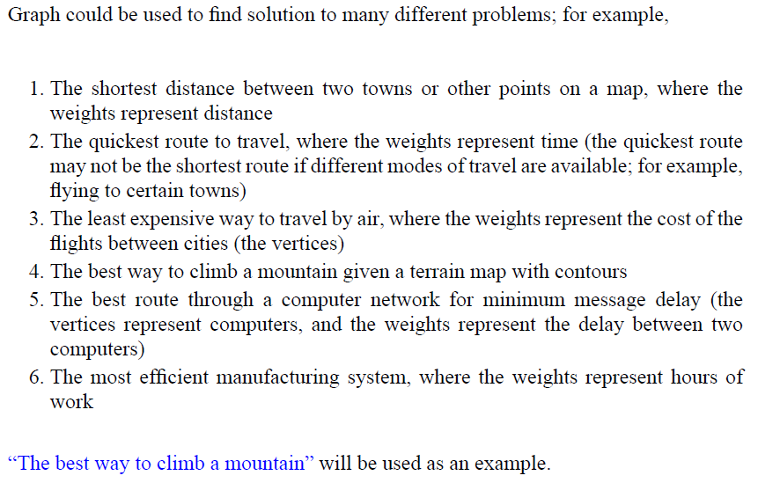
Shortest Path Problem (2)

Slide 39
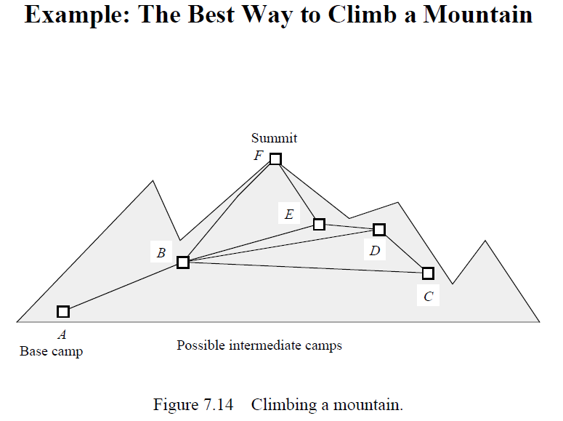
Shortest Path Problem (3)

Slide 40
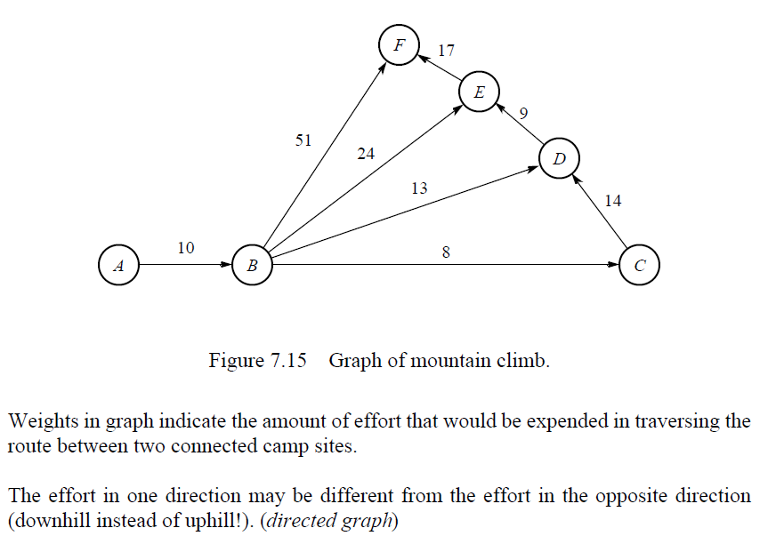
Shortest Path Problem (4)

Slide 41
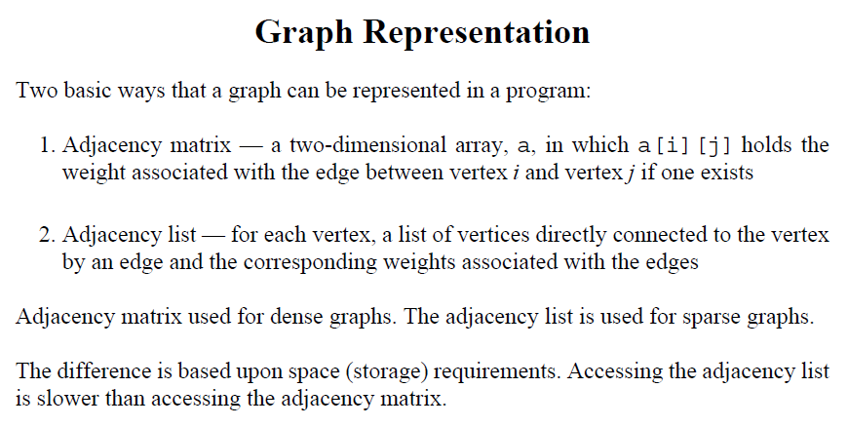
Shortest Path Problem (5)

Slide 42
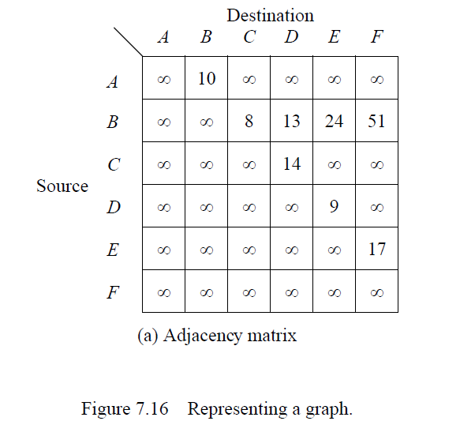
Shortest Path Problem (6)

Slide 43
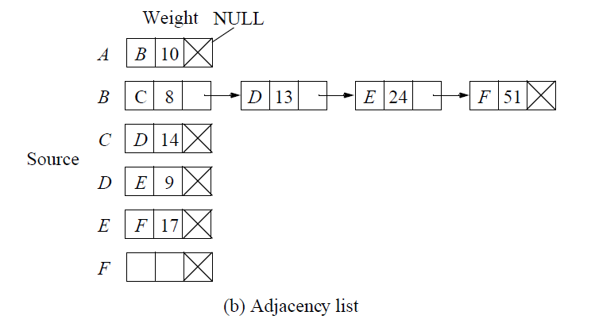
Shortest Path Problem (7)

Slide 44
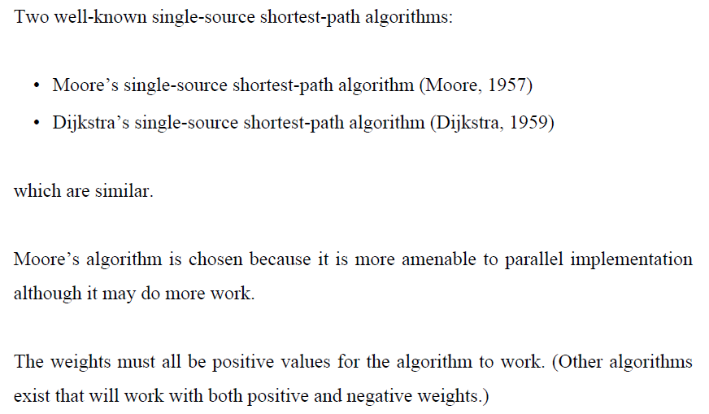
Searching a Graph (1)

Slide 45
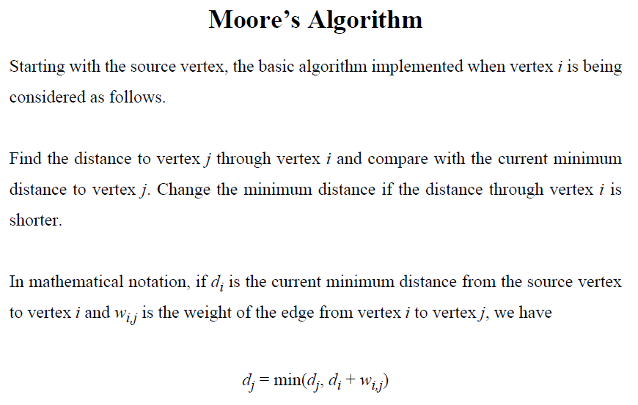
Searching a Graph (2)

Slide 46
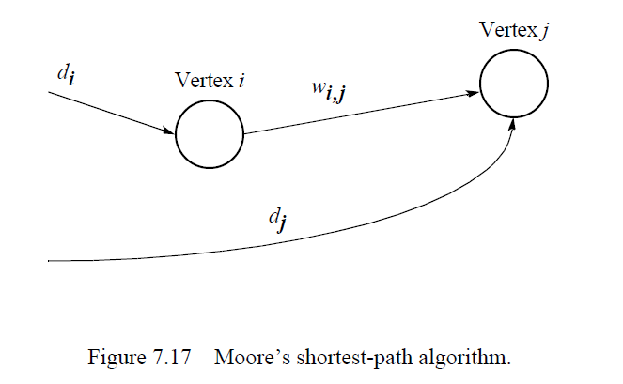
Searching a Graph (3)

Slide 47
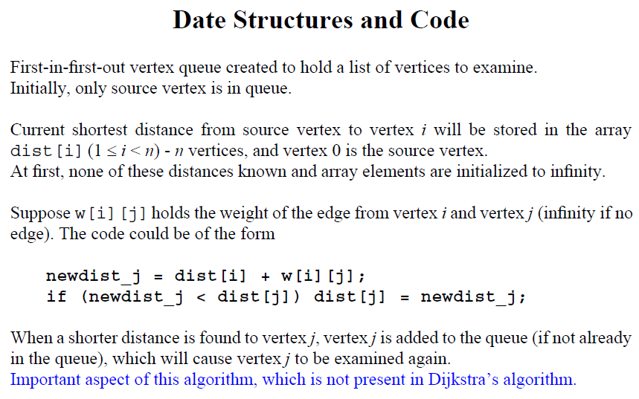
Searching a Graph (4)

Slide 48
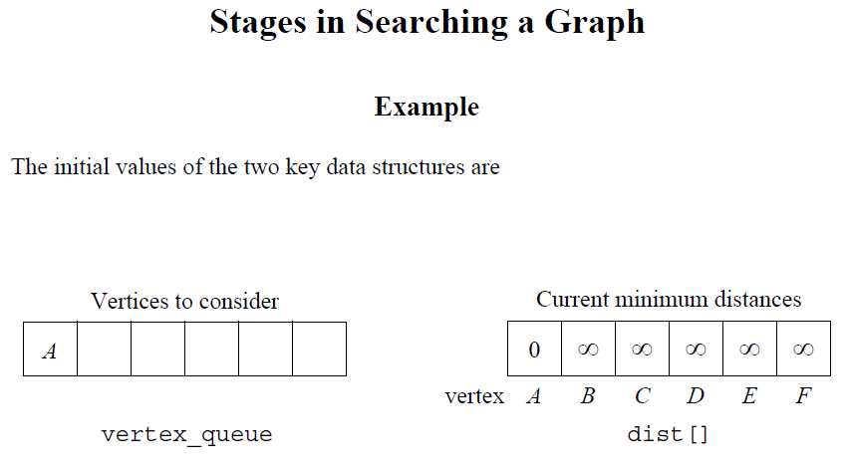
Searching a Graph (5)

Slide 49
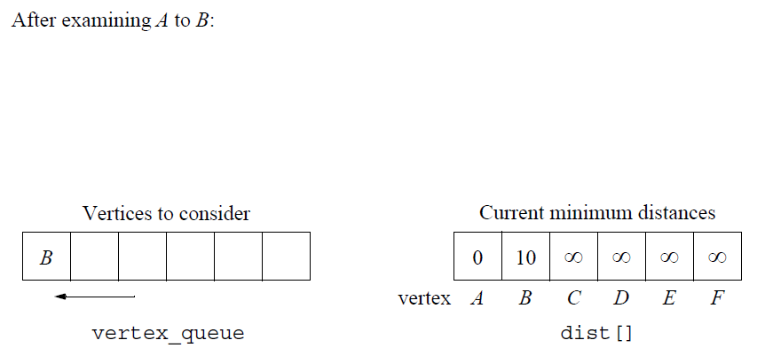
Searching a Graph (6)

Slide 50
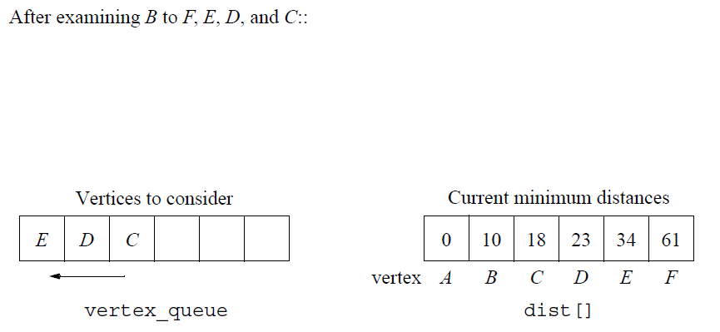
Searching a Graph (7)

Slide 51
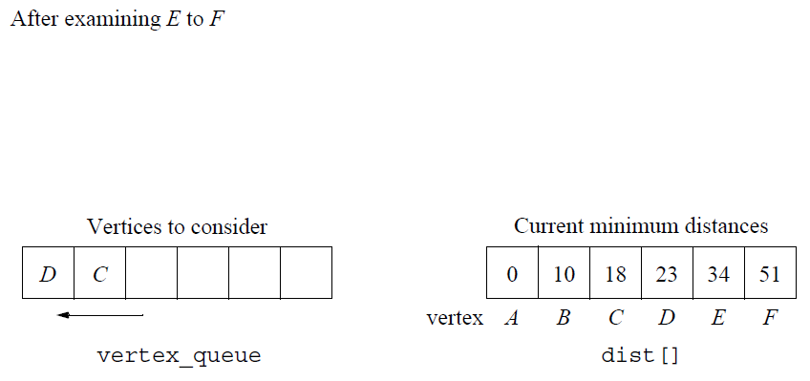
Searching a Graph (8)

Slide 52
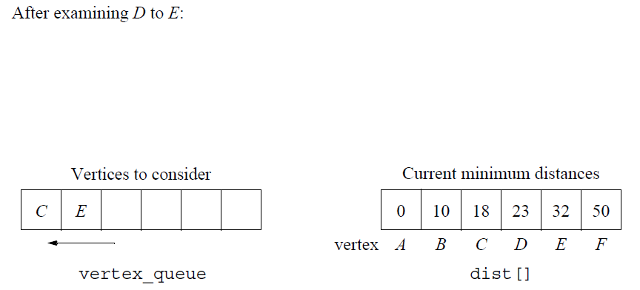
Searching a Graph (9)

Slide 53

Searching a Graph (10)

Slide 54

Searching a Graph (11)

Slide 55

Searching a Graph (12)

Slide 56

Searching a Graph (13)

Slide 57

Searching a Graph (14)

Slide 58

Searching a Graph (15)

Slide 59

Searching a Graph (16)

Slide 60

Searching a Graph (17)

Slide 61

Searching a Graph (18)

Slide 62

Searching a Graph (19)

Slide 63

Searching a Graph (20)

