Slide 1
CSC4005 – Distributed and Parallel Computing
Prof. Yeh-Ching Chung
School of Data Science
Chinese University of Hong Kong, Shenzhen

Slide 2
Outline
Introduction to Parallel Computers
Message Passing Computing and Programming
Multithreaded Programming
CUDA Programming
OpenMP Programming
Embarrassingly Parallel Computations
Partitioning and Divide-and-Conquer Strategies
Pipelined Computations
Synchronous Computations
Load Balancing and Termination Detection
Sorting Algorithms

Slide 3
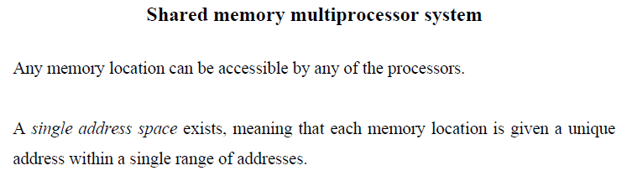
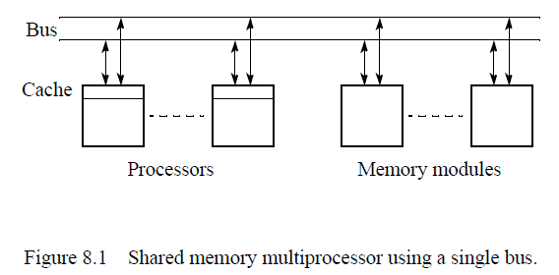
Programming with Shared Memory

Slide 4
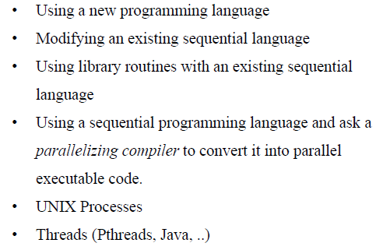
Several Alternatives for Programming (1)

Slide 5
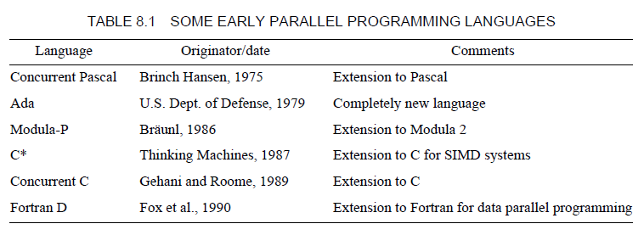
Several Alternatives for Programming (2)

Slide 6
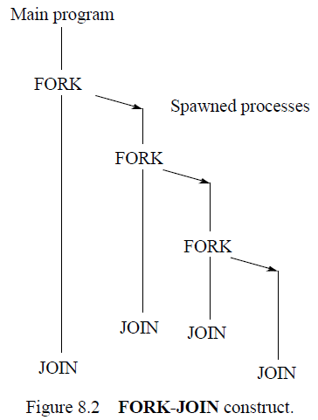
Creating Concurrent Process – FORK-JOIN Construct

Slide 7
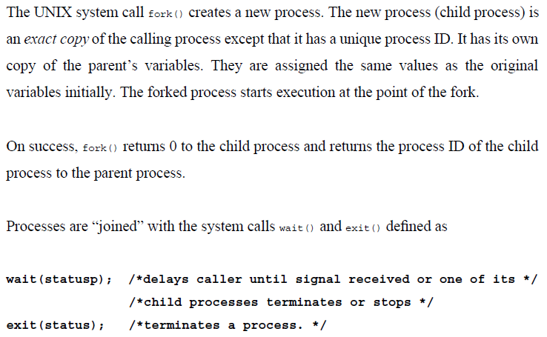
UNIX Heavyweight Processes (1)

Slide 8
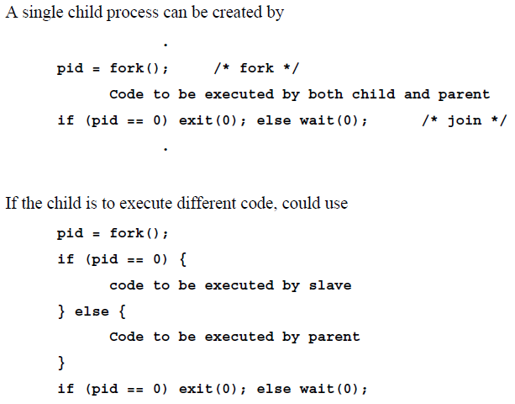
UNIX Heavyweight Processes (2)

Slide 9
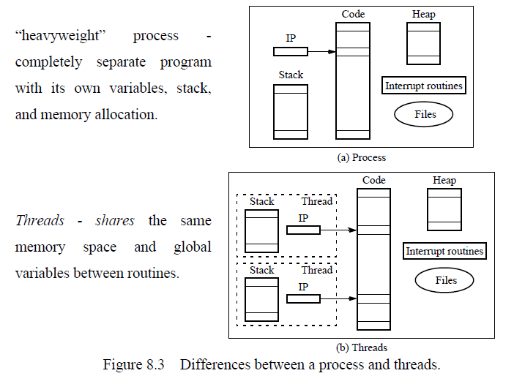
Thread

Slide 10
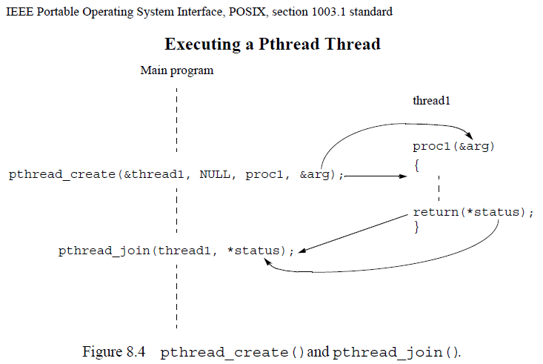
Pthread

Slide 11
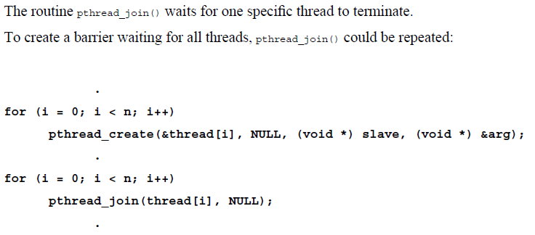
Pthread Barrier

Slide 12
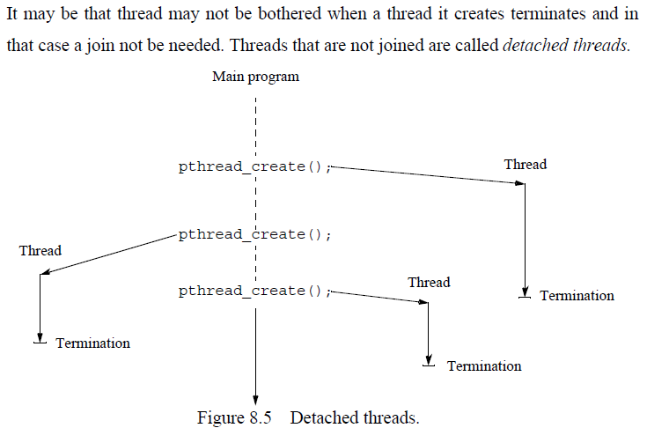
Detached Threads

Slide 13
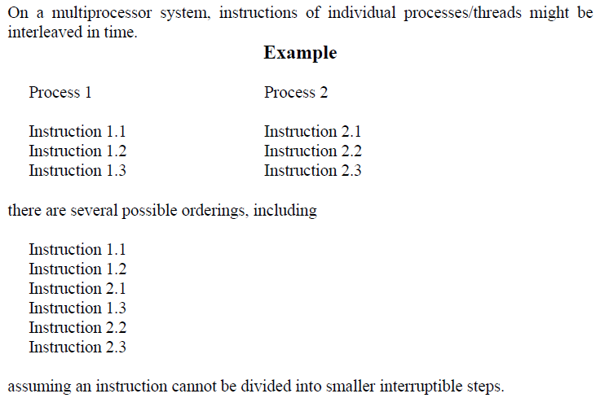
Statement Execution Order (1)

Slide 14
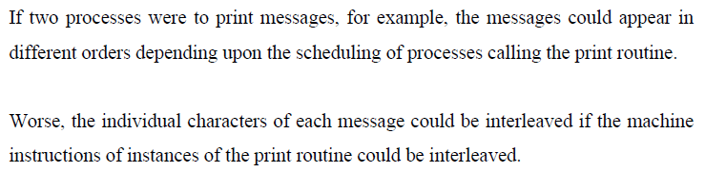
Statement Execution Order (2)

Slide 15
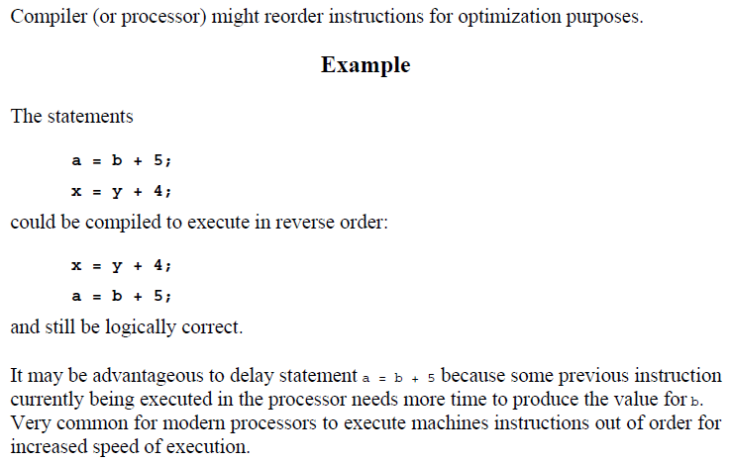
Compiler/Processor Optimizations

Slide 16
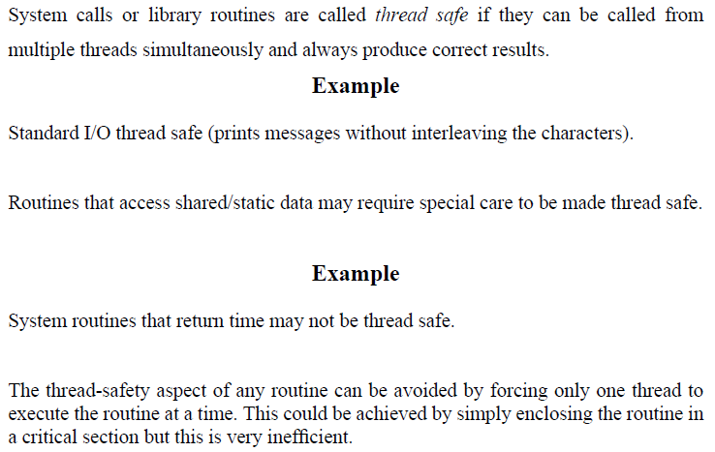
Thread-Safe Routines

Slide 17
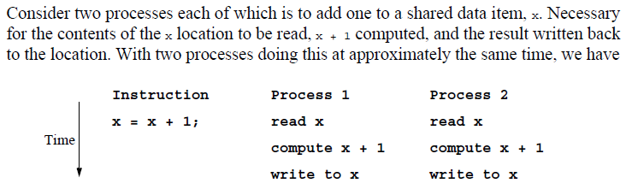
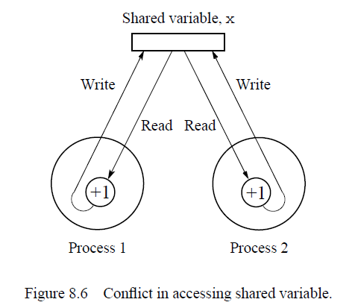
Accessing Shared Data

Slide 18
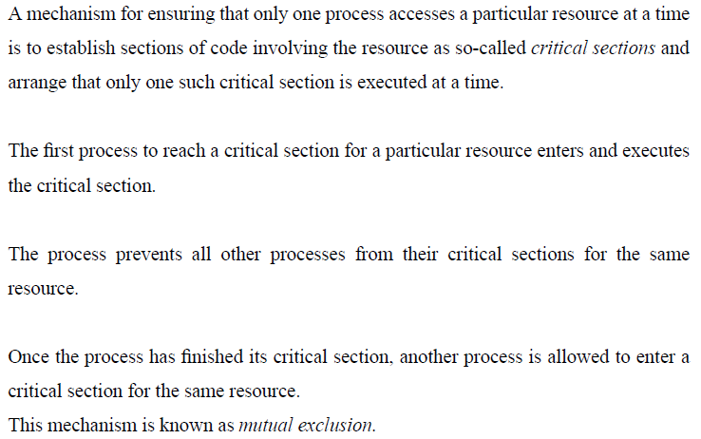
Critical Section

Slide 19
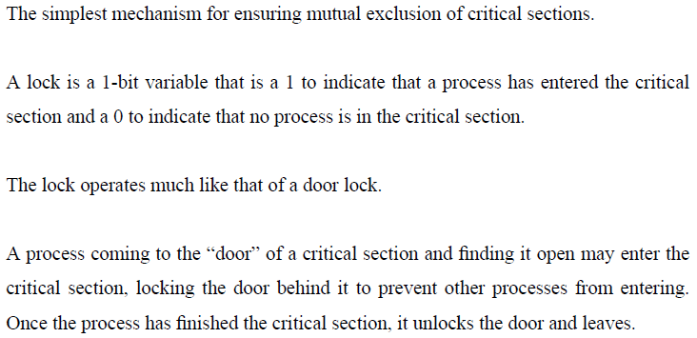
Locks

Slide 20
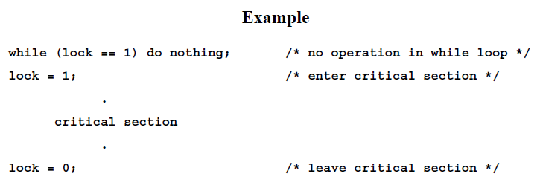
Spin Lock (1)

Slide 21
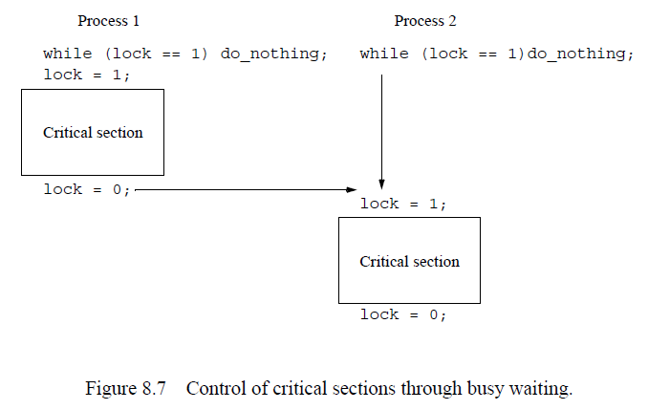
Spin Lock (2)

Slide 22
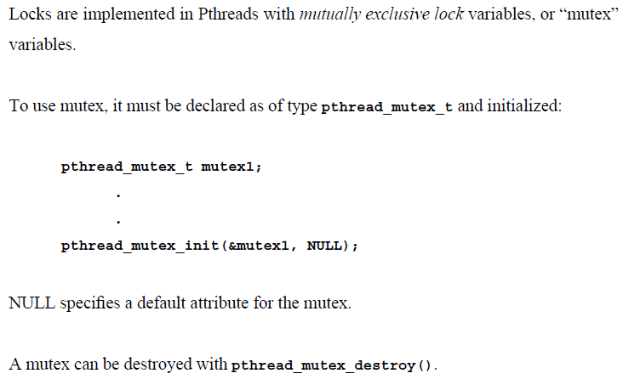
Pthread Lock Routines (1)

Slide 23
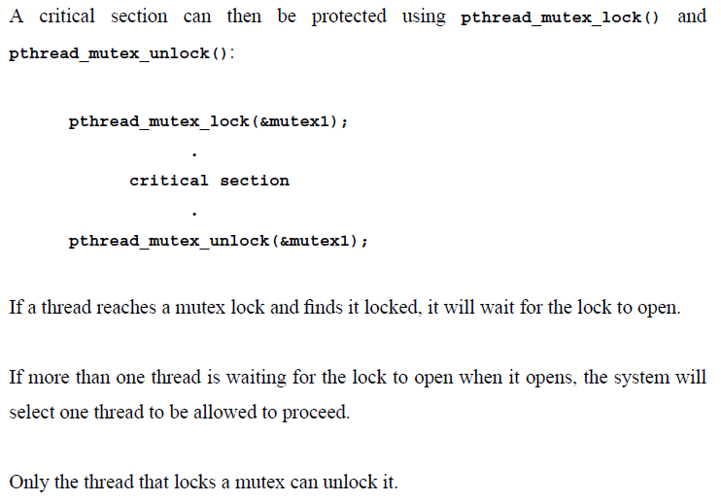
Pthread Lock Routines (2)

Slide 24
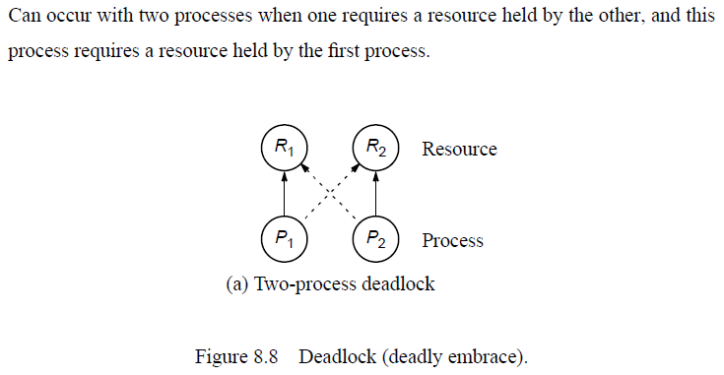
Deadlock (1)

Slide 25
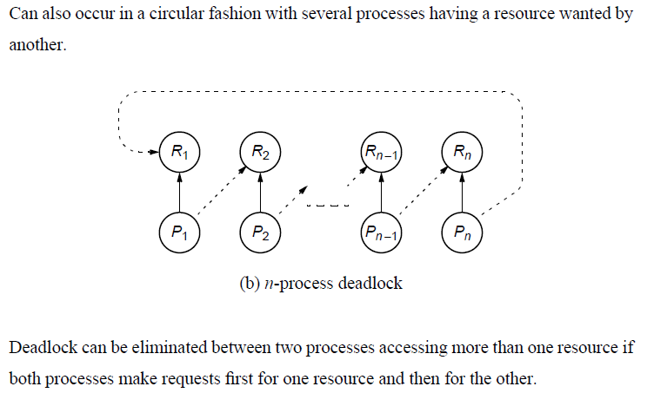
Deadlock (2)

Slide 26
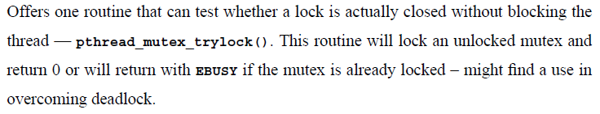
Pthread Lock Checking Routine

Slide 27
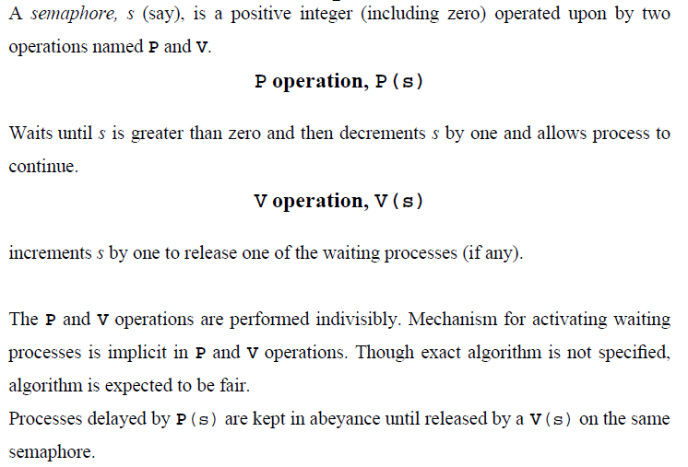
Semaphore

Slide 28
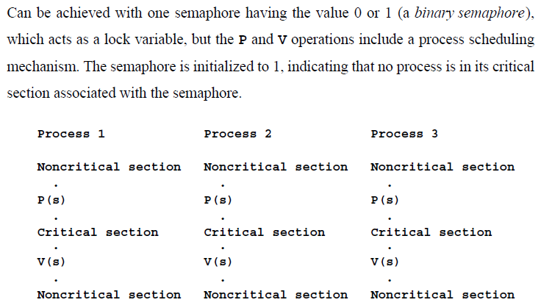
Mutual Exclusion of Critical Sections

Slide 29
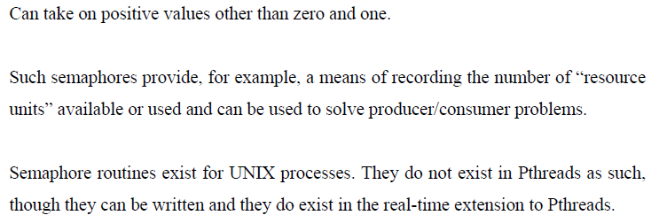
General Semaphore (1)

Slide 30
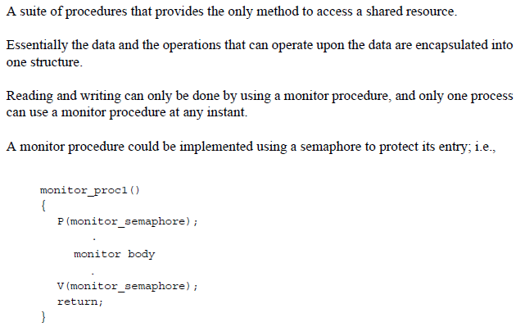
General Semaphore (2)

Slide 31
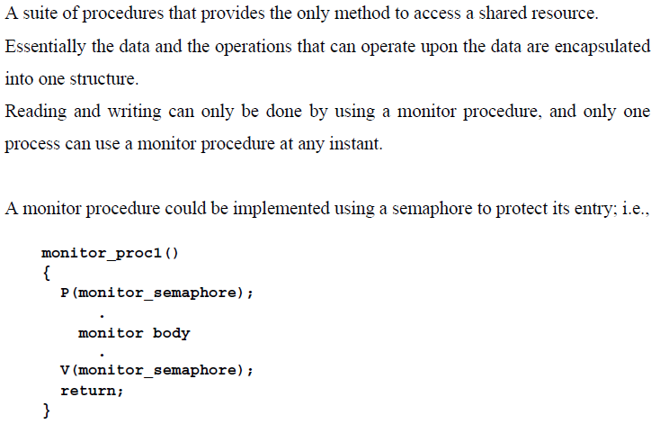
Monitor

Slide 32
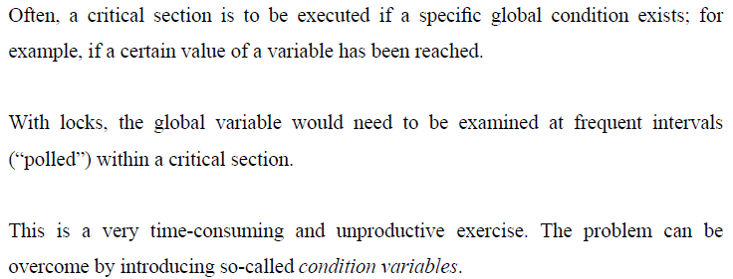
Condition Variables

Slide 33
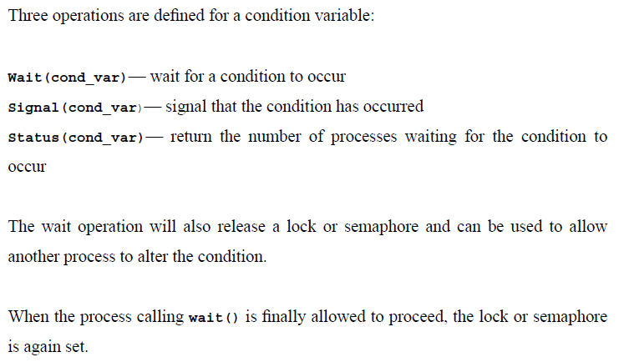
Condition Variable Operations (1)

Slide 34
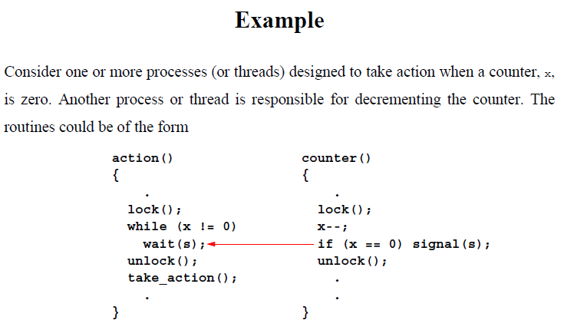
Condition Variable Operations (2)

Slide 35
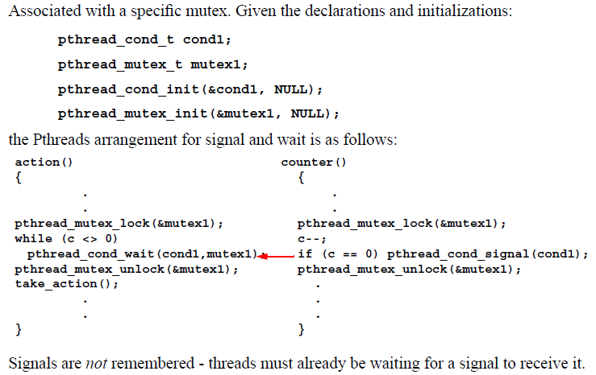
Pthread Condition Variable

Slide 36
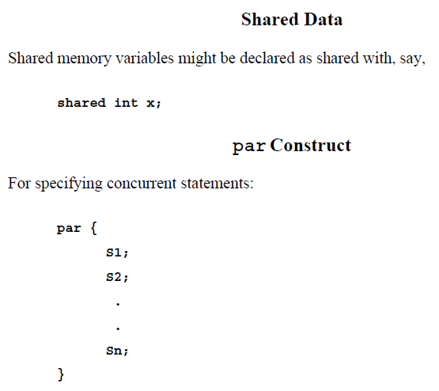
Language Constructs for Parallelism (1)

Slide 37
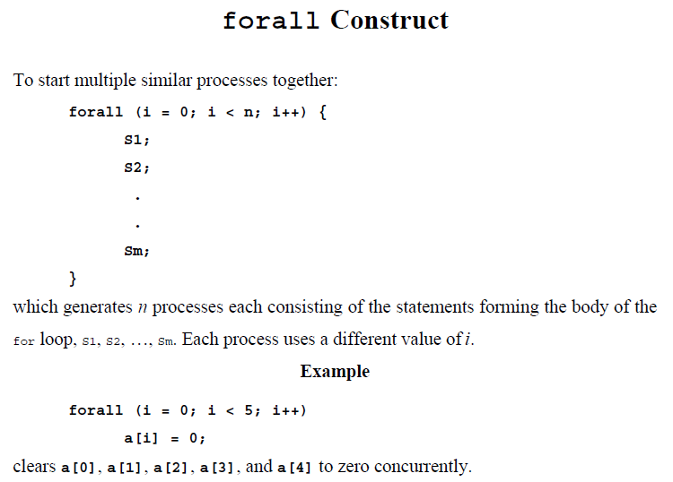
Language Constructs for Parallelism (2)

Slide 38
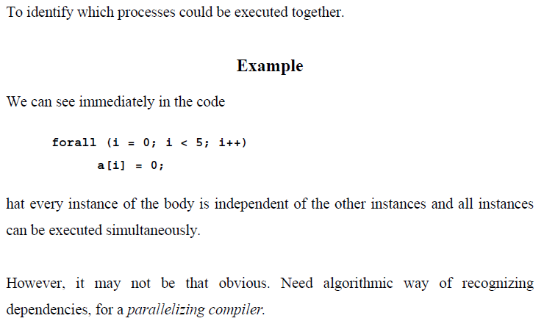
Dependency Analysis

Slide 39
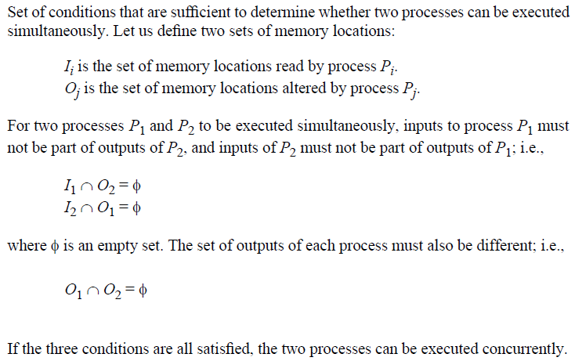
Berstein’s Conditions

Slide 40
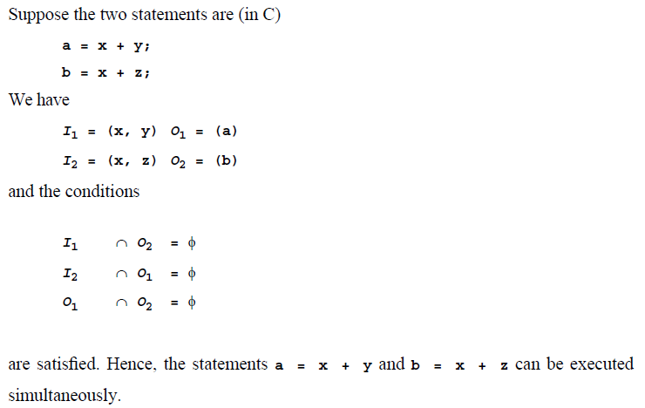
Example

Slide 41
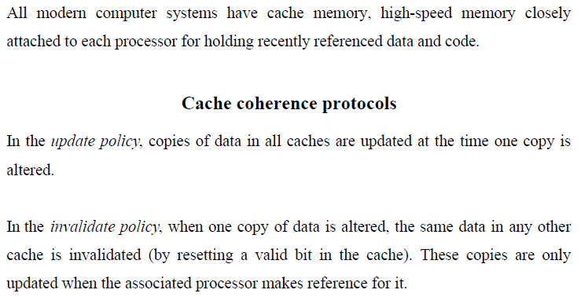
Shared Data in System with Caches (1)

Slide 42
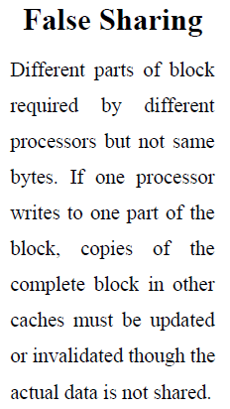
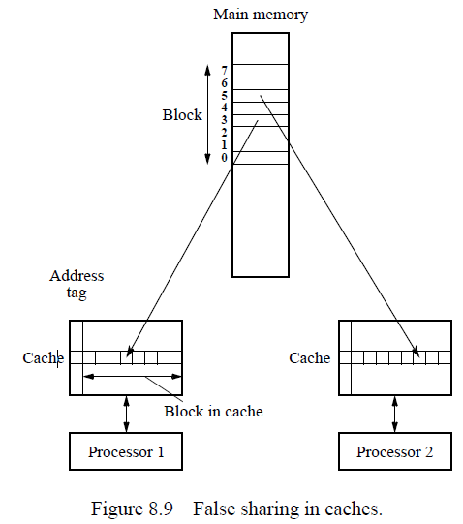
Shared Data in System with Caches (2)

Slide 43
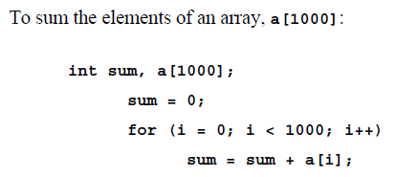
Program Example (1)

Slide 44
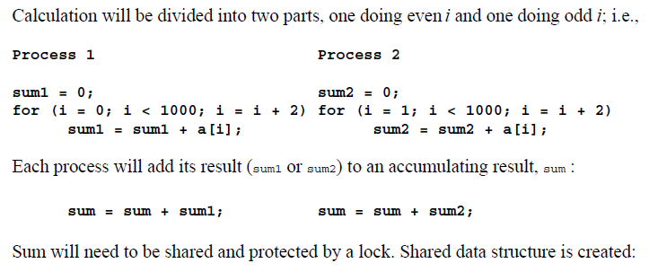
Program Example (2)

Slide 45
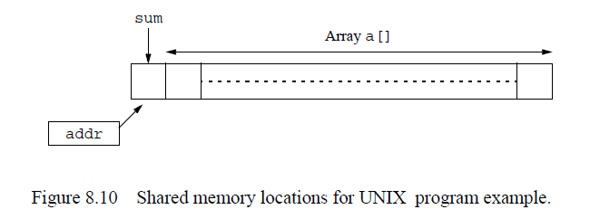
Program Example (3)

Slide 46
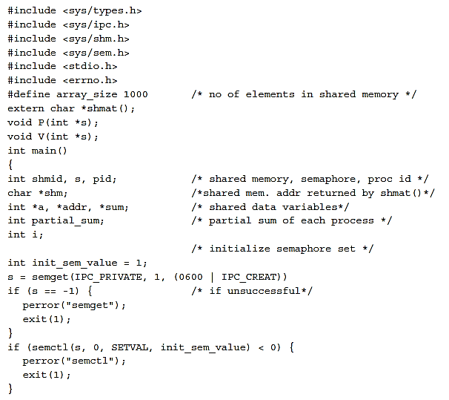
Program Example (4)

Slide 47
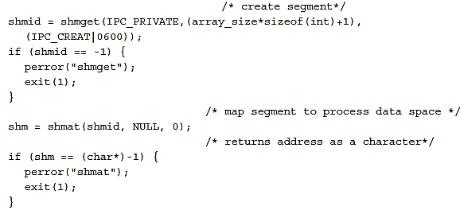
Program Example (5)

Slide 48
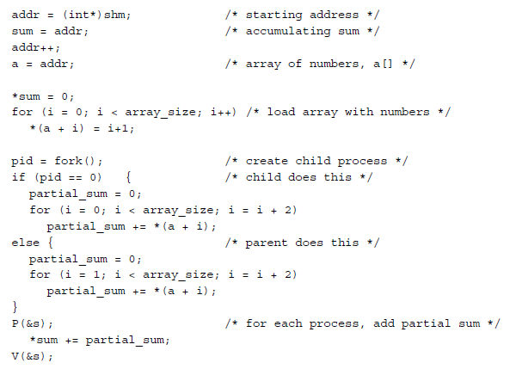
Program Example (6)

Slide 49
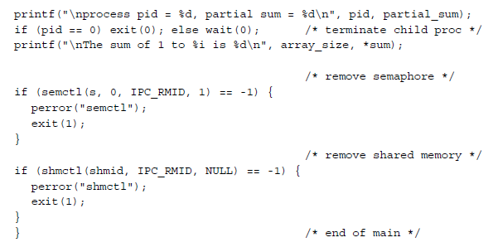
Program Example (7)

Slide 50



Program Example (8)

Slide 51

Pthread Example (1)

Slide 52

Pthread Example (2)

Slide 53

Pthread Example (3)

Slide 54

Pthread Example (4)

