Slide 1
CSC4005 – Distributed and Parallel Computing
Prof. Yeh-Ching Chung
School of Data Science
Chinese University of Hong Kong, Shenzhen

Slide 2
Outline
Introduction to Parallel Computers
Message Passing Computing and Programming
Multithreaded Programming
CUDA Programming
OpenMP Programming
Embarrassingly Parallel Computations
Partitioning and Divide-and-Conquer Strategies
Pipelined Computations
Synchronous Computations
Load Balancing and Termination Detection
Sorting Algorithms

Slide 3
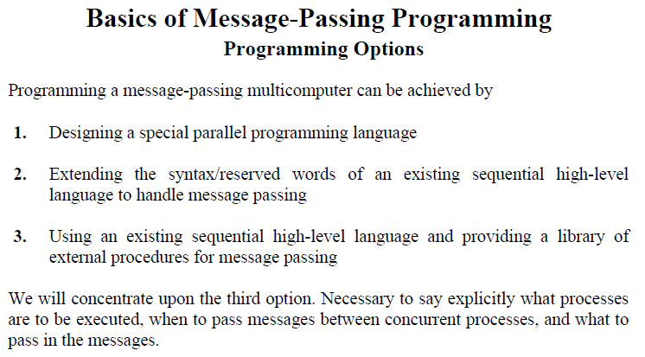
Message-Passing Computing

Slide 4
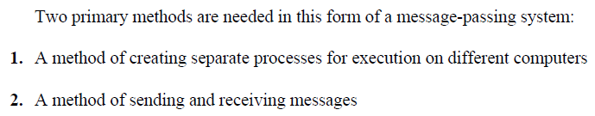
Goals

Slide 5
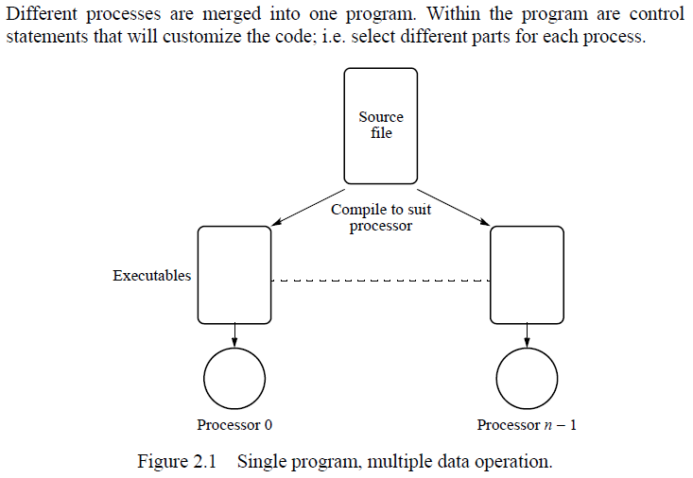
Single Program Multiple Data (SPMD) Model

Slide 6
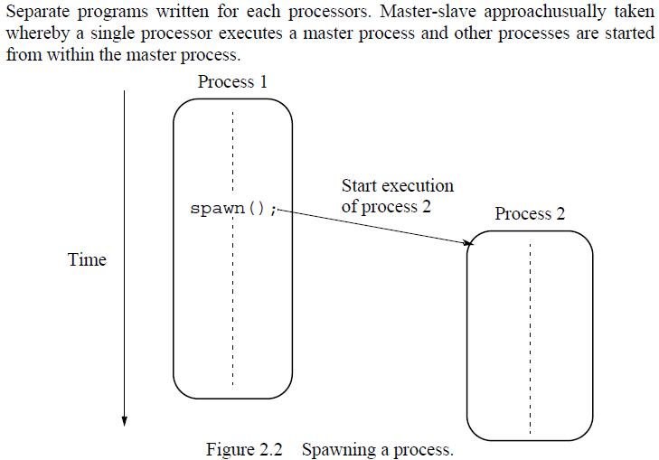
Multiple Program Multiple Data (MPMD) Model

Slide 7
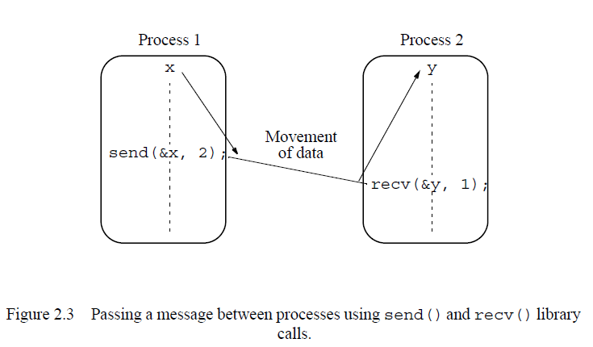
Basic Send and Receive Routines

Slide 8
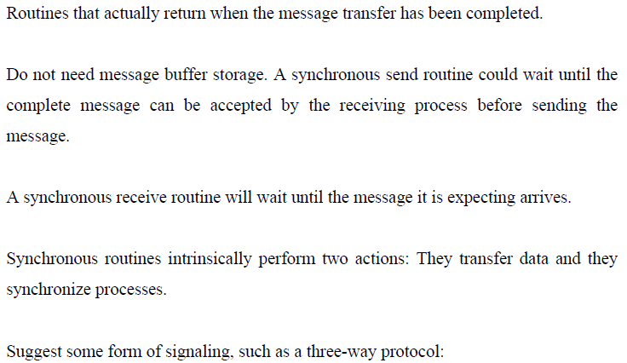
Synchronous Message Passing (1)

Slide 9
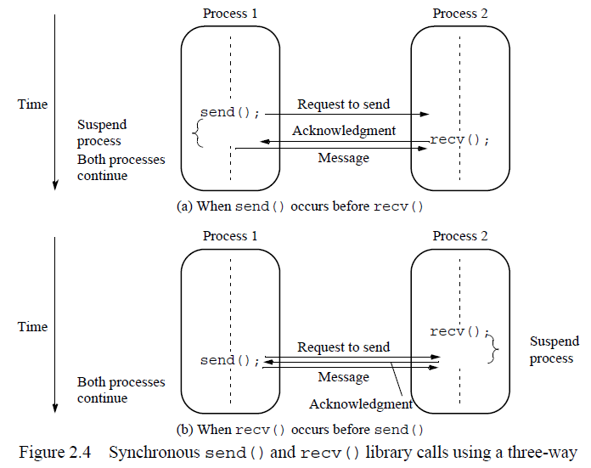
Synchronous Message Passing (2)

Slide 10
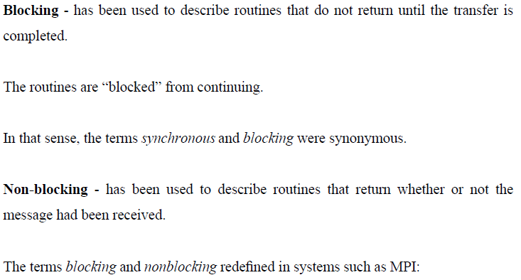
Blocking and Nonblocking Message Passing

Slide 11
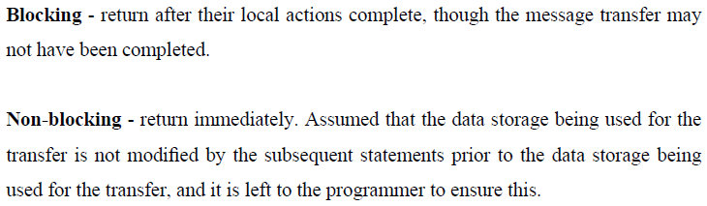
MPI Definitions pf Blocking and Nonblocking

Slide 12
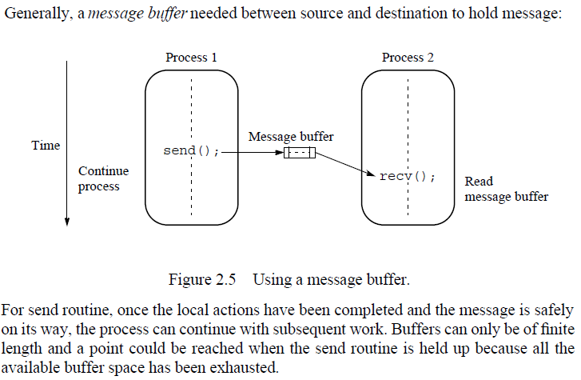
How Message-Passing Routines Can Return Before the Message Transfer Has Been Completed

Slide 13
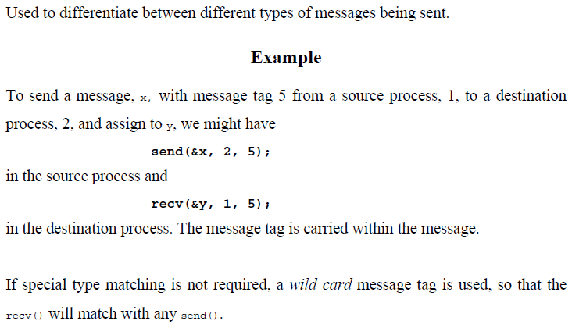
Message Tag

Slide 14
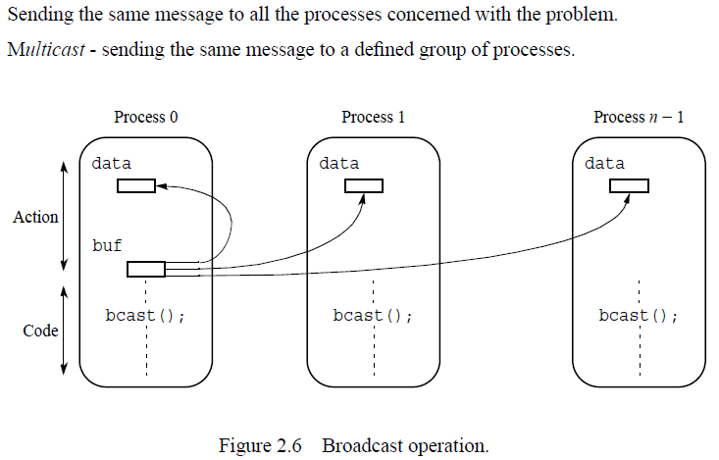
Broadcast

Slide 15
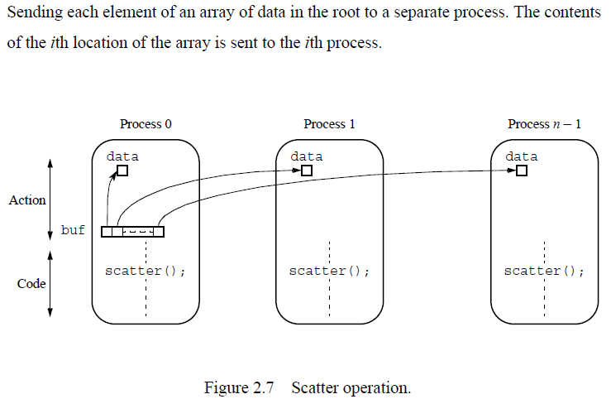
Scatter

Slide 16
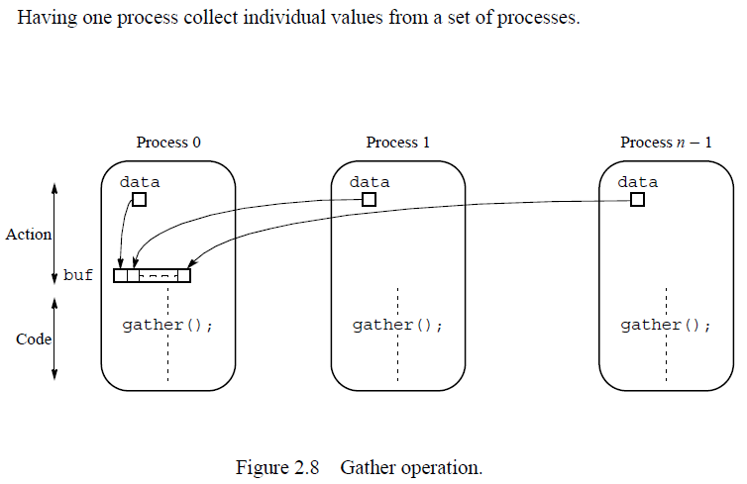
Gather

Slide 17
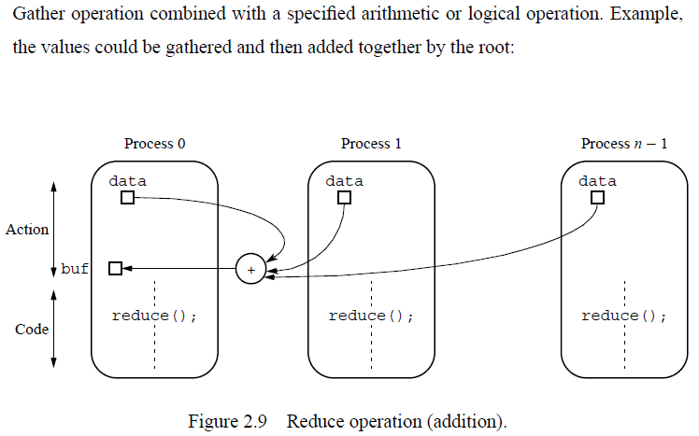
Reduce

Slide 18
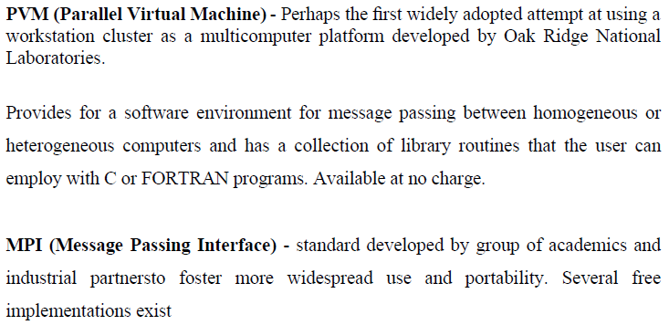
Using Workstation Clusters – Software Tools

Slide 19
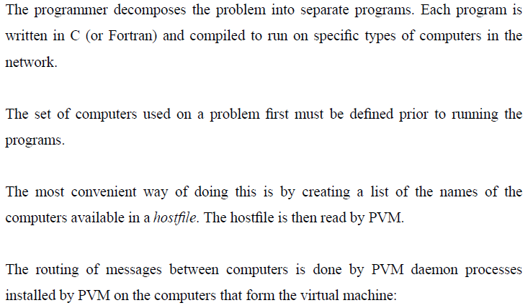
PVM (1)

Slide 20
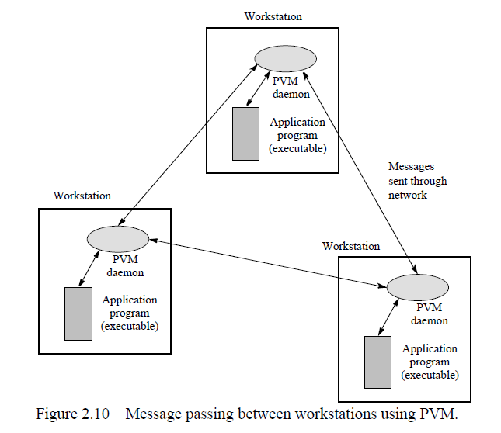
PVM (2)

Slide 21
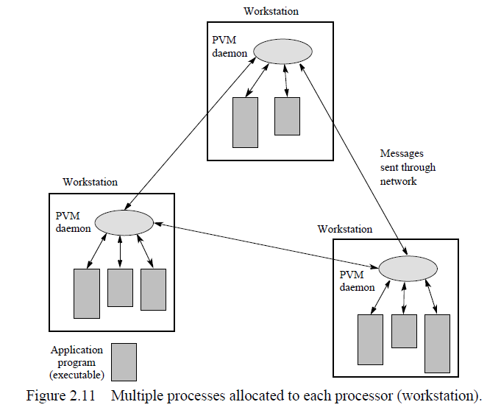
PVM (3)

Slide 22
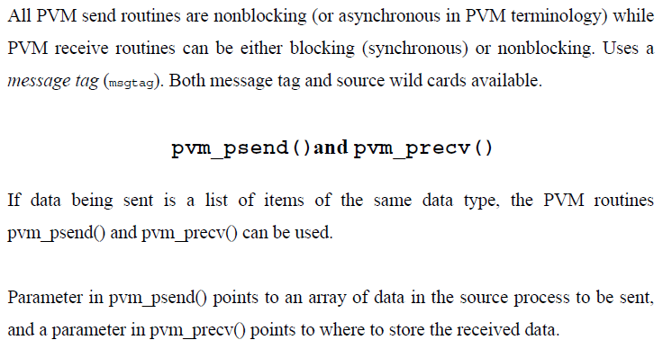
Basic Message-Passing Routines (1)

Slide 23
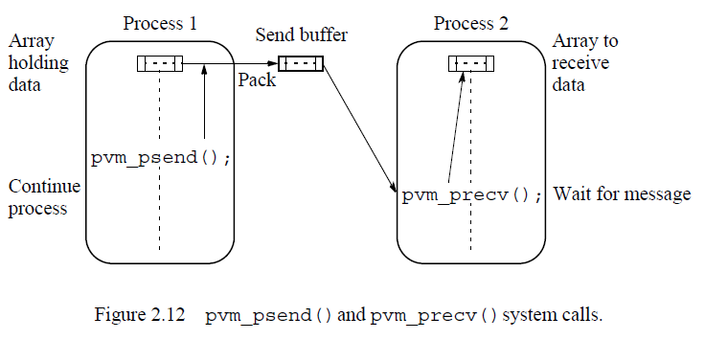
Basic Message-Passing Routines (2)

Slide 24
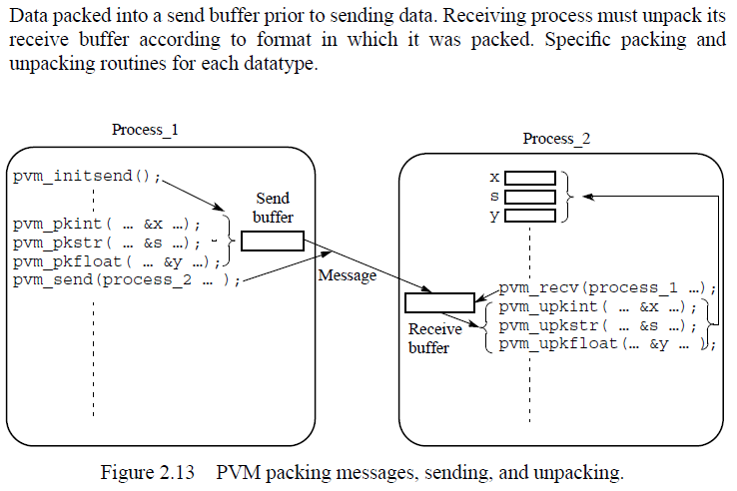
Sending Data Composed of Various Types

Slide 25
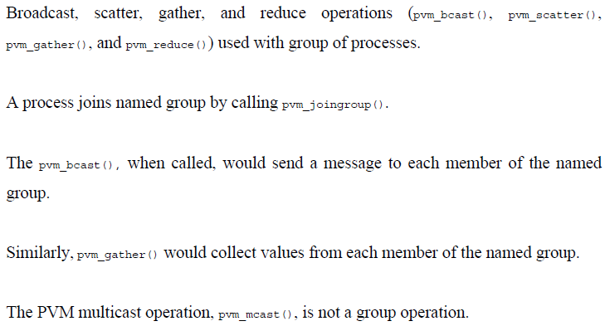
Broadcast, Multicast, Scatter, Gather, and Reduce

Slide 26
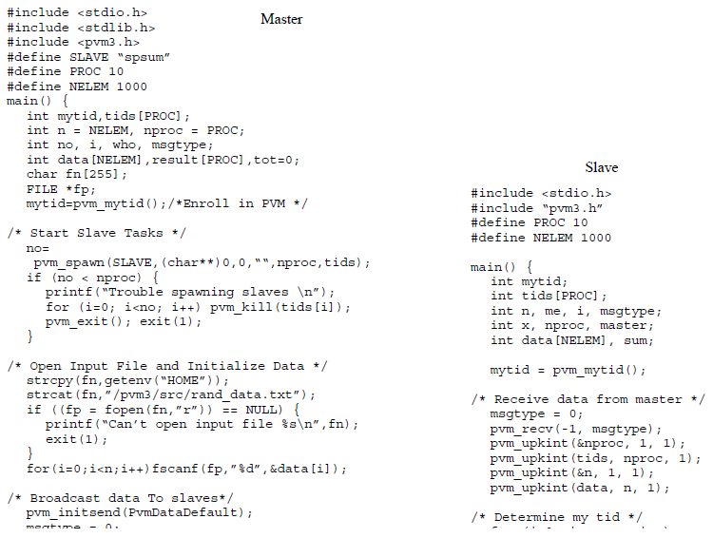
Example - PVM Program (1)

Slide 27
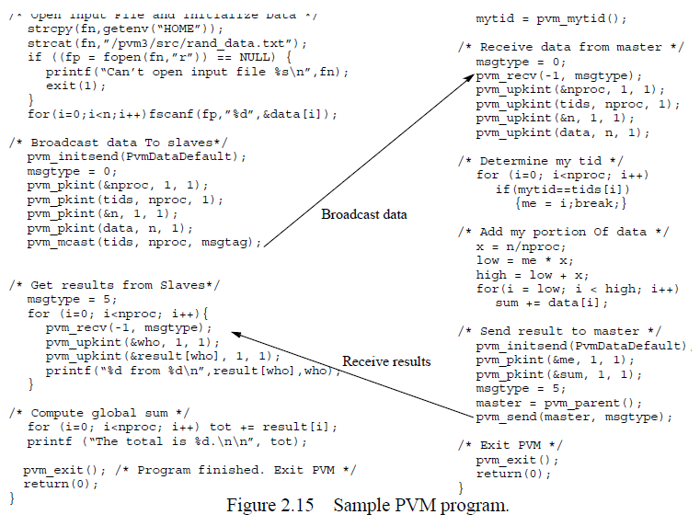
Example - PVM Program (2)

Slide 28
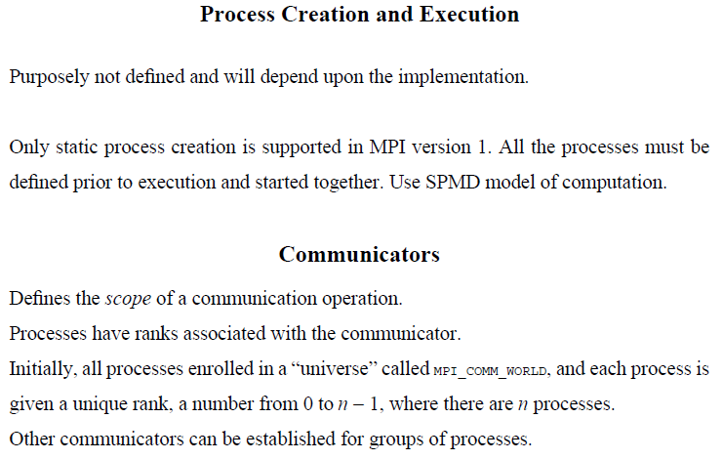
MPI

Slide 29
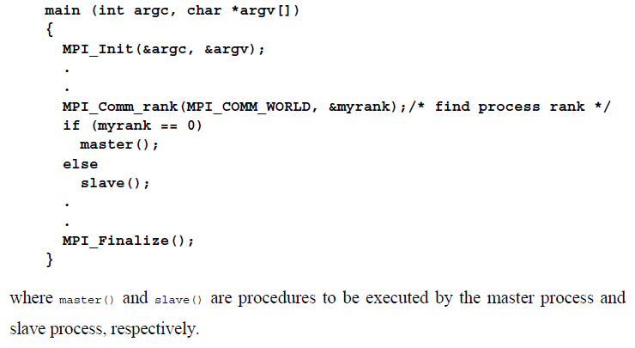
Using the SPMD Computational Model

Slide 30
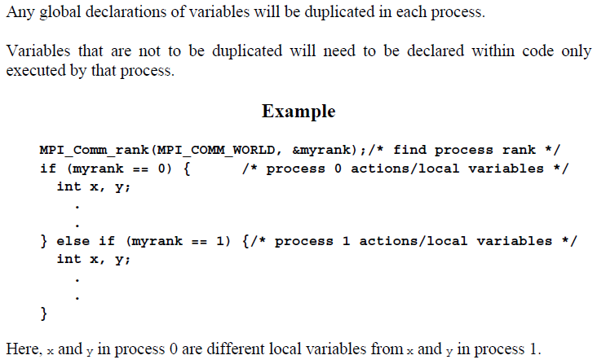
Global and Local Variables

Slide 31
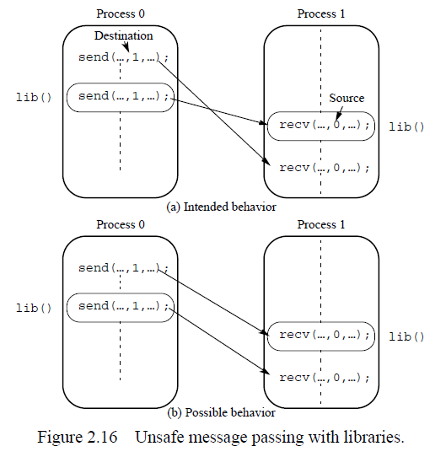
Unsafe Message Passing with Library

Slide 32
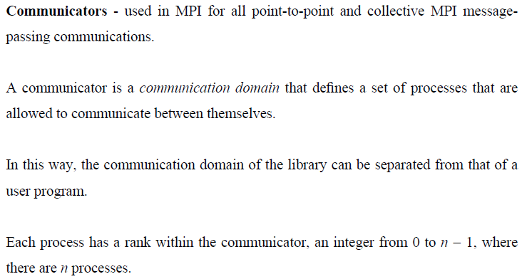
MPI Solution

Slide 33
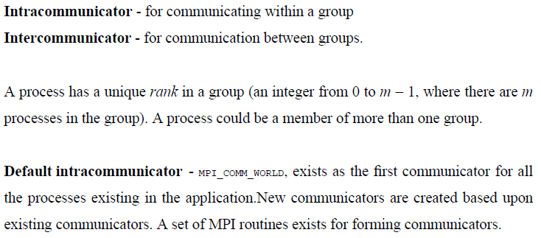
Communication Types

Slide 34
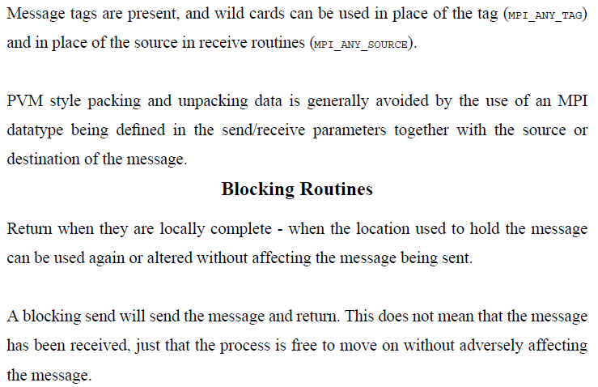
Point-to-Point Communication

Slide 35
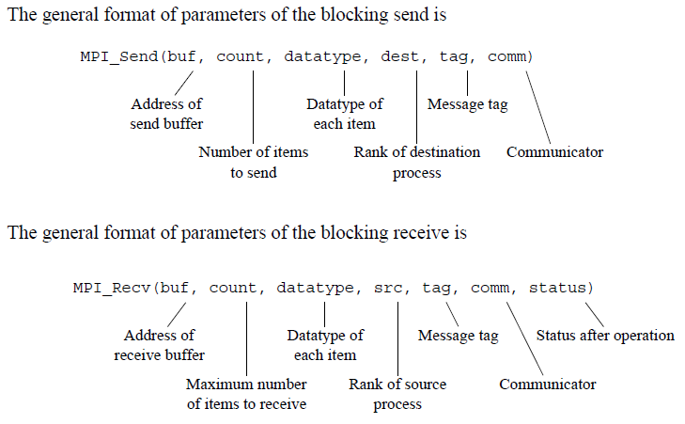
MPI Blocking Send and Receive

Slide 36
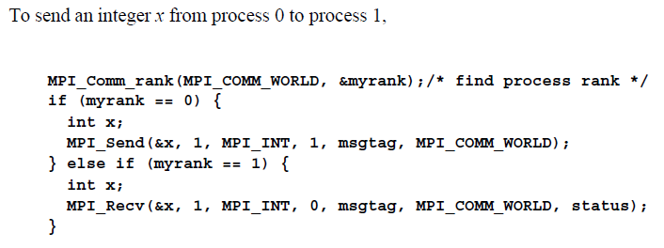
Example

Slide 37
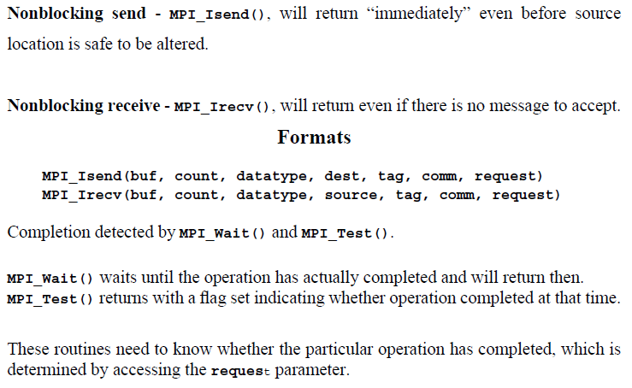
Nonblocking Routines

Slide 38
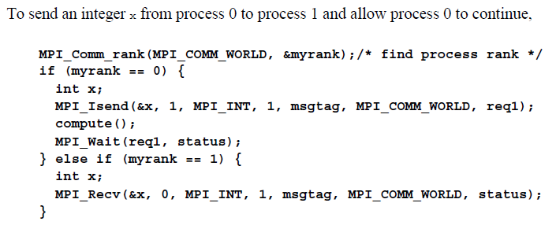
Example

Slide 39
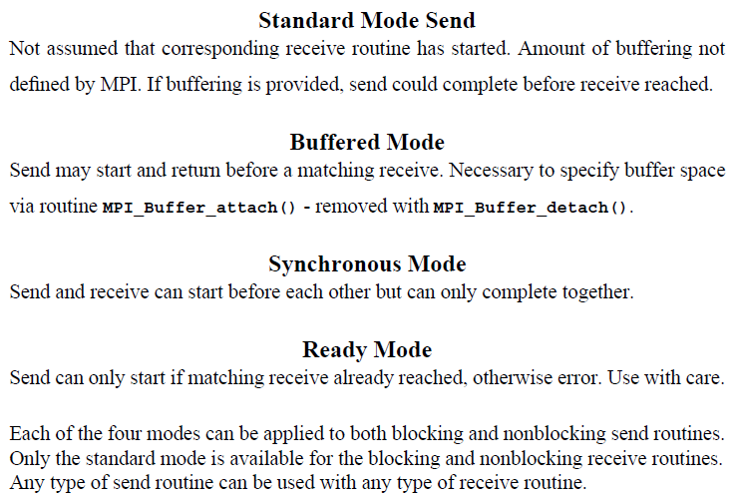
Send Communication Modes

Slide 40
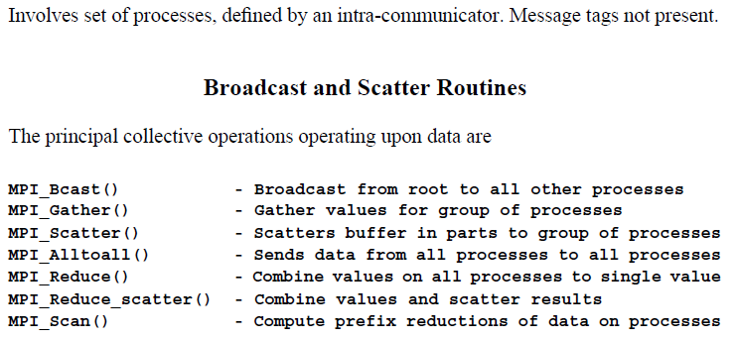
Collective Communication

Slide 41
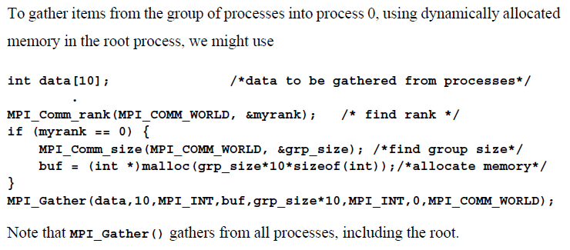
Example

Slide 42
Barrier

Slide 43
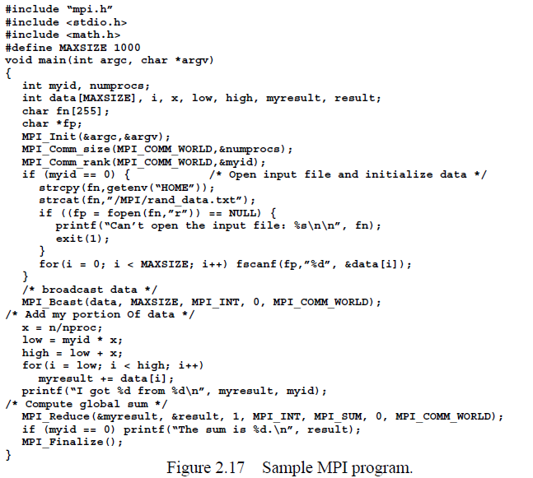
Example

Slide 44
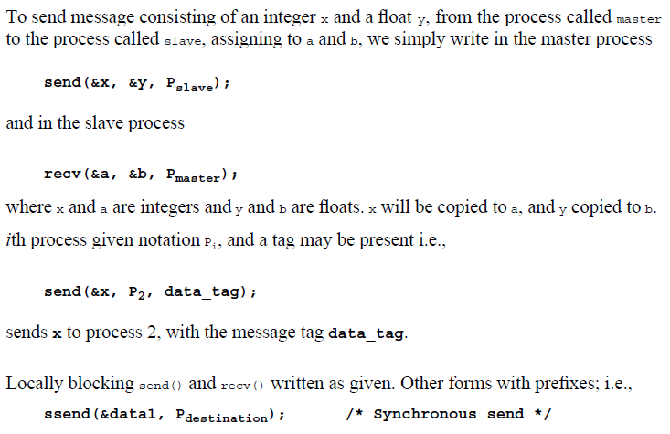
Pseudocode Constructs

Slide 45
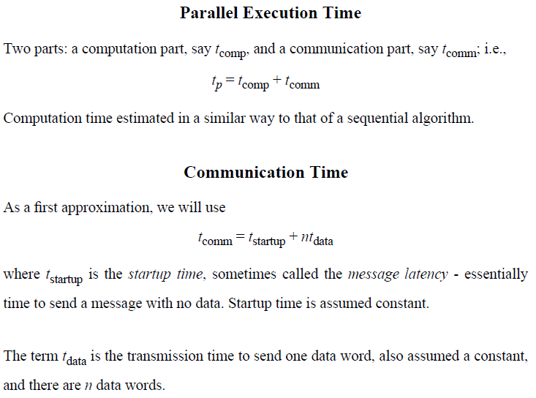
Time Complexity of MPI Program

Slide 46
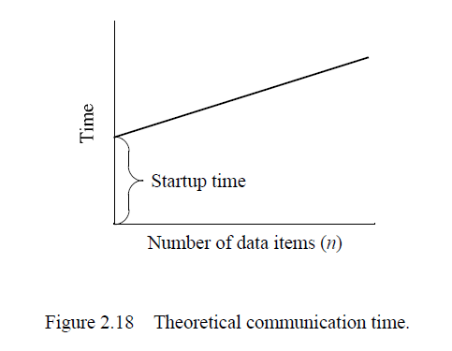
Communication Time

Slide 47
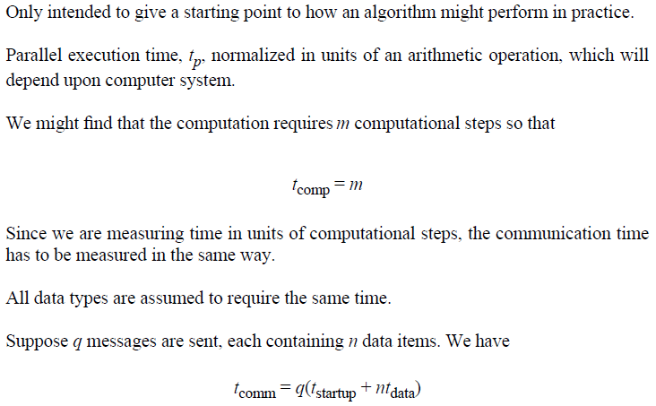
Important Note on Interpretation of Equations

Slide 48
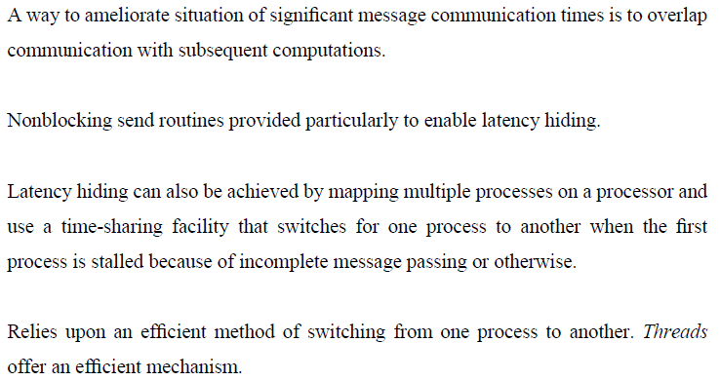
Latency Hidden

Slide 49
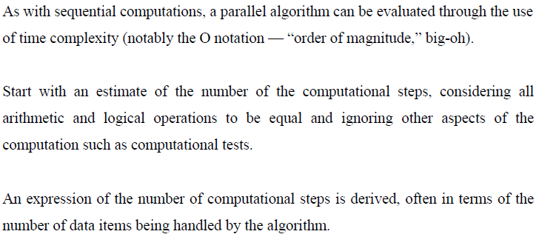
Time Complexity (1)

Slide 50
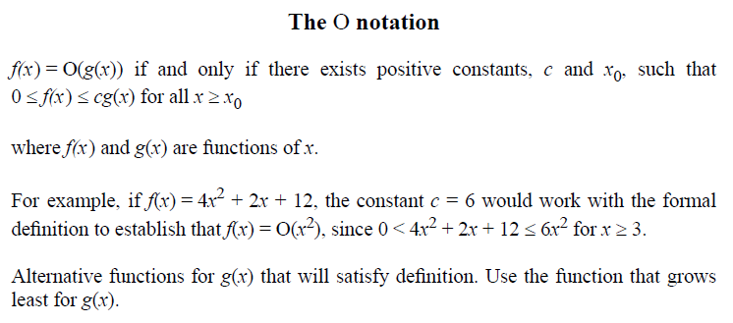
Time Complexity (2)

Slide 51
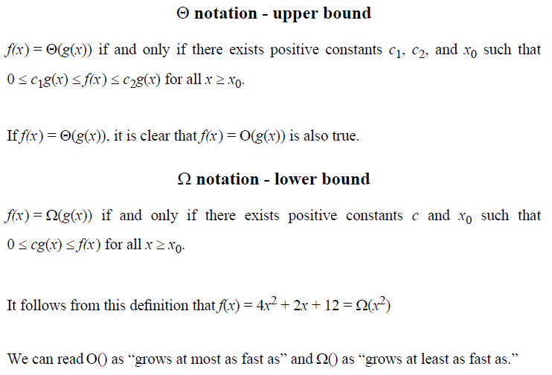
Time Complexity (3)

Slide 52
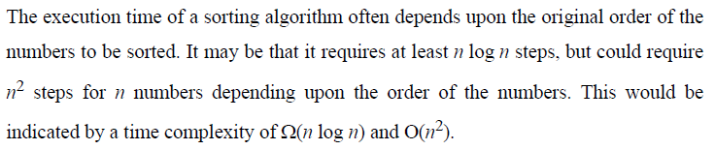
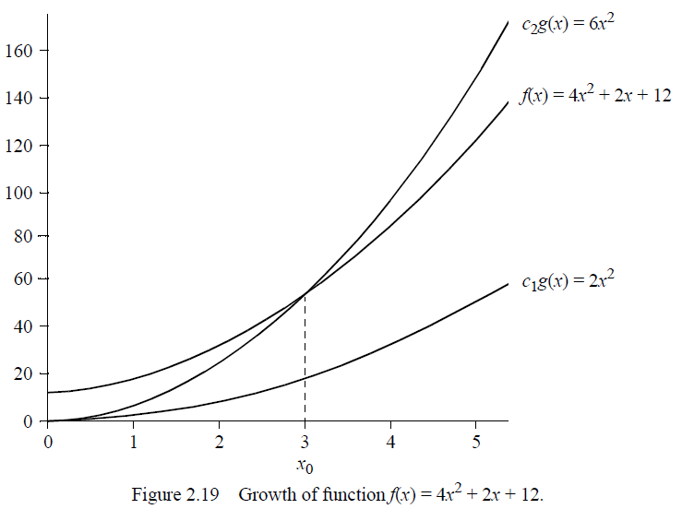
Example

Slide 53

Time Complexity of a Parallel Algorithm

Slide 54

Cost Optimal Algorithms

Slide 55

Time Complexity of Broadcast (1)

Slide 56

Time Complexity of Broadcast (2)

Slide 57

Time Complexity of Broadcast (3)

Slide 58

Time Complexity of Broadcast (4)

Slide 59

Broadcast on a Workstation Cluster

Slide 60

1-to-N Fan-Out Broadcast

Slide 61

1-to-N Fan-Out Broadcast on a Tree

Slide 62

Gather on a Hypercube Network

Slide 63

Debugging and Evaluating Parallel Programs

Slide 64

Debugging Strategies

Slide 65

Evaluating Programs Empirically

Slide 66

Communication Time by the Ping-Pong Method

Slide 67

Profiling

