Slide 1
CSC4005 – Distributed and Parallel Computing
Prof. Yeh-Ching Chung
School of Data Science
Chinese University of Hong Kong, Shenzhen

Slide 2
Outline
Introduction to Parallel Computers
Message Passing Computing and Programming
Multithreaded Programming
CUDA Programming
OpenMP Programming
Embarrassingly Parallel Computations
Partitioning and Divide-and-Conquer Strategies
Pipelined Computations
Synchronous Computations
Load Balancing and Termination Detection
Sorting Algorithms

Slide 3
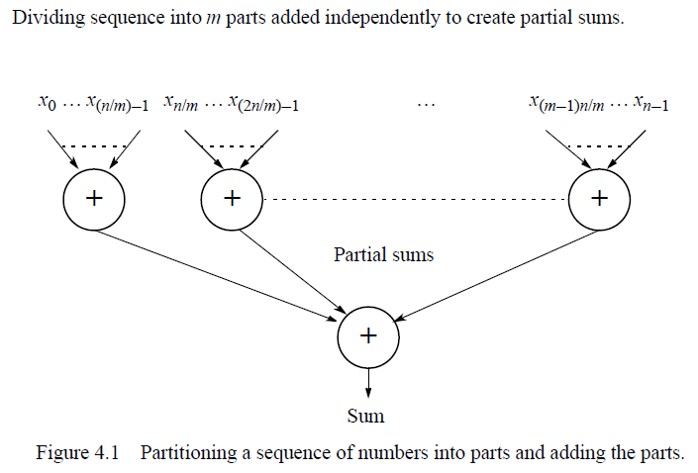
Example – Adding a Sequence of Numbers

Slide 4
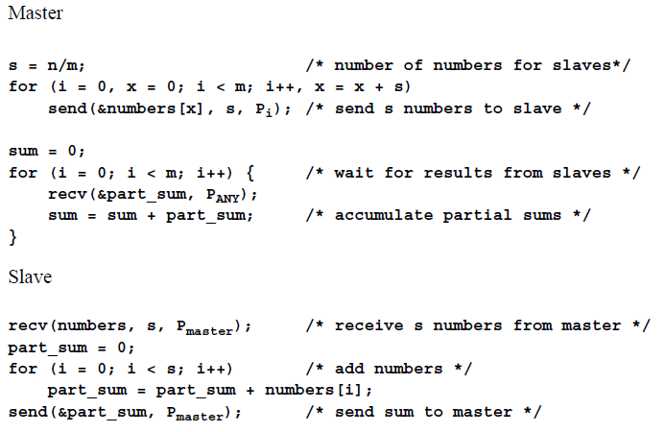
Using Separate send() and recv()

Slide 5
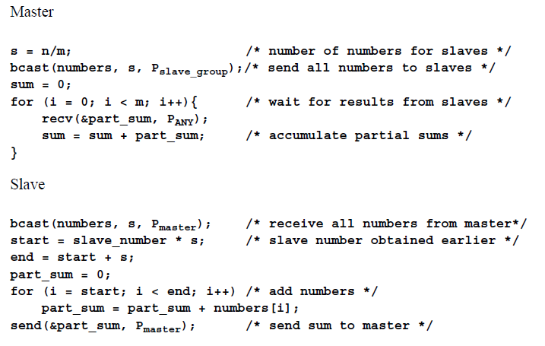
Using Broadcast/Multicast Routines

Slide 6
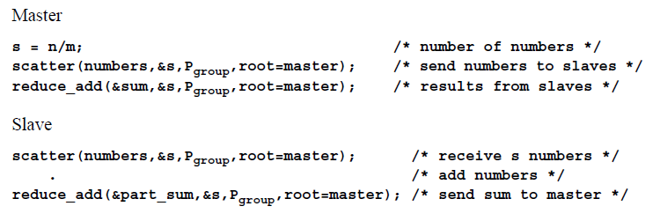
Using Scatter and Reduce Routines

Slide 7
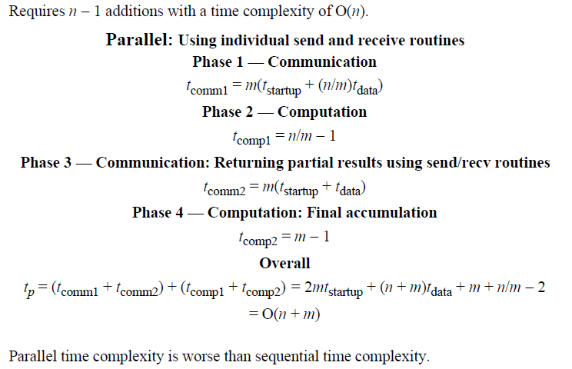
Analysis

Slide 8
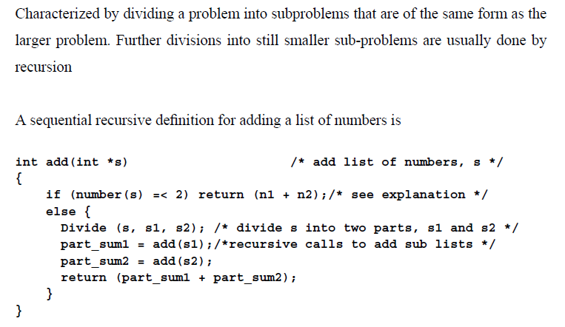
Divide and Conquer (1)

Slide 9
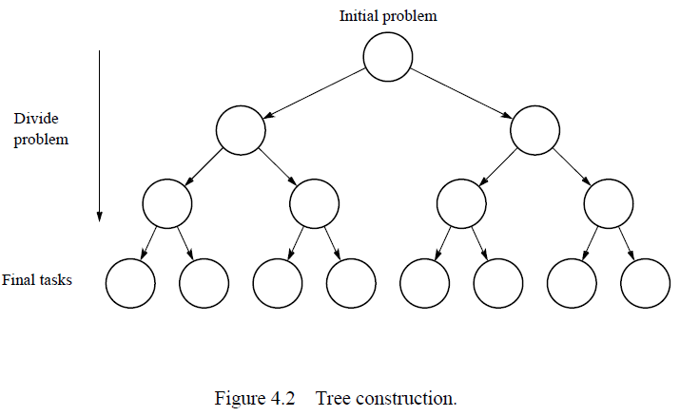
Divide and Conquer (2)

Slide 10
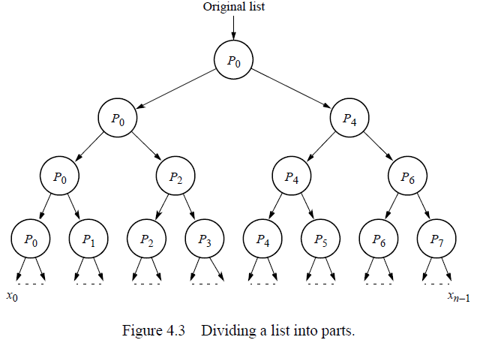
Parallel Implementation (1)

Slide 11
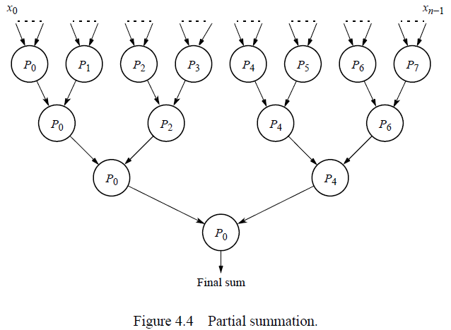
Parallel Implementation (2)

Slide 12
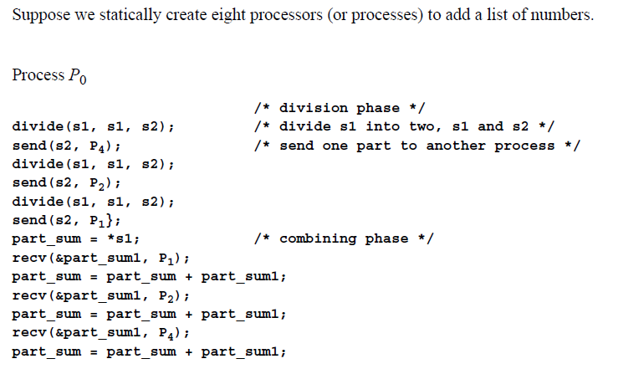
Parallel Implementation (3)

Slide 13
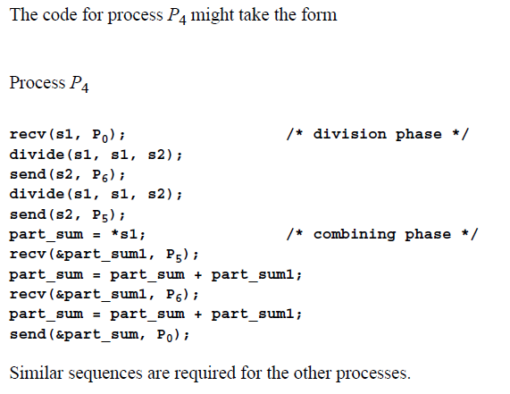
Parallel Implementation (4)

Slide 14
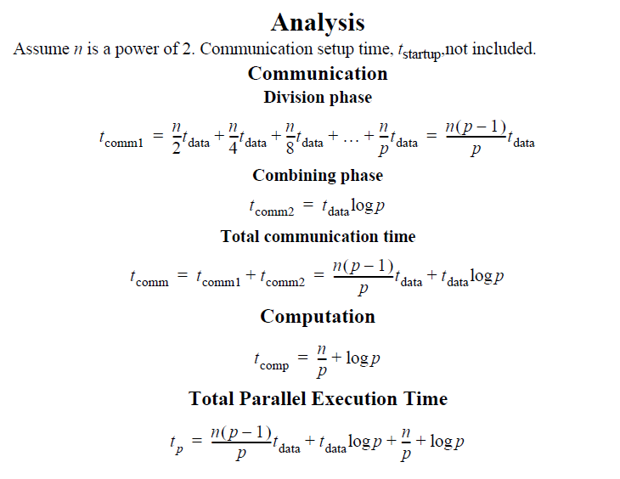
Parallel Implementation (5)

Slide 15
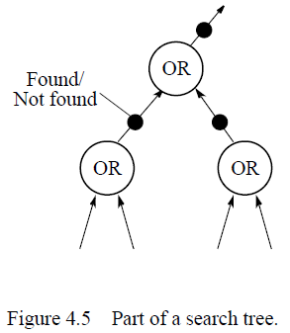
Parallel Implementation (6)

Slide 16
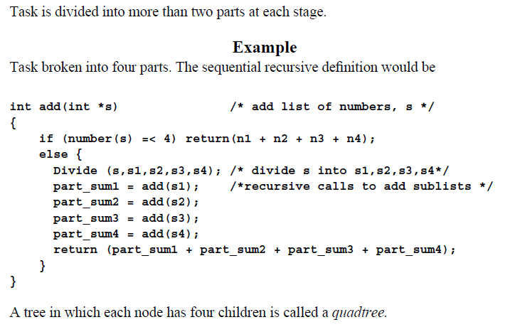
M-ary Divide and Conquer (1)

Slide 17
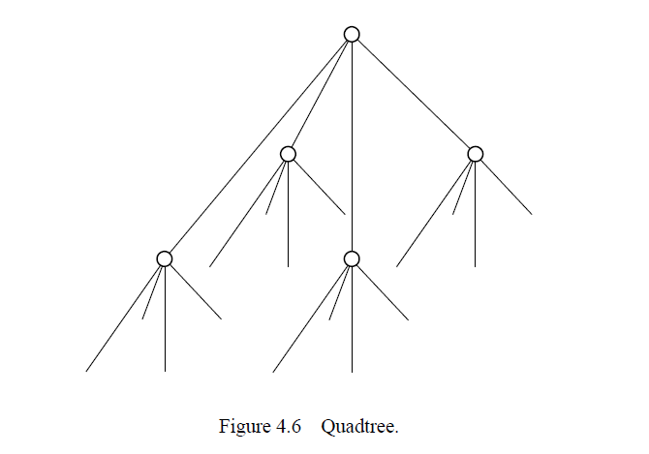
M-ary Divide and Conquer (2)

Slide 18
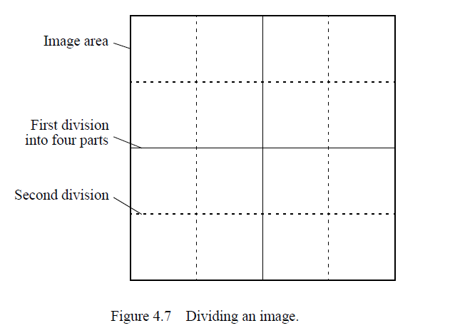
M-ary Divide and Conquer (3)

Slide 19
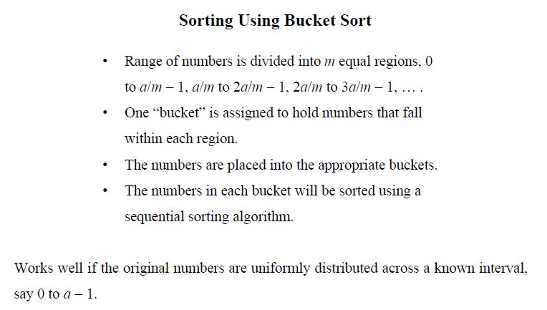
Divide and Conquer Examples (1)

Slide 20
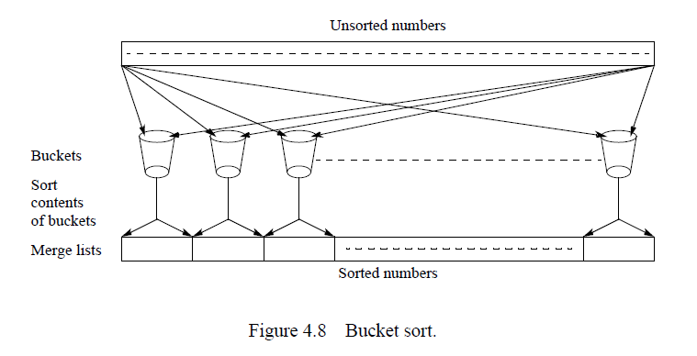
Divide and Conquer Examples (2)

Slide 21
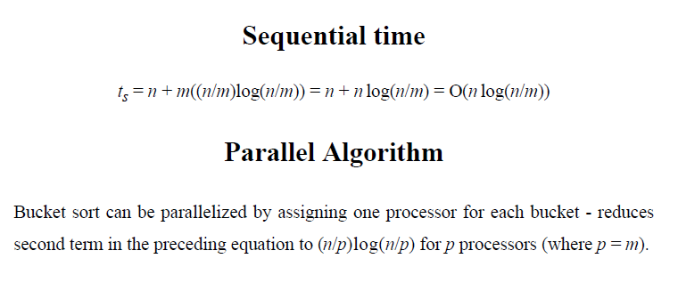
Divide and Conquer Examples (3)

Slide 22
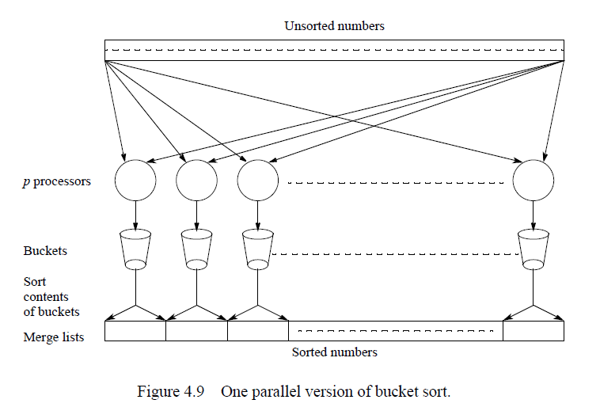
Divide and Conquer Examples (4)

Slide 23
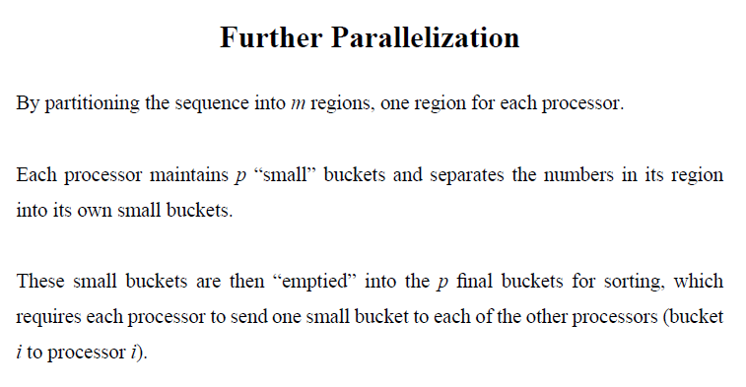
Divide and Conquer Examples (5)

Slide 24
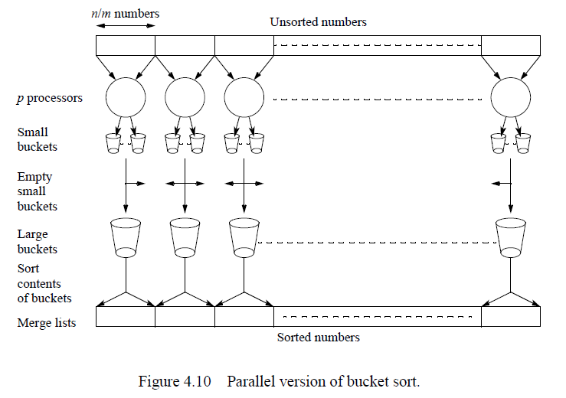
Divide and Conquer Examples (5)

Slide 25
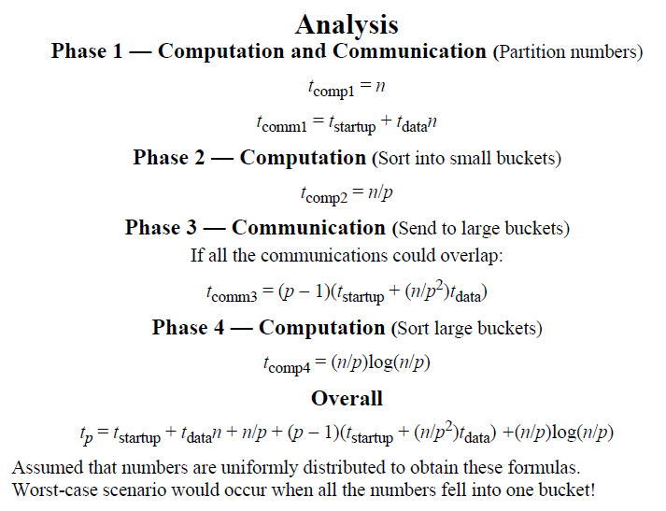
Divide and Conquer Examples (6)

Slide 26
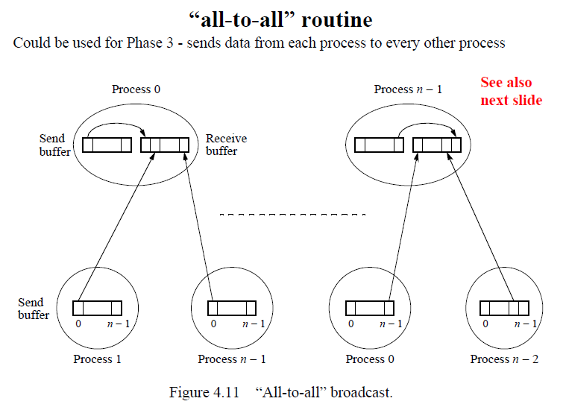
Divide and Conquer Examples (7)

Slide 27
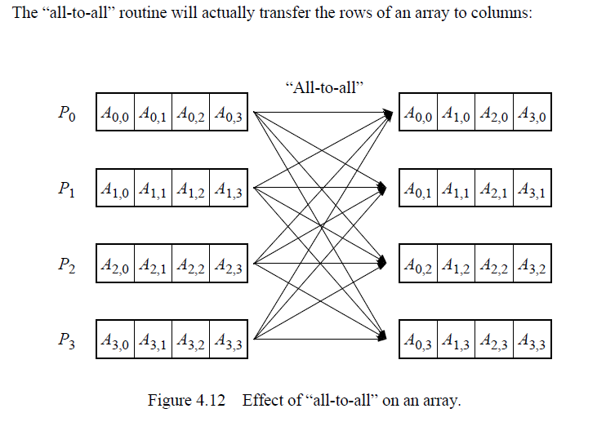
Divide and Conquer Examples (8)

Slide 28
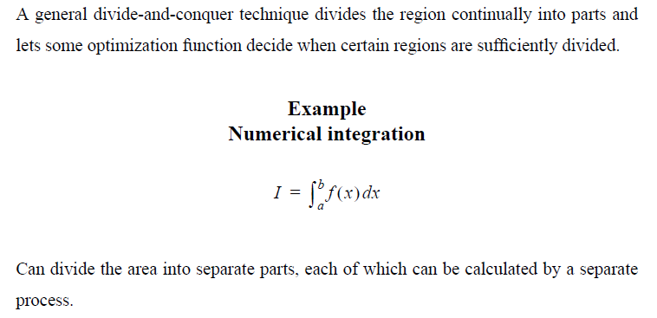
Numerical Integration (1)

Slide 29
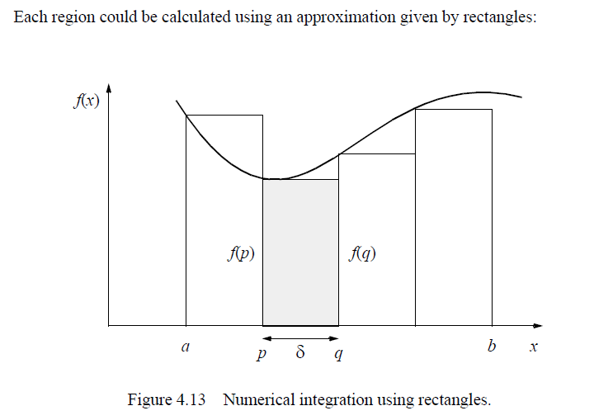
Numerical Integration (2)

Slide 30
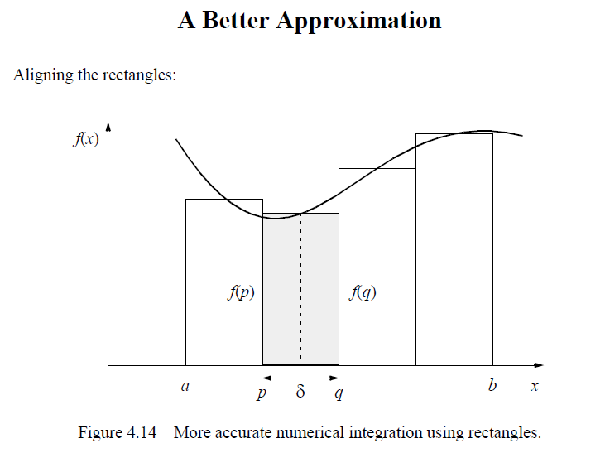
Numerical Integration (3)

Slide 31
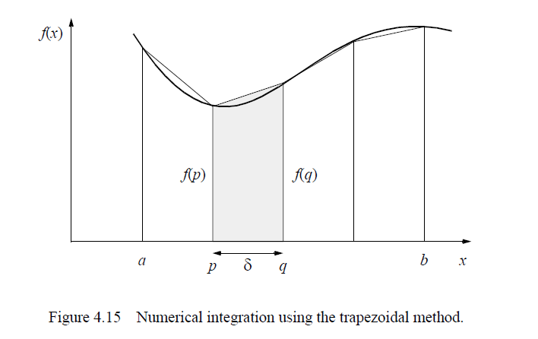
Numerical Integration (4)

Slide 32
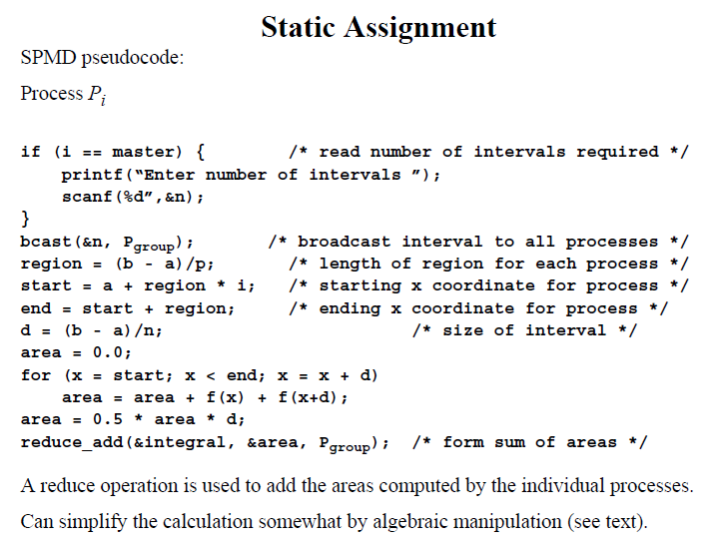
Numerical Integration (5)

Slide 33
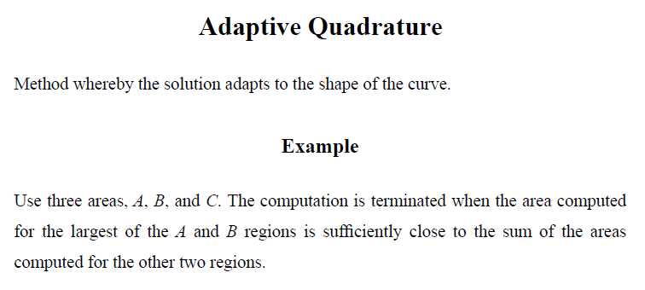
Numerical Integration (6)

Slide 34
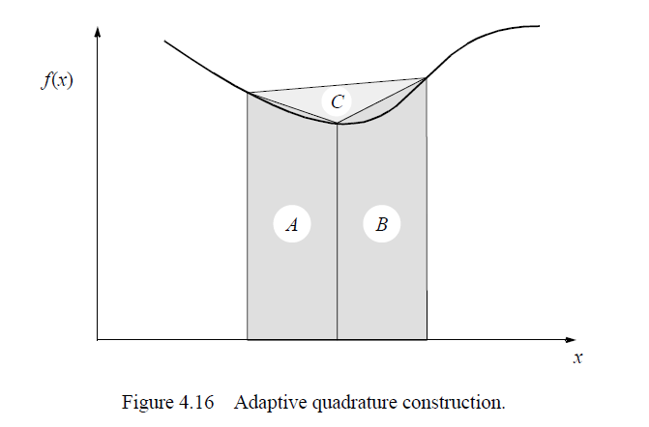
Numerical Integration (7)

Slide 35
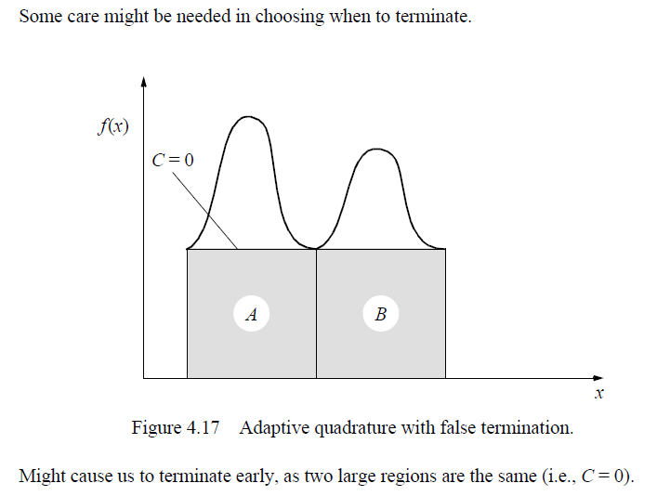
Numerical Integration (8)

Slide 36
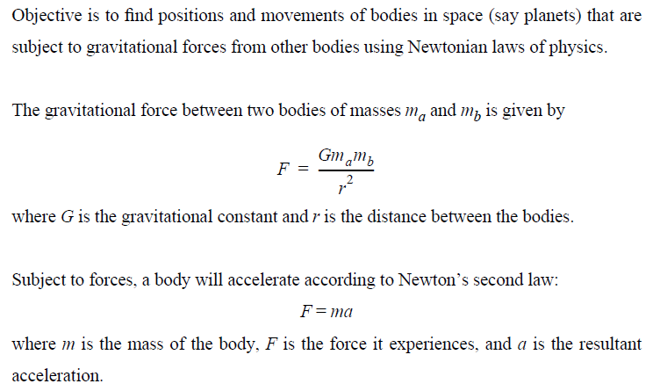
Gravitational N-Body Problem (1)

Slide 37
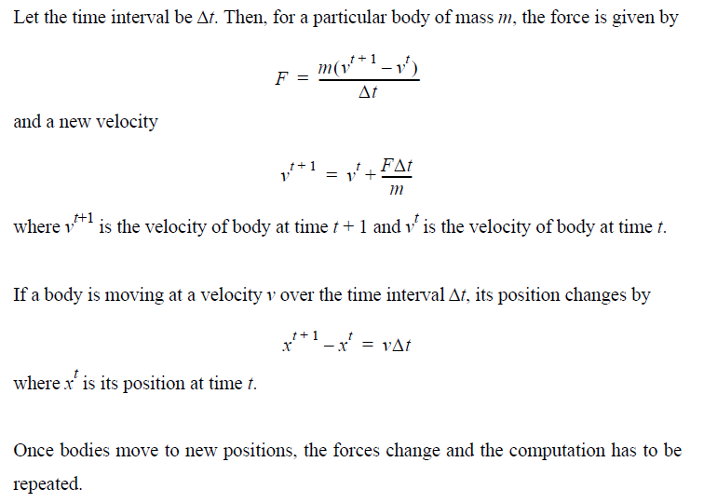
Gravitational N-Body Problem (2)

Slide 38
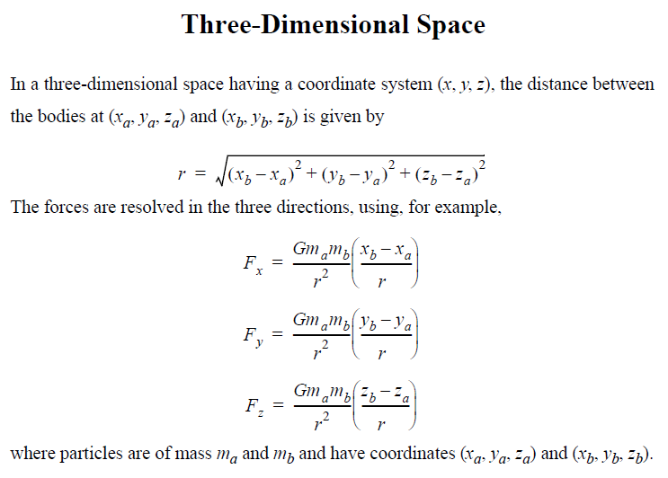
Gravitational N-Body Problem (3)

Slide 39
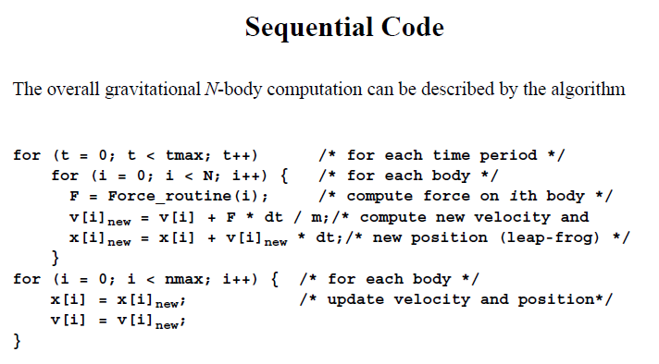
Gravitational N-Body Problem (4)

Slide 40
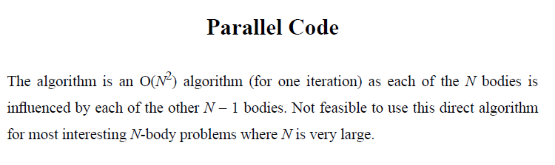
Gravitational N-Body Problem (5)

Slide 41
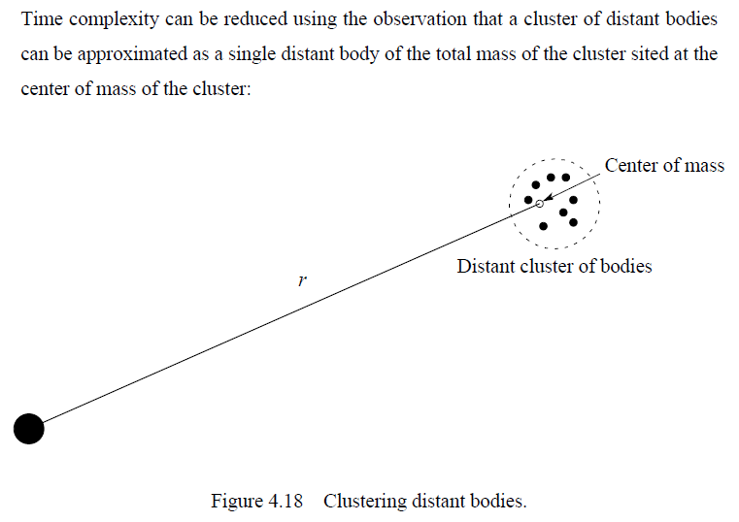
Gravitational N-Body Problem (6)

Slide 42
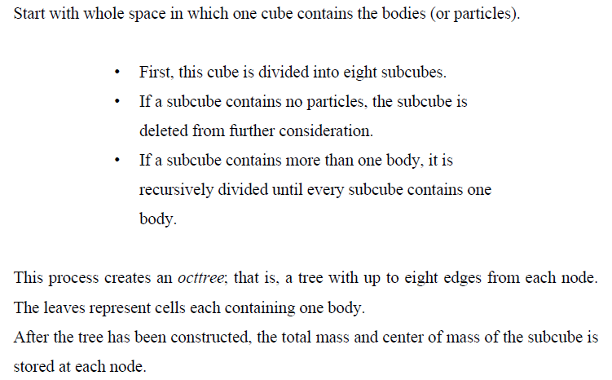
Barnes-Hut Algorithm (1)

Slide 43
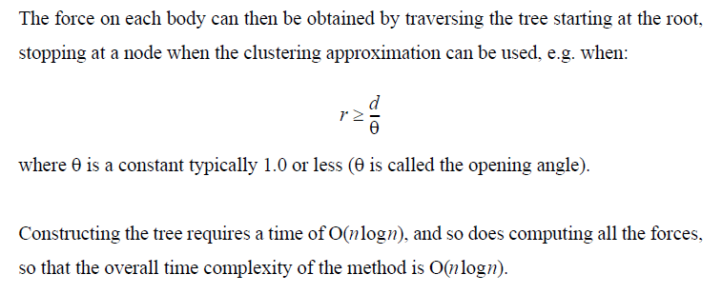
Barnes-Hut Algorithm (2)

Slide 44
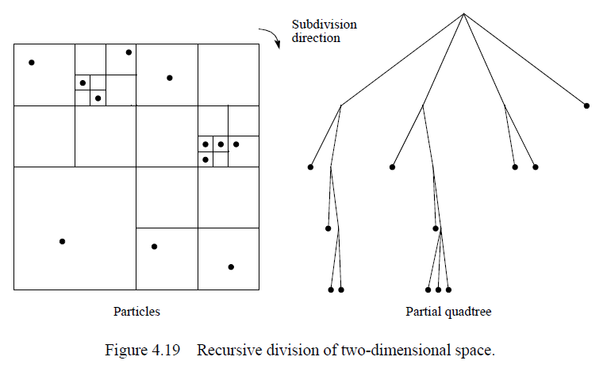
Barnes-Hut Algorithm (3)

Slide 45
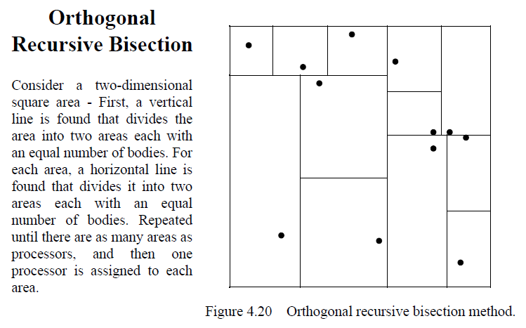
Barnes-Hut Algorithm (4)

