Slide 1
CSC4005 – Distributed and Parallel Computing
Prof. Yeh-Ching Chung
School of Data Science
Chinese University of Hong Kong, Shenzhen

Slide 2
Outline
Introduction to Parallel Computers
Message Passing Computing and Programming
Multithreaded Programming
CUDA Programming
OpenMP Programming
Embarrassingly Parallel Computations
Partitioning and Divide-and-Conquer Strategies
Pipelined Computations
Synchronous Computations
Load Balancing and Termination Detection
Sorting Algorithms

Slide 3
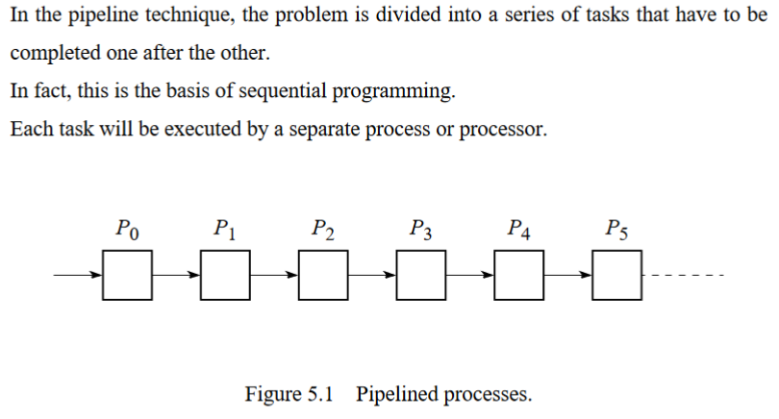
Pipeline Computations

Slide 4
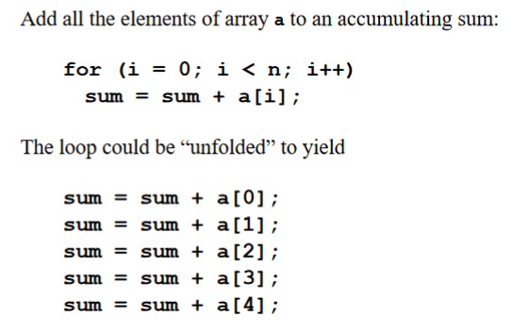
Example (1)

Slide 5
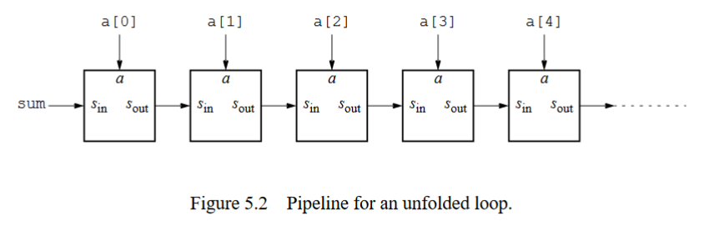
Example (2)

Slide 6
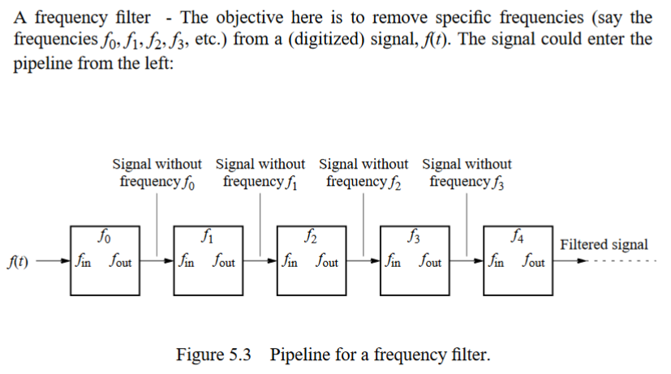
Another Example

Slide 7
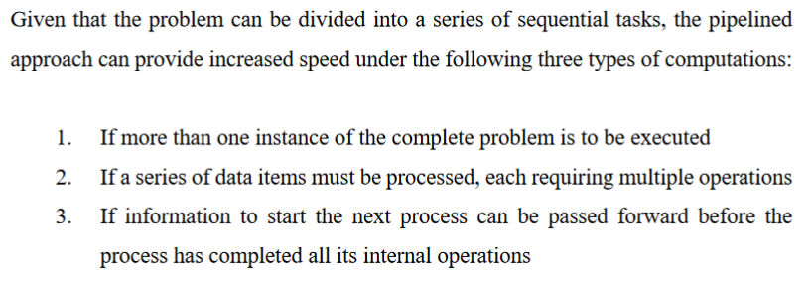
Three Types of Pipelined Computations

Slide 8
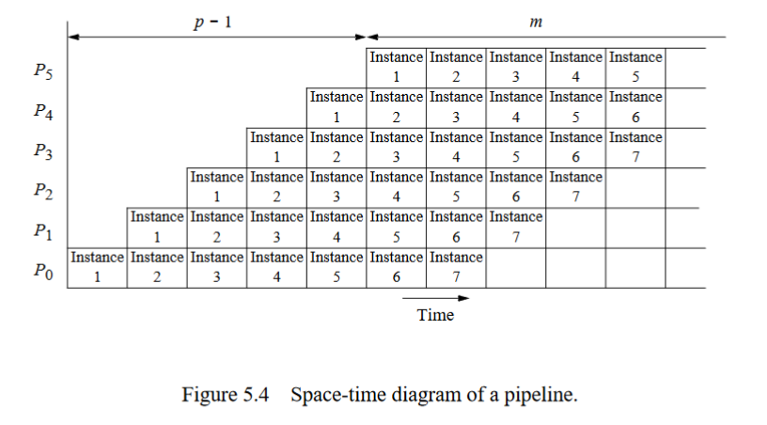
Type-1 Pipeline Space-Time Diagram (1)

Slide 9
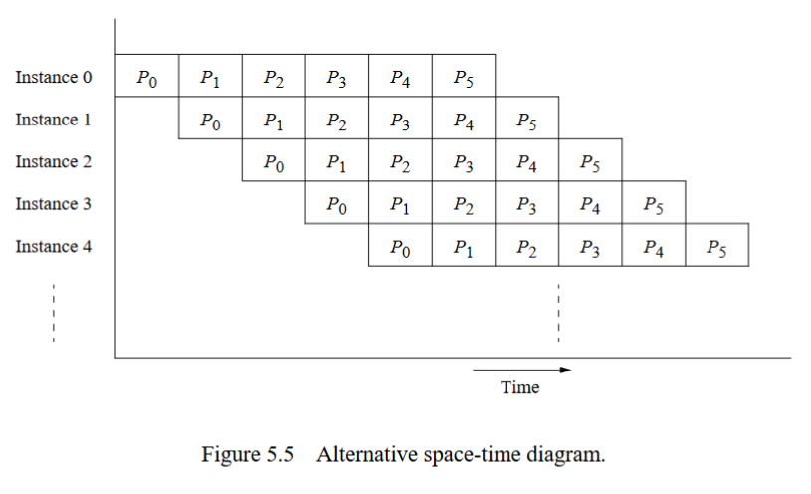
Type-1 Pipeline Space-Time Diagram (2)

Slide 10
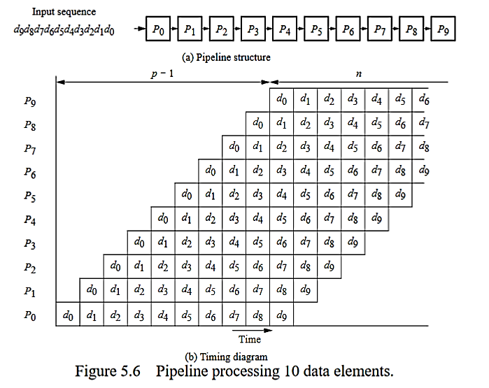
Type-2 Pipeline Space-Time Diagram

Slide 11
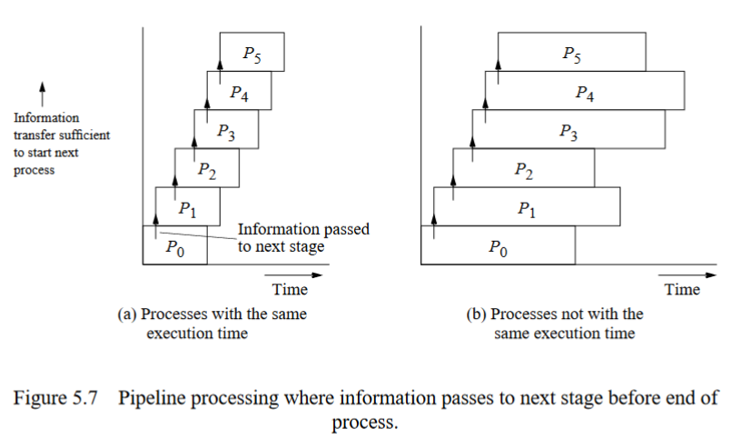
Type-3 Pipeline Space-Time Diagram

Slide 12

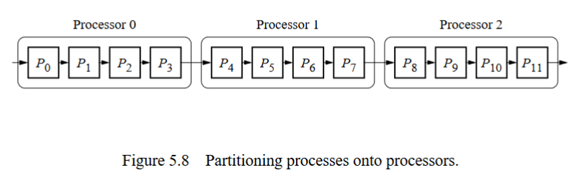
Partitioning of Pipelined Computations

Slide 13
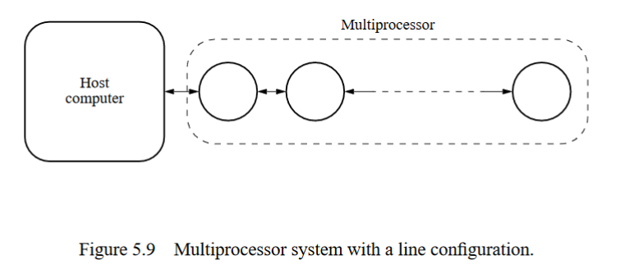
Computing Platform for Pipelined Applications

Slide 14
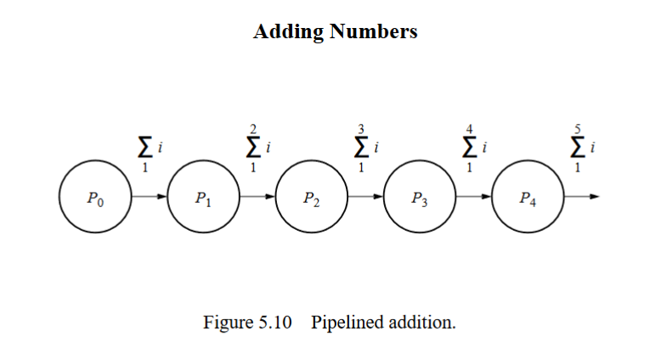
Pipeline Program Examples (1)

Slide 15
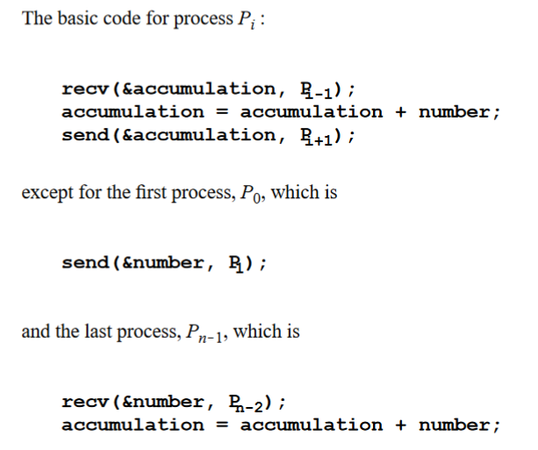
Pipeline Program Examples (2)

Slide 16
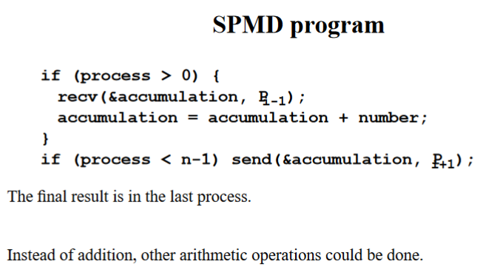
Pipeline Program Examples (3)

Slide 17
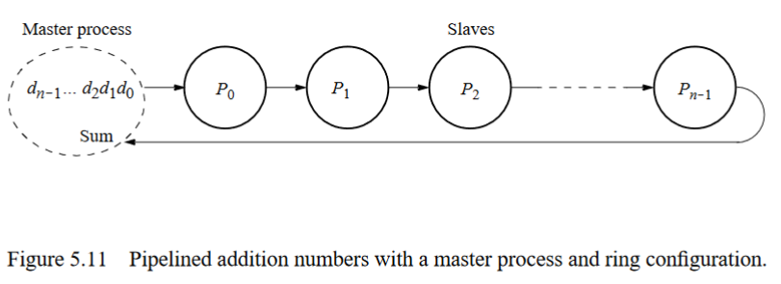
Pipeline Program Examples (4)

Slide 18
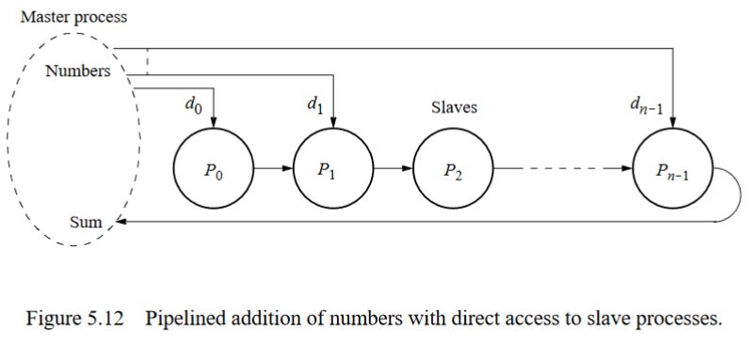
Pipeline Program Examples (5)

Slide 19
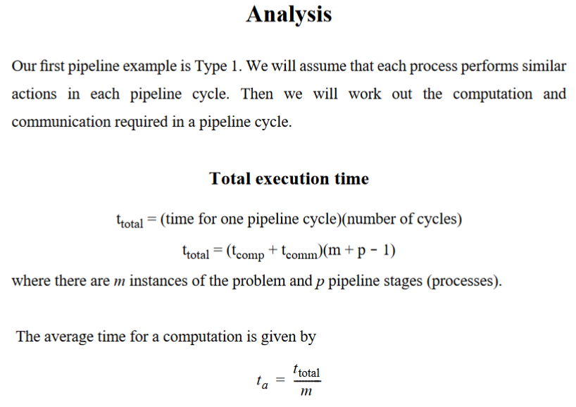
Pipeline Program Examples (6)

Slide 20
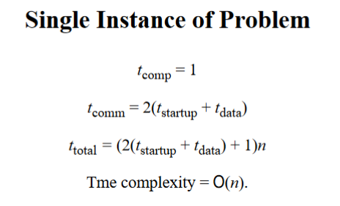
Pipeline Program Examples (7)

Slide 21
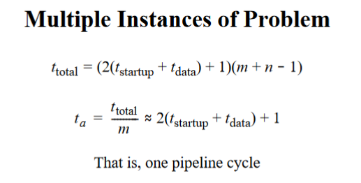
Pipeline Program Examples (8)

Slide 22
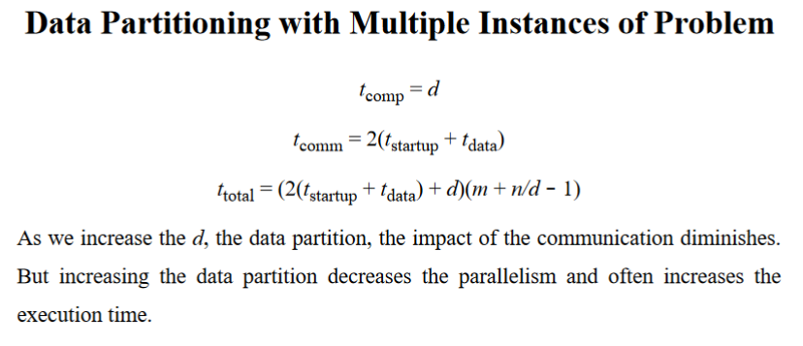
Pipeline Program Examples (9)

Slide 23
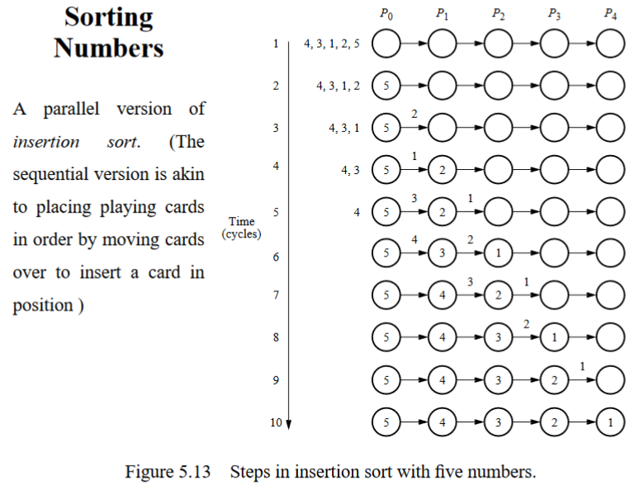
Sorting Numbers (1)

Slide 24
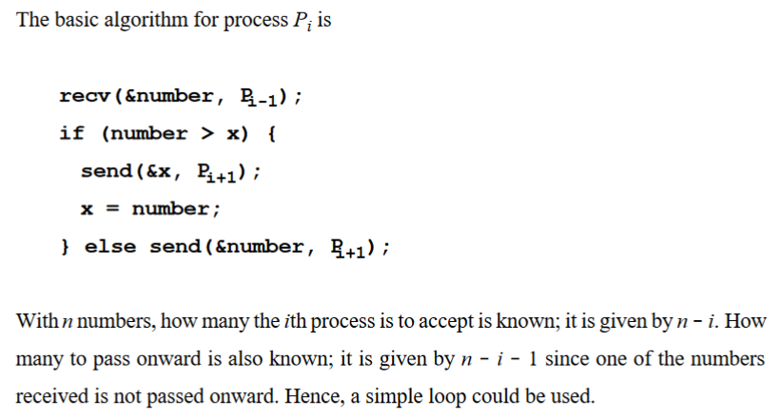
Sorting Numbers (2)

Slide 25
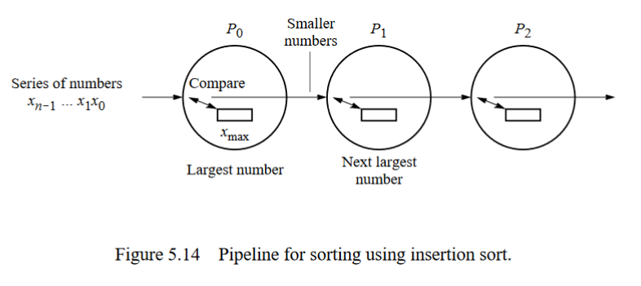
Sorting Numbers (3)

Slide 26
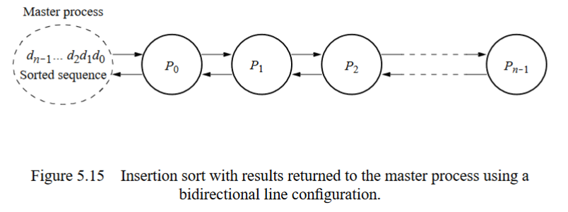
Sorting Numbers (4)

Slide 27
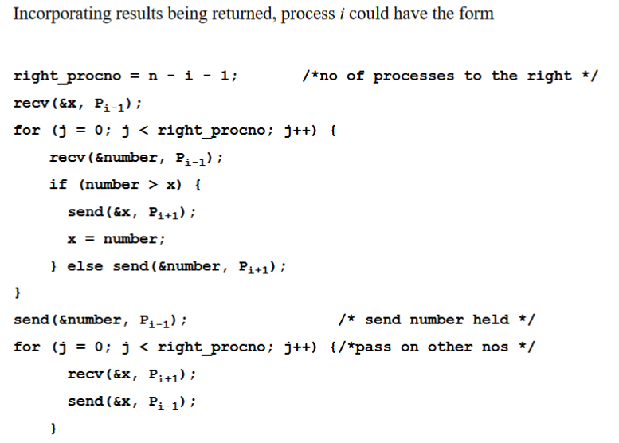
Sorting Numbers (5)

Slide 28
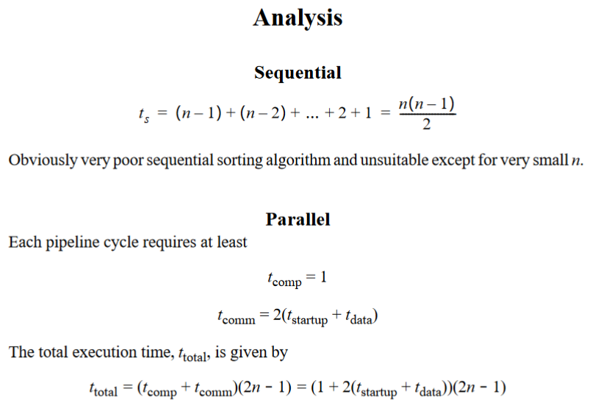
Sorting Numbers (6)

Slide 29
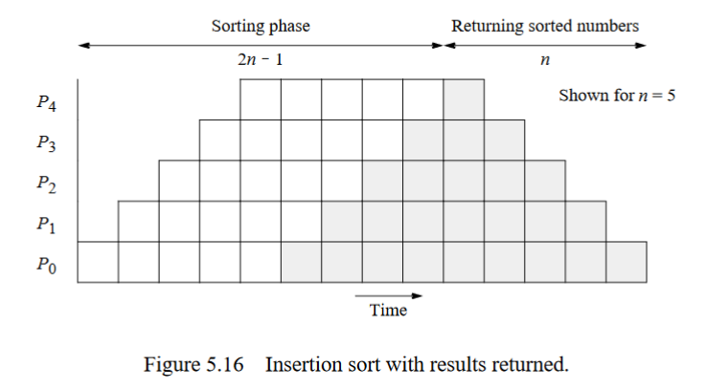
Sorting Numbers (7)

Slide 30
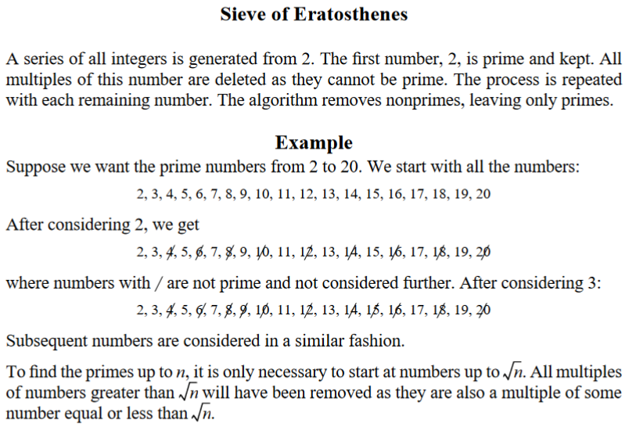
Prime Number Generation (1)

Slide 31
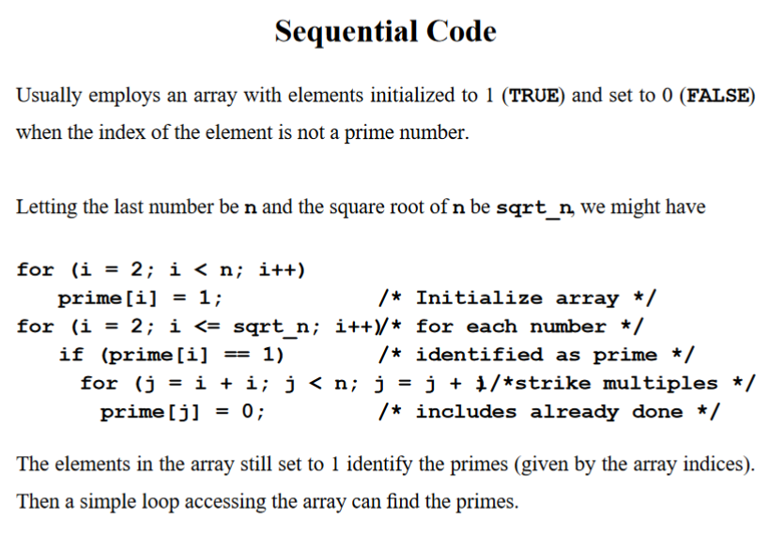
Prime Number Generation (2)

Slide 32
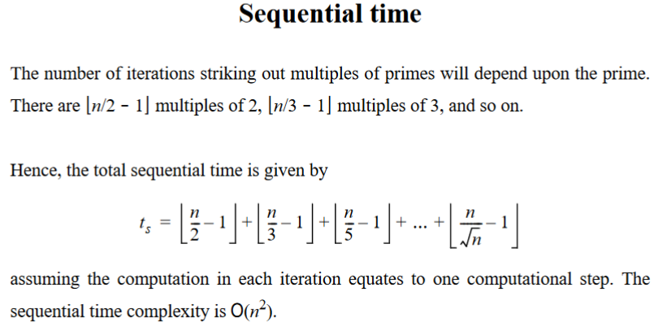
Prime Number Generation (3)

Slide 33
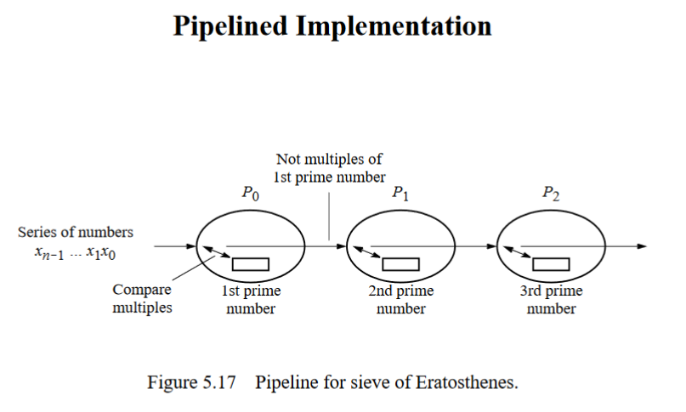
Prime Number Generation (4)

Slide 34
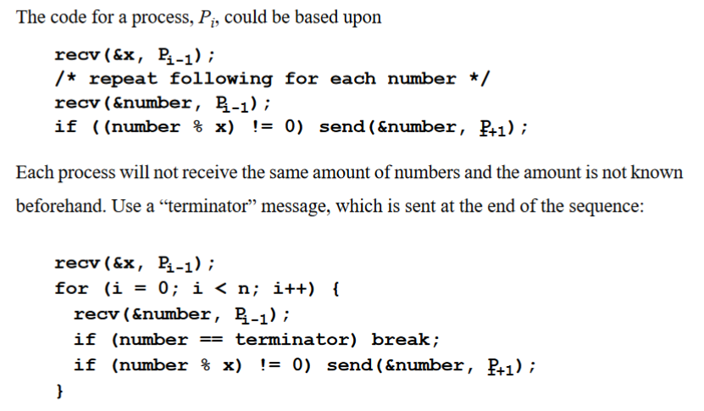
Prime Number Generation (5)

Slide 35
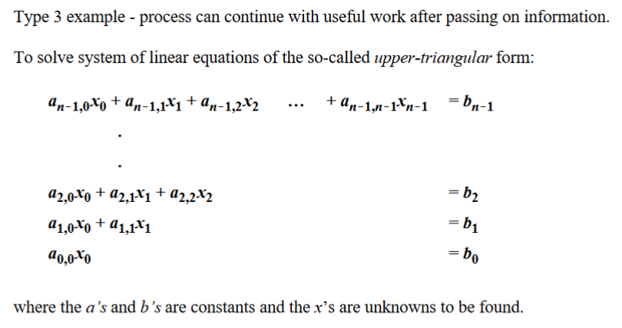
Solving a System of Linear Equations – Special Case (1)

Slide 36
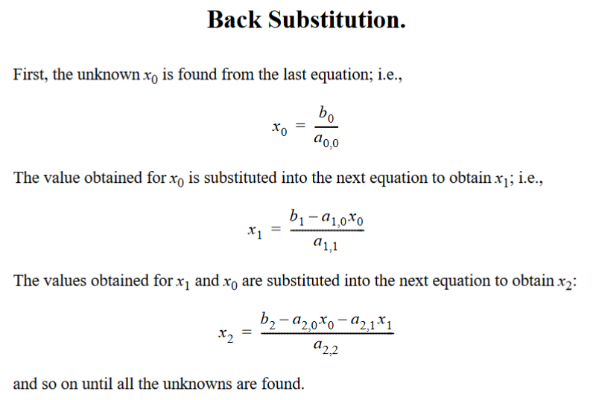
Solving a System of Linear Equations – Special Case (2)

Slide 37
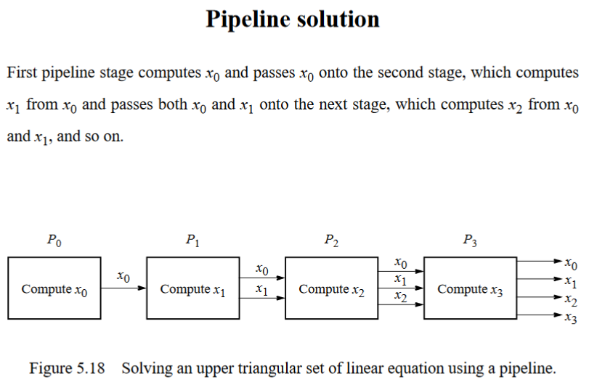
Solving a System of Linear Equations – Special Case (3)

Slide 38
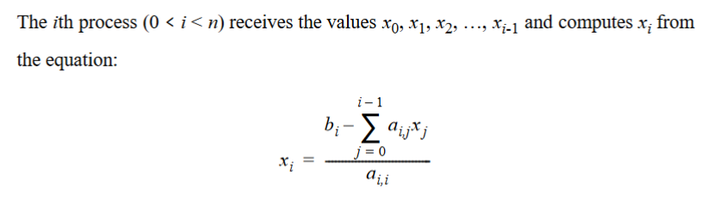
Solving a System of Linear Equations – Special Case (4)

Slide 39
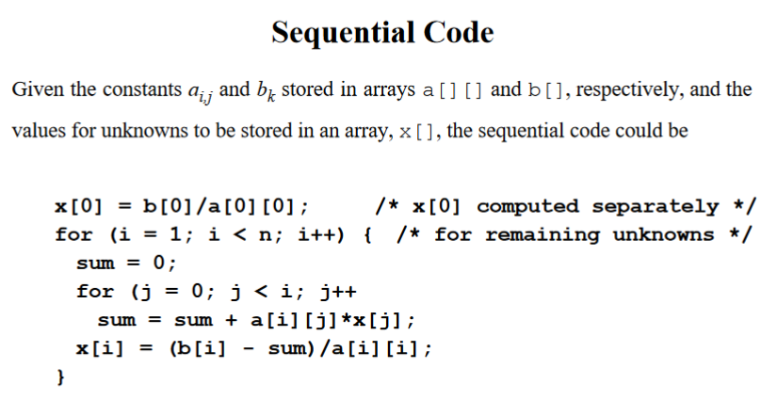
Solving a System of Linear Equations – Special Case (5)

Slide 40
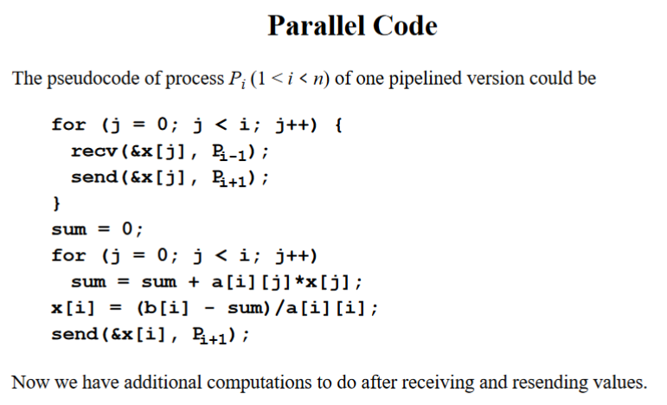
Solving a System of Linear Equations – Special Case (6)

Slide 41
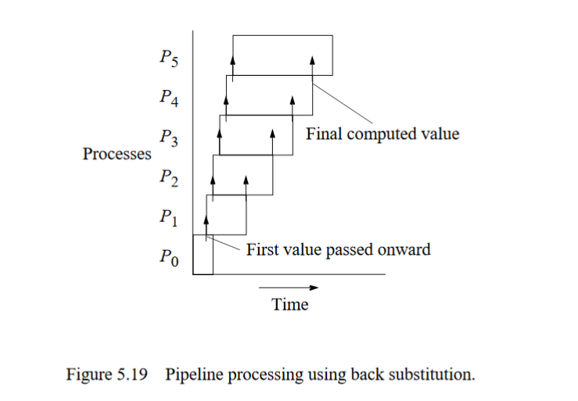
Solving a System of Linear Equations – Special Case (7)

Slide 42
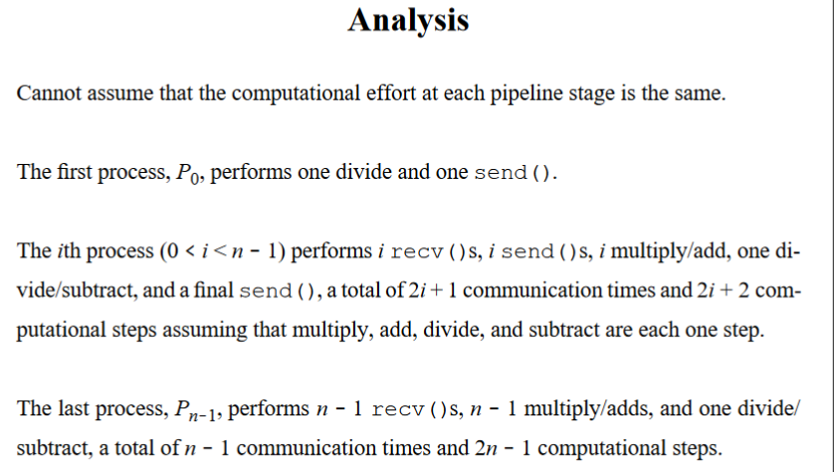
Solving a System of Linear Equations – Special Case (8)

