Slide 1
CSC4005 – Distributed and Parallel Computing
Prof. Yeh-Ching Chung
School of Data Science
Chinese University of Hong Kong, Shenzhen

Slide 2
Outline
Introduction to Parallel Computers
Message Passing Computing and Programming
Multithreaded Programming
CUDA Programming
OpenMP Programming
Embarrassingly Parallel Computations
Partitioning and Divide-and-Conquer Strategies
Pipelined Computations
Synchronous Computations
Load Balancing and Termination Detection
Sorting Algorithms

Slide 3
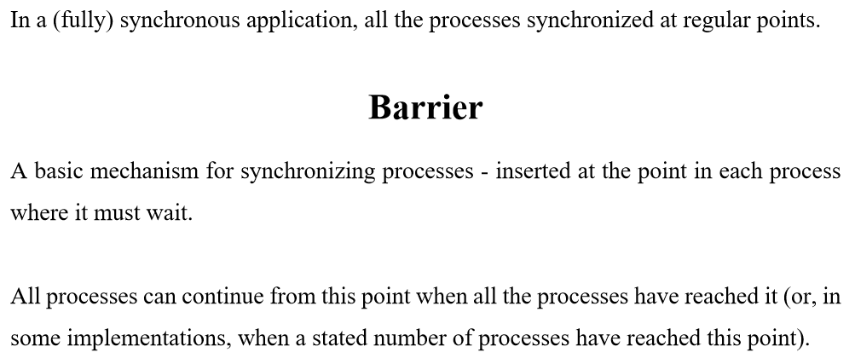
Synchronous Computations (1)

Slide 4
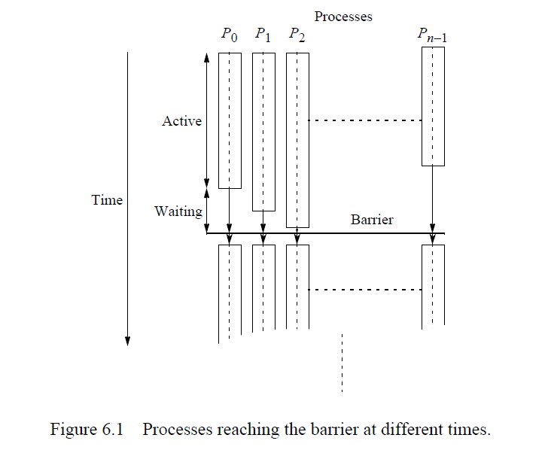
Synchronous Computations (2)

Slide 5
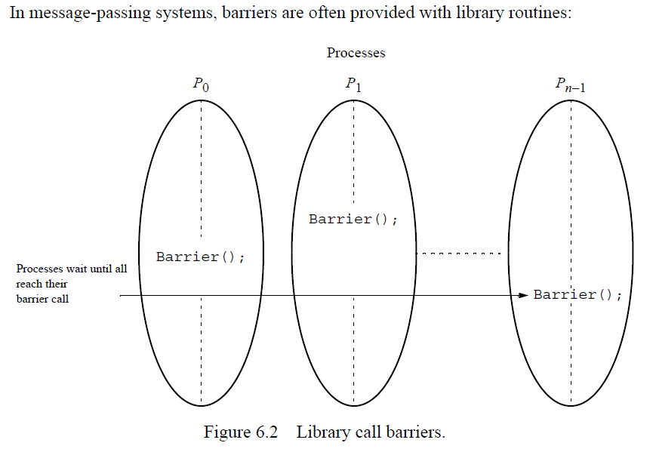
Synchronous Computations (3)

Slide 6
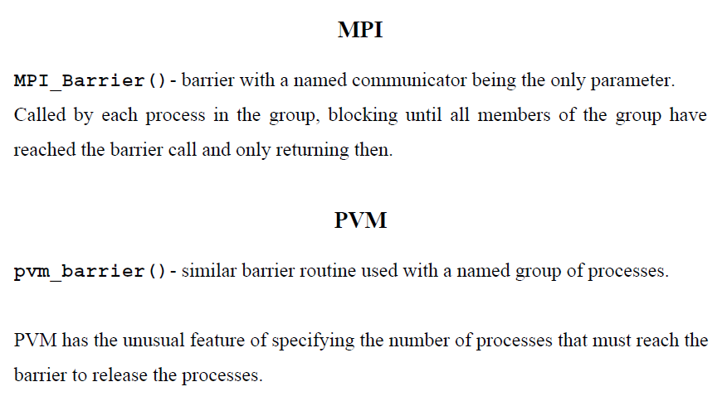
Synchronous Computations (4)

Slide 7
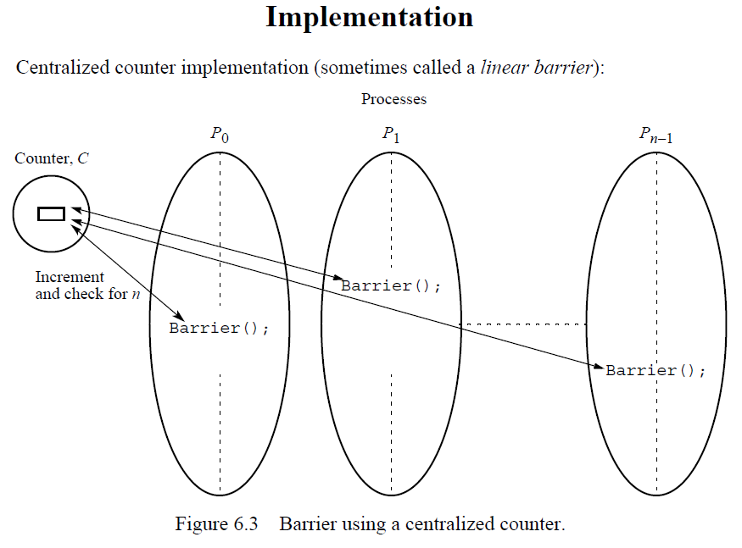
Synchronous Computations (5)

Slide 8
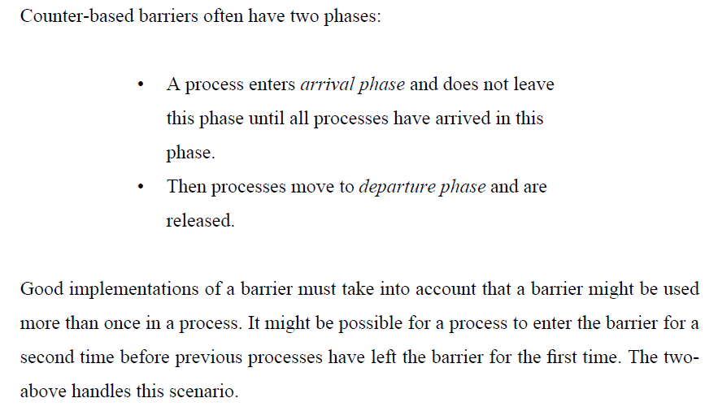
Synchronous Computations (6)

Slide 9
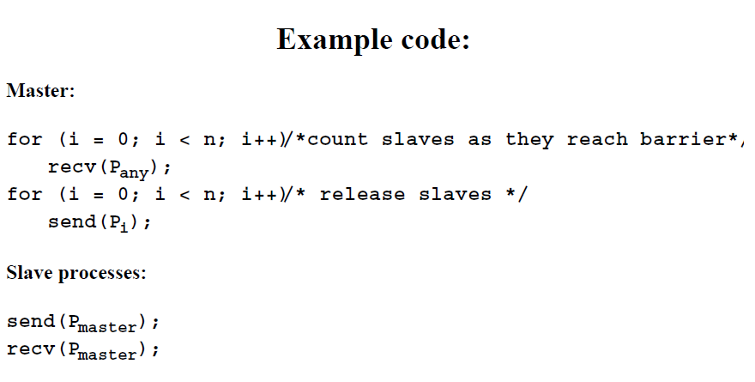
Synchronous Computations (7)

Slide 10
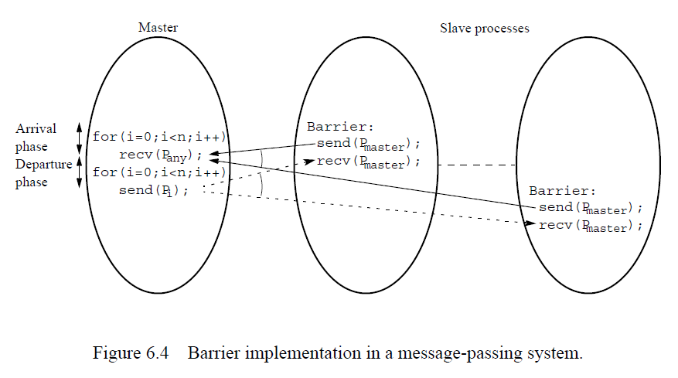
Synchronous Computations (8)

Slide 11
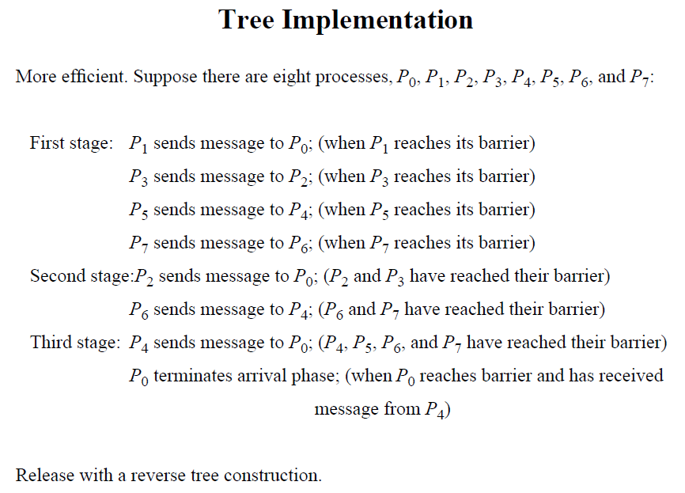
Synchronous Computations (9)

Slide 12
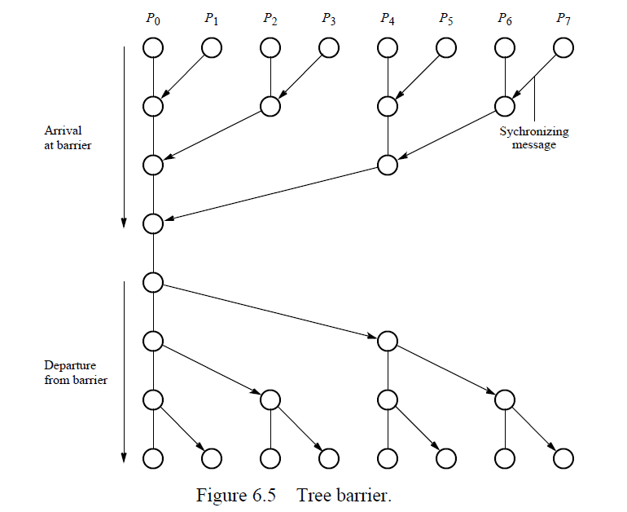
Synchronous Computations (10)

Slide 13
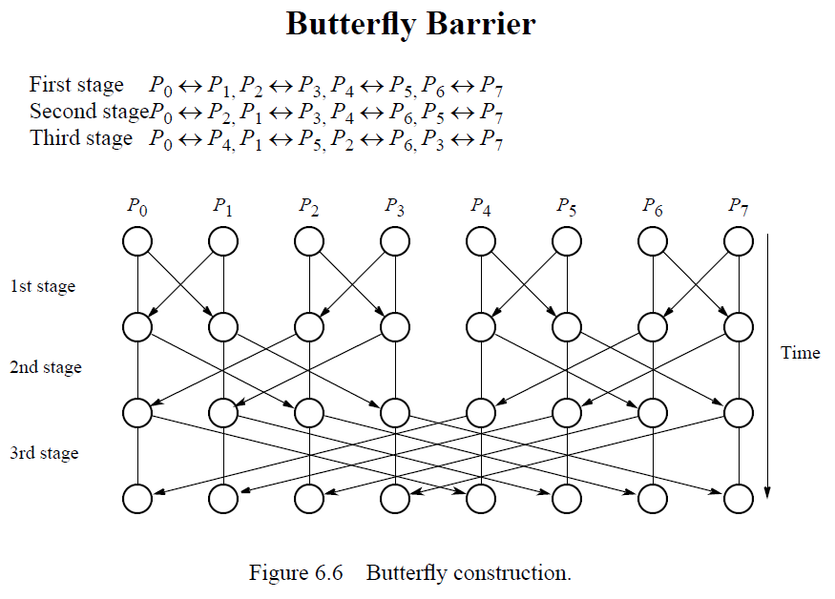
Synchronous Computations (11)

Slide 14
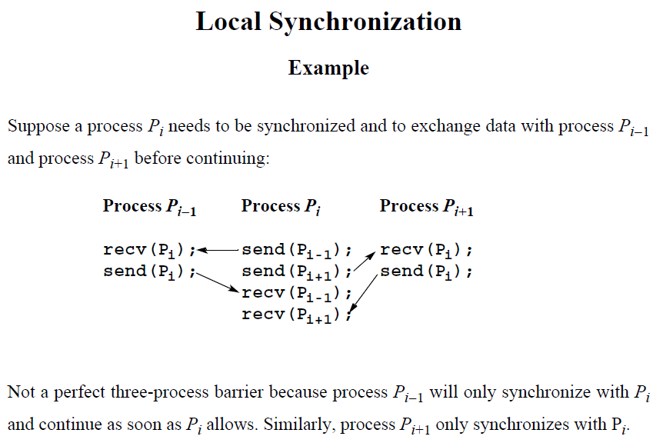
Synchronous Computations (12)

Slide 15
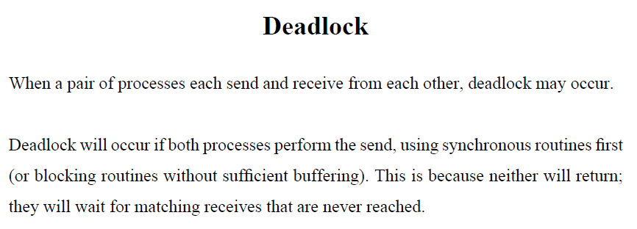
Synchronous Computations (13)

Slide 16
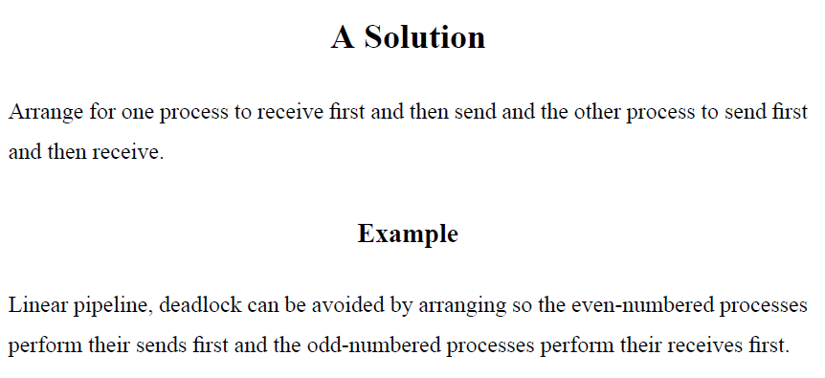
Synchronous Computations (14)

Slide 17
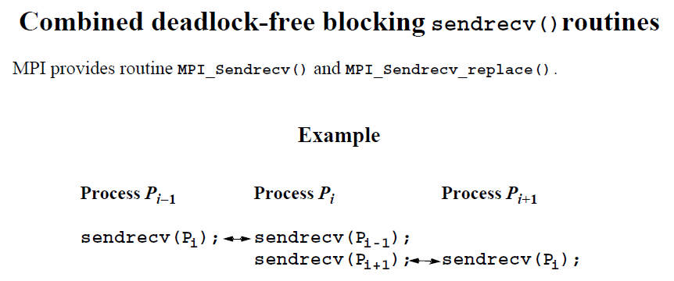
Synchronous Computations (15)

Slide 18
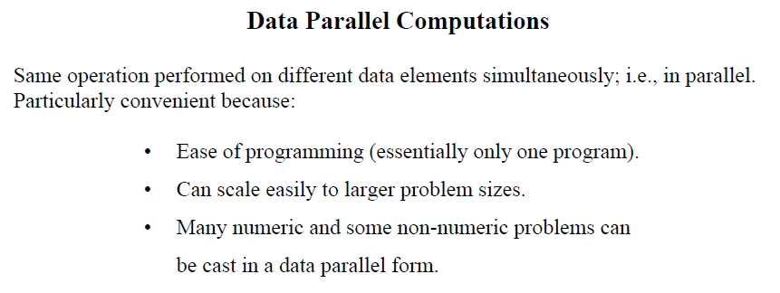
Synchronous Computations (16)

Slide 19
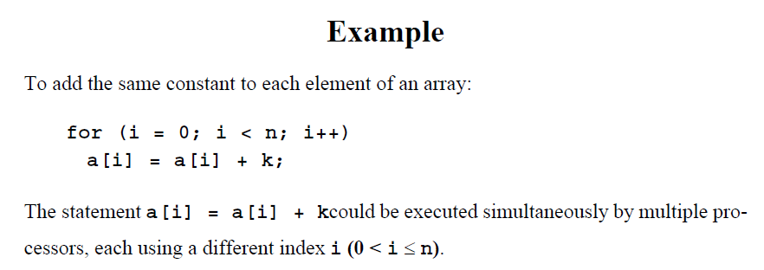
Synchronous Computations (17)

Slide 20
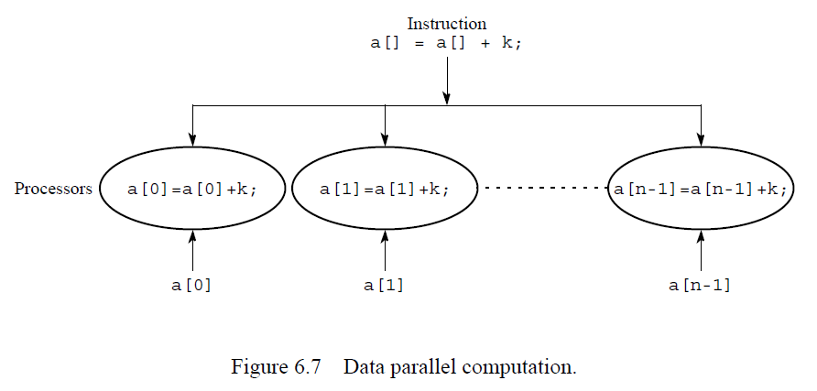
Synchronous Computations (18)

Slide 21
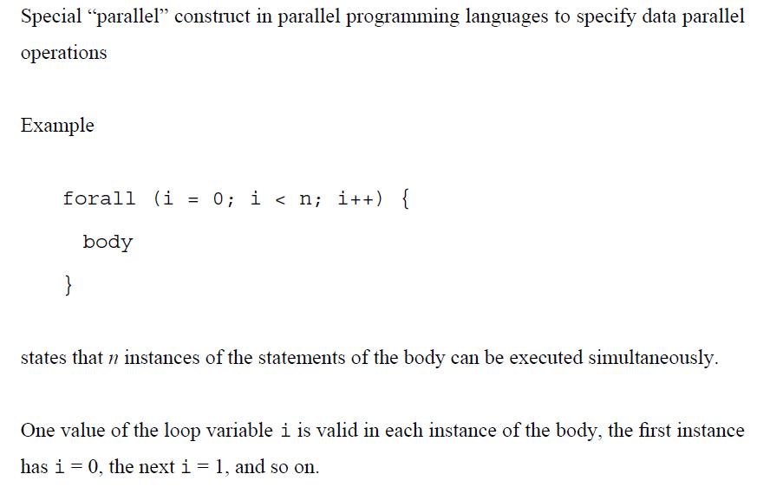
Forall Construction (1)

Slide 22
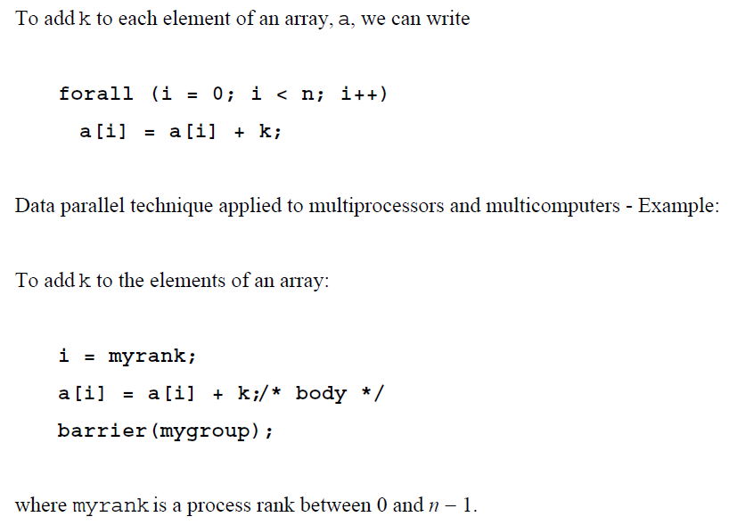
Forall Construction (2)

Slide 23
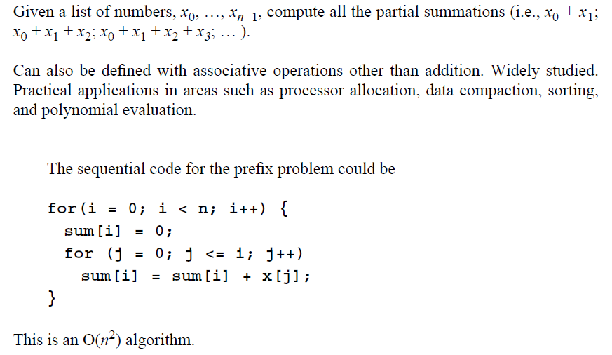
Prefix Sum Problem (1)

Slide 24
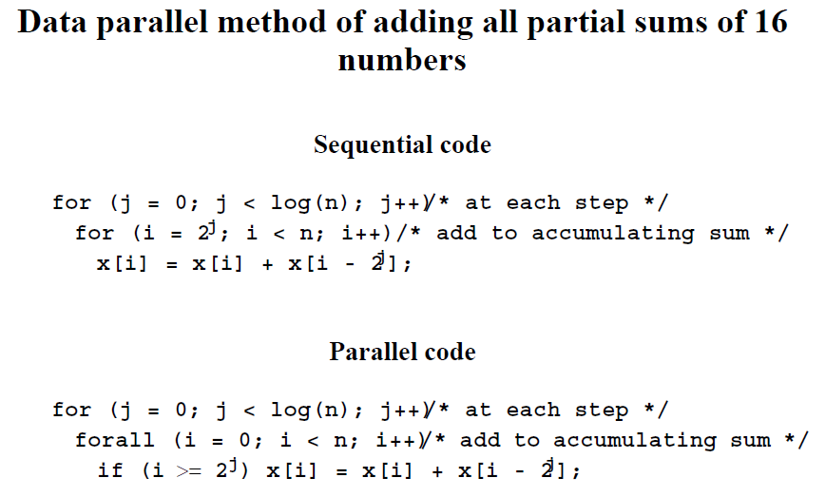
Prefix Sum Problem (2)

Slide 25
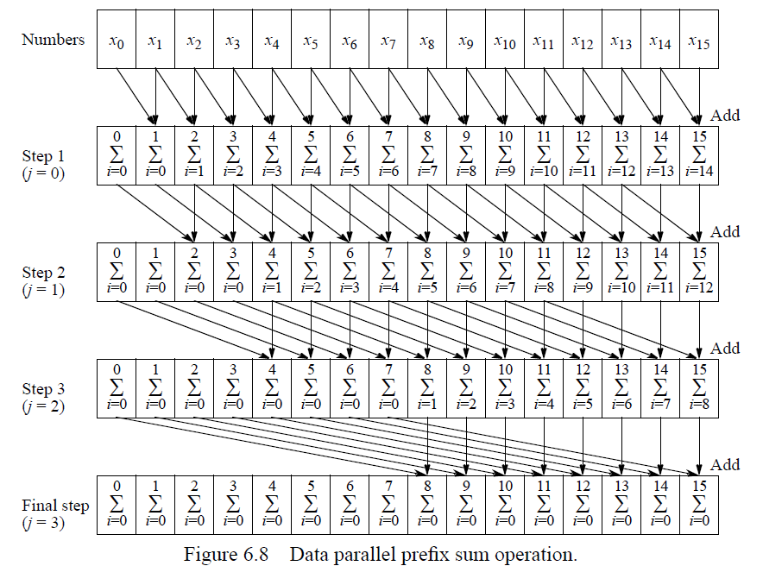
Prefix Sum Problem (3)

Slide 26
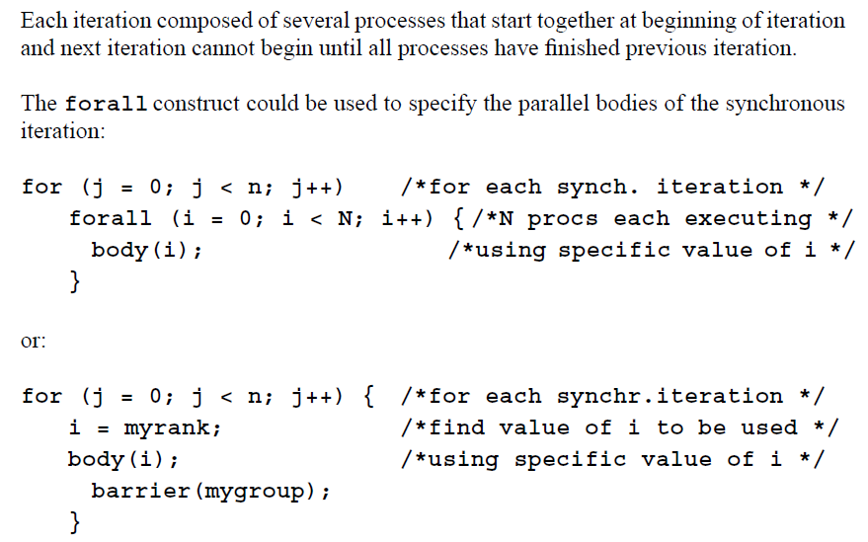
Synchronous Iteration (Synchronous Parallelism)

Slide 27
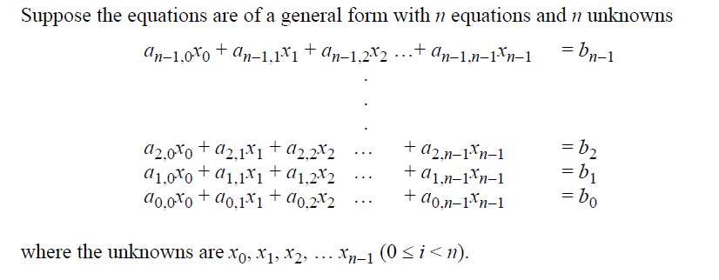
Solving a System of Linear Equations by Iteration (1)

Slide 28
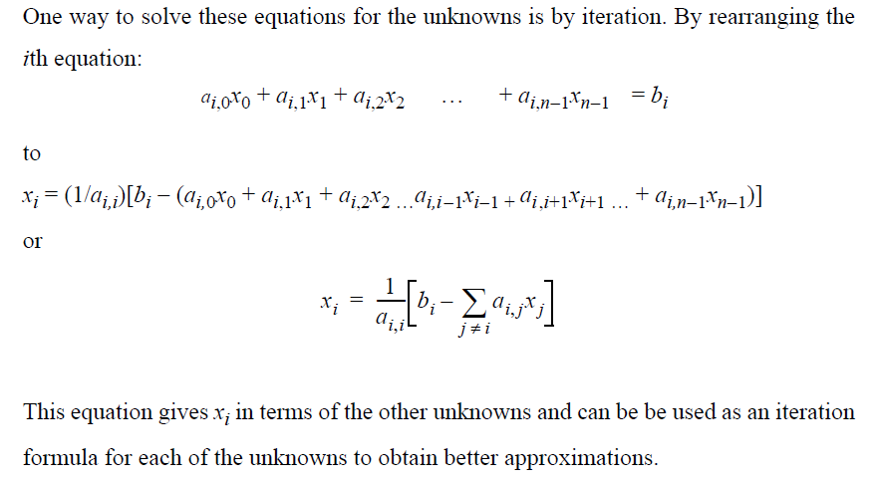
Solving a System of Linear Equations by Iteration (2)

Slide 29
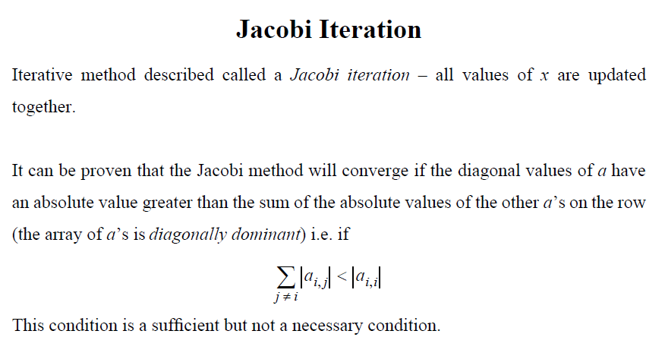
Solving a System of Linear Equations by Iteration (3)

Slide 30
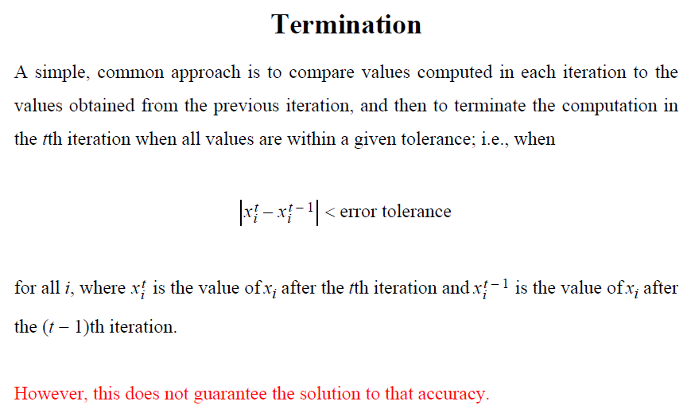
Solving a System of Linear Equations by Iteration (4)

Slide 31
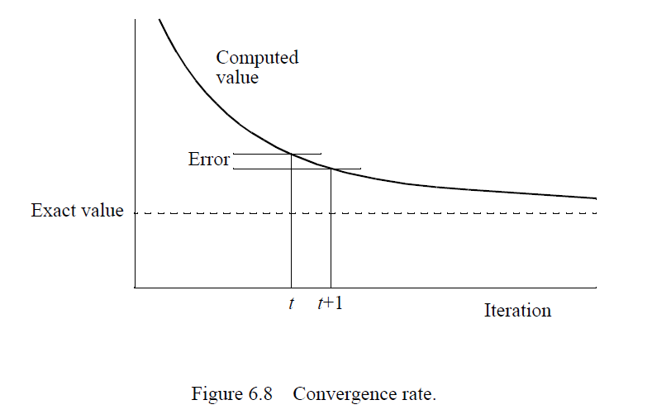
Solving a System of Linear Equations by Iteration (5)

Slide 32
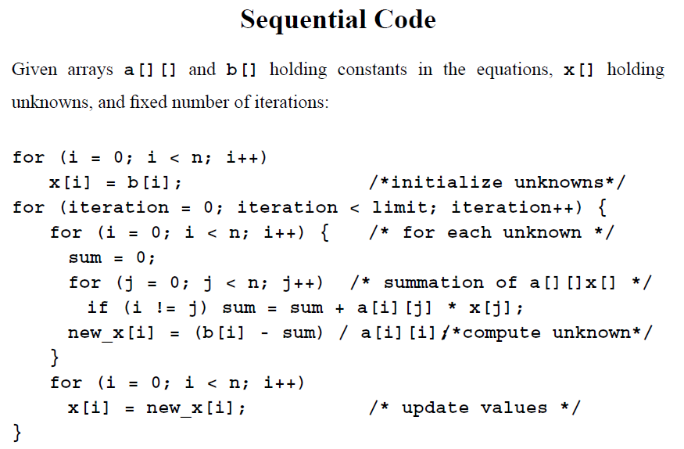
Solving a System of Linear Equations by Iteration (6)

Slide 33
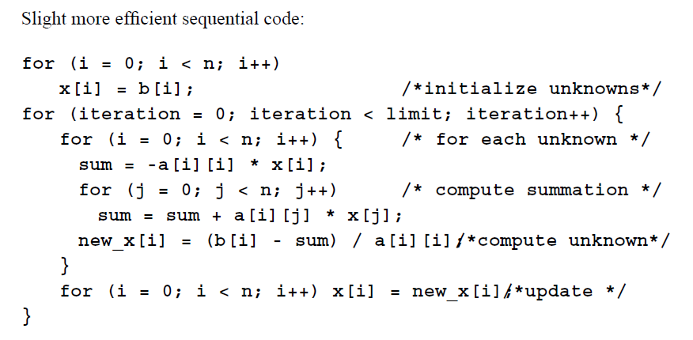
Solving a System of Linear Equations by Iteration (7)

Slide 34
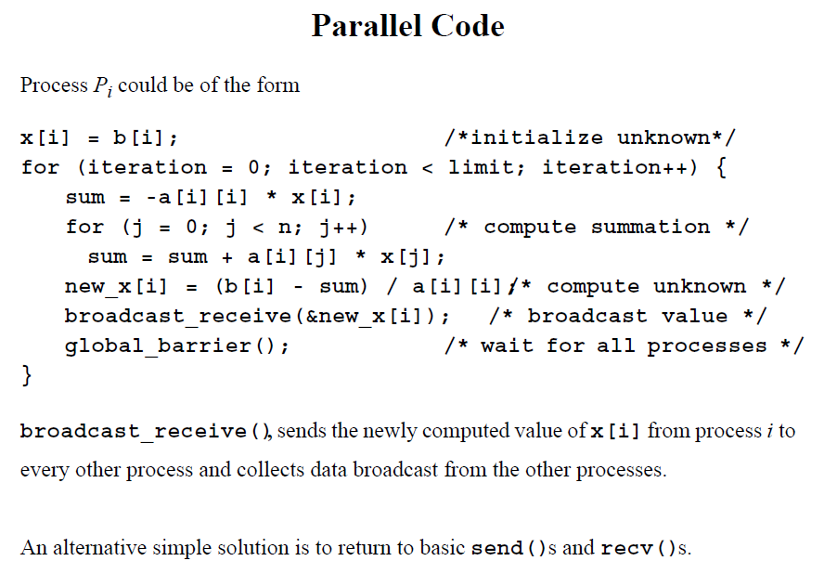
Solving a System of Linear Equations by Iteration (8)

Slide 35
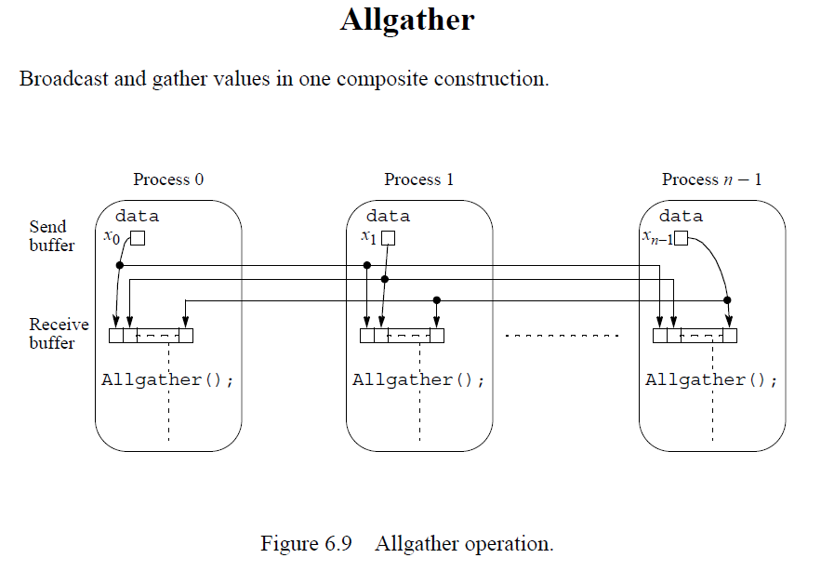
Solving a System of Linear Equations by Iteration (9)

Slide 36
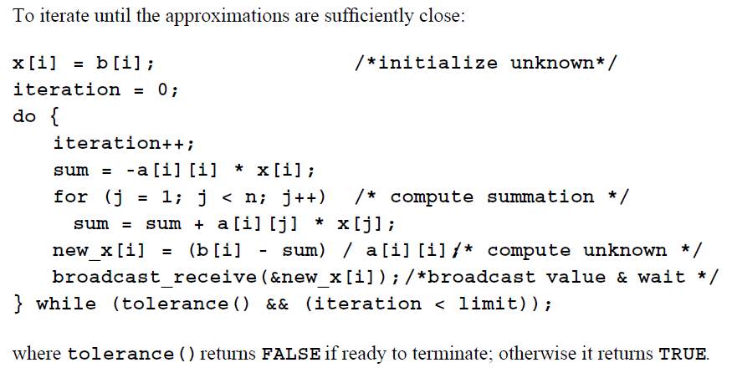
Solving a System of Linear Equations by Iteration (10)

Slide 37
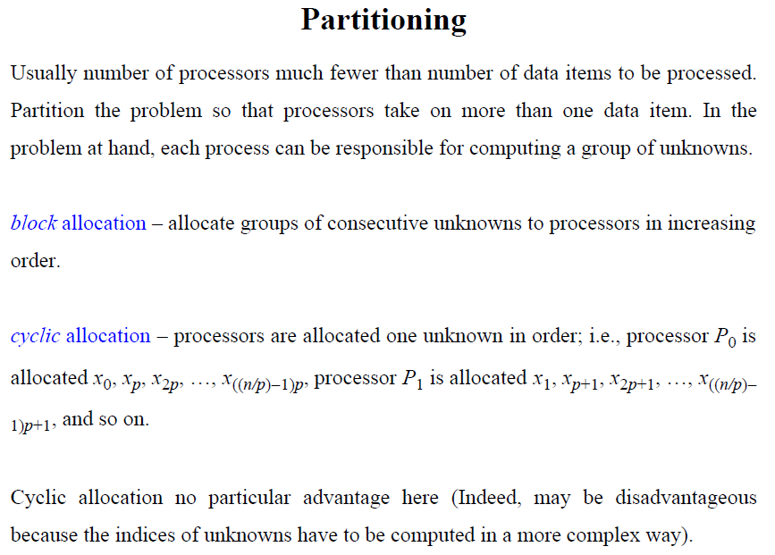
Solving a System of Linear Equations by Iteration (11)

Slide 38
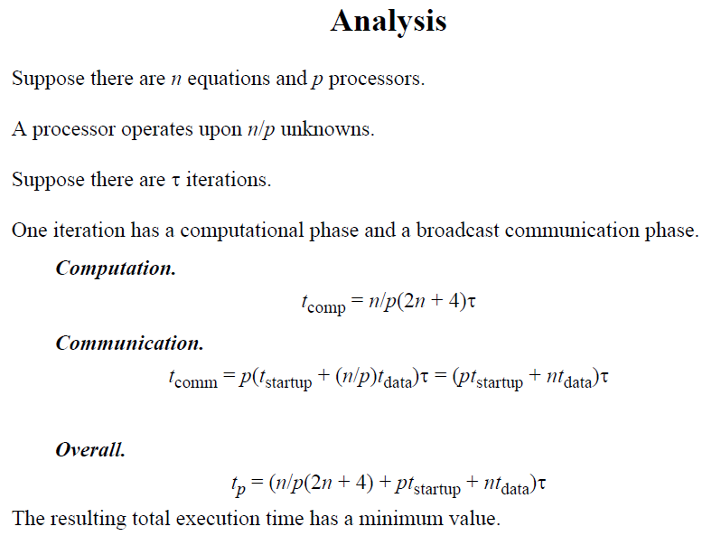
Solving a System of Linear Equations by Iteration (12)

Slide 39
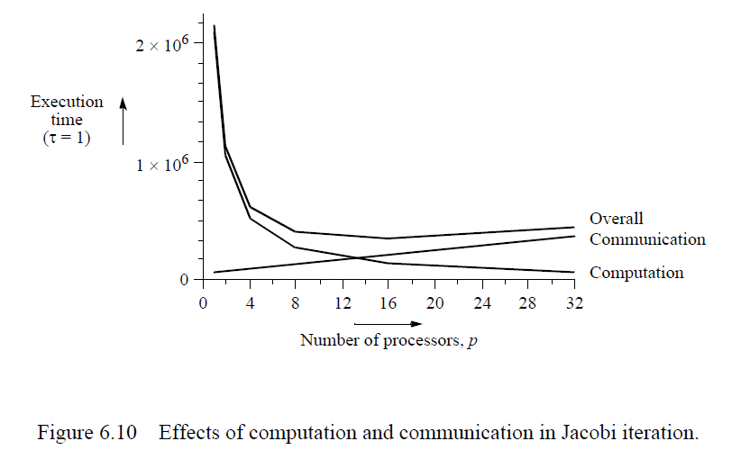
Solving a System of Linear Equations by Iteration (13)

Slide 40
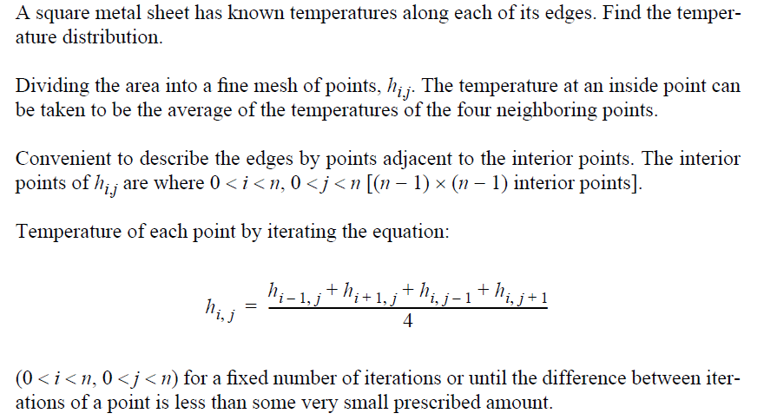
Heat Distribution Problem (1)

Slide 41
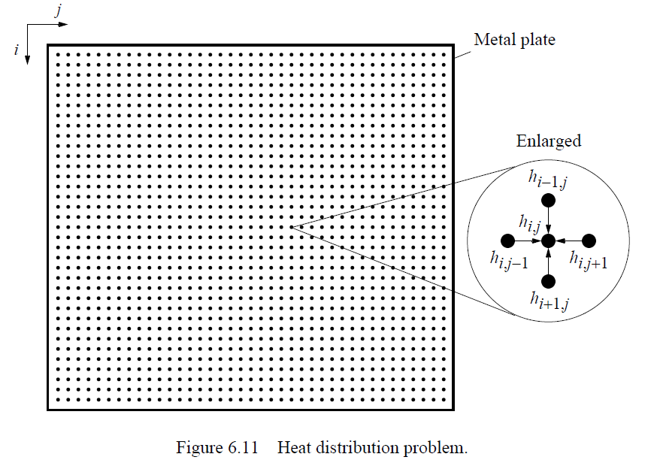
Heat Distribution Problem (2)

Slide 42
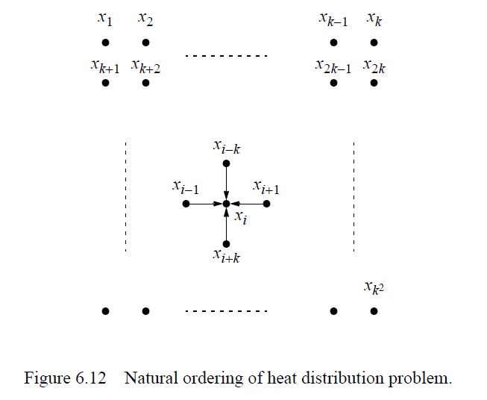
Heat Distribution Problem (3)

Slide 43
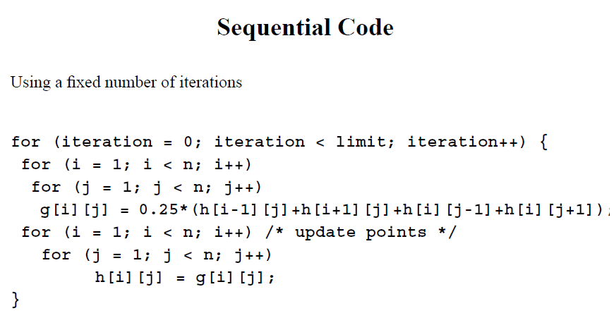
Heat Distribution Problem (4)

Slide 44
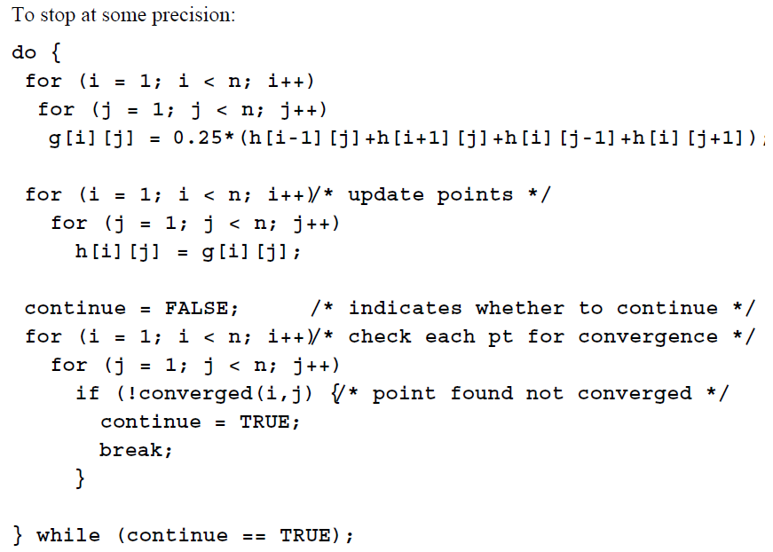
Heat Distribution Problem (5)

Slide 45
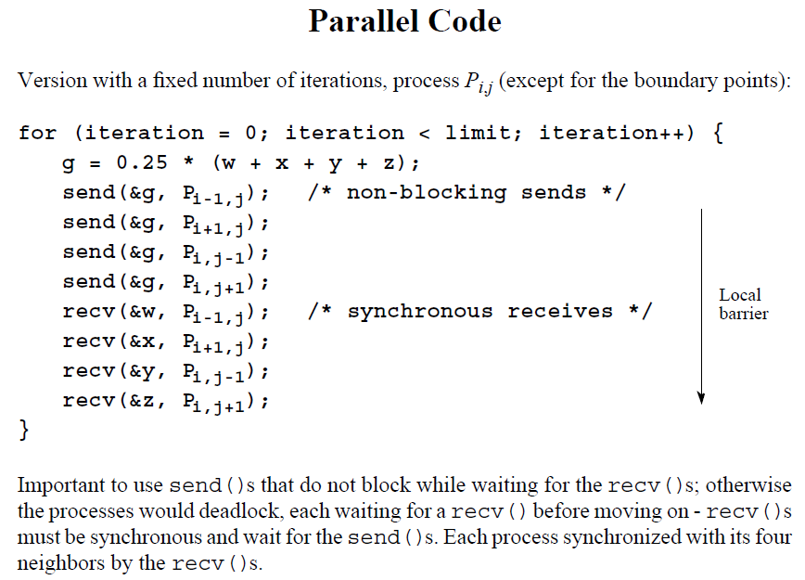
Heat Distribution Problem (6)

Slide 46
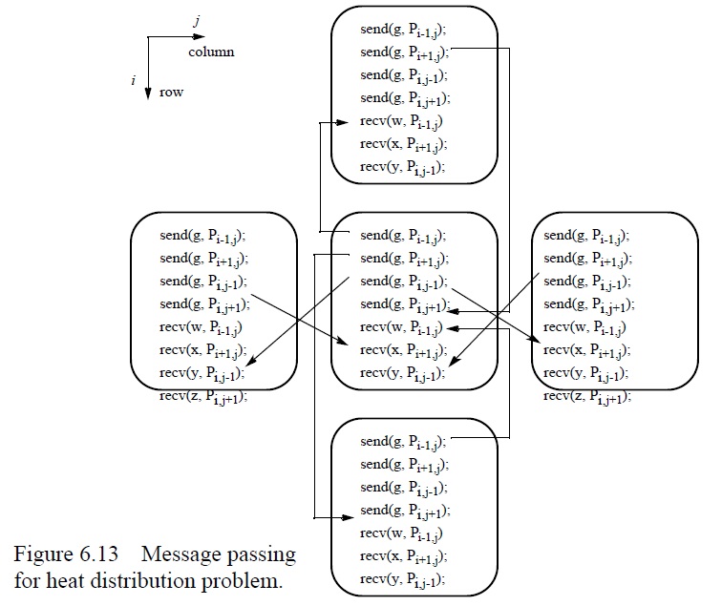
Heat Distribution Problem (7)

Slide 47
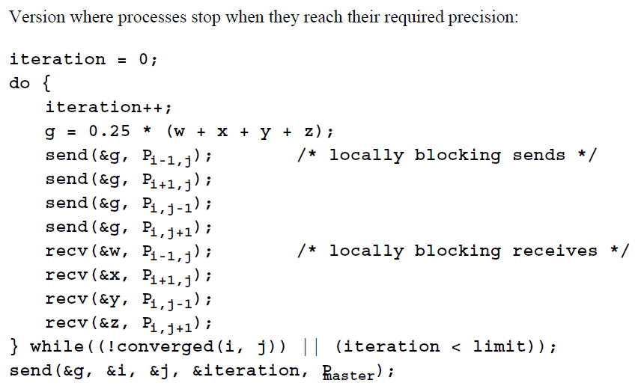
Heat Distribution Problem (8)

Slide 48
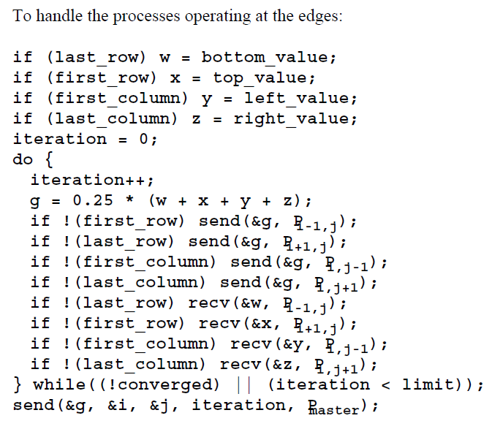
Heat Distribution Problem (9)

Slide 49
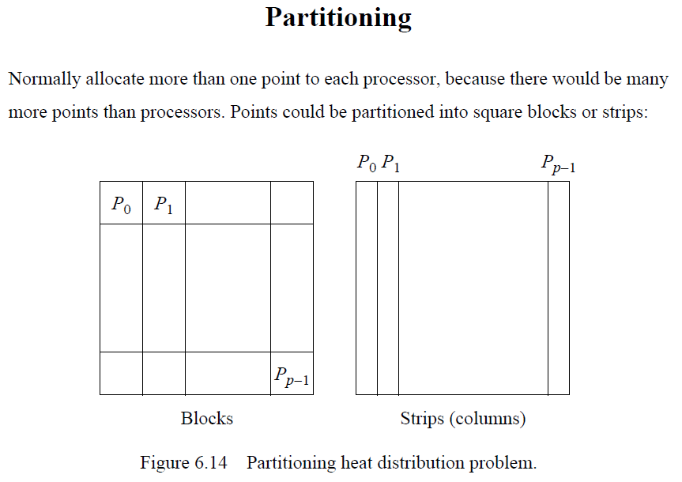
Heat Distribution Problem (10)

Slide 50
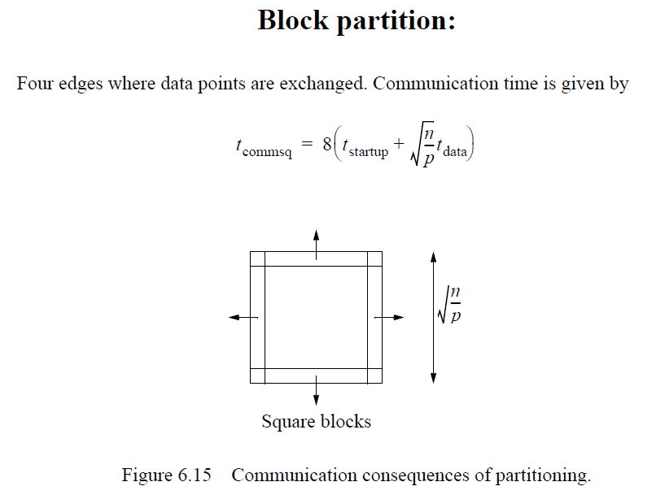
Heat Distribution Problem (11)

Slide 51
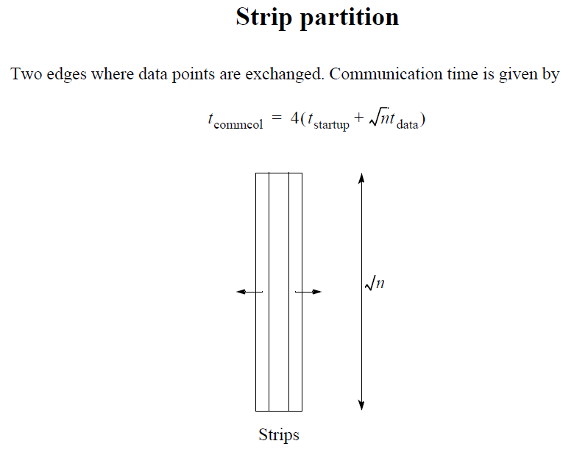
Heat Distribution Problem (12)

Slide 52
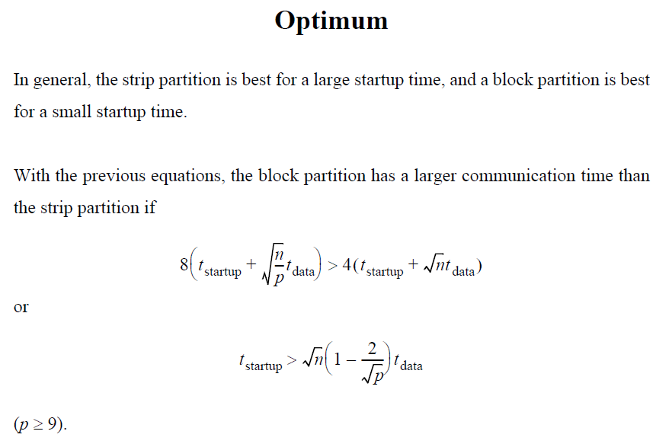
Heat Distribution Problem (13)

Slide 53

Heat Distribution Problem (14)

Slide 54

Heat Distribution Problem (15)

Slide 55

Heat Distribution Problem (16)

Slide 56

Heat Distribution Problem (17)

Slide 57

Heat Distribution Problem (18)

Slide 58

Cellular Automata (1)

Slide 59

Cellular Automata (2)

Slide 60

Cellular Automata (3)

Slide 61

Cellular Automata (4)

Slide 62

Serious Applications for Cellular Automata

