Slide 1

Crazy Putting! Group 4
This Photo by Unknown Author is licensed under CC BY-SA
Notes:
Jean

Slide 2


LibGdx
- Game development framework for java
- Issues
Bad documentation
Lack of experience
Lack of easy-to-use tools and helper functions
This Photo by Unknown Author is licensed under CC BY-SA
This Photo by Unknown Author is licensed under CC BY-SA-NC
Notes:
Jean

Slide 3
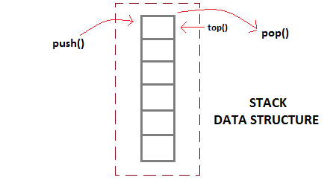
Physics
- Reformat given formula
- Shunting-yard
- Implementing the equations
Notes:
Matthijs

Slide 4

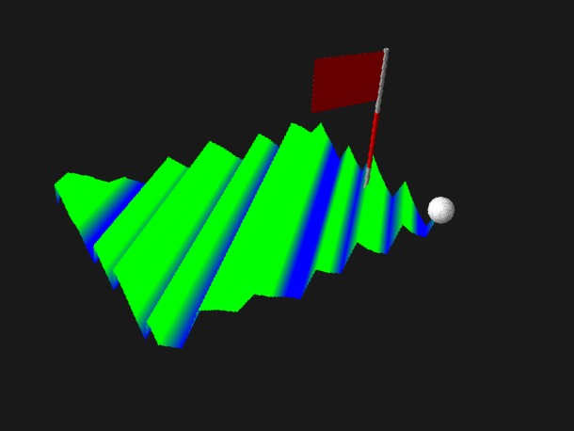
Terrain
- Made out of triangles
- Step size for generation
- Shaders for coloring
- 3D objects for ball and goal
Notes:
René

Slide 5
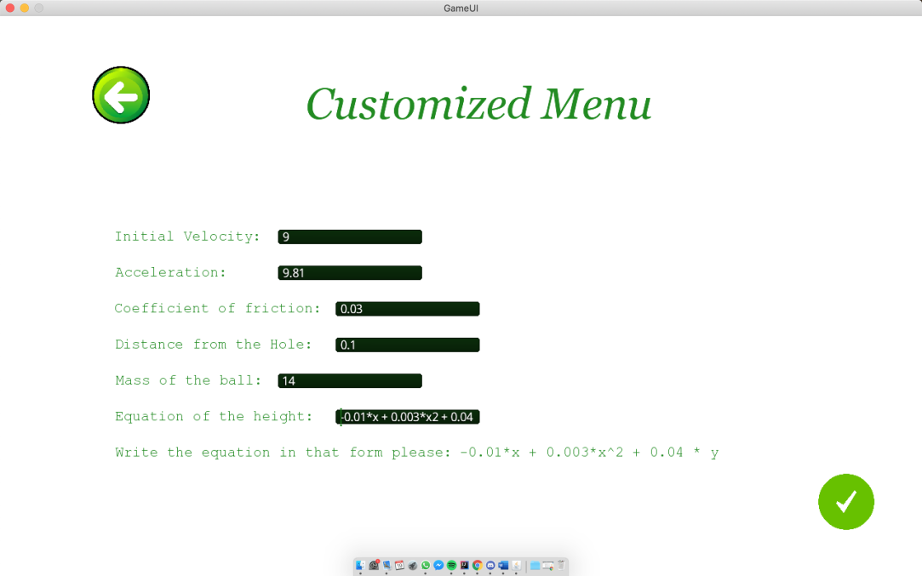
Course designer
- Option for the user to enter their desired values
- File option
- Limitations
Notes:
Aaron

Slide 6

Playing the game
- Shooting the ball
- Water
- Out-of-bounds
Notes:
Aaron
Out-of-bounds: you can give a new point to put to ball that is determined by a distance from the starting point and is on a line from the starting point to the place where you went out-ouf-bounds.

Slide 7

Difficulties
- Teamwork
- Setting up project structure
- Separate projects
- LibGdx
- General lack of time
This Photo by Unknown Author is licensed under CC BY-SA-NC
Notes:
Ivan

Slide 8

Improvements and features for phase 2
- Re-do project structure
- Finish the connection between the UI and the back-end
- Refactor the code to make it easier to expand on it
- Improved physics engine using the second-order Verlet solver and the classical 4th-order Runge-Kutta solver
- A bot that can consistently make a hole-in-one that has knowledge about the terrain
- Visual course designer
- More options for terrain obstacles (trees, sandbanks, improved water)
- Improved terrain rendering
- Improved/expanded 3D UI (show a preview of the ball reset when hitting water and the direction that you’re shooting the ball in)
- Music
Notes:
Haoran

