Slide 1
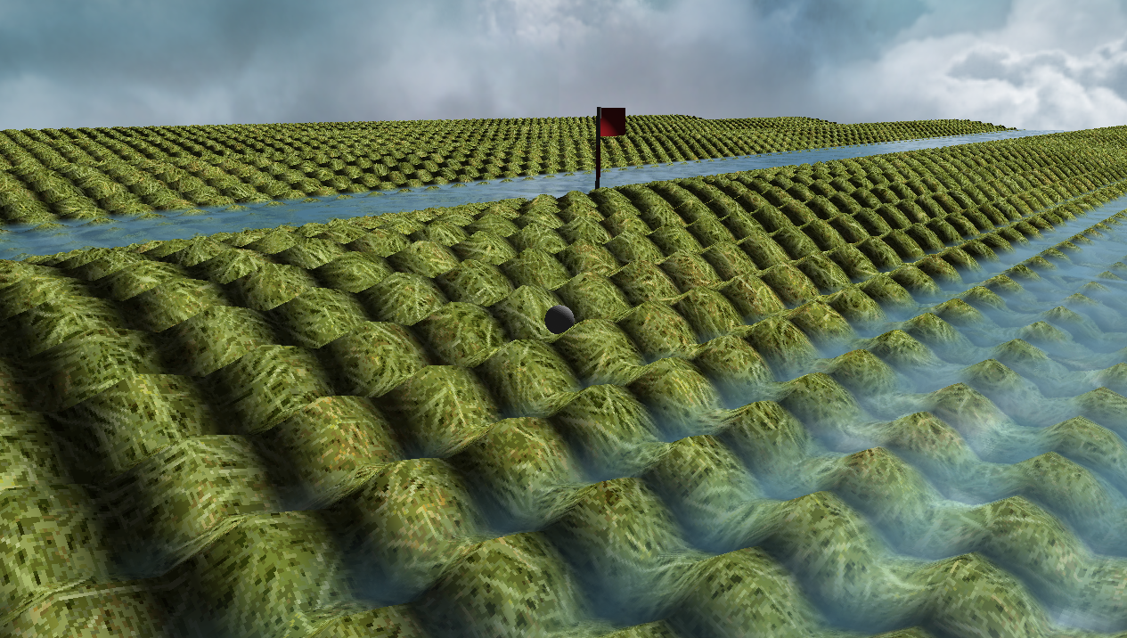
Crazy Putting phase 2
René Steeman
Aaron SchapirA
Ivan Poliakov
Jean Janssen
Matthijs Kusters
Haoran Luan
Notes:
Add game engine image
Jean

Slide 2
The challenge
1. Improve the physics engine by using different solvers
2. Add a bot that can play putting and if possible, can score a hole-in-one
Notes:
Jean

Slide 3
What we did
Create a new game engine that allows us to do more and to understand the engine better
Improve the way we create the terrain, water and other 3D objects
Improve the structure of the physics engine
Add multiple improved solvers for the physics equations
Make the game properly playable
Create a basic and more advanced AI to play the game
Notes:
Jean

Slide 4
Our game engine
We wrote our own game engine based on OpenGL. This means that we made everything from creating a window, a way to render our 3D world, allowing the use of textures, adding a system for importing 3D models, lighting calculations, a third person camera and so on our selves.
Advantages | Disadvantages
We understand how a game engine works behind the scenes | Creating the engine took a lot of time
We have full control over how the engine works | It is difficult to create your own engine
We aren’t dependent on often bad documentation
It is easy to add new features

Slide 5
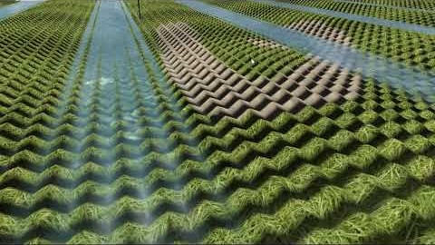
Terrain edit system
With this improved engine we can now edit the terrain in real-time.
Notes:
https://youtu.be/n98XWUwbvXo

Slide 6
Our solvers
We rewrote the entire physics engine to improve the way it interacts with the rest of the game. We also added 3 new solvers to improve the accuracy of our calculations.
Second order Verlet
Second order velocity Verlet
Classical 4th order Runge-Kutta

Slide 7

The formulas 2nd-order Verlet
$x\left(t+∆t\right)=2x\left(t\right)−x\left(t−∆t\right)+\ddot{x}∆t^{2}+O(∆t^{2})$
$v\left(t\right)=\frac{x\left(t+∆t\right)−x(t−∆t)}{2∆t}+O(∆t^{2})$
Notes:
First ask the examiners if they would like us to explain the formulas. Possibly skip this slide

Slide 8

The formulas 2nd-order Velocity Verlet
$x\left(t+∆t\right)=x\left(t\right)+v\left(t\right)∆t+\frac{1}{2}a(t)∆t^{2}$
$v\left(t+\frac{1}{2}∆t\right)=v\left(t\right)+\frac{1}{2}a\left(t\right)∆t$
$a\left(t+∆t\right)= \ddot{x}$
$v\left(t+∆t\right)=v\left(t+\frac{1}{2}∆t\right)+\frac{1}{2}a(t+∆t)∆t$
Notes:
First ask the examiners if they would like us to explain the formulas. Possibly skip this slide

Slide 9

The formulas Classical 4th-order Runge-Kutta
$k_{1}=v_{x}(t)$ $k_{3}=v_{x}(t)+l_{2}\frac{1}{2}h$
$l_{1}=a_{x(t),v_{x}(t)}$ $l_{3}=a_{x(t)+k_{2}\frac{1}{2}h,k_{3} }$
$k_{2}=v_{x}(t)+l_{1}\frac{1}{2}h$ $k_{4}=v_{x}(t)+l_{3}h$
$l_{2}=a_{x(t)+k_{1}\frac{1}{2}h,k_{2}}$ $l_{4}=a_{x(t)+k_{3}h,k_{4}}$
$x\left(t+h\right)=x\left(t\right)+h\frac{1}{6}(k_{1}+2k_{2}+2k_{3}+k_{4})$
$v\left(t+h\right)=v\left(t\right)+h\frac{1}{6}(l_{1}+2l_{2}+2l_{3}+l_{4})$
Notes:
First ask the examiners if they would like us to explain the formulas. Possibly skip this slide

Slide 10
Comparison between solvers
 | Speed | Accuracy | Stability
Euler | ++ |  | -
Second order Verlet | + | + | +
Second order velocity Verlet | + | ++ | +
4th order Runge-Kutta |  | +++ | ++
Notes:
https://gamedev.stackexchange.com/questions/33694/pros-and-cons-of-different-integrators

Slide 11
Our bots
We have a basic and advanced bot. The basic bot is simple to implement, but limited in capability and the advanced bot is smarter, but a little harder to implement.

Slide 12
Basic Bot
Finds the location of the flag
Computes shots in the area of the flag and stores the successful ones
For each successful shot stored, it aims to try the perfect velocity
If there is an obstacle between the ball and the flag, it will shoot the ball with a wider angle
If no hole in one solution is possible, it won’t find a solution.
O(maxVelocity / (degree step * velocity step))

Slide 13
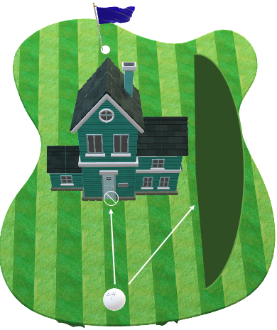
Example of a ’wide shot’

Slide 14
Advanced bot
Olivera Popović. (2020). Breadth-First Search [gif]. Stack Abuse https://stackabuse.com/graphs-in-java-breadth-first-search-bfs/
O(grid * the number of outcoming shots * shot complexity + grid)

Slide 15
Comparison between the bots
 | Calculation Speed | Accuracy | Versatility | Limitation
Basic Bot | ++ | + |  | Can not handle more than one shot.
Advanced Bot | ++ | ++ | ++ | Can handle more than one shot.

Slide 16
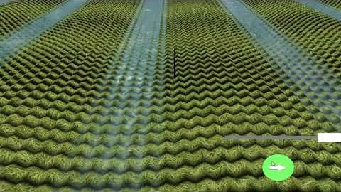
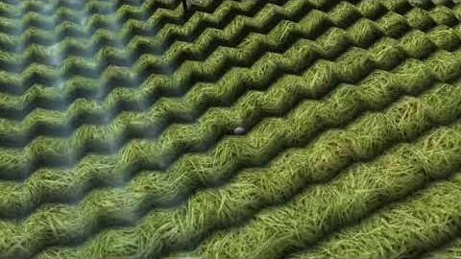
Demonstration of the game

Slide 17
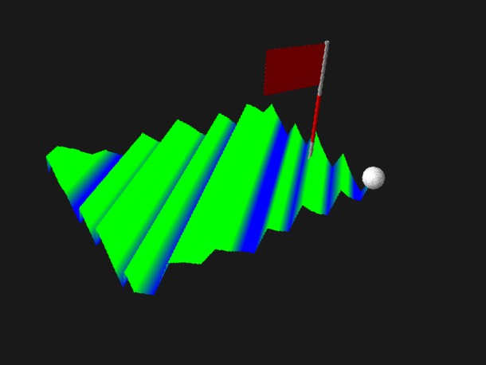
Before
After

Slide 18
Phase 3 advanced topics
1. Having a random error in the initial position and velocity of the ball, including an analysis of the impact on the bot’s performance
2. Handling different (unknown) coefficients of friction and making sure the bot can handle them.
3. Allow for balls that can both fly and bounce, as well as improvements to the bot so it can handle these new options.
Notes:
Haoran

Slide 19
Questions?
Notes:
Haoran

Slide 20
References
Engine tutorials
Thin Matrix. (2014-2016). Videos 1-33. Retrieved from https://www.youtube.com/watch?v=VS8wlS9hF8E&list=PLRIWtICgwaX0u7Rf9zkZhLoLuZVfUksDP
MrManiac. (2015). Button tutorial - ThinMatrix opengl extension video. Retrieved from https://www.youtube.com/watch?v=GmmR37-LBPQ
Water rendering tutorials
Thin Matrix. (2015). Videos 1-8. Retrieved from https://www.youtube.com/watch?v=HusvGeEDU_U&list=PLRIWtICgwaX23jiqVByUs0bqhnalNTNZh
Physics equations
Teschner, M. (n.d.). Simulation in Computer Graphics - Particles. Retrieved from https://cg.informatik.uni-freiburg.de/course_notes/sim_02_particles.pdf
University of Delaware. (n.d.). Verlet Method. Retrieved from http://www.physics.udel.edu/~bnikolic/teaching/phys660/numerical_ode/node5.html
Holm, C. (2012). Simulation Methods in Physics 1. Retrieved from https://www2.icp.uni-stuttgart.de/~icp/mediawiki/images/5/54/Skript_sim_methods_I.pdf

