Slide 1

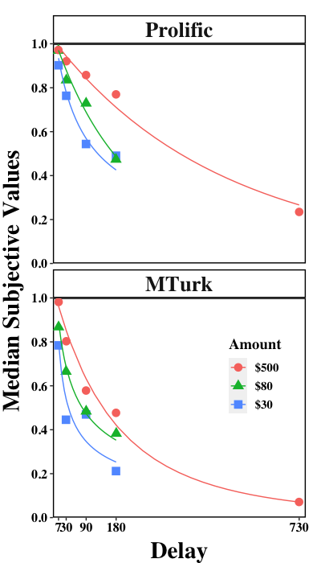
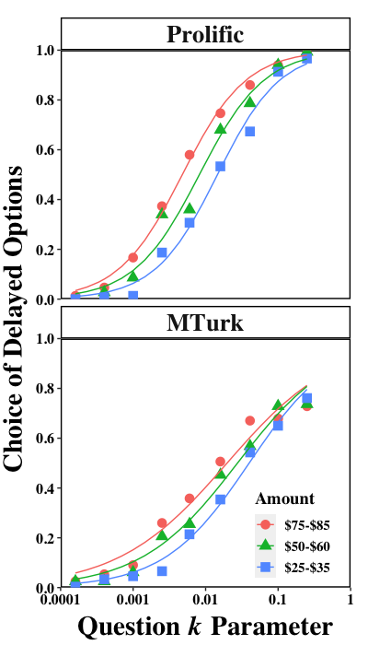
Comparison of the Adjusting-Amount Procedure and the Monetary Choice Questionnaire for Measuring Delay Discounting
Haoran Wan, Joel Myerson, & Leonard Green
Introduction
Results
The Adjusting-Amount Procedure (Adj-Amt) and the Monetary Choice Questionnaire (MCQ) are often used to assess group and individual differences in the discounting of delayed rewards.
The current study compared the two procedures using both atheoretical (AuC, and proportion of delayed choices) and theoretical [log(k), based on the simple hyperbola] measures to evaluate whether the two procedures measure the same underlying construct.
Magnitude effect: In the Adj-Amt procedure, subjective value decreased systematically as a function of delay in all three amount conditions (left panels), and the hyperboloid discounting function provided good fits to the group medians
(R²s > .92). AuC increased systematically and significantly as a function of amount for both samples.
In the MCQ procedure, the proportion of participants choosing the delayed option at each k increased as a function of amount (right panels) for both samples.
Within-procedure intercorrelations: The correlations among individuals’ AuCs for the three amounts, as well as the correlations among individuals’ delayed choice proportions for the three amounts were all high for both samples (Prolific: rs > .73; MTurk: rs > .84).
Method
425 participants from Prolific (N = 150) and MTurk (N = 275) completed both the Adj-Amt Delay Discounting Procedure and the MCQ.
Adjusting-Amount Procedure: Three delayed amounts were studied: $30, $80, and $500.
Four delays (7 days, 30 days, 90 days, 180 days) were used for the $30 and $80 amounts. The $500 amount included an additional delay (730 days).
Area under the curve (AuC) and log(k), based on the simple hyperbola discounting model, were calculated for each individual at each amount.
MCQ: The MCQ (Kirby et al.,1999) consisted of 27 questions, divided into three sets of delayed amounts: $25-35, $50-60, and $75-85.
At the group level, the proportion of participants choosing the delayed option as a function of the k-parameter of each MCQ question was determined.
At the individual level, the proportion of choices of the delayed reward and log(k) using Kirby’s method were measured for each individual at each amount.
To address the major issue of the current study, namely, Do the Adj-Amt and MCQ procedures both measure the same construct, between-procedure correlations were conducted:
Correlations between AuC (Adj-Amt) and proportion of delayed choices (MCQ) on the common amounts
(i.e., $30 and $80) were greater than .80 for the Prolific and .78 for the MTurk samples.
The correlations between the log(k) measures for the Adj-Amt and MCQ also were strong and significant
(Prolific: rs > .76; MTurk: rs > .74).
Conclusion
Regardless of the source of the participants (Prolific or MTurk) and the type of discounting measure (atheoretical: AuC, proportion of delayed choices; theoretical: log[k]), correlations between the adjusting-amount and the MCQ procedures were significant and strong.
This pattern of significant correlations between the two delay discounting procedures supports the hypothesis that they are measuring the same construct (trait, ability).

