Slide 1

Comparison of the Adjusting-Amount Procedure and the Monetary Choice Questionnaire for Measuring Delay Discounting
Haoran Wan, Joel Myerson, and Leonard Green
Psychological & Brain Sciences
Washington University in St. Louis

Slide 2
Method
Participants: Prolific (N = 150) and MTurk (N = 275)
Adjusting-Amount Procedure
MCQ
Amounts: $30, $80, $500
Delays: 7, 30, 90, 180 days
(730 days [$500])
Amounts: $25-35, $50-60, $75-85
Measures: AuC, log(k)
Measures: Proportion of delayed choices, log(k)

Slide 3
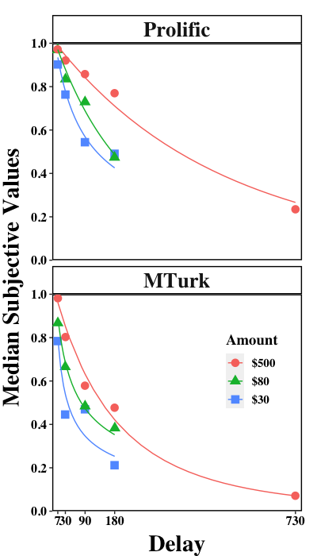
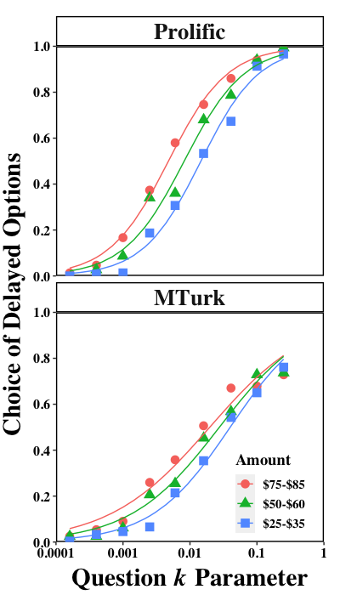
Results
Adjusting-Amount
MCQ

Slide 4
Results
Do the Adj-Amt and MCQ procedures
both measure the same construct?
Correlations between AuC (Adj-Amt) and proportion of delayed choices (MCQ) on the common amounts (i.e., $30 and $80) were greater than .80 for the Prolific and .78 for the MTurk samples.
The correlations between the log(k) measures for the Adj-Amt and MCQ also were strong and significant (Prolific: rs > .76; MTurk: rs > .74).

Slide 5
