Slide 1
CS 4476 Project 1
Jie Lyu
jie.lyu@gatech.edu
jlyu31
903329676

Slide 2
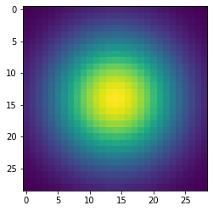
Part 1: Image filtering
I first generate a 1d Gaussian array using numpy.fromfunction() and a helper method I wrote that does the Gaussian calculation using the standard 1D Gaussian formula. Then I used numpy.outer to find the outer product of the 1D array with itself, which is a 2d Gaussian array
2d Gaussian kernel

Slide 3
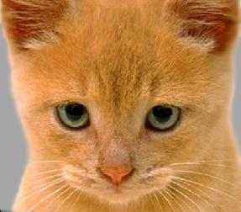

Part 1: Image filtering
Identity filter
Small blur with a box filter

Slide 4
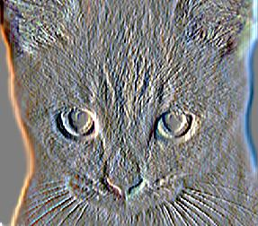
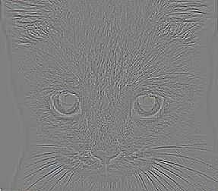
Part 1: Image filtering
Sobel filter
Discrete Laplacian filter

Slide 5
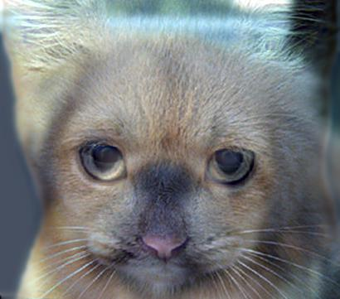
Part 1: Hybrid images
I used my_imfilter() to get the low frequency filtered version of both images a and b, and subtracted the filtered image b one from the original image b to get the high frequency one. Then I added the low frequency version of image a and high frequency version of image b to get the final hybrid image. I used numpy.clip() to make sure the pixel values are between 0 and 1
Cat + Dog
Cutoff frequency: 5

Slide 6
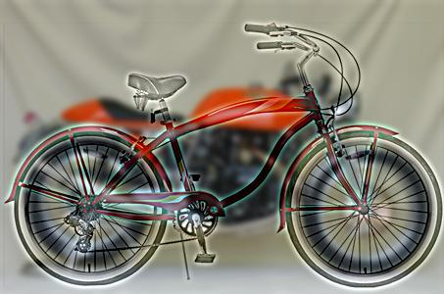
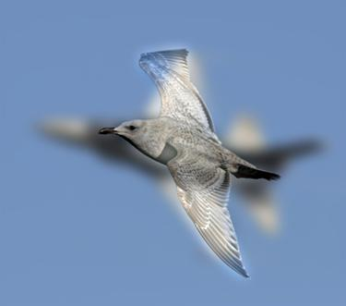
Part 1: Hybrid images
Motorcycle + Bicycle
Cutoff frequency: 3
Plane + Bird
Cutoff frequency: 7

Slide 7
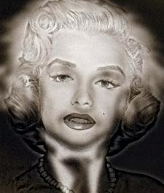
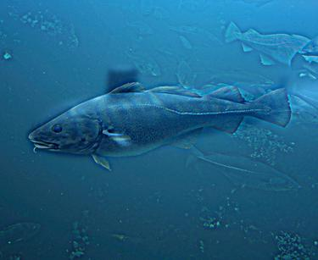
Part 1: Hybrid images
Einstein + Marilyn
Cutoff frequency: 3
Submarine + Fish
Cutoff frequency: 3

Slide 8
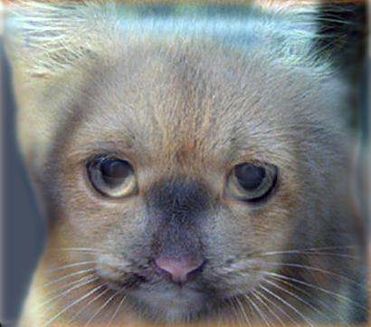

Part 2: Hybrid images with PyTorch
Cat + Dog
Motorcycle + Bicycle

Slide 9

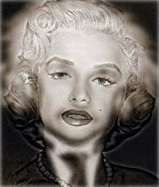
Part 2: Hybrid images with PyTorch
Plane + Bird
Einstein + Marilyn

Slide 10
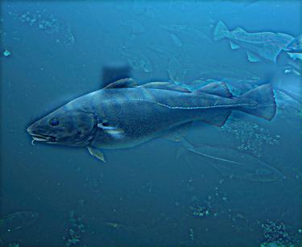
Part 2: Hybrid images with PyTorch
Submarine + Fish
Part 1 vs. Part 2
Part 1 took 9.276 seconds and part 2 took 1.677 second. Part 2 is 82% faster. To me that means better.

Slide 11
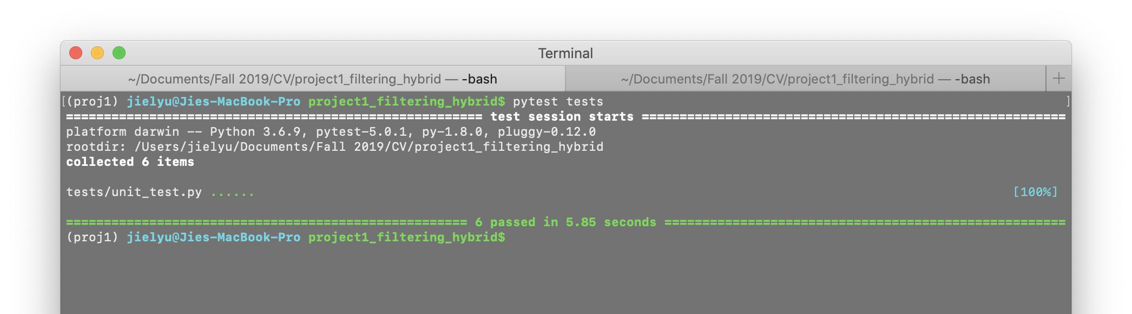
Tests

Slide 12
Conclusions
With a default cutoff frequency at 7, some high frequency images shows too much edge (e.g. Einstein + Marilyn), thus dominating the hybrid images and making people hard to ignore it. Lowering the cutoff frequency in those cases will produce a better result. Also I found it better to set the frequency to 5 for the cat and dog case. Rods and cones works different for everybody, so for me this frequency works the best. The biggest challenge has been learning to work with numpy, but it is also rewarding since it is an awesome tool.
Thank you for reading!

