Slide 1
Machine Learning
Lecture 17b: Gaussian BC and Generative vs. Discriminative Classifier
Dr. Beilun Wang
Southeast University
School of Computer Science
and Engineering

Slide 2
Course Content Plan
Regression (supervised)
Classification (supervised)
Unsupervised models
Learning theory
Y is a continuous
Y is a discrete
NO Y
About f()
Graphical models
About interactions among X1,… Xp
Reinforcement Learning
Learn program to Interact with its environment

Slide 3
Today: More Generative Bayes Classifiers
Generative Bayes Classifier
Naïve Bayes Classifier
Gaussian Bayes Classifiers
Gaussian distribution
Naïve Gaussian BC
Not-naïve Gaussian BC → LDA, QDA
LDA: Linear Discriminant Analysis
QDA: Quadratic Discriminant Analysis
Extra: Discriminative vs. Generative classifier

Slide 4
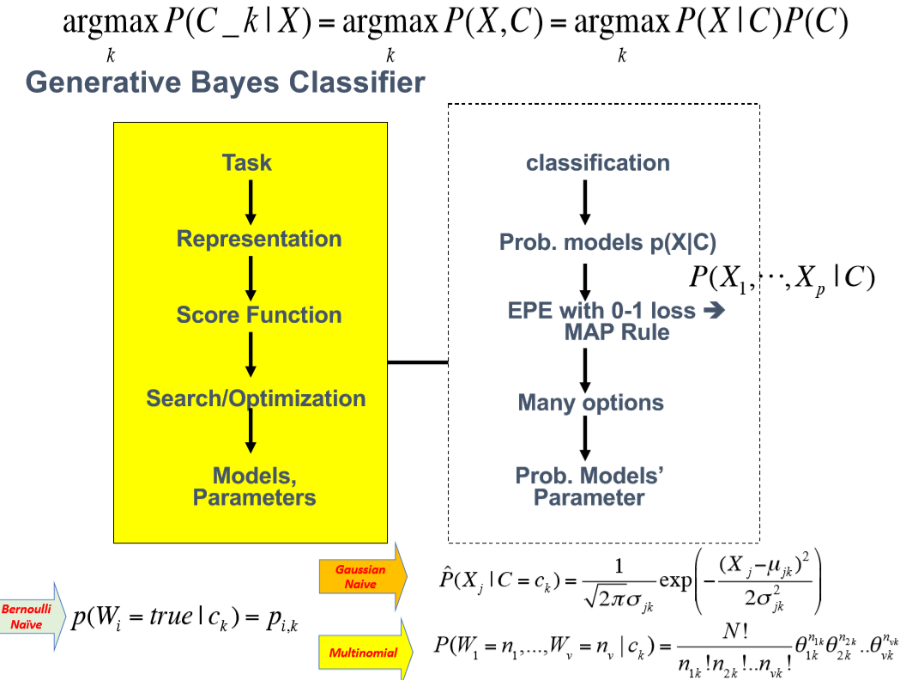

Slide 5
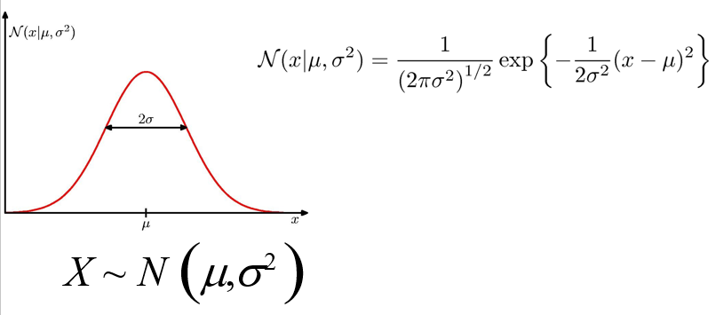
Review: Single-Variate Gaussian Distribution

Slide 6

Multivariate Normal (Gaussian) PDFs
The only widely used continuous joint PDF is the multivariate normal (or Gaussian):
Mean
Covariance Matrix
Mean of normal PDF is at peak value. Contours of equal PDF form ellipses.
The covariance matrix captures linear dependencies among the variables

Slide 7
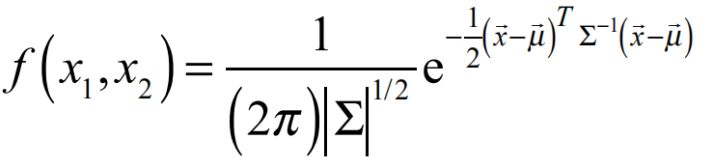
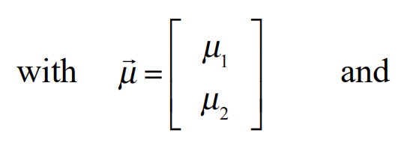
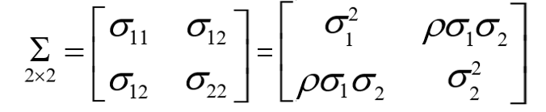

Example: the Bivariate Normal distribution
2×2
11

Slide 8
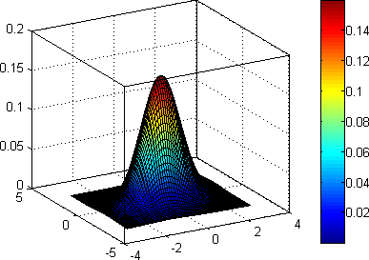
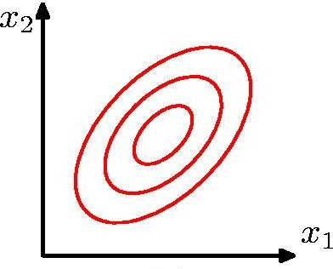
Bi-Variate Gaussian Distribution
Bivariate normal PDF
Mean of normal PDF is at peak value. Contours of equal PDF form ellipses.
The covariance matrix captures linear dependencies among the variables

Slide 9
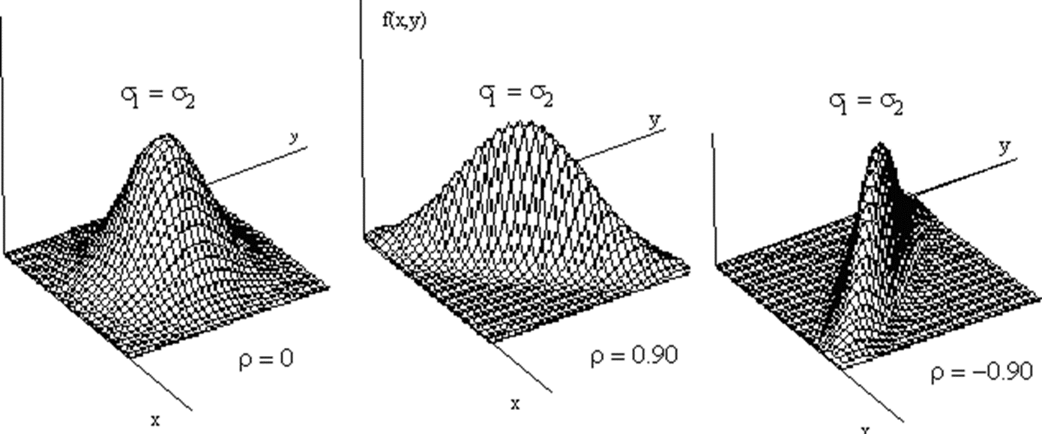
Surface Plots of the bivariate Normal distribution

Slide 10
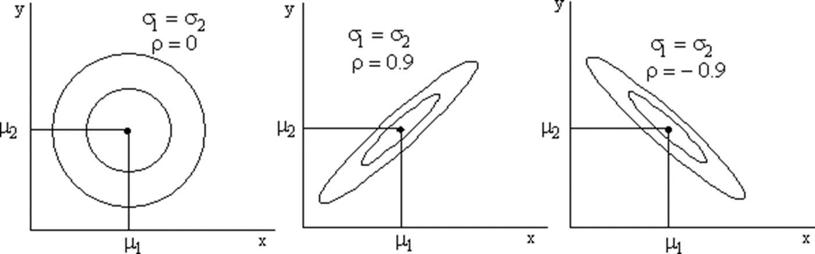
Contour Plots of the bivariate Normal distribution

Slide 11
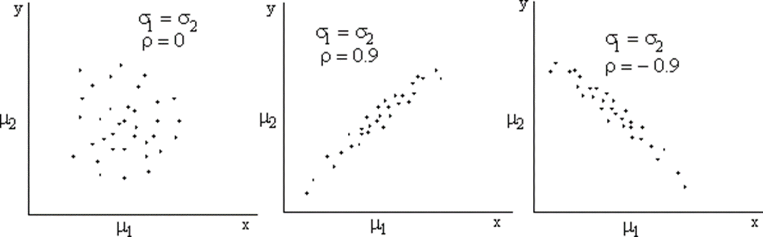
Scatter Plots of the bivariate Normal distribution

Slide 12
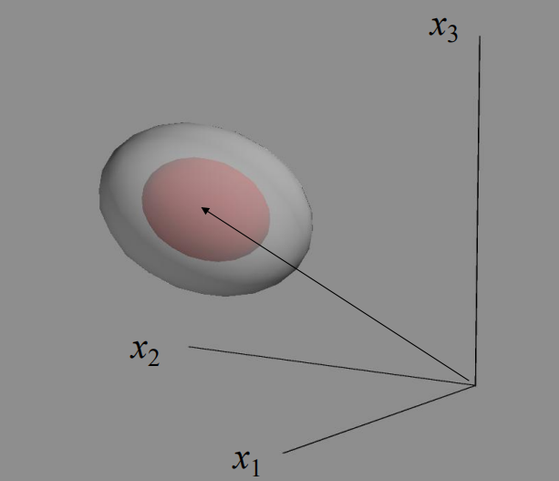
Trivariate Normal distribution

Slide 13


The Big Picture
Probability
Model
i.e. Data generating process
Observed Data
MLE Estimation / learning / statistics / Data mining

Slide 14
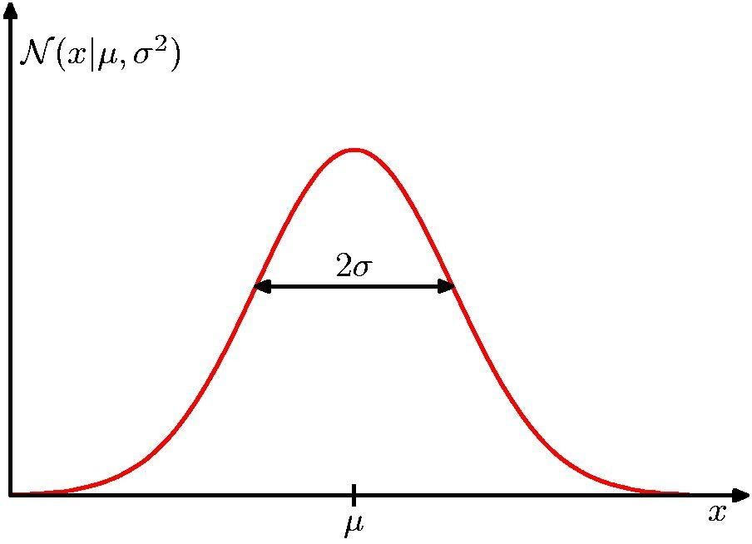


How to Estimate 1D Gaussian: MLE
In the 1D Gaussian case, we simply set the mean and the variance to the sample mean and the sample variance:
$$\overline{μ}=\frac{1}{n}\sum_{i=1}^{n}{x_{i}}$$
$$\overline{σ^{2}}=\frac{1}{n}\sum_{i=1}^{n}{(x_{i}−\overline{μ})^{2}}$$

Slide 15
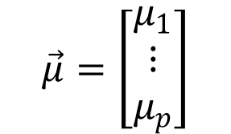
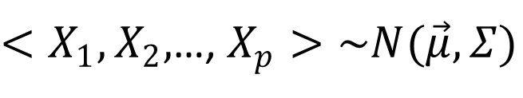
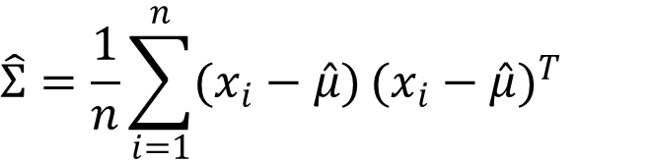
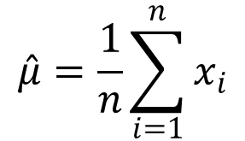
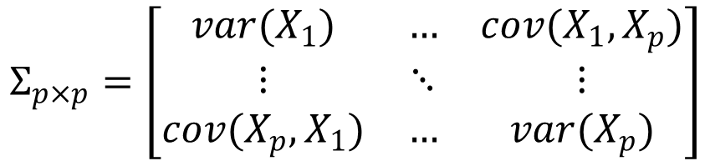
How to Estimate p-D Gaussian: MLE
$<X_{1},X_{2},$…, $X_{p}>\sim N(\vec{μ},Σ)$
$$\vec{μ}=\left[\begin{matrix}μ_{1} \\ ⋮ \\ μ_{p}\end{matrix}\right]$$
$$Σ_{p×p}=\left[\begin{matrix}var(X_{1}) & … & cov(X_{1},X_{p}) \\ ⋮ & ⋱ & ⋮ \\ cov(X_{p},X_{1}) & … & var(X_{p})\end{matrix}\right]$$
$$\hat{μ}=\frac{1}{n}\sum_{i=1}^{n}{x_{i}}$$
$$\hat{Σ}=\frac{1}{n}\sum_{i=1}^{n}{(x_{i}−\hat{μ})}{(x_{i}−\hat{μ})}^{T}$$

Slide 16
Review: Generative BC
P(X |C ) ,
C = c₁ ,⋅⋅⋅,c_{L} , X = (X₁ ,⋅⋅⋅, X_{p} )
P(x|c₁ )
P(x|c₂ )
P(x|c_{L} )
Generative Probabilistic Model for Class 1
Generative Probabilistic Model for Class 2
Generative Probabilistic Model for Class L
• • •
• • •
x_{p}
• • •
x_{p}
• • •
x_{p}
x₁ x₂
x₁ x₂
x₁ x₂
x = (x₁, x₂,⋅⋅⋅, x_{p} )

Slide 17
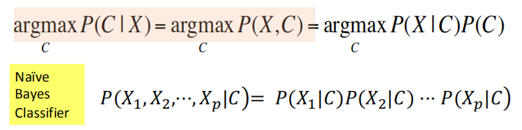
Review: Naïve Bayes Classifier

Slide 18
Today: More Generative Bayes Classifiers
Generative Bayes Classifier
Naïve Bayes Classifier
Gaussian Bayes Classifiers
Gaussian distribution
Naïve Gaussian BC
Not-naïve Gaussian BC → LDA, QDA
LDA: Linear Discriminant Analysis
QDA: Quadratic Discriminant Analysis
Extra: Discriminative vs. Generative classifier

Slide 19
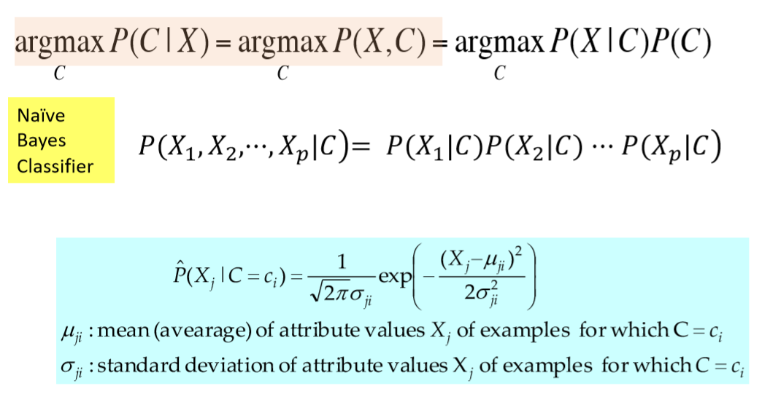
Gaussian Naïve Bayes Classifier

Slide 20
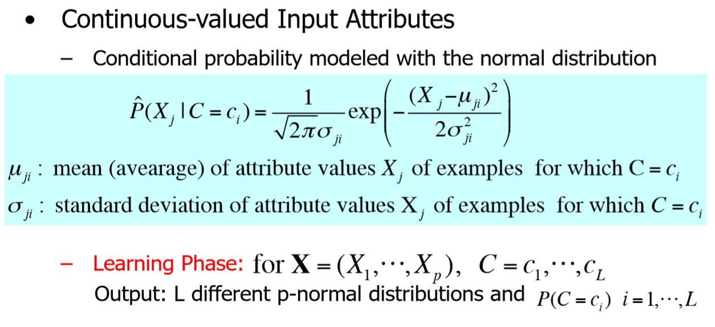
Gaussian Naïve Bayes Classifier

Slide 21
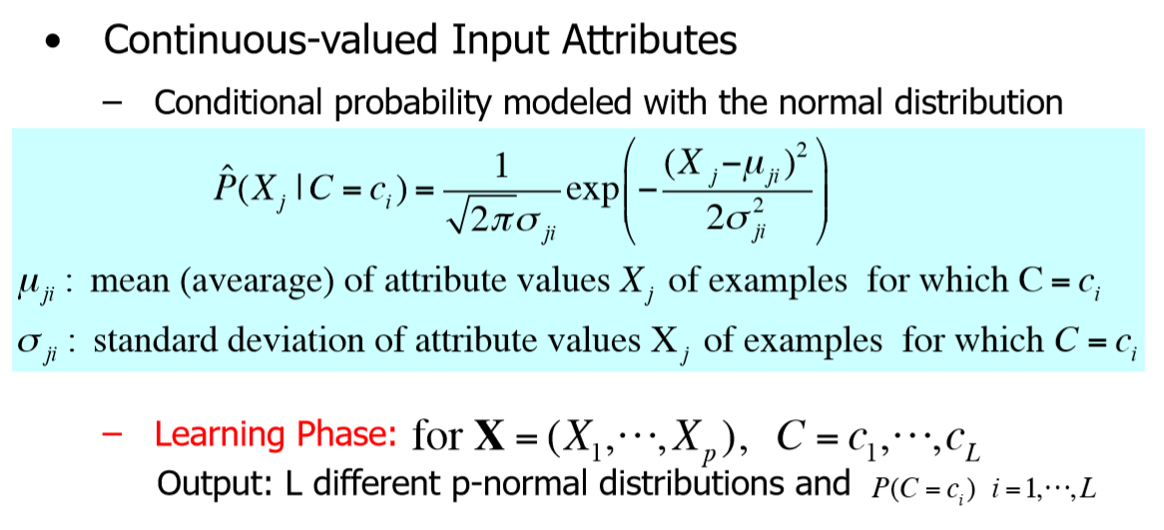
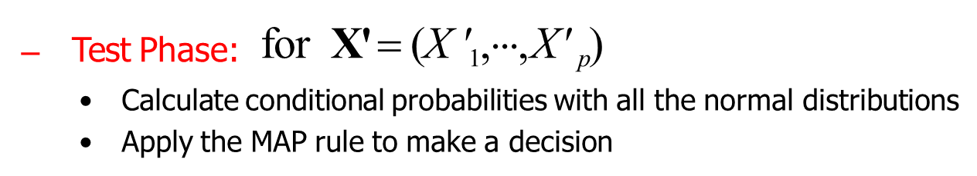
Gaussian Naïve Bayes Classifier

Slide 22
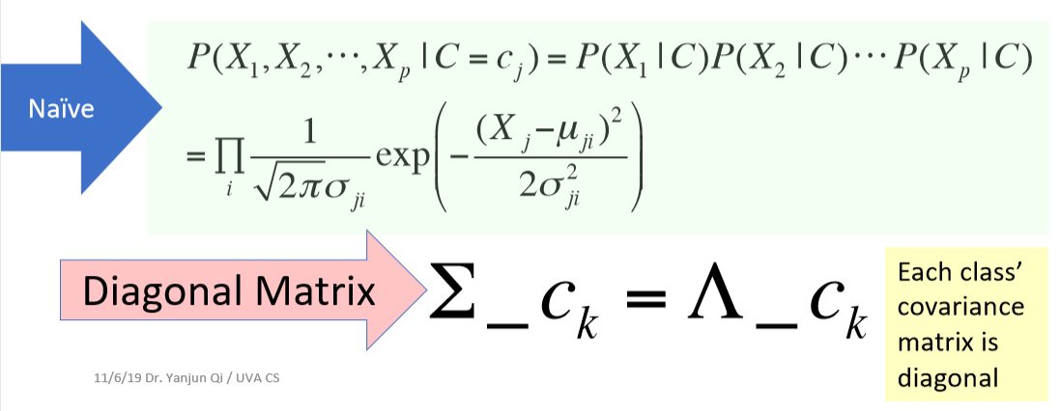
Gaussian Naïve Bayes Classifier

Slide 23
Today: More Generative Bayes Classifiers
Generative Bayes Classifier
Naïve Bayes Classifier
Gaussian Bayes Classifiers
Gaussian distribution
Naïve Gaussian BC
Not-naïve Gaussian BC → LDA, QDA
LDA: Linear Discriminant Analysis
QDA: Quadratic Discriminant Analysis
Extra: Discriminative vs. Generative classifier

Slide 24
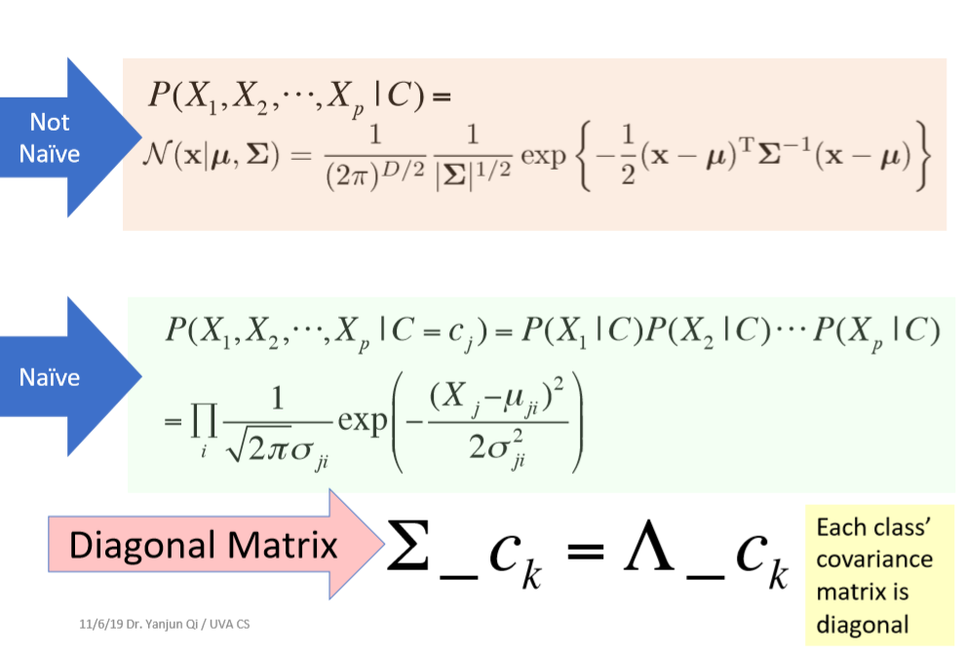
Not-naïve Gaussian means?

Slide 25
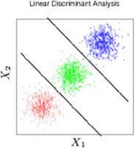
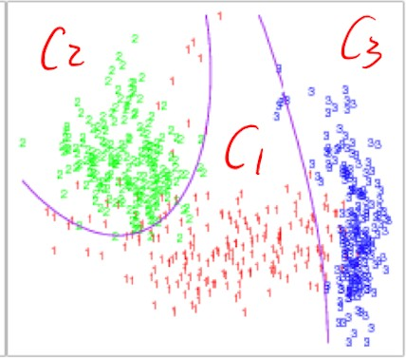
Not-naïve Gaussian BC
LDA: Linear Discriminant Analysis
QDA: Quadratic Discriminant Analysis

Slide 26
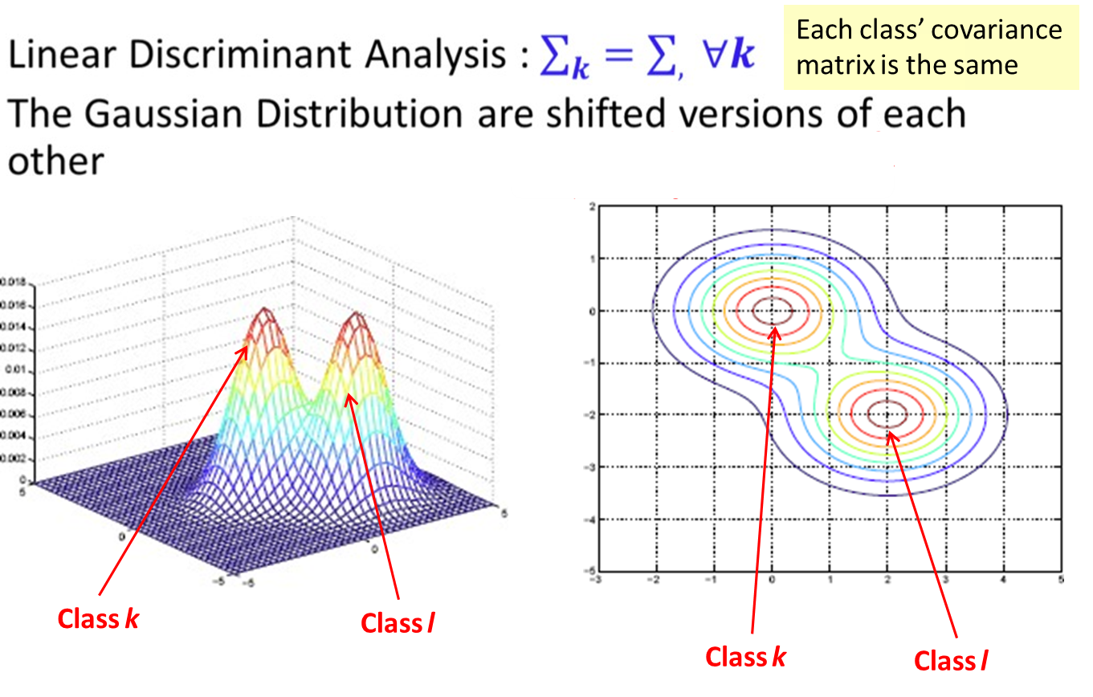
covariance matrix are the same across classes
LDA (Linear Discriminant Analysis)

Slide 27
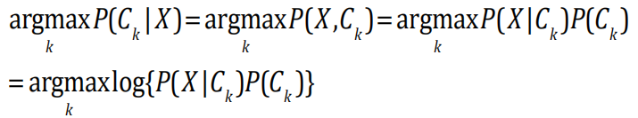
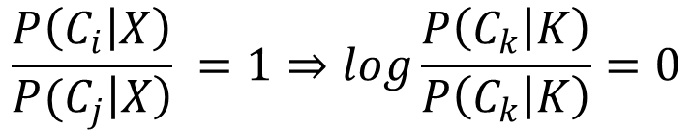

Decision Boundary Points satisfying:
$P\left(C_{i} | X\right)=$ $P\left(C_{j} | X\right)$
$$\frac{P\left(C_{i} | X\right)}{P{(C}_{j}\left|X\right)} =1⇒\log{\frac{P\left(C_{k} | K\right)}{P\left(C_{k} | K\right)}=0}$$

Slide 28

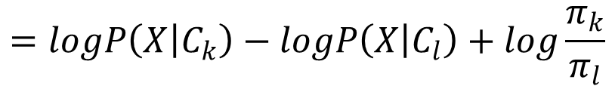

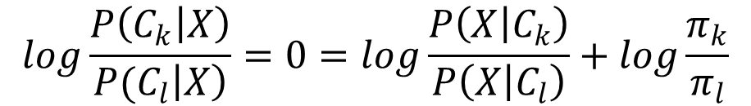
$$=arg\max_{k}{logP\left(x | C_{k}\right)+logP(C_{k})}$$
$$π_{k}$$
Decision Boundary Points
$$\log{\frac{P\left(C_{k} | X\right)}{P{(C}_{l}\left|X\right)}}=0=\log{\frac{P\left(X | C_{k}\right)}{P\left(X | C_{l}\right)}+log\frac{π_{k}}{π_{l}}}$$
$$=logP\left(X | C_{k}\right)−logP\left(X | C_{l}\right)+log\frac{π_{k}}{π_{l}}$$

Slide 29
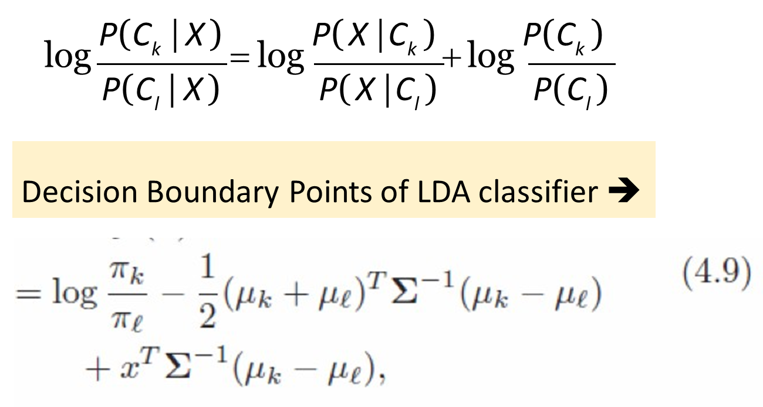
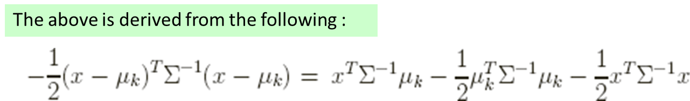

Slide 30
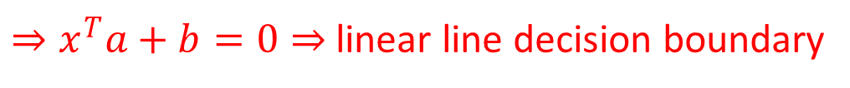


=0
$$b$$
$$a$$
$⇒x^{T}a+b=0⇒$ linear line decision boundary

Slide 31
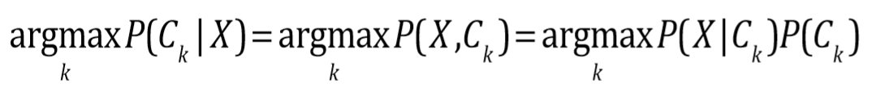
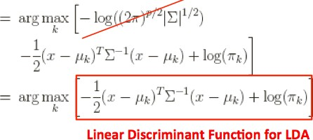
LDA Classification Rule
Also called as Linear discriminant function

Slide 32
Not-naïve Gaussian BC
LDA: Linear Discriminant Analysis
QDA: Quadratic Discriminant Analysis

Slide 33
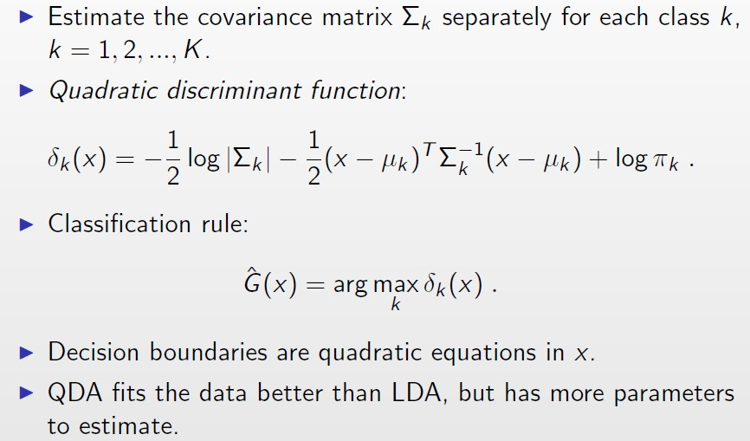
If covariance matrix are not the same
QDA (Quadratic Discriminant Analysis)

Slide 34
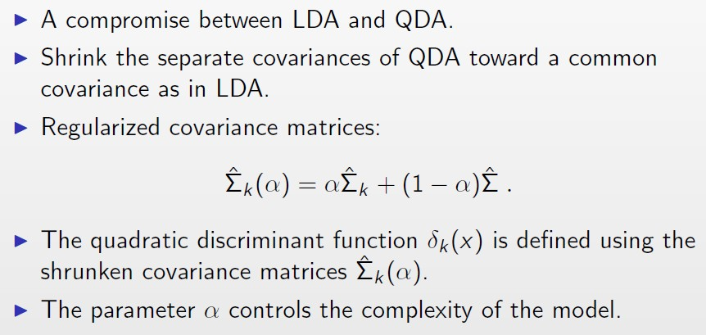
Regularized Discriminant Analysis

Slide 35
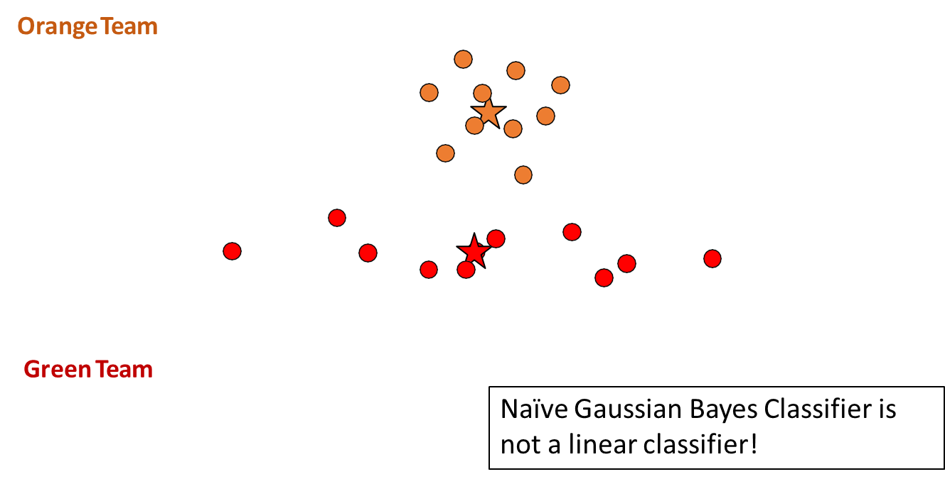
More: Decision Boundary of Gaussian naïve Bayes Classifiers?
Red Team

Slide 36


Gaussian Naïve Bayes Classifier
Orange Team
Red Team
Green Team
Naïve Gaussian Bayes Classifier is not a linear classifier!

Slide 37
Today: More Generative Bayes Classifiers
Generative Bayes Classifier
Naïve Bayes Classifier
Gaussian Bayes Classifiers
Gaussian distribution
Naïve Gaussian BC
Not-naïve Gaussian BC → LDA, QDA
LDA: Linear Discriminant Analysis
QDA: Quadratic Discriminant Analysis
Extra: Discriminative vs. Generative classifier

Slide 38
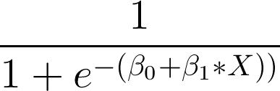
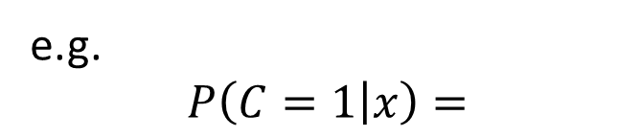
Discriminative vs. Generative
Generative approach
Model the joint distribution p(X, C) using p(X | C = c_{k}) and p(C = c_{k})
Discriminative approach
Model the conditional distribution p(c| X) directly
e.g.
$$P\left(C=1 | x\right)=$$

Slide 39
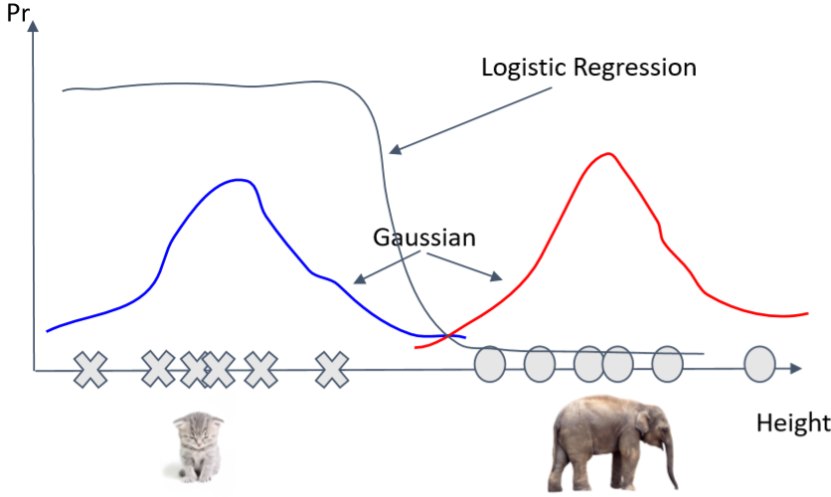
Discriminative vs. Generative

Slide 40
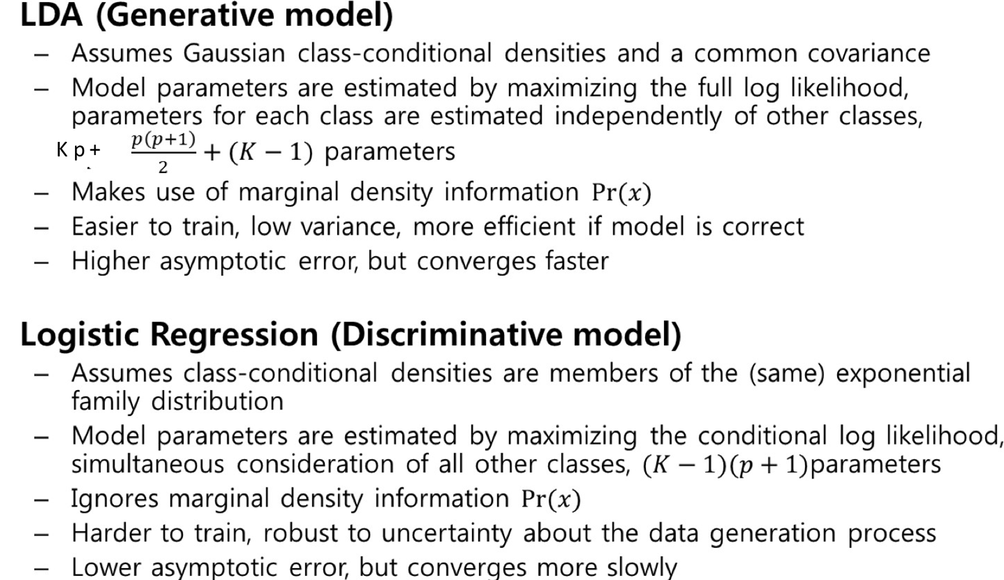
LDA vs. Logistic Regression

Slide 41
LDA vs. Logistic Regression
Discriminative classifier (Logistic Regression)
Smaller asymptotic error
Slow convergence ~ O(p)
Generative classifier (Naive Bayes)
Larger asymptotic error
Can handle missing data (EM)
Fast convergence ~ O(lg(p))
the speed at which a convergent sequence approaches its limit is called the rate of convergence.

Slide 42
Summary: Discriminative vs. Generative
Empirically, generative classifiers approach their asymptotic error faster than discriminative ones
Good for small training set
Handle missing data well (EM)
Empirically, discriminative classifiers have lower asymptotic error than generative ones
Good for larger training set

Slide 43
References
https://qiyanjun.github.io/2019f-UVA-CS6316-MachineLearning/
Prof. Tan, Steinbach, Kumar’s “Introduction to Data Mining” slide
Prof. Andrew Moore’s slides
Prof. Eric Xing’s slides
Prof. KeChen NB slides qHastie, Trevor, et al. The elements of statistical learning. Vol. 2. No. 1. New York: Springer, 2009.

Slide 44
Thanks for listening

