Slide 1
Machine Learning
Lecture 17c: Naïve Bayes Classifier for Text Classification
Dr. Beilun Wang
Southeast University
School of Computer Science
and Engineering

Slide 2
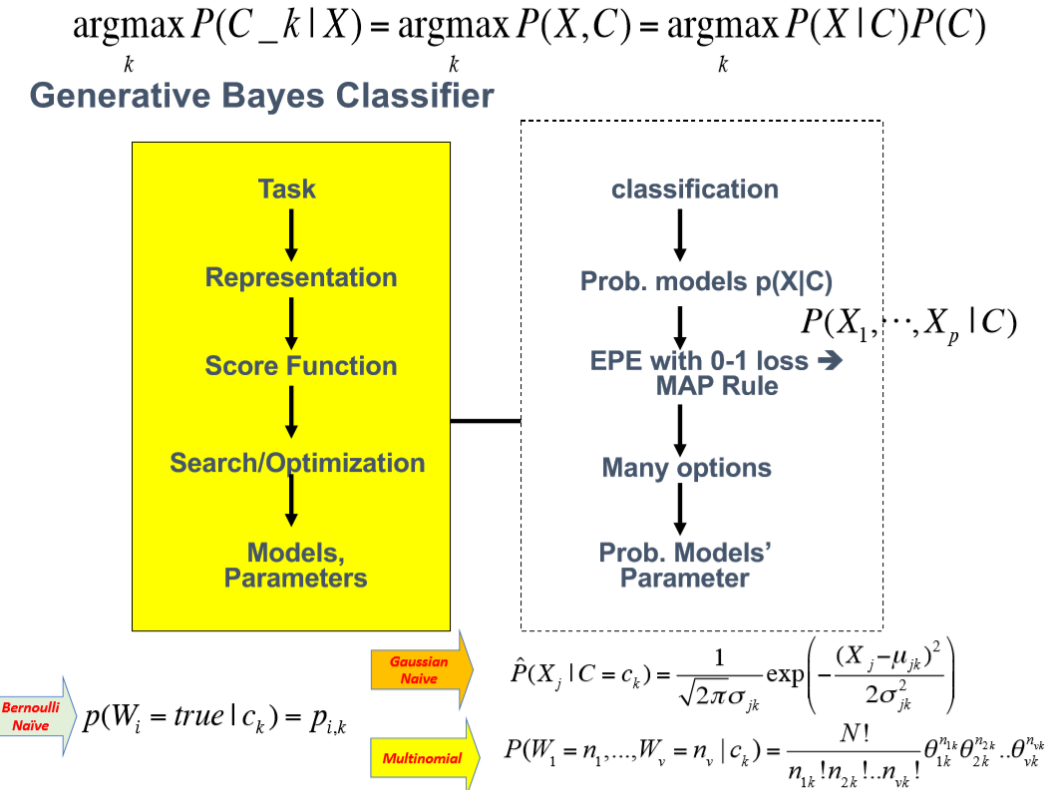

Slide 3
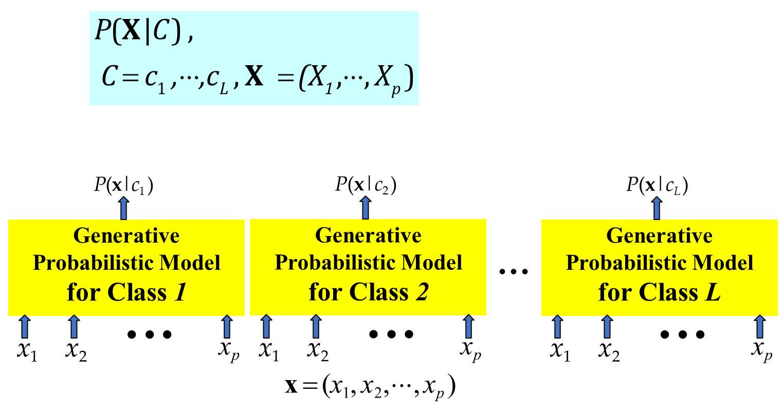
Review: Generative BC

Slide 4
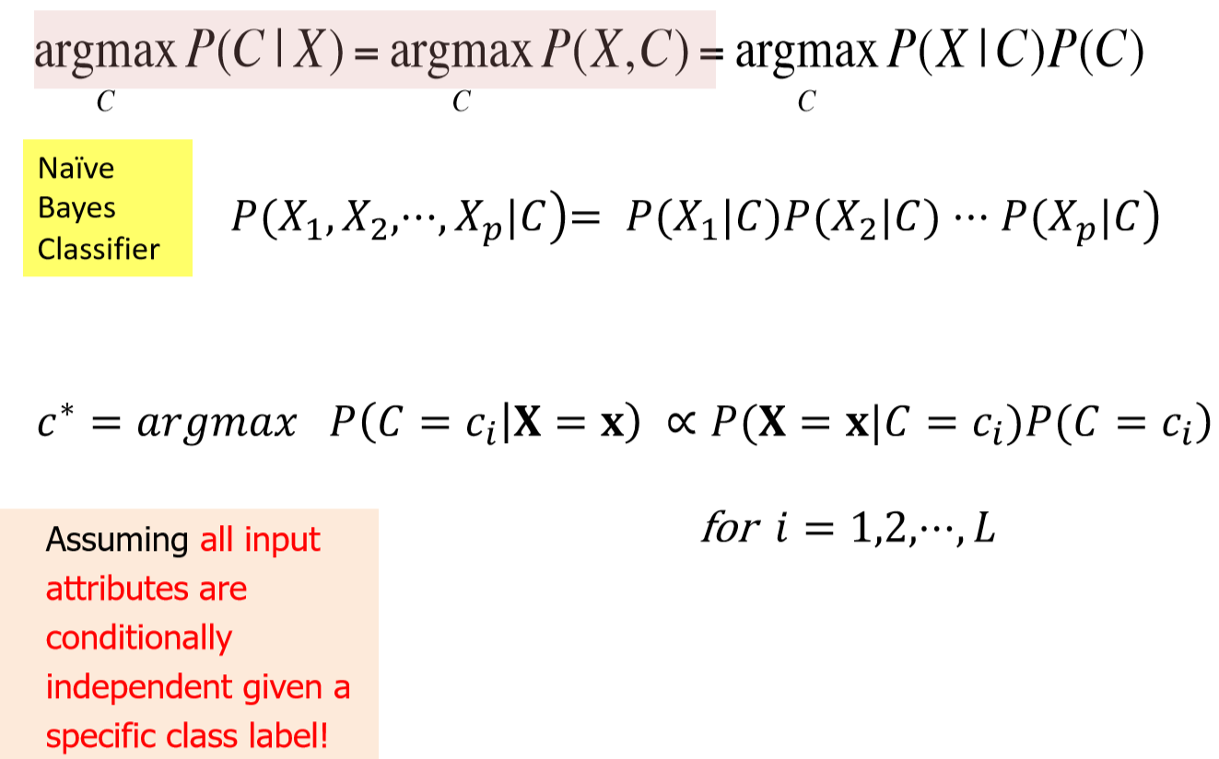
Review: Naïve Bayes Classifier

Slide 5
Today: Naïve Bayes Classifier for Text
Dictionary based Vector space representation of text article
Multivariate Bernoulli vs. Multinomial
Multivariate Bernoulli naïve Bayes classifier
Testing
Training With Maximum Likelihood Estimation for estimating parameters
Multinomial naïve Bayes classifier
Testing
Training With Maximum Likelihood Estimation for estimating parameters

Slide 6
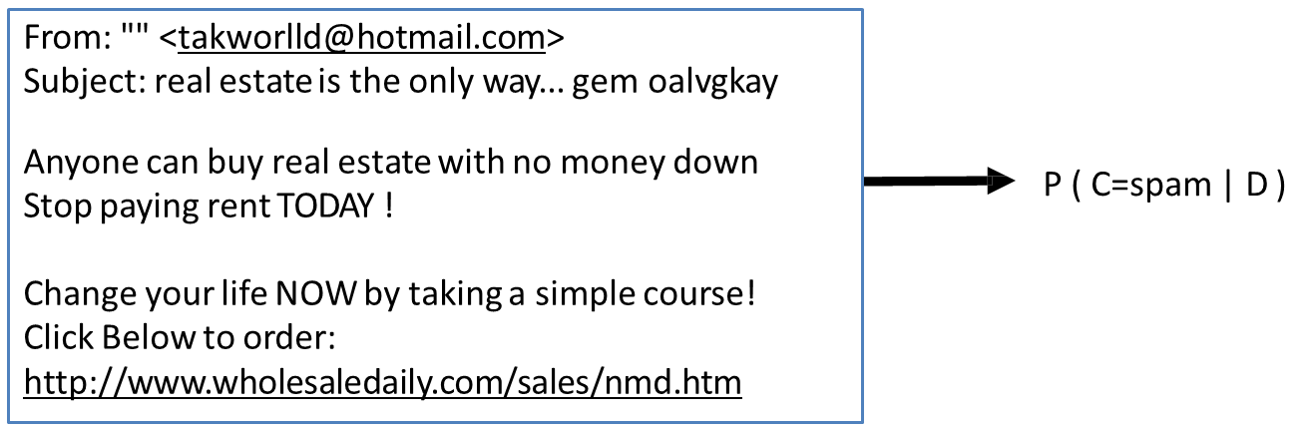
Text classification Tasks
Input: document D
Output: the predicted class C, c is from {c₁,...,c_{L}}
Text classification examples:
Classify email as 'Spam ' , ' Other ' .

Slide 7
Text classification Tasks
Input: document D
Output: the predicted class C, c is from {c₁,...,c_{L}}
Text classification examples:
Classify email as 'Spam' , 'Other ' .
Classify web pages as 'Student' , 'Faculty' , 'Other '
Classify news stories into topics 'Sports' , 'Politics' ..
Classify movie reviews as 'Favorable' , 'Unfavorable' , ' Neutral'
… and many more.

Slide 8
Text Categorization/Classification
Given:
A representation of a text document d
Issue: how to represent text documents.
Usually some type of high-dimensional space – bag of words
A fixed set of output classes:
C = {c₁, c₂,…, c_{J}}

Slide 9
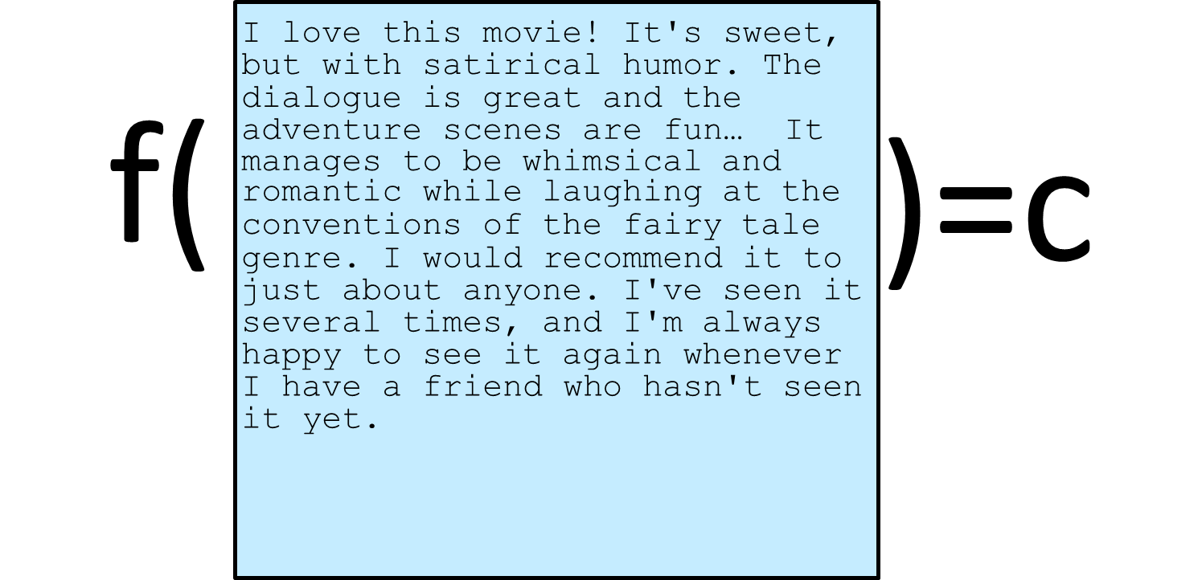
The bag of words representation

Slide 10
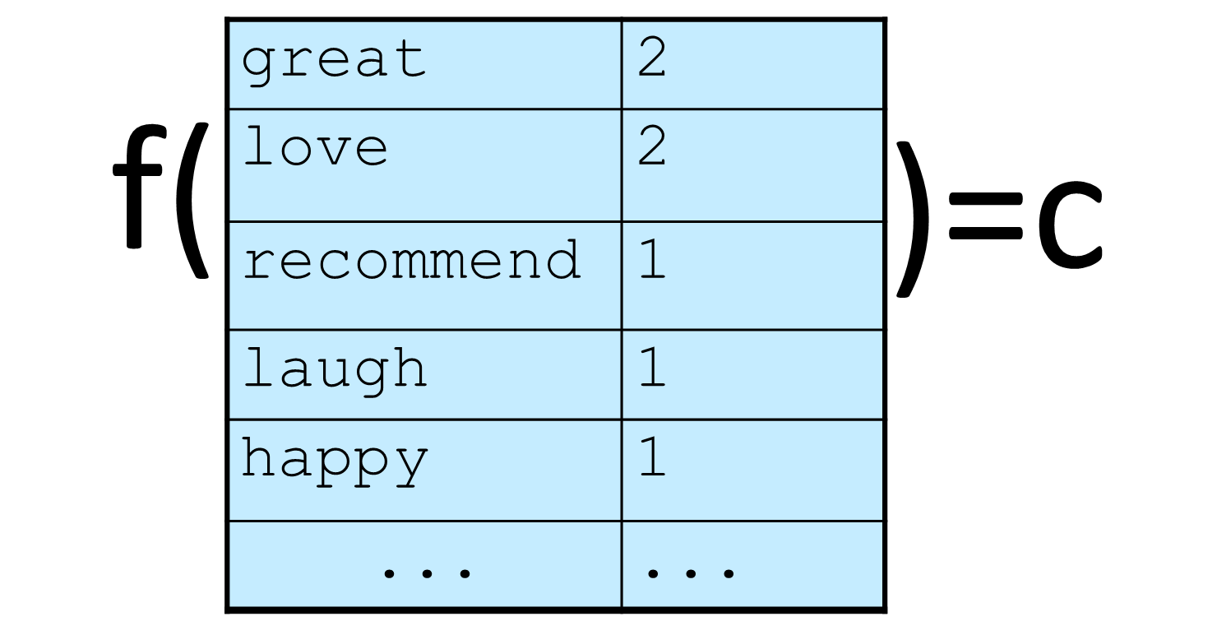
The bag of words representation

Slide 11
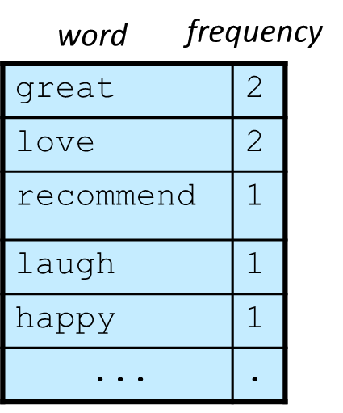
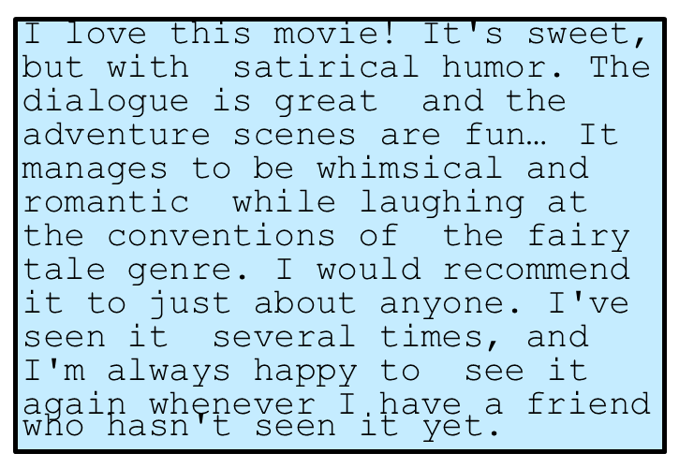


Representing text: a list of words → Dictionary
Common refinements: remove stopwords, stemming, collapsing multiple occurrences of words into one….

Slide 12
‘Bag of words’ representation of text
Bag of word representation: Represent text as a vector of word frequencies.

Slide 13
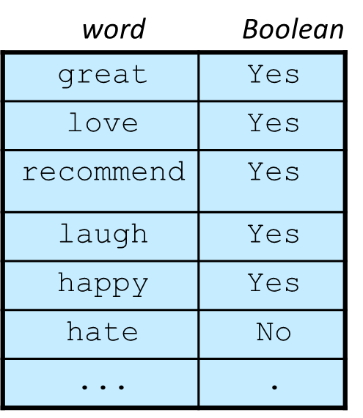
Another ‘Bag of words’ representation of text → Each dictionary word as Boolean
Bag of word representation: Represent text as a vector of Boolean representing if a word Exists or NOT.

Slide 14
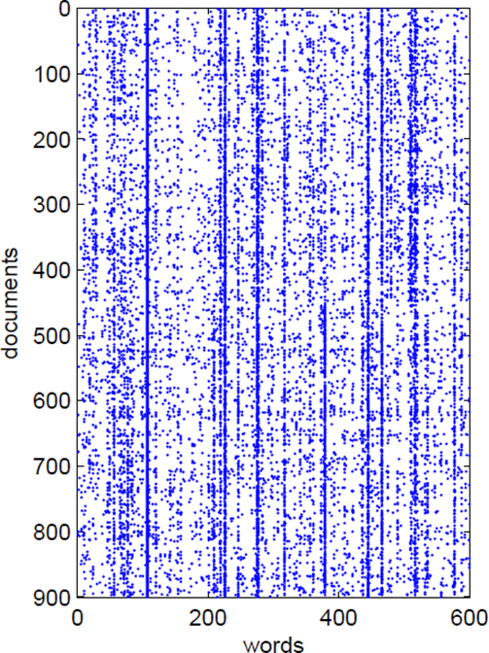
Bag of words
What simplifying assumption are we taking?
We assume word order is not important.

Slide 15
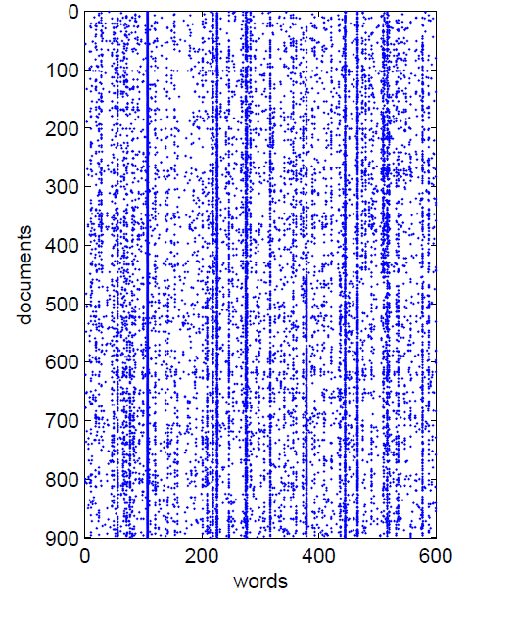
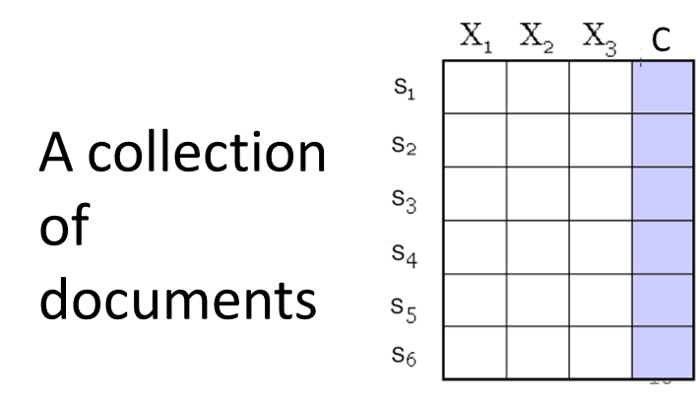
Bag of words representation
W₁ W₂ … W_{|v|}
document i
e.g., X (i,j) = Frequency of word j in document i
word j

Slide 16
Unknown Words
How to handle words in the test corpus that did not occur in the training data, i.e. out of vocabulary (OOV) words?
Train a model that includes an explicit symbol for an unknown word (<UNK>).
Choose a vocabulary in advance and replace other (i.e. not in vocabulary) words in the corpus with
<UNK>.
Very often, <UNK> also used to replace rare words

Slide 17
Today: Naïve Bayes Classifier for Text
Dictionary based Vector space representation of text article
Multivariate Bernoulli vs. Multinomial
Multivariate Bernoulli naïve Bayes classifier
Testing
Training With Maximum Likelihood Estimation for estimating parameters
Multinomial naïve Bayes classifier
Testing
Training With Maximum Likelihood Estimation for estimating parameters

Slide 18
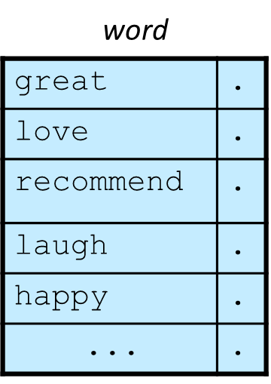
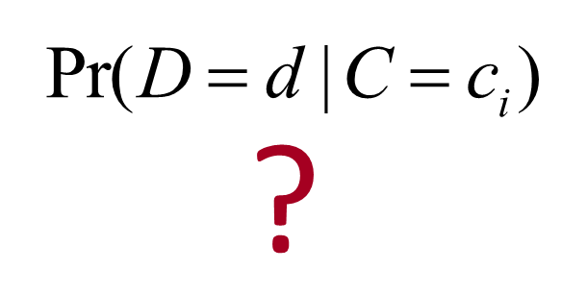
‘Bag of words’→what probability model?

Slide 19
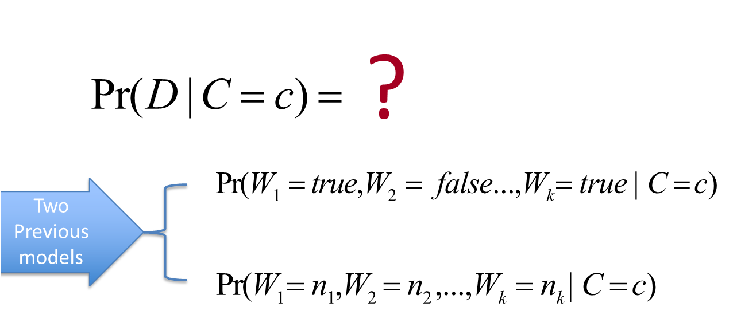
‘Bag of words’→what probability model?

Slide 20
Naïve Probabilistic Models of text documents
Multinomial vs Multivariate Bernoulli?
Multinomial model is almost always more effective in text applications!
Multivariate Bernoulli Distribution
Multinomial Distribution

Slide 21
Experiment: Multinomial vs multivariate Bernoulli
M&N (1998) did some experiments to see which is better
Determine if a university web page is {student, faculty, other_staff}
Train on ~5,000 hand-labeled web pages
– Cornell, Washington, U.Texas, Wisconsin
Crawl and classify a new site (CMU)

Slide 22
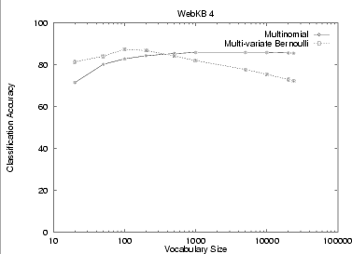
Multinomial vs. multivariate Bernoulli

Slide 23
Today: Naïve Bayes Classifier for Text
Dictionary based Vector space representation of text article
Multivariate Bernoulli vs. Multinomial
Multivariate Bernoulli naïve Bayes classifier
Testing
Training With Maximum Likelihood Estimation for estimating parameters
Multinomial naïve Bayes classifier
Testing
Training With Maximum Likelihood Estimation for estimating parameters

Slide 24
Model 1: Multivariate Bernoulli
Model 1: Multivariate Bernoulli
For each word in a dictionary, feature X_{w}
X_{w} = true in document d if w appears in d

Slide 25
Model 1: Multivariate Bernoulli
Model 1: Multivariate Bernoulli
For each word in a dictionary, feature X_{w}
X_{w} = true in document d if w appears in d
Naive Bayes assumption:
Given the document’s class label,
appearance of one word in the document tells us nothing about chances that another word appears

Slide 26
Model 1: Multivariate Bernoulli
Naïve Bayes Classifier
Conditional Independence Assumption: Features (word presence) are independent of each other given the class variable:
Multivariate Bernoulli model is appropriate for binary feature variables

Slide 27
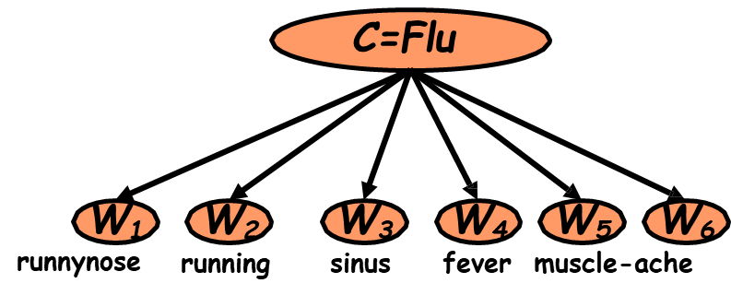
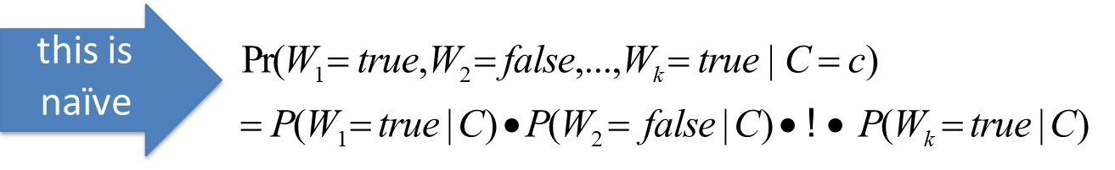

Model 1: Multivariate Bernoulli

Slide 28

Parameter estimation
Multivariate Bernoulli model:
Smoothing to Avoid Overfitting

Slide 29
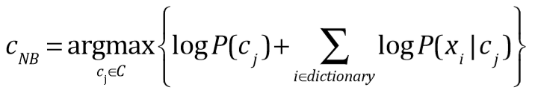
Underflow Prevention: log space
Multiplying lots of probabilities, which are between 0 and 1, can result in floating-point underflow.
Since log(xy) = log(x) + log(y), it is better to perform all computations by summing logs of probabilities rather than multiplying probabilities.
Class with highest final un-normalized log probability score is still the most probable.
Note that model is now just max of sum of weights…

Slide 30
Today: Naïve Bayes Classifier for Text
Dictionary based Vector space representation of text article
Multivariate Bernoulli vs. Multinomial
Multivariate Bernoulli naïve Bayes classifier
Testing
Training With Maximum Likelihood Estimation for estimating parameters
Multinomial naïve Bayes classifier
Testing
Training With Maximum Likelihood Estimation for estimating parameters

Slide 31

Model 2: Multinomial Naïve Bayes
‘Bag of words’ representation of text
Can be represented as a multinomial distribution.
Words = like colored balls, there are K possible type of them (i.e. from a dictionary of K words)
A Document = contains N words, each word occurs n_{i} times (like a bag of N colored balls)

Slide 32
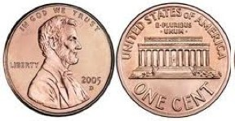
Review: Multinomial distribution
The multinomial distribution is a
generalization of the binomial distribution.
The binomial distribution counts successes of an event (for example, heads in coin tosses).
The parameters:
N (number of trials)
p (the probability of success of the event)

Slide 33
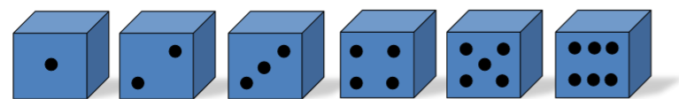
Review: Multinomial distribution
The multinomial counts the number of a set of events (for example, how many times each side of a die comes up in a set of rolls).
The parameters:
N (number of trials)
θ₁,…, θ_{k} (the probability of success for each category)

Slide 34
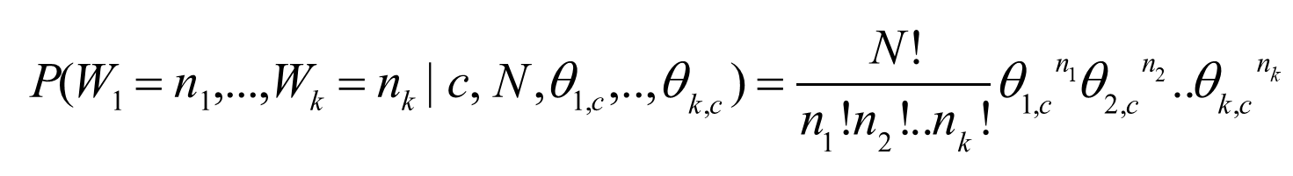
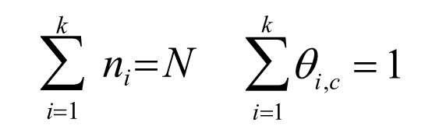
Multinomial Distribution for Text Classification
W₁,W₂,..W_{k} are variables
Number of possible orderings of N balls
Label invariant

Slide 35
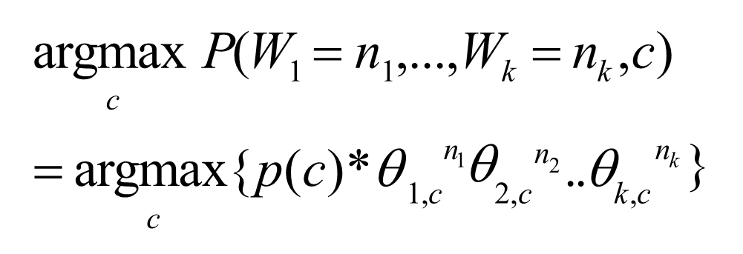
Model 2: Multinomial Naïve Bayes
‘Bag of words’ – Testing Stage

Slide 36
Today: Naïve Bayes Classifier for Text
Dictionary based Vector space representation of text article
Multivariate Bernoulli vs. Multinomial
Multivariate Bernoulli naïve Bayes classifier
Testing
Training With Maximum Likelihood Estimation for estimating parameters
Multinomial naïve Bayes classifier
Testing
Training With Maximum Likelihood Estimation for estimating parameters

Slide 37
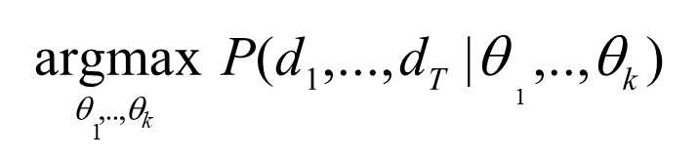
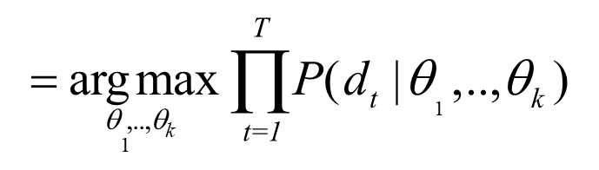
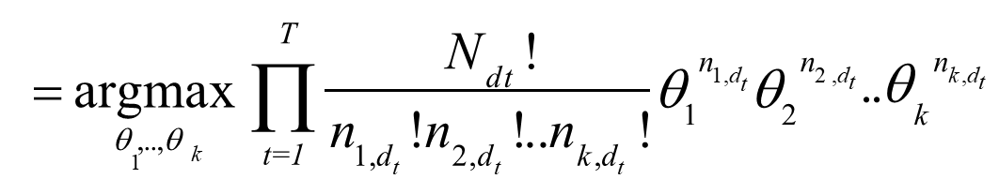
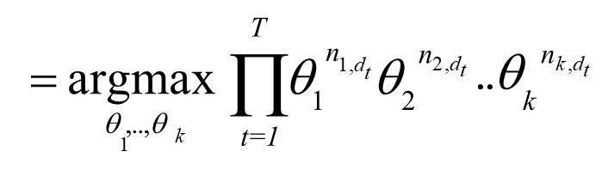
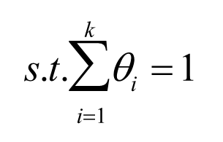
Deriving the Maximum Likelihood Estimate for multinomial distribution
LIKELIHOOD:
function of θ

Slide 38
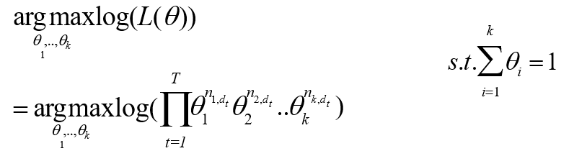
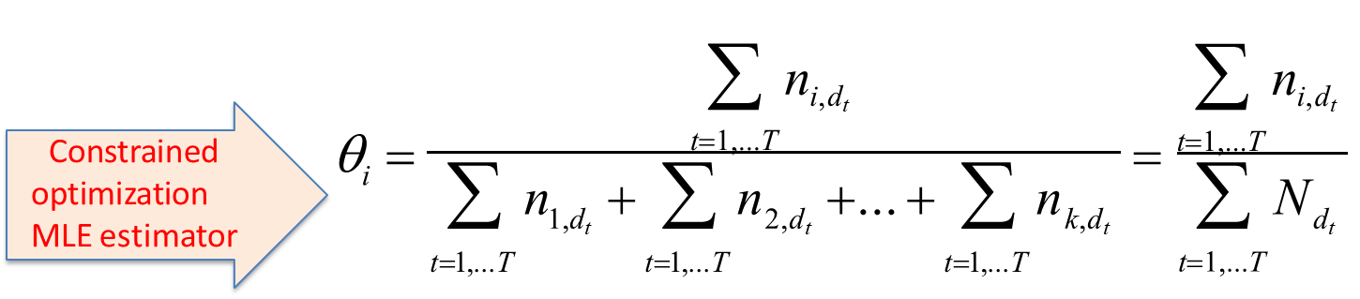
Deriving the Maximum Likelihood Estimate for multinomial distribution
→ i.e. We can create a mega-document by concatenating all documents d_1 to d_T
→ Use relative frequency of w_{i} in mega-document

Slide 39
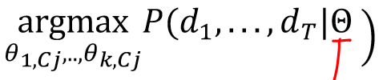
Deriving the Maximum Likelihood Estimate for multinomial Bayes Classifier
LIKELIHOOD:

Slide 40
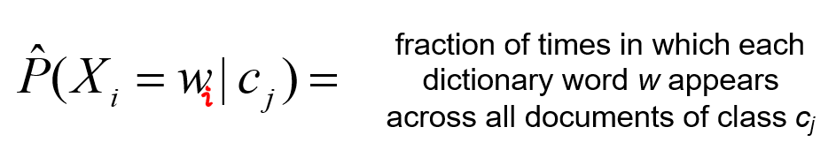
Parameter estimation
Multinomial model:
Can create a mega-document for class j by concatenating all documents on this class,
Use frequency of w in mega-document

Slide 41
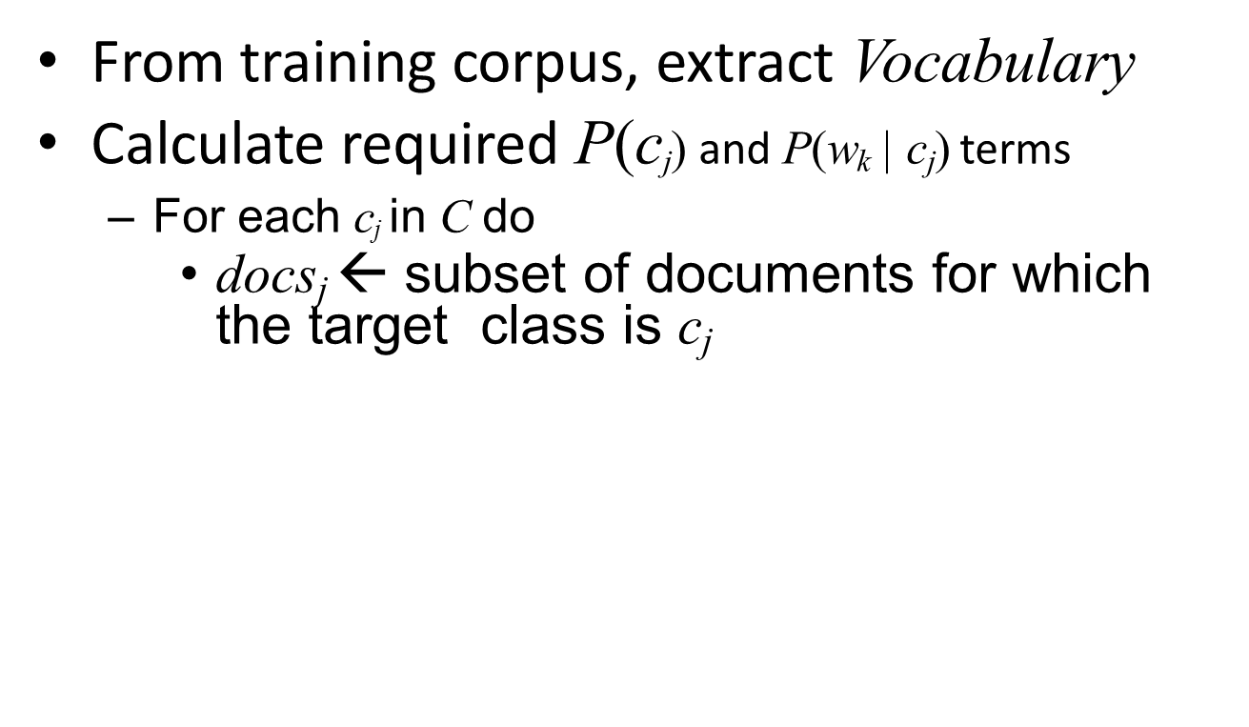
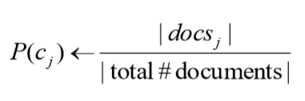
Multinomial: Learning Algorithm for parameter estimation with MLE

Slide 42
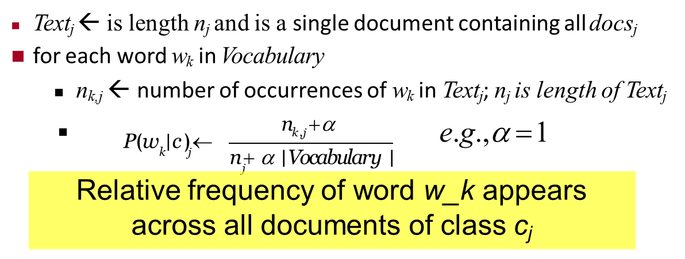
Multinomial: Learning Algorithm for parameter estimation with MLE

Slide 43
Naive Bayes is Not So Naive
Naïve Bayes: First and Second place in KDD-CUP 97 competition, among 16 (then) state of the art algorithms
Goal: Financial services industry direct mail response prediction model: Predict if the recipient of mail will actually respond to the advertisement – 750,000 records.
Robust to Irrelevant Features
Irrelevant Features cancel each other without affecting results
Instead Decision Trees can heavily suffer from this.
Very good in domains with many equally important features
Decision Trees suffer from fragmentation in such cases – especially if little data
A good dependable baseline for text classification (but not the best)!
Optimal if the Independence Assumptions hold: If assumed independence is correct, then it is the Bayes Optimal Classifier for problem
Very Fast: Learning with one pass of counting over the data; testing linear in the number of attributes, and document collection size
Low Storage requirements

Slide 44
References
https://qiyanjun.github.io/2019f-UVA-CS6316-MachineLearning/
Prof. Andrew Moore’s review tutorial
Prof. Ke Chen NB slides
Prof. Carlos Guestrin recitation slides
Prof. Raymond J. Mooney and Jimmy Lin’s slides about language model
Prof. Manning’ textCat tutorial

Slide 45
Thanks for listening

