Slide 1
GraphCloud: Graph Analytics on YARN
Haosong Huang
Developed at HCI@SCAU
February 9, 2014

Slide 2
Graphs are Essential to Data Mining and Machine Learning
Identify influential people and information
Find communities
Understand people’s shared interests
Model complex data dependencies

Slide 3



Predicting Political Bias
?
?
Liberal
Conservative
?
?
?
?
?
?
?
?
Post
?
Post
?
Post
Post
?
Post
Post
Post
Post
?
Post
Post
Post
Post
?
Post
?
Post
?
?
?
?
?
Post
?
Post
Post
Post
Conditional Random Field
Belief Propagation
Post
Post
Post
?
Post
?
?
?
?
?
?
?

Slide 4
Triangle Counting
Count the triangles passing through each vertex:
Measures “cohesiveness” of local community
2
3
1
4
Fewer Triangles
Weaker Community
More Triangles
Stronger Community

Slide 5










Collaborative Filtering
Users
Ratings
Items

Slide 6
Many More Graph Algorithms
Collaborative Filtering
Alternating Least Squares
Stochastic Gradient Descent
Tensor Factorization
SVD
Structured Prediction
Loopy Belief Propagation
Max-Product Linear Programs
Gibbs Sampling
Semi-supervised ML
Graph SSL
CoEM
Graph Analytics
PageRank
Single Source Shortest Path
Triangle-Counting
Graph Coloring
K-core Decomposition
Personalized PageRank
Classification
Neural Networks
Lasso
…

Slide 7
Structure of Computation
Data-Parallel
Graph-Parallel
Table
Dependency Graph
Row
Row
Result
Row
Row
MapReduce
???

Slide 8
Why not use MapReduce for Graph-Parallel Algorithms?

Slide 9














MapReduce in Graph-Parallel
MapReduce does not efficiently express dependent data
User must code substantial data transformations
Costly data replication
Independent Data Rows

Slide 10
MapReduce in Graph-Parallel
MapReduce not efficiently express iterative algorithms:
Iterations
Data
Data
Data
Data
CPU 1
CPU 1
CPU 1
Data
Data
Data
Data
Data
Data
Data
Data
Slow
Processor
CPU 2
CPU 2
CPU 2
Data
Data
Data
Data
Data
Data
Data
Data
CPU 3
CPU 3
CPU 3
Data
Data
Data
Data
Data
Data
Data
Data
Barrier
Barrier
Barrier

Slide 11
MapReduce in Graph-Parallel
Only a subset of data needs computation:
Iterations
Data
Data
Data
Data
CPU 1
CPU 1
CPU 1
Data
Data
Data
Data
Data
Data
Data
Data
CPU 2
CPU 2
CPU 2
Data
Data
Data
Data
Data
Data
Data
Data
CPU 3
CPU 3
CPU 3
Data
Data
Data
Data
Data
Data
Data
Data
Barrier
Barrier
Barrier

Slide 12
MapReduce in Graph-Parallel
System is not optimized for iteration:
Iterations
Data
Data
Data
Data
CPU 1
CPU 1
CPU 1
Data
Data
Data
Data
Data
Data
Data
Data
CPU 2
CPU 2
CPU 2
StartupPenalty
Disk Penalty
Startup Penalty
Disk Penalty
Startup Penalty
Data
Data
Disk Penalty
Data
Data
Data
Data
Data
Data
CPU 3
CPU 3
CPU 3
Data
Data
Data
Data
Data
Data
Data
Data

Slide 13
Exist Graph-Parallel Solution
A user-defined Vertex-Program runs on each vertex
Graph constrains interaction along edges
Using messages and Bulk synchronous (e.g. Pregel [PODC’09, SIGMOD’10])
Through shared state and Asynchronous (e.g., GraphLab [UAI’10, VLDB’12])
Parallelism: run multiple vertex programs simultaneously

Slide 14
Pregel in Graph-Parallel
Compute
Communicate
Barrier

Slide 15
Bulk synchronous computation can be highly inefficient.
Problem
Example: Loopy Belief Propagation

Slide 16
Loopy Belief Propagation (Loopy BP)
Iteratively estimate the “beliefs” about vertices
Read in messages
Updates marginal estimate (belief)
Send updated out messages
Repeat for all variables until convergence

Slide 17

Bulk Synchronous Loopy BP
Often considered embarrassingly parallel
Associate processor with each vertex
Receive all messages
Update all beliefs
Send all messages
Proposed by:
Brunton et al. CRV’06
Mendiburu et al. GECC’07
Kang,et al. LDMTA’10
…

Slide 18
GraphLab in Graph-Parallel
Graph Based
Data Representation
Update Functions
User Computation
Scheduler
Consistency Model

Slide 19
GraphLab in Graph-Parallel
Graph Based
Data Representation
Update Functions
User Computation
Scheduler
Consistency Model

Slide 20
GraphLab in Graph-Parallel
The scheduler determines the order that vertices are updated.
CPU 1
b
c
d
a
b
c
Scheduler
e
f
b
e
f
g
a
i
h
i
j
h
i
j
k
CPU 2
The process repeats until the scheduler is empty.

Slide 21
Triangle Counting on Twitter
40M Users, 1.4 Billion Links
Counted: 34.8 Billion Triangles
Hadoop [WWW’11]
1536 Machines
423 Minutes
64 Machines
15 Seconds
1000 x Faster
GraphLab
S. Suri and S. Vassilvitskii, “Counting triangles and the curse of the last reducer,” WWW’11

Slide 22
Why GraphLab Fast
Asynchronous Computation
Shared state in Memory

Slide 23
The shortcoming of GraphLab
Keep the entire graph model in memory requires enough machines and memory
Difficult to use
difficult to deploy and maintain
couldn’t use exist computing resources

Slide 24
Why GraphCloud?

Slide 25
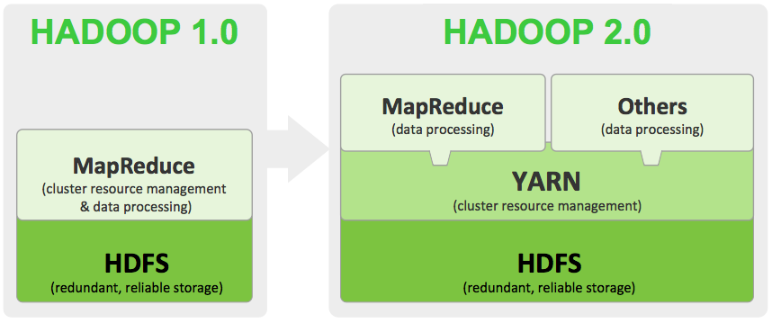
A GraphLab Implementation on YARN

Slide 26
A GraphLab Implementation on YARN
Use shared resources of Hadoop cluster
Easy to manage
Deployed and Maintained by YARN
MapReduce
GraphCloud
Others
YARN

Slide 27


How I achieve GraphCloud
Keep the entire graph model in HBase
Use akka to handle fault tolerance and message delivery

Slide 28
Keep the entire graph model in HBase
in HBase (GraphCloud)
VS
in memory (GraphLab)

Slide 29
In Memory
In HBase
Require enough machines and memory to start
Require enough disk spaces
The processing speed depends on memory and the number of machines

Slide 30
Keep the entire graph model in HBase
Vertex
Table
Tables Graphs
Graph
Edge
Table

Slide 31
Graph-Parallel Processing
Update
Vertex
Table
Queue
Actor
Task
……
Task
Add Task
Update
Edge
Table
Until Queue is Empty

Slide 32
Graph-Parallel Processing
Many Actors
Vertex
Table
Queue
Machine A
Task
Actor
Actor
……
Machine B
Actor
......
......
Edge
Table

Slide 33
Fault Tolerance
Many Actors
Queue
Machine A
Task
Actor
Actor
……
Task
Restore Task

Slide 34
Integrated into YARN(Uncompleted)
Under rebuilding
Since the wrong order of development
Submit a job
Apply resources
YARN

Slide 35
Progress (For Demo version)
Complete
TODO
Communication part
Fault Tolerance and Supervision parts
The storage of graph model
Graph-Parallel processing
Gather part
Apply and Scatter parts
Integrated into YARN
Speed test

Slide 36
Summary
 | GraphCloud | GraphLab | GraphX
API | Table API | Graph API | Table API
Platform | YARN | -- | YARN/--
Shared state | HBase | Memory | RDDs
Communication | Akka | MPI | RPC

