Slide 1
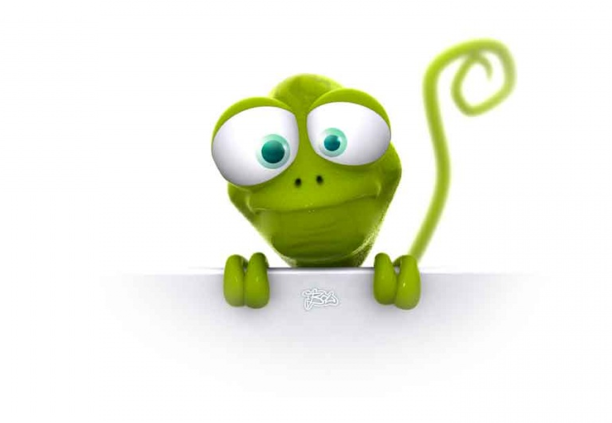
Multi-Terrain Locomotion of Lizard Robot
Mahdi Khoramshahi

Slide 2
Outline:
Model Water Contact
CPG network

Slide 3
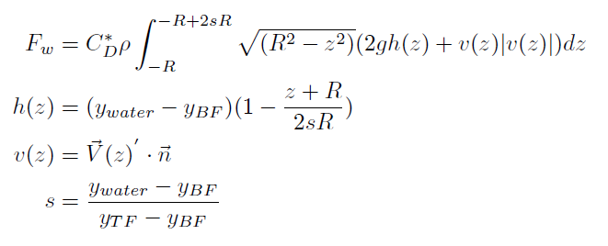
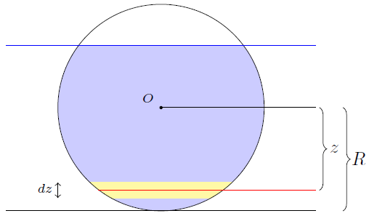
Water Contact
depth
Water level
Normal velocity
Submerging factor

Slide 4




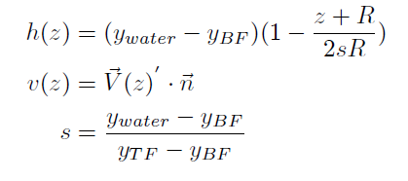
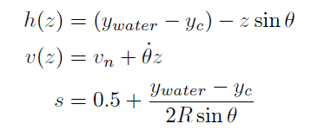

Water Contact
Change of variables

Slide 5

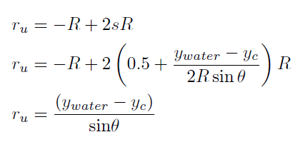
Water Contact
Upper boundary

Slide 6
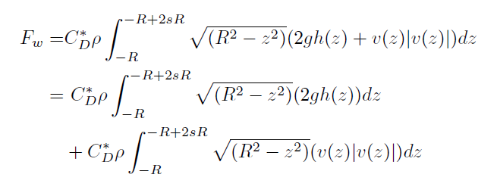
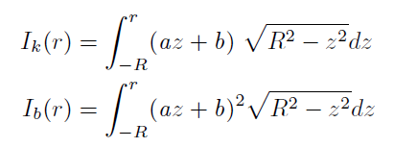
Water Contact
Decomposition
Linear w.r.t z
Quadratic w.r.t z

Slide 7
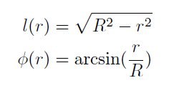




Water Contact
Analytic solution
Defining two auxiliary function

Slide 8




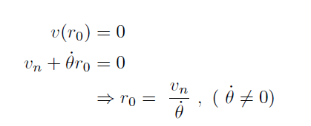
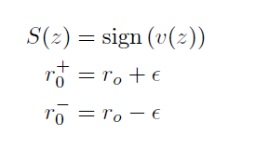
Water Contact
Dealing with absolute value

Slide 9


Water Contact
Dealing with absolute value

Slide 10
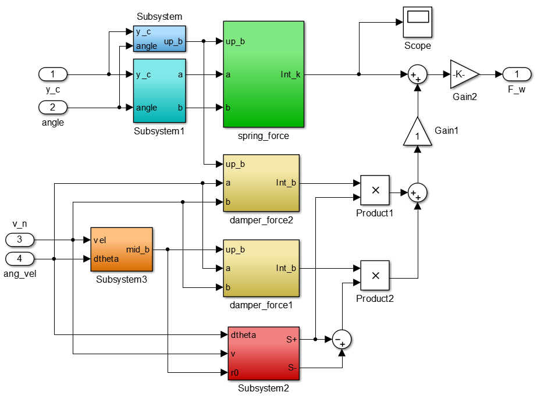
Water Contact
Outcome

Slide 11
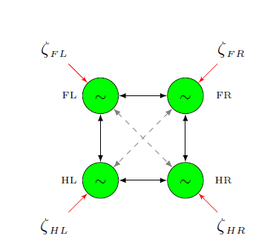
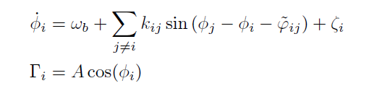
CPG Network
CPG (Central Pattern Generator) Network
Consists of connected oscillatory nodes

Slide 12
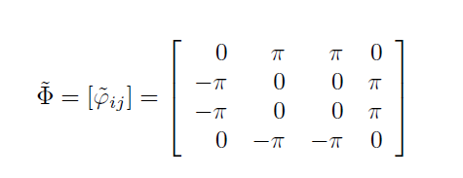

CPG Network
CPG (Central Pattern Generator) Network
Phase lags determine the gait
In our case “Trot”

Slide 13
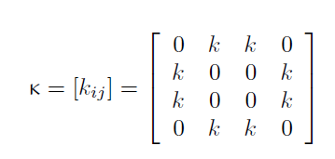
CPG Network
CPG (Central Pattern Generator) Network
Gains determine connectivity and convergence behavior

Slide 14

CPG Network
CPG (Central Pattern Generator) Network
External forces ( ) change instantaneous velocity.
In our case, this inputs are provided by controller

Slide 15
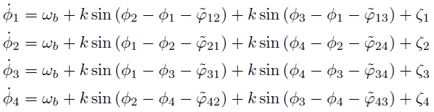
CPG Network
CPG (Central Pattern Generator) Network
Equations:

Slide 16
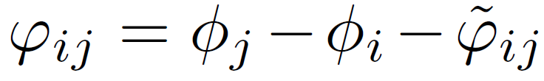
CPG Network
CPG (Central Pattern Generator) Network
Study convergence behavior
Linear transformation

Slide 17
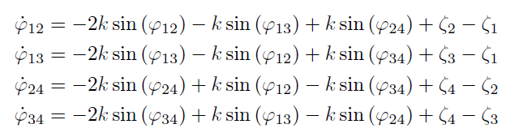
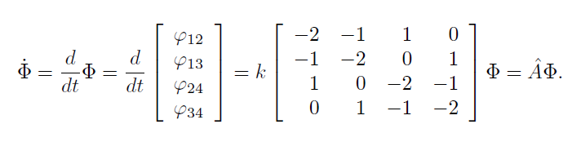
CPG Network
CPG (Central Pattern Generator) Network
Study convergence behavior

Slide 18

CPG Network
CPG (Central Pattern Generator) Network
Study convergence behavior

Slide 19


CPG Network
CPG (Central Pattern Generator) Network
Effect of input signal

Slide 20
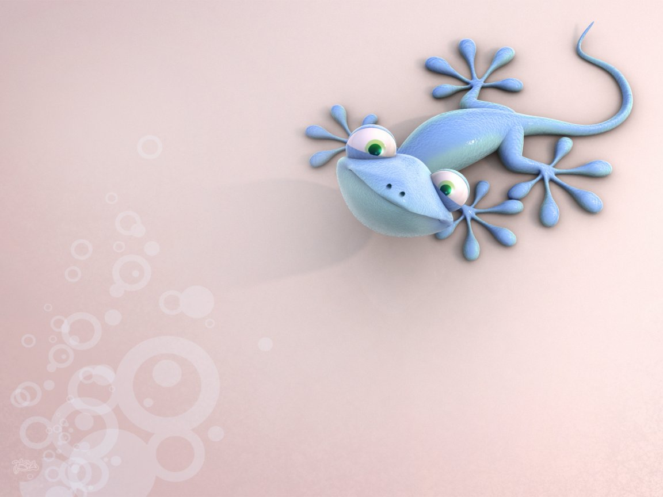
Questions?

Slide 22

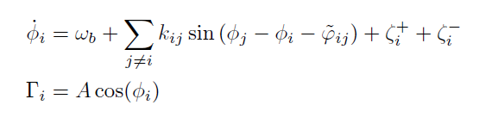
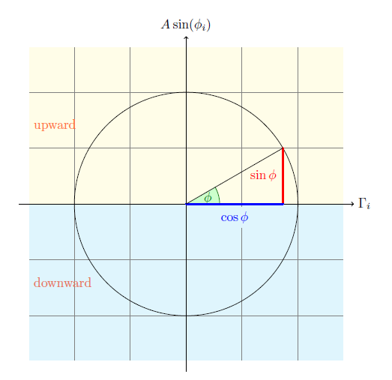
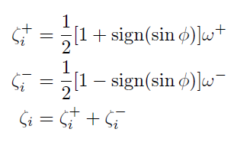
CPG Network

